Slide 2
Notes:
Speaker notes: This is a summary of what we’ll be talking about today.

Slide 3
Diet, Physical Activity and Cancer Risk
Notes:
Speaker notes:
Diet and physical activity are second only to tobacco in raising the risk of developing cancer. In the US, about 1 in 5 cancers are linked to factors involved with nutrition and physical activity.
Let’s discuss how certain behaviors contribute to cancer risk and what you can do to reduce your risk.

Slide 4
Reducing Risk With Diet and Physical Activity
Notes:
Speaker notes:
Actions such as avoiding exposure to tobacco, getting to and staying at a healthy weight, staying physically active throughout life, eating a healthy diet and avoiding alcohol can greatly reduce one's lifetime risk of developing cancer. These same behaviors are also linked with a lower risk of developing cardiovascular disease and diabetes.

Slide 5
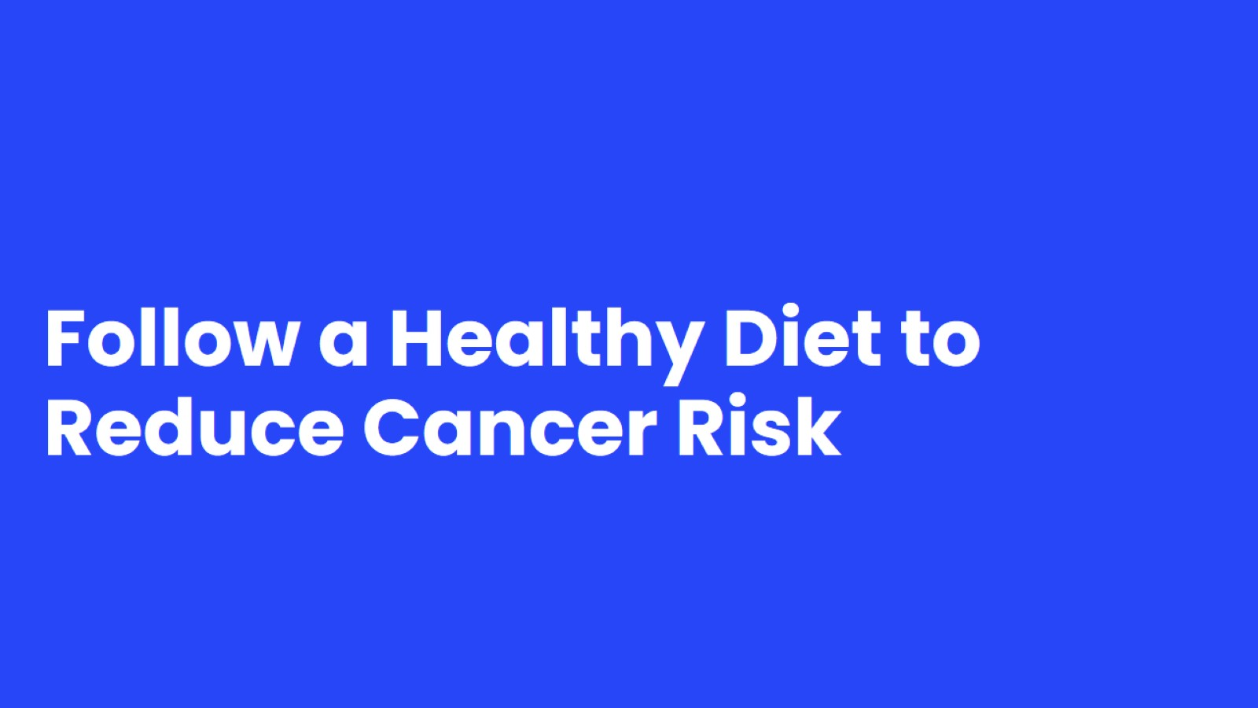
Follow a Healthy Diet to Reduce Cancer Risk
Notes:
Speaker notes:
Let's dive deeper into healthy nutrition habits

Slide 6
Proteins, Fruits, and Vegetables
Notes:
Speaker notes:
Vegetables (including beans) and fruits are complex foods, containing vitamins, minerals, fiber, and other substances that may help prevent cancer.
Vegetables and fruits may also lower cancer risk by their effects on calorie intake and body weight. They help you feel fuller and can decrease overall calorie intake.
Legumes (including kidney beans, pinto beans, black beans, white beans, garbanzo beans (chickpeas), lima beans, lentils, and soy foods and soybeans) are rich in protein, fiber, iron, zinc, potassium and folate.

Slide 7
Whole Grains
Notes:
Speaker notes:
Whole-grain foods, which are those made from the entire grain seed, are lower in caloric density than their processed (refined) grain counterparts. They are also higher in fiber, certain vitamins, and minerals than refined grain products. They are linked to a lower risk of weight gain and being overweight.
Whole grains include brown rice, 100% whole grain bread or pasta, regular oatmeal, quinoa, and other grains.
Eat less food made with white flour, and learn to read labels. For instance, some people may not know that “wheat bread” is not the same as “100% whole wheat,” even if the bread looks brown.

Slide 8
Red Meats
Notes:
Speaker notes:
Red meat includes beef, veal, pork, lamb, mutton, horse, or goat meat. Examples of processed meat include bacon, sausage, ham, bologna, hot dogs, and deli meats.
Eating processed meats has been linked to cancer and red meats probably contribute to cancer as well. It is not known how much you could safely eat of either.
Use meat as a side dish or flavor enhancer rather than as the focus of a meal.
Try other protein sources such as fish and poultry in place of red and processed meats.
Beans may also be a healthier source of protein

Slide 9
Tips for Eating Healthy
Notes:
Speaker Notes
In general, the dietary patterns showing the most health benefits are based mainly on plant foods.
When shopping or eating out, look for choices that include vegetables, whole fruits, and whole grain options.
Eat smaller portions of high-calorie foods. When you eat away from home, be extra careful to choose foods low in calories, fat, and added sugar, and avoid eating large portions

Slide 10
Alcohol
Notes:
Speaker notes:
Research shows that drinking any alcohol increases the risk of cancer. If you choose to drink alcohol, the American Cancer Society recommends that women have no more than 1 and men should have no more than 2 alcohol drinks on any given day. A drink is 12 ounces of regular beer, 5 ounces of wine, or 1.5 ounces of hard liquor.
These daily limits do not mean you can drink larger amounts on fewer days of the week, since this can lead to health, social, and other problems.

Slide 11
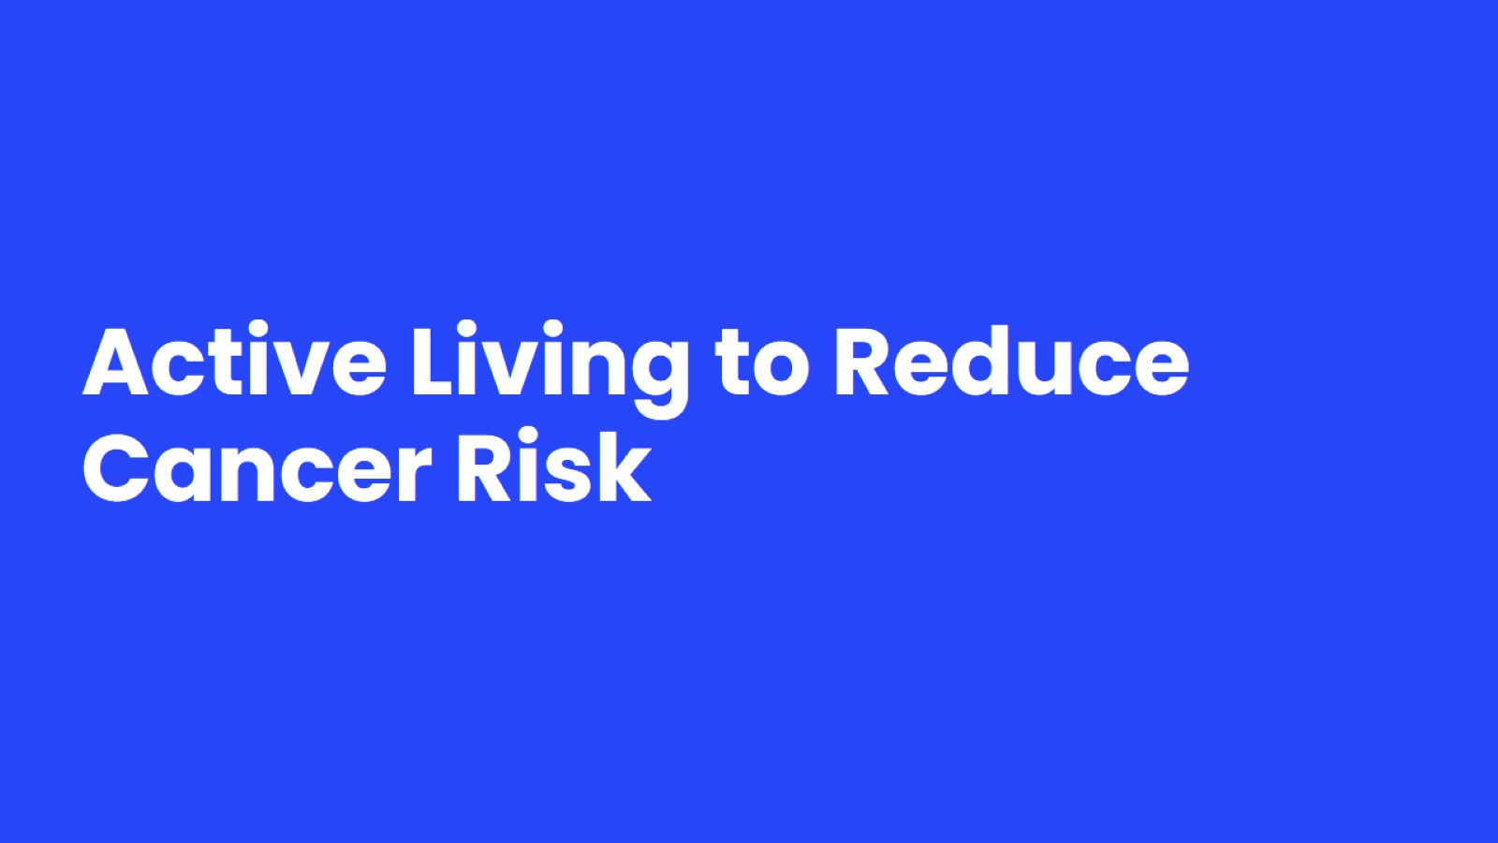
Active Living to Reduce Cancer Risk
Notes:
Speaker notes:
Now that we've discussed food and nutrition, let's dive deeper into what kind of physical activities we can perform to keep us healthy.

Slide 12
Adopt a physically active lifestyle
Notes:
The biggest message is to move more and sit less!
What qualifies as physical activity? Anything from work around the house to brisk walking to triathlons. What you choose depends on your level of fitness, and people with medical conditions should talk about physical activity with their doctors first. You do want to go beyond your usual daily physical activity of working and self-care. Moderate activity is like a brisk walk, but vigorous activity makes you breathe faster, gets your heart rate up, and makes you sweat.

Slide 13
What does active living mean?
Notes:
Speaker notes:
What qualifies as physical activity? Anything from work around the house to brisk walking to triathlons. What you choose depends on your level of fitness, and people with medical conditions should talk about physical activity with their doctors first. You do want to go beyond your usual daily physical activity of working and self-care. Moderate activity is like a brisk walk, but vigorous activity makes you breathe faster, gets your heart rate up, and makes you sweat.

Slide 14
Move more and sit less!
Notes:
There is growing evidence that the amount of time spent sitting is important, regardless of your activity level. Limiting the amount of time spent sitting may help maintain a healthy body weight and reduce the risk of certain cancers.
The point of this is to become active for the rest of your life!
You should also limit the time you spend sitting since this can affect health and cancer risks even if you are active.
Limit sedentary behavior such as sitting, lying down, watching television, or other forms of screen-based entertainment.
Doing more physical activity than usual activities, no matter what a person’s level of activity, can have many health benefits.

Slide 15
Ways to Reduce Sitting Time
Notes:
Speaker notes:
There is growing evidence that the amount of time spent sitting is important, regardless of your activity level. Limiting the amount of time spent sitting may help maintain a healthy body weight and reduce the risk of certain cancers.
There are many ways you can reduce your sitting time. Here are some suggestions. These may not be options for everyone. Think about how you could increase your time spent being physically active.

Slide 16
Notes:
Speaker notes:
Excess body weight is clearly associated with an increased risk of developing many cancers, such as:
Breast (after menopause)
Colon and rectum
Endometrial
Esophageal
Kidney
Liver
Meningioma
Multiple myeloma
Ovary
Pancreas
Stomach
Thyroid
Gallbladder
Having excess body weight may also increase the risk of:
Non-Hodgkin lymphoma
Male breast cancer
Cancers of the mouth, throat, and voice box
Aggressive forms of prostate cancer
Losing weight is a complex process that requires multiple approaches. People who might need to lose weight should work with their health care team to develop a plan for weight loss. These people also need help accessing resources to help them be successful in their weight loss journey.

