Slide 2
Notes:
Speaker Notes
Lung cancer is the leading cause of cancer death among both men and women in the U.S.
Lung cancer accounts for more than 1 in 5 cancer deaths each year.
In 2024, an estimated 234,580 new cases of lung cancer will be diagnosed in the US and 125,070 people will die from the disease.

Slide 3
Notes:
Speaker Notes Let’s learn about what you can do to prevent and detect lung cancer. This is a summary of what we’ll be talking about today.

Slide 4
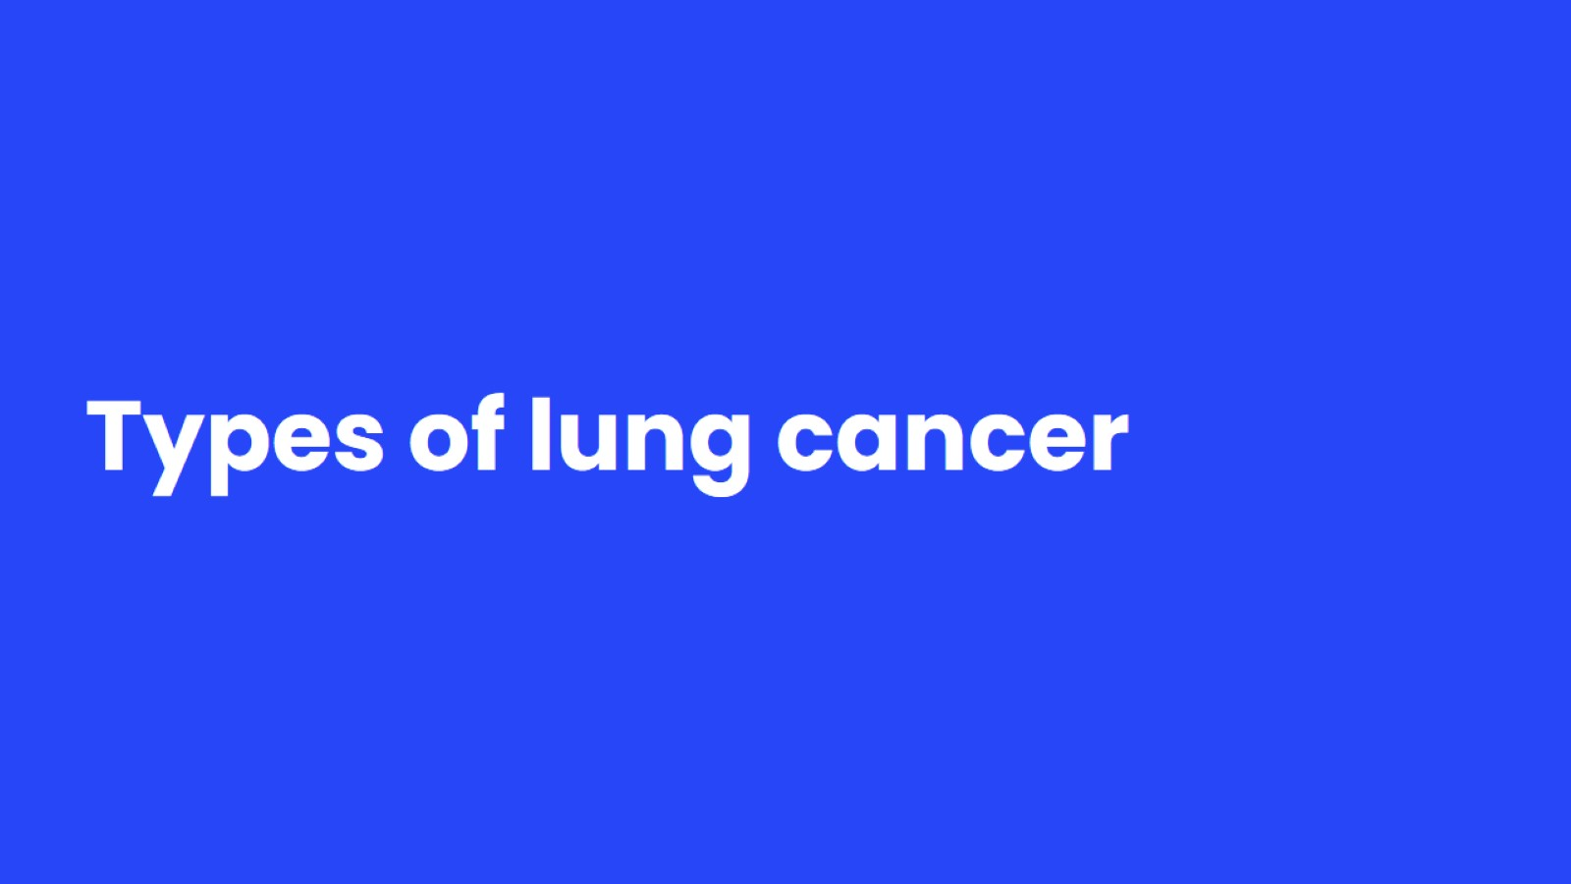
Types of lung cancer
Notes:
Speaker Notes
To understand lung cancer, it helps to know about the normal structure of the lungs and how they work. Then we will discuss where lung cancers commonly develop and the types of lung cancer.

Slide 5
Notes:
Speaker notes:
​
The lungs are two sponge-like organs in the chest. Taking in oxygen and getting rid of carbon dioxide are your lungs’ main functions.
Let’s discuss the key parts of the lungs in this process.
When you breathe in (inhale), air enters through your mouth or nose and goes into your lungs through the windpipe also called the trachea (tray-key-uh). ​
​
The trachea divides into two tubes called the bronchi (brong-ki) which are tubes that takes air from the windpipe to the lungs.
​
At the end of the branches of the bronchi are the alveoli (al-vee-uh-lie)​ which absorb oxygen into your blood from the inhaled air and remove carbon dioxide from the blood when you exhale.
Lung cancers typically start in the cells lining the bronchi and parts of the lung such as the bronchioles or alveoli

Slide 6
Notes:
Speaker notes:
Lung cancer is a cancer that starts in the lungs.
Lung cancers are thought to develop over many years.
The 2 types of lung cancer are treated differently and have a different outlook. We will not be discussing them separately here.​
​
There are other types of lung cancer but they are much rarer.​
​
If asked: Lung Carcinoid tumor and Malignant Mesothelioma are other rare cancers that start in the chest. More information on each of these is available on our website, but they are not discussed here.

Slide 7
Tobacco use and lung cancer
Notes:
Speaker Notes
Smoking is by far the leading risk factor for lung cancer. Let’s review different types of tobacco use and exposure and the role they play in lung cancer.

Slide 8
Notes:
Speaker Notes
Smoking is by far the leading risk factor for lung cancer. About 80% of lung cancer deaths are thought to result from smoking, and this number is probably even higher for SCLC. It’s very rare for someone who has never smoked to have SCLC.
The risk of lung cancer for people who smoke is many times higher than for people who don't smoke. It’s important to note that 2 out of 20 people who have never smoked can get lung cancer.
Secondhand smoke is the third most common cause of lung cancer in the US.
Let’s talk about different types of tobacco exposure in the next few slides.

Slide 9
Notes:
The longer you smoke and the more packs per day you smoke, the greater your risk.​
Low tar or "light" cigarettes increase lung cancer risk as much as regular cigarettes.​
Menthol cigarettes may increase the risk even more since the menthol lets smokers inhale more deeply​
Hookah (hoo-kuh) is often marketed as being safer than cigarettes because the percent of tobacco in the product smoked is low and the smoke is filtered through water. But it’s not true that hookah smoking is safe. And even though the smoke is run through water, the water can’t actually filter it.​
​
If asked: Hookah involves burning tobacco in a water pipe and inhaling the flavored smoke through a long hose.​
​
If you stop smoking before a cancer develops, your damaged lung tissue can gradually start repairing itself. No matter what your age or how long you've smoked, quitting may help you live longer.

Slide 10
Notes:
Speaker Notes
Secondhand smoke (SHS) is also called environmental tobacco smoke (ETS). It’s a mixture of 2 forms of smoke that come from burning tobacco:
Mainstream smoke: The smoke exhaled by a person who smokes.
Sidestream smoke: Smoke from the lighted end of a cigarette, pipe, or cigar, or tobacco burning in a hookah. This type of smoke has higher concentrations of nicotine and cancer-causing agents (carcinogens) than mainstream smoke.
When people who don't smoke are exposed to SHS it’s called involuntary smoking or passive smoking. When you breathe in SHS, you take in nicotine and toxic chemicals the same way people who smoke do. The more SHS you breathe, the higher the levels of these harmful chemicals in your body.
E-cigarettes are also known as vapes (such as JUUL), electronic nicotine delivery systems (ENDS), e-hookahs, among others. ​
​
It is not known at this point whether e-cigarettes increase the risk of cancer.​
​
e-cigarettes contain nicotine which may harm the developing brains of teenagers. ​
The Food and Drug Administration has not approved e-cigarettes as aids to help quit smoking.
​

Slide 11
Other risk factors for lung cancer
Notes:
Speaker Notes
A risk factor is anything that affects your chance of getting a disease such as cancer. Different cancers have different risk factors. Some risk factors, like smoking and excess sun exposure, can be changed. Others, like your age or family history, can’t be changed.​
​
Having a risk factor, or even several risk factors, does not mean that you will get the disease. And some people who get the disease may not have any known risk factors. Even if a person with lung cancer has a risk factor, it’s often very hard to know how much that risk factor may have contributed to the cancer. ​
​
Still, researchers have found several risk factors that may increase a person’s chance of developing lung cancer. Some of these cannot be changed, but many can.

Slide 12
Notes:
Speaker Notes
Radon: Outdoors the radon spreads out and dissipates; there’s so little radon that it’s not dangerous. But indoors, radon can become more concentrated, creating a possible risk for cancer.​
​
If you are concerned about radon exposure, state and local offices of the EPA can give you the names of reliable companies that perform home radon testing and renovation to reduce your risk. For more information, see our separate document, Radon and Cancer.​
​
If asked: The radon gas emitted by soil or rock enters the buildings through cracks in floors or walls; or gaps in foundations around pipes, wires, or pumps. Without ventilation or another way of dissipating, radon can build up and reach rather high levels. Within buildings, radon levels are usually highest in the basement. This level is closest to the soil from which the radon-containing gas diffuses. That means that people who spend much of their time in basement rooms at home or at work would have a greater risk for exposure.

Slide 13
Notes:
Speaker Notes
Asbestos: People who work with asbestos (in some mines, mills, textile plants, places where insulation is used, shipyards, etc.) are several times more likely to die of lung cancer.
In workers exposed to asbestos who also smoke, the lung cancer risk is much greater than even adding the risks from these exposures separately.
It's not clear to what extent low-level or short-term exposure to asbestos might raise lung cancer risk.
Government regulations have greatly reduced the use of asbestos in commercial and industrial products in the US.
Asbestos is still present in many homes and commercial buildings but is not usually considered harmful as long as it’s not released into the air by deterioration, demolition, or renovation. For more information, see our separate document, Asbestos and Cancer.

Slide 14
Notes:
Speaker Notes
The government and industry have taken steps in recent years to protect workers. But the dangers are still present, and if you work around these agents, you should be careful to limit your exposure whenever possible.
Studies of people whose drinking water has high levels of arsenic have found a higher risk of lung cancer. For most Americans who are on public water systems, drinking water is not a major source of arsenic.
Occupational exposures that increase risk include rubber manufacturing, paving, roofing, painting, and chimney sweeping.

Slide 15
Notes:
Speaker Notes
Bullet #1: People who have ever had radiation treatments to the chest for cancer are at higher risk for lung cancer, particularly if they smoke.
Bullet #2: If you have had lung cancer, you have a higher risk of developing another lung cancer. Brothers, sisters, and children of those who have had lung cancer may have a slightly higher risk of lung cancer themselves, especially if it was diagnosed at a younger age. It is not clear how much of this risk might be due to genetics and how much might be from shared exposures (such as tobacco smoke or radon).
Bullet #3: This risk is far less than the risk caused by smoking, but some researchers estimate that worldwide about 5% of all deaths from lung cancer may be due to outdoor air pollution.

Slide 16
Ways to lower the risk of lung cancer
Notes:
Speaker Notes
There is no sure way to prevent lung cancer.
But there are things everyone can do to reduce their risk of both small cell and non-small cell lung cancers

Slide 17
The best way for most people to reduce their risk of lung cancer is to not smoke and to avoid breathing in other people’s smoke.
Notes:
Speaker Notes
We don't know how to prevent all cases of lung cancer. Most important step is to avoid any form of tobacco and tobacco smoke.
If you stop smoking before a cancer develops, your damaged lung tissue gradually starts to repair itself. No matter what your age or how long you’ve smoked, quitting may lower your risk of lung cancer and help you live longer.
If you or someone you care about needs help quitting, please call your American Cancer Society.

Slide 18
Notes:
Speaker Notes
You can find out more about radon from the EPA, including information about having your home tested and air quality where you live, at: http://www.epa.gov/radon
You can learn about the specific materials you are exposed to by asking for Material Safety Data Sheets (MSDS) at your workplace. The full name of the compound, known dangers, how it gets into the body, and how to limit exposures are typically in the MSDS information. At the very least, you can find out more about what to ask and contact NIOSH or the EPA for more information.

Slide 19
Notes:
Speaker Notes
Follow a healthy eating pattern:
Eating lots of fruits and vegetables can help reduce your cancer risk. These foods contain important vitamins, minerals, phytochemicals, and antioxidants and they’re usually low in calories. In general, those with the most color – dark green, red, yellow, and orange – have the most nutrients.
Think about how you can add more vegetables, fruits, and whole grains to your day while you watch your intake of refined carbohydrate and sugar.
Limiting the intake of certain foods:
Limit or avoid processed and red meat consumption. Instead, choose lean protein sources like poultry, fish, beans, or tofu. If you choose to eat red meat, choose lean cuts. Look for the words “loin” or “round” in the name. Trim meat of visible fat before cooking.
Examples of red meats: beef, pork, and lamb
Examples of processed meats: bacon, sausage, luncheon meats, and hot dogs
It’s also important to limit sugar-sweetened beverages and find ways to integrate whole grains rather than highly processed or refined grain products.
Alcohol:
It's best not to drink alcohol. Drinking any amount of alcohol increases your risk of colorectal cancer
People who do choose to drink alcohol should limit their consumption to 1 drink per day for women and 2 drinks per day for men.
If asked: In the United States, a standard drink is equal to
--12 ounces of beer
--8 ounces of malt liquor
--5 ounces of wine
--1.5 ounces or a “shot” of 80-proof distilled spirits or liquor (such as gin, rum, vodka, or whiskey)
[From the Centers for Disease Control and Prevention, website: www.cdc.gov/alcohol/faqs.htm#standDrink]

Slide 20
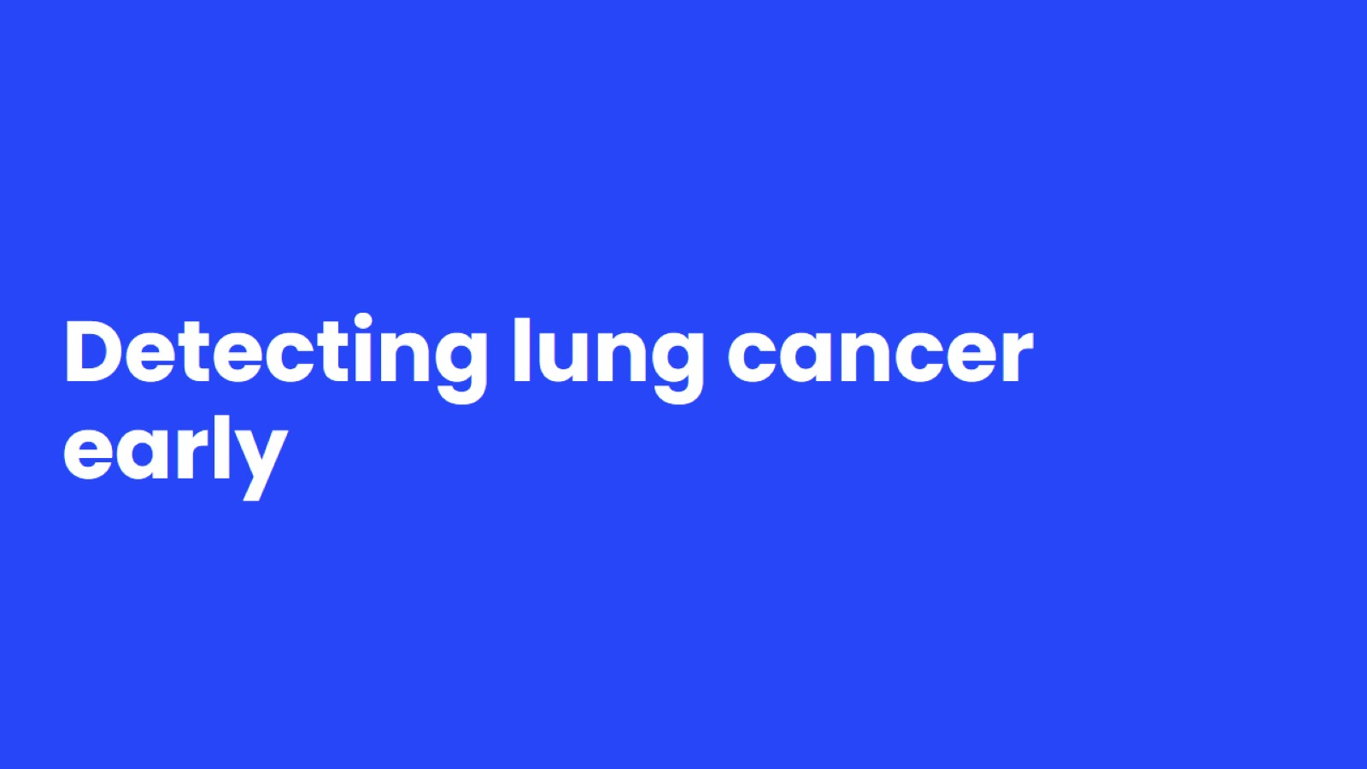
Detecting lung cancer early
Notes:
Speaker Notes
Some lung cancers can be found early – when it might be easier to treat. Let’s talk about screening methods and when people should be screened.

Slide 21
Notes:
If lung cancer is found at an earlier stage, when it is small and before it has spread, it is more likely to be successfully treated.
Usually symptoms of lung cancer do not appear until the disease is already at an advanced stage when it is harder to treat.
Screening people at higher risk for lung cancer increases the chance of finding the cancer when treatment is more likely to be effective.

Slide 22
Notes:
Speaker Notes
Yearly screening for lung cancer is recommended with low-dose CT (LDCT) scan for adults aged 50 to 80 years who currently smoke or used to smoke and have a 20 or more pack-year history. We will discuss pack year calculations in the next slide.

Slide 23
Notes:
Speaker Notes
Smoking history is written as pack-year history. This is the number of years you smoked multiplied by the number of packs of cigarettes per day. For example, someone who smoked 2 packs per day for 10 years [2 x 10 = 20] has 20 pack-years of smoking.

Slide 24
Discuss lung cancer screening with your doctor
Notes:
Speaker Notes
Screening is testing to find cancer, or other diseases in people who don’t have any symptoms.
Lung cancer screening is covered by Medicare and many private health insurance plans. Your doctor or nurse can help you find out more about your coverage.
To have the most potential benefit from screening, people need to be in good health. People should not be screened if they have serious health problems that will likely limit how long they will live, or if they won’t be able to or won’t want to get treatment if lung cancer is found.
Talk to your doctor about:
Your overall health
Purpose of screening
How it is done
Benefits
Limits
Possible harms of screening

Slide 25
Notes:
Speaker Notes
Screening does not replace stopping smoking. If you need resources to help you or a loved one on their quitting journey, visit cancer.org or call today.

Slide 26
You can get more information on lung cancer and lung cancer screening on our website, cancer.org, or call 1-800-227-2345 and talk with one of our Cancer Information Specialists.

