Slide 1
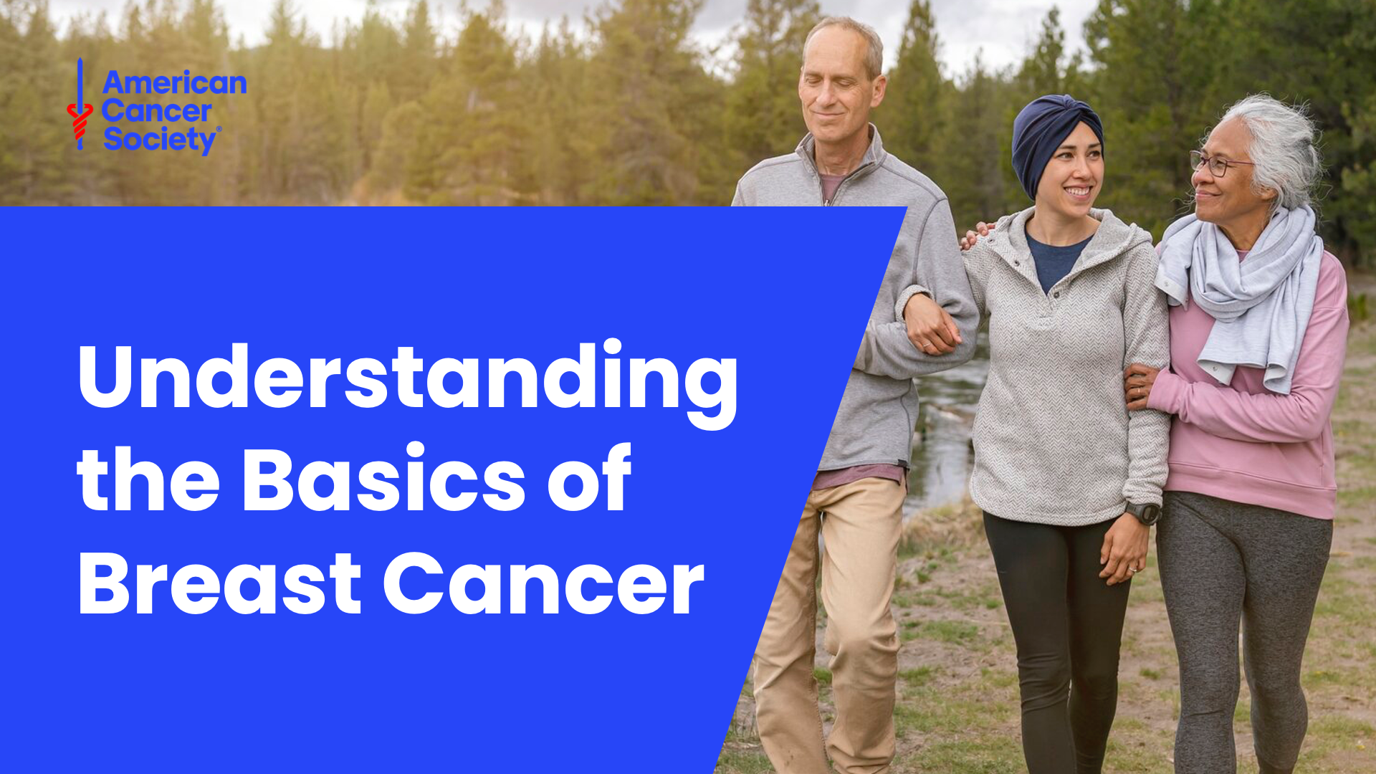

Slide 2
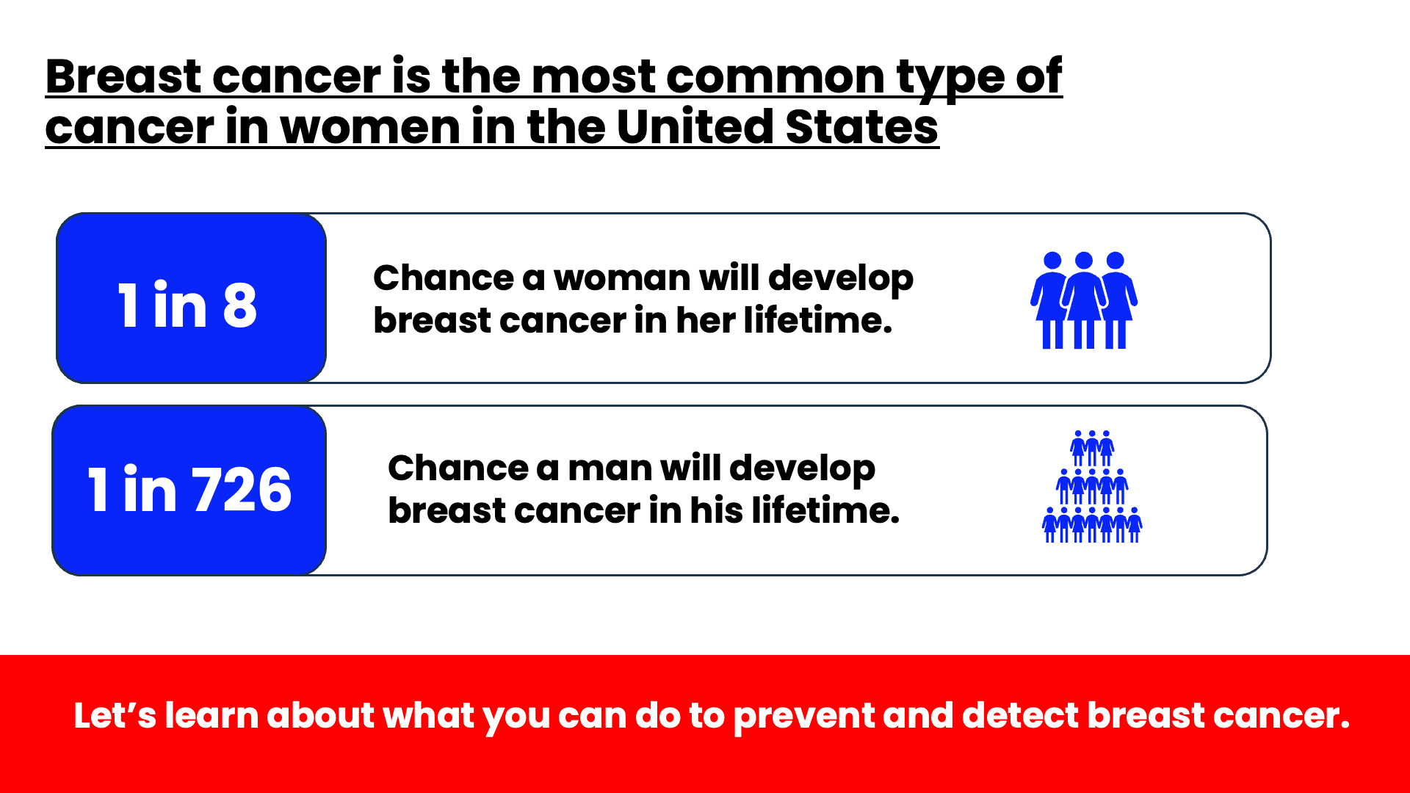
Notes:
Speaker Notes
Breast cancer is the most common type of cancer in women in the United States behind skin cancer. Breast cancer cases rose at a rate of 1.0% each year between 2012 to 2021. This number is a little steeper in women younger than 50 (1.4%).
In 2025, the American Cancer Society estimates that:
About 316,950 new cases of invasive breast cancer will be diagnosed in women with an additional 59,080 cases of ductal carcinoma in situ – or DCIS.
About 2,800 new cases of invasive breast cancer will be diagnosed in men
Breast cancer accounts for about 32% (or 1 in 3) of all new female cancers each year. There is a 1 in 8 chance a woman will develop breast cancer in her lifetime, but there is also a 7 in 8 chance she will not.
Breast cancer is less common in men, with an average lifetime risk of getting breast cancer of about 1 in 726.

Slide 3
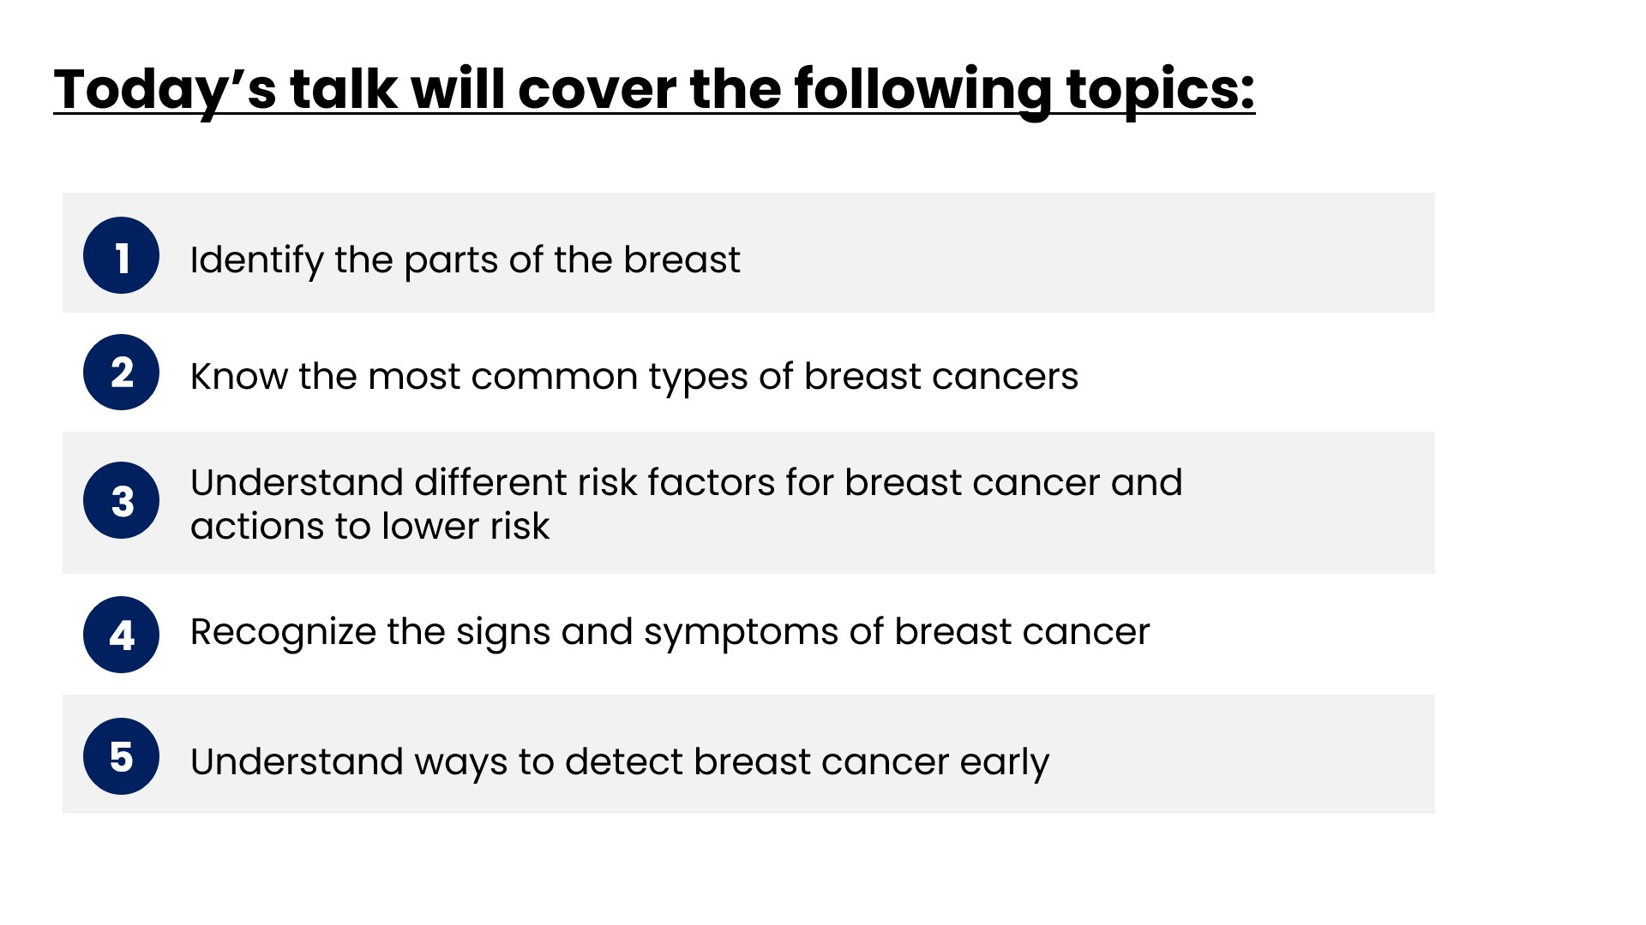
Notes:
Speaker Notes
Let’s learn about what you can do to prevent and detect breast cancer early. This is a summary of what we’ll be talking about today.

Slide 4

Notes:
Speaker Notes
Breast cancers can start from different parts of the breast. Let’s get to know what these parts are and their function in the human body.

Slide 5
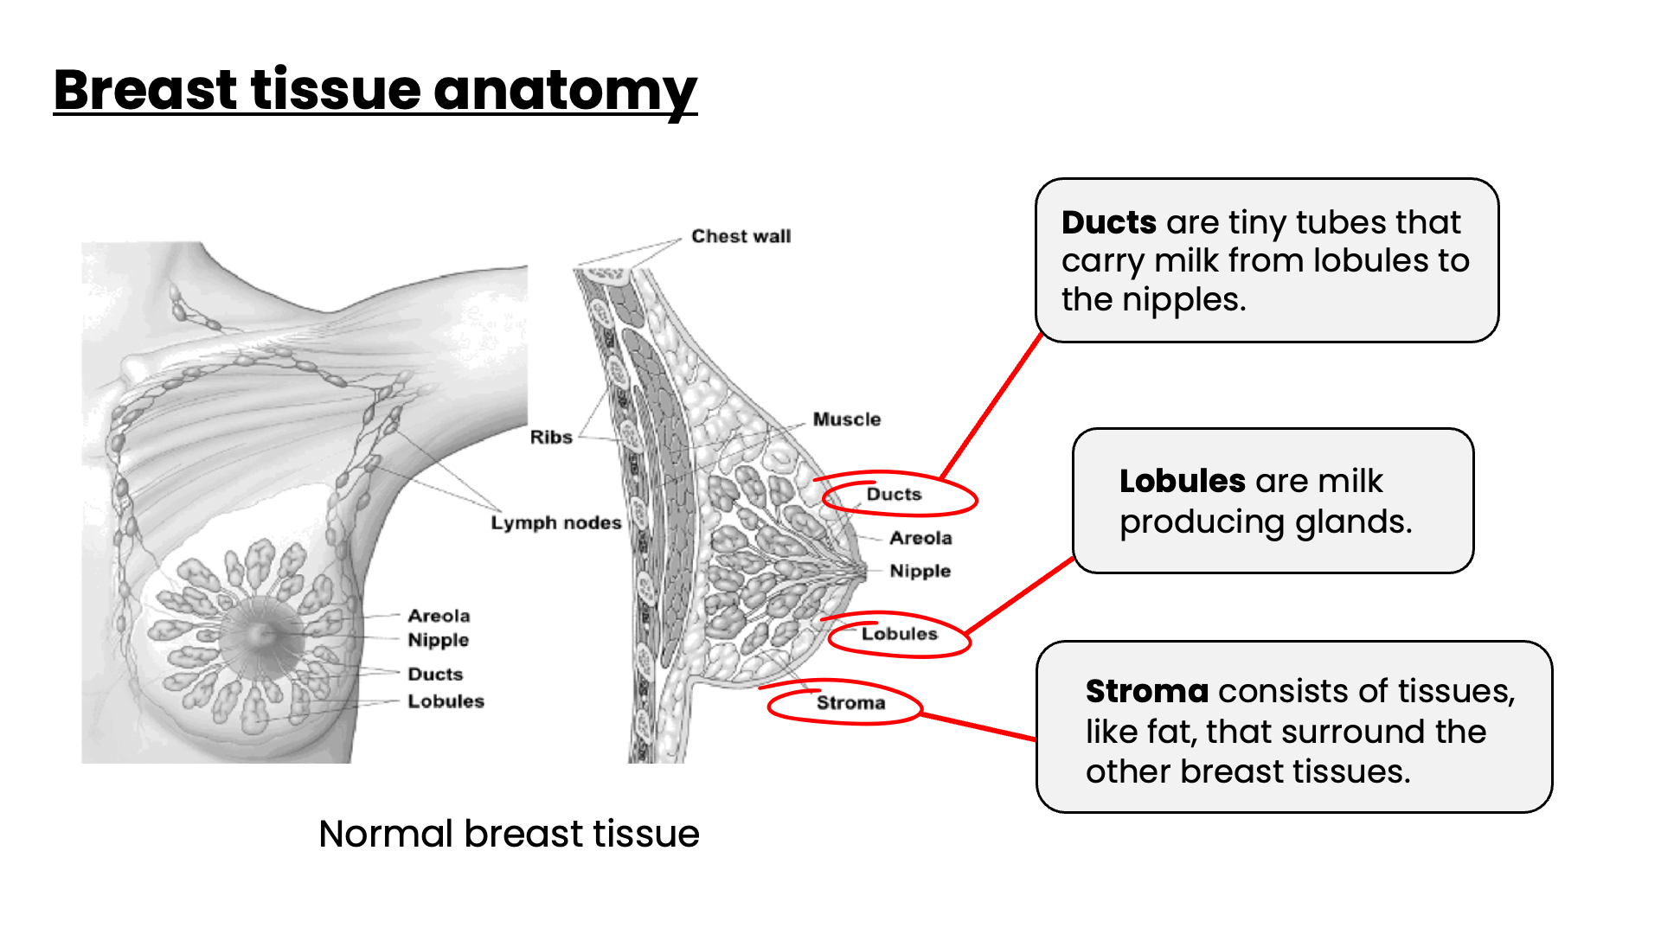
Notes:
Speaker Notes
The breast is an organ that sits on top of the upper ribs and chest muscles. There is a left and right breast and each one has mainly glands, ducts, and fatty tissue. In women, the breast makes and delivers milk to feed newborns and infants. The amount of fatty tissue in the breast determines the size and shape of each breast.
Ducts are small canals that come out from the lobules and carry the milk to the nipple. This is the most common place for breast cancer to start.
Lobules are the glands that make breast milk.
Stroma or the fat and connective tissue (stroma) surround the ducts and lobules and help keep them in place.

Slide 6
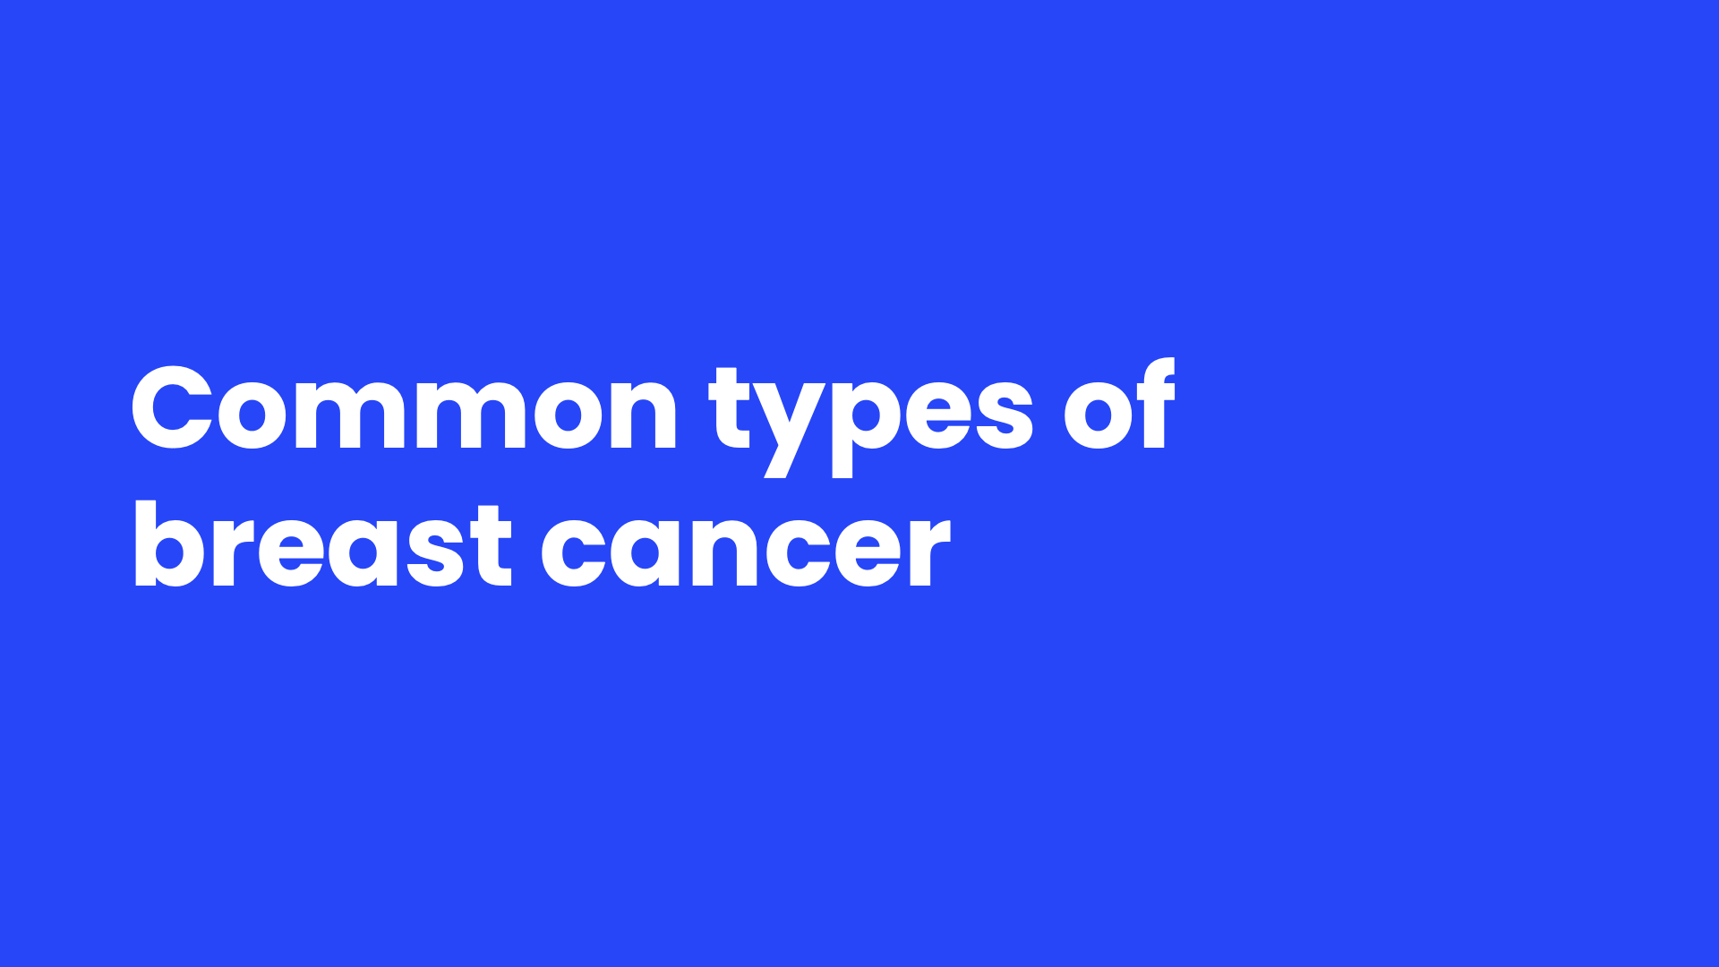
Notes:
Speaker Notes
Now that we know about the parts of the breast and what they do, let’s move into the common types of breast cancer.

Slide 7
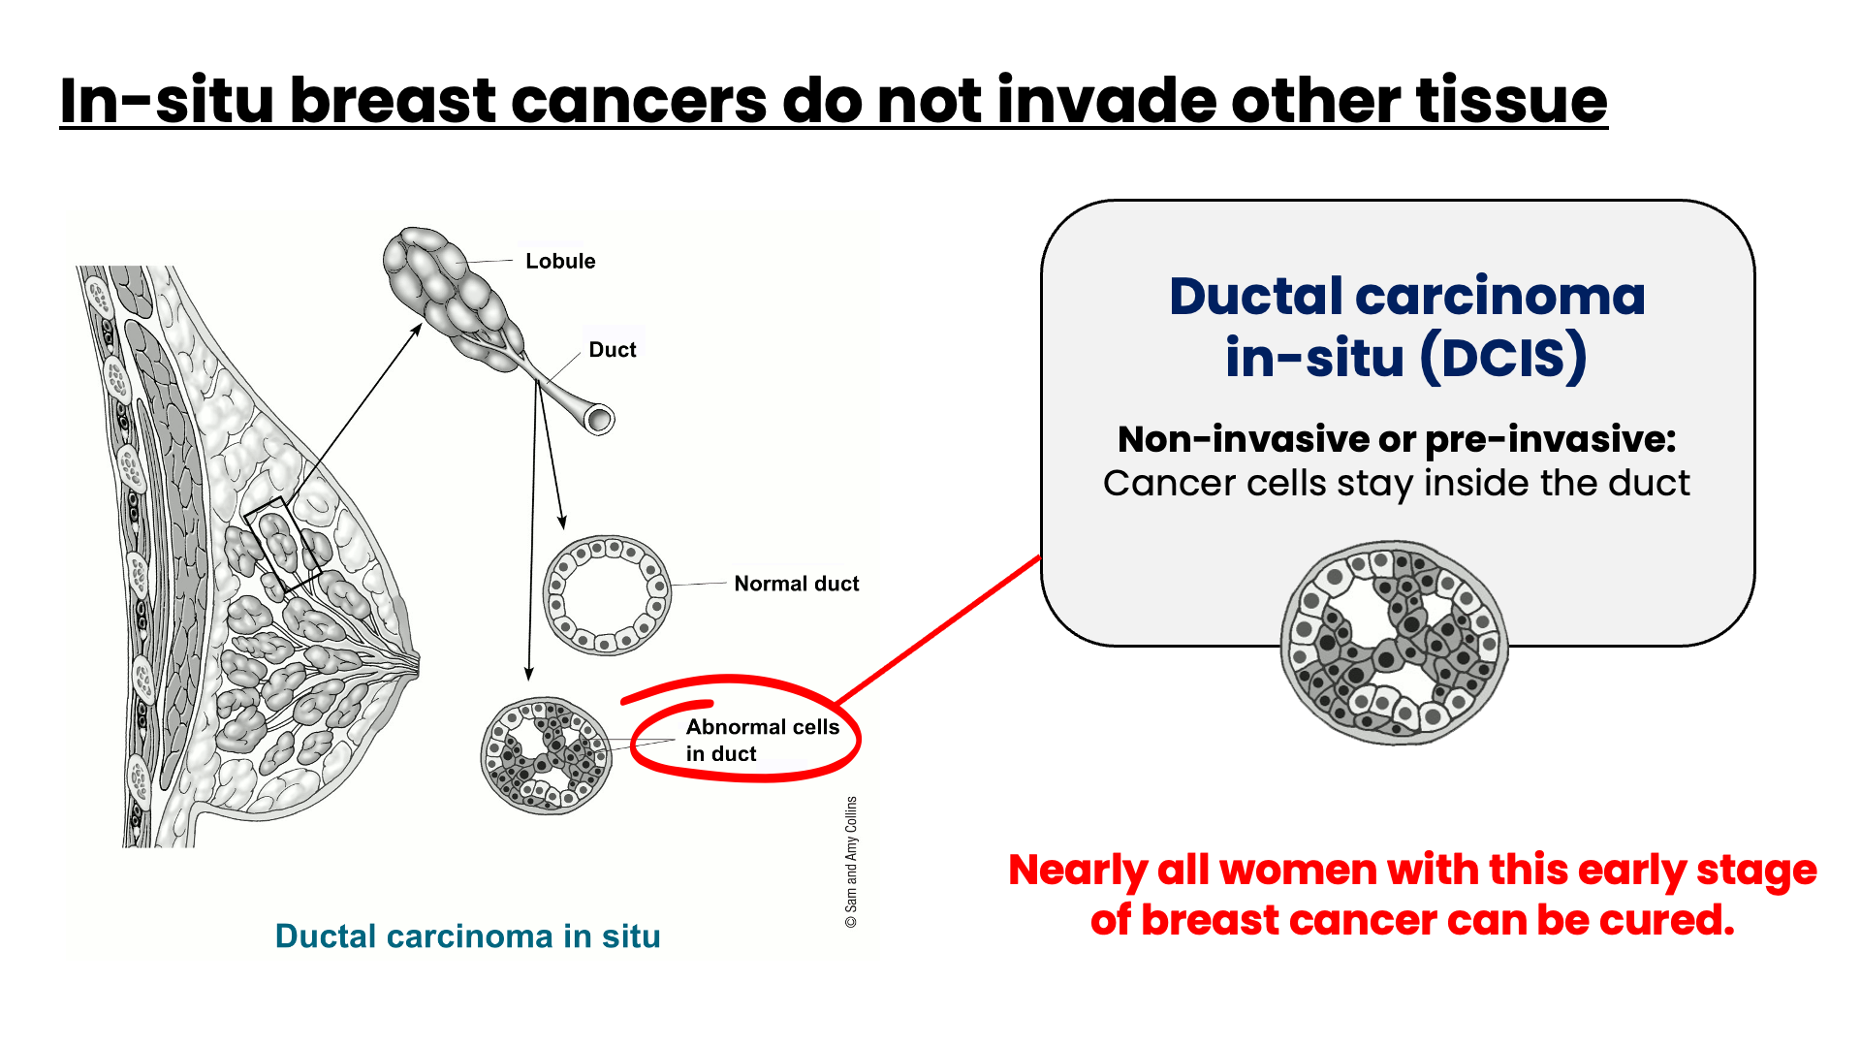
Notes:
Speaker Notes
Cancer is out-of-control growth of abnormal cells in the breast that can invade and damage normal tissue. In the picture shown, you see that abnormal cells that are staying inside the duct. They have not yet invaded or damaged into surrounding tissue.
Most breast cancers start in the cells that line the ducts (ductal cancers).
Ductal carcinoma in situ (DCIS) is a non-invasive or pre-invasive breast cancer. Invasive or infiltrating means that the cancer cells have grown out of the ducts or lobules and into the nearby breast tissue. Invasive cancers have the potential to spread out of the breast to lymph nodes and other organs.
About 1 in 6 new breast cancers will be DCIS. Nearly all women with this early stage of breast cancer can be cured. DCIS is also called intraductal carcinoma or stage 0 breast cancer.
​

Slide 8
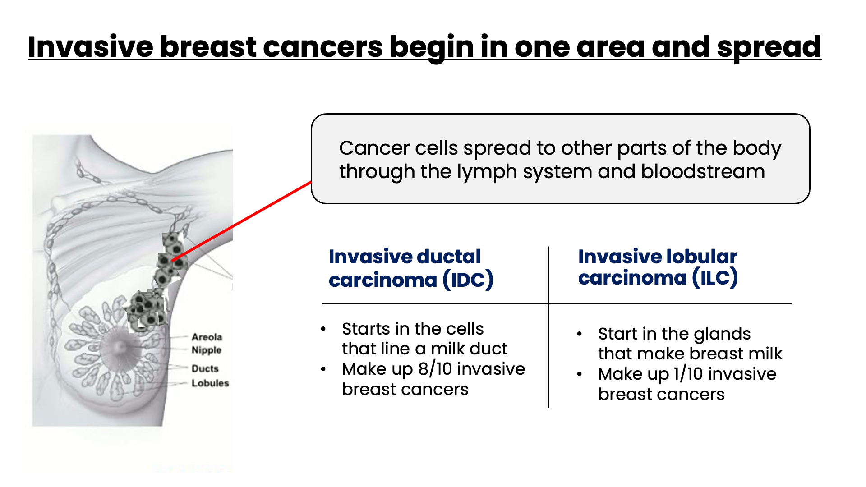
Notes:
Speaker Notes
Breast cancer can spread when the cancer cells get into the blood or lymph system and then are carried to other parts of the body.
Most breast cancers are invasive types of cancer, (or carcinomas), but there are two main types of invasive breast cancer: invasive ductal carcinoma and invasive lobular carcinoma.
Let’s talk a bit more about each of these types.

Slide 9
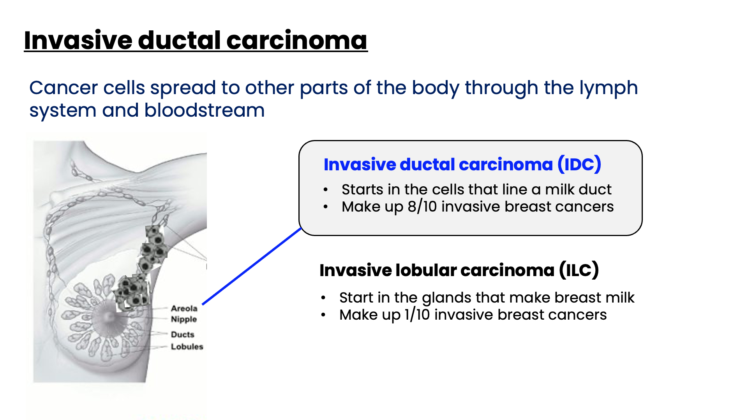
Notes:
Speaker Notes
Invasive (or infiltrating) ductal carcinomas (or IDC) starts in the cells that line a milk duct in the breast. From there, the cancer breaks through the wall of the duct and grows into the nearby breast tissues. At this point, it may be able to spread (metastasize) to other parts of the body through the lymph system and bloodstream.
On average, about 8 in 10 invasive breast cancers are IDC.

Slide 10
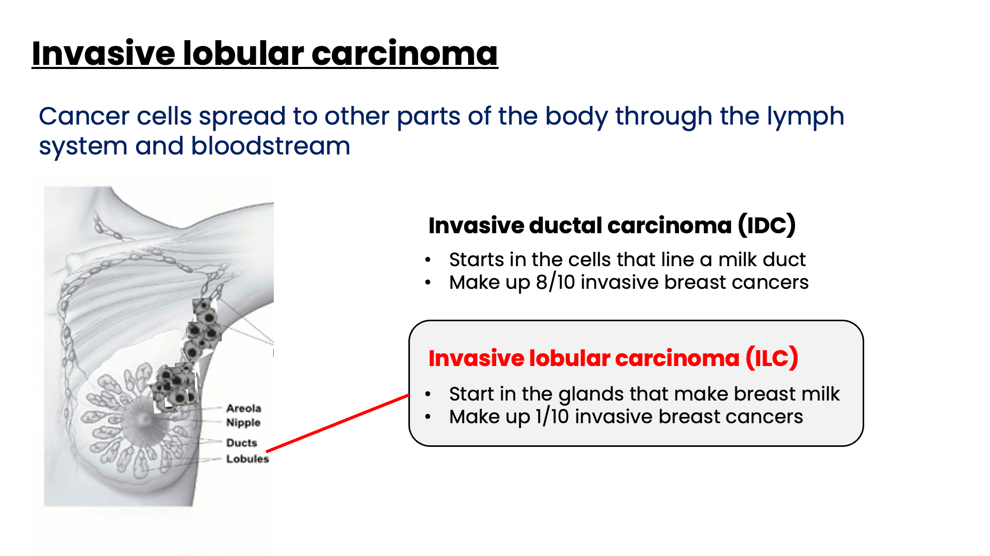
Notes:
Speaker Notes
Some breast cancers start in the glands that make breast milk (lobular cancers). Invasive types of these cancers are called invasive lobular carcinoma and similarly, can break through the walls of the lobules and spread – or metastasize- to other parts of the body.
About 1 in 10 invasive breast cancers is an invasive lobular carcinoma (ILC).
Invasive lobular carcinoma may be harder to detect on physical exam and imaging, like mammograms, than IDC.

Slide 11
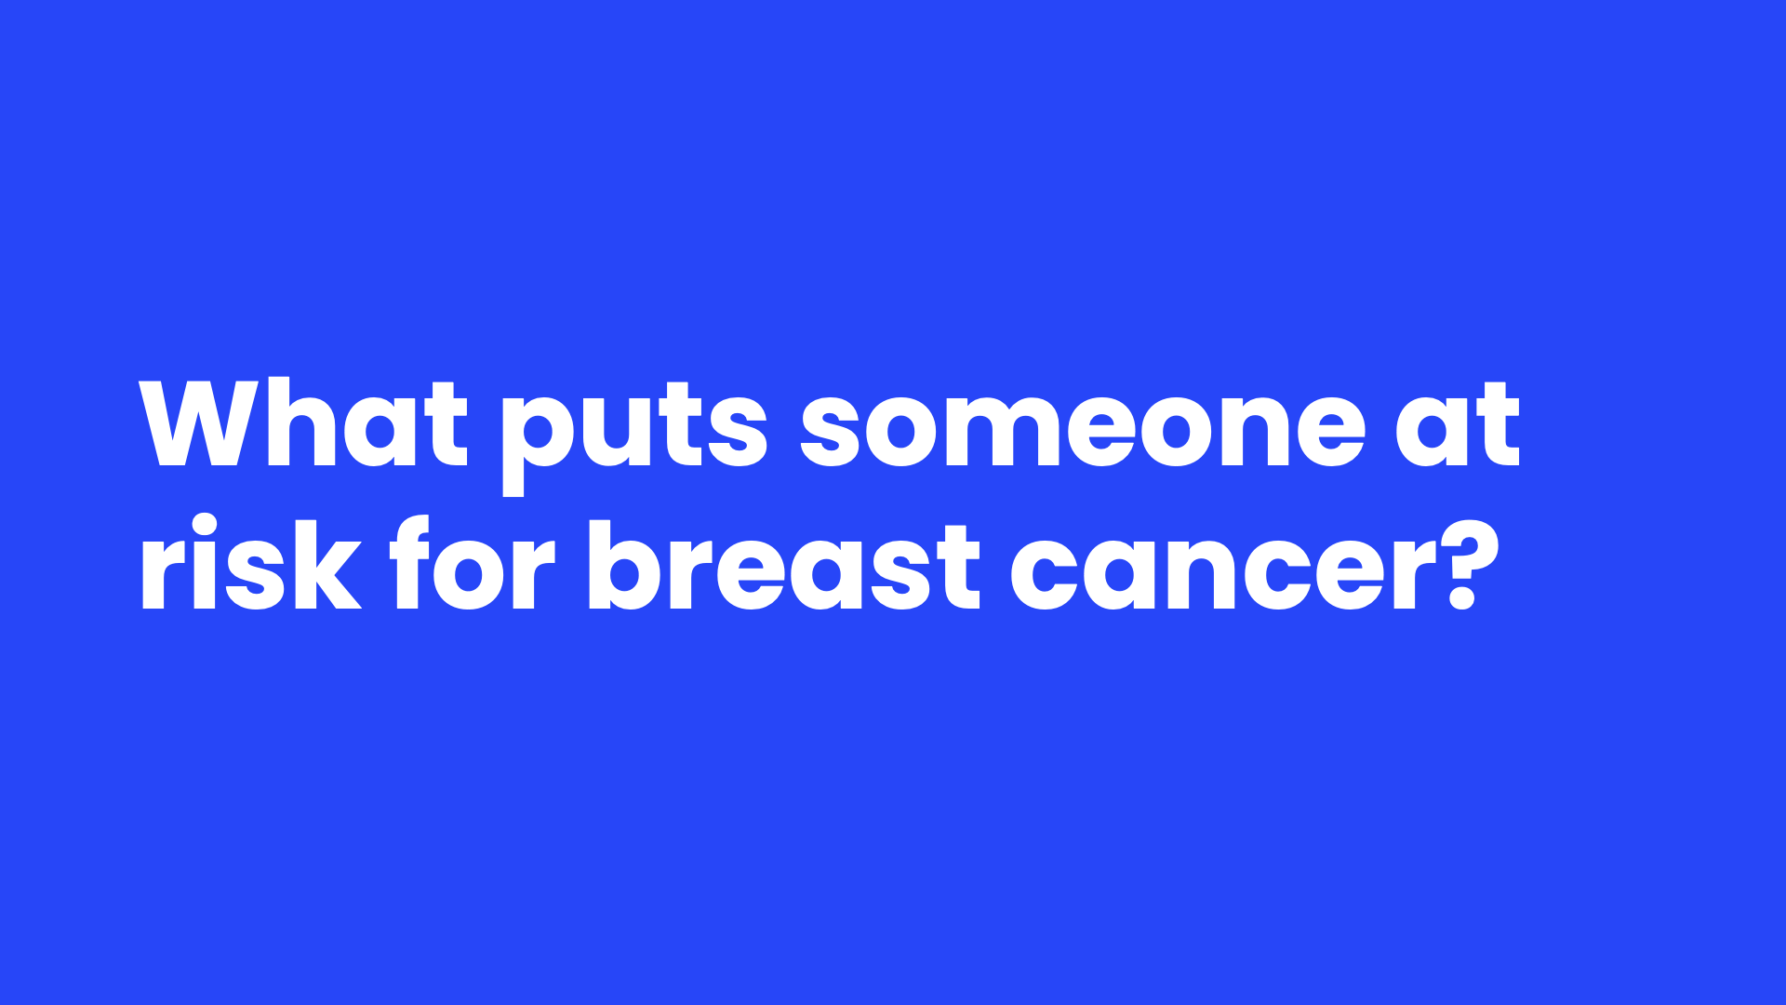
Notes:
Speaker Notes
A risk factor is anything that affects your chance of getting a disease such as cancer. Different cancers have different risk factors. Some risk factors, like smoking and excess sun exposure, can be changed. Others, like your age or family history, can’t be changed.
Having a risk factor, or even several risk factors, does not mean that you will get the disease. And some people who get the disease may not have any known risk factors.
Still, researchers have found several risk factors that may increase a person's chance of developing breast cancer.

Slide 12
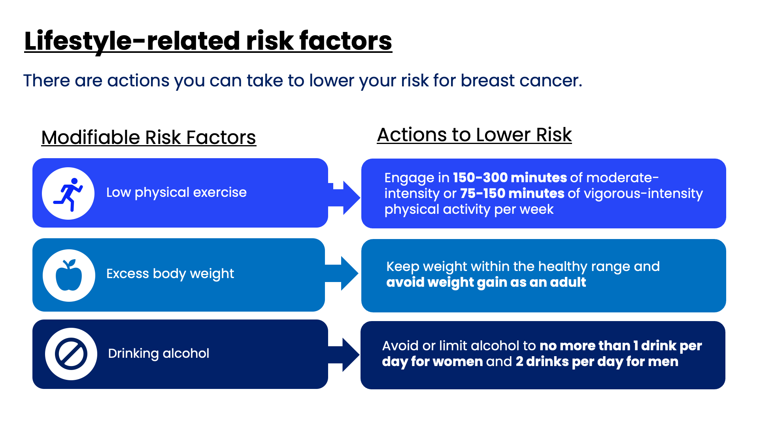
Notes:
Speaker Notes
The way people live can impact their risk for breast cancer. Lifestyle risk factors include:
​
Physical activity: Evidence is growing that regular physical activity reduces breast cancer risk, especially in women after menopause. Exactly how physical activity might reduce breast cancer risk isn’t clear, but it may be due to its effects on body weight, inflammation, hormones, and energy balance. The American Cancer Society recommends that adults get 150-300 minutes of moderate-intensity physical activity per week, or 75-150 minutes of vigorous-intensity physical activity, or an equivalent combination; getting to or going over the upper limit of 300 minutes.
Unhealthy body weight: Before menopause, the ovaries produce most estrogen, and fat tissue produces a small amount. After menopause (when the ovaries stop making estrogen), most of a woman's estrogen comes from fat tissue. Having more fat tissue after menopause can increase estrogen levels and increase the likelihood of developing breast cancer. Also, women who are overweight tend to have higher blood insulin levels. Higher insulin levels have been linked to breast cancer.​ Still, the connection between weight and breast cancer risk is complex. For example, the risk appears to be increased for women who gained weight as an adult but the risk before menopause is actually lower in women who are obese.
​
Alcohol use: Women who have 1 alcoholic drink a day have a small (about 7% to 10%) increase in risk compared with non-drinkers, while women who have 2 to 3 drinks a day have about a 20% higher risk than non-drinkers.​
If asked, a drink of alcohol is defined as:​
12 ounces of beer ​
5 ounces of wine​
1.5 ounces or a “shot” of 80-proof distilled spirits or liquor (such as gin, rum, vodka, or whiskey).

Slide 13
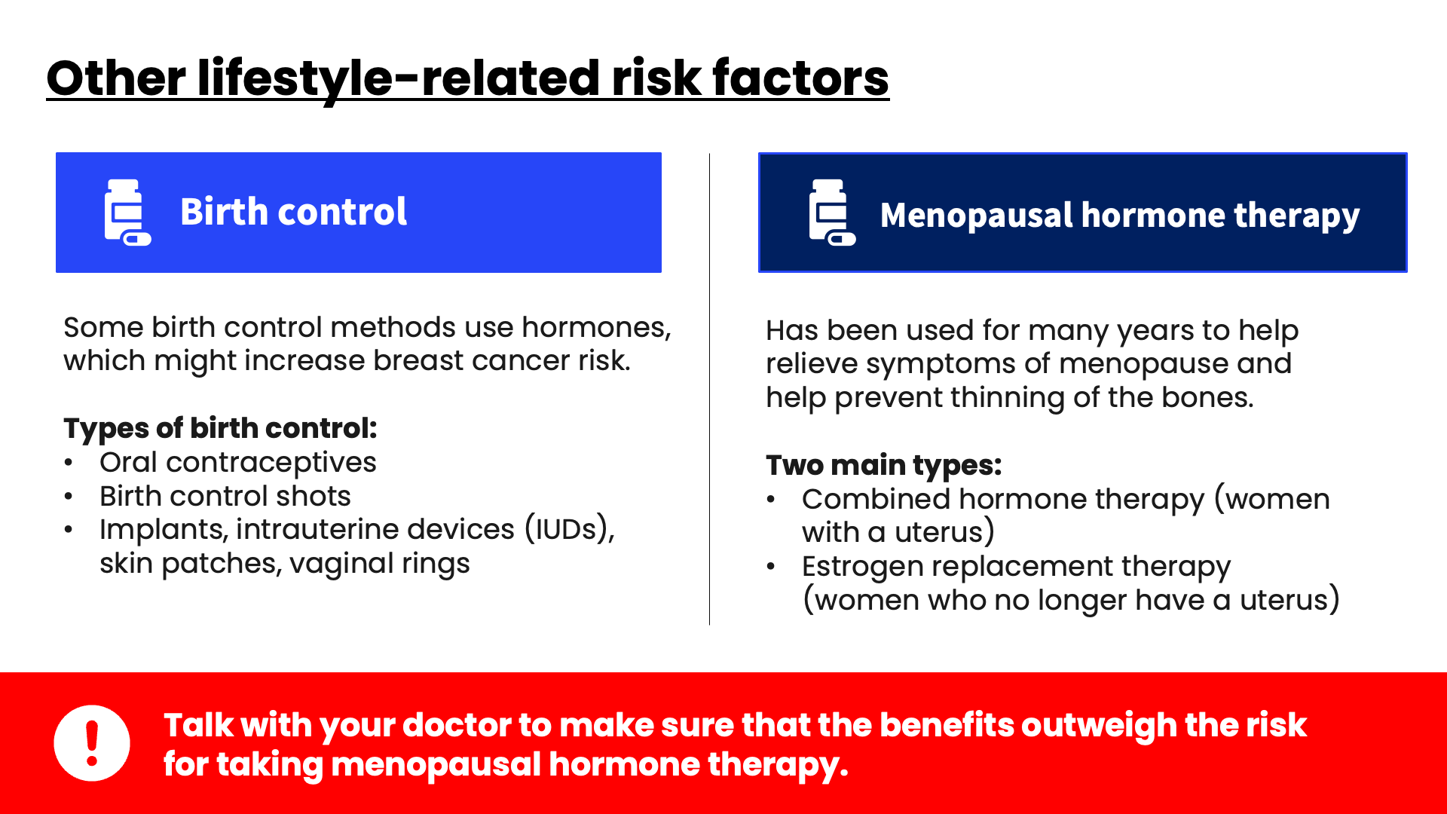
Notes:
Speaker Notes
​
Medication Use
Some birth control methods use hormones, which might increase breast cancer risk. Ask your physician for more information about oral contraceptives, birth control shots, and birth control implants such as, IUDs, skin patches, or vaginal rings.
Hormones given to treat symptoms of menopause including hot flashes and sweating. Treatments can include pills, skin patches, injections, or vaginal rings. Several large studies have looked at possible links between systemic hormone therapy in menopausal women and different types of cancer. Talk with your doctor to make sure that the benefits outweigh the risk for taking menopausal hormone therapy.

Slide 14
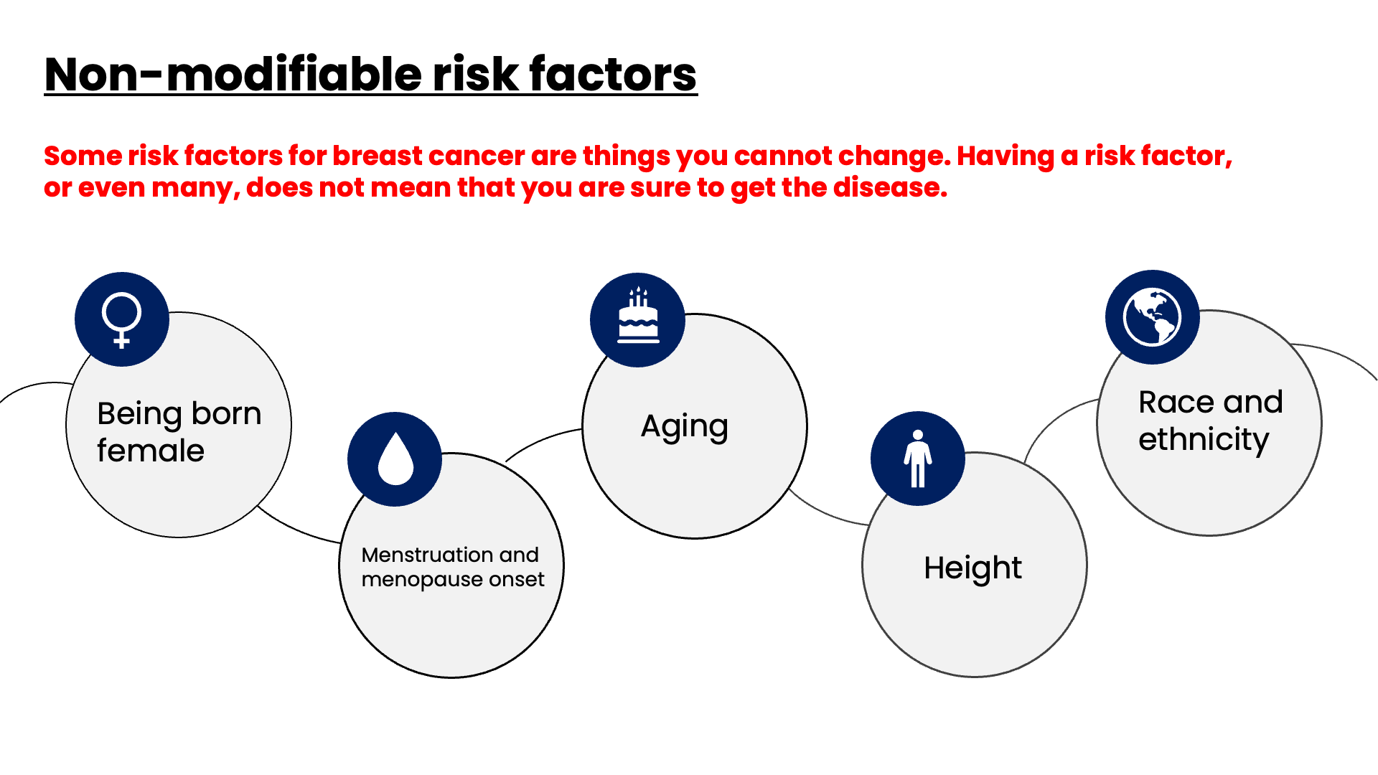
Notes:
Speaker Notes
These are nonmodifiable risk factors found to increase risk for breast cancer.
Being born female
This is the main risk factor for breast cancer. Men can get breast cancer, too, but this disease is much more common in women than in men.
Aging
As you get older, your risk of breast cancer goes up. Most breast cancers are found in women aged 55 years and older.
Starting menstrual periods early
Women who have had more menstrual cycles because they started menstruating early (especially before age 12) have a slightly higher risk of breast cancer. The increase in risk may be due to a longer lifetime exposure to the hormones estrogen and progesterone.
Going through menopause later
Women who have had more menstrual cycles because they went through menopause later (typically after age 55) have a slightly higher risk of breast cancer. The increase in risk may be because they have a longer lifetime exposure to the hormones estrogen and progesterone.
Being taller
Many studies have found that taller women have a higher risk of breast cancer than shorter women. The reasons for this aren’t exactly clear, but it may have something to do with factors that affect early growth, such as nutrition early in life, as well as hormonal or genetic factors.
Race and Ethnicity: Overall, White women are slightly more likely to develop breast cancer than Black women, although the gap between them has been closing in recent years. In women under age 40, breast cancer is more common in Black women. Black women are also more likely to die from breast cancer at any age. Asian, Hispanic, and Native American women have a lower risk of developing and dying from breast cancer.

Slide 15
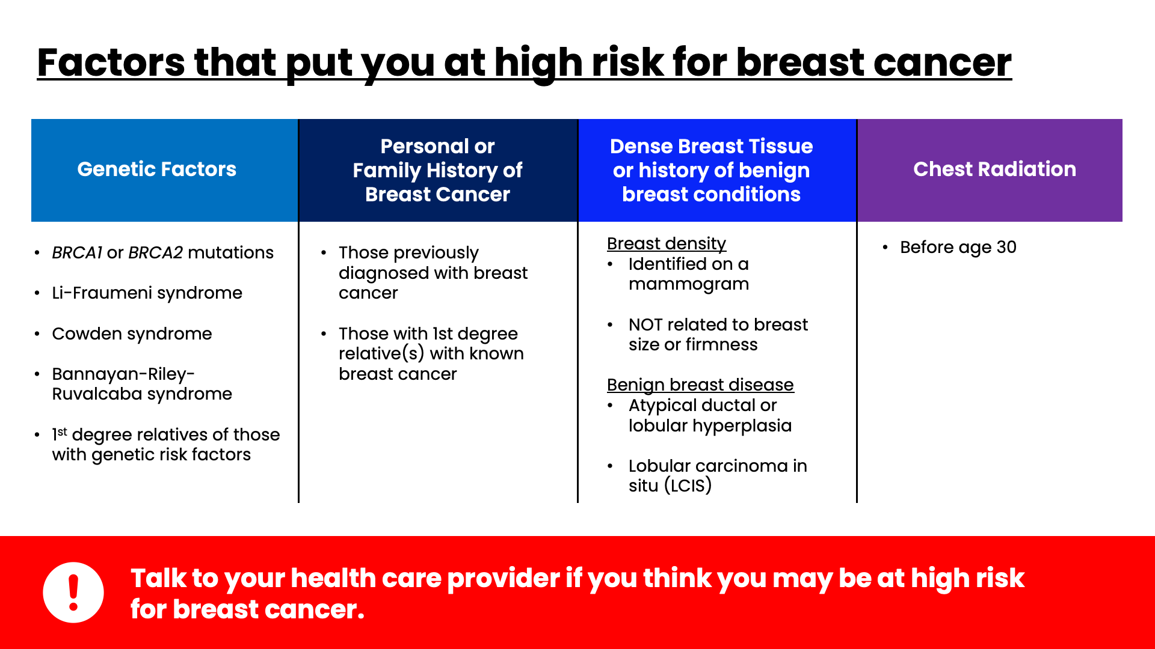
Notes:
Speaker Notes
It’s important to note that women with the risk factors shown here should talk to their doctor as these can place them at high risk for breast cancer.
This includes women who:
Have a known BRCA1 or BRCA2 gene mutation (based on having had genetic testing);
Have Li-Fraumeni syndrome, Cowden syndrome, or Bannayan-Riley-Ruvalcaba syndrome, or have first-degree relatives with one of these syndromes.
Have a first-degree relative (parent, brother, sister, or child) with a BRCA1 or BRCA2 gene mutation, and have not had genetic testing themselves;
Have had breast cancer before or have at least 1 first degree relative with a breast cancer diagnosis regardless of genetics. This includes women who have a father or brother with breast cancer.
Have dense breast tissue identified on mammogram or a history of benign breast conditions. Breast density is a measure of how much fibrous and glandular tissue (also known as fibroglandular tissue) there is in your breast, as compared to fat tissue. It isn’t related to breast size or firmness. Benign breast conditions including atypical ductal or lobular hyperplasia and lobular carcinoma in situ can place you at higher risk for breast cancer.
Had radiation therapy to the chest before 30 years of age.

Slide 16
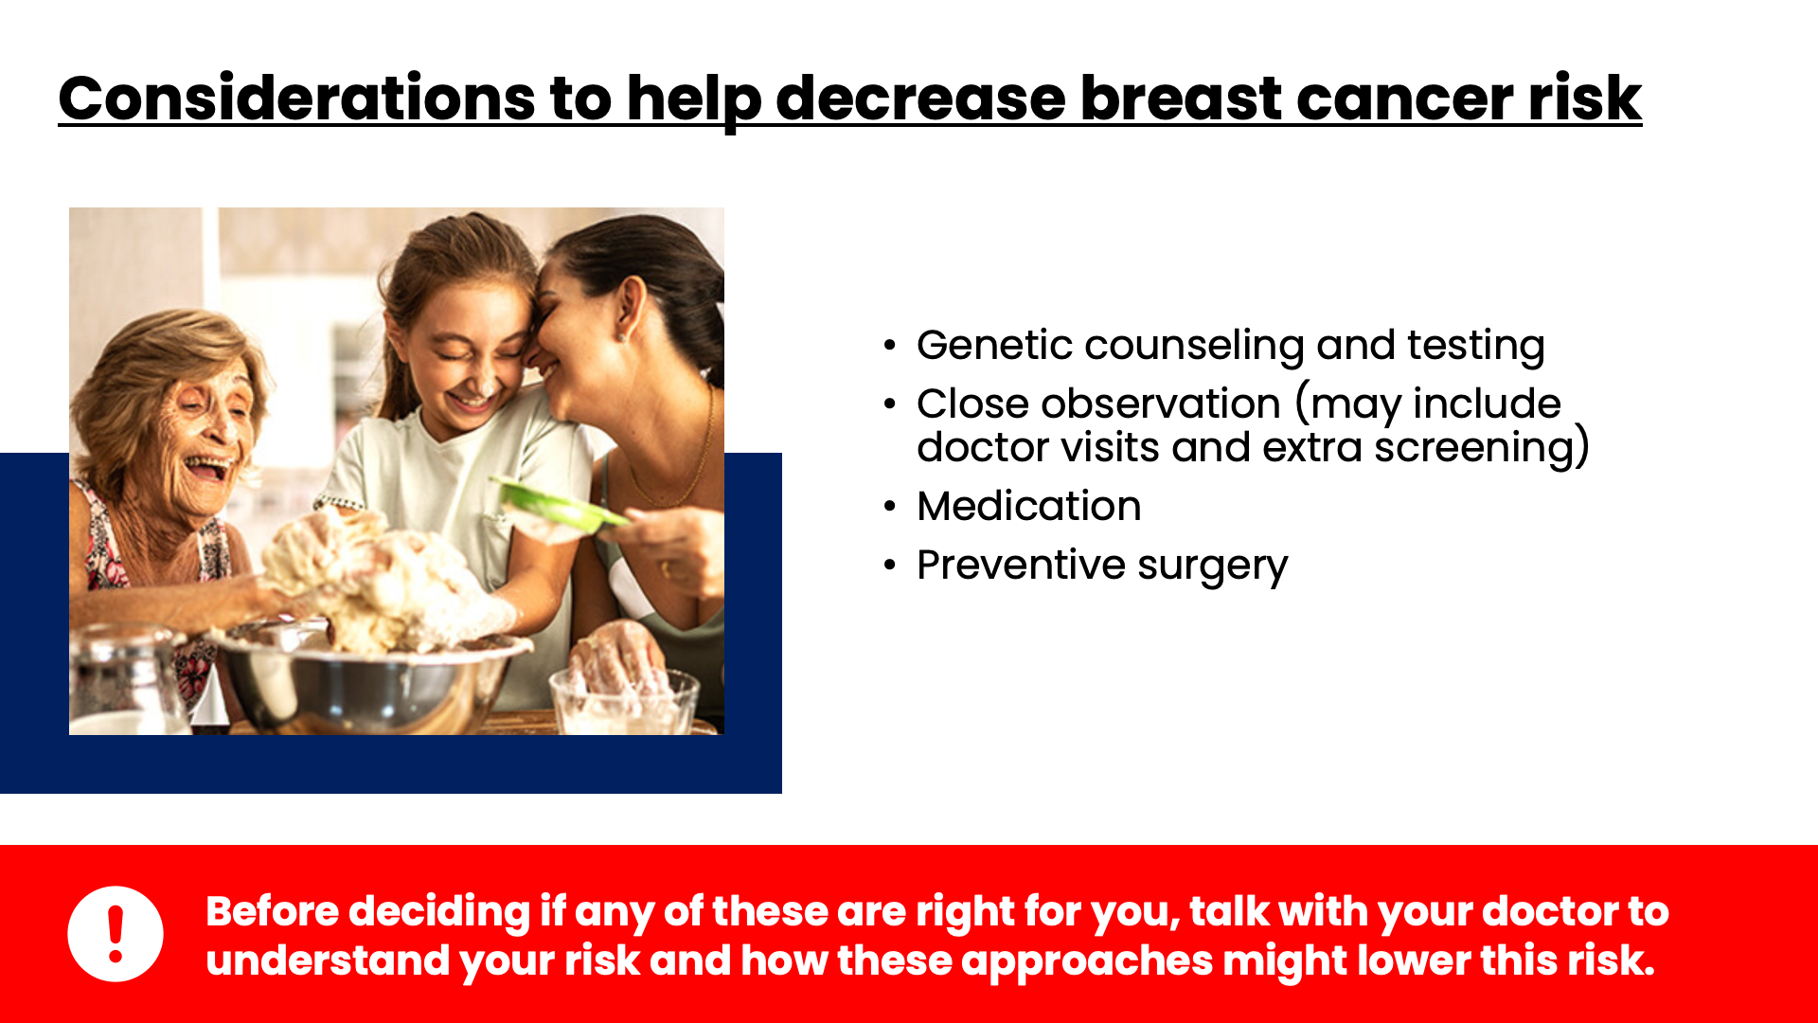
Notes:
Speaker Notes
Before deciding which, if any, of these may be right for her, a woman needs to talk with her doctor to understand what her risk is and how much any of these approaches might lower this risk. ​
​
​
Genetic counseling and testing:​
If there are reasons to think you might have inherited a gene change that increases your risk of breast cancer (such having as a strong family history of breast cancer, or a family member with a known gene mutation), you might want to talk to your doctor about genetic counseling to see if you should be tested​
​
Close observation:​
For women at increased breast cancer risk who don’t want to take medicines or have surgery, some doctors might recommend close observation. This might include more frequent doctor visits, for breast exams and risk assessment, starting breast cancer screening at an earlier age, or possibly adding another screening test, such as breast MRI.​
Medicines to lower breast cancer risk: ​
Prescription medicines can be used to help lower breast cancer risk in certain women at increased risk of breast cancer.​
Tamoxifen is a drug that blocks some of the effects of estrogen on breast tissue. Tamoxifen might be an option even if you haven’t gone through menopause.​
Raloxifene also blocks the effect of estrogen on breast tissue. It’s only used for women who have gone through menopause. ​
Other drugs, called aromatase inhibitors, might also be an option for women who have gone through menopause.​
​
Preventive surgery for women with very high breast cancer risk:​
For the few women who have a very high risk for breast cancer such as from BRCA1 or BRCA2 gene mutations, prophylactic surgery may be an option. ​
Preventive (prophylactic) bilateral mastectomy: removing both breasts before cancer is diagnosed reduces the risk of breast cancer by 90% or more​
Prophylactic oophorectomy (ovary removal): Ovaries are the main source of estrogen in the body.​
It is important to remember that not all women at very high risk will develop cancer. ​

Slide 17
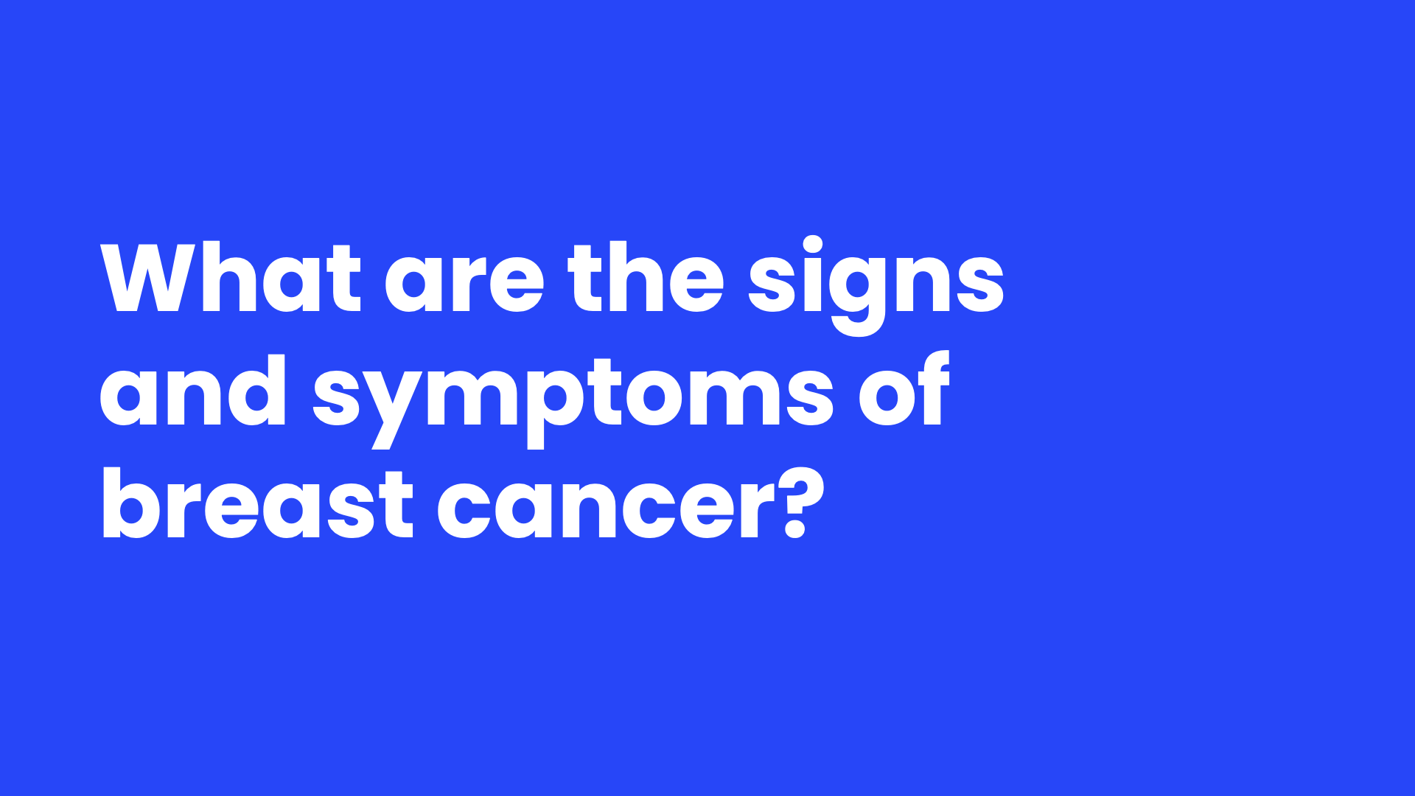
Notes:
Speaker Notes
Now that we know what can put people at risk for breast cancer, let's see what signs and symptoms many of them experience.

Slide 18
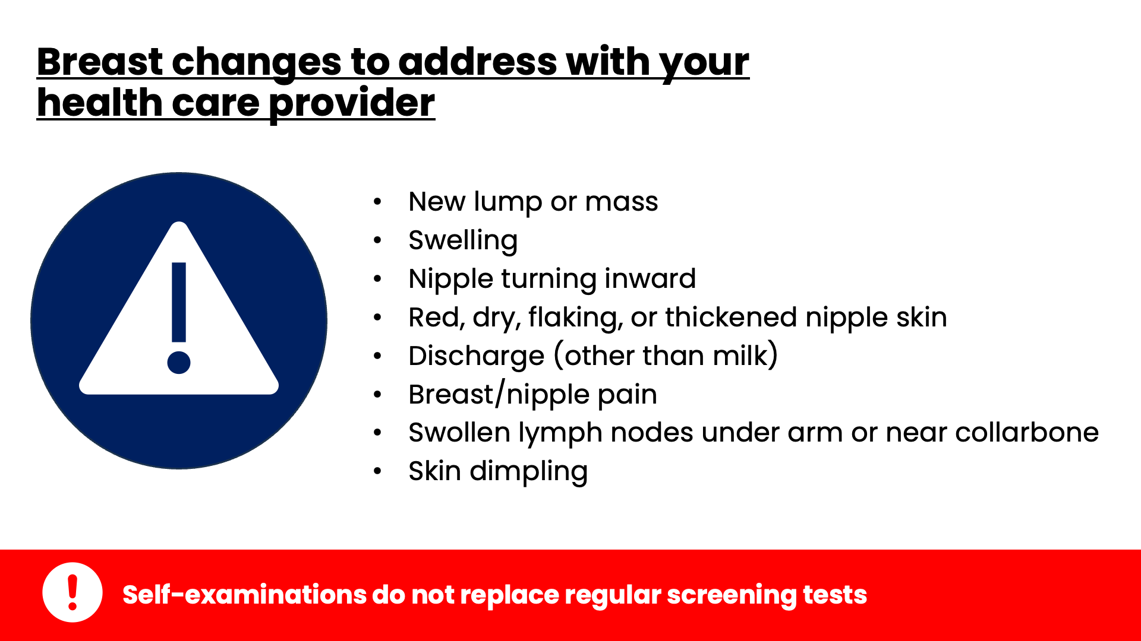
Notes:
Speaker Notes
Although regular clinical breast exam and breast self-exam are not recommended in the screening guidelines, all women should be familiar with how their breasts normally look and feel and report any changes to a health care provider right away.
Here are some signs and symptoms to be on the look out for:
New breast lump or mass: This is the most common symptom of breast cancer. Lumps can be painless, tender, soft, round, and some can even be painful. Most breast lumps are not cancer, but is important to have any new breast mass, lump, or change checked by a health care professional​
​
Swelling: Even if no lump is felt​
​
Skin dimpling: Skin dimpling can sometimes look like an orange peel​
​
Swollen lymph nodes: Sometimes a breast cancer can spready to lymph nodes under the arm or around the collar bone and cause a lump or swelling there, even before the original tumor in the breast is big enough to be felt.​
​
Remember that knowing what to look for does not take the place of having regular mammograms and other screening tests. Next, we will discuss screening tests.

Slide 19

Notes:
Speaker Notes
Screening tests can help find breast cancer early, before any symptoms appear. Finding breast cancer early gives you a better chance of successful treatment.​
Let’s take a closer look at ACS screening guidelines.
​

Slide 20
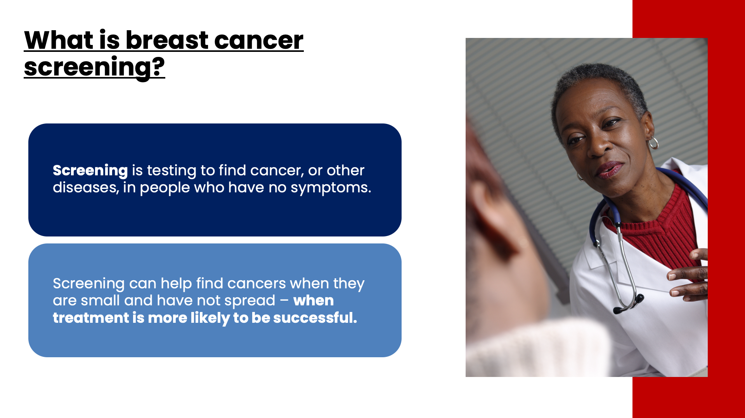
Notes:
Speaker Notes
In general, screening is testing to find cancer, or other diseases, in people who have no symptoms. Screening can help find breast cancers when they are small and have not spread – when treatment is more likely to be successful.

Slide 21
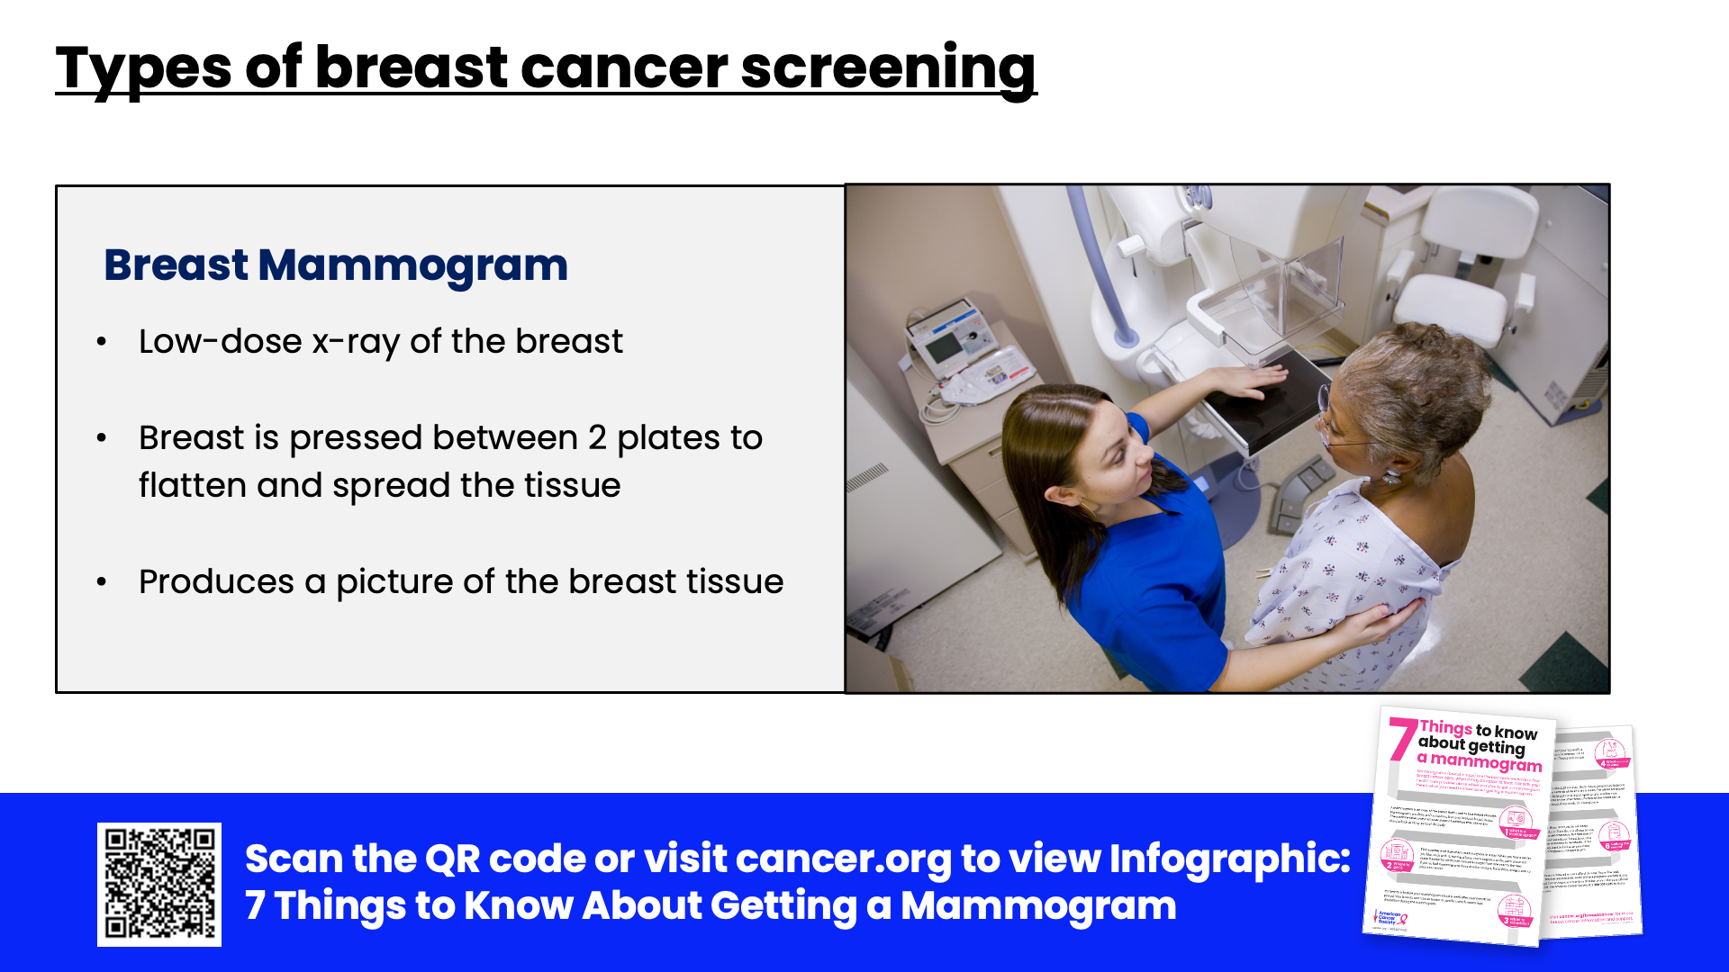
Notes:
Speaker Notes
Breast cancer screening is done with mammograms​
Although mammograms may be uncomfortable for a moment, squeezing is necessary to get a good, "readable" mammogram. The compression should only last a few seconds each time.​ The entire procedure for a screening mammogram takes about 20 minutes. This procedure produces a picture of the breast tissue either on a large sheet of film or as a digital computer image that is read, or interpreted, by a radiologist (a doctor trained to interpret images from x-rays, ultrasound, MRI, and related tests).​

Slide 22
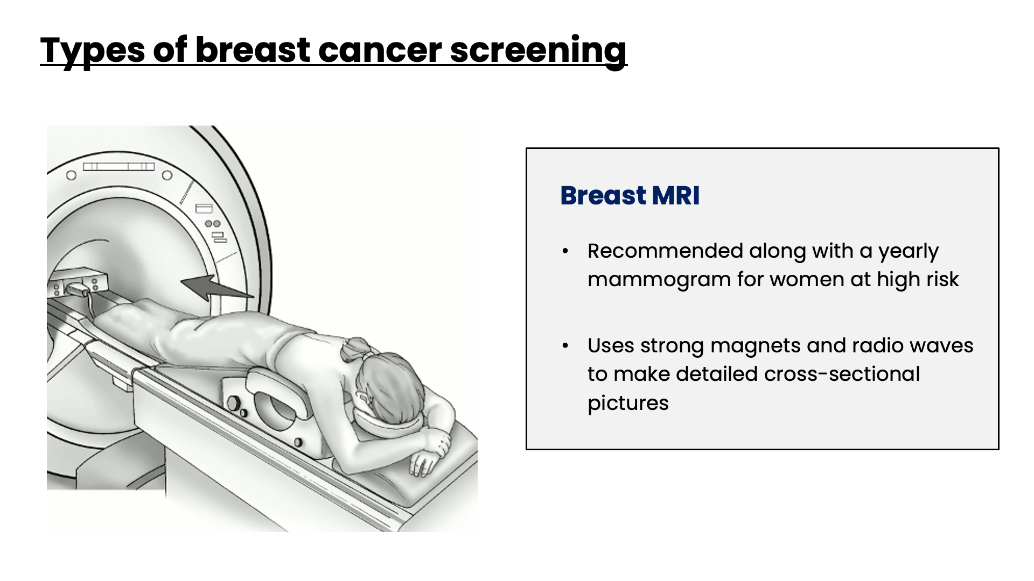
Notes:
Speaker notes:
In some cases, such as women at high risk for breast cancer, screening with breast MRI may be used.
MRI is not generally recommended as a screening tool by itself, because although it is a sensitive test, it may still miss some cancers that mammograms would detect. ​
MRI is more expensive than mammography. Check with your insurance provider before getting an MRI. Many major insurance companies will likely pay for these screening tests if a woman can be shown to be at high risk.

Slide 23
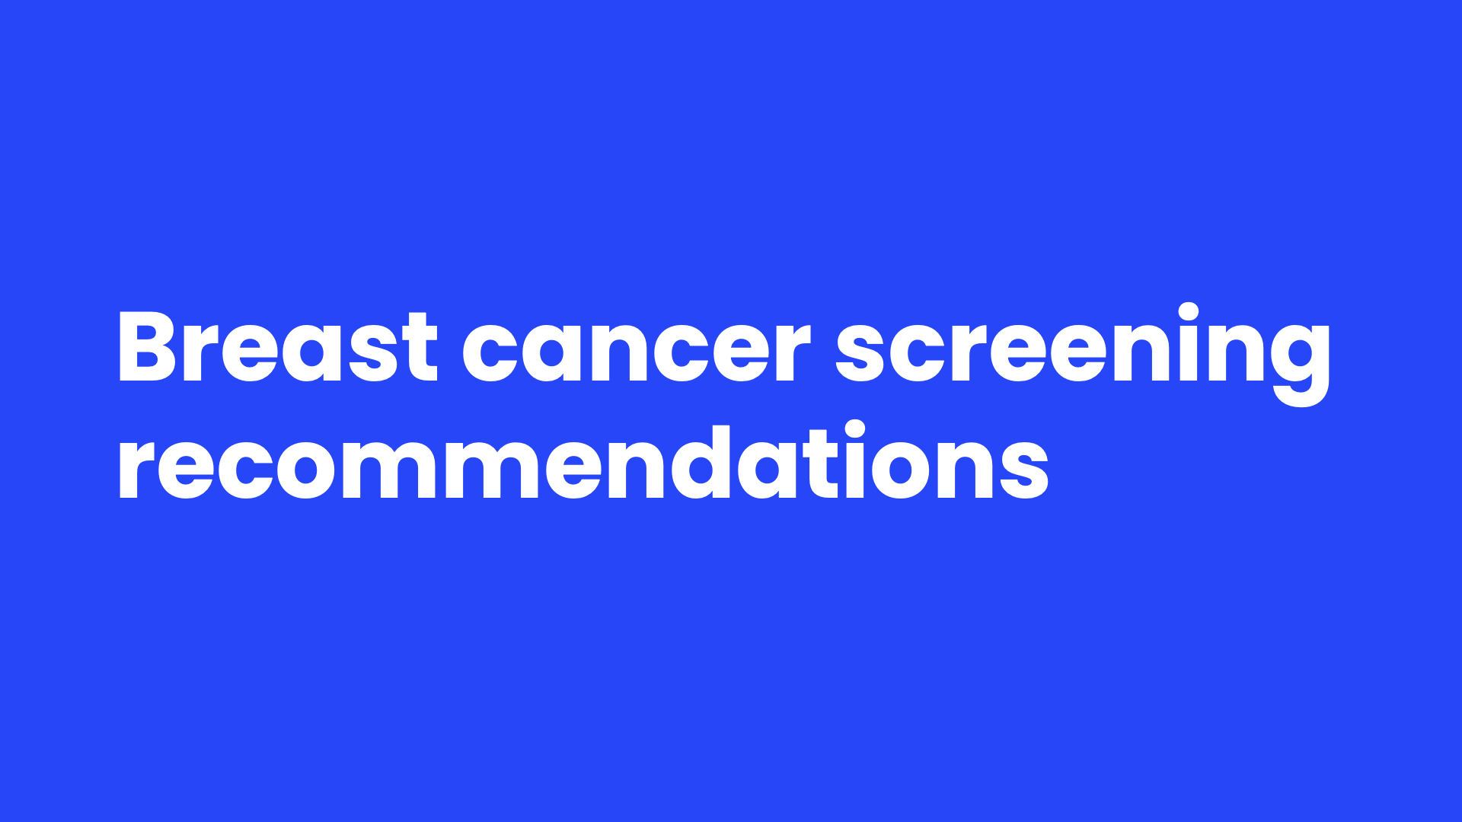
Notes:
Speaker Notes
Let’s discuss the American Cancer Society’s recommendations for breast cancer screening.

Slide 24
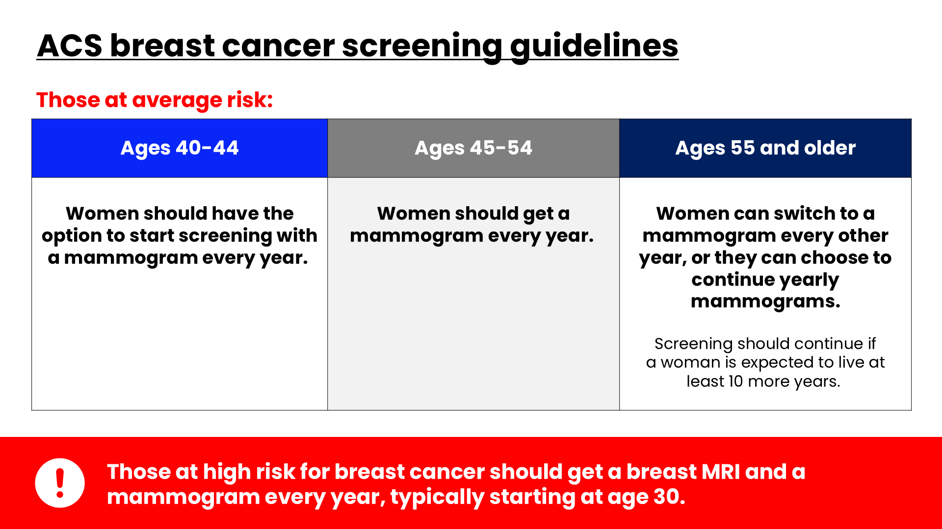
Notes:
Speaker Notes
For an average risk individual, ACS recommends the following:
Women between 40 and 44 have the option to start screening with a mammogram every year.
Women 45 to 54 should get mammograms every year.
Women 55 and older can switch to a mammogram every other year, or they can choose to continue yearly mammograms. Screening should continue as long as a woman is in good health and is expected to live at least 10 more years.
All women should understand what to expect when getting a mammogram for breast cancer screening – what the test can and cannot do.
Clinical breast exams are not recommended for breast cancer screening among average-risk women at any age. There is very little evidence that these tests help find breast cancer early when women also get screening mammograms.
Most often when breast cancer is detected because of symptoms (such as a lump), a woman discovers the symptom during usual activities such as bathing or dressing. Women should be familiar with how their breasts normally look and feel and should report any changes to a health care provider right away.
Women at high risk for breast cancer based on certain factors should get an MRI and a mammogram every year, typically starting at age 30. This includes women who:​
Have a lifetime risk of breast cancer of about 20% to 25% or more, according to risk assessment tools ​
Have a known BRCA1 or BRCA2 gene mutation ​
Have a first-degree relative (parent, sibling, or child) with a BRCA1 or BRCA2 gene mutation, and have not had genetic testing themselves​
Had radiation therapy to the chest prior to age 30
Have Li-Fraumeni syndrome, Cowden syndrome, or Bannayan-Riley-Ruvalcaba syndrome, or have first-degree relatives with one of these syndromes
SOURCE: https://www.cancer.org/cancer/breast-cancer/screening-tests-and-early-detection/american-cancer-society-recommendations-for-the-early-detection-of-breast-cancer.html

Slide 25
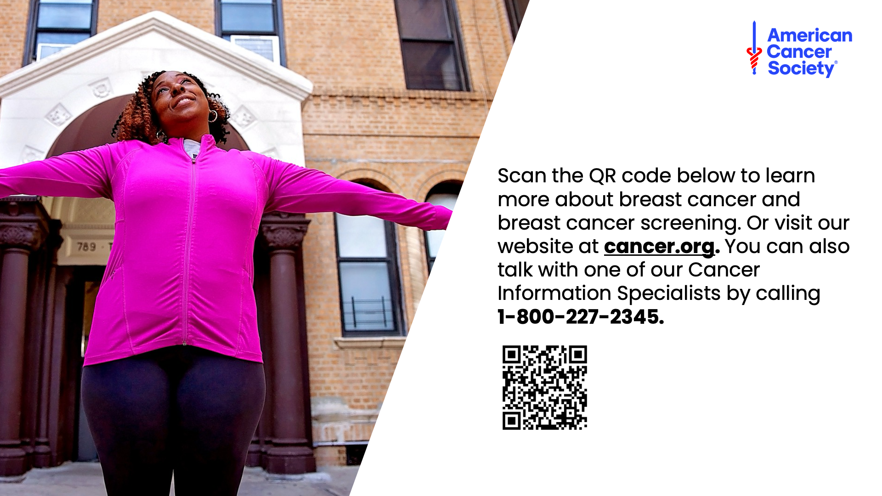
Notes:
Speaker Notes
This concludes our presentation about breast cancer and breast cancer screening. For more information, scan our QR code or visit our website (cancer.org) or call the number on the screen and speak with one of our Cancer Information Specialists.

Slide 26

Notes:
Speaker Notes
Thank you for your time and attention.

