Slide 1
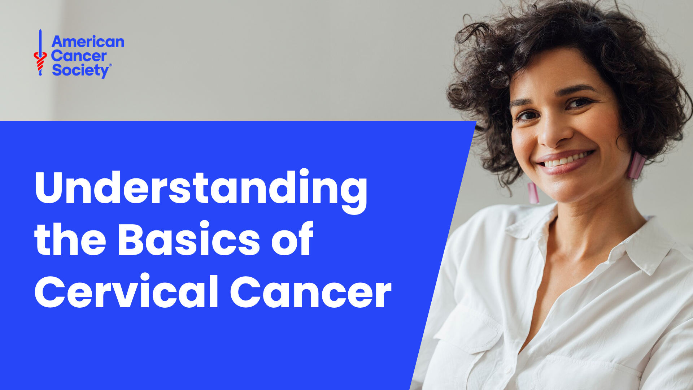

Slide 2
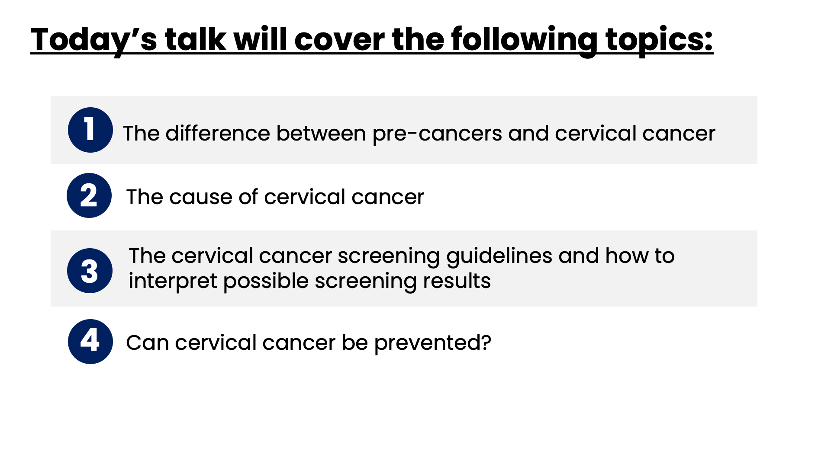
Notes:
Speaker Notes
Let’s learn about what you can do to prevent and detect cervical cancer. This is a summary of what we’ll be talking about today.

Slide 3
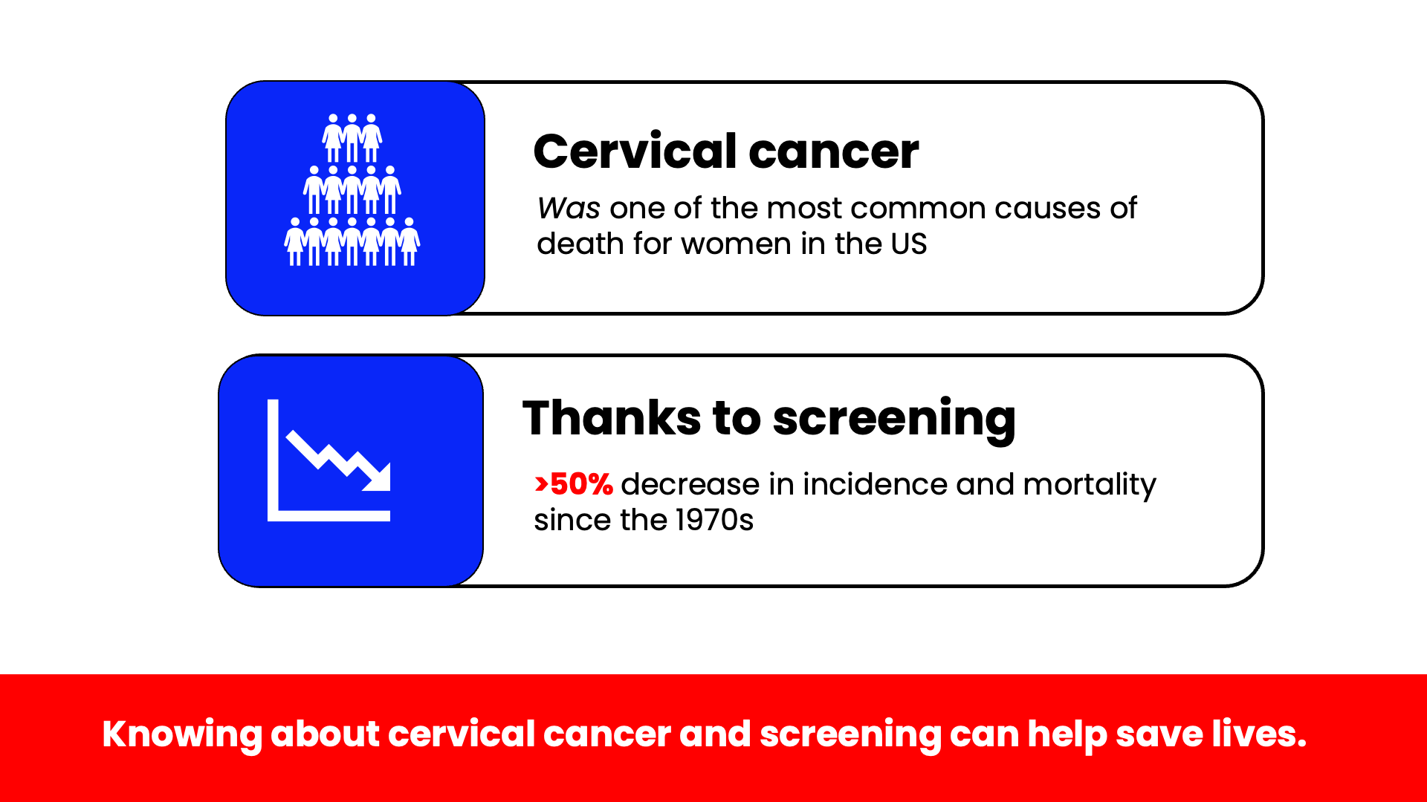
Notes:
Speaker Notes
Cervical cancer was once one of the most common causes of cancer death for women in the U.S. In 2025, an estimated 13,360 cases of invasive cervical cancer will be diagnosed in the United States.
The cervical cancer death rate dropped by over 50% in recent decades with the increased use of screening. The numbers are clear—screening saves lives. This presentation will go over all you need to know to see for yourself if you’re up to date with your knowledge of cervical cancer and how to get screened.

Slide 4
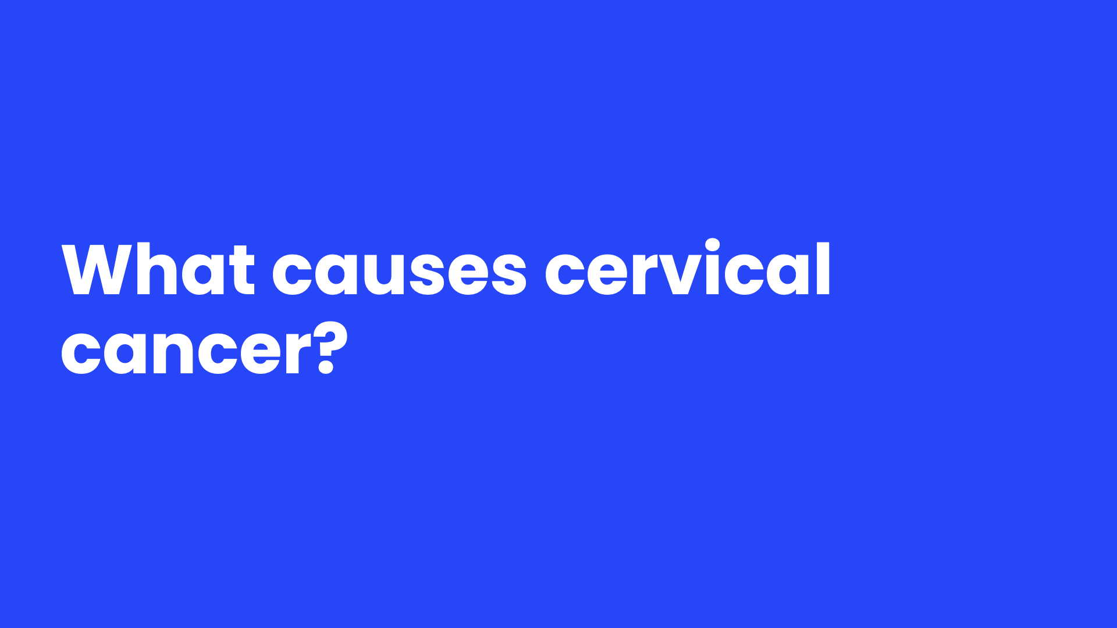
Notes:
Speaker Notes
What causes cancer in this tissue? Let's find out.

Slide 5
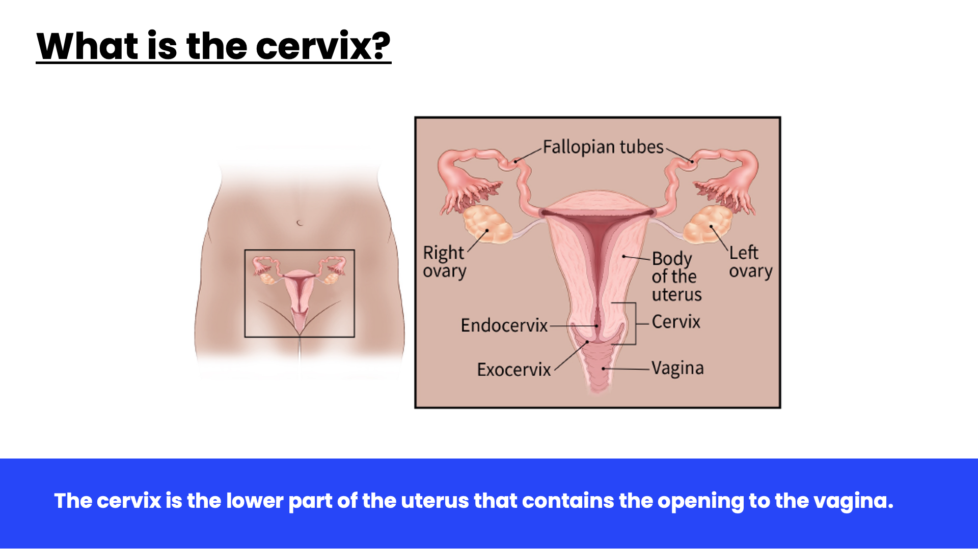
Notes:
Speaker Notes
First, let's describe what the cervix is. The cervix is the lower part of the uterus (womb) that connects to the to the vagina (birth canal).

Slide 6
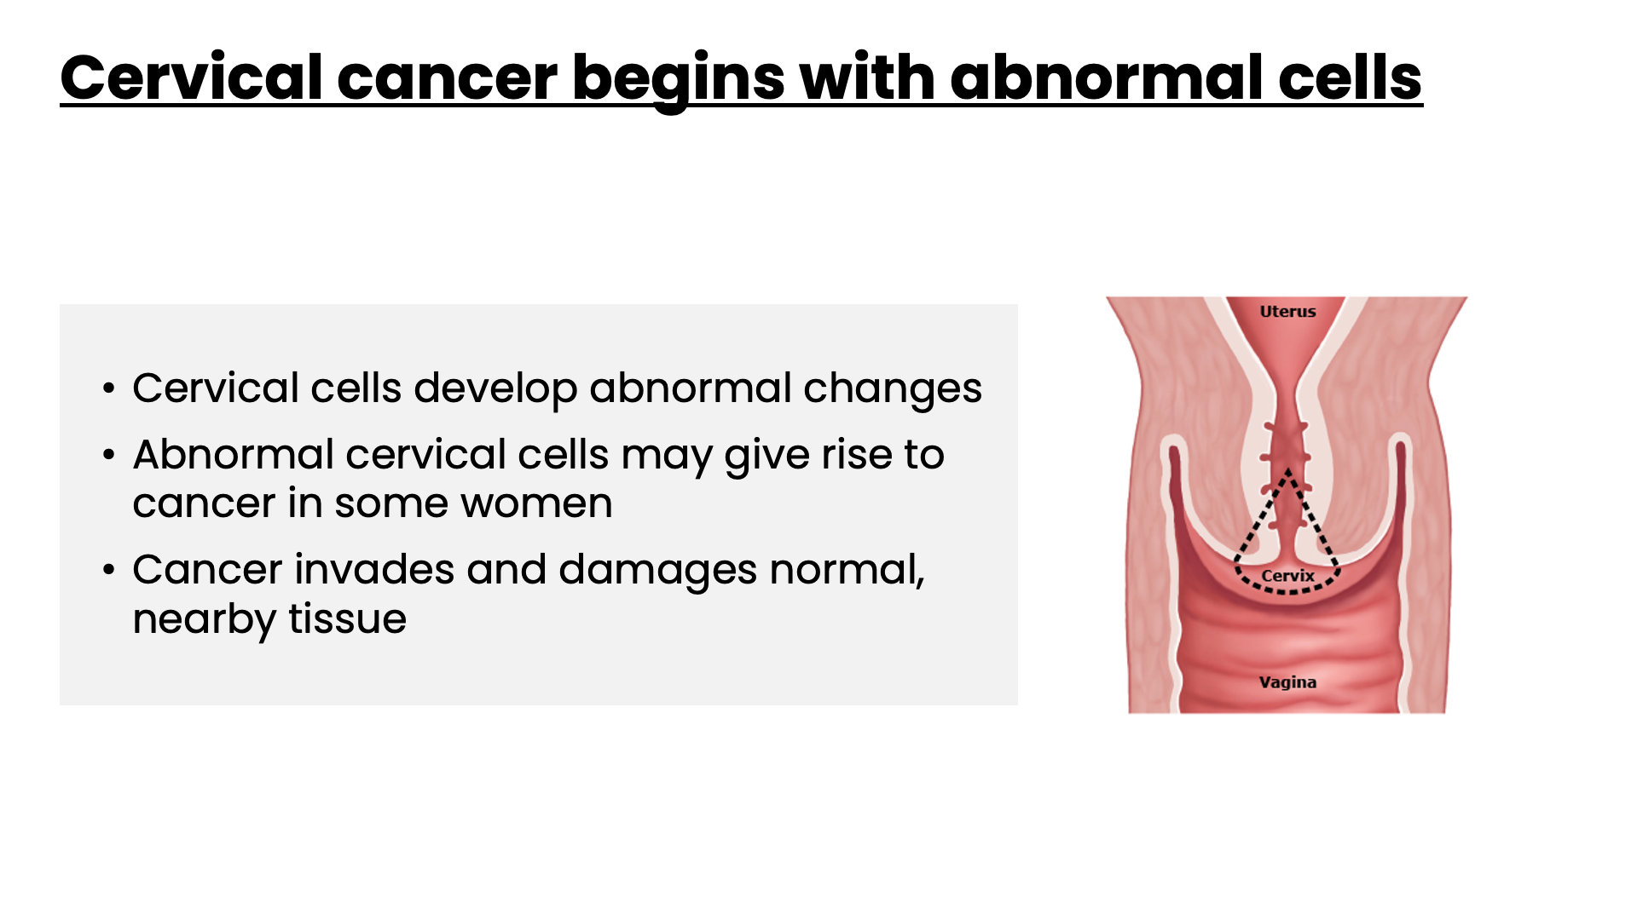
Notes:
Speaker Notes
Cervical cancer occurs when the cells of the cervix develop the ability to grow out of control and out of sync with the rest of the tissues in your body. Cervical cancer is dangerous because it can develop the ability to invade and damage other tissues.

Slide 7
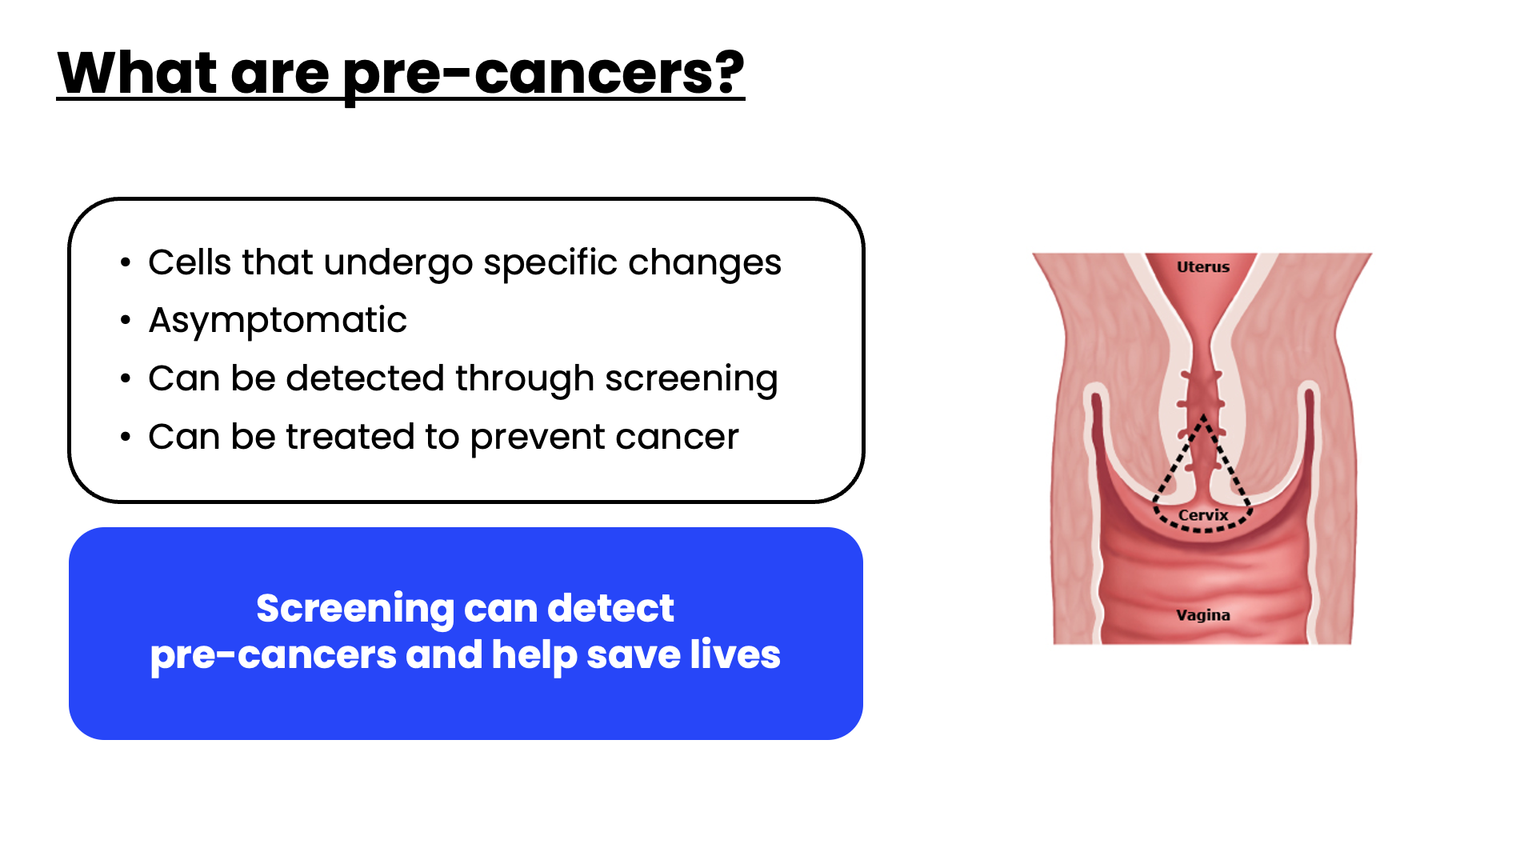
Notes:
Speaker Notes
To understand the basis for cervical cancer screening, it’s important to learn about pre-cancers. So, what are pre-cancers?
Before cervical cancer develops, the cells of the cervix undergo specific changes that can be identified by screening. These changes are called pre-cancers.
Pre-cancers themselves are usually asymptomatic, so no one would know they had pre-cancers without screening. The good thing about pre-cancers is that they can be treated to prevent cervical cancer from developing. Identifying pre-cancers through screening and treating them is the reason that screening has saved so many lives from cervical cancer.

Slide 8
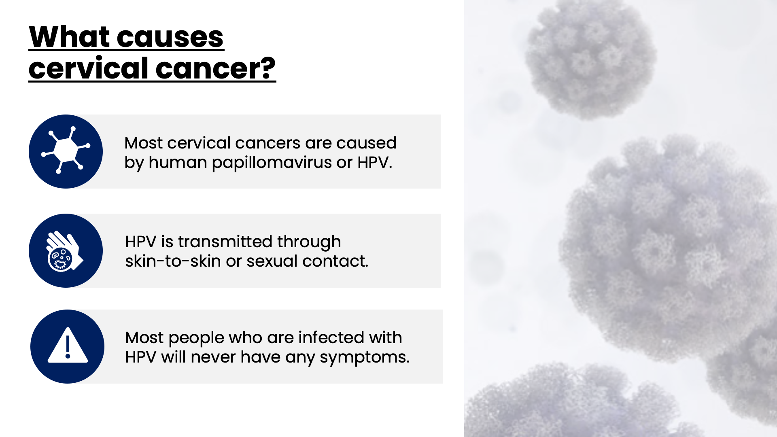
Notes:
Speaker Notes
Next, what causes cervical cancer? Unlike most cancers, we have a simple answer to this cancer.
The virus Human papillomavirus, or HPV, causes almost all cases of cervical cancer. There are many types of HPV, some which cause warts, some which cause cancer, and many varieties that cause no symptoms at all in most people.
HPV can be passed from one person to another during skin-to-skin contact. One way HPV is spread is through sex, including vaginal, anal, and oral sex. Most people who have HPV will never have any symptoms.

Slide 9
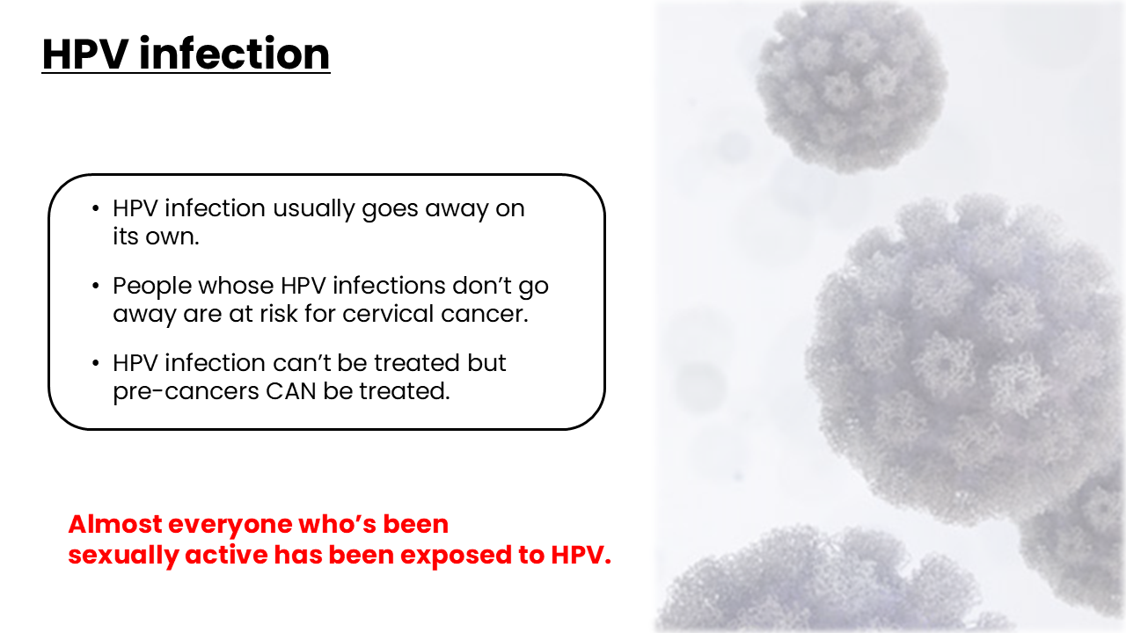
Notes:
Speaker Notes
HPV is incredibly common. Almost everyone who’s been sexually active has been exposed to HPV. Luckily, in most cases, your body will rid itself of the infection all on its own—and you’ll likely never experience any symptoms.
However, in a small percentage of cases, your body doesn’t clear HPV on its own. These are the infections that put people at risk for developing cancer. Luckily, with screening HPV infections and pre-cancers can be identified and treated so that cervical cancer doesn’t develop.

Slide 10

Notes:
Speaker Notes
Now that we’ve covered the cervical cancer basics, let dig a bit deeper into cervical cancer screening.

Slide 11
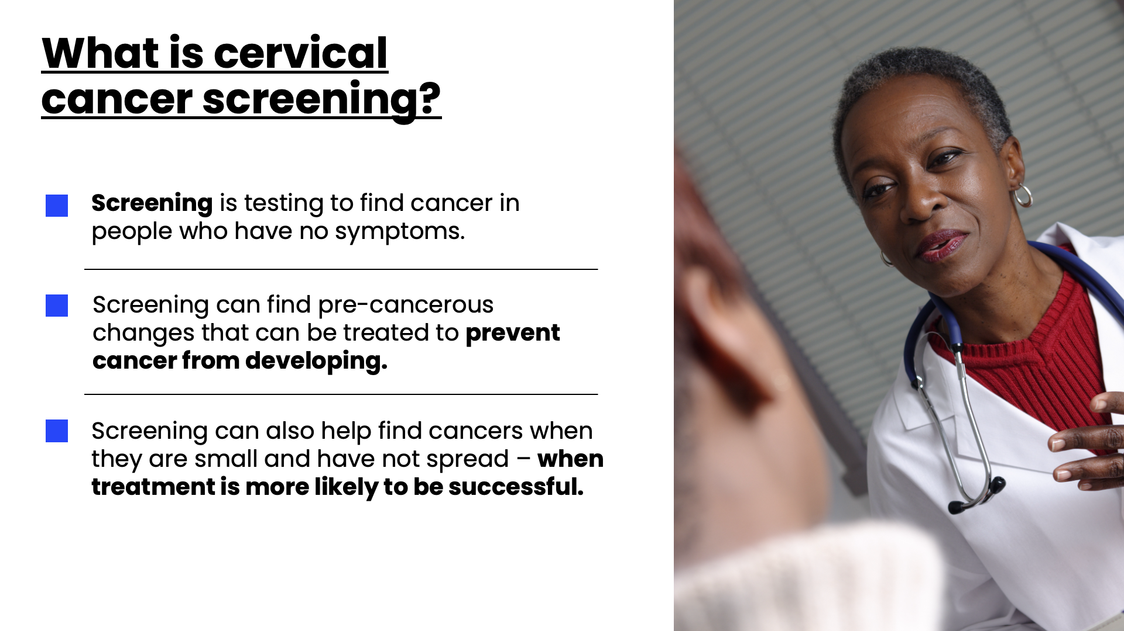
Notes:
Speaker Notes
So what is cervical cancer screening?
In general, screening is testing to find cancer, or other diseases, in people who have no symptoms. For cervical cancer, screening can find pre-cancerous changes that can be treated to prevent cancer from developing. Screening can also help find cancers when they are small and have not spread – when treatment is more likely to be successful.

Slide 12
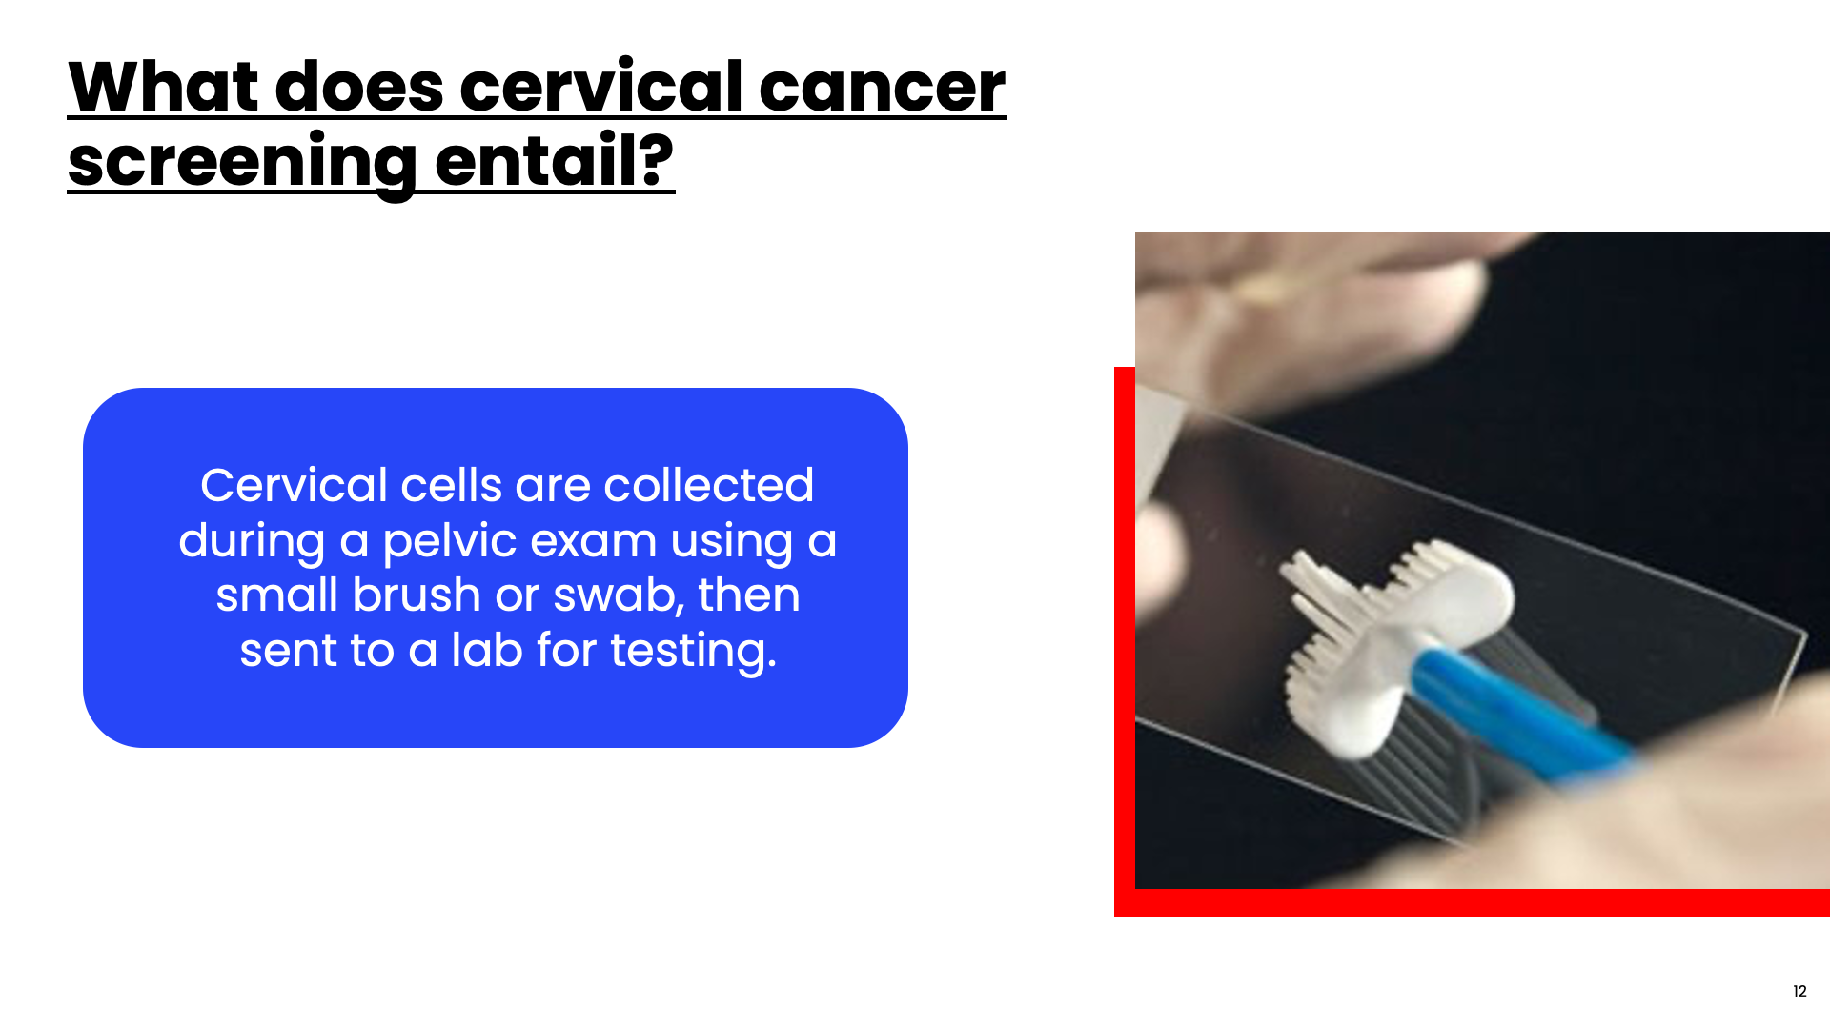
Notes:
Speaker Notes
What does cervical cancer screening entail? Your health care provider will do a pelvic exam and will insert a small brush or swab into the vagina and collect cells from your cervix for testing. In some situations (depending on where you are having screening done and what type of test is being performed, you may be able to collect the specimen yourself. This is called self-sampling).

Slide 13
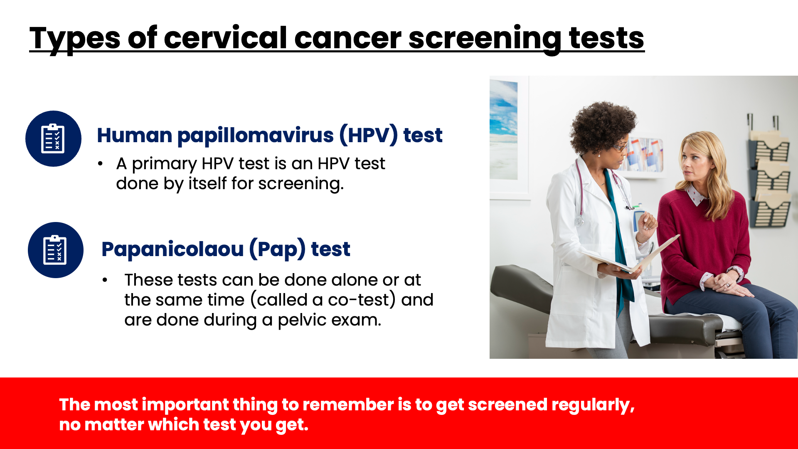
Notes:
Speaker Notes
An HPV Test is a test which checks the cervical cells for infection with the high-risk types of HPV that are most likely to cause cervical cancer. It cannot detect pre-cancers or cancer itself, but results can help the doctor decide if more testing is needed.
The HPV test can be done by itself (primary HPV test) or at the same time as another type of test called a Pap test.
The Pap test is collected the same way as the HPV test during a pelvic exam. However, it looks at the cervical cells under a microscope to see if they show pre-cancerous or cancerous changes. It cannot detect HPV.
If pap tests are used as part of cancer screening, the ACS recommends they be done at the same time as HPV testing (called co-testing).
The ACS recommends primary HPV testing as the preferred test for cervical cancer screening. Research evidence shows that primary HPV testing is more efficient than co-testing and more effective than Pap testing alone. However, screening using any method is effective in identifying people at risk for cervical cancer.

Slide 14
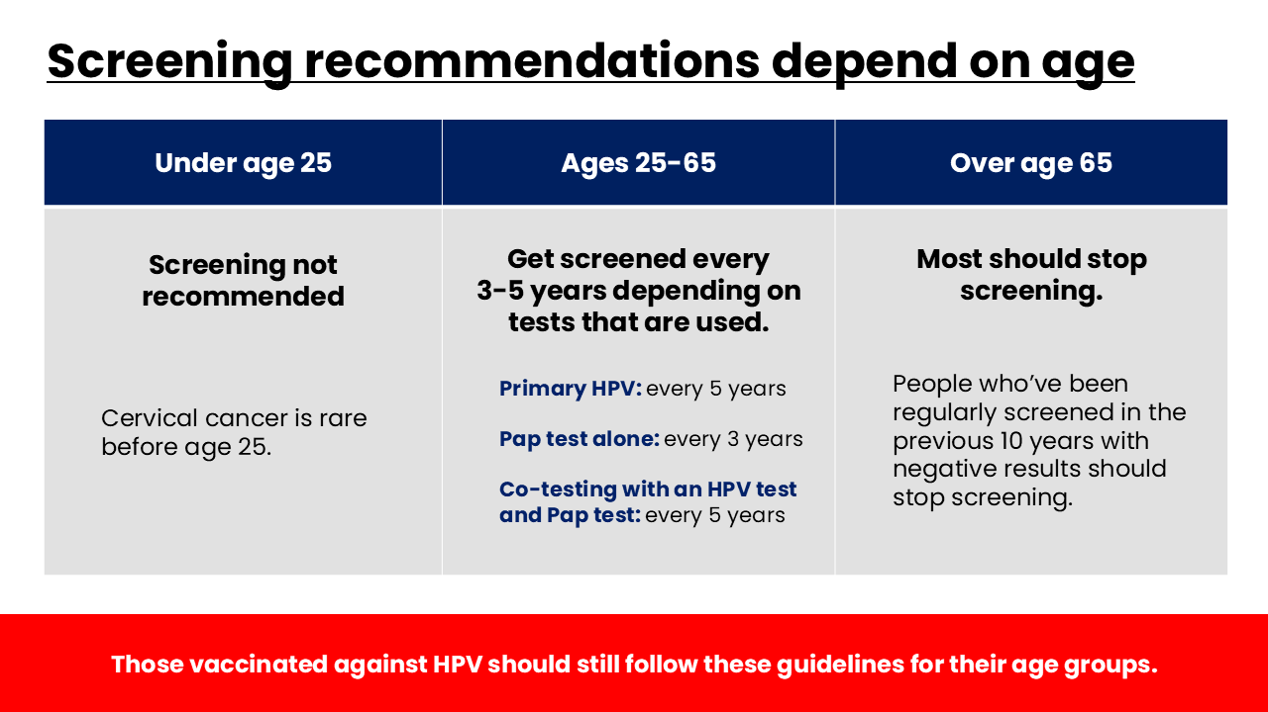
Notes:
Speaker Notes
Screening for cervical cancer is recommended for individuals with a cervix starting at age 25 years. This is because cervical cancer before age 25 is extremely rare.
For individuals aged 25 to 65 years, screening should be done every 3-5 years depending on the type of testing that is done. Your health care provider will advise you how often to get screened based on your screening history.
Individuals older than 65 years who have had regular screening with normal results should not be screened for cervical cancer. Once screening is stopped, it should not be started again.
Individuals who do not have a cervix (for example, because of a hysterectomy) and who do not have a history of cervical cancer or a serious precancer should not be screened.
Less than 1% of cervical cancer deaths are in women who were diagnosed before each 25. Disease burden was just one of many factors considered that led to the change for the starting age for screening.
People who have received the HPV vaccine should still follow age-appropriate screening guidelines.
SOURCES:
https://www.cancer.org/cancer/cervical-cancer/detection-diagnosis-staging/cervical-cancer-screening-guidelines.html
https://www.cancer.org/cancer/cervical-cancer.html
https://acsjournals.onlinelibrary.wiley.com/doi/10.3322/caac.21871
Siegel RL, Kratzer TB, Giaquinto AN, Sung H, Jemal A. Cancer Statistics 2025. Update from the American Cancer Society; CA Cancer J Clin 2025

Slide 15
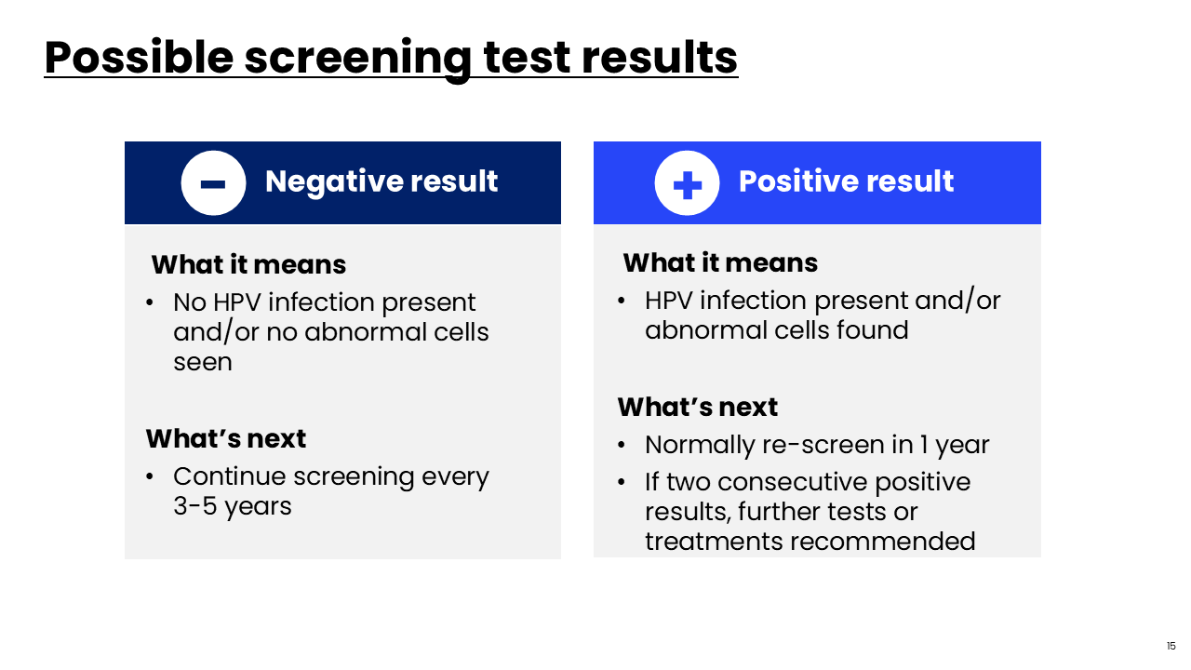
Notes:
Speaker Notes
After cervical cancer screening, you may receive positive or negative results. Negative test results mean no HPV infection was found (in the case where HPV testing was performed as part of screening) and if a Pap test was performed, it means no abnormal cells were seen (pre-cancerous or cancerous). In this case, you’ll be recommended to continue screening at the recommended interval—every 3-5 years depending on the type of test used.
If you get a positive/abnormal result this means that HPV infection was found during screening (if an HPV test was performed) and/or pre-cancerous or cancerous cells were found on Pap testing. As mentioned previously, HPV infection is extremely common and most infections go away on their own—without any treatment. So, in most cases, your provider will advise you of the result and will have you re-screen in one year to see if the infection has gone away or not.
If you have two consecutive positive screening results, your provider may recommend further tests or treatments to prevent cervical cancer from developing.

Slide 16
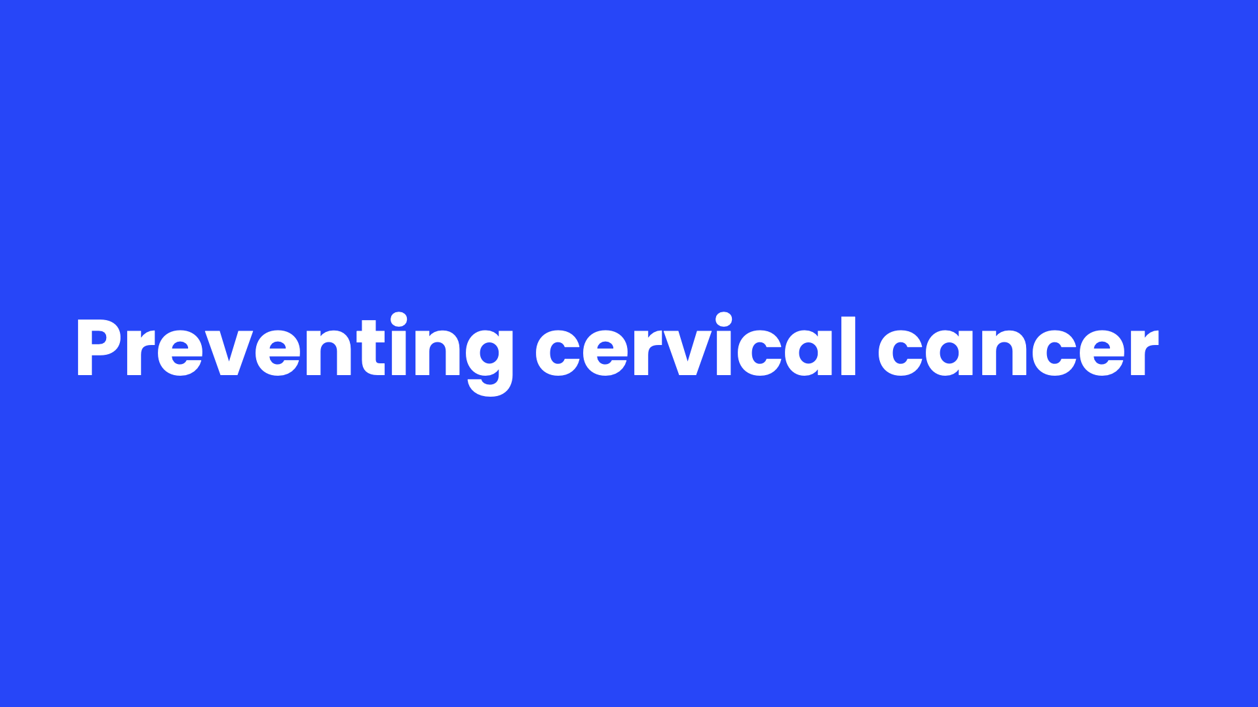
Notes:
Speaker Notes
Next, we’ll discuss additional ways you can lower your risk for cervical cancer.

Slide 17
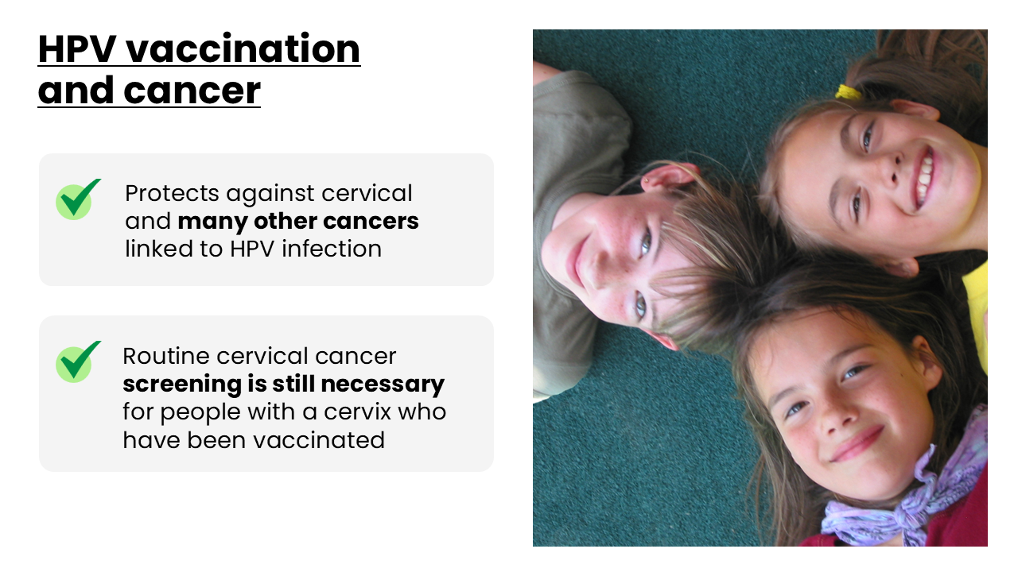
Notes:
Speaker Notes
We’d be remiss if we didn’t talk about the importance of HPV vaccination. HPV causes multiple other cancers besides cervical cancer. In fact, these days there are more head and neck cancers caused by HPV diagnosed in men in the USA than there are cases of cervical cancer. That emphasizes the importance of getting all genders vaccinated by age 12.
Routine screening for cervical cancer is still necessary for vaccinated individuals. That’s because there are some types of HPV that can cause cancer that aren’t covered by the vaccine.

Slide 18
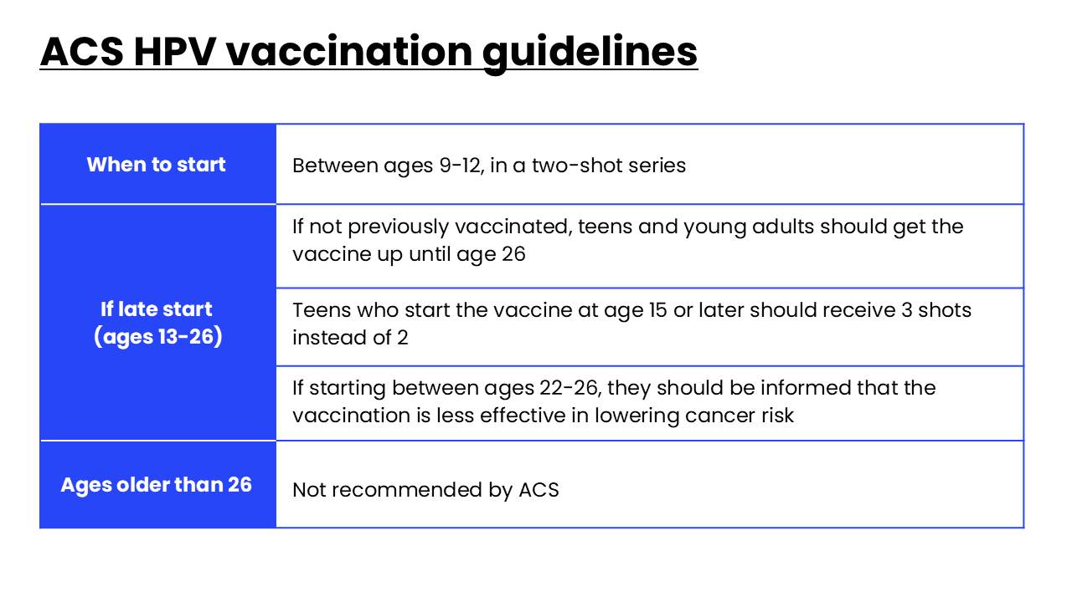
Notes:
Speaker Notes
Here are the HPV vaccination guidelines for your reference.
The vaccine works best between the ages of 9-12. Research shows that younger people have a better immune response to the vaccine than those in their late teens and early 20s. And, the vaccines will prevent the covered types of HPV only if they are given before exposure to the virus.
Teens and young adults age 13 through 26 who have not been vaccinated, or who haven’t gotten all their doses, should get the vaccine as soon as possible. Vaccination of young adults will not prevent as many cancers as vaccination of children and teens.
The HPV vaccine is most effective in early adolescence, but this starts to decrease by age 18. Because of this, it is unlikely to provide much benefit for cancer prevention as people get older which is why the ACS does not recommend that people over the age of 26 get vaccinated against HPV.

Slide 19
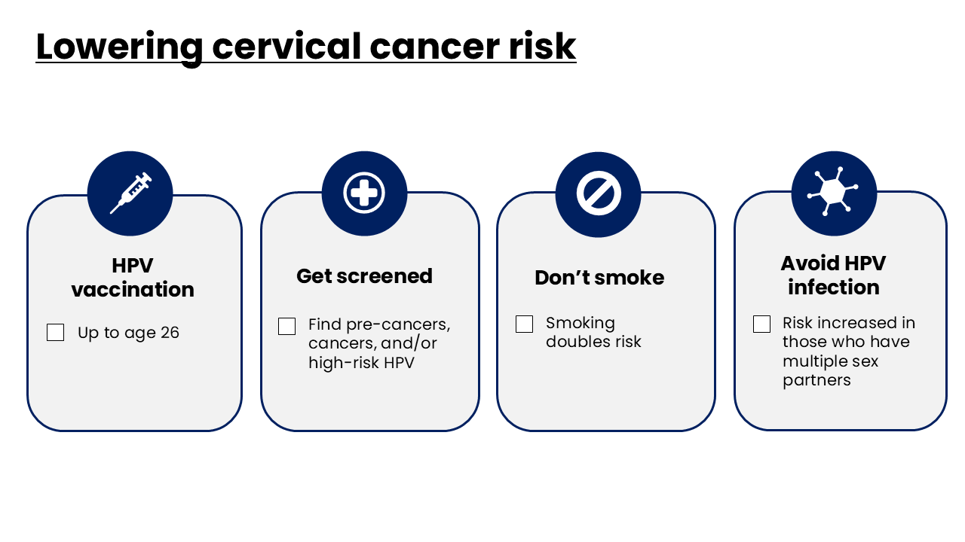
Notes:
Speaker Notes
First and foremost, the most powerful way you can be protected from cervical cancer is by getting the HPV vaccination before age 26. One of the most important way to lower your risk for cervical cancer is by getting screened at the recommended intervals.
Not smoking tobacco is another important way to lower your risk for cervical cancer as smoking is known to double your risk for cervical cancer.
Limiting the number of sex partners and avoiding sex with people who have had many other sex partners may lower risk of exposure to HPV. But HPV is very common, so having sexual activity with even one other person can put a person at risk.

Slide 20
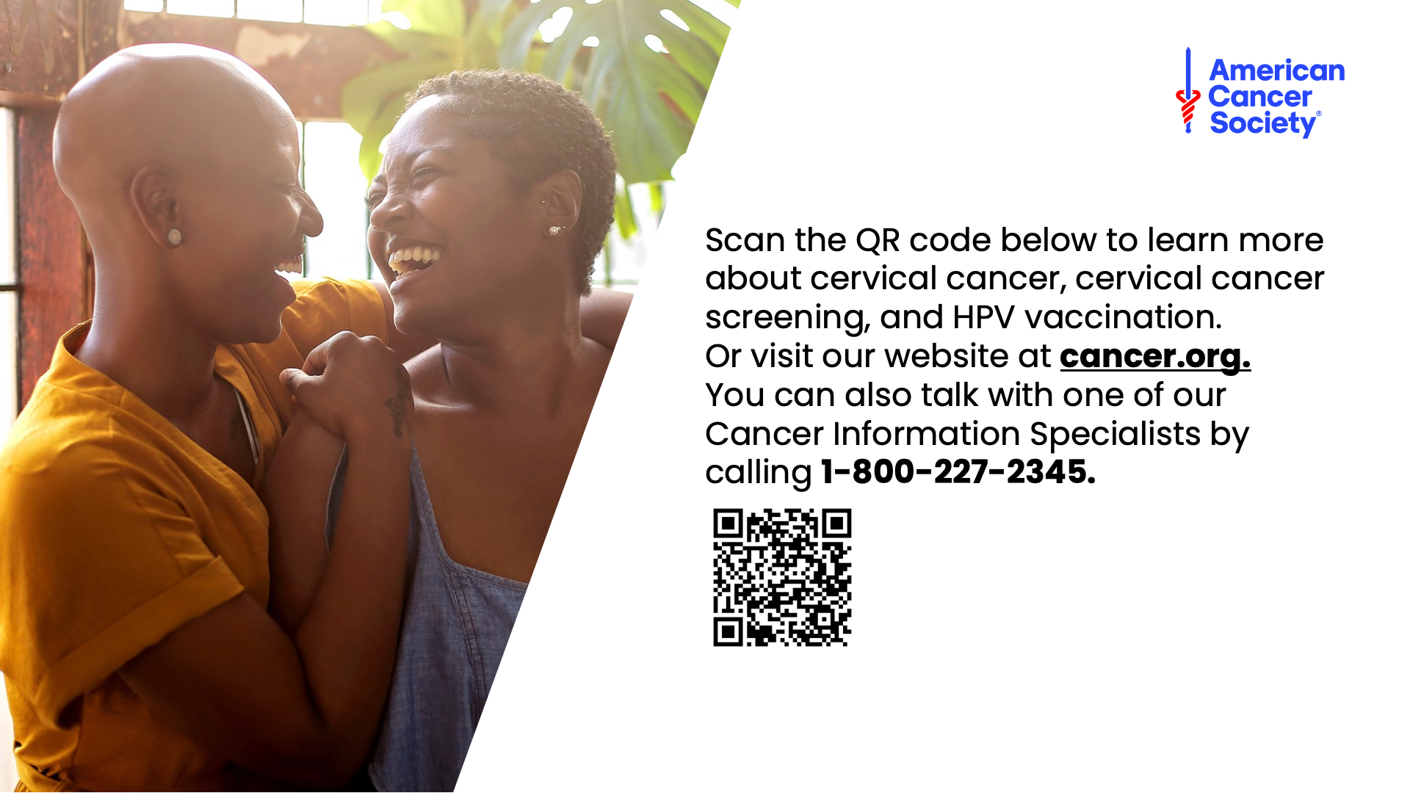
Notes:
Speaker Notes
This concludes our presentation about cervical cancer and cervical cancer screening. For more information, scan our QR code or visit our website (cancer.org) or call the number on the screen and speak with one of our Cancer Information Specialists.

Slide 21

Notes:
Speaker Notes
Thank you for your time and attention.

