Slide 1

Notes:
Speaker Notes:
This presentation will help provide an understanding of the basics of clinical trials, what you should know if you choose to participate in a clinical trial, and how to find clinical trials.

Slide 2
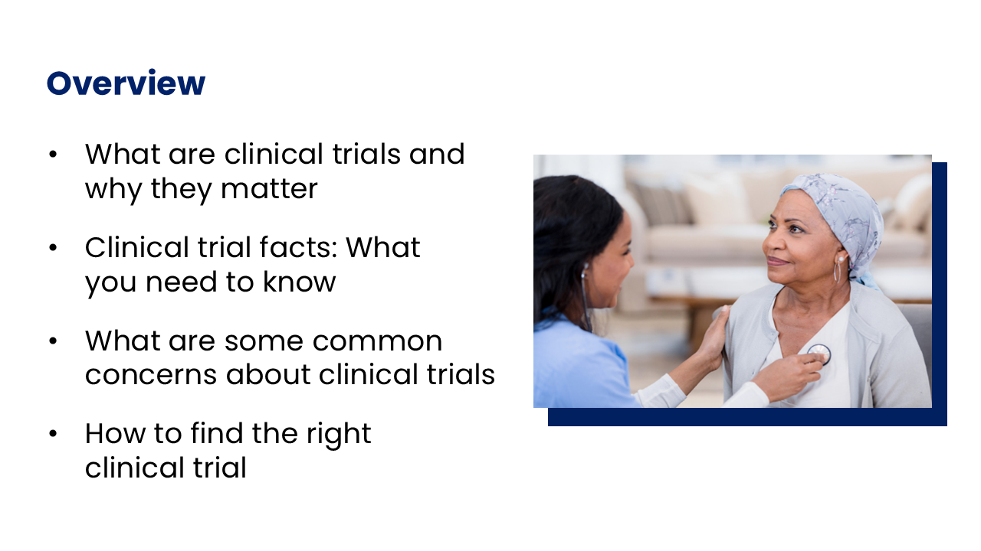
Notes:
Speaker Notes:
Here is a summary of what we’ll be talking about today.

Slide 3
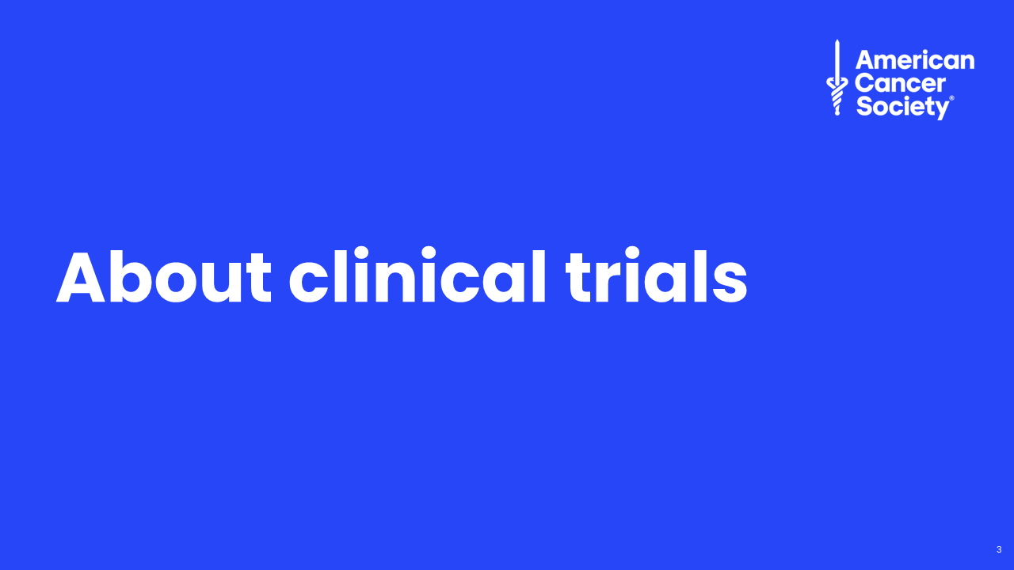
Notes:
Speaker notes:
In this first section, we’ll learn about clinical trials.

Slide 4
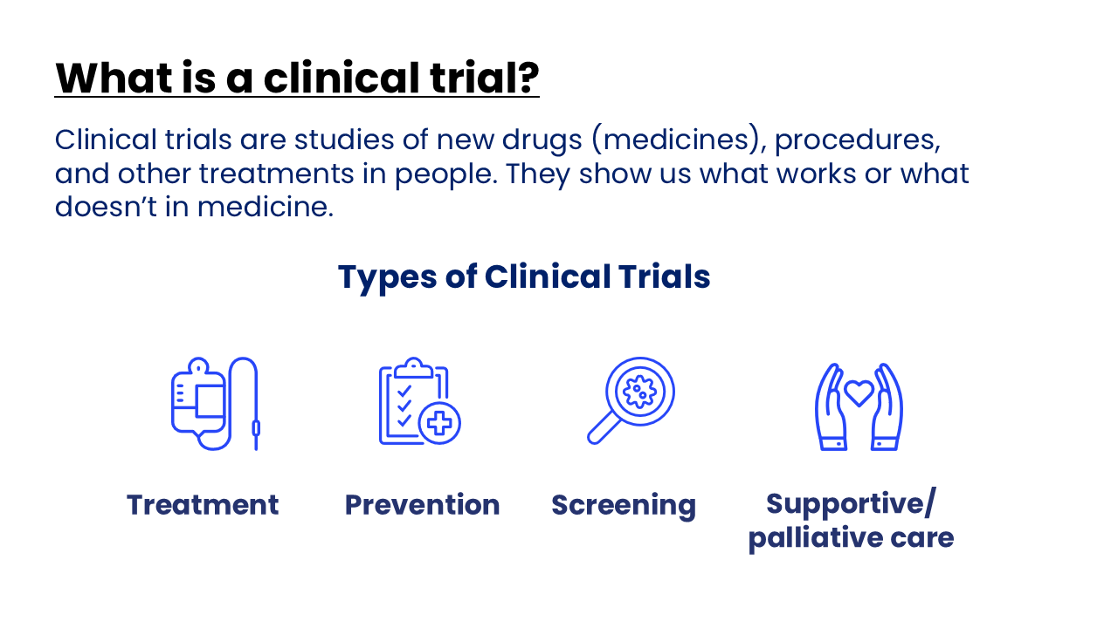
Notes:
Speaker Notes:
Clinical trials are studies of new drugs (medicines), procedures, and other treatments in people. They show us what works or what doesn’t in medicine. All new treatments must go through clinical trials before they are approved to treat cancer in the United States.
There are several types of clinical trials:
Treatment trials study new treatments or new treatment combinations.
Prevention trials study ways to prevent cancer.
Screening trials study ways to find cancer early when treatment is more likely to be successful.
Supportive care/palliative care trials study ways to improve side effects and quality of life of people with cancer.

Slide 5
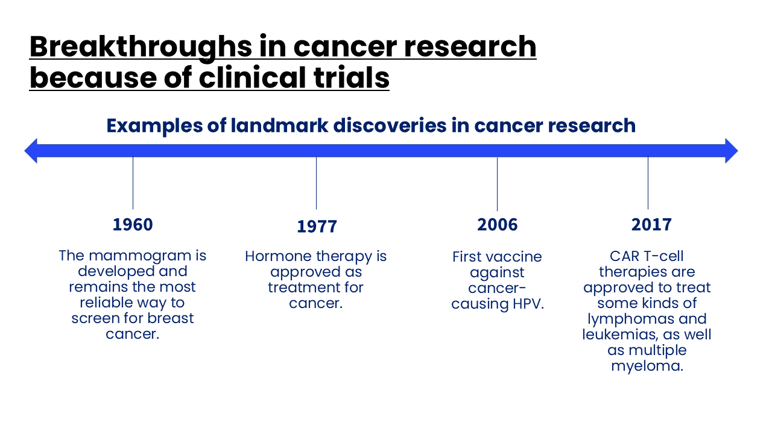
Notes:
Speaker Notes:
When it comes to cancer research, clinical trials are crucial.
Clinical trials have paved the way for many landmark discoveries in cancer care. Many of these discoveries have either affected you, your family, or your friends. Let's look at some examples.
In 1960, The mammogram was developed and remains the most reliable way to screen for breast cancer.
In 1977, the FDA approved tamoxifen, which is a medicine that blocks hormone activity without the need for surgery.
In 1999, human papillomavirus (HPV) was shown to be present in 99.7% of cervical cancers. This led to the development of the HPV vaccine to prevent cervical cancer in 2006.
CAR T-cell therapies are approved by the United States Food and Drug Administration (FDA) to treat some kinds of lymphomas and leukemias, as well as multiple myeloma.
Clinical trials are essential for developing new forms of cancer treatment that can help cancer that has spread, or metastatic cancer.

Slide 6
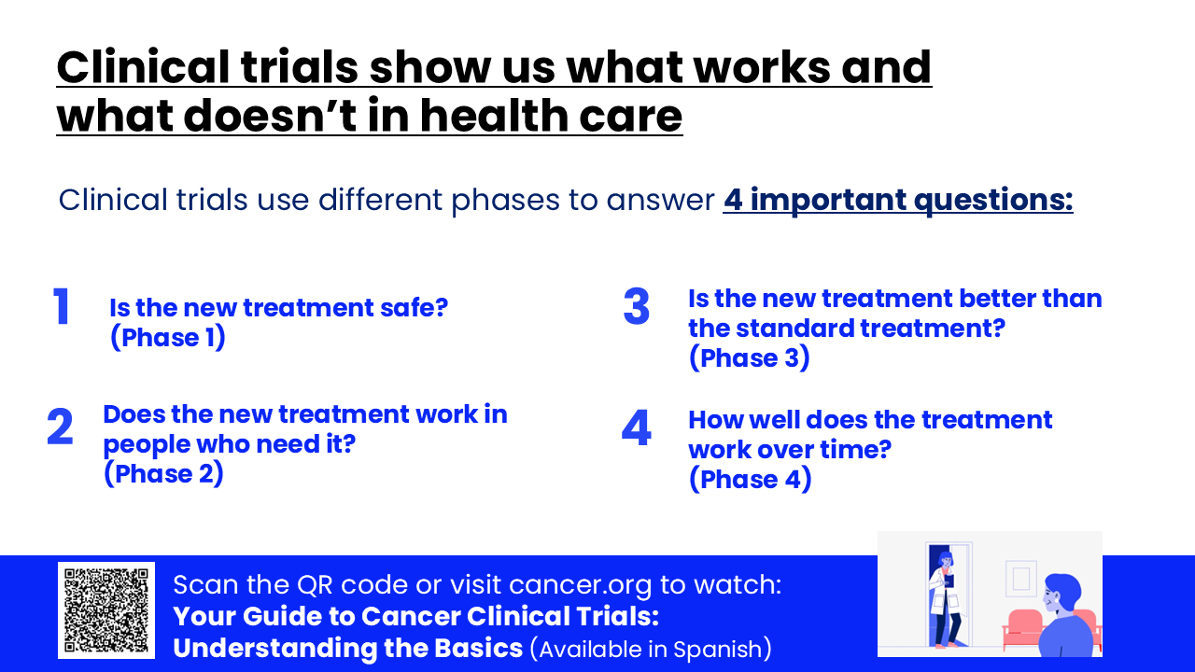
Notes:
Speaker Notes:
We mentioned earlier that a clinical trial is a research study involving human volunteers that determines if a new treatment is safe and effective.
A clinical trial accomplishes this by answering some very important questions:
What are the side effects of the treatment? Do the benefits outweigh the risks?
How well does this treatment help the people who need it?
How does this new treatment compare to treatment people are currently using?
How well does this treatment work in the long-run? Even if we see some short-term improvements, does the treatment work over time? Are there any long-term side effects over time?

Slide 7
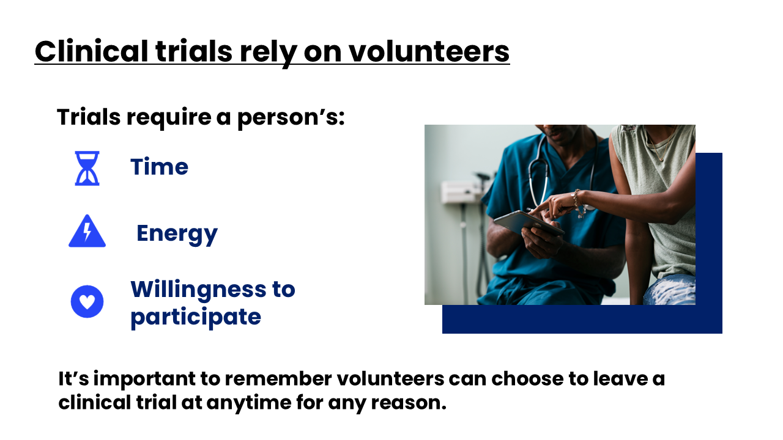
Notes:
Speaker Notes:
What's the most important component of a clinical trial? It's the people who volunteer.
Clinical trials require people's time, energy, and willingness to participate. Sometimes, clinical trials even require more.
For example, some trials require additional doctors visits and/or lab or imaging tests.
It's important to remember volunteers can choose to leave a clinical trial at anytime for any reason.

Slide 8
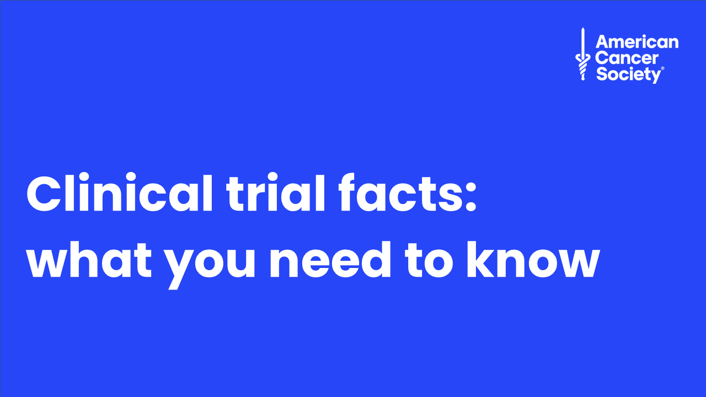
Notes:
Speaker Notes:
Let’s review some things to consider before deciding to take part in a clinical trial.

Slide 9
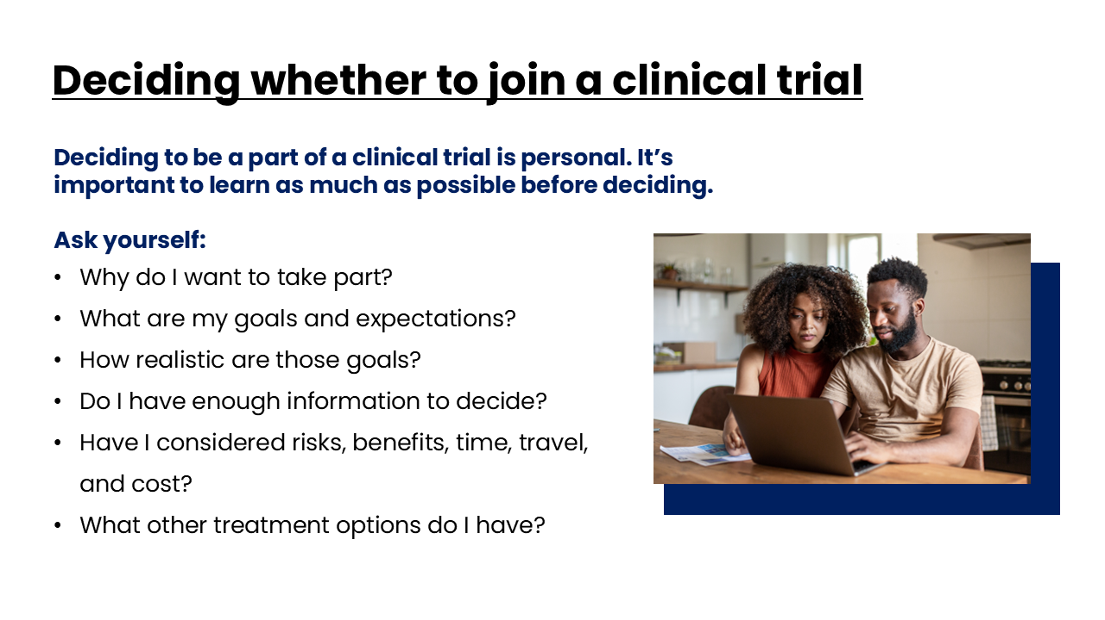
Notes:
Speaker Notes:
Deciding to be a part of a clinical trial is personal. Before you decide to be in one, learning about clinical trials and getting all your questions answered is important.
Some of these questions may not have clear answers but should help you start thinking about these issues.

Slide 10
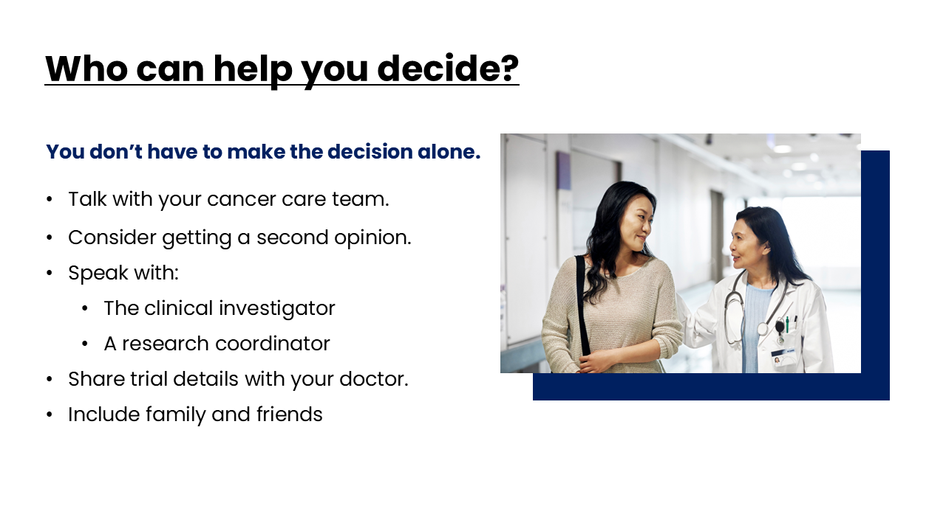
Notes:
Speaker Notes:
You don’t have to make the decision alone.
If your cancer care team is involved with the clinical trial, be sure to ask them your questions. Also, getting a second opinion from a doctor who’s not part of the study may help you decide if a certain study is the best option for you.
Talk with someone linked to the clinical trial. This could be the clinical investigator – the person in charge of the study – or a research coordinator. They should be able to answer your questions about the clinical trial.
Be sure to share the details about the clinical trial with your doctor so they can help you decide what might be right for you. Your doctor knows your medical situation best and can probably tell you if the study is worth thinking about.
You might find it helpful to include friends and family members in your decision-making process. They might ask questions you hadn’t thought of and can help you make sure that you’re choosing what's right for you.

Slide 11
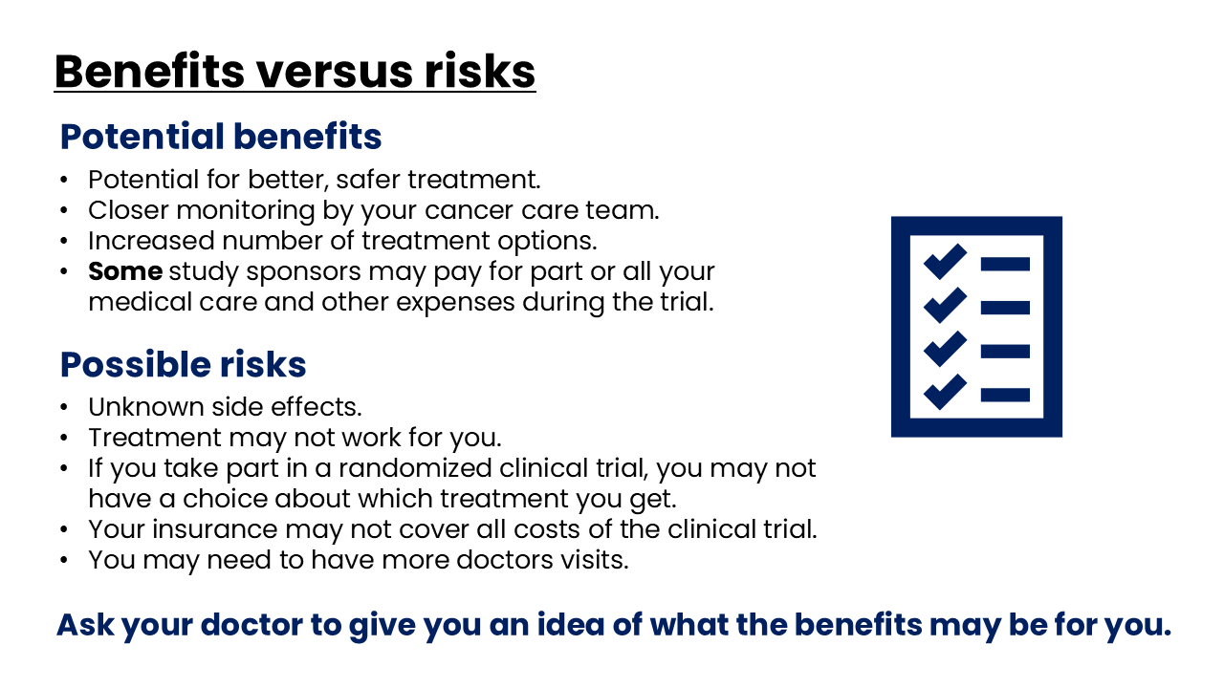
Notes:
Speaker Notes:
All clinical trials have risks. This is especially true of phase I and II clinical trials, where the treatment has been studied in fewer people.
A bigger question is whether the possible benefits outweigh the risks. People with cancer are often willing to accept a certain amount of risk for a chance to be helped. But it’s always important to be clear on what this chance is. Ask your doctor to give you an idea of what the benefits may be for you. Some people may decide that any chance of being helped is worth the risk, while others may not. Others may be willing to take certain risks to help others.

Slide 12
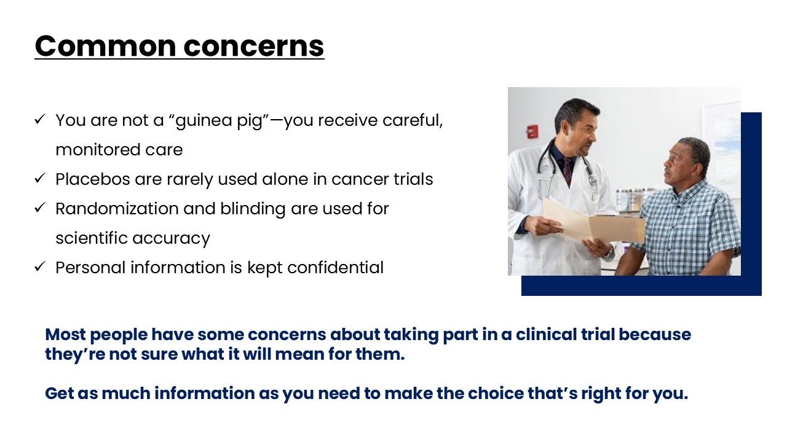
Notes:
Speaker Notes:
Most people have some concerns about taking part in a clinical trial because they’re not sure what it will mean for them. Get as much information as you need to make the choice that’s right for you.
Will I be a “guinea pig?”
You will not be a guinea pig, but it's true that the role of a clinical trial is to answer a medical question. People who take part in clinical trials may need to do extra things or have certain tests done as part of the clinical trial. But this doesn’t mean that you won’t get excellent care. In fact, most people enrolled in clinical trials welcome the extra attention they get from their cancer care team.
Will I get a placebo?
A placebo is an inactive treatment used in some types of clinical trials – sometimes called a “sugar pill.” Researchers compare it to the new treatment to help make sure any results are actually from the new treatment. Most clinical trials for cancer don’t use placebos unless they are given along with the standard treatment. It’s unethical to give someone a placebo instead of a treatment that’s known to work.
Can my doctor or I pick which group I’m in?
No, not for studies that are randomized. This means that each person in the study gets assigned by chance to either the treatment group (who gets the new treatment) or the control group (who gets the best standard treatment). Randomization helps to make sure that the groups have people in similar states of health, so the results are not affected by differences between the groups.
Will my information be kept confidential?
As much as possible; your cancer care team needs some personal and medical data to give you the best possible care, just as they would if you were not in a clinical trial. Information that’s needed for the clinical trial, like test results, is put in special forms and into computer systems. This is only shared with the people who analyze the results. Your data is given a number or code so your name isn’t on the forms or in the study system

Slide 13
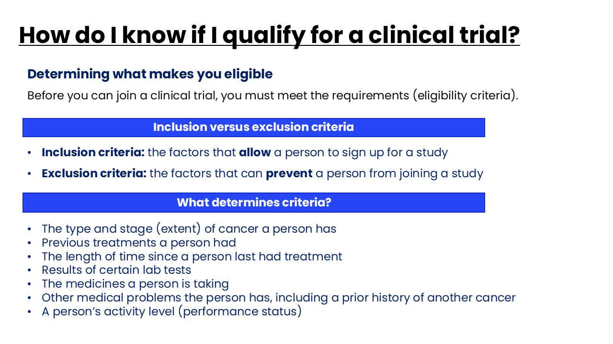
Notes:
Speaker Notes:
If you decide that a clinical trial is right for you, there are several steps that must happen.
First, you need to meet with your provider to see if you are eligible. These requirements are known as inclusion and exclusion criteria.
Criteria are different for each study. For cancer clinical trials, the inclusion and exclusion criteria usually have to do with:
The type and stage (extent) of cancer a person has
Previous treatments a person had
The length of time since a person last had treatment
Results of certain lab tests
The medicines a person is taking
Other medical problems the person has, including a prior history of another cancer
A person’s activity level (performance status)
Talk with your doctor or someone on the clinical trial team to see if you may be eligible for a clinical trial you are interested in.

Slide 14
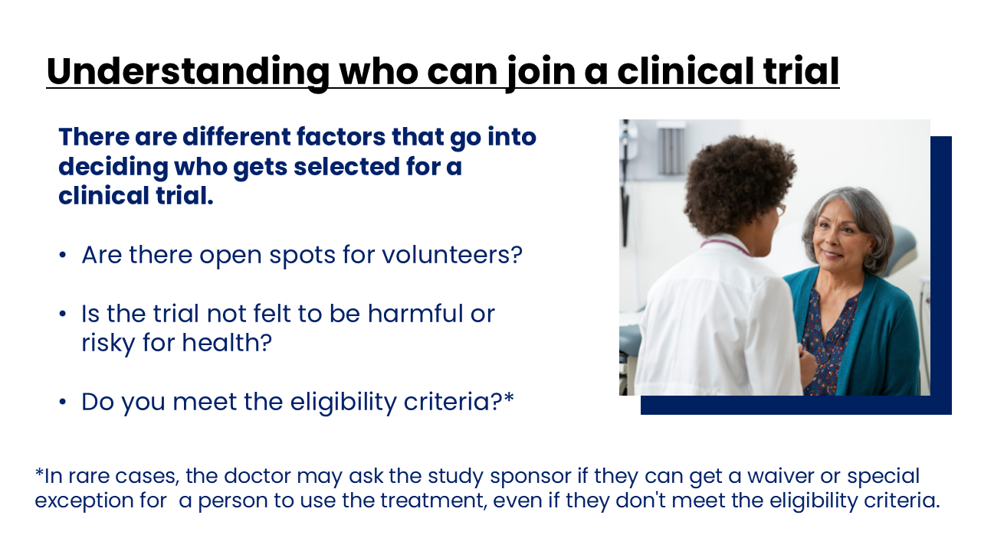
Notes:
Speaker Notes:
There are different factors that go into deciding who gets selected for a clinical trial. These can be:
1 – If the trial has enrolled enough people and can’t take anymore participants
2 – The study coordinators may determine that the clinical trial is too harmful or risky for your health
3 – You may not meet all the criteria for eligibility
In rare cases, the doctor may ask the study sponsor if they can get a waiver or special exception for a person to use the treatment, even if they don't meet the eligibility criteria.

Slide 15
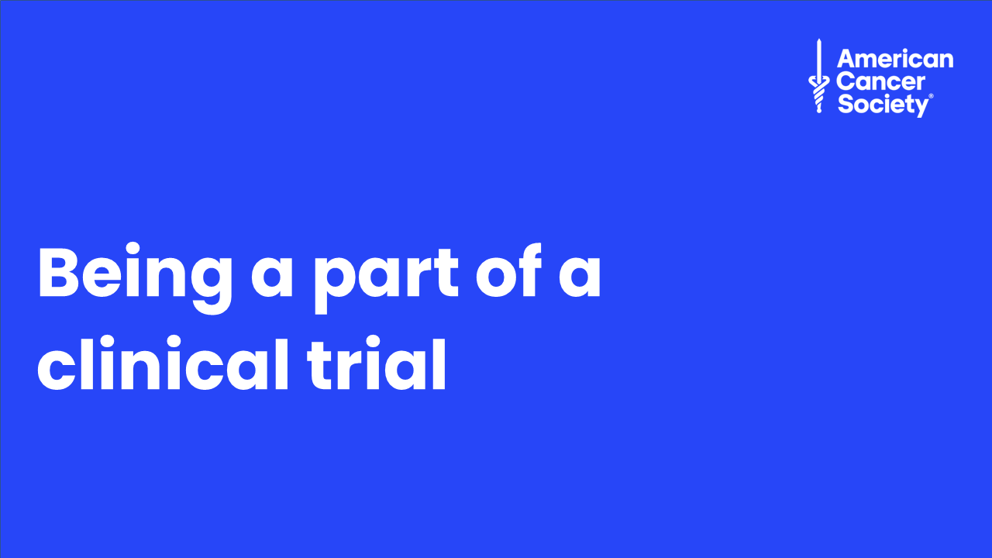
Notes:
Speaker Notes:
If you decide to join a clinical trial, here’s some information to help you know what to expect.

Slide 16
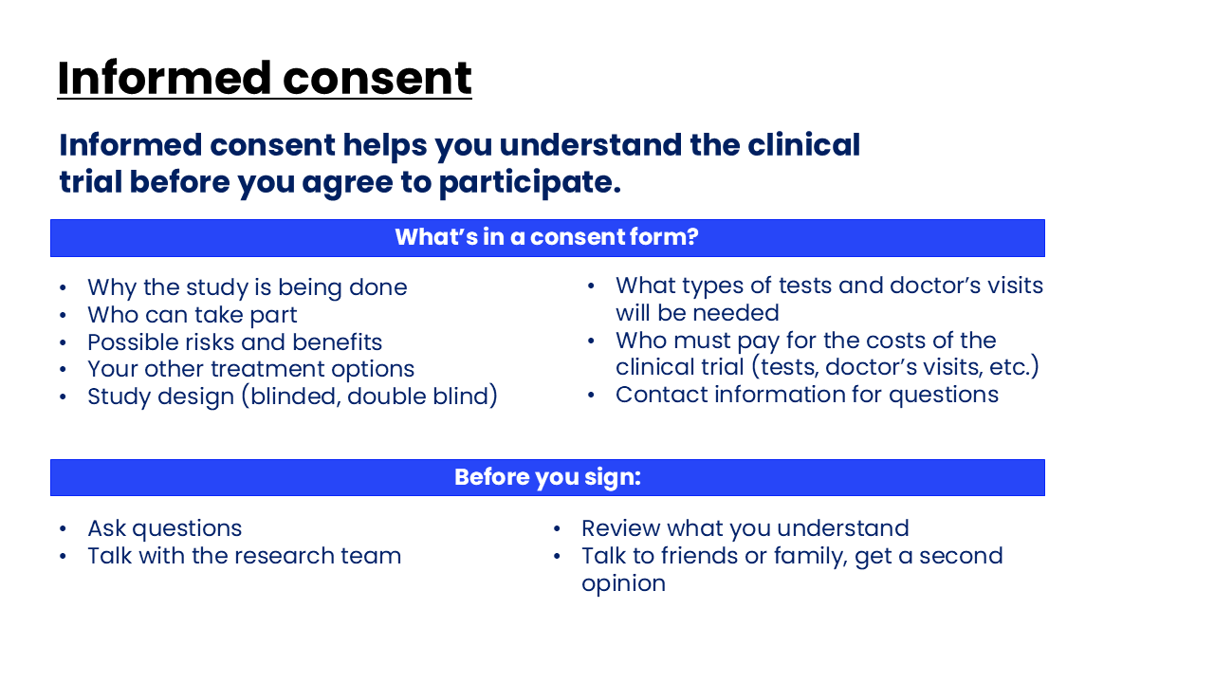
Notes:
Speaker Notes:
If you meet the eligibility criteria, the next thing you must do is provide informed consent.
During the informed consent process, the researchers (doctors or nurses) will explain the details of the trial to you and answer your questions and concerns.
It is very important that, before giving consent (including but not limited to signing a consent form), you have a chance to have your questions answered and concerns addressed.
A consent form will explain to you why the study is being done, eligibility, the risks and benefits, other treatment options you have, how the study is designed, who will pay for the costs of tests and doctors visits, and who to contact for more information.
Once you have had a chance to ask your questions and review the consent form, you will need to sign it and confirm you have read and understood the information provided.
Before you sign the consent form, ask questions. Consent forms are not always easy to understand. Be sure someone from the research team goes over what’s involved and what’s expected of you.
Don’t feel rushed to make a decision.

Slide 17
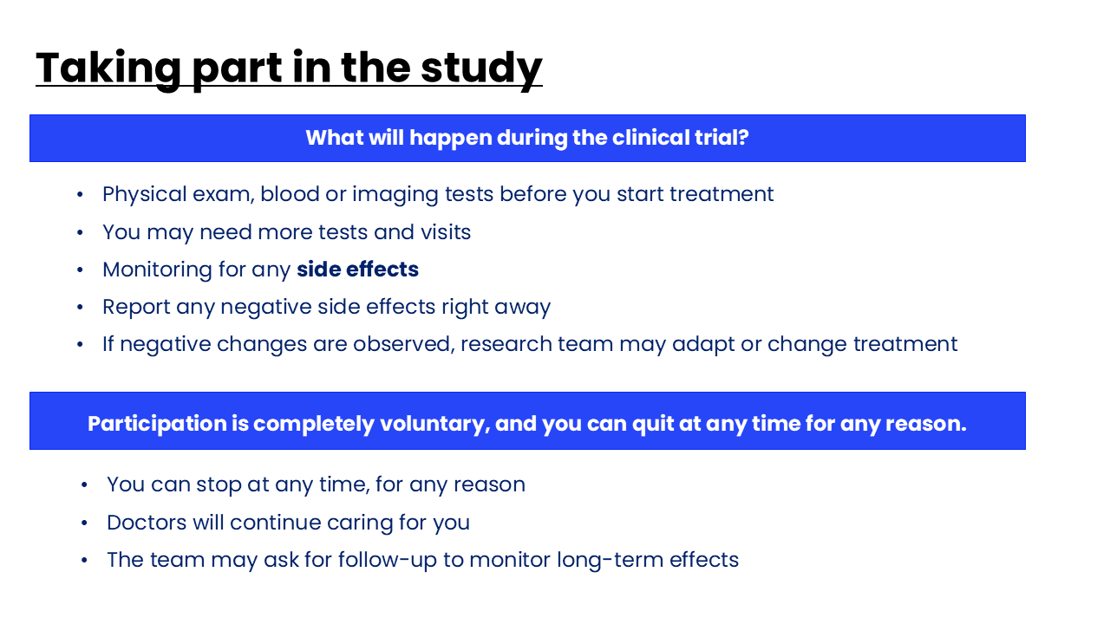
Notes:
Speaker Notes:
Once you’ve signed the consent form, you’ll probably need to have blood tests and/or imaging tests before you start treatment. Usually, you’ll be asked about your medical history and have a physical exam. These are needed to be sure that you can safely join the clinical trial.
Doctors and nurses may examine you more often and will want to know if you’re having any side effects or adverse events while being treated.
It’s very important to let the research team know if you have any symptoms that are not normal for you. The research team will decide if symptoms you’re having are related to the clinical trial and if they need to be treated or your treatment needs to be changed.
Taking part in a clinical trial is always voluntary. You (or your child) have the right to stop taking part in the study at any time.
You can stop at any time, for any reason
Doctors will continue caring for you
The team may ask for follow-up to monitor for long-term effects

Slide 18
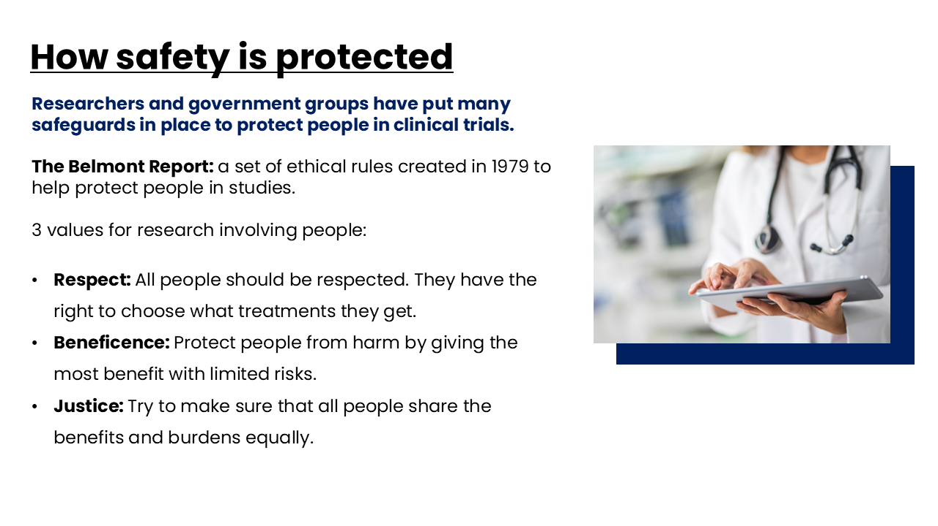
Notes:
Speaker Notes:
Researchers and government groups have put many safeguards in place to protect people in clinical trials.
One important guide is The Belmont Report, a set of ethical rules created in 1979 to help protect people in studies. It outlines 3 values for research involving people:
Respect: All people should be respected. They have the right to choose what treatments they get.
Beneficence: Protect people from harm by giving the most benefit with limited risks.
Justice: Try to make sure that all people share the benefits and burdens equally.

Slide 19
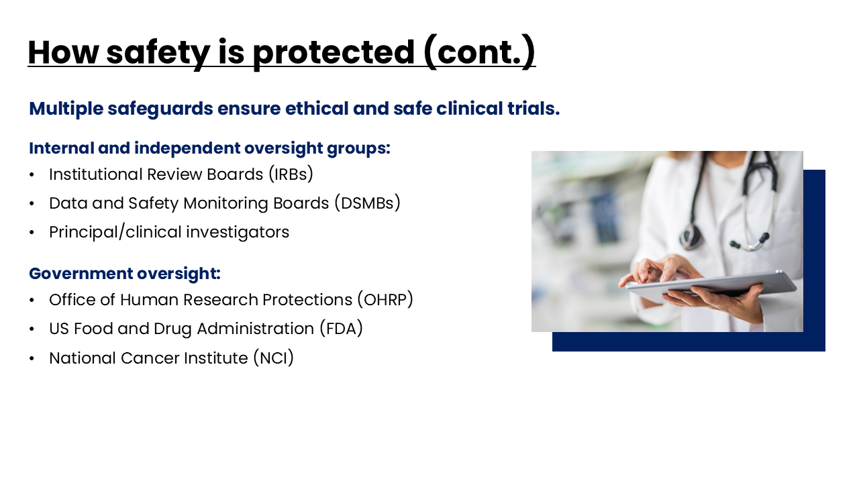
Notes:
Speaker Notes:
Multiple safeguards ensure ethical and safe clinical trials.
Institutional review boards (IRBs) make sure that people in clinical trials are protected and that federal laws are followed. The IRB also makes sure that the informed consent form is accurate, complete, and easy to understand. Once a clinical trial begins, the IRB watches over it to look for problems. If you’re in a clinical trial, you can contact the IRB with any questions or concerns.
Data and safety monitoring boards (DSMBs) are used for phase III (and some earlier phase) clinical trials. The job of the DSMB is to watch the progress and results of the clinical trial. The DSMB can stop a clinical trial before it’s done if:
It becomes clear that the new treatment is much more (or less) effective than the standard treatment to allow all people on the clinical trial to get the better treatment.
Safety concerns come up, such as risks being much greater than benefits, so that no one else is exposed to possible harm.
The clinical investigator or principal investigator is responsible for patient safety. They must let the study sponsor (the group or company that funds the trial) know right away when severe side effects occur.
Several government agencies help make sure clinical trials are safe and follow the rules:
The Office of Human Research Protections (OHRP) makes sure that the rules of informed consent, IRBs, and participation of people with special needs are followed. OHRP can stop clinical trials when problems are found. They also teach research sites and individuals to follow current clinical trial standards.
The US Food and Drug Administration (FDA) must approve any new medicine, treatment, or device before clinical trials can begin. They may also inspect (audit) sites doing clinical trials to make sure proper procedures are followed. Lastly, the FDA has the final say about whether a new treatment is approved and can be given to people.
The National Cancer Institute (NCI) pays for many clinical trials after careful review. They also audit sites to make sure rules are followed.

Slide 20
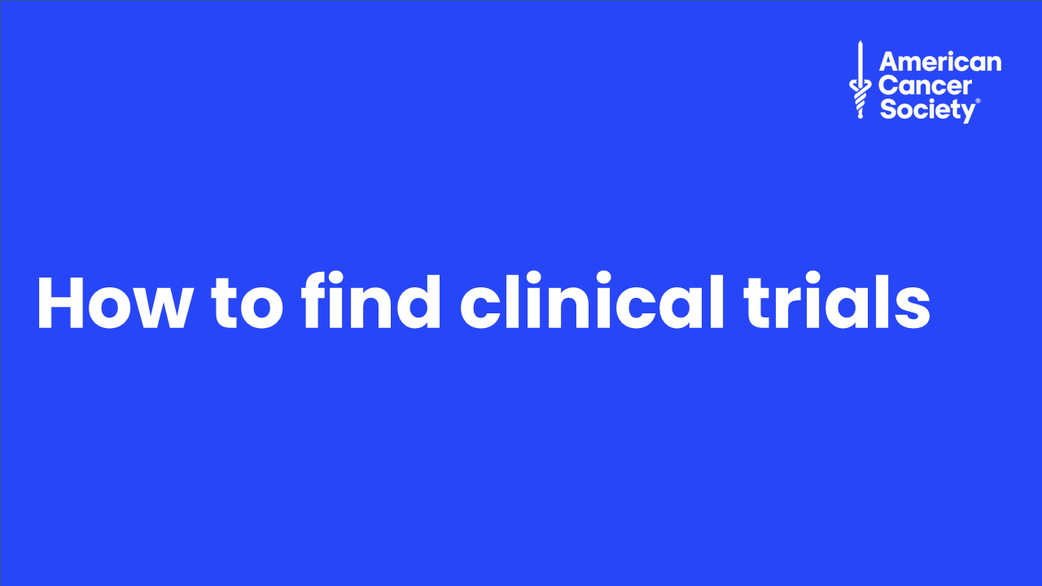
Notes:
Speaker Notes:
Most people who take part in clinical trials hear about them from their doctors. But you don’t have to wait for your doctor to bring up a clinical trial. People with cancer can also look for clinical trials online or in other places to find more options for treatment.

Slide 21
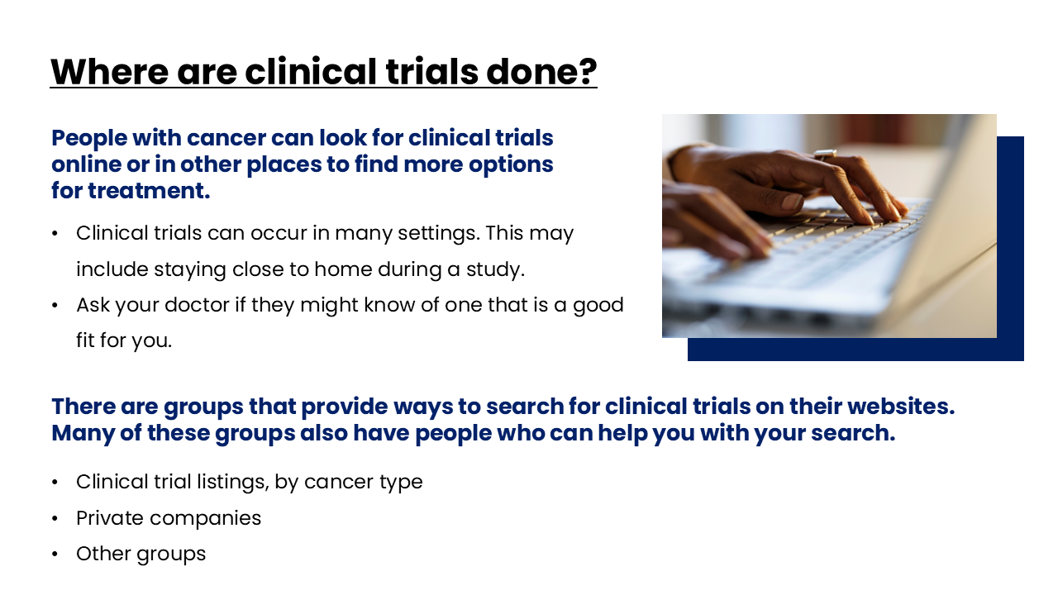
Notes:
Speaker Notes:
Clinical trials can occur in many settings. This may include staying close to home during a study or with your own doctors. Your doctor may or may not be involved in clinical trials. Ask your doctor if they might know of one that is a good fit for you.
Some phase I and phase II studies are only done at major medical centers. But this isn’t always a bad thing. Some people prefer to be treated at major cancer centers because of their experience, reputation, and resources.
There are groups that provide ways to search for clinical trials on their websites. Many of these groups also have people who can help you with your search.
Many cancer organizations offer help in finding clinical trials that might be a good fit for you. Because many of these groups focus on a specific type of cancer, they can help you find trials for your type of cancer.
Pharmaceutical and biotechnology companies also sponsor clinical trials. They may list the studies they’re sponsoring on their websites or offer toll-free numbers so you can call and ask.
Finally, there are doctors, medical centers, foundations, volunteer groups, and other nonprofit groups that sponsor clinical trials.

Slide 22

Notes:
Speaker notes:
ACS has clinical trial resources for the public and for health care providers. Work with your local staff partner to get access to these resources.

Slide 23
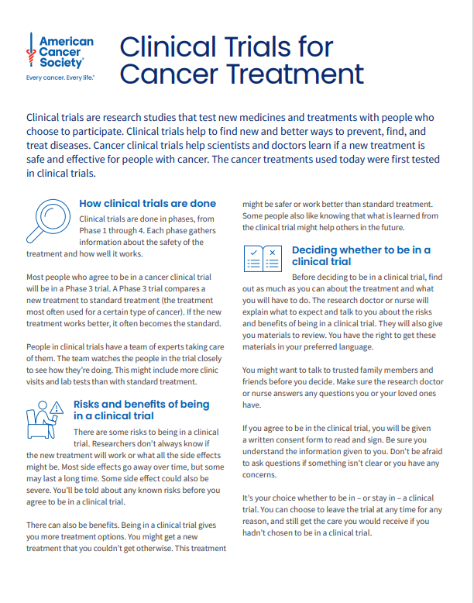
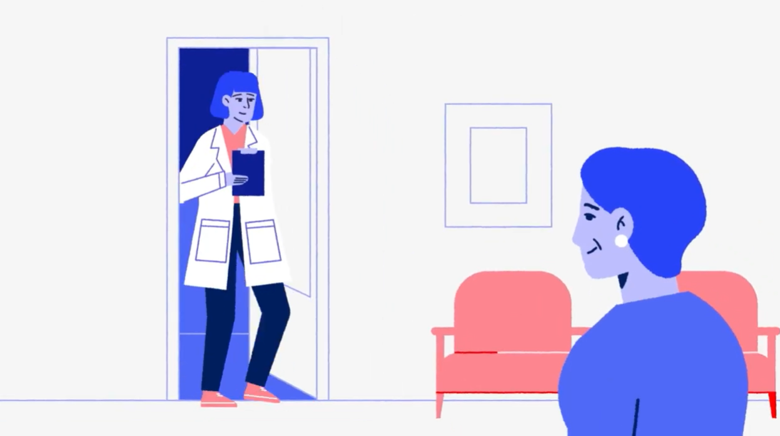

Resources
Clinical Trials for Cancer Treatment
Video: Your Guide to Cancer Clinical Trials: Understanding the Basics
ACS ACTS: Access to Clinical Trial Support
Cancer.org has information on:
  Phases of clinical trials
  Things to consider before taking part in a
  clinical trial
  Being part of a clinical trial
Notes:
Speaker directions:
Links are to items available on cancer.org and many are available in Spanish.

