Slide 1
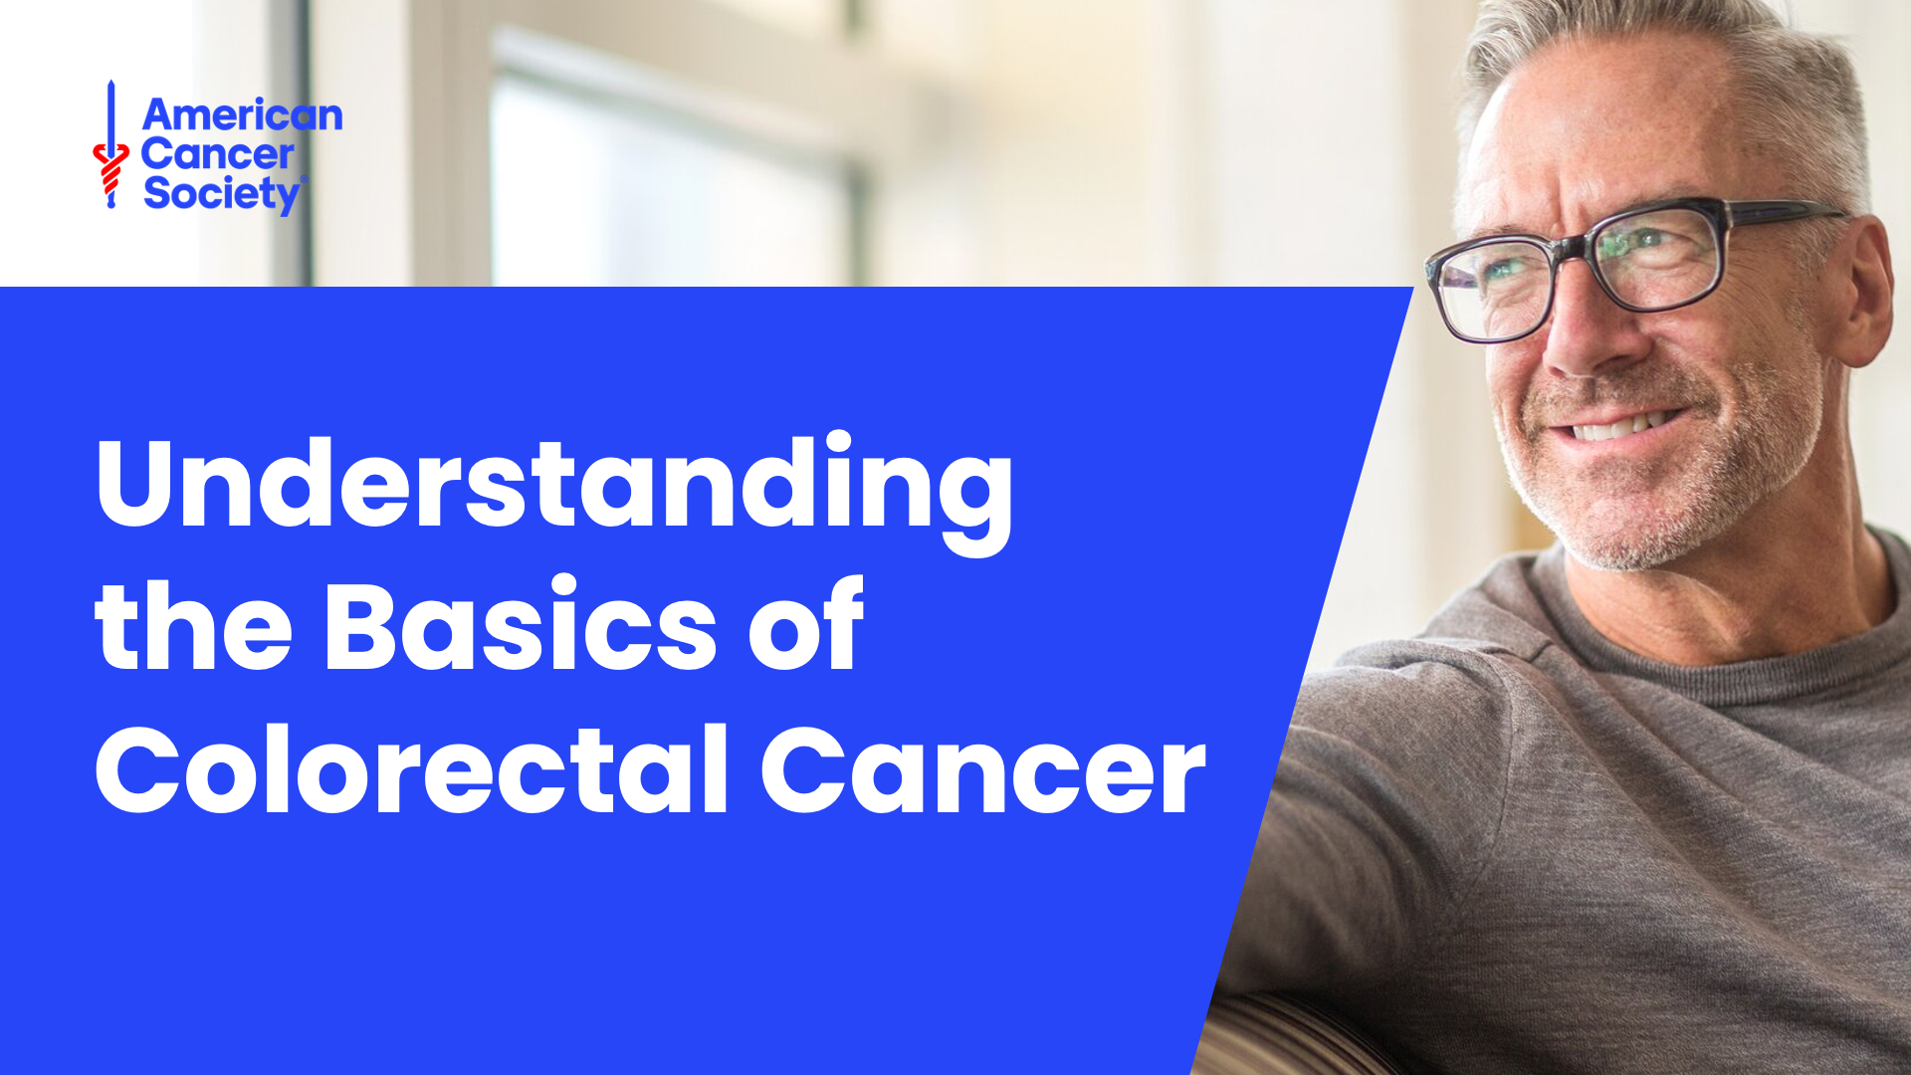

Slide 2
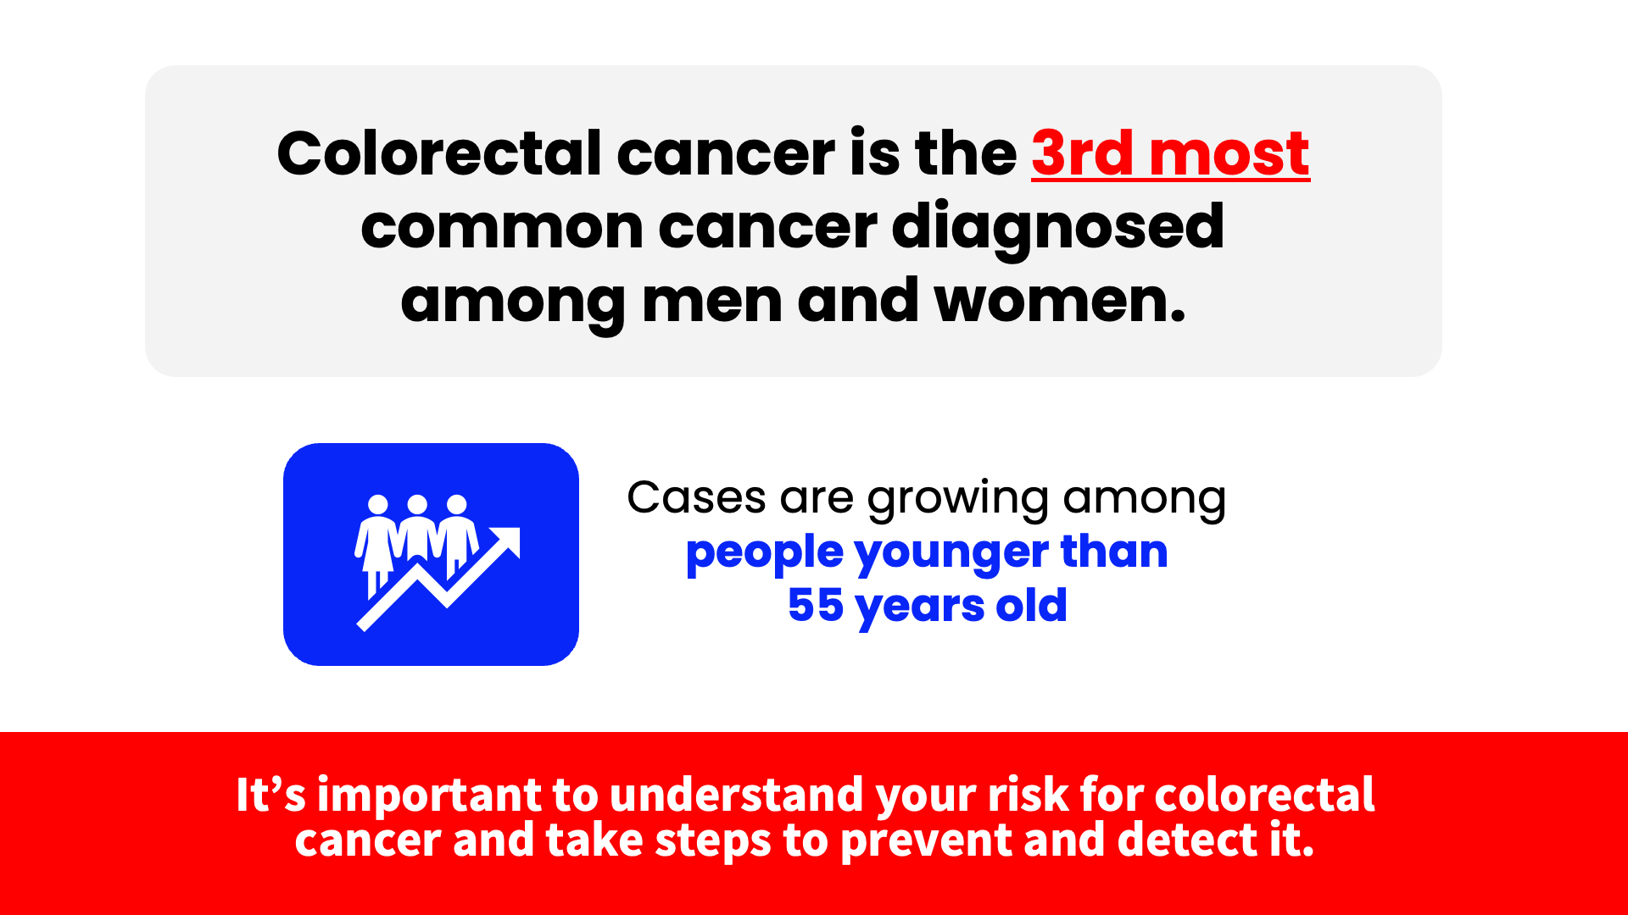
Notes:
Speaker Notes
In 2025 in the United States, colorectal cancer is the third most common cancer diagnosed among men and women, excluding skin cancers.
A higher number of cases have been seen in people younger than 55 years old.
Let’s talk about ways to understand your risk for colorectal cancer and steps you can take to prevent and detect it.
SOURCE: Facts and Figures 2025

Slide 3
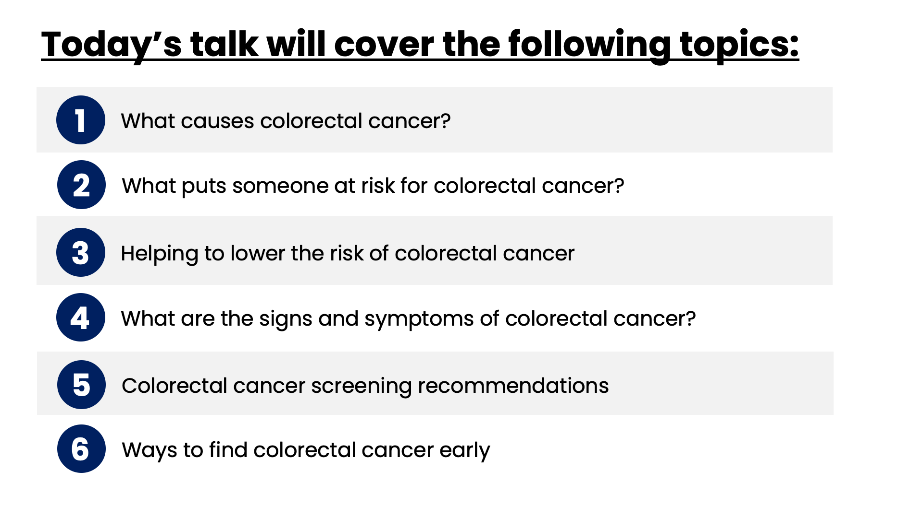
Notes:
Speaker Notes
Let’s learn about what you can do to prevent and detect colorectal cancer. This is a summary of what we’ll be talking about today.

Slide 4
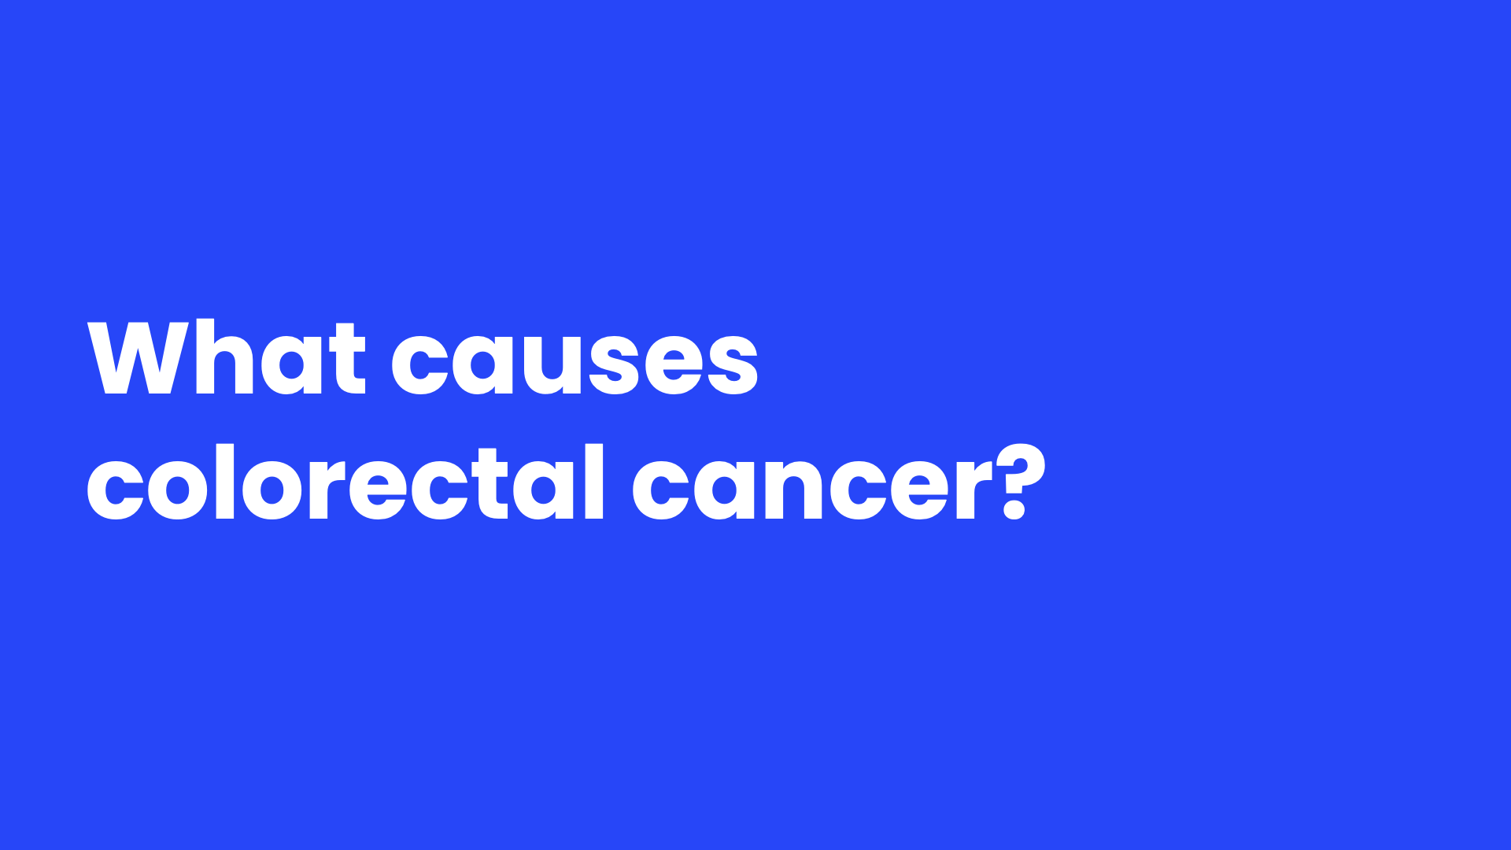
Notes:
Speaker Notes
When we refer to colorectal cancer, we are really talking about cancers that can develop in the colon or the rectum. Let's discuss more clearly what these two body parts do and what happens when cancer develops in the colon or rectum.

Slide 5
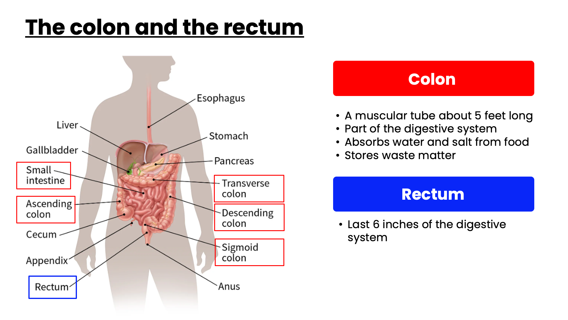
Notes:
Speaker Notes
The colon and rectum make up the large intestine (or large bowel), which is part of the digestive system, also called the gastrointestinal (GI) system.
After food is chewed and swallowed, it travels through the esophagus (ih-sof-uh-gus) to the stomach. There, it is partly broken down and then sent to the small intestine, also known as the small bowel. The small intestine continues breaking down the food and absorbs most of the nutrients.
The colon absorbs the remaining water and salt from the food.
The waste material that’s left after going through the colon is known as feces or stool. It goes into the rectum. From there it leaves the body through the anus.

Slide 6
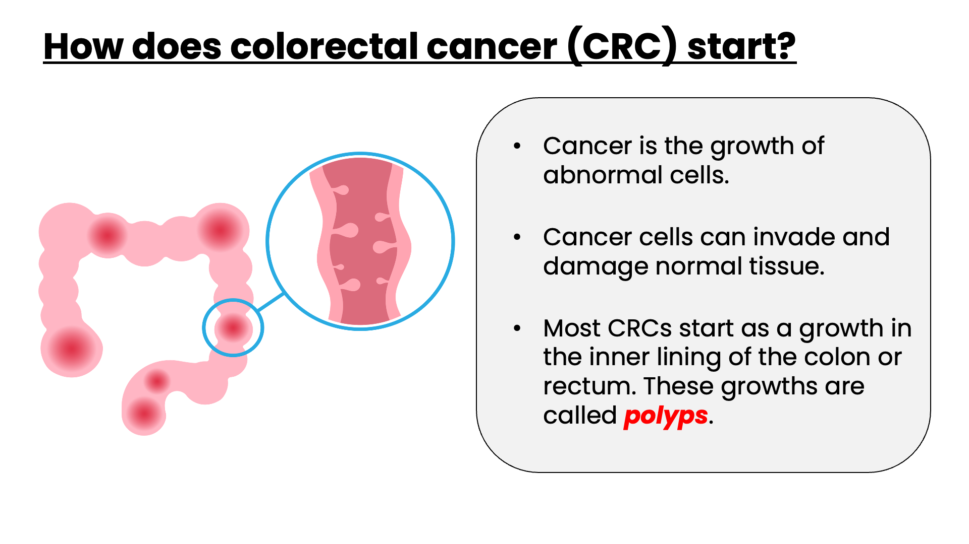
Notes:
Speaker Notes
Colorectal cancer, often abbreviated CRC, is sometimes referred to separately as colon cancer or rectal cancer, depending on where they start. But colon cancer and rectal cancer have many features in common and we will be discussing them together today.
Most colorectal cancers start as a growth on the inner lining of the colon or rectum. These growths are called polyps.

Slide 7
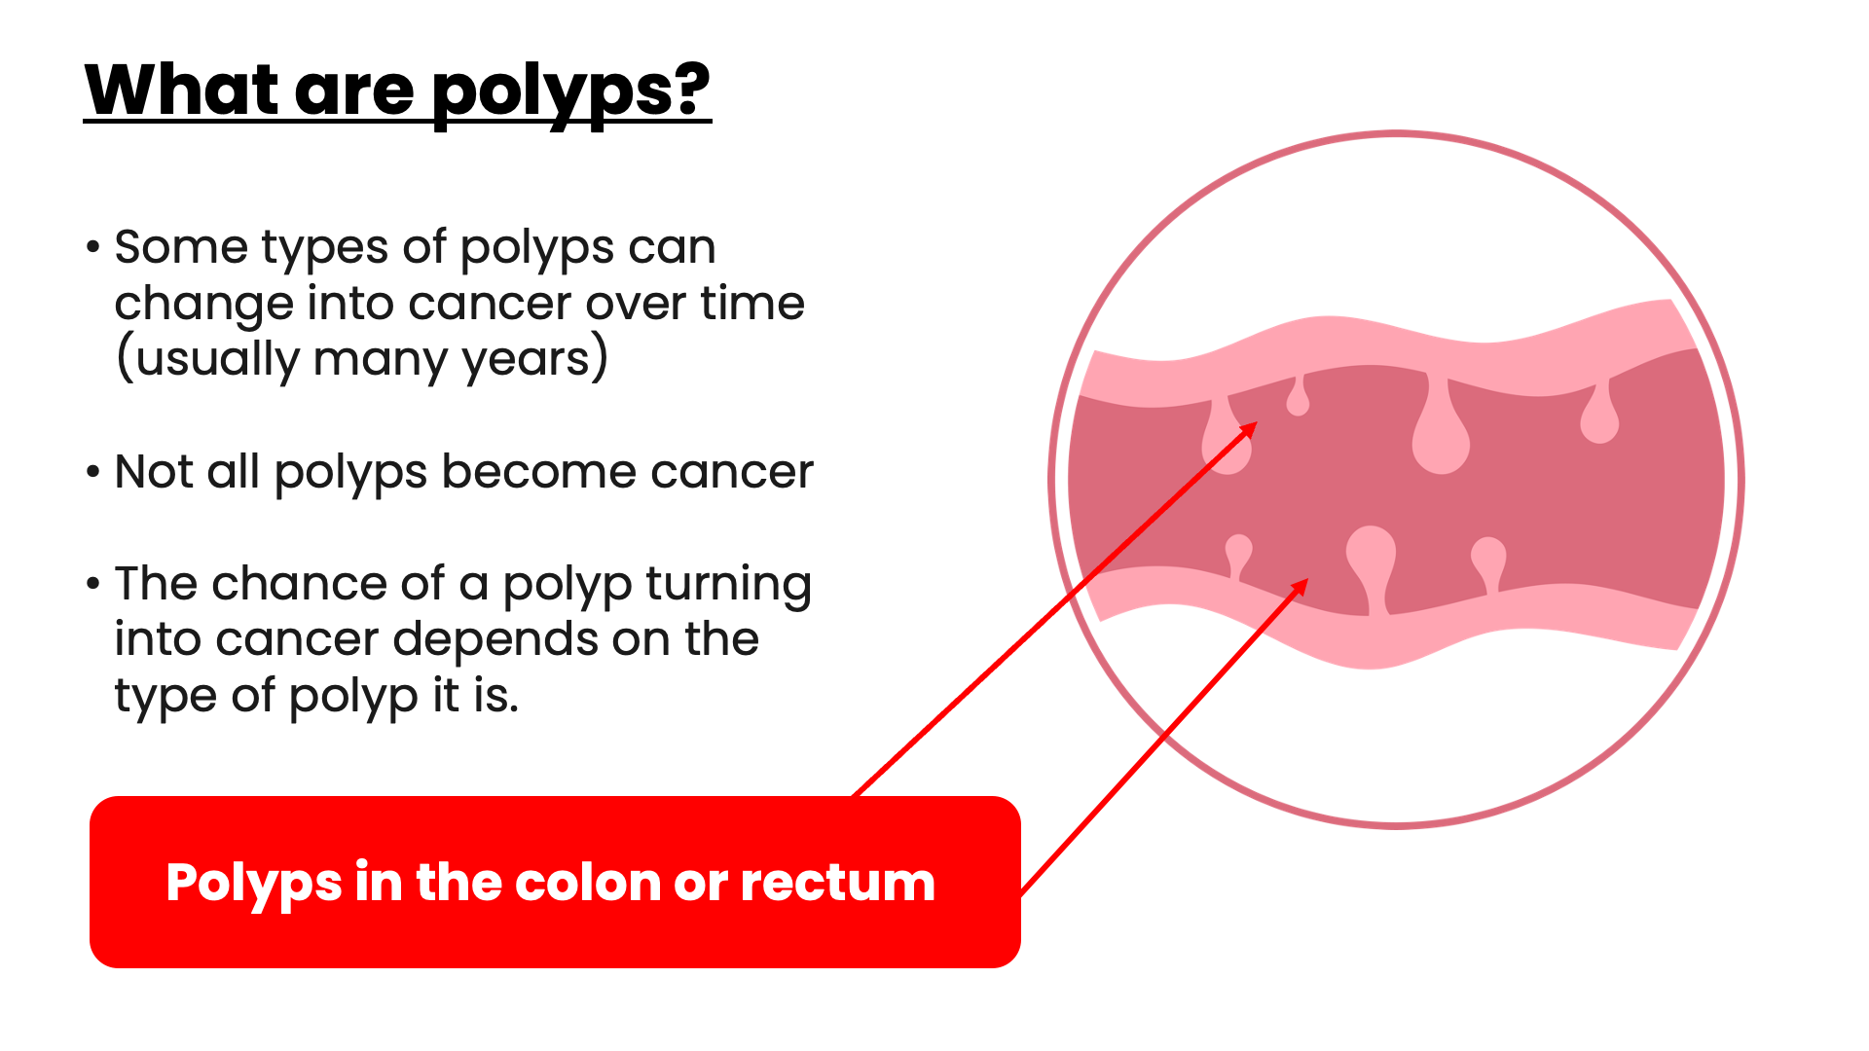
Notes:
Speaker Notes
Polyps are growths on the inner lining of the colon or rectum. Adenomatous polyps (ad-no-muh-tus or ad-uh-NO-muh-tus pa-lips) are the kind of polyps that can change into cancer.
Some types of polyps can change into cancer over time (usually many years), but not all polyps become cancer.

Slide 8
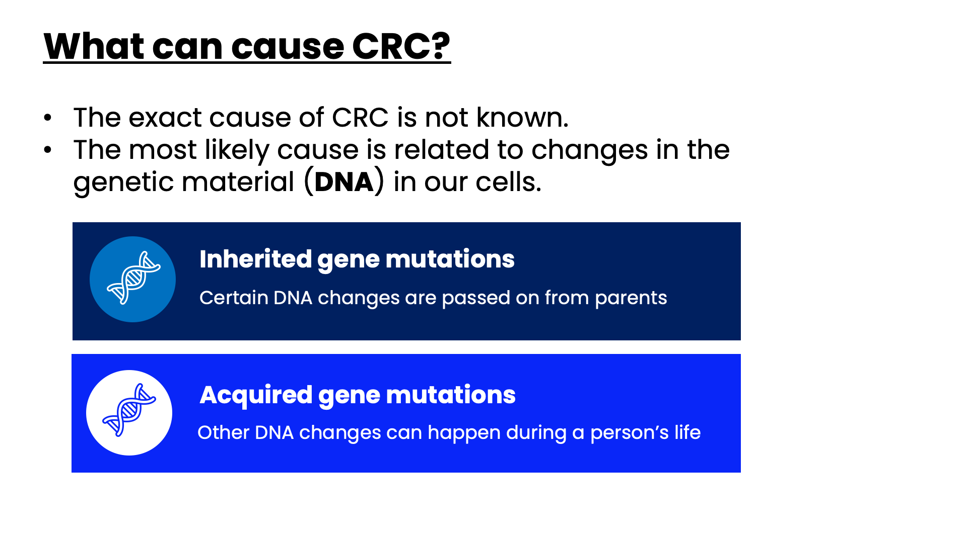
Notes:
Speaker Notes
How can polyps become cancerous? The answer may lie in our DNA.
Inherited gene mutations: those that can be passed on to children. These mutations can increase the risk for a small number of colorectal cancers. Inherited mutations affect all the cells in the body.
Acquired gene mutations: changes that take place during a person’s life and are not passed on to children. These changes only affect the cells that grow from the one cell where the changes began. Most cases of colorectal cancer are caused by these types of changes.

Slide 9
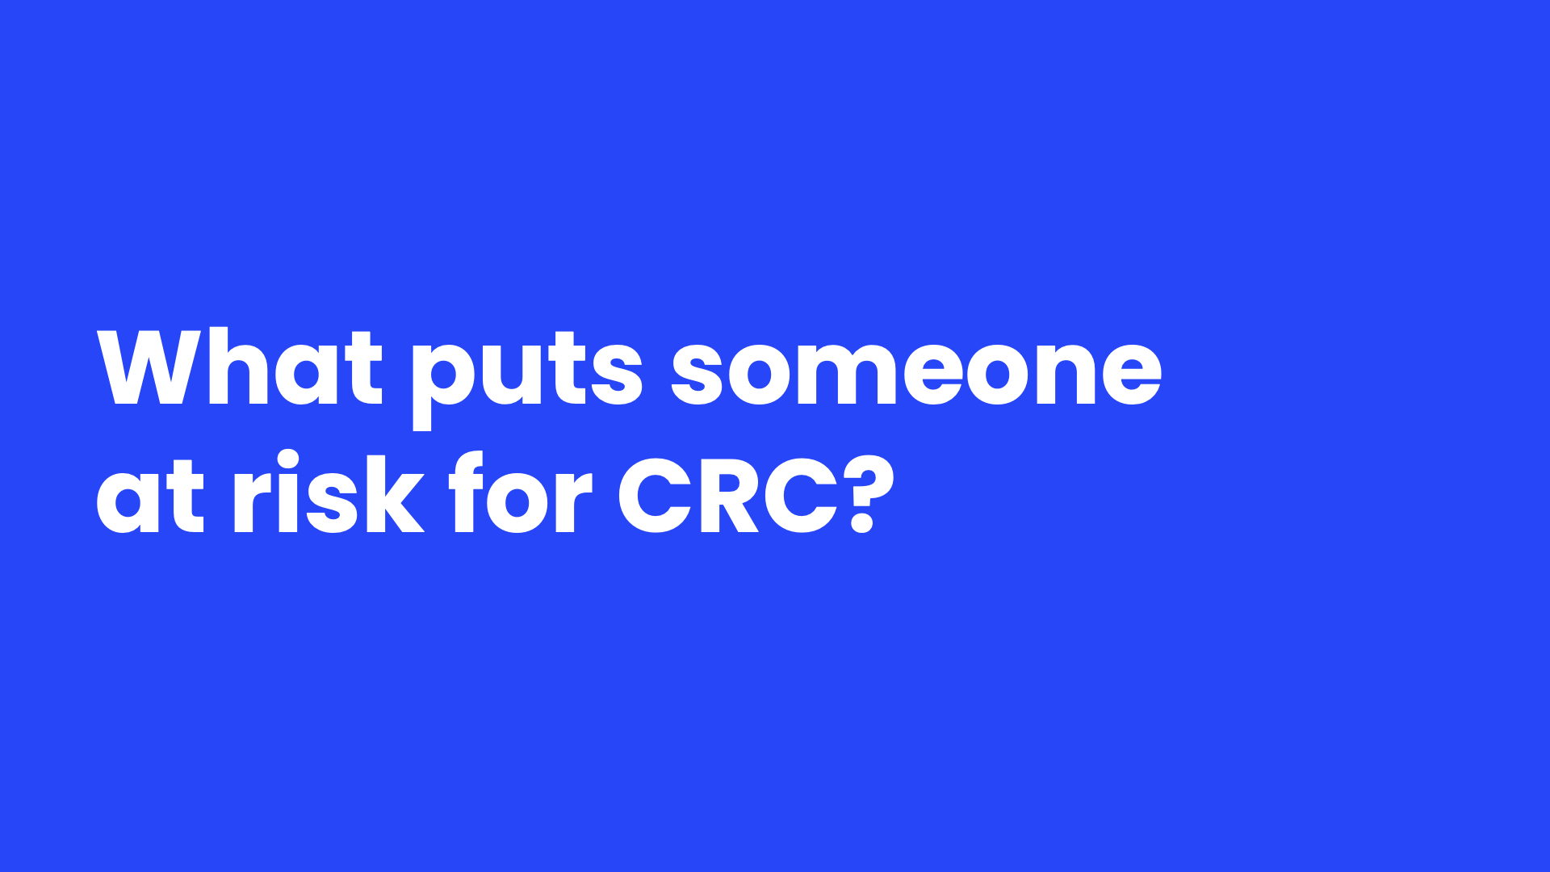
Notes:
Speaker Notes
A risk factor is anything that affects your chance of getting a disease such as cancer. Different cancers have different risk factors. Some risk factors, like smoking and excess sun exposure, can be changed. Others, like your age or family history, can’t be changed.
Having a risk factor, or even several risk factors, does not mean that you will get the disease. And some people who get the disease may not have any known risk factors.
Still, researchers have found several risk factors that may increase a person's chance of developing colorectal polyps or colorectal cancer.

Slide 10
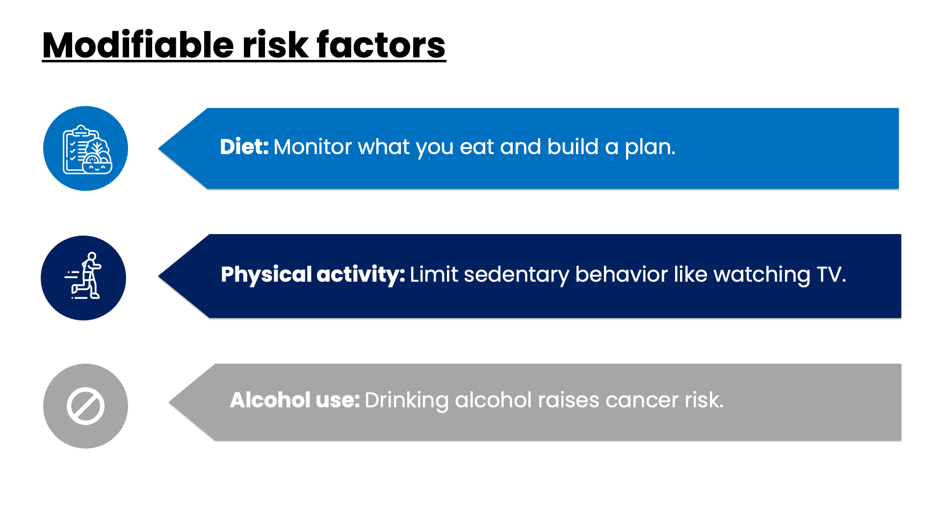
Notes:
Speaker Notes
Let’s first talk about risk factors that can be modified.
A diet high in red meats (such as beef, pork, lamb, or liver) and processed meats (like hot dogs and some luncheon meats) raises your colorectal cancer risk. Not getting enough dairy can also increase the risk of colorectal cancer.
Following a healthy eating pattern that includes plenty of fruits, vegetables, and whole grains, and that limits or avoids red and processed meats and sugary drinks may lower risk.
Regular physical activity can help lower colorectal cancer risk. We will cover both topics in a little more detail later.
Colorectal cancer has been linked to moderate to heavy alcohol use. Even light to moderate alcohol intake has been associated with some risk. If people do drink alcohol, they should have no more than 2 drinks a day for men and 1 drink a day for women.

Slide 11
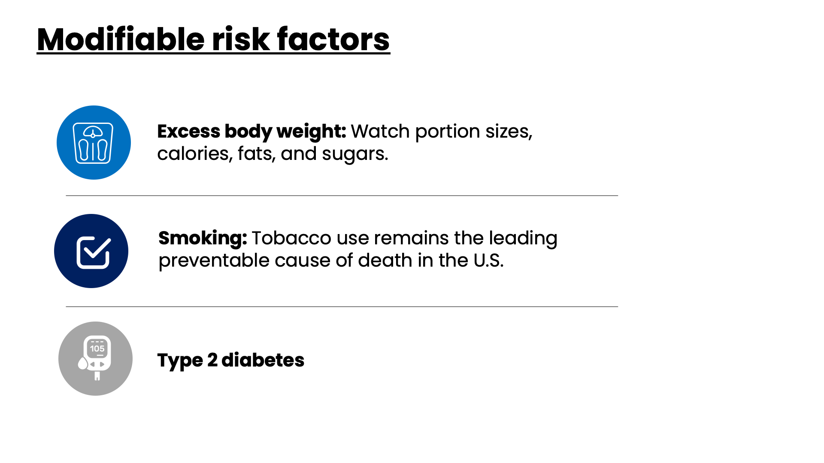
Notes:
Speaker Notes
Carrying excess body weight raises the risk of colon and rectal cancer in both men and women.
People who have smoked tobacco for a long time are more likely than people who don’t smoke to develop and die from colorectal cancer.
Diabetes
People with type 2 diabetes have an increased risk of colorectal cancer.

Slide 12
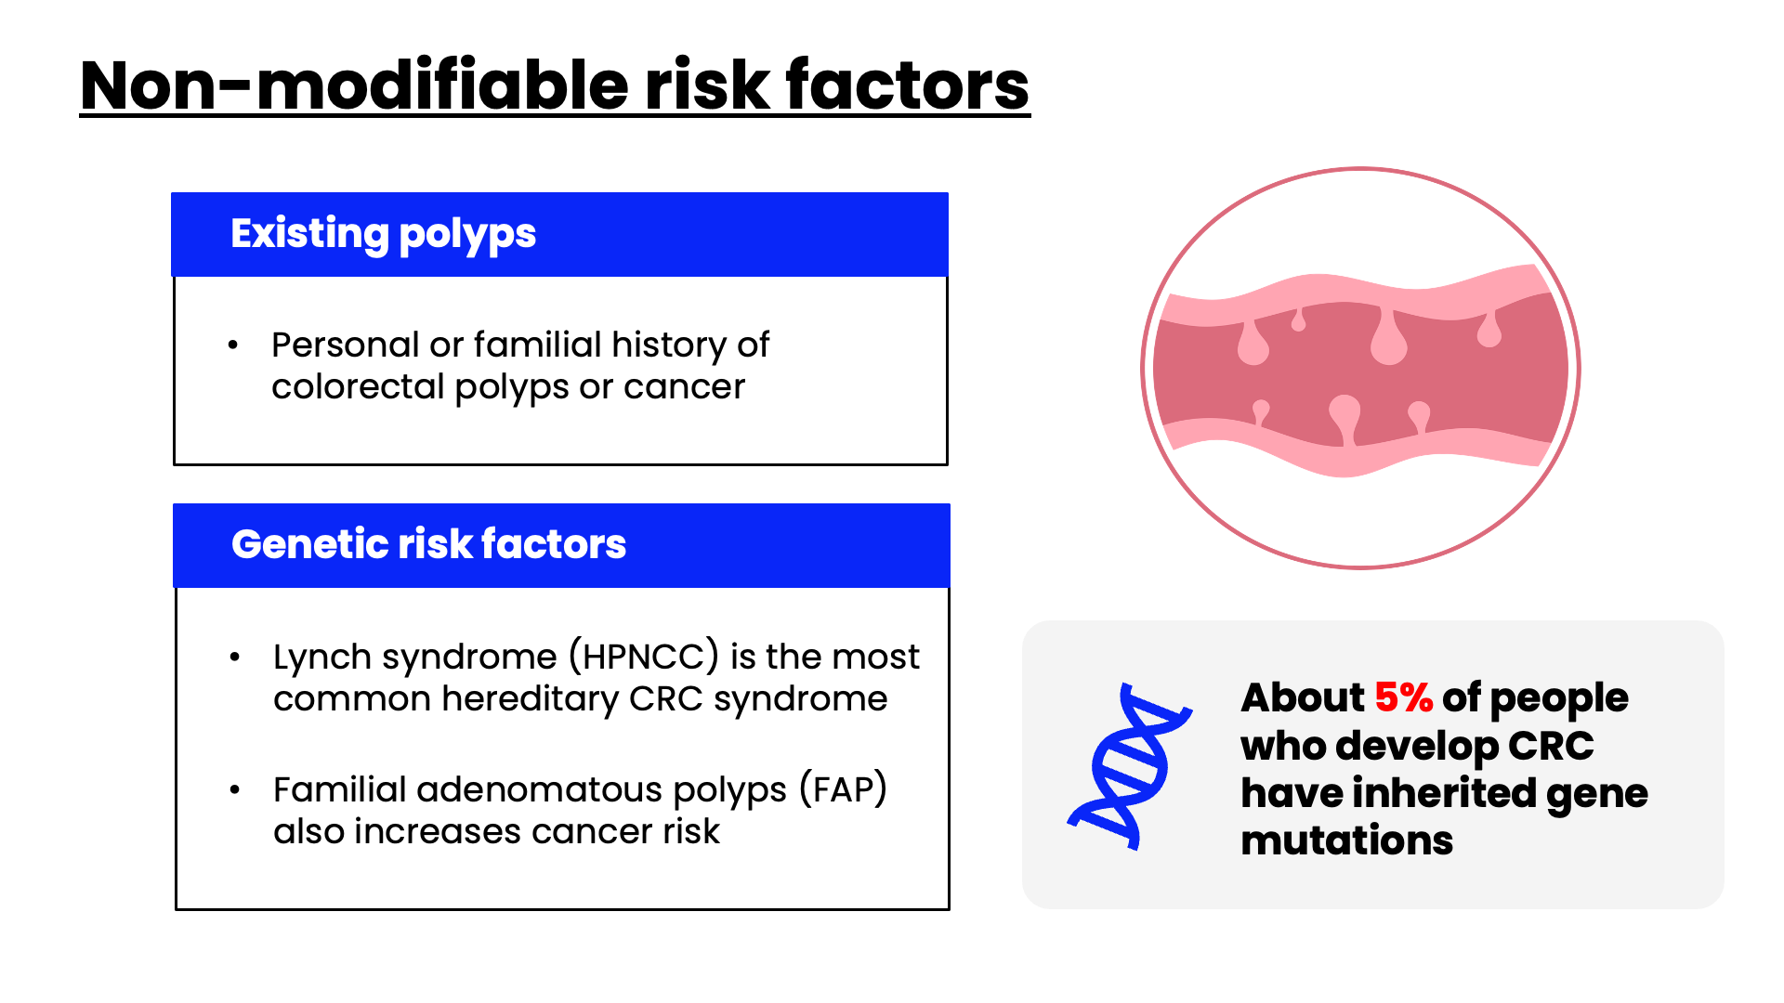
Notes:
Speaker Notes
Now, let’s talk about risk factors that cannot be changed.
Box #1:
If you have a personal history of adenomatous polyps, you are at increased risk of developing colorectal cancer.
If you've had colorectal cancer, even though it was completely removed, you are more likely to develop new cancers in other parts of the colon and rectum. The chances of this happening are greater if you had your first colorectal cancer when you were younger.
People with a familial history of colorectal cancer in a first-degree relative (parent, sibling, or child) are at increased risk. The risk is even higher if that relative was diagnosed with cancer when they were younger than 50 , or if more than one first-degree relative is affected.
Having family members who have had adenomatous polyps is also linked to a higher risk of colon cancer.
Box #2:
Lynch syndrome accounts for about 2% to 4% of all colorectal cancers. The cancers linked to this syndrome tend to develop when people are relatively young.
FAP accounts for about 1% of all colorectal cancers. In the most common type of FAP, hundreds or thousands of polyps develop in a person’s colon and rectum. Cancer usually develops in 1 or more of these polyps as early as age 20. By age 40, almost all people with FAP will have colon cancer if their colon hasn’t been removed to prevent it.
Talk to a doctor about genetic screening: Since many of these syndromes are linked to colorectal cancer at a young age and also linked to other types of cancer, identifying families with these inherited syndromes is important. It lets doctors recommend specific steps such as screening and other preventive measures when the person is younger.
Talk to your doctor if you or people in your family have any of these syndromes or if you have a personal or family history of colorectal polyps or cancer.

Slide 13
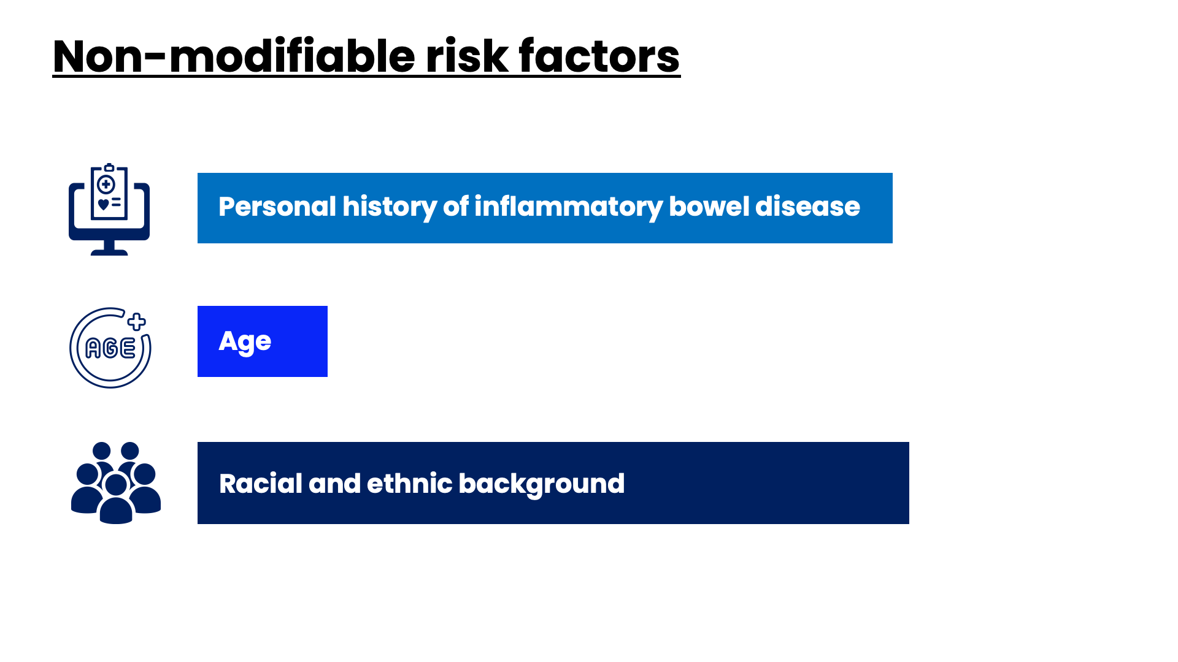
Notes:
Speaker Notes
Personal History
If you have inflammatory bowel disease (IBD), including either ulcerative colitis or Crohn's disease, your risk of colorectal cancer is increased. If you have IBD, you may need to start getting screened for colorectal cancer when you are younger and/or be screened more often.
Inflammatory bowel disease is different from irritable bowel syndrome (IBS), which does not appear to increase your risk for colorectal cancer.
Age
Younger adults can get it, but it is still much more common after age 50.
Racial and Ethnic Background
Alaska Natives, American Indians, African Americans/Blacks, and people of Ashkenazi Jewish descent are at highest risk for colorectal cancer.

Slide 14
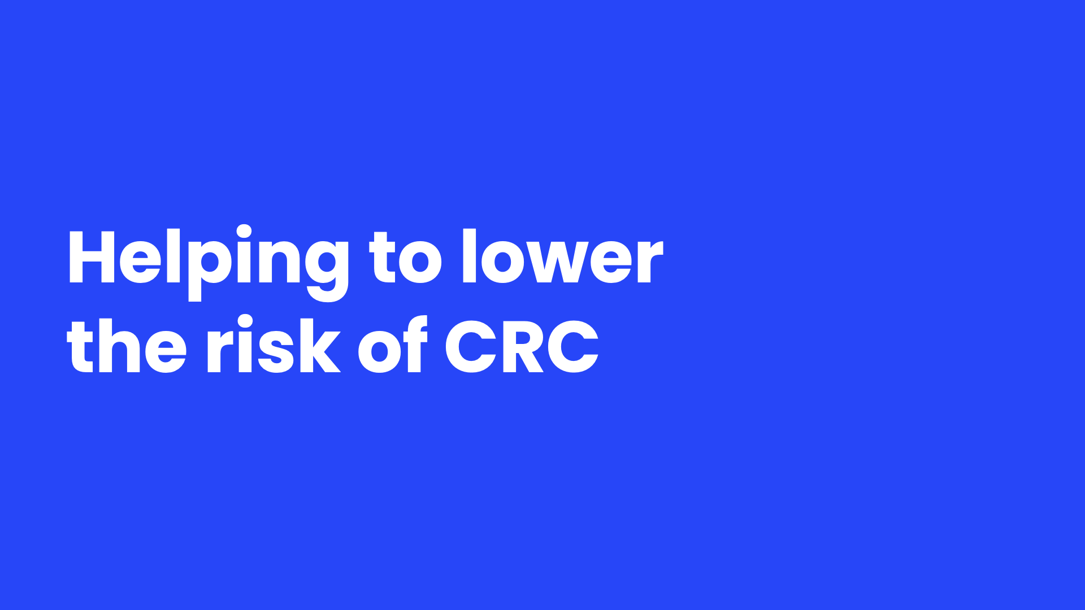
Notes:
Speaker Notes
There is no sure way to prevent colorectal cancer.
But there are things everyone can do that might help lower their risk of colorectal cancer.

Slide 15
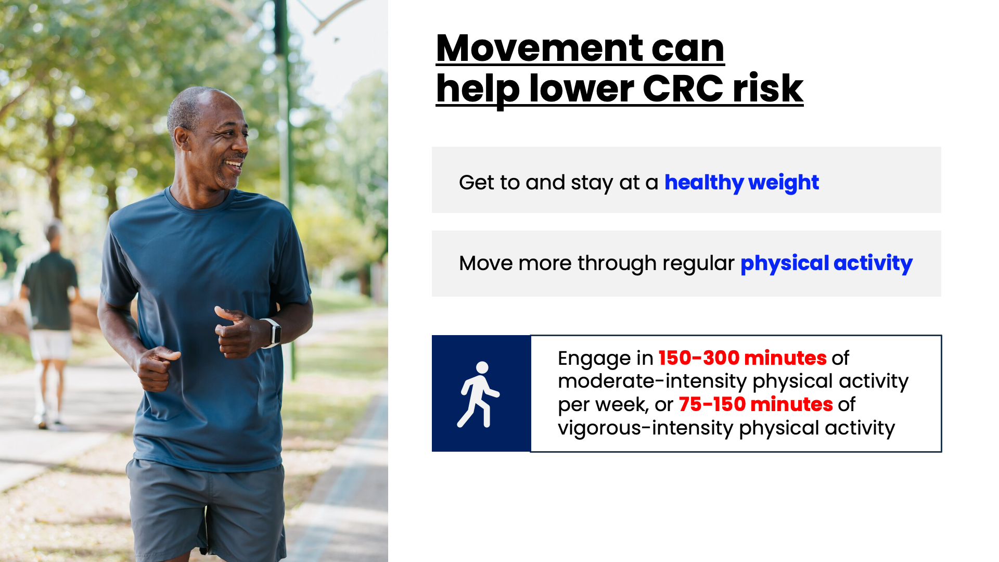
Notes:
Speaker Notes
Bullet 1:
Carrying excess weight increases the risk of colorectal cancer in both men and women. People should talk to their doctor about what a healthy weight would be for them.
Bullet 2:
Being more active lowers your risk of colorectal cancer and polyps.
The American Cancer Society recommends that adults get 150-300 minutes of moderate-intensity physical activity per week, or 75-150 minutes of vigorous-intensity physical activity, or an equivalent combination; getting to or going over the upper limit of 300 minutes in even better.

Slide 16
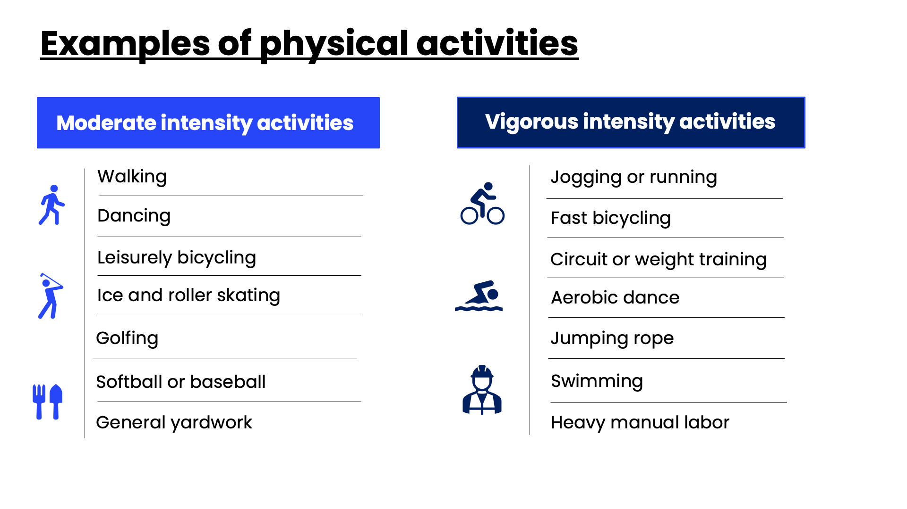
Notes:
Speaker Notes
Moderate-intensity activities are those that require effort equivalent to that of a brisk walk. Examples include walking, dancing, leisurely bicycling, ice and roller skating, volleyball, golfing, softball, baseball, downhill skiing, mowing the lawn, general yardwork, and walking and lifting as part of a job. ​
​
Vigorous-intensity activities generally engage large muscle groups and cause a noticeable increase in heart rate, breathing depth and frequency, and sweating. Examples include jogging or running, fast bicycling, circuit, weight training, aerobic dance, martial arts, jumping rope, swimming, soccer, basketball, lacrosse, cross-country skiing, digging, carrying and hauling, carpentry, and heavy manual labor.​
​
Limit sedentary behavior such as sitting, lying down, and watching television and other forms of screen-based entertainment.​

Slide 17
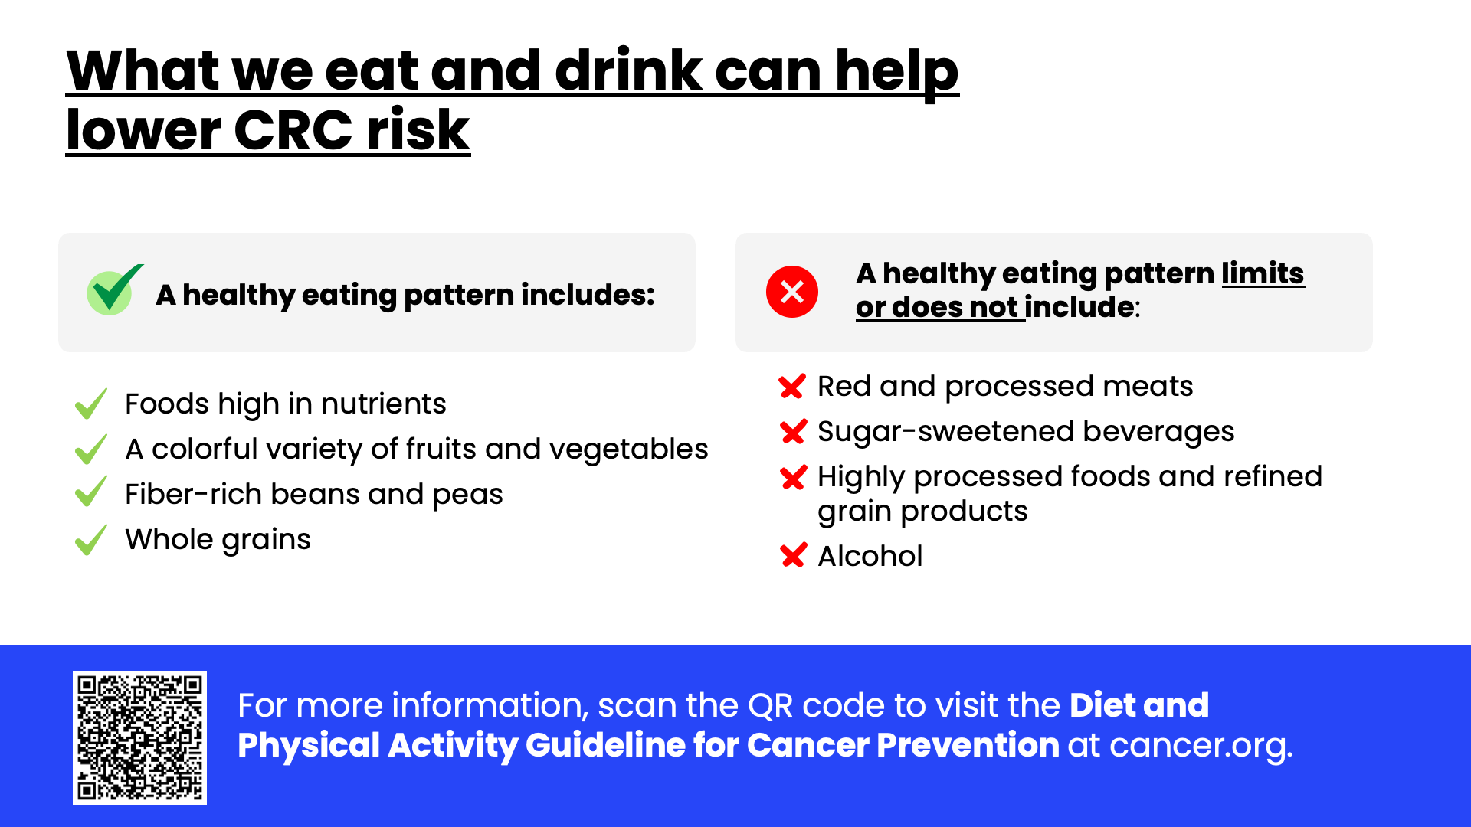
Notes:
Speaker Notes
Follow a healthy eating pattern:
Eating lots of fruits and vegetables can help reduce your cancer risk. These foods contain important vitamins, minerals, phytochemicals, and antioxidants and they’re usually low in calories. In general, those with the most color – dark green, red, yellow, and orange – have the most nutrients.
Think about how you can add more vegetables, fruits, and whole grains to your day while you watch your intake of refined carbohydrate and sugar.
Limiting the intake of certain foods:
Many studies have found a link between red meats and increased colorectal cancer risk.
Examples of red meats: beef, pork, and lamb
Examples of processed meats: bacon, sausage, luncheon meats, and hot dogs
Limit or avoid processed and red meat consumption. Instead, choose lean protein sources like poultry, fish, beans, or tofu. If you choose to eat red meat, choose lean cuts. Look for the words “loin” or “round” in the name. Trim meat of visible fat before cooking.
It’s also important to limit sugar-sweetened beverages and find ways to integrate whole grains rather than highly processed or refined grain products.
Alcohol:
It's best not to drink alcohol. Drinking any amount of alcohol increases your risk of colorectal cancer
People who do choose to drink alcohol should limit their consumption to 1 drink per day for women and 2 drinks per day for men.
If asked: In the United States, a standard drink is equal to
--12 ounces of beer
--8 ounces of malt liquor
--5 ounces of wine
--1.5 ounces or a “shot” of 80-proof distilled spirits or liquor (such as gin, rum, vodka, or whiskey)
[From the Centers for Disease Control and Prevention, website: www.cdc.gov/alcohol/faqs.htm#standDrink]

Slide 18
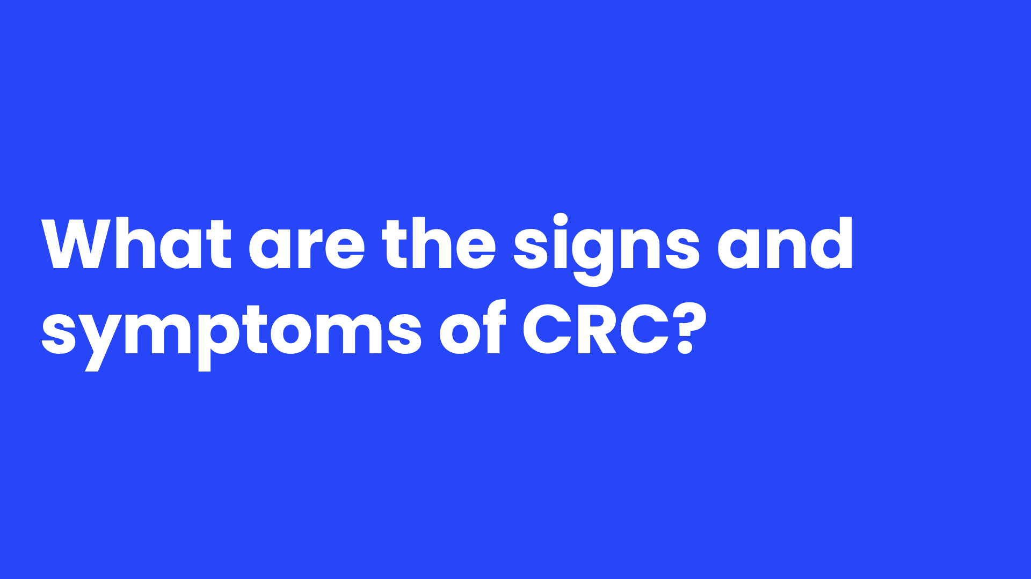
Notes:
Speaker Notes
Now that we know what can put people at risk for colorectal cancer, let's see what signs and symptoms many of them experience.

Slide 19
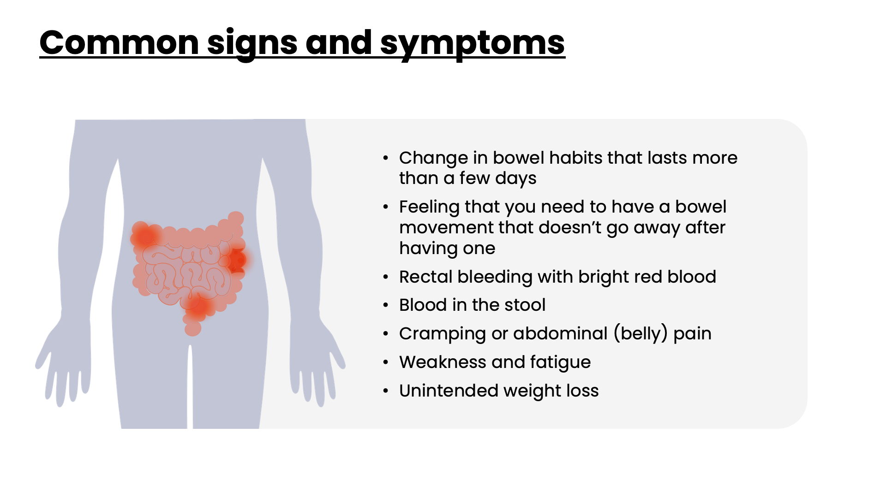
Notes:
Speaker Notes
Colorectal cancer might not cause symptoms right away, but if it does, it may cause one of these symptoms
Change in bowel habits that lasts more than a few days. These may include diarrhea, constipation, or narrowing of the stool.
Feeling that you need to have a bowel movement that doesn’t go away after having one
Rectal bleeding with bright red blood
Blood in the stool. This can make the stool look dark brown or black
Cramping or abdominal (belly) pain
Weakness and fatigue
Unintended weight loss
Many of these symptoms can be caused by conditions other than colorectal cancer. Still, if you have any of these symptoms it’s important to see your doctor right away so the cause can be found and treated, if needed.

Slide 20
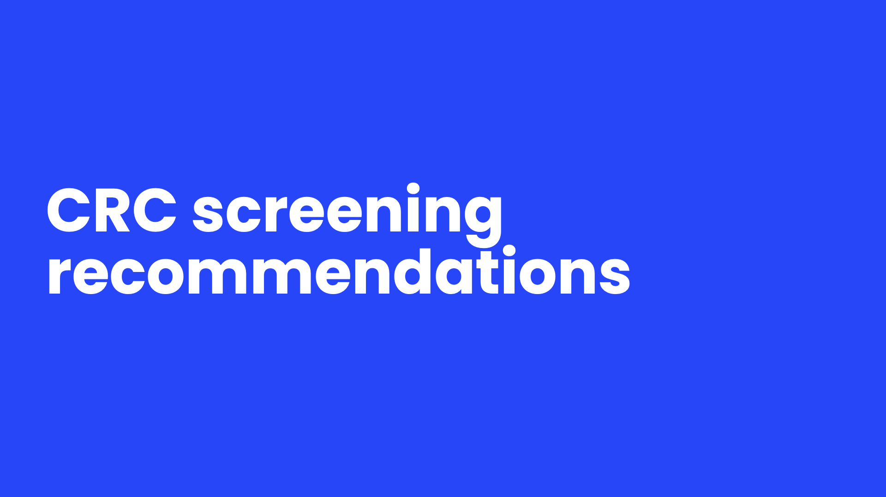
Notes:
Speaker Notes
Let's talk about how to get screened for colorectal cancer to help detect it early.
Early detection means finding and diagnosing a disease earlier than if you had waited for symptoms to start. Let’s discuss the American Cancer Society’s screening recommendations for people at average risk of developing CRC.

Slide 21
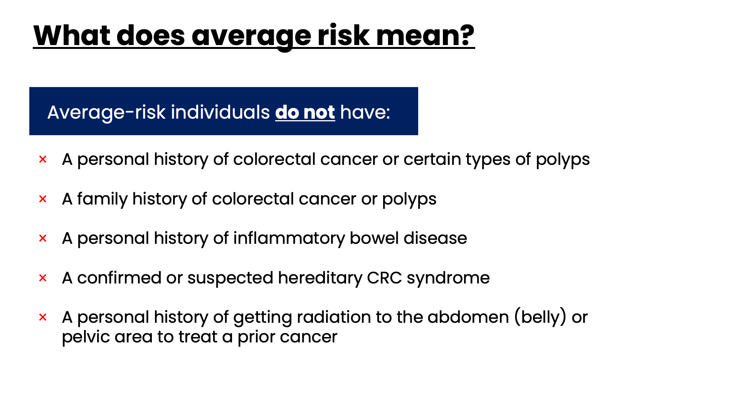
Notes:
Speaker Notes
First, let’s define what average risk means:
For screening, people high-risk at average risk if they do not have:
A personal history of colorectal cancer or certain types of polyps
A family history of colorectal cancer or polyps
A personal history of inflammatory bowel disease (ulcerative colitis or Crohn’s disease)
A confirmed or suspected hereditary colorectal cancer syndrome, such as familial adenomatous polyposis (FAP) or Lynch syndrome
A personal history of getting radiation to the abdomen (belly) or pelvic area to treat a prior cancer
For anyone WITH high risk characteristics, colonoscopy is the only recommended screening test.

Slide 22
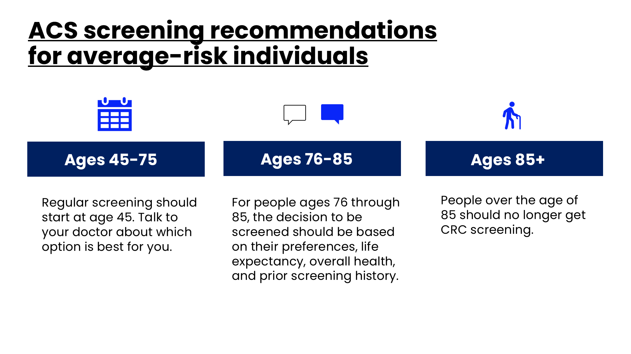
Notes:
Speaker Notes
For average-risk individuals, regular screening should begin at age 45. We will discuss screening options in a few minutes. Consult with your doctor to find out which one is right for you.
After age 75, individuals should discuss whether to continue with screening.
Screening should end at age 85. People over the age of 85 should no longer get CRC screening.

Slide 23
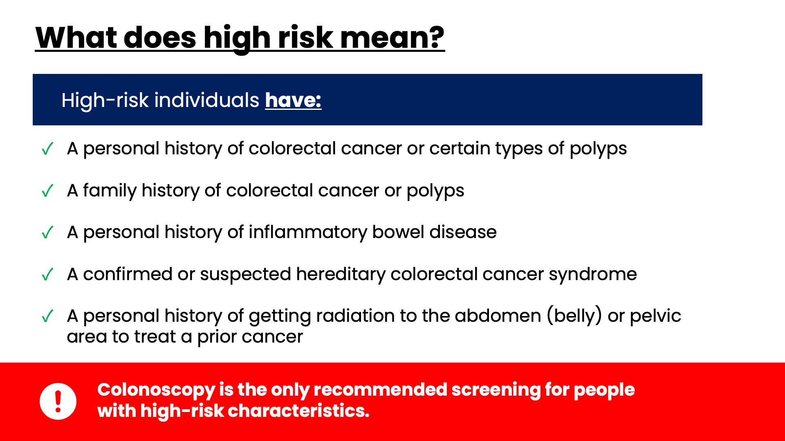
Notes:
Speaker Notes
High-risk individuals have one or more of the following characteristics:
A personal history of colorectal cancer or certain types of polyps
A family history of colorectal cancer or polyps
A personal history of inflammatory bowel disease (ulcerative colitis or Crohn’s disease)
A confirmed or suspected hereditary colorectal cancer syndrome, such as familial adenomatous polyposis (FAP) or Lynch syndrome
A personal history of getting radiation to the abdomen (belly) or pelvic area to treat a prior cancer
For anyone WITH high-risk characteristics, colonoscopy is the only recommended screening test.

Slide 24

Notes:
Speaker Notes
Here are ways to detect colorectal cancer. Remember, discussing these options with your doctor is an important step before screening.

Slide 25
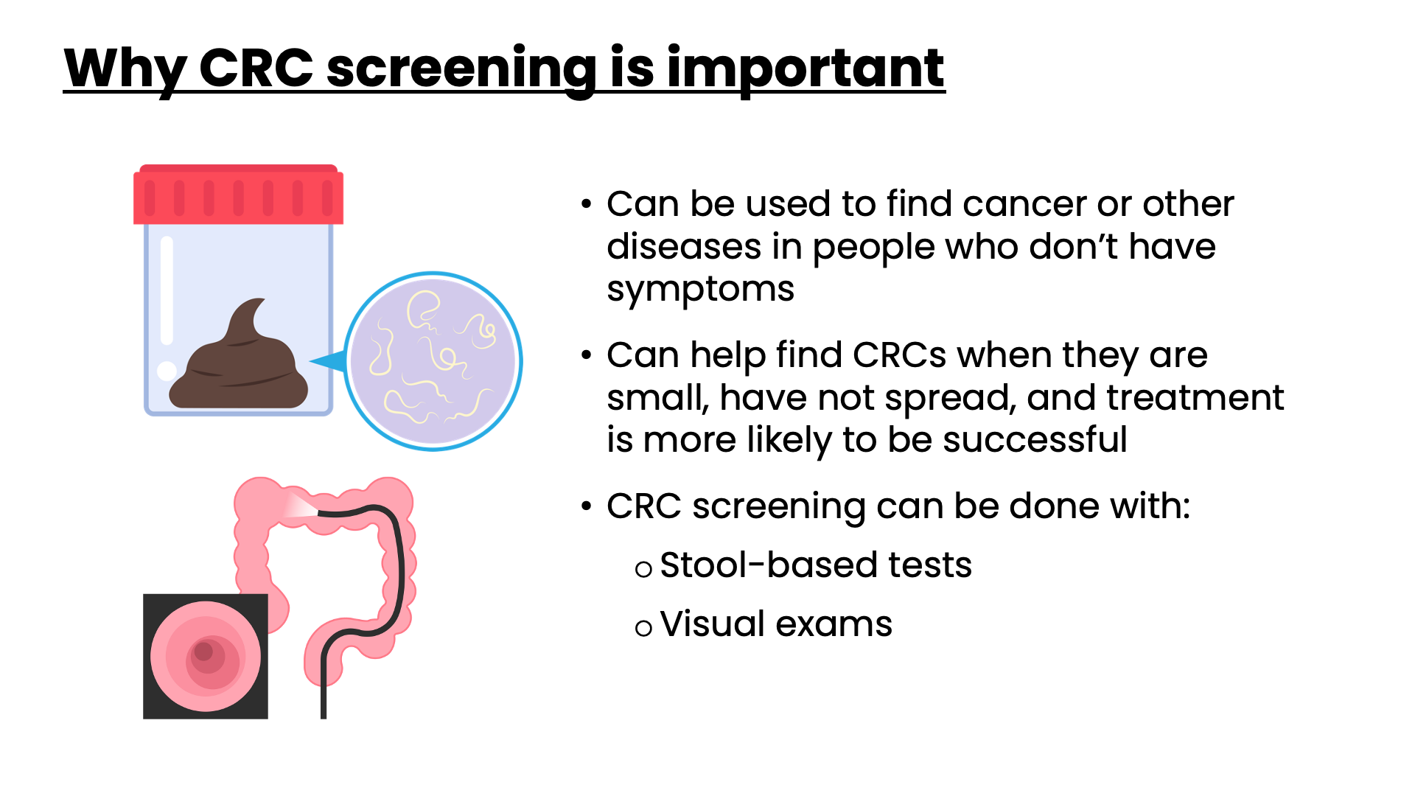
Notes:
Speaker Notes
Screening is testing used to find cancer or other diseases in people who don’t have symptoms.
Screening can help find colorectal cancers when they are small, have not spread, and treatment is more likely to be successful.
Colorectal cancer screening can be done with:
Stool-based tests
Visual exams

Slide 26
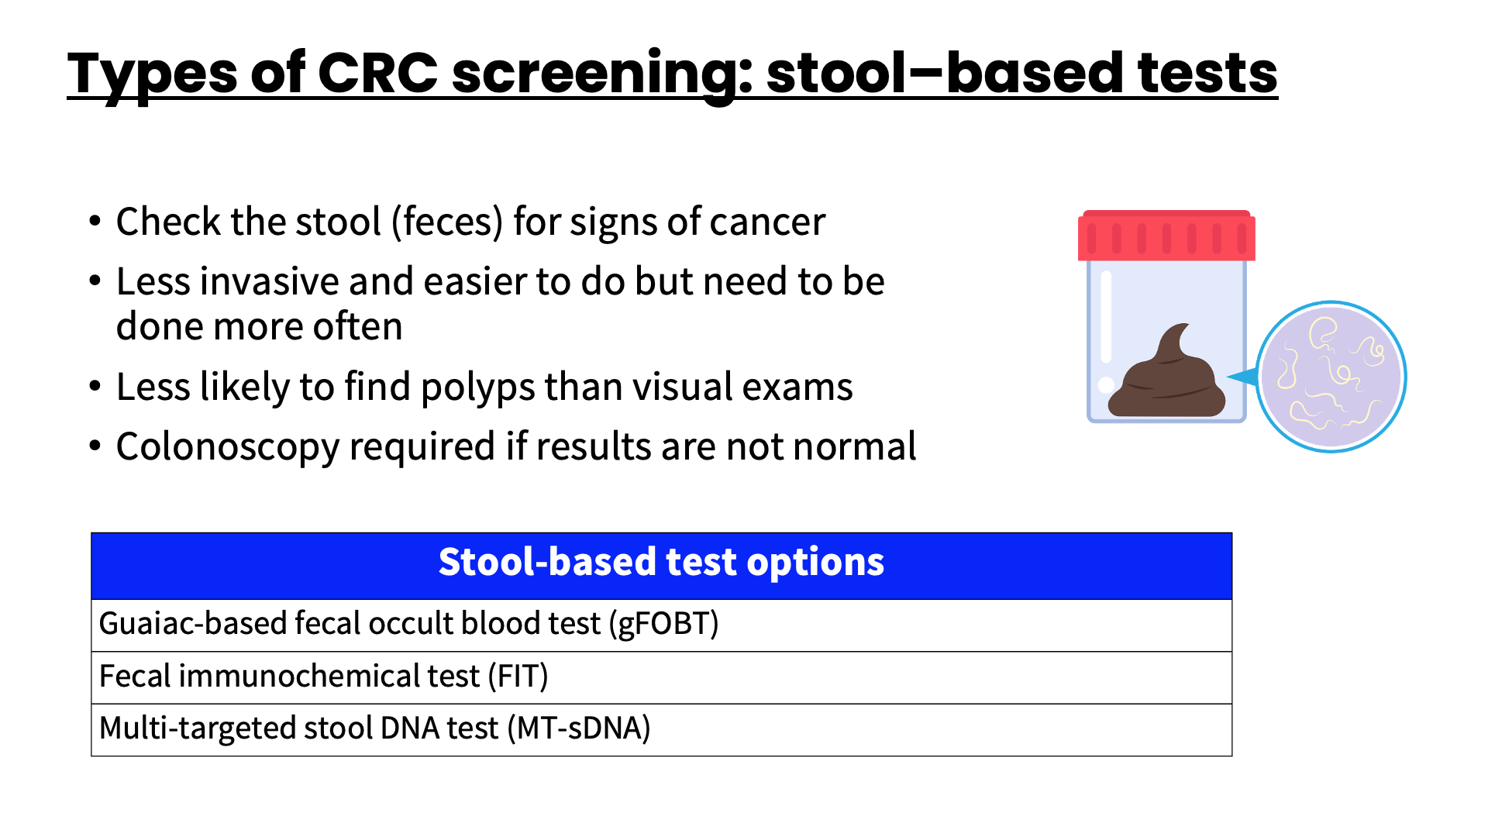
Notes:
Speaker Notes
These test the stool (feces) for signs that cancer may be present, such as blood and/or abnormal DNA (or deoxyribonucleic acid) which tells the cell what to do and when to grow and divide.
Since these tests are less invasive and easier to do, they can often be done at home. However, they are less likely to find polyps and cancer than visual tests so need to be done more often.
If the result from one of these stool tests is positive (abnormal), you will still need a colonoscopy to see if you have cancer. We will talk about colonoscopy in a little bit.

Slide 27
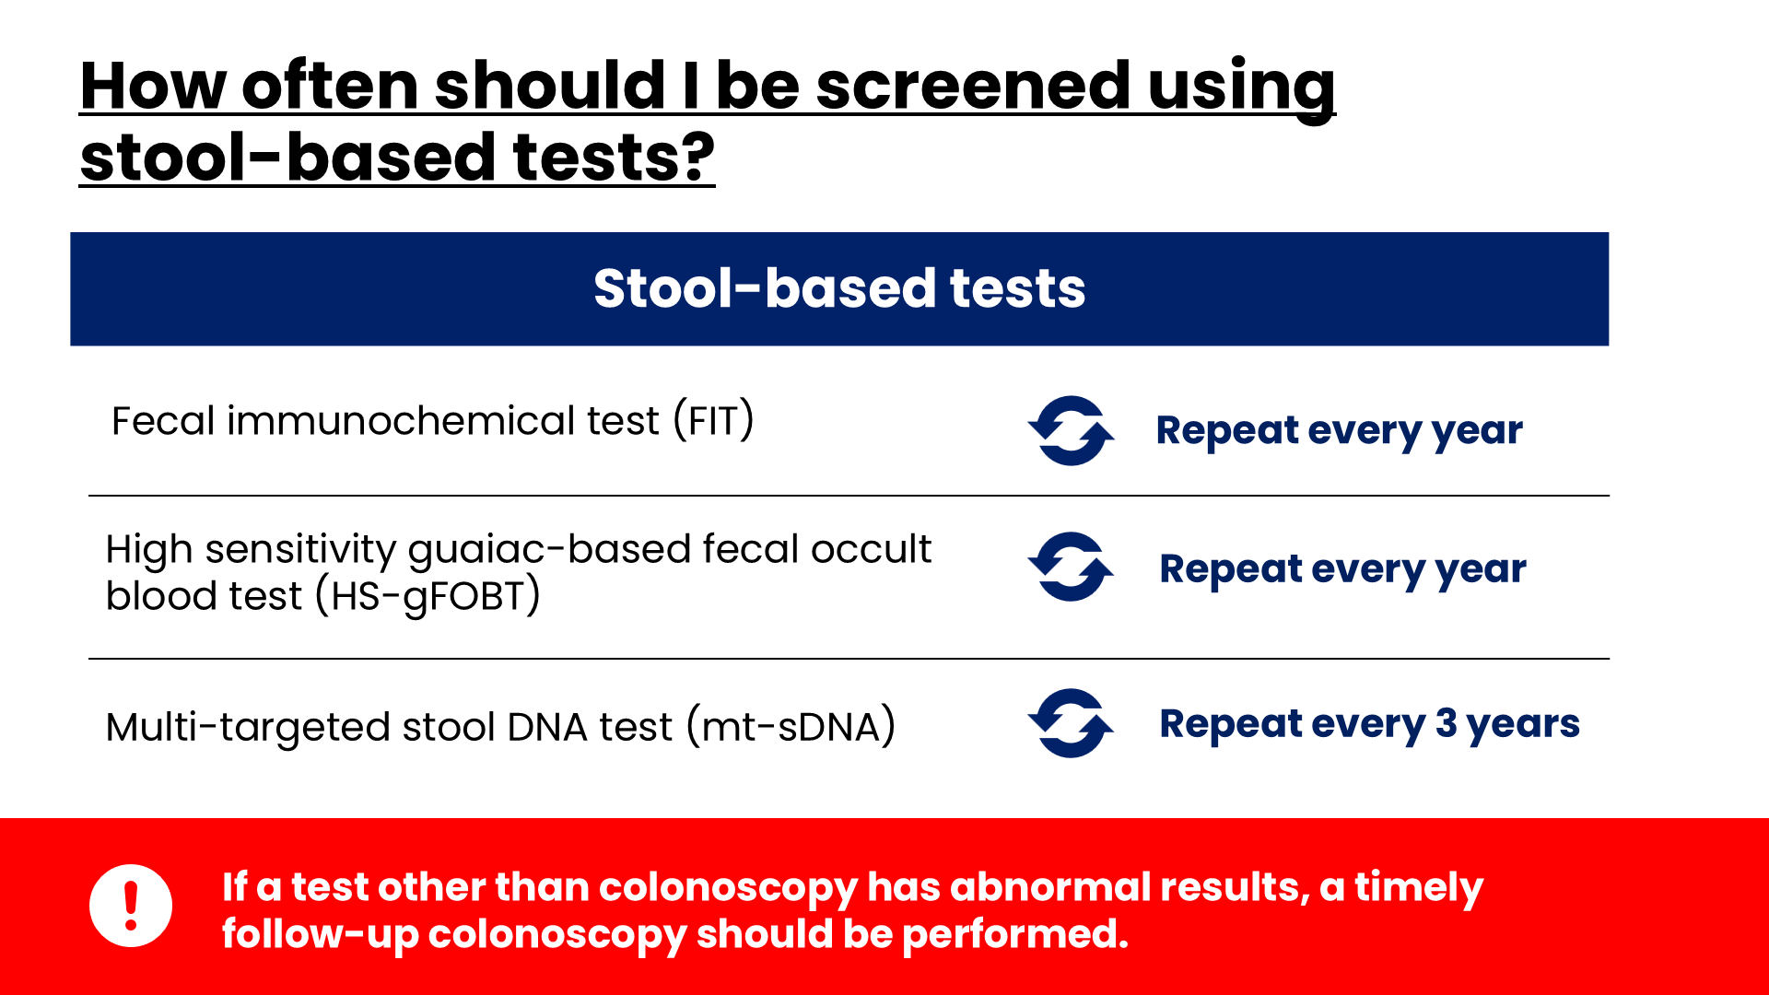
Notes:
Speaker Notes
Pronunciation if needed
Fecal = fee-kuhl
Immunochemical = im-you-no-KIM-uh-kuhl
Guaiac = gwai-ak
How often you need to get screened for colorectal cancer depends on the type of test you choose to have. You should talk to your doctor about what’s a good choice for you.
If any test has an abnormal results, a follow-up colonoscopy should be performed.

Slide 28
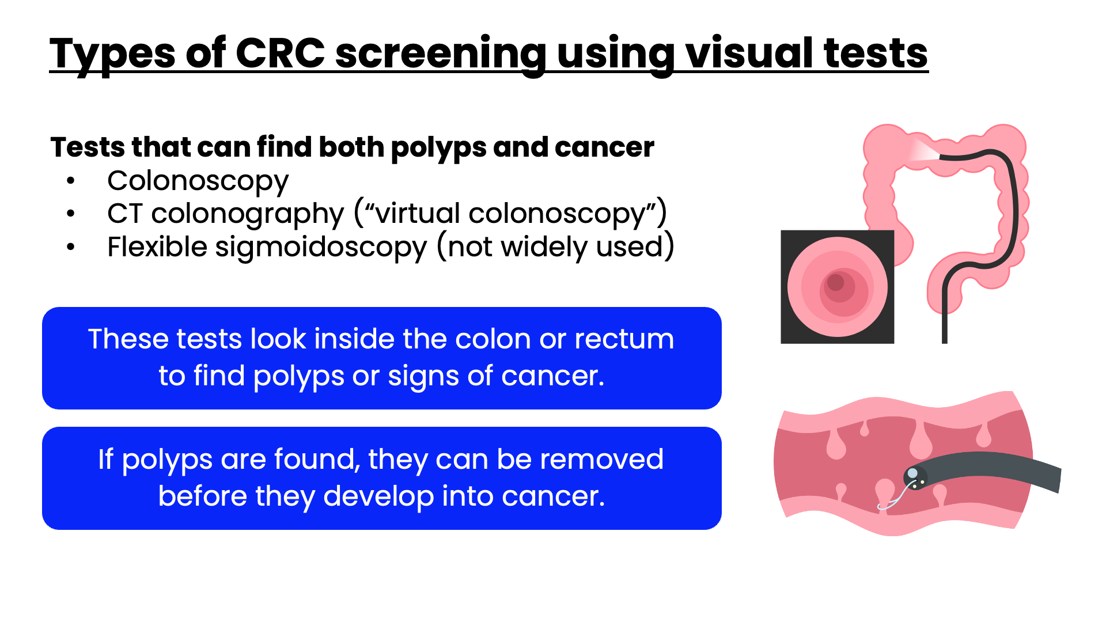
Notes:
Speaker Notes
Pronunciation if needed
Colonoscopy = ko-lun-AH-skuh-pee
Colonography = ko-lun-AH-gruh-fee
Sigmoidoscopy = sig-moid-AH-skuh-pee
These tests look at the inside of the colon and rectum for any abnormal areas that might be cancer or polyps. These tests can be done less often than stool-based tests, but they require more preparation ahead of time, and can have some risks not seen with stool-based tests.
A polyp can take as many as 10 to 15 years to develop into cancer. With screening, doctors can find and remove polyps before they have the chance to turn into cancer.

Slide 29
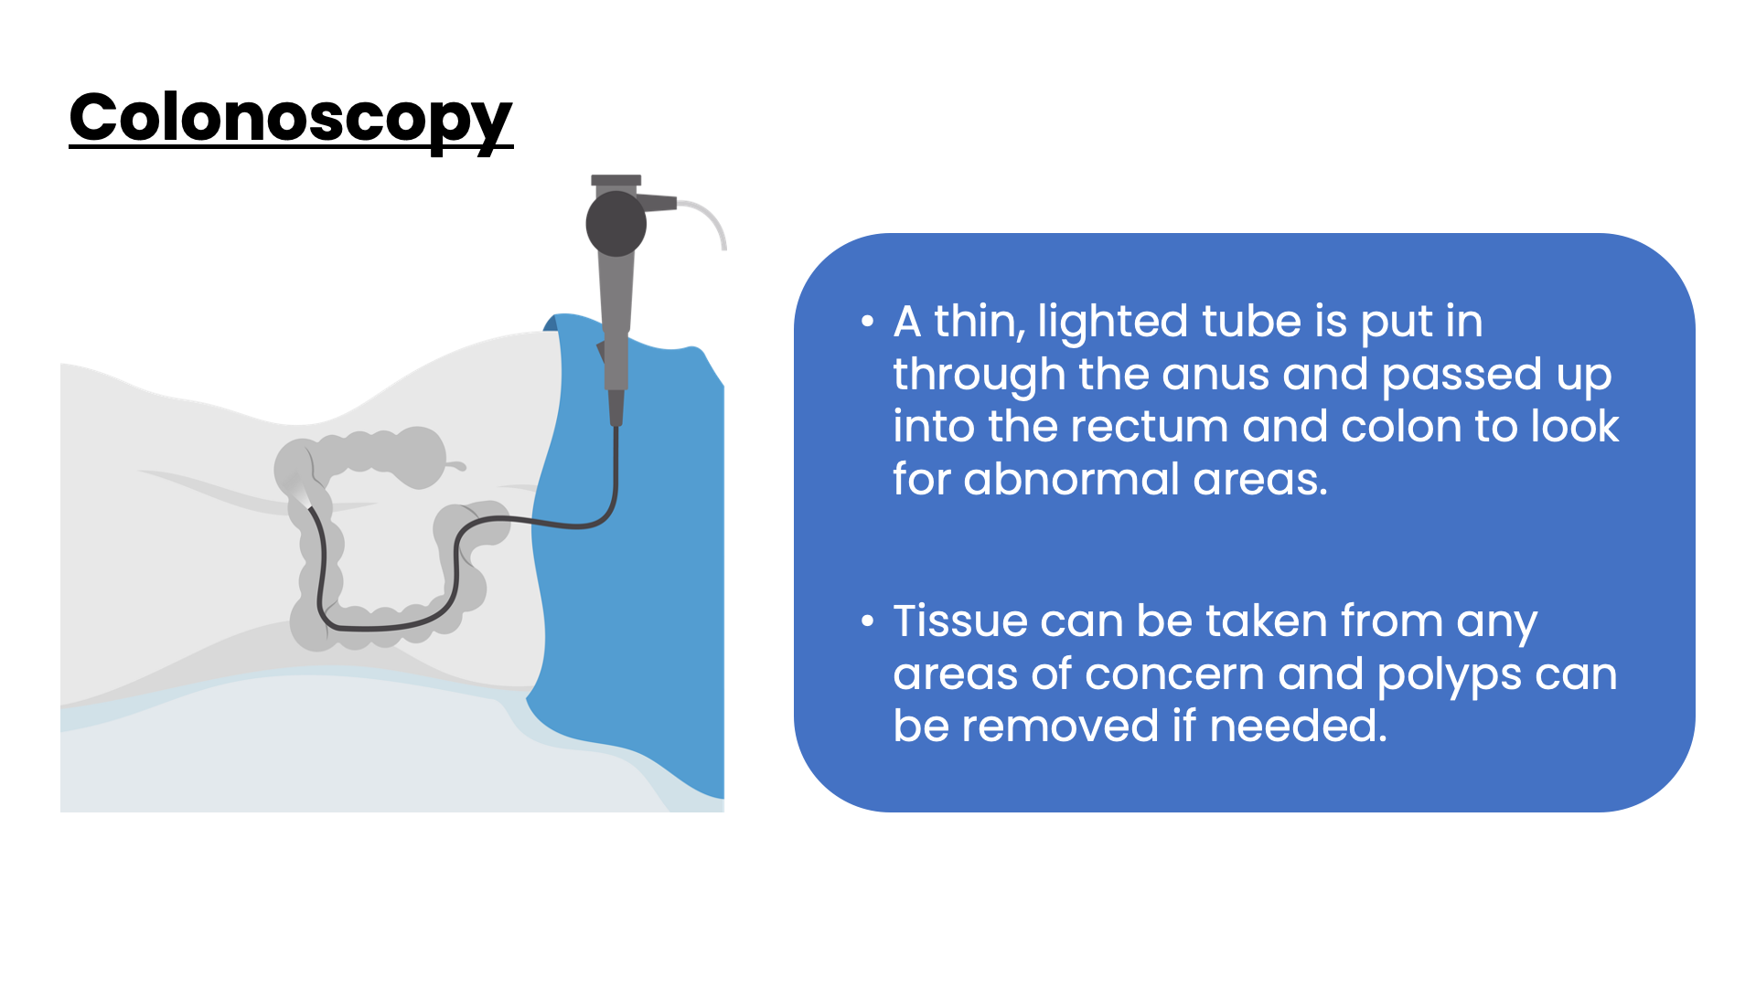
Notes:
Speaker Notes
Bullet #1:
For a colonoscopy, the doctor looks at the entire length of the colon and rectum with a colonoscope (ko-LAHN-uh-scope). It’s put in through the rectum into the colon.
Bullet #2:
If polyps are found during a colonoscopy, special instruments can be passed through the colonoscope to remove them, if needed. The polyp can then be sent to a lab to be checked under a microscope to see if it has any cells that have changed into cancer. If a tumor or other suspicious area is seen, the doctor can take a sample (biopsy) through the colonoscope.

Slide 30
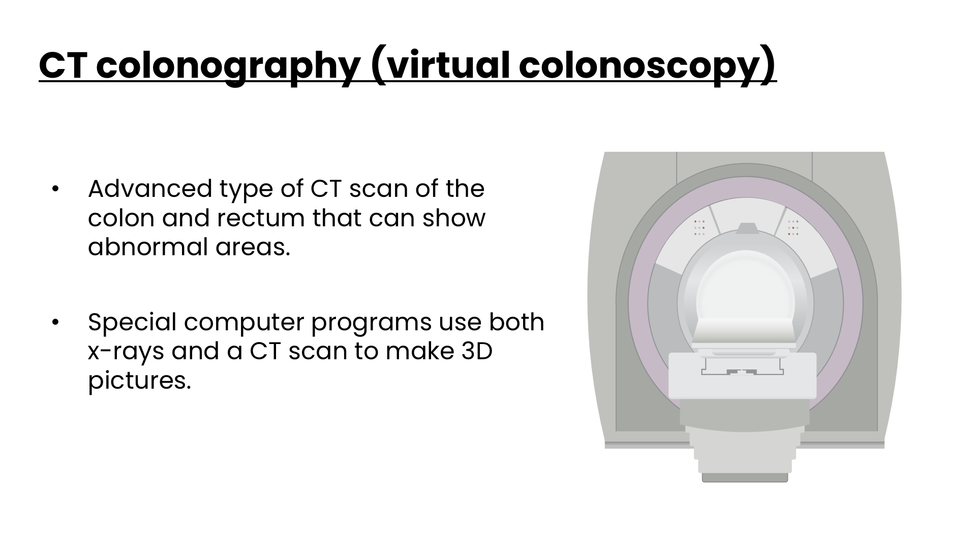
Notes:
Speaker Notes
Unlike the colonoscopy, the CT colonography does not require any type of instrument or scope to be put into the rectum or colon.
If polyps or other suspicious areas are seen on this test, a colonoscopy will still be needed to remove them or to see the area in more detail.

Slide 31
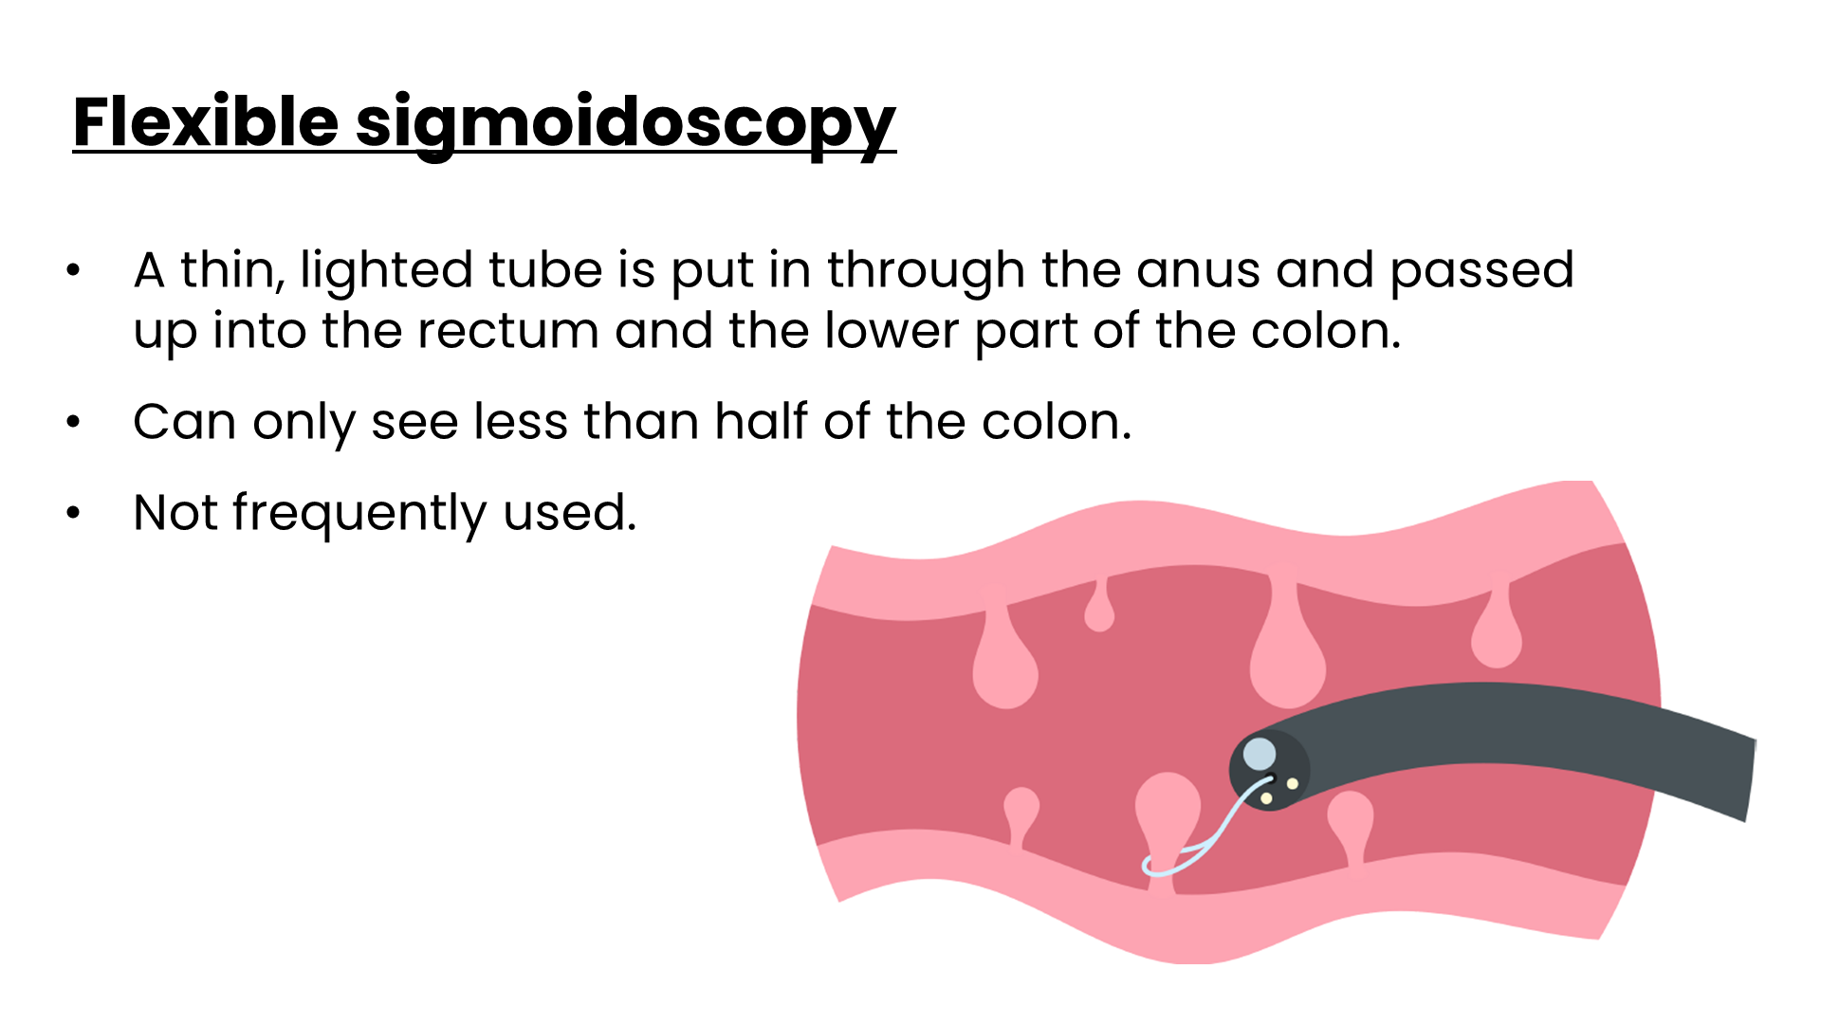
Notes:
Speaker Notes
Pronunciation if needed
Sigmoidoscope = sig-MOYD-uh-scope
Similar to a colonoscopy except it doesn’t examine the entire colon. A sigmoidoscope (a flexible, lighted tube about the thickness of a finger with a small video camera on the end) is put in through the anus, into the rectum and then moved into the lower part of the colon. But the sigmoidoscope is only about 2 feet (60cm) long, so the doctor can only see less than half of the colon and the entire rectum.
If polyps or other suspicious areas are seen on this test, a colonoscopy will still be needed to remove them or to see the area in more detail.
This test is not widely used as a screening tool for colorectal cancer in the United States as polyps and cancers in the rest of the bowel will not be detected.

Slide 32
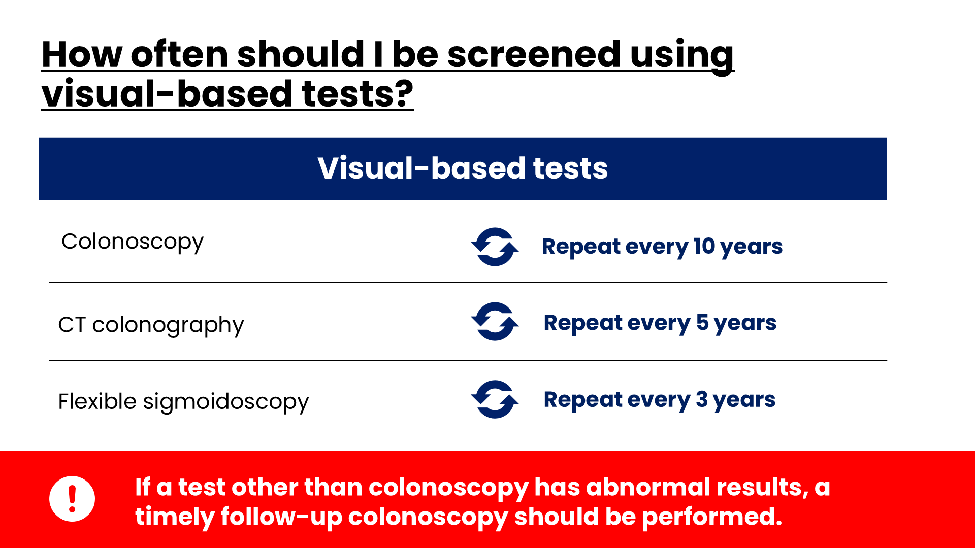
Notes:
Speaker Notes
How often you need to get screened for colorectal cancer depends on the type of test you choose to have. You should talk to your doctor about what’s a good choice for you.
(Review time frames listed on slide)
Similar to the stool-based tests, a colonoscopy should be scheduled if other options have an abnormal result.

Slide 33
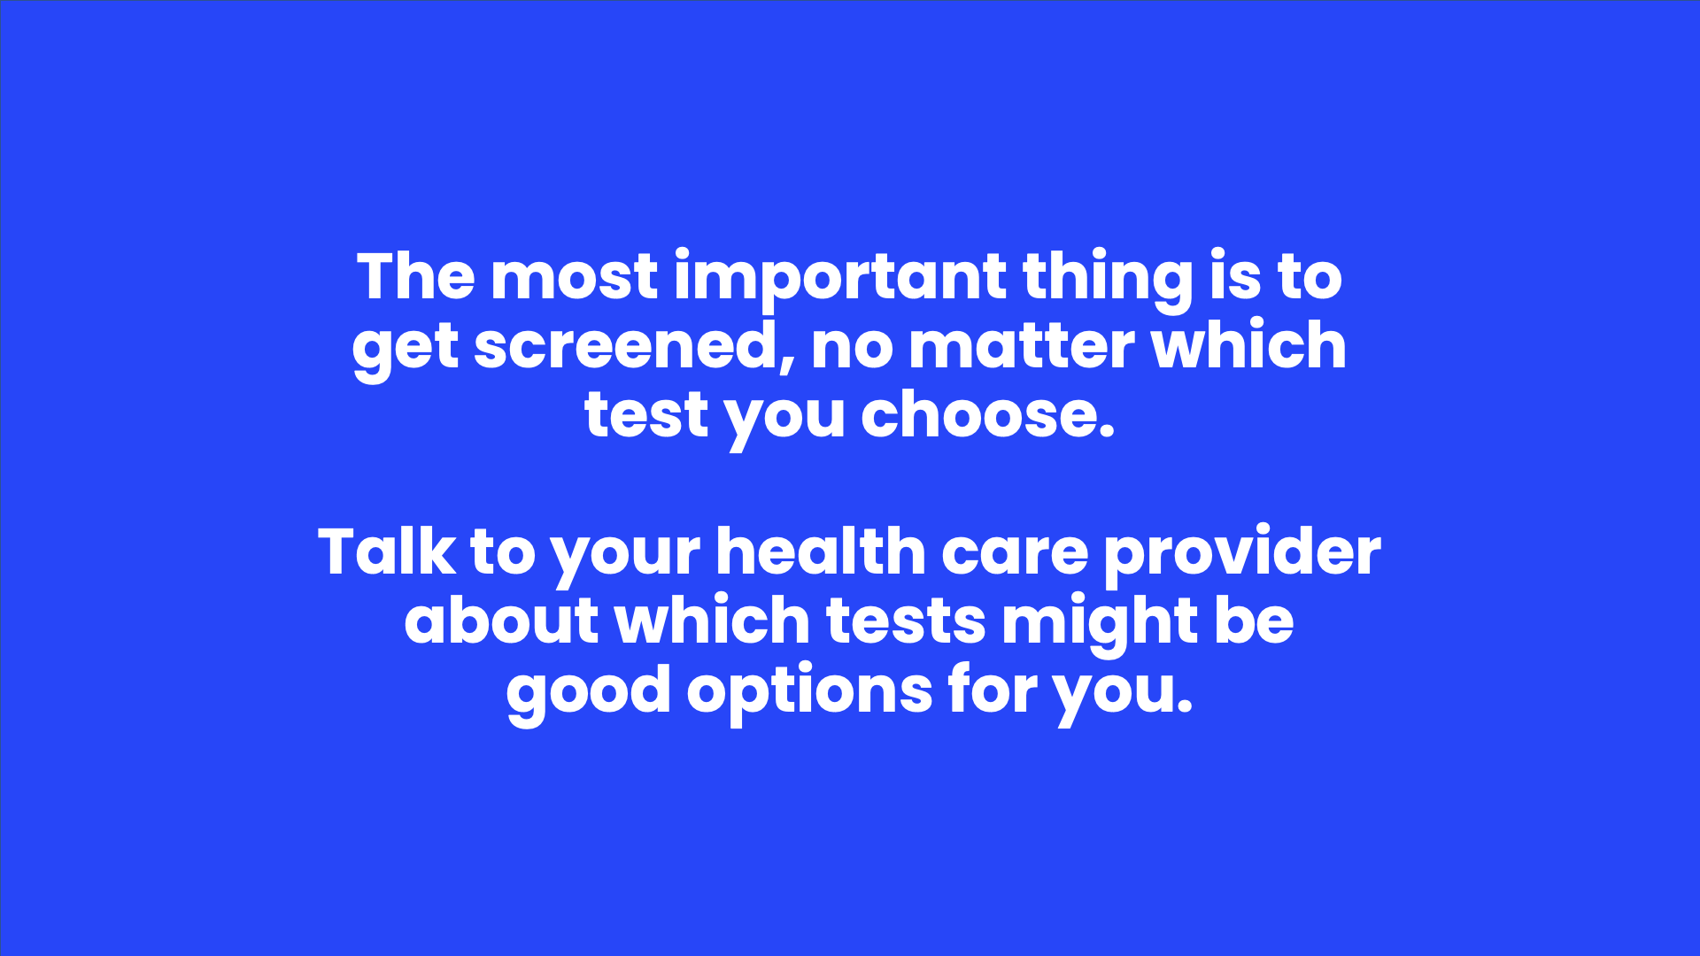
Notes:
Speaker Notes
The most important thing is to get screened, no matter which test you choose.
Talk to your health care provider about which tests might be good options for you.

Slide 34
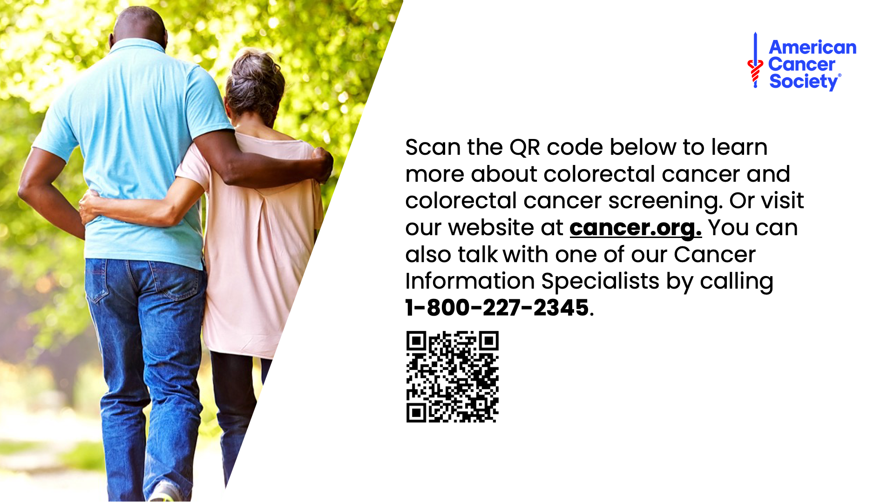
Notes:
Speaker Notes
This concludes our presentation about colorectal cancer and colorectal cancer screening. For more information, scan our QR code or visit our website (cancer.org) or call the number on the screen and speak with one of our Cancer Information Specialists.

Slide 35

Notes:
Speaker Notes
Thank you for your time and attention.

