Slide 1
Cancer Statistics 2011
A Presentation from the
American Cancer Society
©2010, American Cancer Society, Inc.

Slide 2
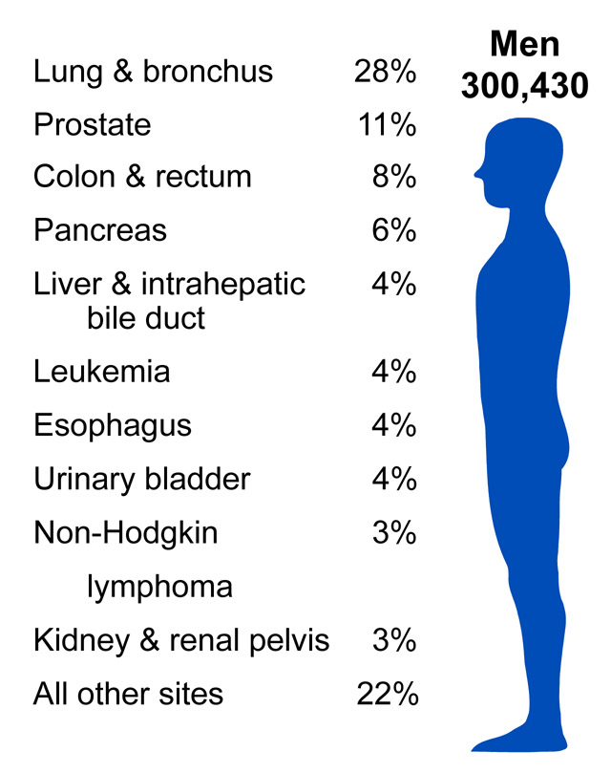
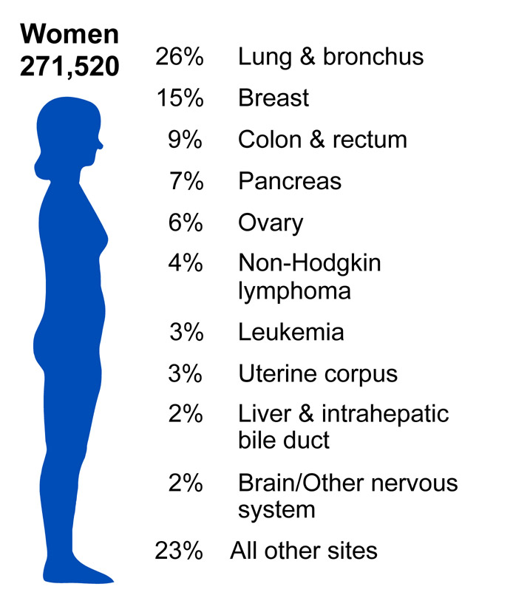
Notes:
Lung cancer is by far the most common fatal cancer in men (28%), followed by prostate (11%), and colon & rectum (9%). In women, lung (26%), breast (15%), and colon & rectum (9%) are the leading sites of cancer death.

Slide 3
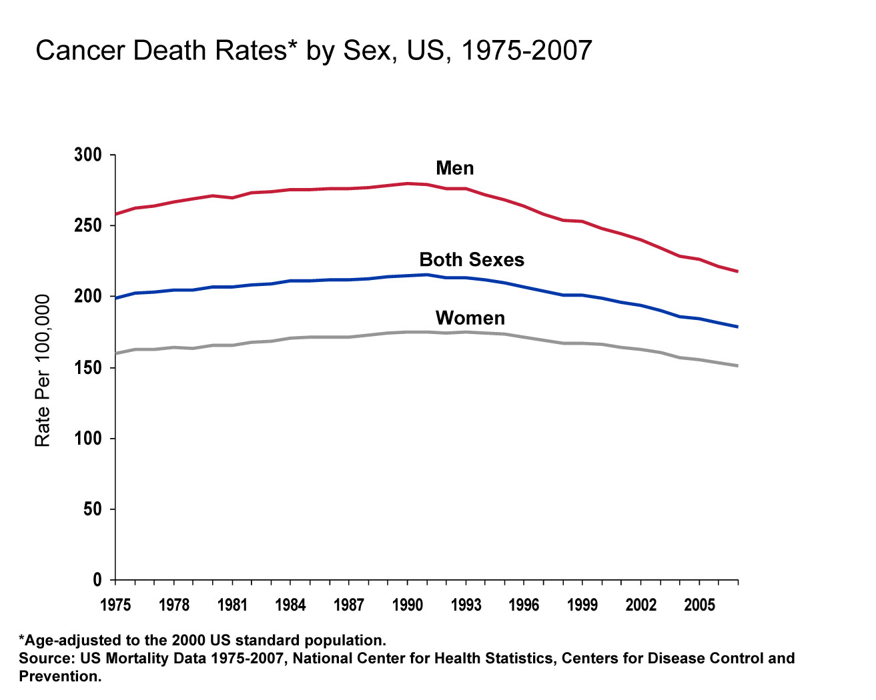
Notes:
The death rate for all cancers combined decreased by 1.9% per year from 2001 to 2007 in men and 1.5% per year from 2002 to 2007 in women. Compared to the peak rates -- in 1990 for men and 1991 for women -- the cancer death rate for all sites combined in 2007 was 22.2% lower in men and 13.9% lower in women.

Slide 4
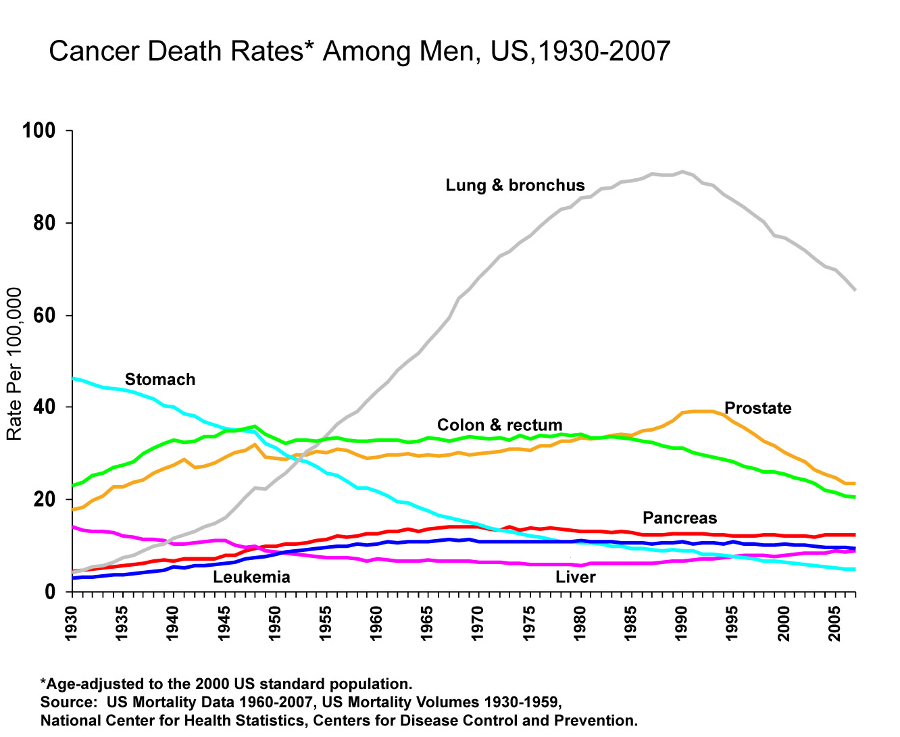
Notes:
Most of the increase in cancer death rates for men prior to 1990 was attributable to lung cancer. However, since 1990, the age-adjusted lung cancer death rate in men has been decreasing; this decrease has been estimated to account for nearly 40% of the overall decrease in cancer death rates in men. The death rate for stomach cancer, which was the leading cause of cancer death early in the 20th century, has decreased considerably since 1930. Death rates for prostate and colorectal cancers have also been declining.

Slide 5
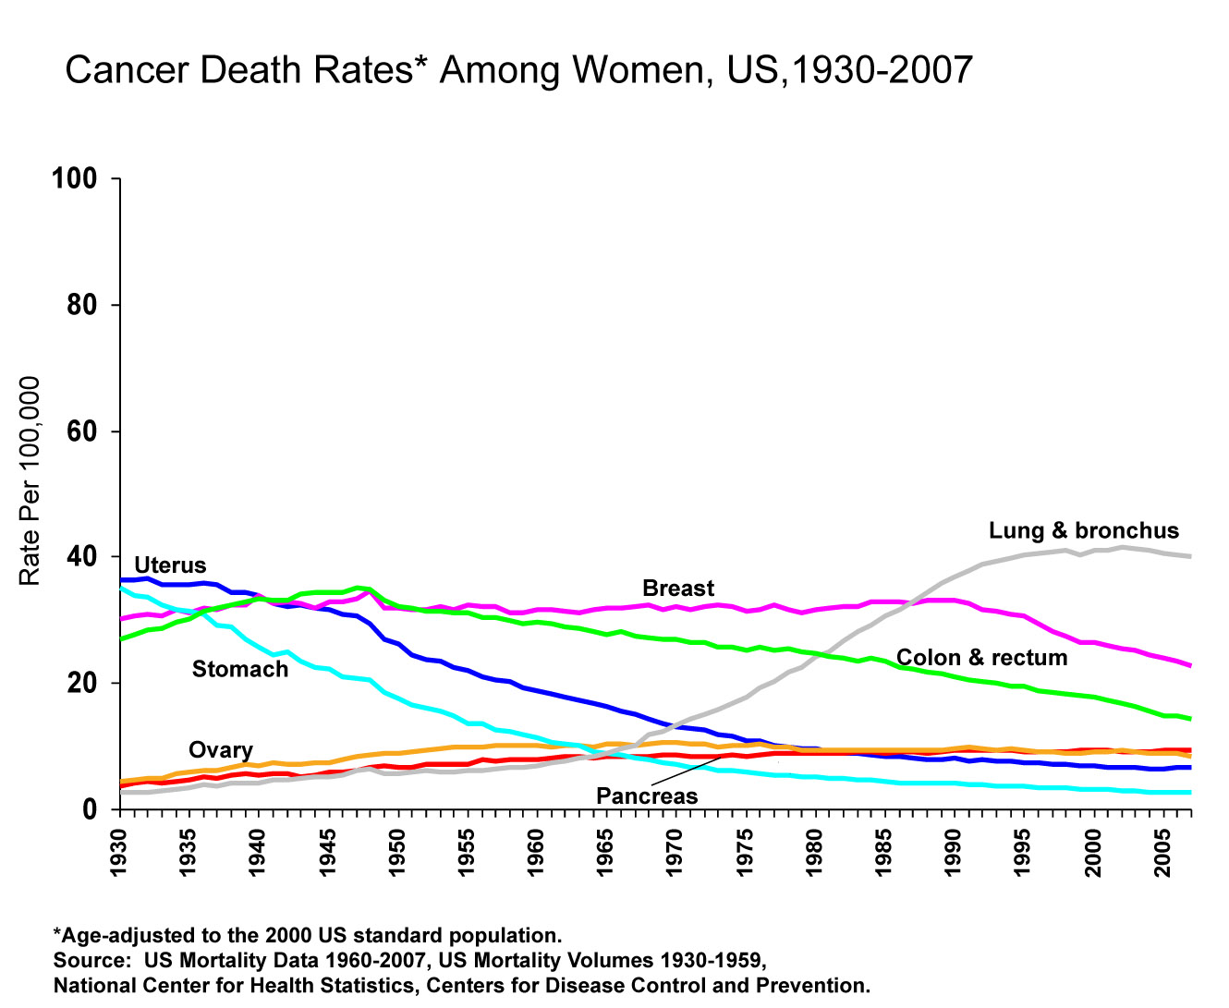
Notes:
The lung cancer death rate in women has finally begun to decline after increasing since at least 1930. The lag in the decline in lung cancer in women compared to men reflects differences in smoking patterns; smoking rates peaked in women a couple of decades later than in men. In comparison, breast cancer death rates changed little between 1930 and 1990, but decreased 31% between 1989 and 2007. Since 1930, the death rate for stomach cancer has decreased steadily and the death rate for uterine cancer declined until 1997 and has since been fairly stable. Colorectal cancer death rates have been decreasing for more than 50 years.

Slide 6
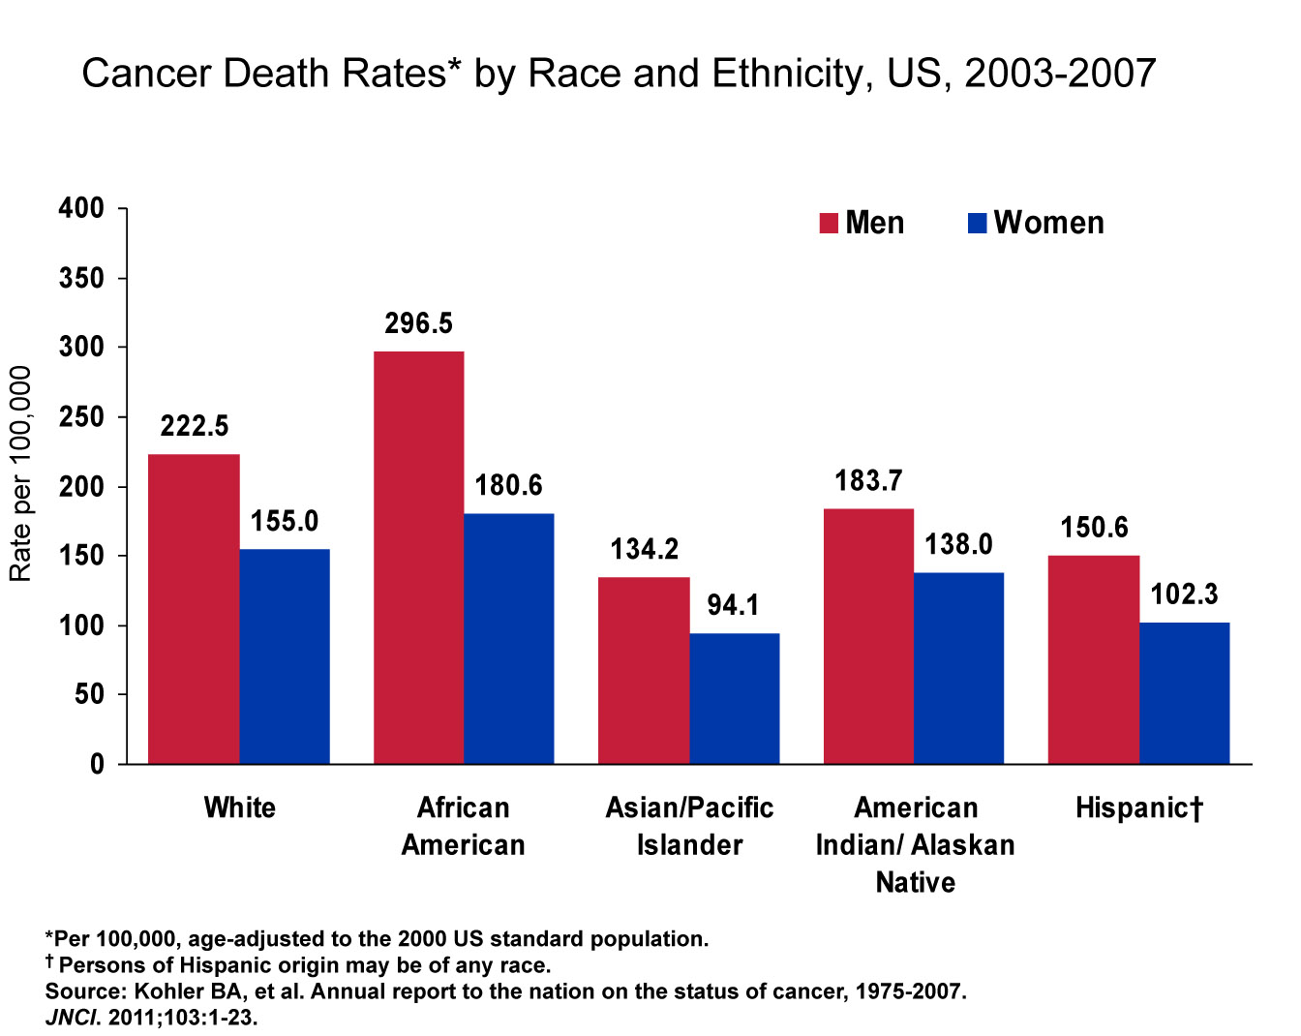
Notes:
Cancer death rates are higher in men than women in every racial and ethnic group. African American men and women have higher rates of cancer mortality than their counterparts in every other racial and ethnic group. Asian American and Pacific Islander men and women have the lowest cancer death rates, about half the rate of African American men and women, respectively.
Note: Rates for populations other than white and African American may be affected by problems in ascertaining race/ethnicity information from medical records. This is likely to result in reported death rates that are lower than true death rates.

Slide 7
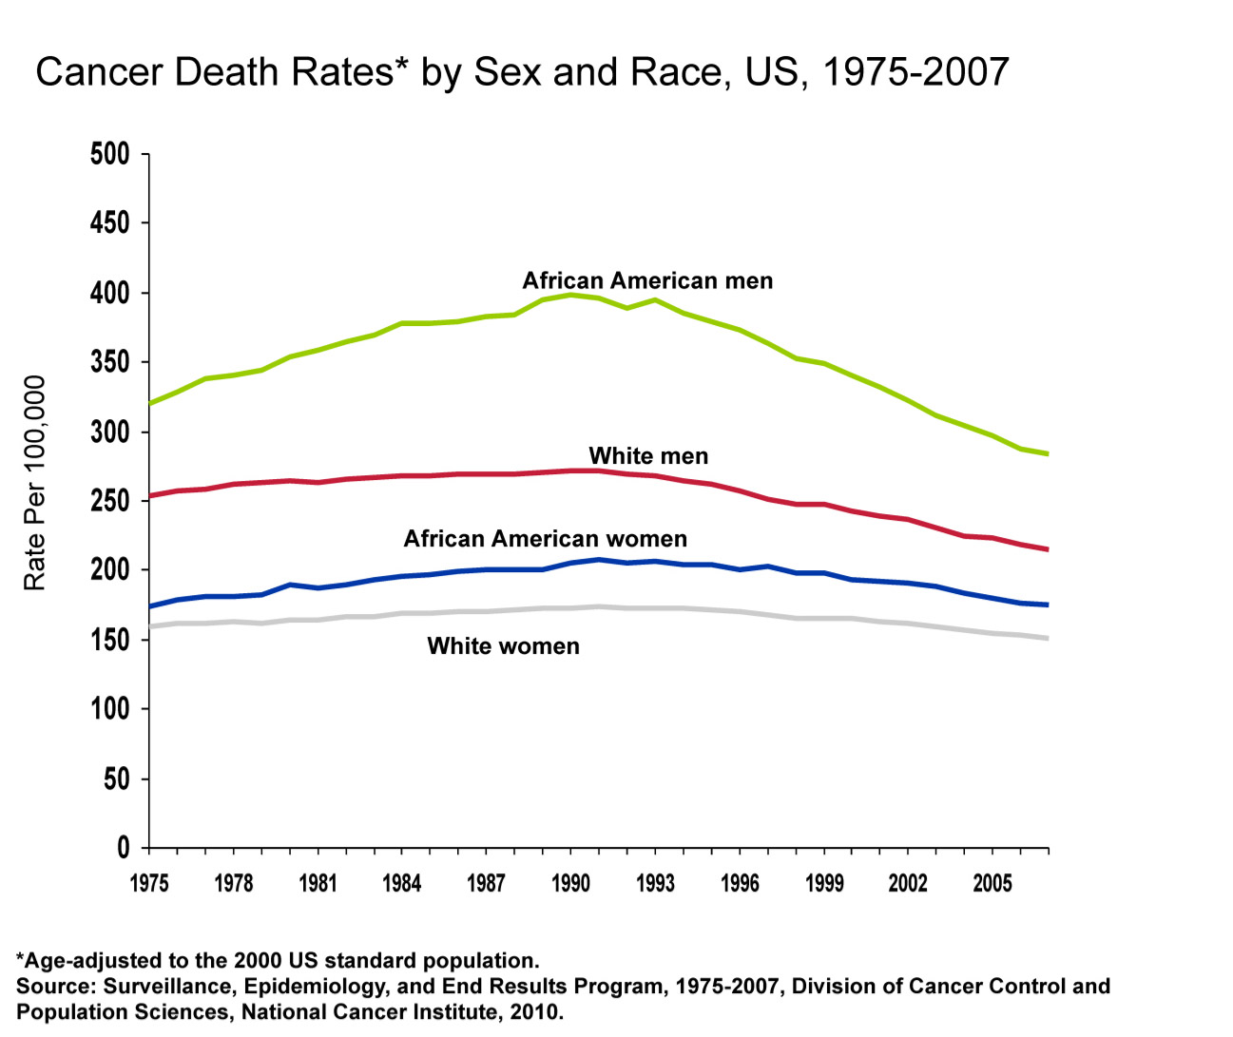
Notes:
Although the overall cancer death rate continues to be higher in African American men than white men, since 1998 the decline in death rates has been larger in African American men (2.5% per year versus 1.6% per year).

Slide 8
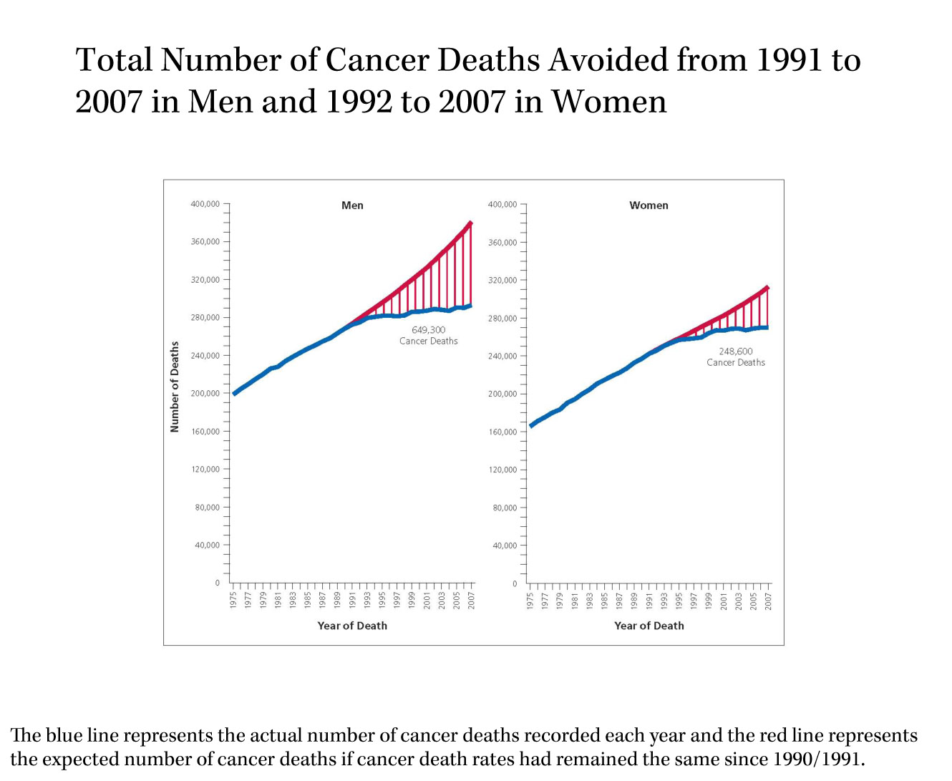
Notes:
About 898,000 cancer deaths were averted from 1991 through 2007 as a result of the continued decline in cancer deaths rates.

Slide 9
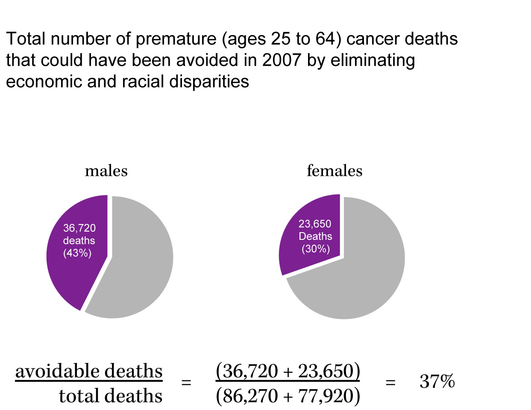
Notes:
Level of education is often used as a marker for socioeconomic status. If the death rates of the most educated non-Hispanic whites are applied to all individuals ages 25 to 64 – i.e., if everyone had the cancer burden of the most educated -- the number of cancer deaths in this age group could be reduced by 37%.

Slide 10
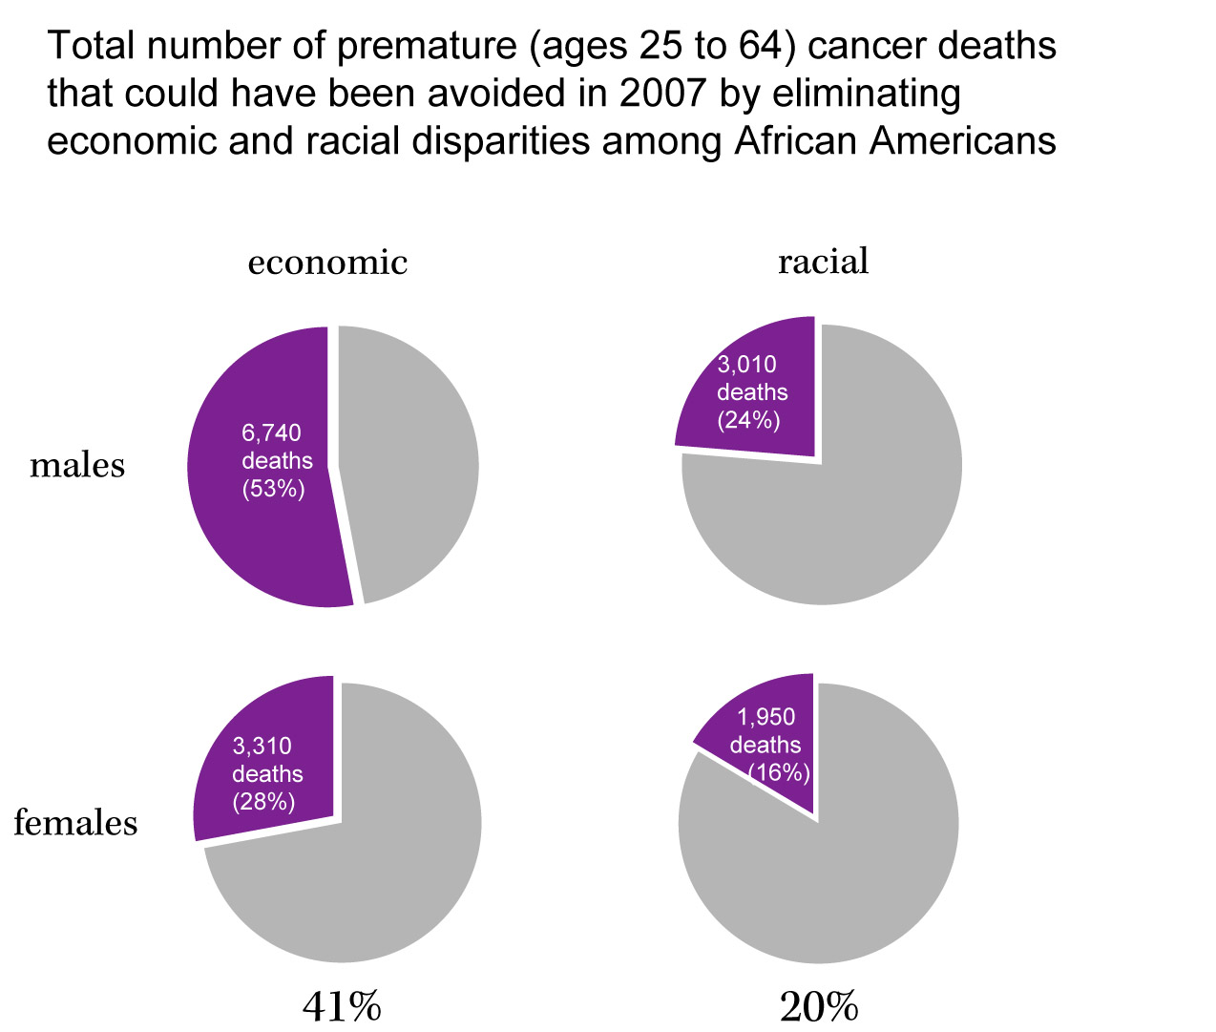
Notes:
Among African Americans aged 25-64, there were 12,710 cancer deaths in men and 11,850 cancer deaths in women in 2007. Eliminating economic disparities among African Americans could potential avoid 10,050 cancer deaths, twice as many as eliminating racial disparities.

Slide 11

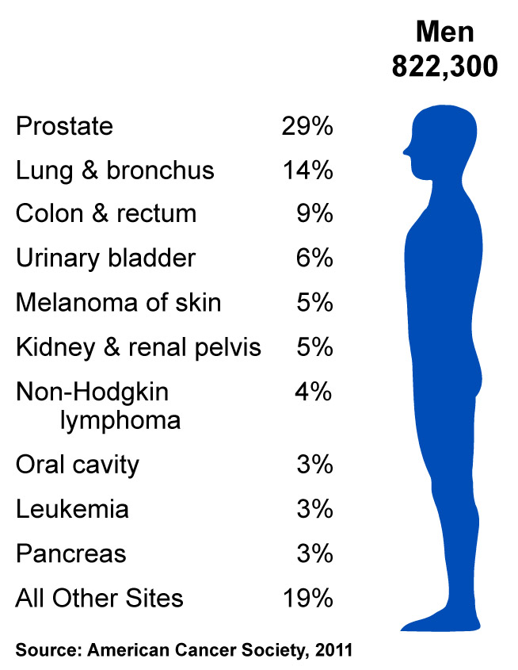
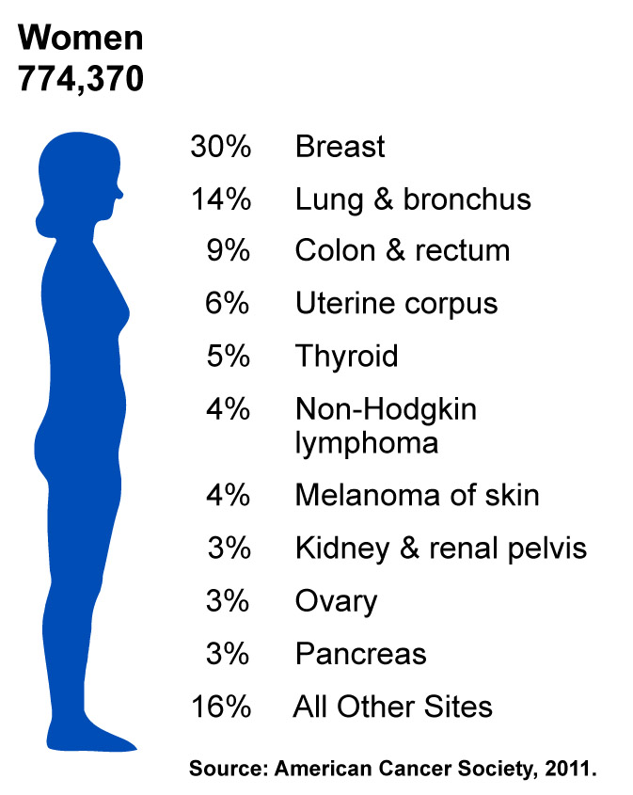
Notes:
Now we will turn our attention to the number of new cancers anticipated in the US this year. It is estimated that almost 1.6 million new cases of cancer will be diagnosed in 2011. The most common cancers are prostate in men and breast in women; lung and colorectal cancers are the second and third most common cancers in both men and in women.

Slide 12
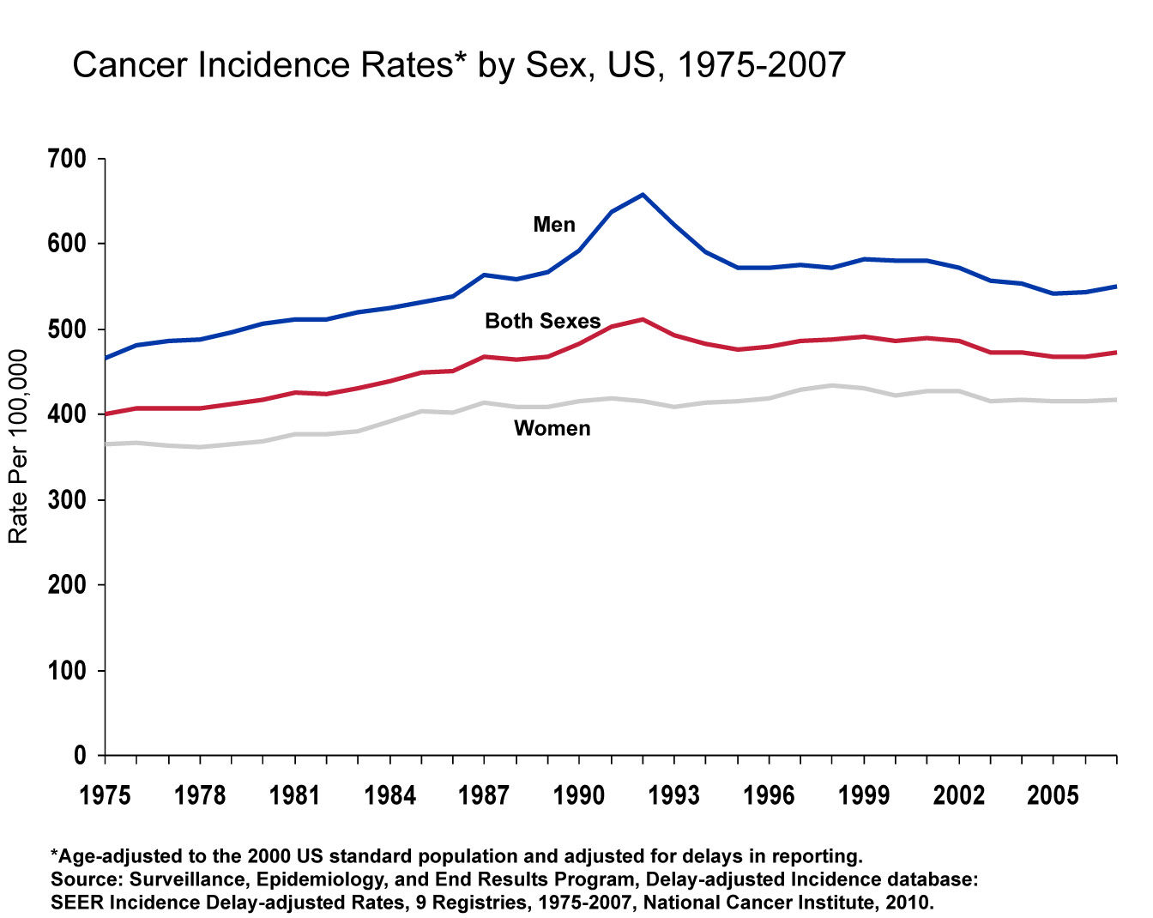
Notes:
This slide shows trends in cancer incidence for all sites combined, for the years 1975-2007. Overall incidence rates decreased by 0.7% per year from 1999 through 2007 in both sexes combined, by 1.1% per year from 2000 through 2007 in men, and by 0.5% per year from 1998 through 2007 in women.

Slide 13
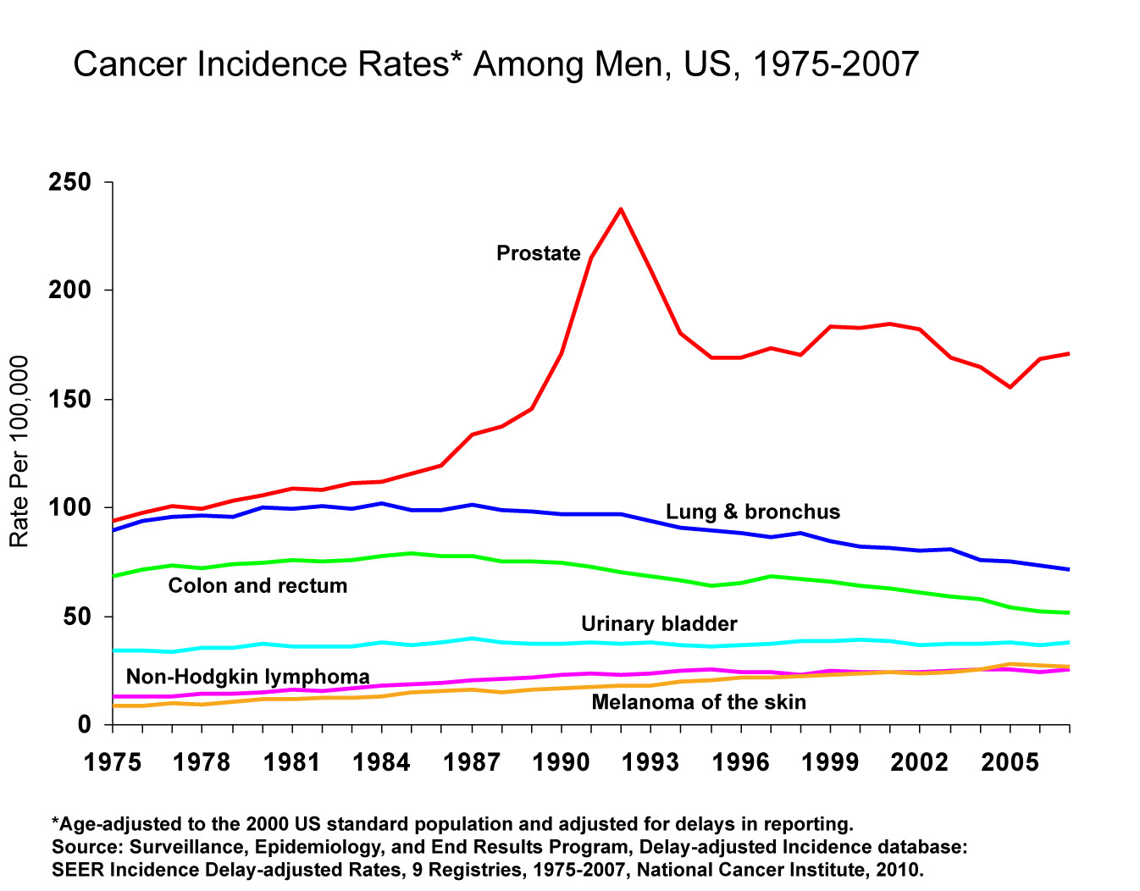
Notes:
Incidence rates of prostate cancer have changed substantially over the last 20 years: rapidly increasing from 1988 to 1992, declining sharply from 1992 to 1995, remaining stable from 1995 to 2000, and decreasing from 2000 to 2007, due, in part, to changes in prostate cancer screening with the prostate-specific antigen (PSA) blood testing. Incidence rates for both lung and colorectal cancers in men have been declining for many decades.

Slide 14
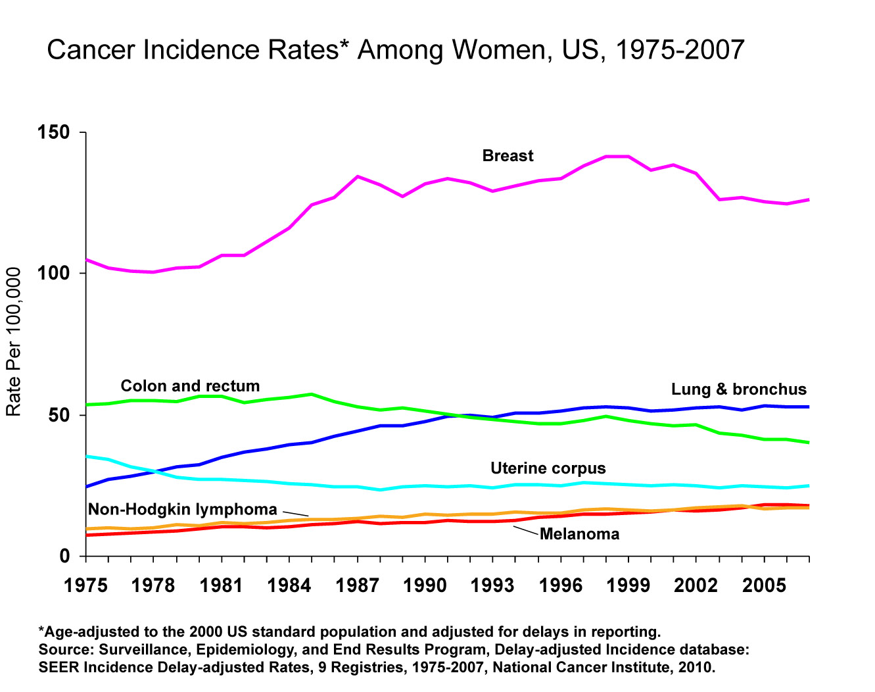
Notes:
Breast cancer incidence rates in women decreased by 1.6% per year from 1998 to 2007, likely due in part to a reduction in use of hormone replacement therapy and a slight decline in mammography utilization from 2003 to 2005. However, close inspection of the data show that after dramatically decreasing from 2002 to 2003, breast cancer incidence rates remained relatively unchanged from 2003 to 2007. Similarly, although incidence of lung cancer has increased slightly by 0.4% per year since 1991, rates in the most recent several years have plateaued; in fact, analysis of a larger data set (that only goes back to 1992) shows a significant decrease of 0.3% per year in lung cancer incidence rates in women from 2003 to 2007. Colorectal cancer incidence rates have been decreasing rapidly by 2.2% per year since 1998.

Slide 15
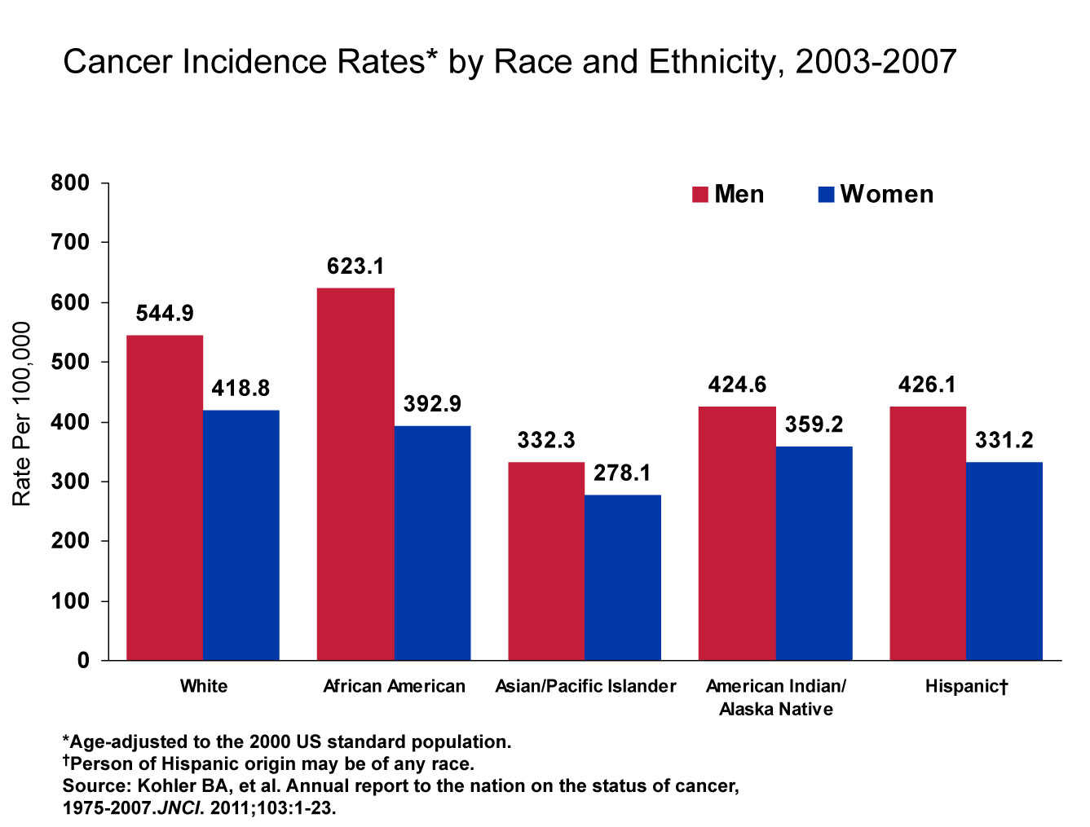
Notes:
Cancer incidence rates are higher in men than women in each racial/ethnic population. Among men, African Americans have the highest incidence followed by whites, Hispanics, American Indians/Alaska Natives, and Asian Americans/Pacific Islanders. Racial differences in cancer incidence among women are less pronounced; white women have the highest incidence rates followed by African American, American Indian/Alaskan Native, Hispanic, and Asian American/Pacific Islander women.
Important Note: Rates for populations other than white and African American may be affected by problems in ascertaining race/ethnicity information from medical records. This is likely to result in reported rates that are lower than true incidence rates. Data for American Indians/Alaska Natives is based on Contract Health Service Delivery Areas.

Slide 16
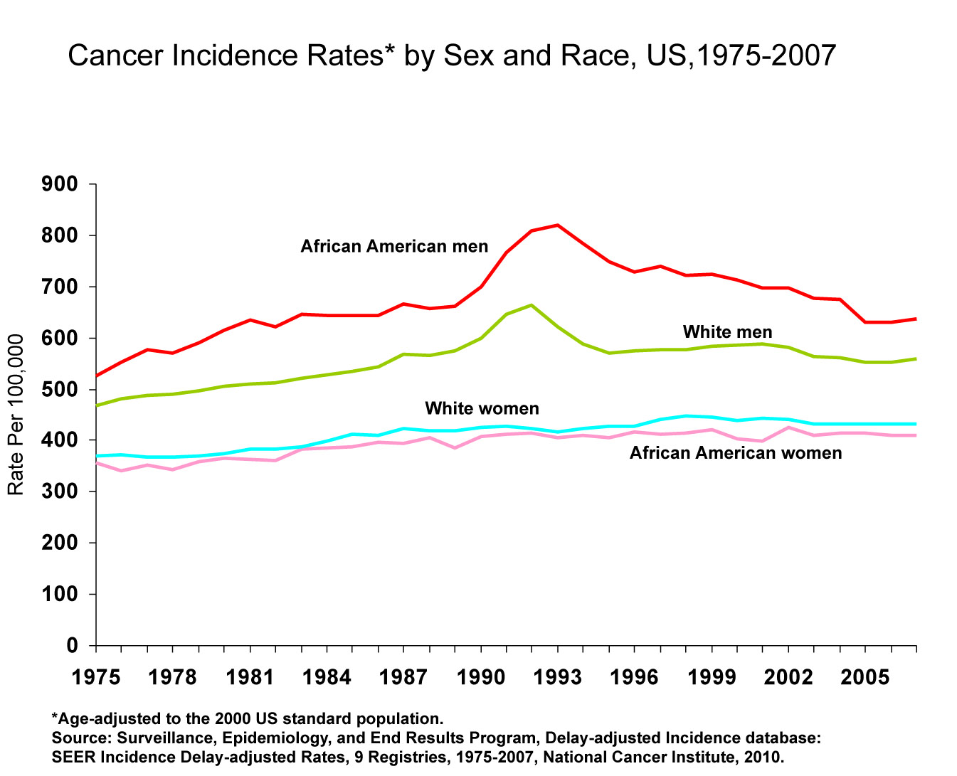
Notes:
Cancer incidence rates are consistently higher in African American men than white men. In contrast, overall cancer incidence rates are generally higher in white women than African American women, largely driven by higher breast cancer incidence rates in whites.

Slide 17
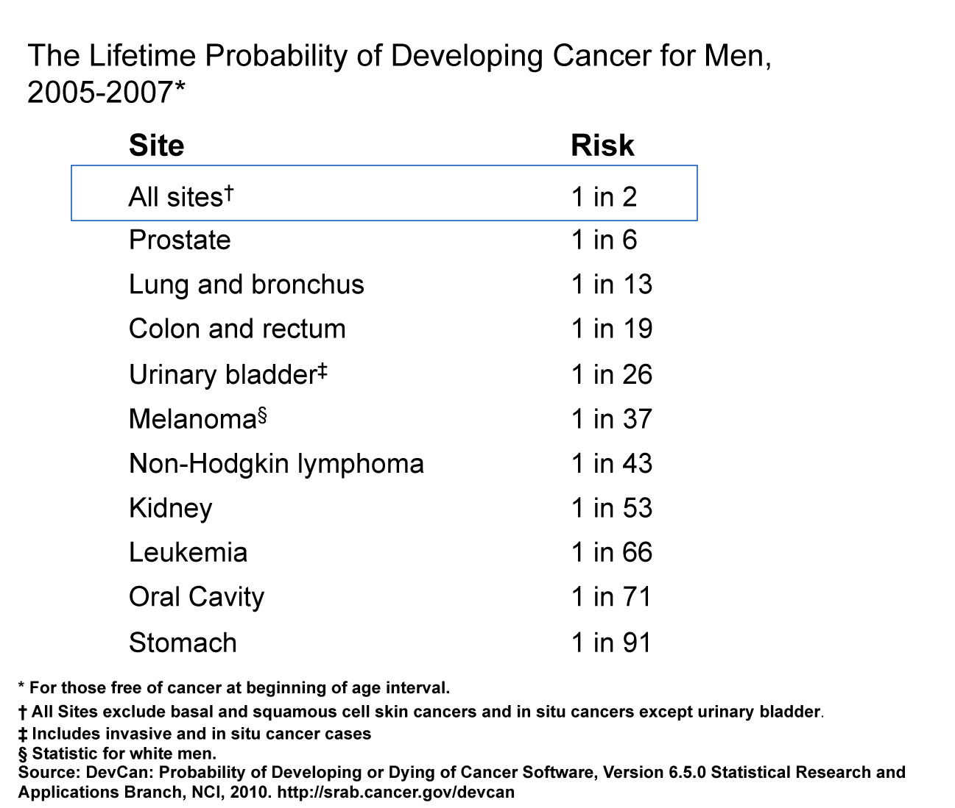
Notes:
The next four slides look at the lifetime probability of developing cancer and relative survival rates of cancer.
Presently, the risk of an American man developing cancer over his lifetime is one in two.

Slide 18
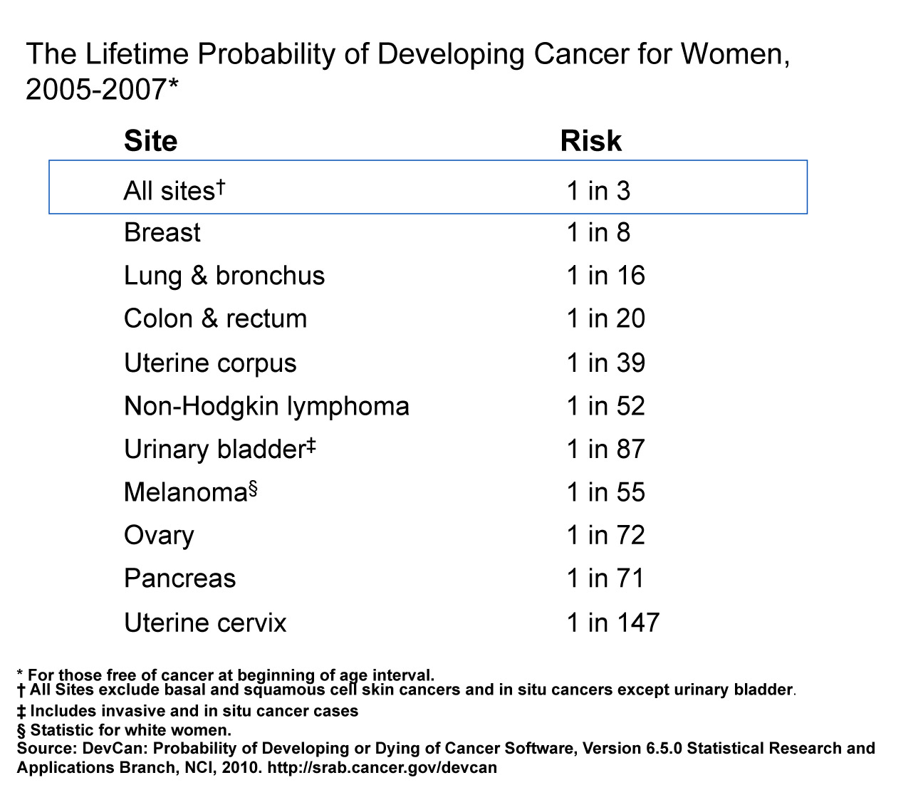
Notes:
The risk of an American woman developing cancer over her lifetime is one in three.

Slide 19
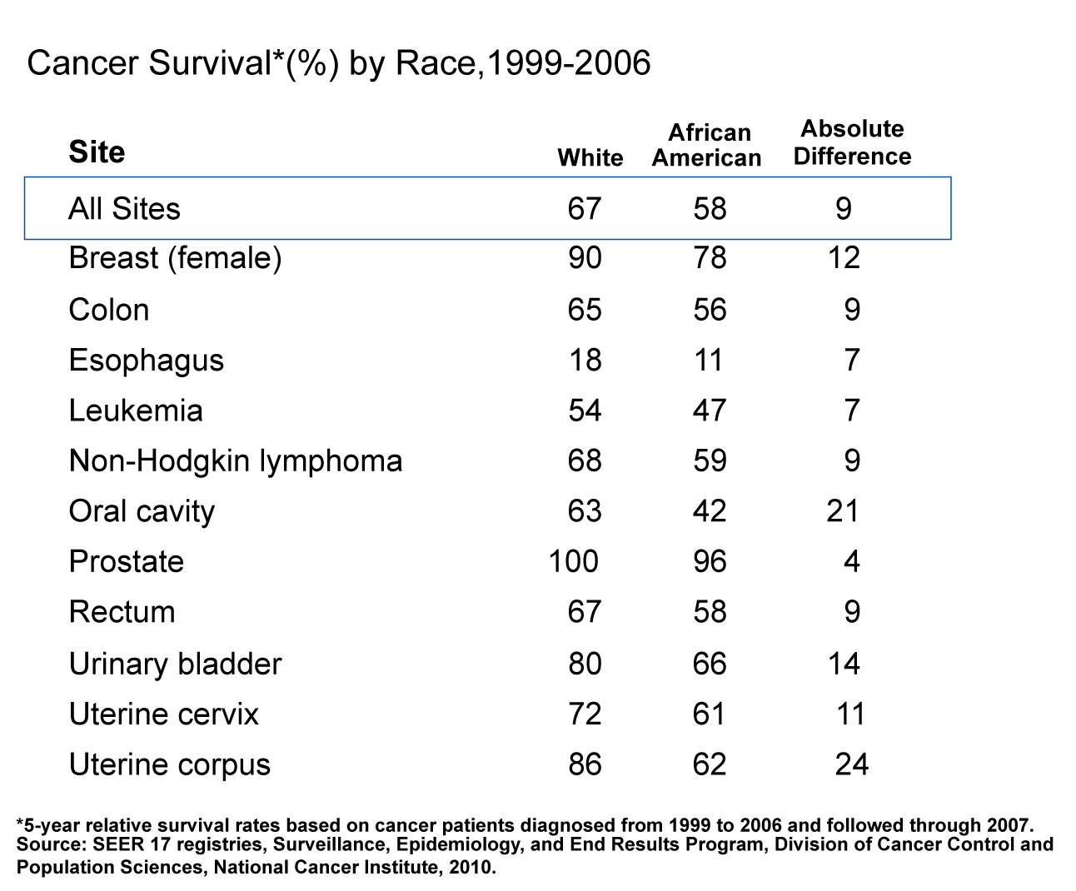
Notes:
The 5-year relative survival rate for cancer is 67% among whites and 58% among African Americans (taking normal life expectancy into consideration). For many sites, survival rates in African Americans are 10% to more than 20% lower than in whites. This is due, in part, to African Americans being less likely to receive a cancer diagnosis at an early, localized stage, when treatment can improve chances of survival. Additional factors that contribute to the survival differential include unequal access to medical care and tumor characteristics not related to early detection.

Slide 20
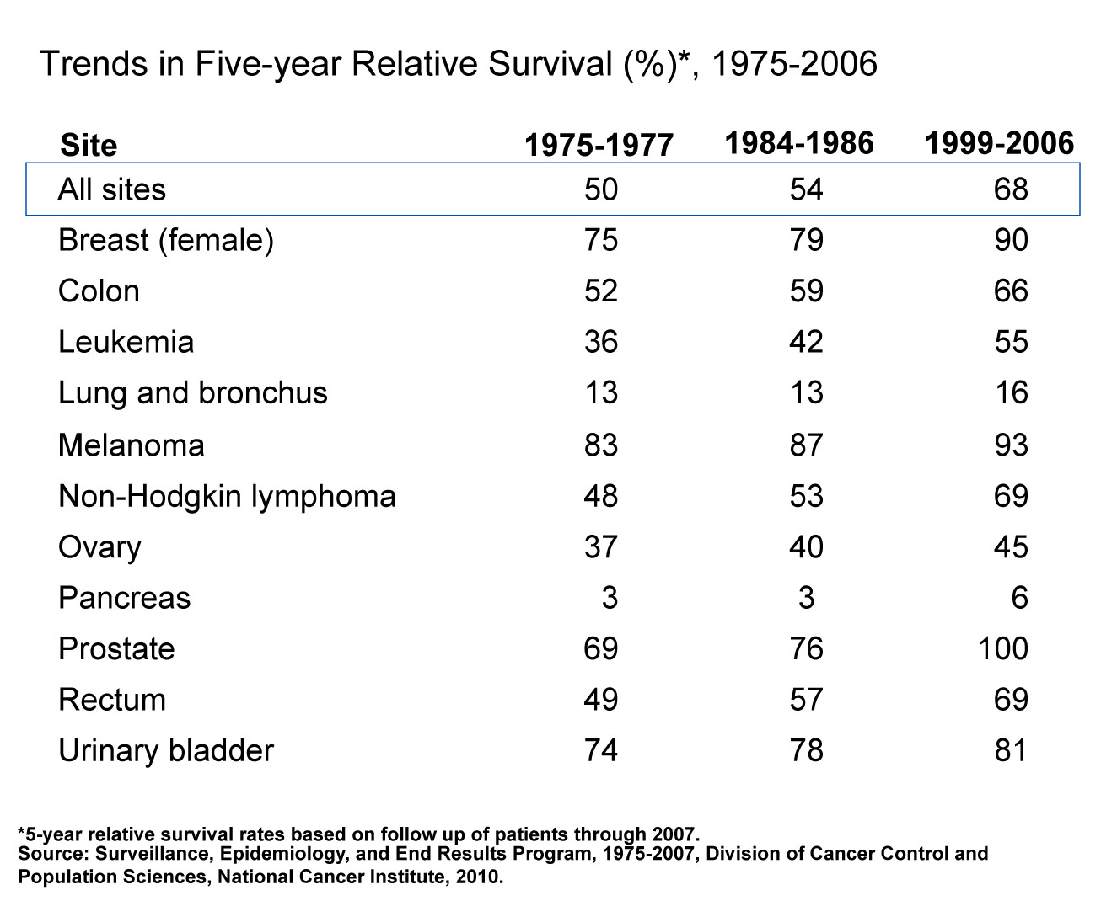
Notes:
The survival rates for all cancers combined and for certain site-specific cancers have improved significantly since the 1970s, due, in part, to both earlier detection and advances in treatment. Survival rates markedly increased for cancers of the prostate, breast, colon, rectum, and for leukemia. With new treatment techniques and increased utilization of screening, there is hope for even greater improvements in the near future.

Slide 21
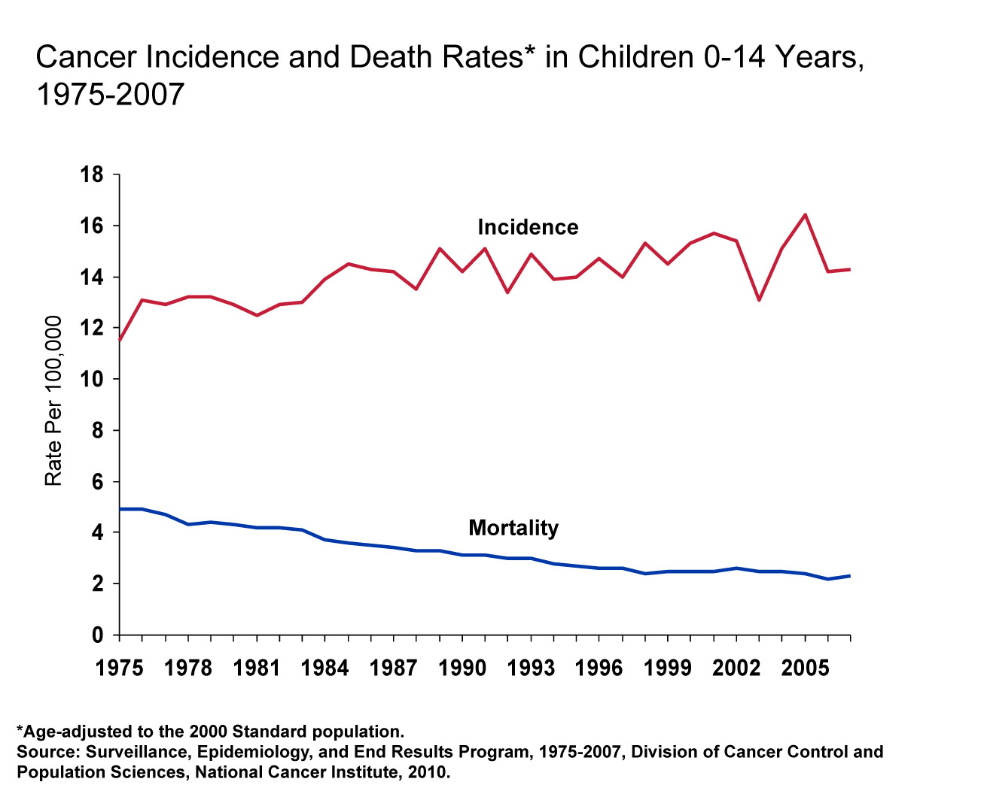
Notes:
The next series of slides look at the burden of cancer among our nation's children. Cancer incidence among children ages 0-14 years has been increasing slightly, by about 0.6% per year, since 1975. Cancer-related mortality in children ages 0-14 decreased 2.9% per year from 1975 to 1997, and since has been decreasing by 1.0% per year.

Slide 22
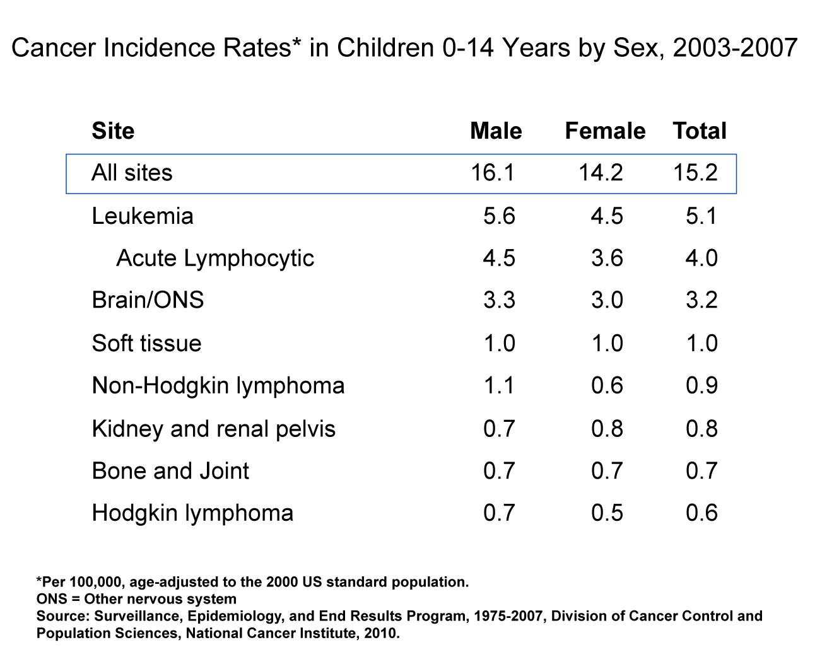
Notes:
Leukemia is the most common cancer among children ages 0-14 years and comprises approximately one-third of all childhood cancers. Acute lymphocytic leukemia is the most common form of leukemia in children. Cancers of the brain and other nervous system are the second most common incident cancer in both boys and girls.

Slide 23
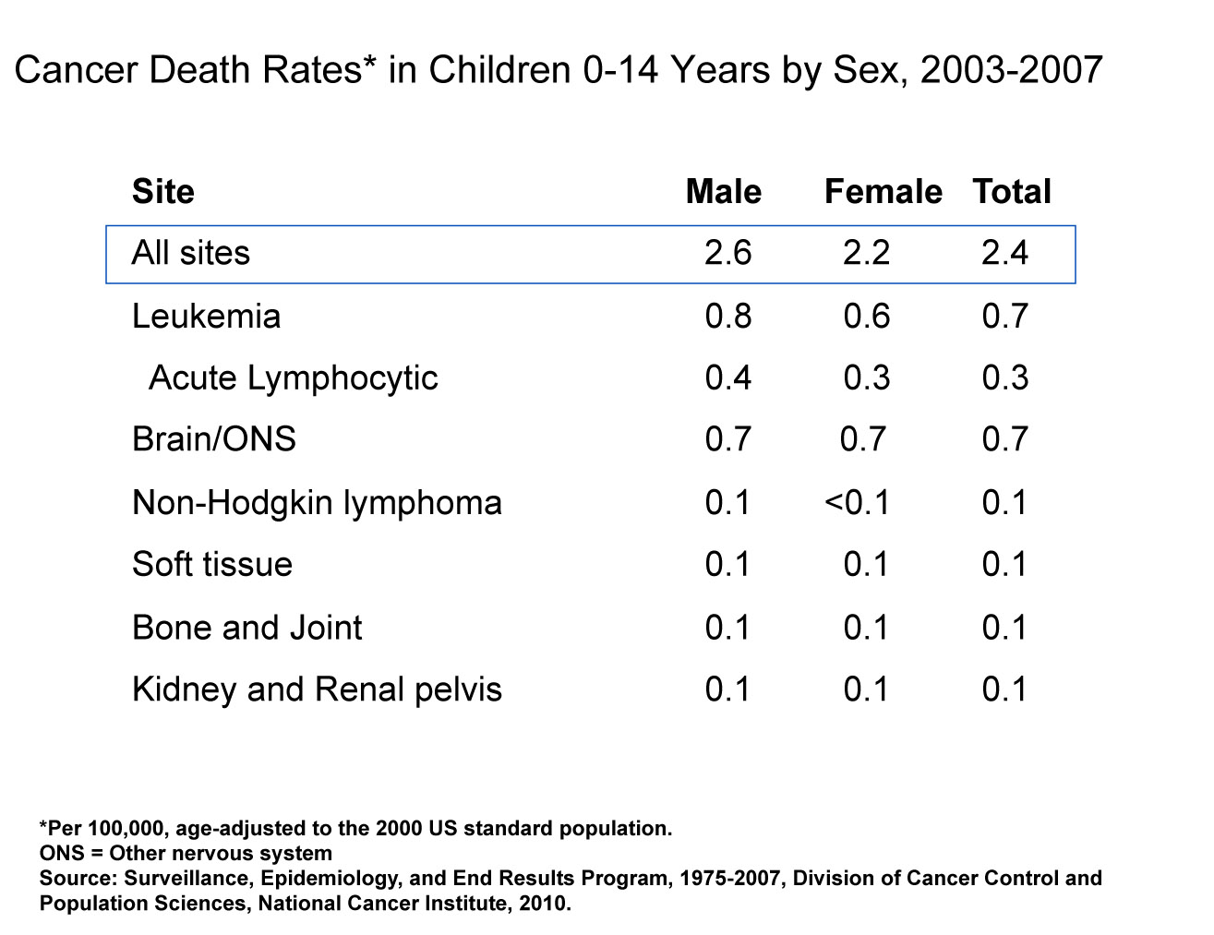
Notes:
Leukemia also accounts for the most cancer deaths in children, comprising roughly a third of cancer deaths among boys and girls 0-14 years. Cancers of the brain and other nervous system are the second leading cause of cancer death in children 0-14.

Slide 24
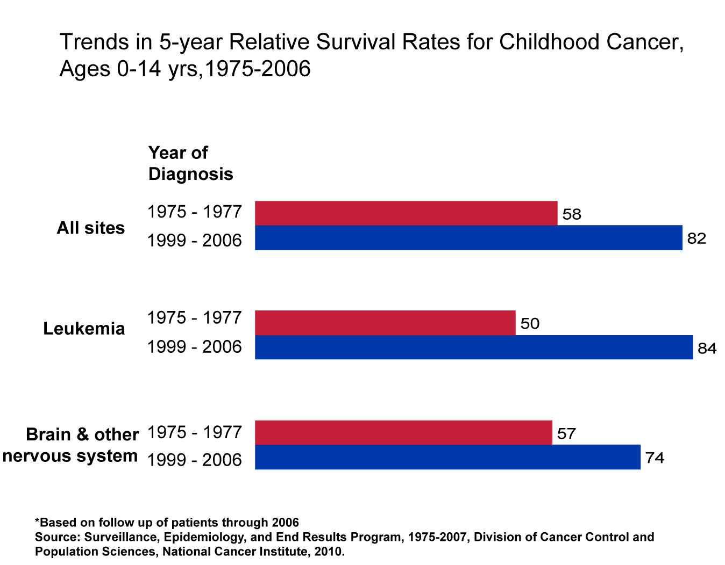
Notes:
The 5-year relative survival rate for childhood cancer has increased significantly during the past 3 decades. For example, the 5-year survival for childhood leukemia patients has improved from 50% for those diagnosed in the mid 1970s to 84% in 1999-2006.

Slide 25
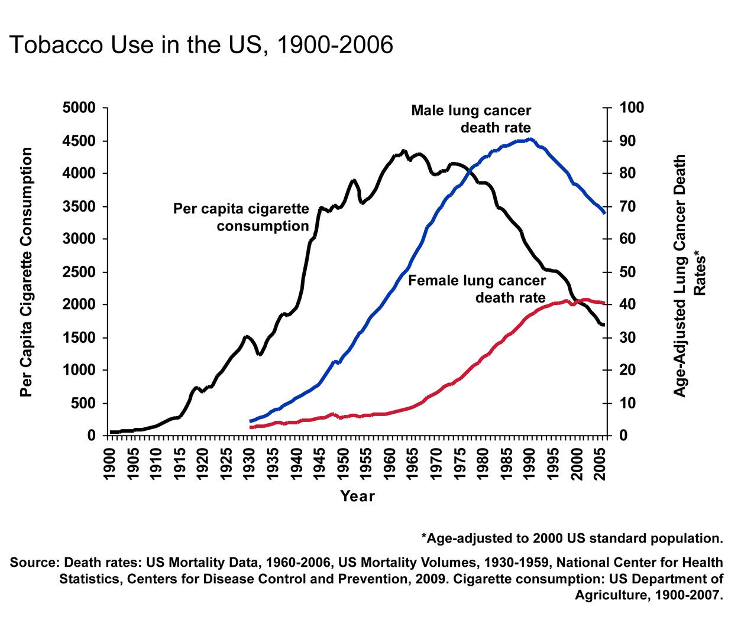
Notes:
Tobacco use is a major preventable cause of death, particularly from lung cancer. The year 2004 marks the anniversary of the release of the first Surgeon General’s report on Tobacco and Health, which initiated a decline in per capita cigarette consumption in the United States. As a result of the cigarette smoking epidemic, lung cancer death rates showed a steady increase through 1990, then began to decline among men. The lung cancer death rate among US women, who began regular cigarette smoking later than men, has begun to plateau after increasing for many decades.

Slide 26
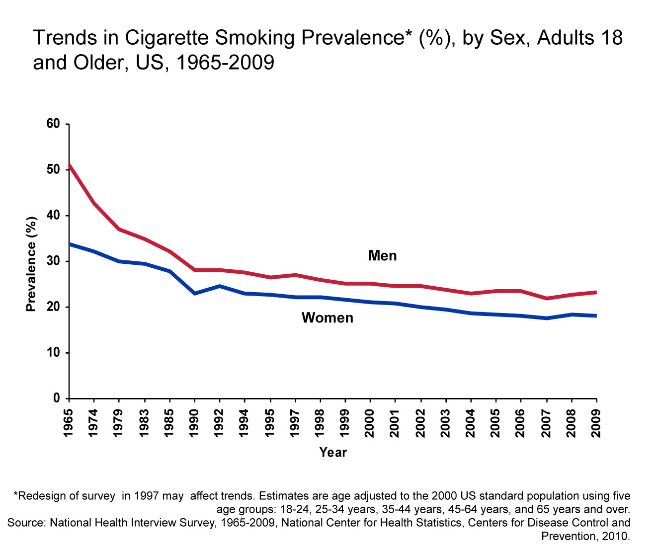
Notes:
The reduction in cigarette consumption has been associated with a decrease in adult smoking prevalence in both men and women since 1965. The difference in cigarette smoking across gender narrowed from 1965 to 1985, a result of smoking becoming more popular among women and higher rates of quitting among male smokers following the Surgeon General’s Report.
Between 1997 and 2004, the percentage of adults who smoke decreased significantly. Between 2004 and 2009, age-adjusted smoking rates were steady between 2004 and 2006, declined in 2007, and remained unchanged between 2007 and 2009 (men: 23.2%, women: 18.1%).

Slide 27
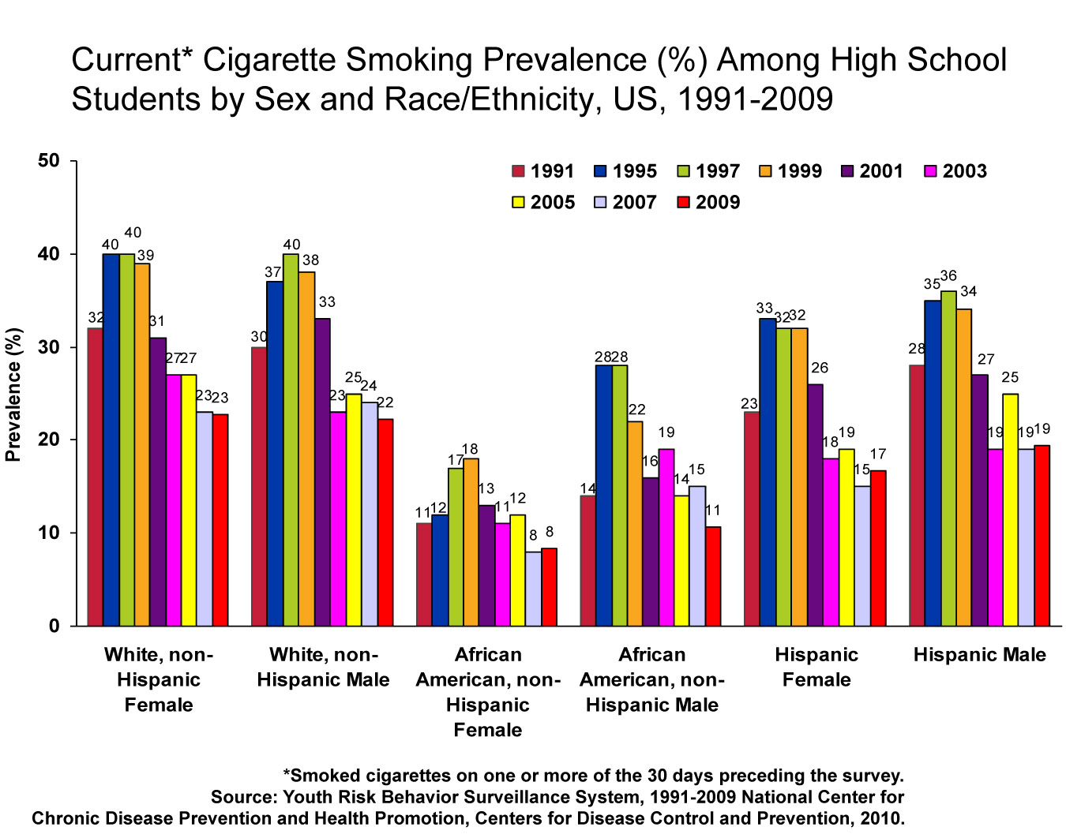
Notes:
Reduction in cigarette smoking among youth is an important factor in reducing prevalence and addiction in adulthood. Smoking among high school students increased from 1991 to 1997, declined between 1997 and 2003, and remained stable between 2003 and 2009. It is thought that the increase in smoking from 1991 to 1997 was due to aggressive youth targeted marketing and promotions; tobacco companies greatly increased their expenditures and promotions during that period. The subsequent decline is thought to be due to increased price of cigarettes as well as comprehensive tobacco control efforts. However, the recent stall in the rate of decline may reflect increased tobacco industry expenditures on marketing and promotion and declines in funding for comprehensive tobacco control programs. Patterns were similar for all gender and racial/ethnic groups, except for African American females, who have shown a continuous decline since 1999.

Slide 28
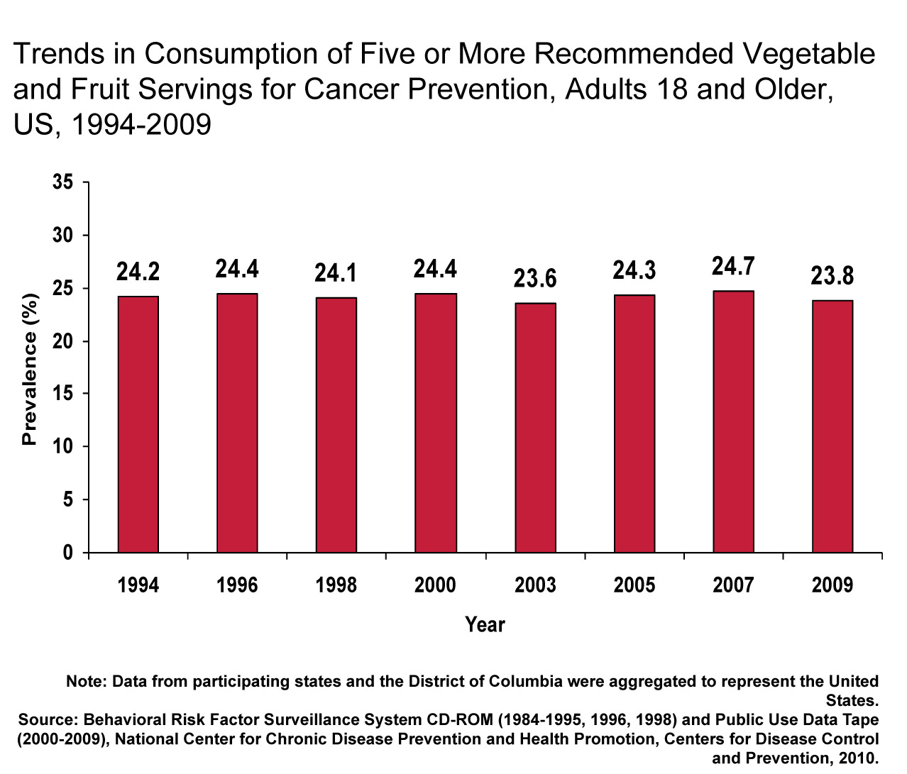
Notes:
The American Cancer Society recommends that individuals eat five or more servings of vegetables and fruits a day for cancer prevention. Fruit and vegetable consumption may protect against cancers of the mouth and pharynx, esophagus, lung, stomach, and colon and rectum. However, there has been little improvement in consumption since the mid-1990s. About one in four adults was eating the recommended servings in 2009.

Slide 29
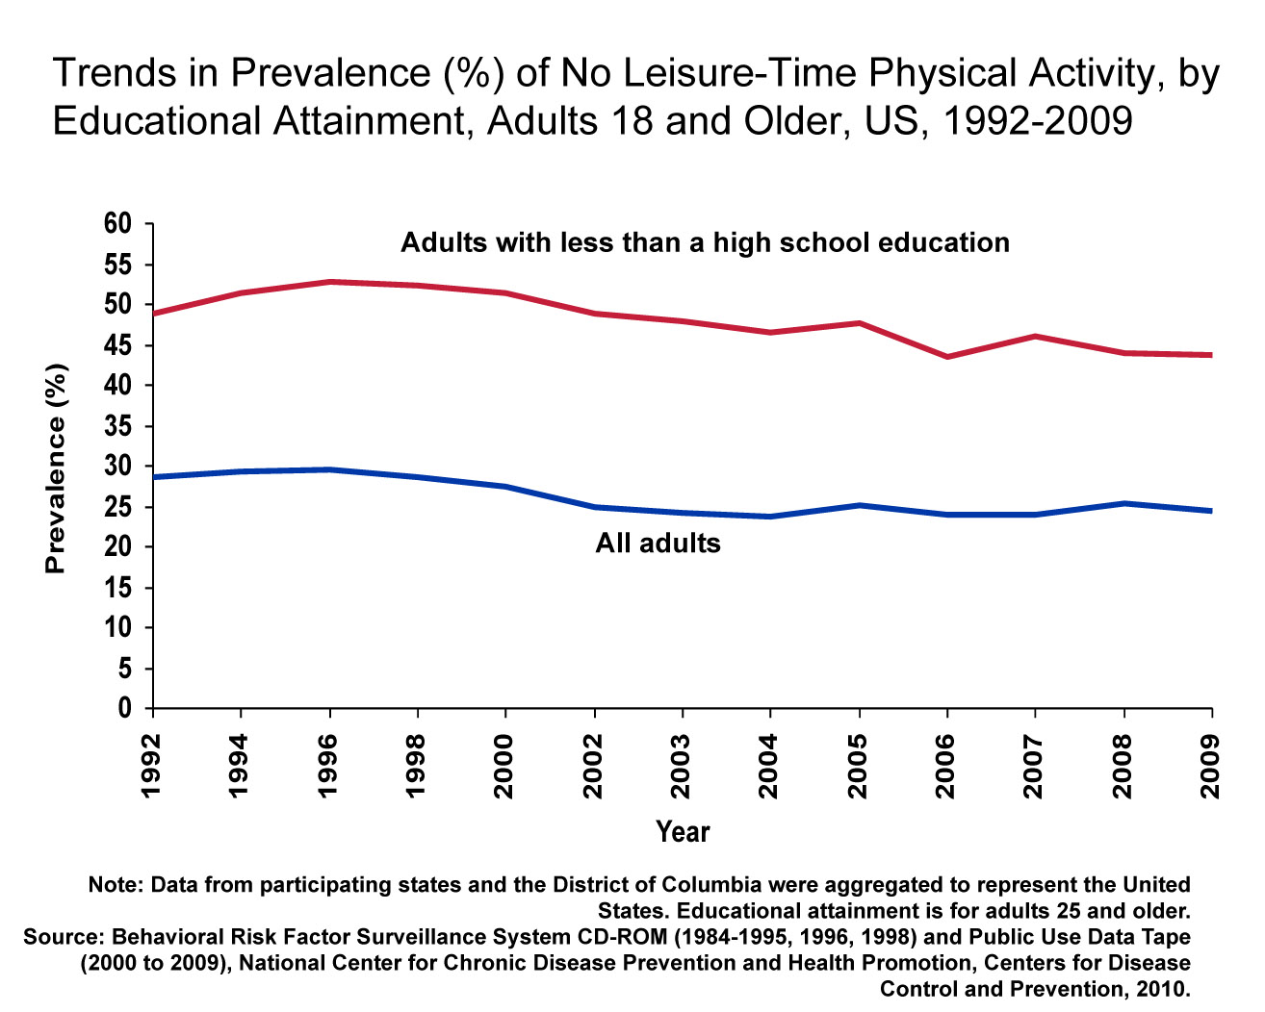
Notes:
The American Cancer Society recommends that adults engage in at least 30 minutes of moderate to vigorous physical activity, above usual activities, on 5 or more days of the week; 45 to 60 minutes of intentional physical activity is preferable. However, similar to trends in nutrition, there has been little change in leisure-time physical activity during the 1990s. About one-fourth of adults do not engage in any leisure-time physical activity. Even more striking is that almost half of adults with less than a high school education do not participate in any leisure-time physical activity. It should be noted that leisure-time physical activity, as presented in this graph, does not reflect job-related physical activity for the currently employed population.
While there has been little change in leisure-time physical activity since the early 1990s, data from other sources illustrates long-term social changes have contributed to reduced total physical activity in US adults, including reduced leisure time for physical activity, shifts from using walking as a mode of transportation to increased reliance on automobiles, and shifts to more sedentary or mechanized work.

Slide 30
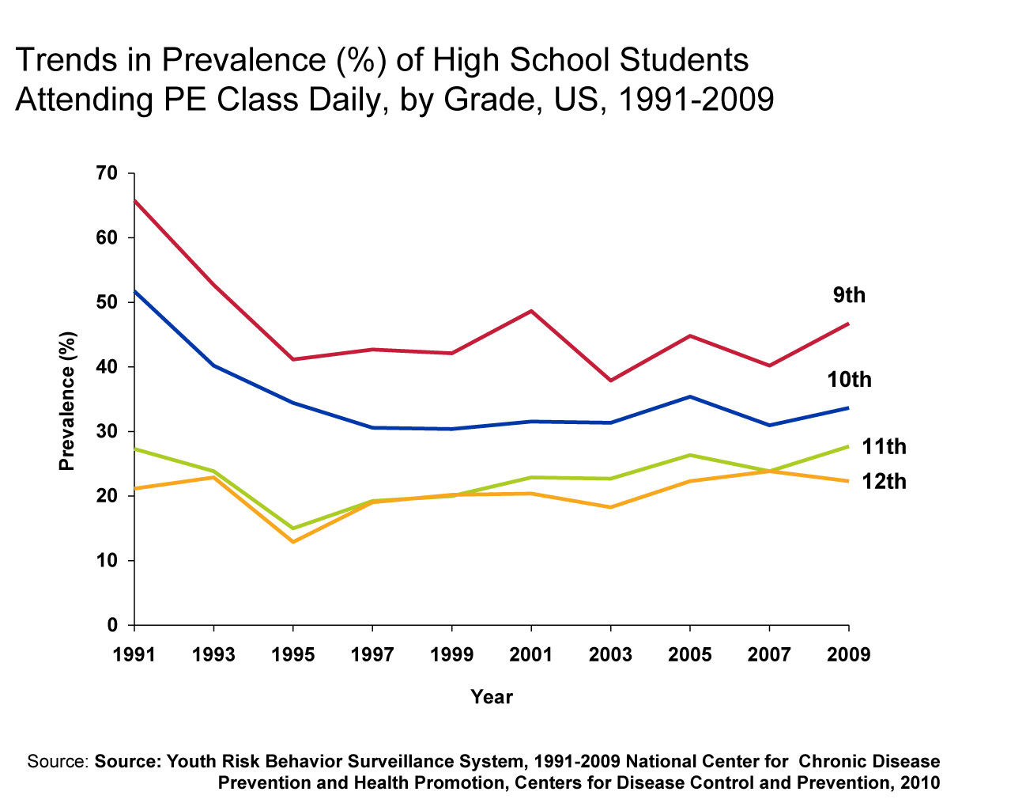
Notes:
Regular physical activity has many important health benefits, including reducing risk factors for cardiovascular disease, cancer, and other chronic diseases. The prevalence of students attending physical education (PE) class daily declined significantly between 1991 and 1995, and has remained unchanged between 1995 and 2009. Given the dramatic rise in the prevalence of overweight among teens (it has tripled since 1980), schools are increasingly being identified as an opportunity to increase physical activity among students.

Slide 31
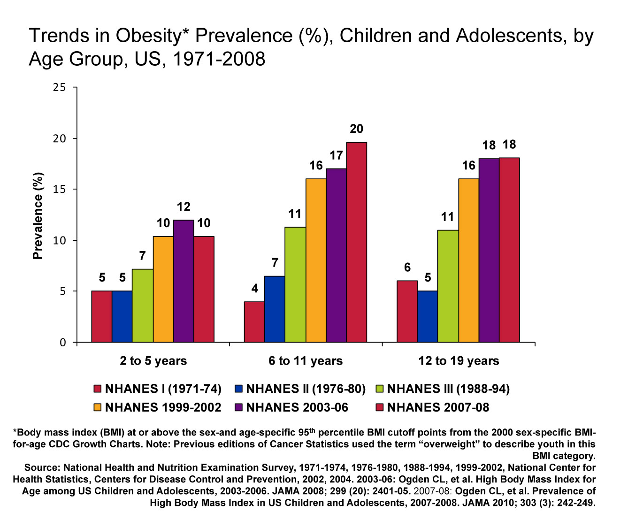
Notes:
People who become overweight in childhood and adolescence are more likely to be overweight or obese as adults. With at least half of the overweight children becoming overweight adults, future adult populations are at increased risk for developing cancer and other serious chronic diseases.
The prevalence of obese children and adolescents has increased since the 1970s, with the most dramatic increases occurring in the late 1980s and 1990s. In fact, over the past three decades the proportion of obese children has more than doubled among children 2-5 years and 6-11 years, and tripled among adolescents 12-19 years. More recently, however, no changes in obesity prevalence was observed between 1999-2000 and 2007-2008.

Slide 32
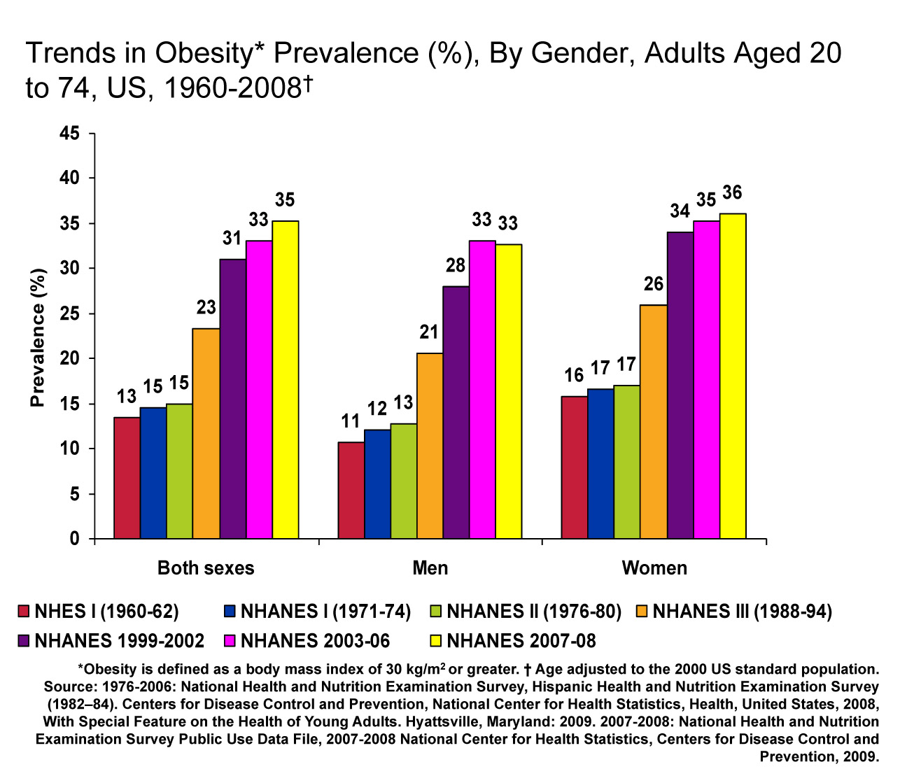
Notes:
Obesity has reached epidemic proportions in the United States. The percentage of adults age 20 to 74 who are obese increased from the late 1970s to 2000, with the largest increases occurring in the 1990s. Similar trends were observed among men and women. In the past decade, obesity trends in women have remained relatively stable, from 34% in 1999-2002 to 36% in 2007-2008; among men, prevalence increased from 28% to 33% during this period.

Slide 33
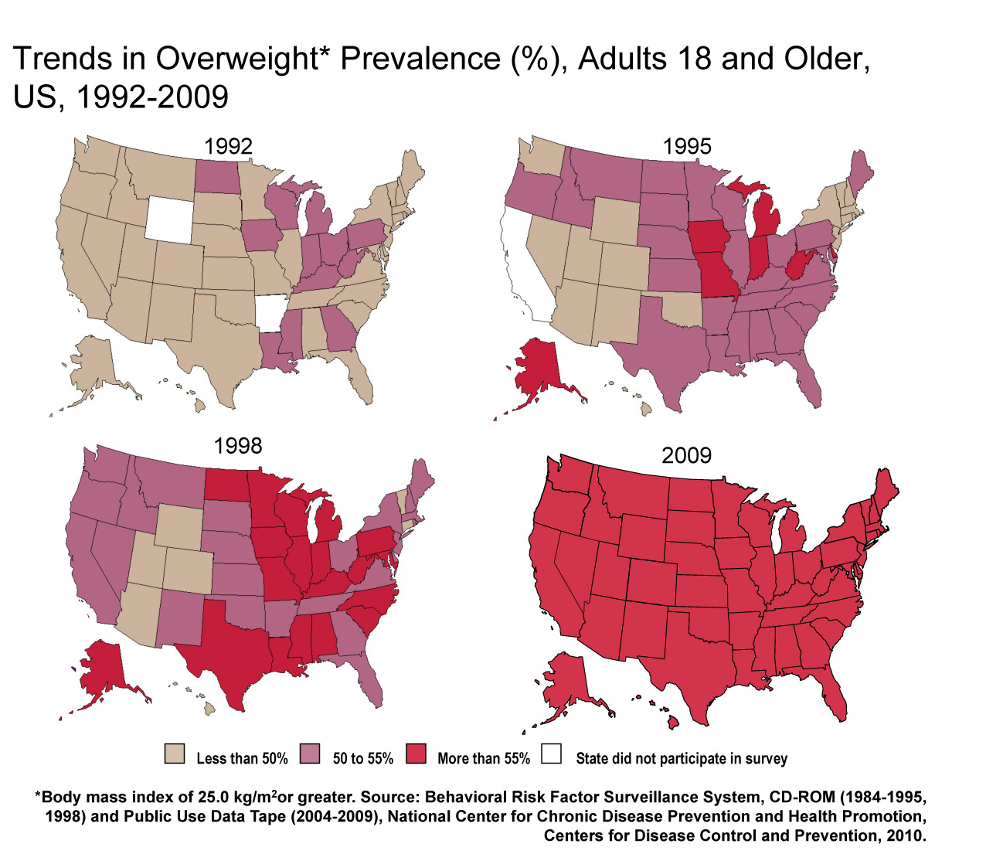
Notes:
This slide highlights the obesity epidemic as mentioned in the previous slide. In 2009, over 55% of adults in all states, except District of Columbia, were overweight or obese, compared to none in 1992.

Slide 34
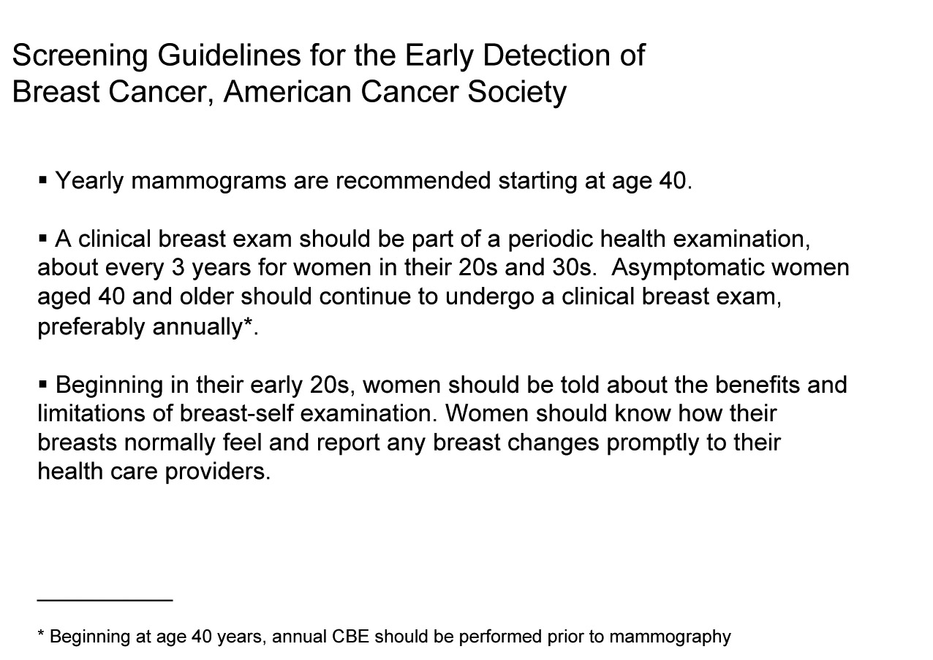
Notes:
The American Cancer Society states that women aged 40 and older should have an annual mammogram and clinical breast exam (CBE) as part of a periodic health exam. Women should know how their breasts normally feel and report any changes to their health care provider. A breast self-examination (BSE) is an option for women starting in their 20s.

Slide 35
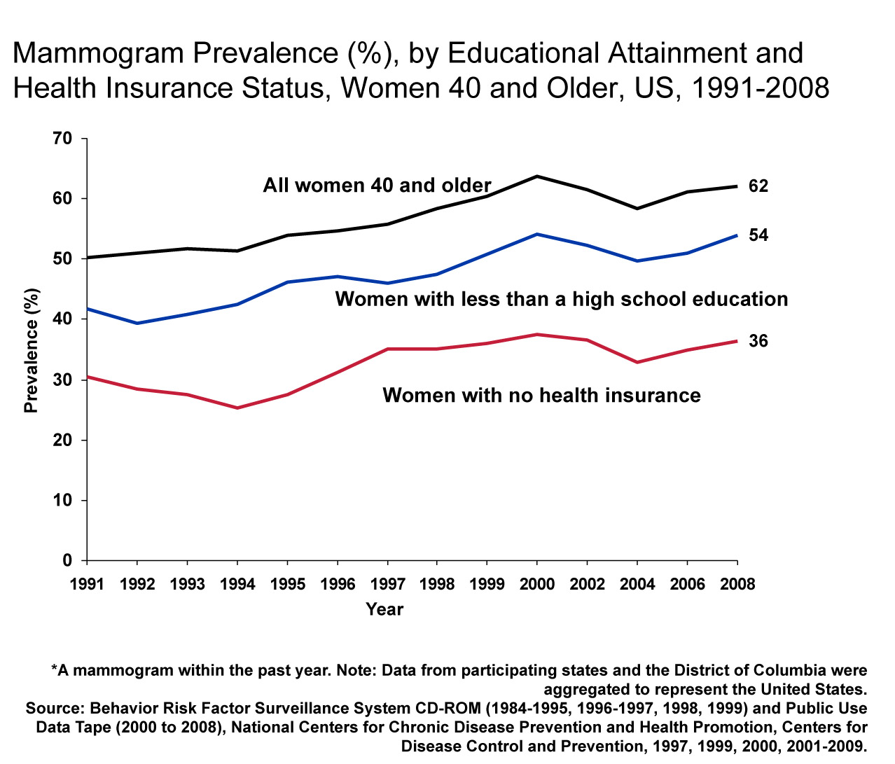
Notes:
The prevalence of women reporting a mammogram within the past year increased from 50% in 1991 to 64% in 2000, and has since remained relatively stable (2008: 62%). During this time, mammogram utilization varied considerably by educational attainment. The prevalence of women with less than a high school education reporting a recent mammogram was approximately 8 percentage points lower than the prevalence for all women. Even more striking is that the prevalence for women with no health insurance is approximately 26 percentage points lower than the prevalence for all women.

Slide 36
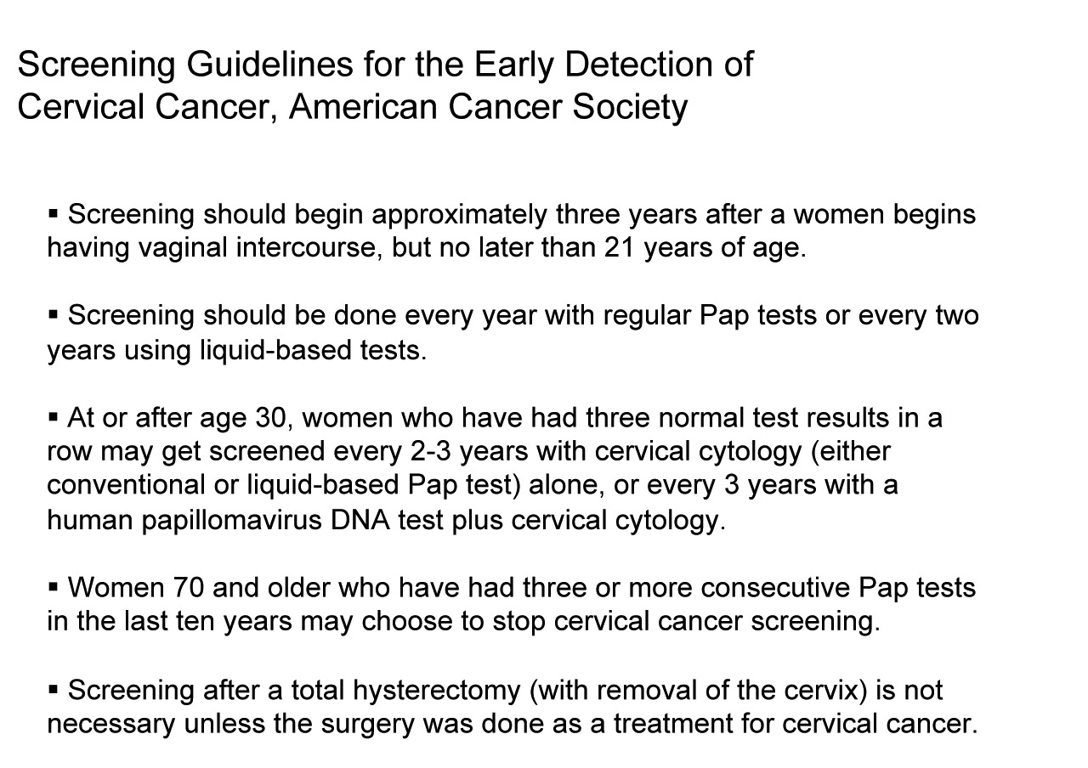
Notes:
The American Cancer Society cervical cancer screening guidelines state that women should begin screening approximately three years after she begins having vaginal intercourse, but no later than 21 years of age. Screening should be done every year with regular Pap tests or every two years using liquid-based tests. At or after age 30, women who have had three normal tests in a row may get screened every 2-3 years. Women 70 and older who have had three or more consecutive normal Pap tests in the last 10 years may choose to stop cervical cancer screening.

Slide 37
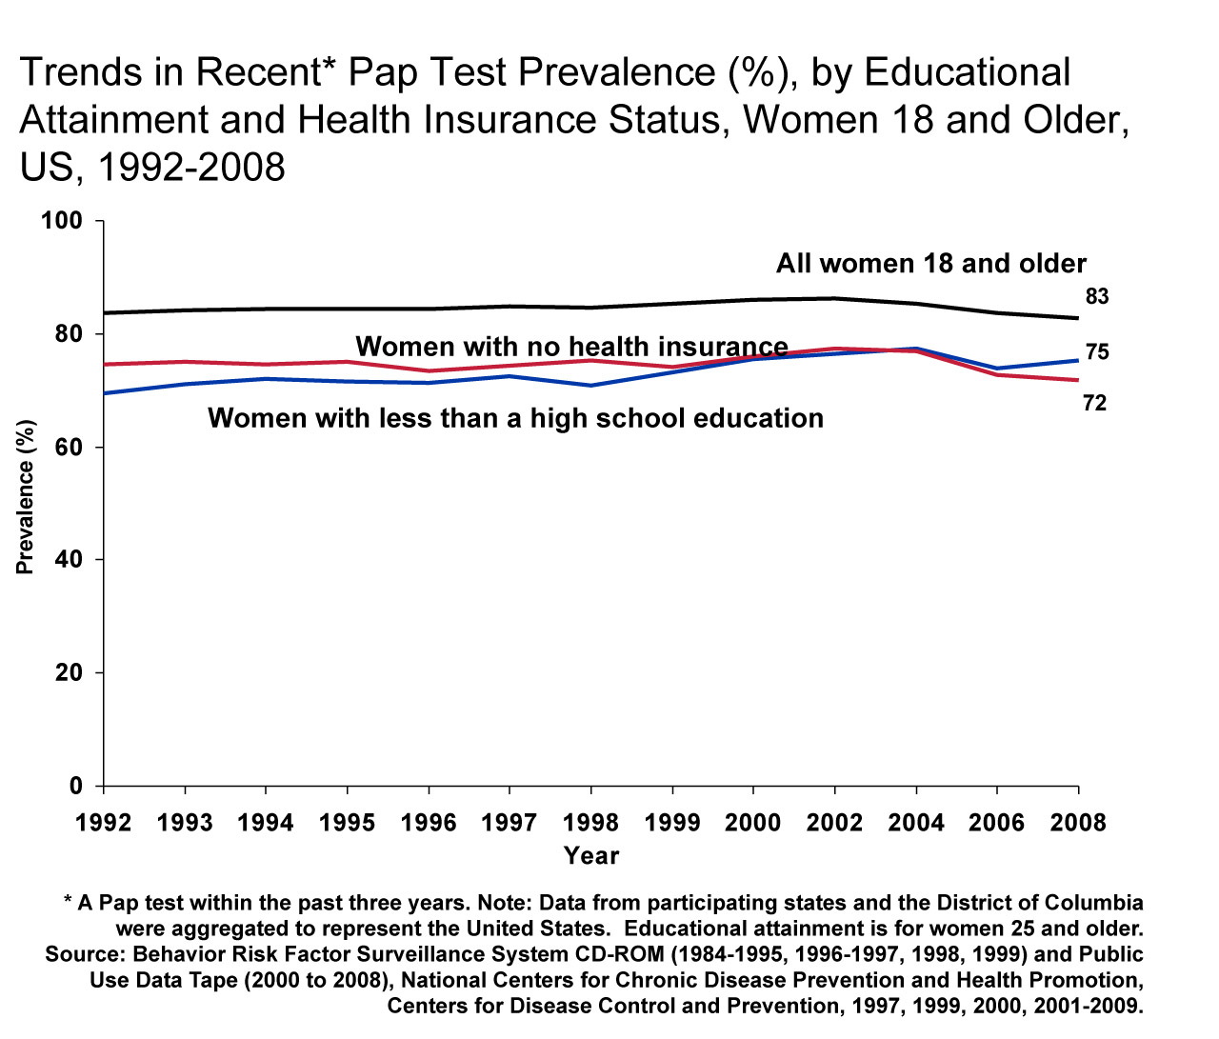
Notes:
This graph shows that the prevalence of women who have had a Pap test within the past three years has remained high, and has increased during the late 1990s. Throughout the decade, the prevalence among women with less than a high school education as well as the prevalence among women with no health insurance was approximately 10 percent lower than the percentage for all women.

Slide 38
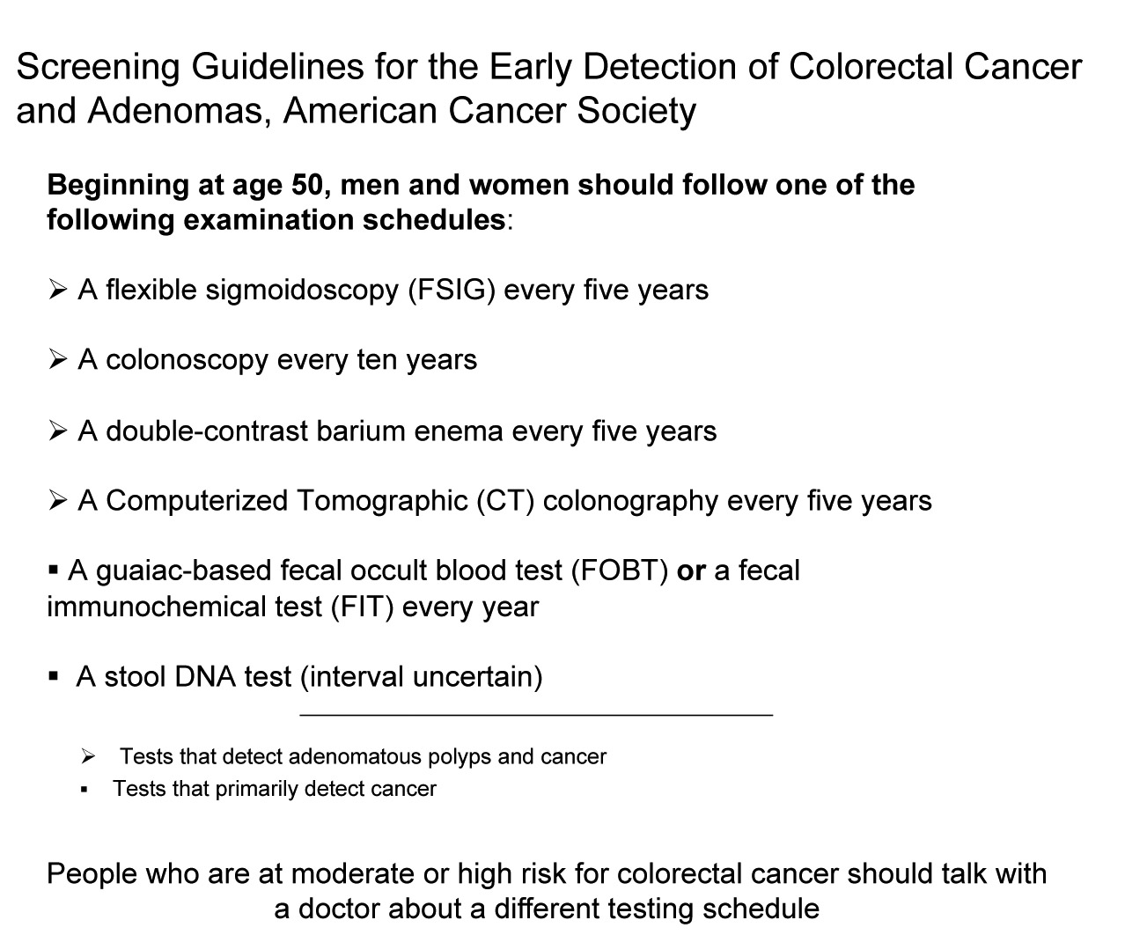
Notes:
The American Cancer Society recommends that beginning at age 50, men and women, who are at average-risk, should receive one of several options as screening for the early detection of colorectal cancer and adenomas
There are significant updates to the guidelines for colorectal cancer screening. Two new tests are now recommended as options for colorectal cancer screening. They are stool DNA (sDNA) and computerized tomographic colonography (also known as virtual colonoscopy). For the first time, screening tests are grouped into categories based on performance characteristics: those that primarily detect cancer early and those that can also detect precancerous polyps. Tests that primarily detect cancer early are fecal (stool) tests, including guaiac-based and immunochemical-based fecal occult blood tests (gFOBT & FIT), and stool DNA tests (sDNA). Tests that detect both precancerous polyps and cancer include flexible sigmoidoscopy, colonoscopy, the double contrast barium enema, and computerized tomographic colonography (also known as virtual colonoscopy). It is the strong opinion of the expert panel that colon cancer prevention should be the primary goal of colorectal cancer screening. Exams that are designed to detect both early cancer and precancerous polyps should be encouraged if resources are available and patients are willing to undergo an invasive test.

Slide 39
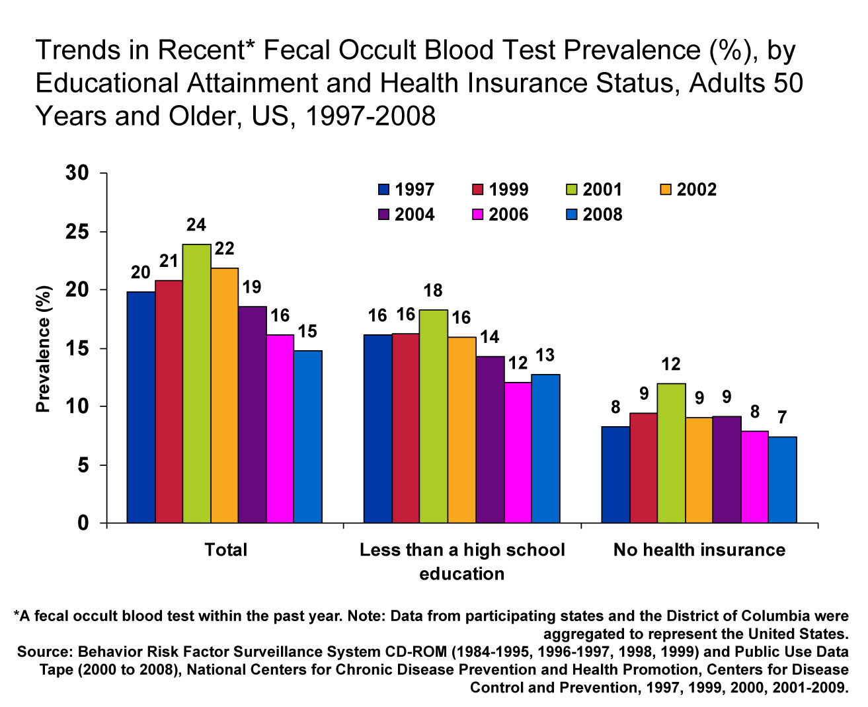
Notes:
In 2008, approximately 15% of US adults 50 and older had a fecal occult blood test (FOBT) in the previous year. Adults with less than a high school education are less likely to report a recent FOBT. The prevalence for adults with no health insurance is about 8 percentage points lower than the prevalence for all adults.

Slide 40
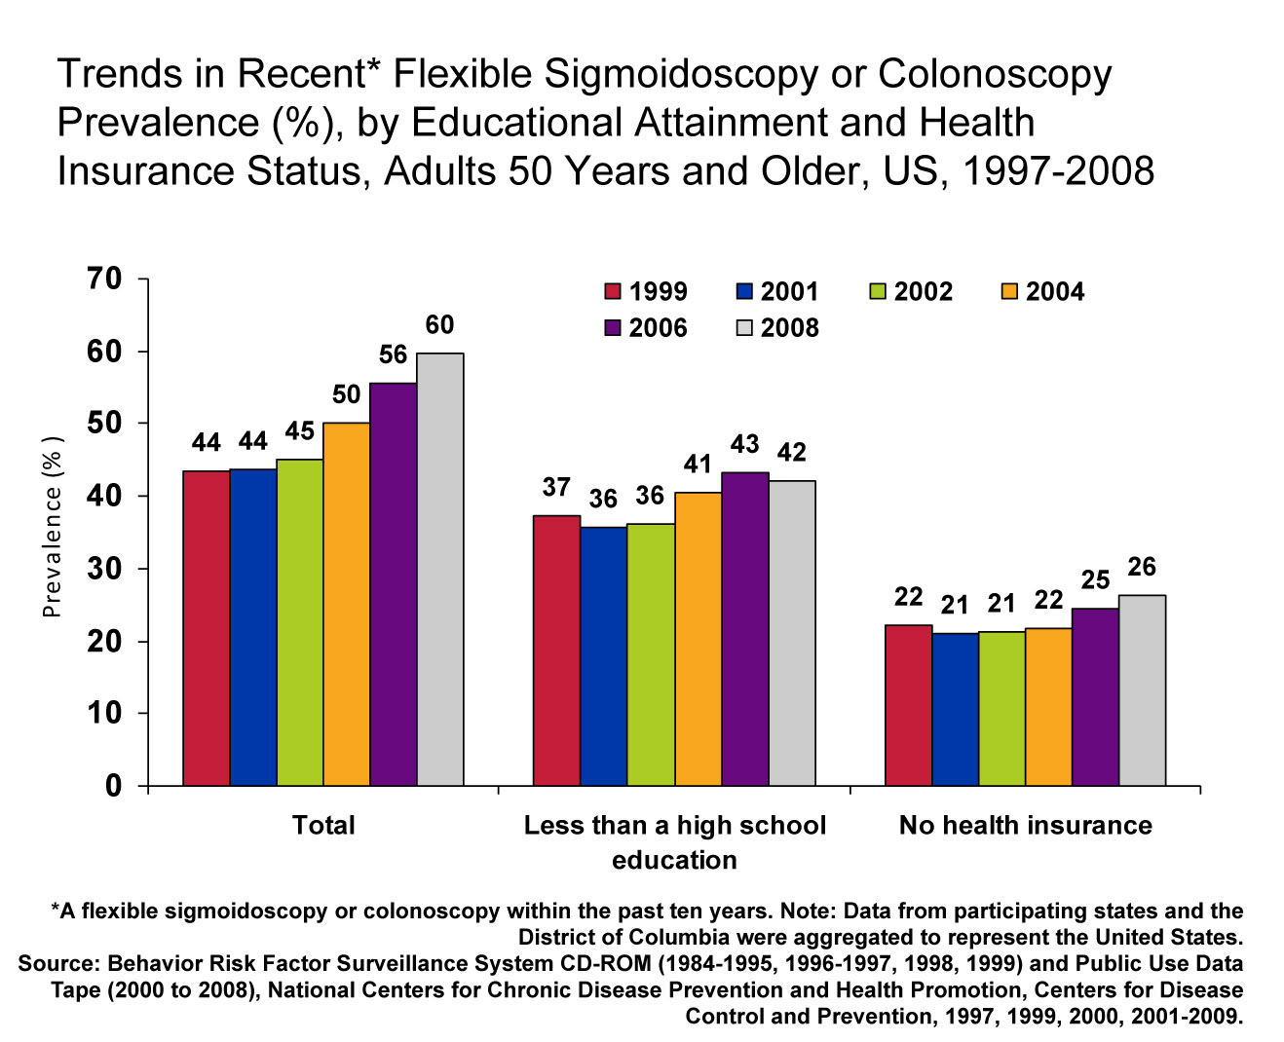
Notes:
While there has been a downward trend during recent years in the use of FOBT, the prevalence of flexible sigmoidoscopy (FSIG) or colonoscopy has continuously increased from 1997 to 2008. Adults with less than a high school education were less likely to report FSIG or colonoscopy than all adults. Even more striking is that the prevalence for adults with no health insurance is less than half of that for all adults. Continuing efforts are needed to address health system barriers to colon cancer screening, to encourage health care practitioners to promote screening to their patients, and to raise awareness among eligible adults about the importance of getting screened for CRC.

Slide 41
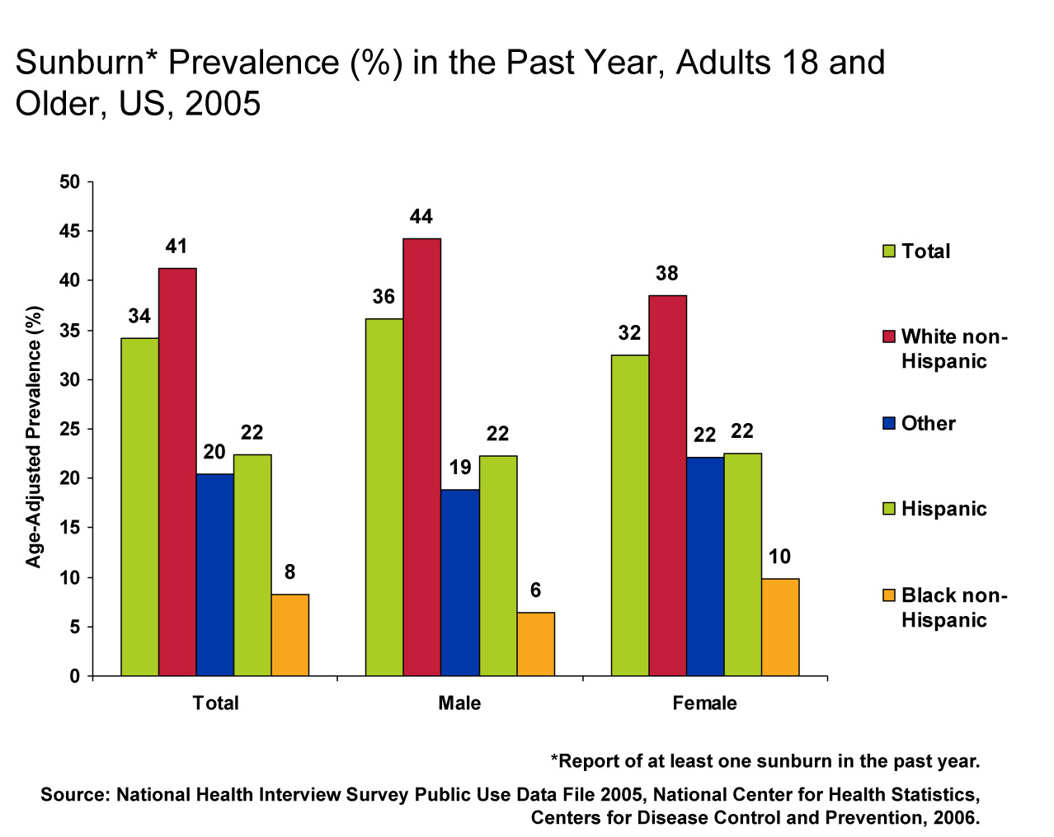
Notes:
The vast majority of skin cancers are the result of unprotected and excessive ultraviolet radiation exposure. The American Cancer Society estimates that UV exposure is associated with more than one million cases of basal and squamous cell cancers and 59,940 cases of malignant melanoma in 2006.
Sunburns, a short-term consequence of unprotected or excessive UV exposure, were reported more frequently by men than women. Variations by race, ethnicity, and gender were observed with the highest prevalence of sunburns among white non-Hispanic males and females.

Slide 42
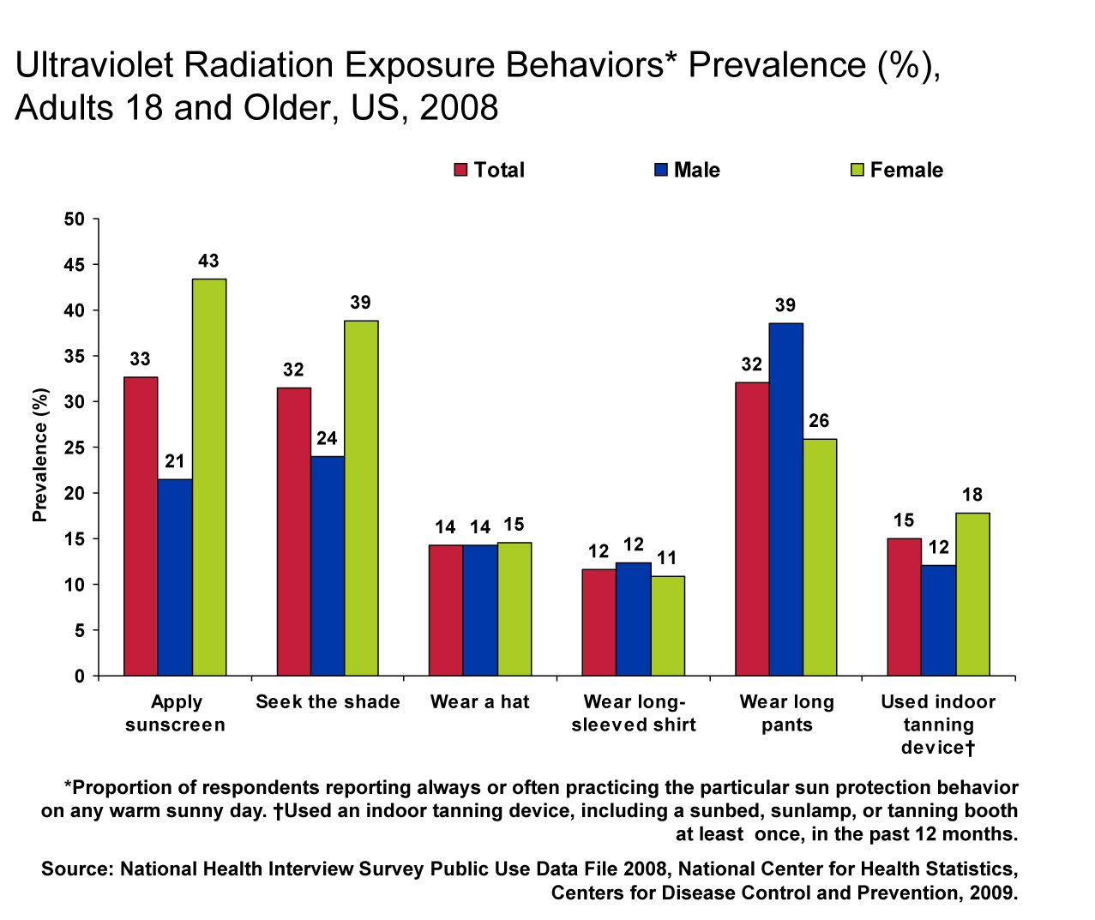
Notes:
The vast majority of skin cancers are caused by unprotected exposure to excessive ultraviolet radiation (UVR), primarily from the sun. Studies also suggest that exposure to artificial UVR exposure from indoor tanning devices is a risk factor for skin cancer. UVR damage of unprotected skin can be avoided by practicing recommended sun protection behaviors and avoiding indoor tanning devices, including lamps and booths.
The practice of UVR protection behaviors is generally low. In a national sample of US adults, application of sunscreen and shade seeking were the most commonly practiced sun protection behaviors, whereas clothing protection, especially the use of hats and long-sleeved shirts were less frequently practiced. The same survey showed that 15% of adults, primarily women and young adults, reported using an indoor tanning device at least once in the past year.

Slide 43

Thank you

