Slide 1

Cancer Statistics 2014
A Presentation from the
American Cancer Society
©2014, American Cancer Society, Inc.

Slide 2
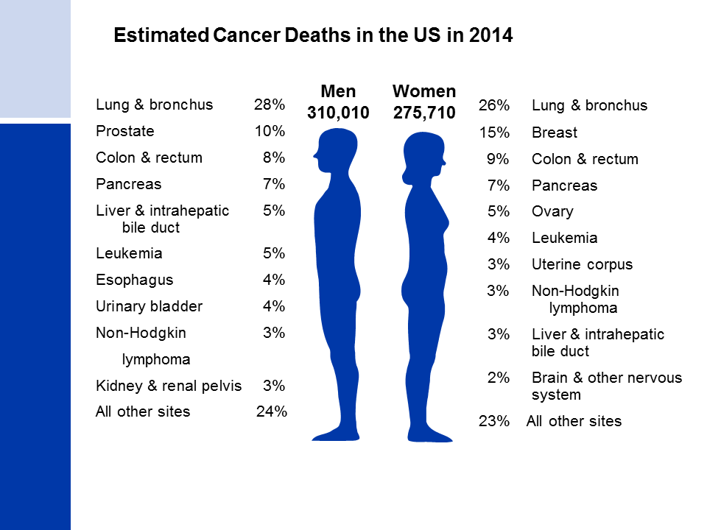
Notes:
Lung cancer is by far the leading cause of cancer death among men (28%), followed by prostate (10%) and colon & rectum (8%) cancers. Among women, lung (26%), breast (15%), and colon & rectum (9%) cancers are the leading causes of cancer death.

Slide 3
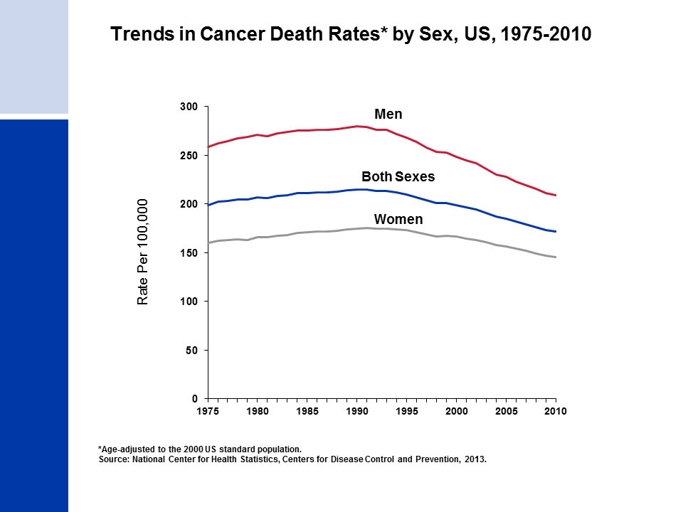
Notes:
From 2006 to 2010, the death rate for all cancers combined decreased by 1.8% per year in men and by 1.4% per year in women. Compared to the peak rates -- in 1990 for men and 1991 for women -- the cancer death rate for all sites combined in 2010 was 25% lower in men, 17% lower in women, and 20% lower overall.

Slide 4
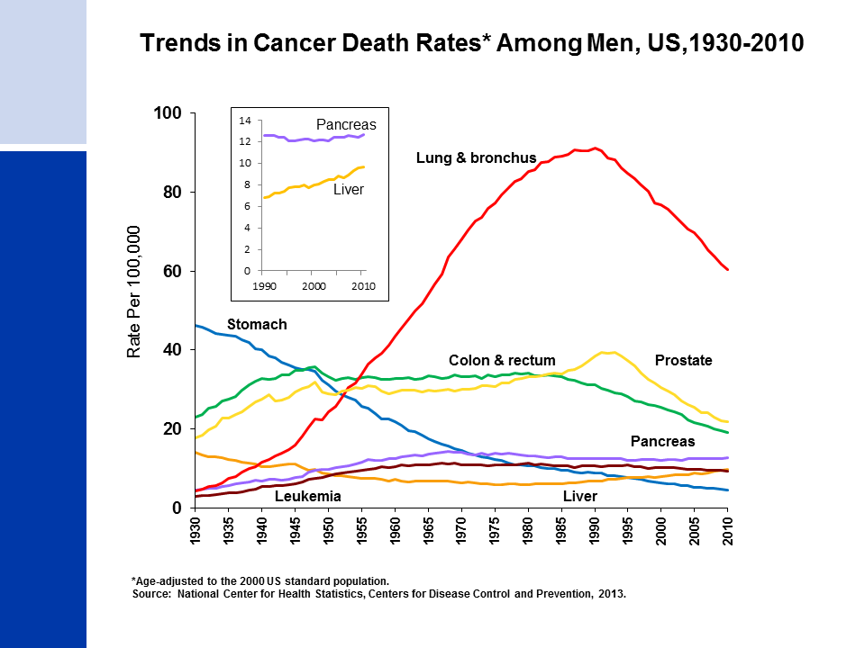
Notes:
Most of the increase in overall cancer death rates for men prior to 1990 was attributable to the rapid increase in lung cancer deaths due to the tobacco epidemic. However, since 1990, the lung cancer death rate in men has been decreasing; this decline has accounted for over 40% of the overall decrease in cancer death rates in men since 1990. The death rate for stomach cancer, which was the leading cause of cancer death among men early in the 20th century, has decreased by 90% since 1930. Death rates for prostate and colorectal cancers have been declining since the early 1990s and 1980s, respectively. In contrast to declining death rates for most cancer types, liver cancer death rates increased by more than 2% per year during the past decade of data (2001 to 2010). Death rates for pancreatic cancer have also been increasing slightly.

Slide 5
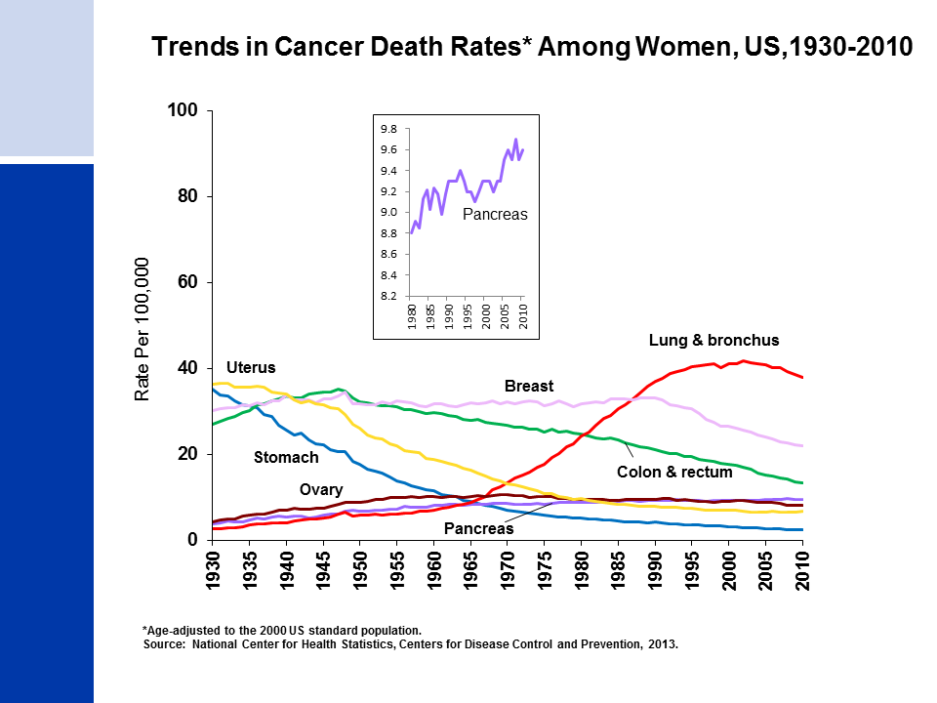
Notes:
The lung cancer death rate in women began declining in the early 2000s after increasing for the previous 70 years. The lag in the decline in lung cancer in women compared to men reflects differences in smoking patterns; smoking rates peaked about two decades later in women than in men and women lagged behind men in quitting smoking in large numbers. In comparison, breast cancer death rates changed little between 1930 and 1990, but decreased 34% between the peak year (1989) and 2010. Since 1930, the death rate for stomach cancer has decreased by more than 90%. The death rate for uterine cancer (uterine cervix and uterine corpus combined), which was the leading cause of cancer death in the early 20th century, declined 80% from 1930 to 1997, but has since been fairly stable. Colorectal cancer death rates have been decreasing for more than 60 years. Similar to men, pancreatic cancer death rates have been increasing slightly, from 8.8 (per 100,000 women) in 1980 to 9.6 in 2010.

Slide 6
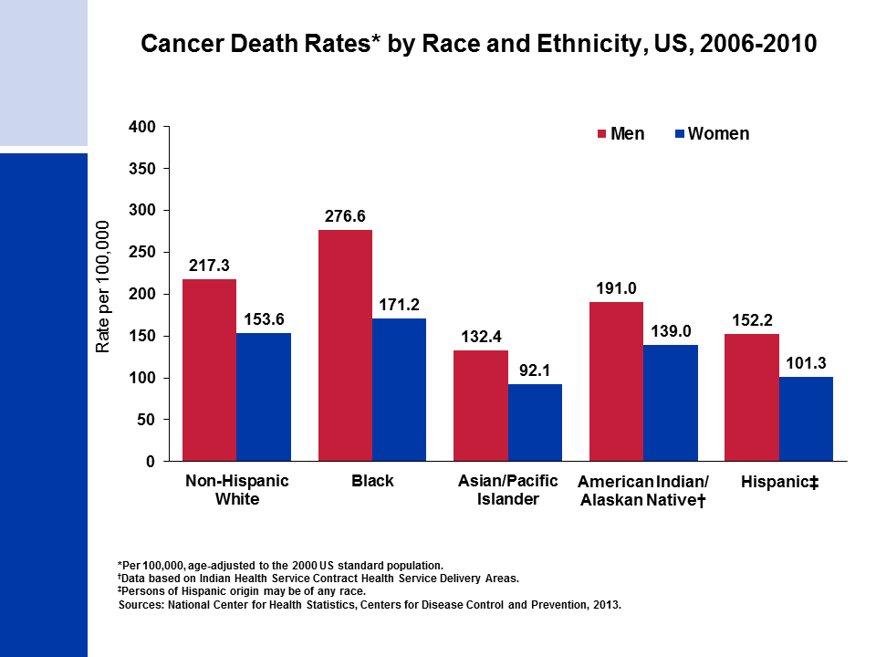
Notes:
Cancer death rates are higher among men than among women for every racial and ethnic group. Black men and women have the highest cancer mortality rates of any racial and ethnic group. Asian and Pacific Islander men and women have the lowest cancer death rates, which are about half the rates of black men and women, respectively.
Note: Rates for populations other than white and black may be underestimated due to incomplete information on race/ethnicity in medical records.

Slide 7
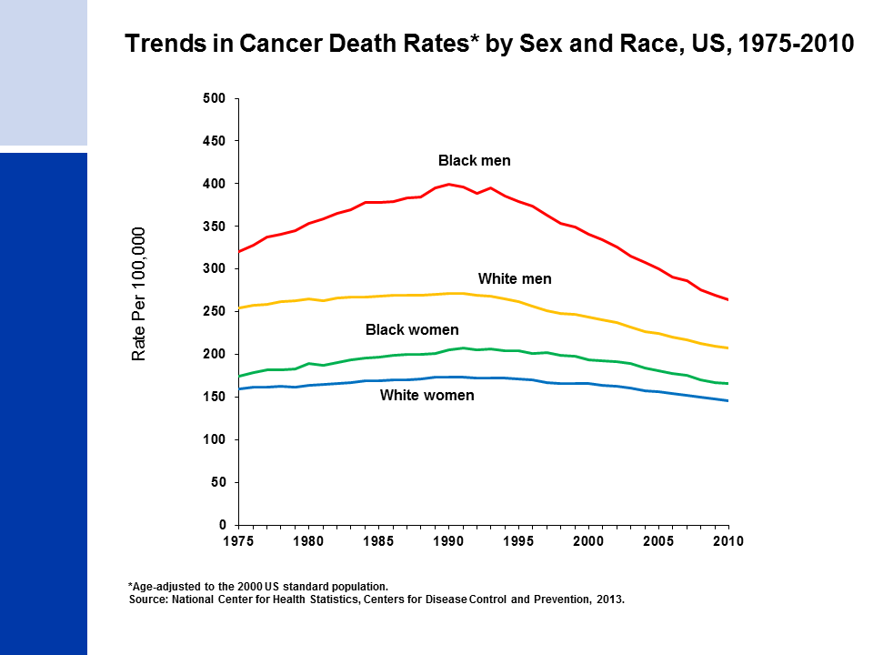
Notes:
Although the overall cancer death rate continues to be highest among black men, from 1991 to 2010, black men have had the largest decline in cancer death rates (33%) in comparison to white men (24%), black women (20%), and white women (16%).

Slide 8
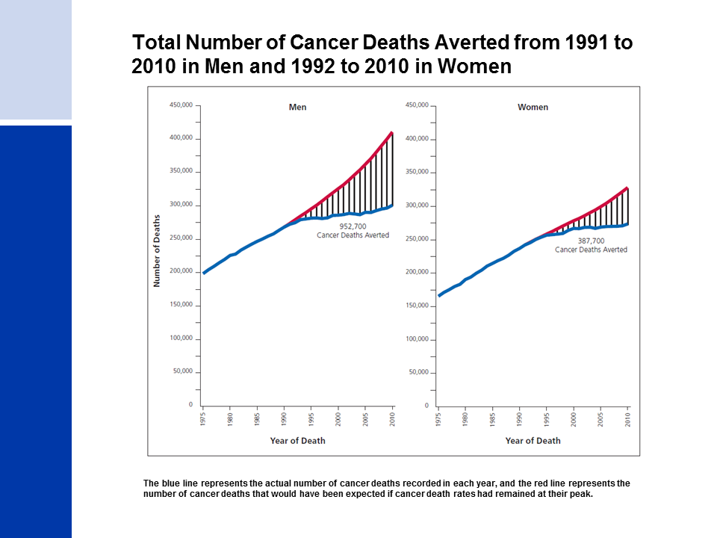
Notes:
Almost 1.3 million cancer deaths were averted as a result of almost two decades of consistent declines in cancer deaths rates.

Slide 9
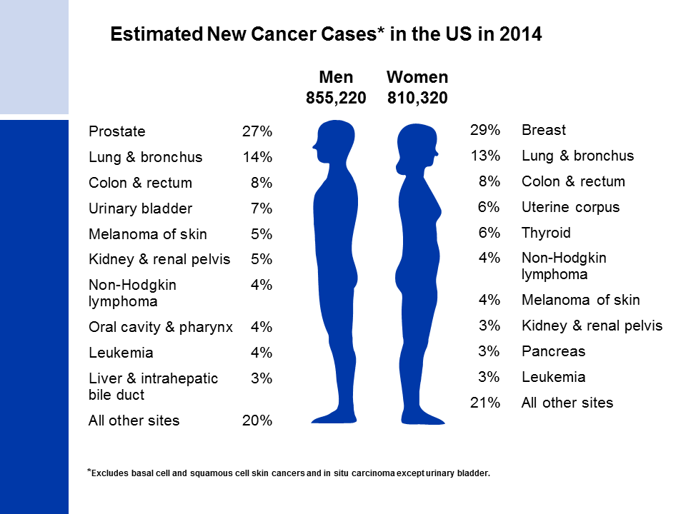
Notes:
Now we will turn our attention to the number of new cancers projected for the US this year. It is estimated that more than 1.6 million new cases of cancer will be diagnosed in 2014. The most common cancers are estimated to be prostate in men and breast in women; lung and colorectal cancers are the second and third most common cancers in both men and in women.

Slide 10
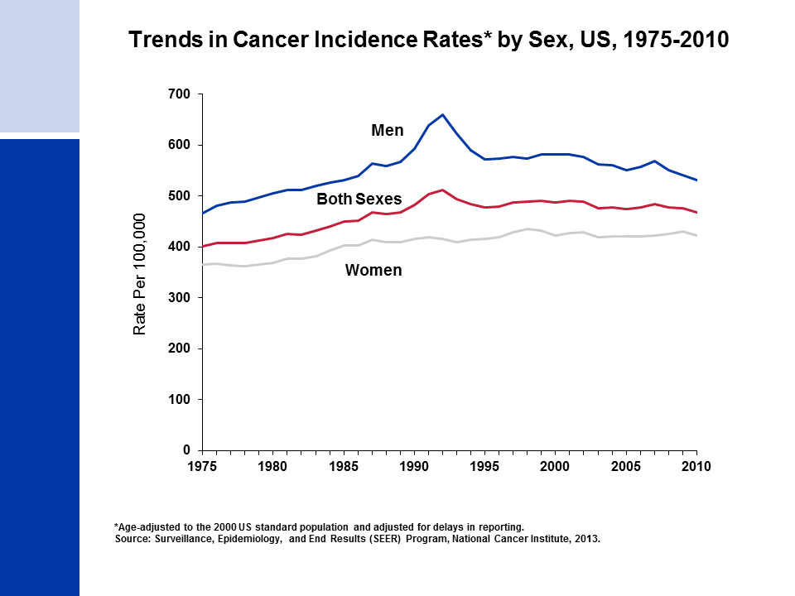
Notes:
This slide shows trends in cancer incidence rates for all sites combined from 1975 to 2010. Over the most recent five years of available data (2006 to 2010) the overall cancer incidence rate was 23% lower among women compared with men. From 2006 to 2010, overall incidence rates in the SEER 9 areas decreased slightly in men (by 0.6% per year) and were stable in women. The decrease among men is attributed mainly to declines in colorectal, prostate, and lung cancers.
SEER 9 represents approximately 10% of the US population and is the only source for long-term (since 1975) population-based incidence data.

Slide 11
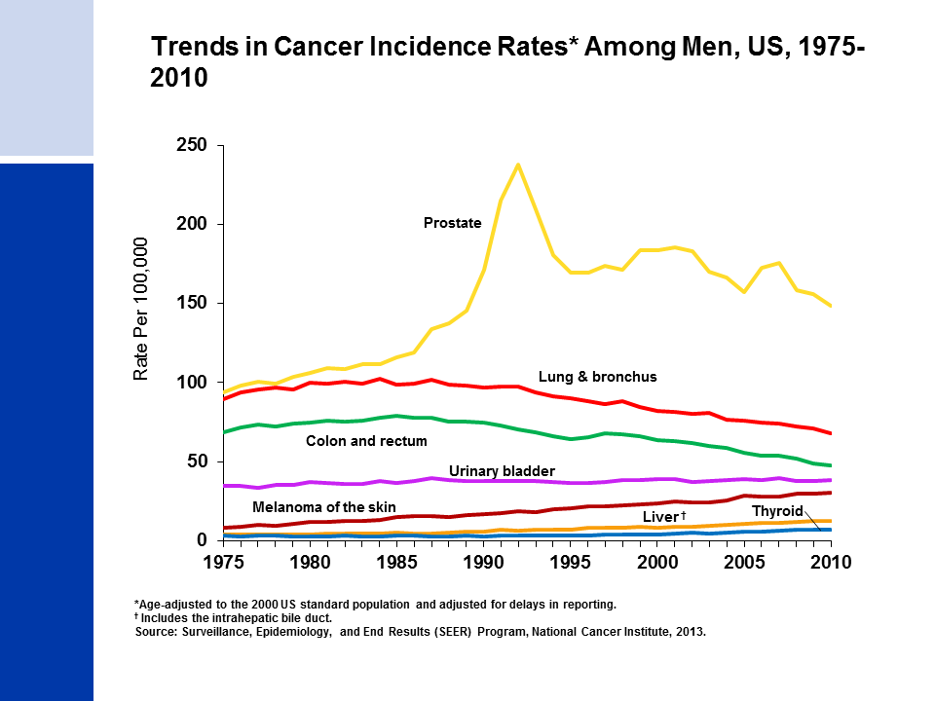
Notes:
Incidence rates of prostate cancer have changed substantially over the past 20 years: rapidly increasing from 1988 to 1992, declining sharply from 1992 to 1995, remaining stable from 1995 to 2000, and decreasing (on average) from 2000 to 2010. This erratic trend primarily reflects changing patterns in the utilization of prostate-specific antigen (PSA) blood testing for the detection of prostate cancer. Incidence rates for both lung and colorectal cancers in men have been declining for many decades, while rates for liver and thyroid cancers and melanoma are increasing.

Slide 12
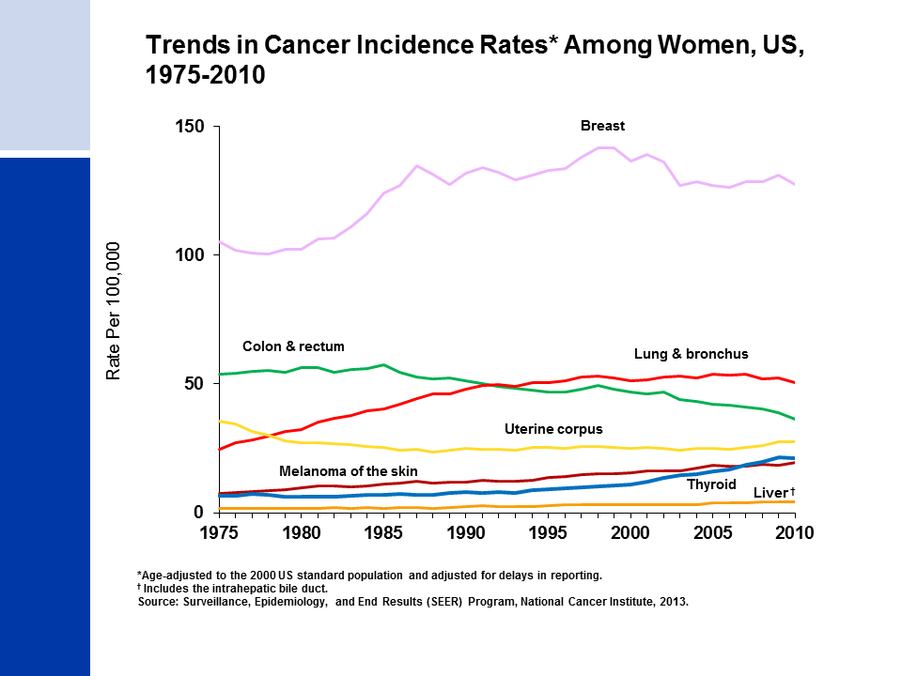
Notes:
Breast cancer incidence rates in women have been relatively stable since 2003, after decreasing 6% from 2002 to 2003, primarily due to a reduction in use of hormone replacement therapy. Lung cancer rates have recently begun to decline after increasing for several decades. Differences in the lung cancer pattern between men and women reflect later smoking uptake and slower cessation among women. Colorectal cancer incidence rates have been declining since the mid 1980s. Women have experienced the largest annual increase for thyroid cancer (6.5% per year) during the last five years for which data are available (2006-2010).

Slide 13
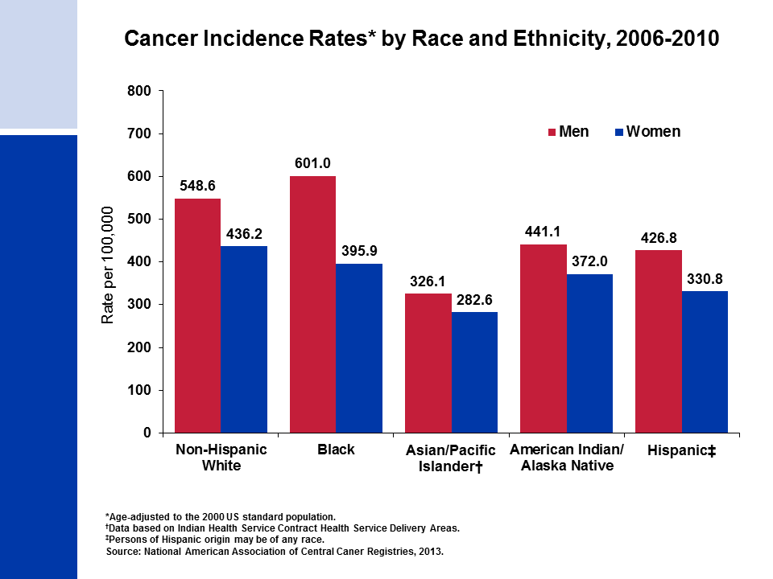
Notes:
Cancer incidence rates are higher in men than women in each racial/ethnic population. Among men, blacks have the highest incidence followed by non-Hispanic whites, American Indians/Alaska Natives, Hispanics, and Asian/Pacific Islanders. Among women, non-Hispanic whites have the highest rates, followed by blacks, American Indians/Alaska Natives, Hispanics, and Asian/Pacific Islanders.
Important Note: Rates for populations other than white and black individuals may be underestimated due to incomplete information on race/ethnicity information in medical records.

Slide 14
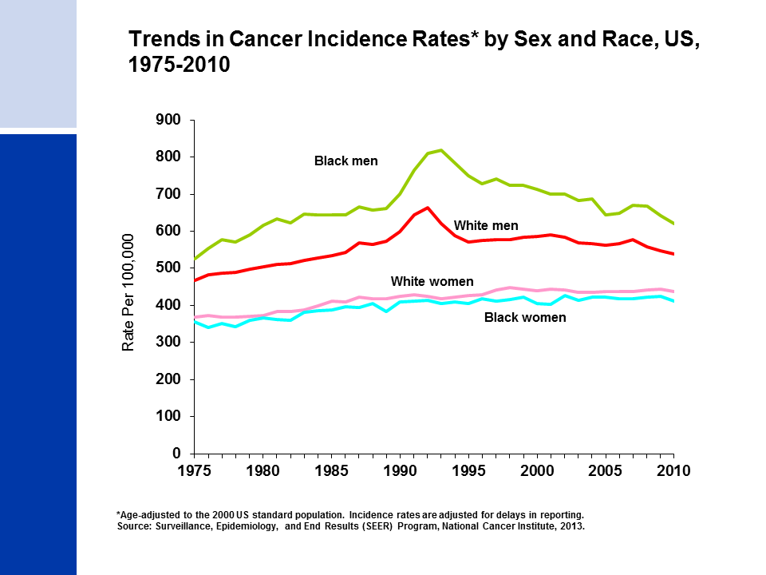
Notes:
Overall cancer incidence rates are higher among black than white men. In contrast, among women, incidence rates are slightly higher among whites. This is largely driven by higher rates of melanoma of the skin, thyroid cancer, and breast cancer among white women.

Slide 15
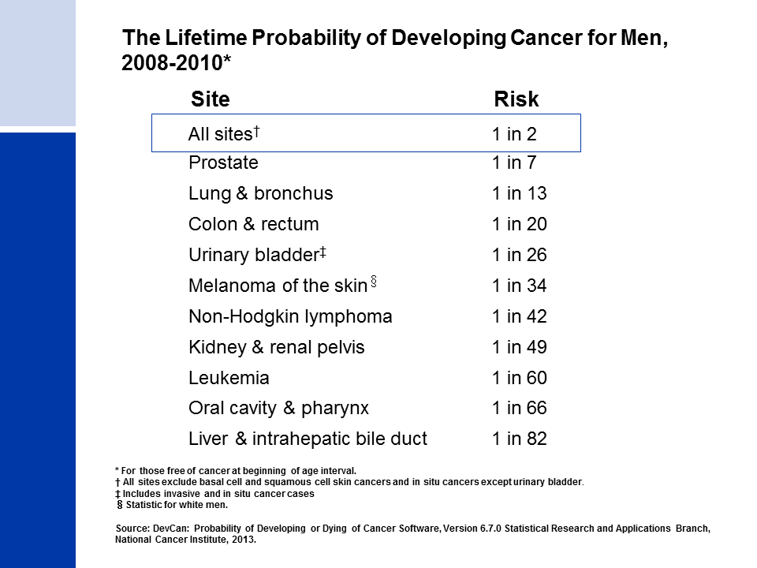
Notes:
The next four slides look at the lifetime probability of developing cancer and relative survival rates of cancer.
Presently, the risk of an American man developing cancer over his lifetime is a little less than one in two.

Slide 16
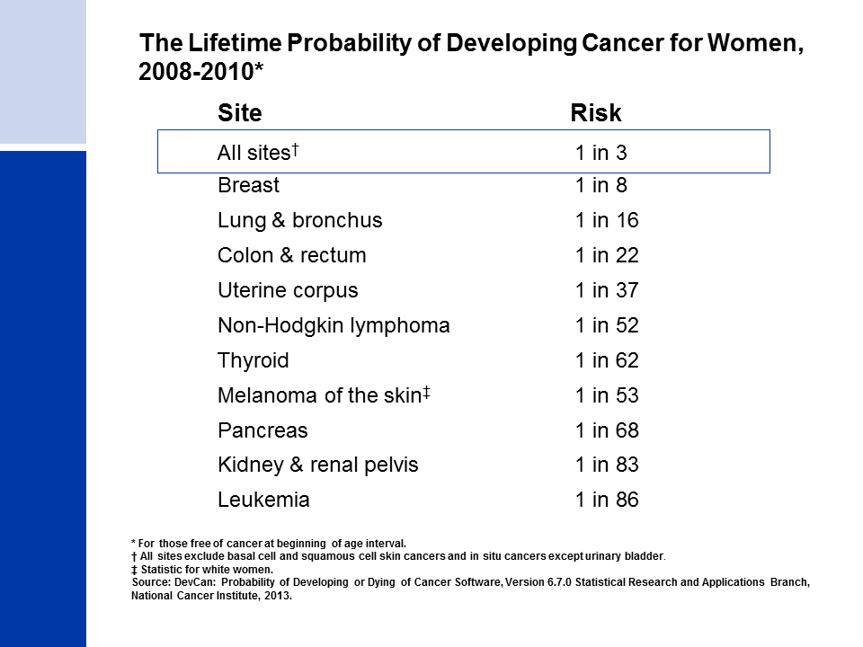
Notes:
The risk of an American woman developing cancer over her lifetime is a little more than one in three.

Slide 17
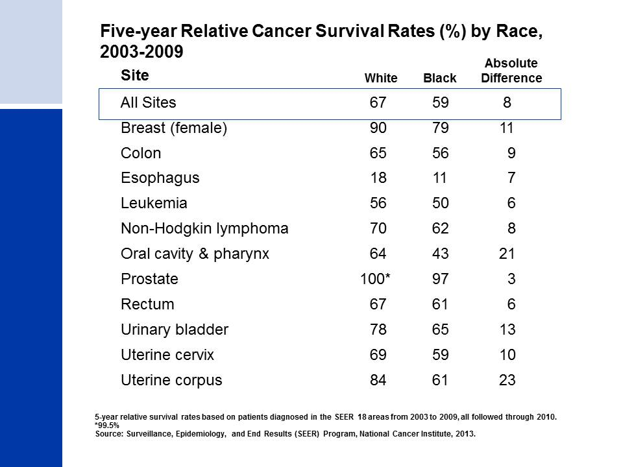
Notes:
The 5-year relative survival rate for all cancers combined is 67% among whites and 59% among blacks (taking normal life expectancy into consideration) in the 18 SEER areas (covering approximately 28% of the US population). Survival rates among blacks are more than 10% lower than among whites for 9 of the 11 cancer sites shown in this slide. Contributing factors include blacks being less likely to receive a cancer diagnosis at an early stage, when treatment is more successful, and also being less likely to receive appropriate cancer treatment. Additional factors that influence survival disparities include unequal access to medical care, differences in tumor characteristics unrelated to early detection, and differences in the prevalence of comorbidities (other health conditions).

Slide 18
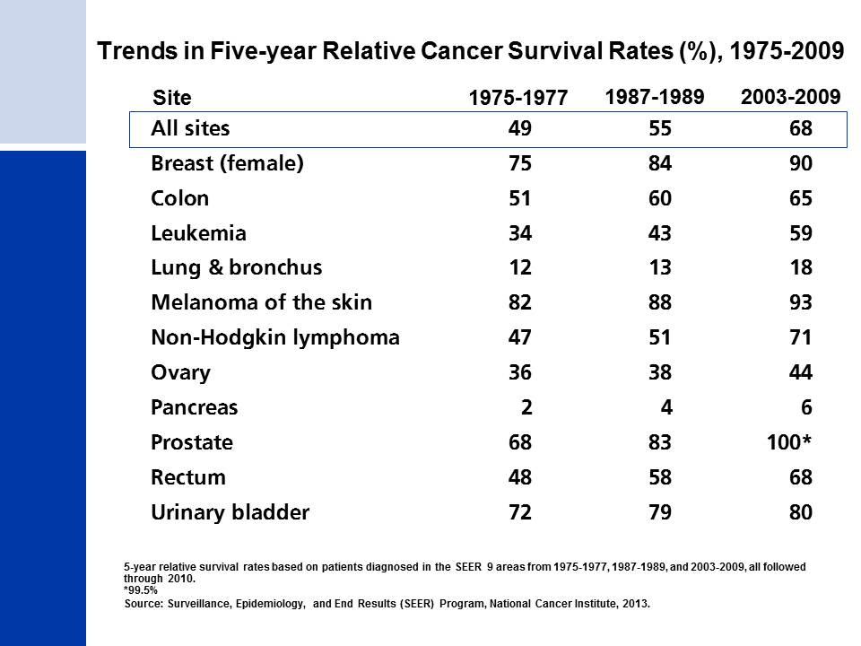
Notes:
In the SEER 9 areas (covering approximately 10% of the US population), survival rates for all cancers presented on this slide have improved significantly since the 1970s, due largely to earlier detection and/or advances in treatment. Survival rates have markedly increased for cancers of the prostate, breast, colon, and rectum, and for leukemia. Progress has been slower for cancers of the pancreas and lung and bronchus.

Slide 19
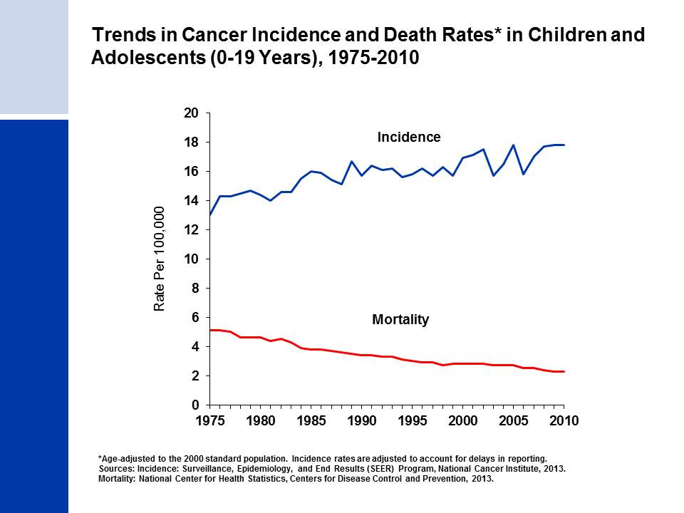
Notes:
The next series of slides present the burden of cancer among our nation's children. Since 1975, cancer incidence rates among children have been increasing slightly (by about 0.6% per year), while cancer death rates have decreased by more than half, from 5.1 (per 100,000 children 0-19 years) in 1975 to 2.4 in 2010.

Slide 20
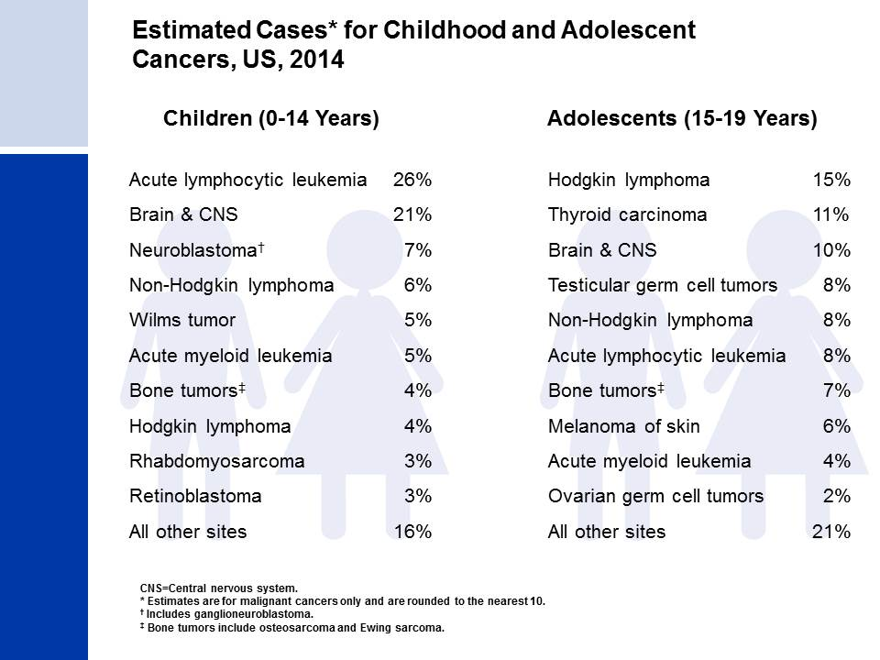
Notes:
In 2014, the most common types of cancer that will occur among children (ages 0-14 years) are acute lymphocytic leukemia (26%), brain & CNS cancer (21%), and neuroblastoma (7%). Among adolescents (ages 15-19 years), the leading types of cancer will be Hodgkin lymphoma (15%), thyroid carcinoma (11%) and brain and CNS cancer (10%).
In addition, 730 children and 630 adolescents will be diagnosed with benign and borderline brain tumors.

Slide 21
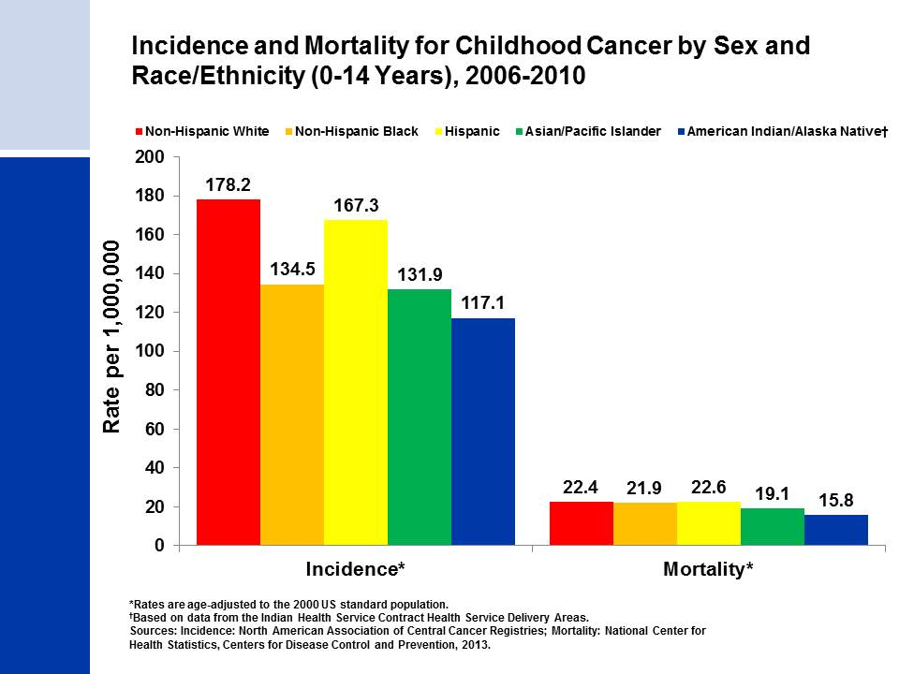
Notes:
Childhood cancer incidence rates vary by race/ethnicity, with non-Hispanic white children having the highest rate. Although incidence rates are substantially lower among black than non-Hispanic white children, death rates for the two groups are similar. Native American/Alaska Native children have the lowest cancer incidence and mortality of all racial/ethnic groups.
Racial/ethnic differences in childhood cancer incidence are not well understood. In contrast to adults, lower socioeconomic status is not associated with higher cancer incidence among children.

Slide 22
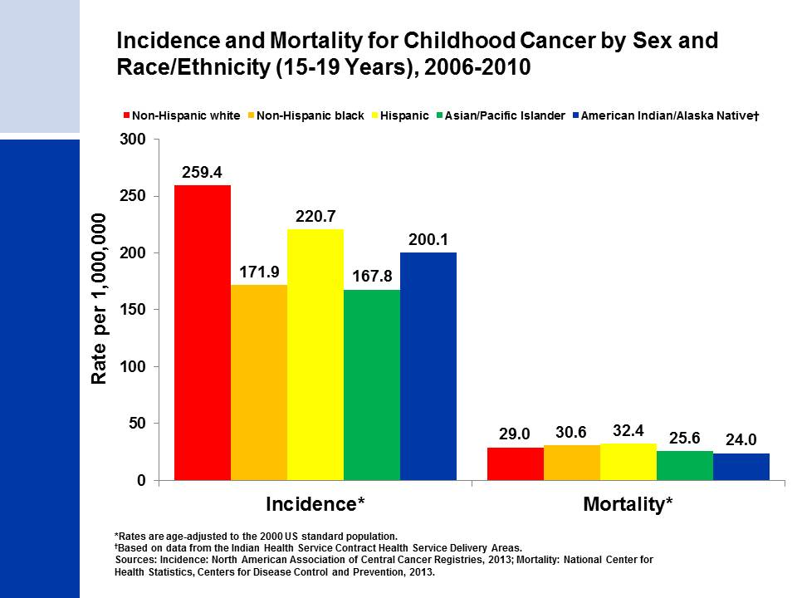
Notes:
Among all racial/ethnic groups, Non-Hispanic white adolescents have the highest cancer incidence rate and Hispanic adolescents have the highest mortality rate. Despite black adolescents having a 33% lower cancer incidence rate than whites, death rates are slightly higher among blacks. Some of the disparity in mortality between racial/ethnic groups may be due to differences in the distribution of incident cancers.

Slide 23
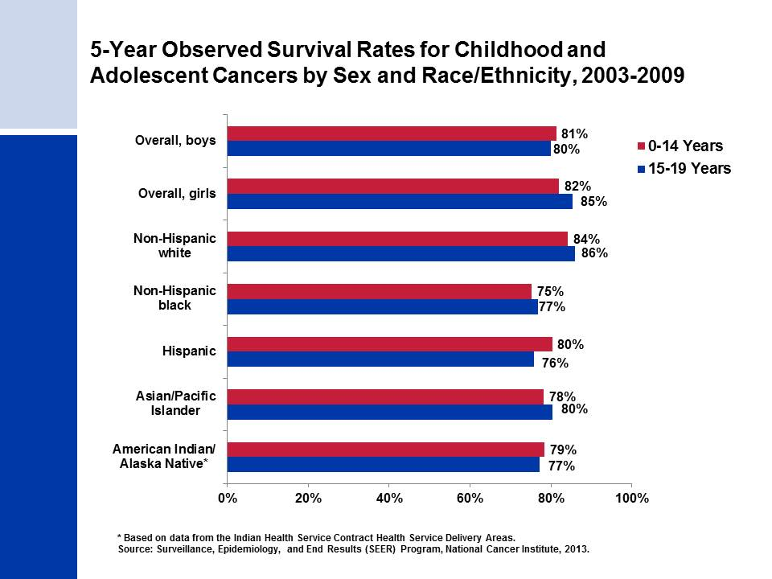
Notes:
Among adolescents (15-19 years), survival rates are higher among girls than among boys, whereas boys and girls younger than 15 have similar survival rates. Among racial/ethnic groups, survival rates are highest overall in non-Hispanic white children and adolescents (84% and 86%, respectively). Survival rates are lowest among non-Hispanic black children (75%) and Hispanic adolescents (76%) in their respective age groups. Factors that could potentially be associated with survival disparities include socioeconomic status, health insurance status, timely diagnosis and treatment and supportive care quality, and genetic factors.

Slide 24
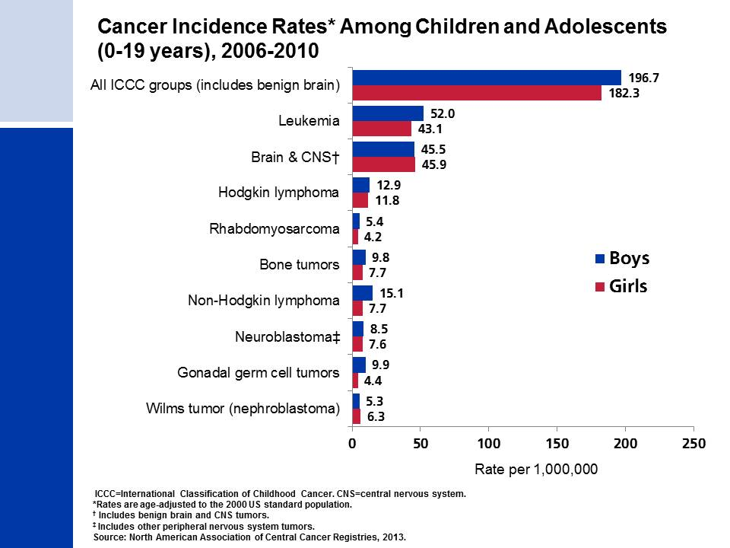
Notes:
Childhood cancers are best categorized based on a combination of both histology (microscopic structure) and tumor location rather than location alone, as adult tumors are classified. For this reason, the cancers presented in this slide are grouped according to the International Classification of Childhood Cancers. Leukemia accounts for about one-quarter of all cancers diagnosed in those younger than 20 years, but about one-third among kids diagnosed before age 15.
Cancer registries were mandated by law to begin reporting benign and borderline malignant brain and central nervous system tumors on January 1, 2004. Reporting was expanded for these cancers because benign tumors cause disruption to normal function similar to malignant tumors and because the location of a brain tumor is as important as whether it is benign or malignant in terms of prognosis. Approximately one-third of all brain tumors diagnosed in children and adolescents from 2006 to 2010 were benign or borderline malignant.

Slide 25
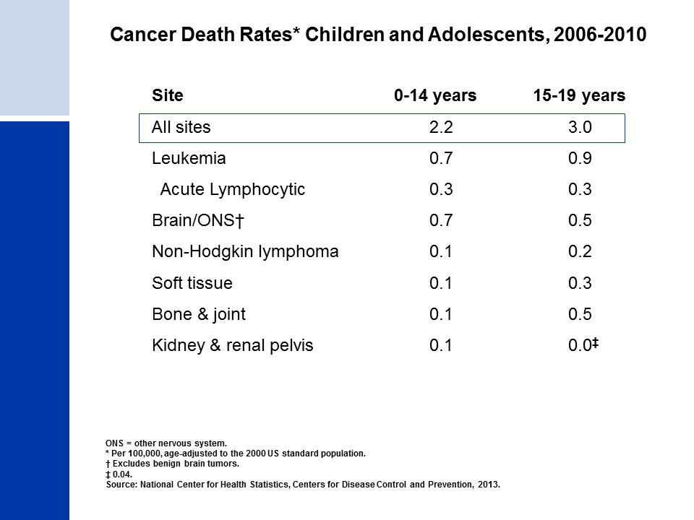
Notes:
Leukemia accounts for the most cancer deaths in children, comprising almost one-third of cancer deaths among boys and girls 0-14 years. Cancers of the brain and other nervous system are the second leading cause of cancer death in children.

Slide 26
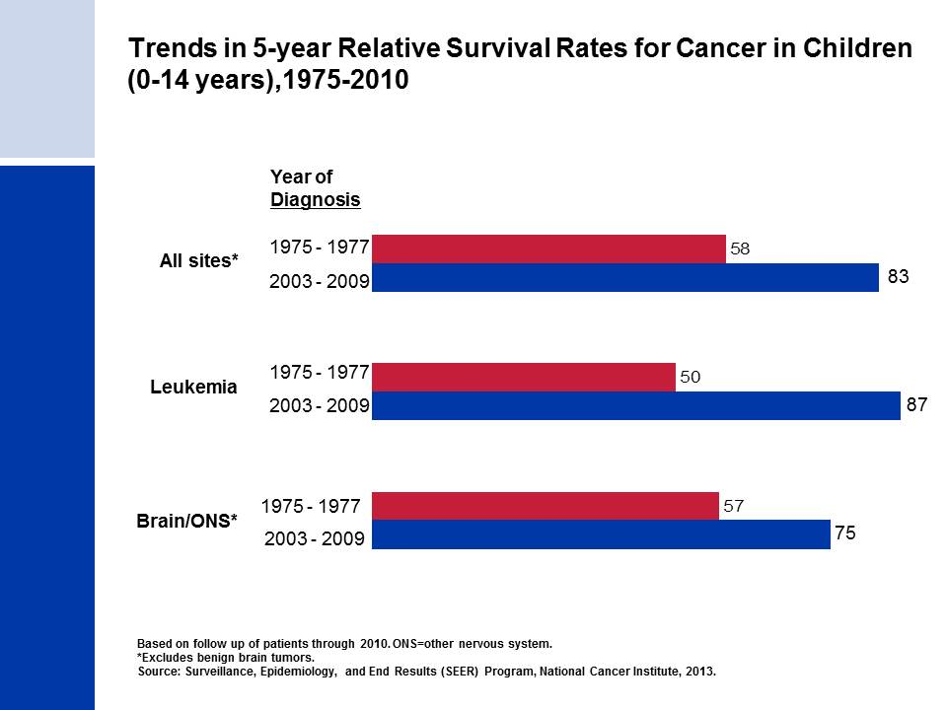
Notes:
The 5-year relative survival rate for childhood cancer has increased significantly during the past 3 decades. For example, the 5-year survival for childhood leukemia patients has improved from 50% for those diagnosed in the mid 1970s to 87% in the most recent time period.

Slide 27
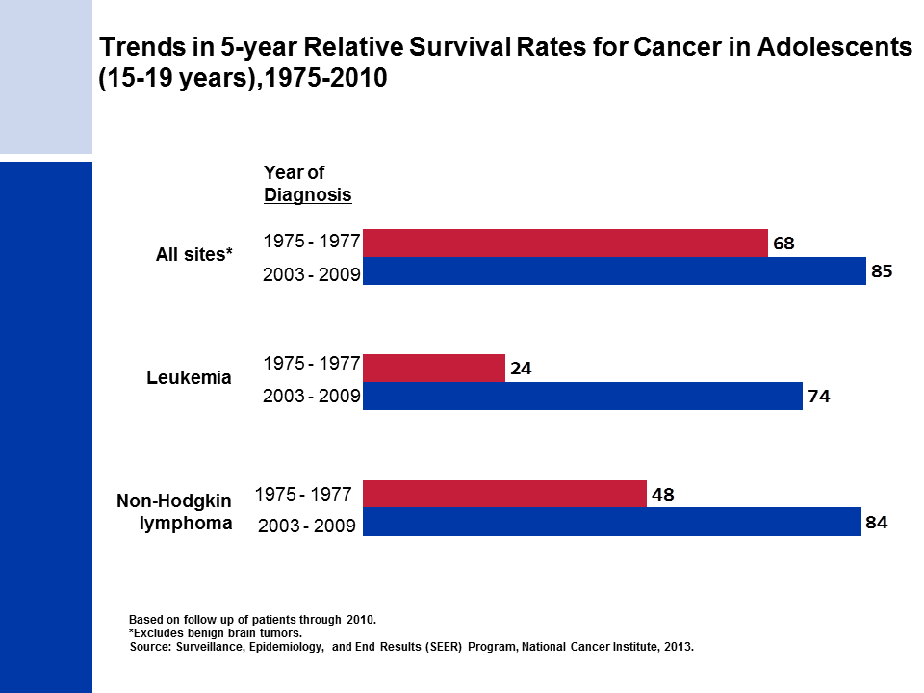
Notes:
The 5-year relative survival rate for leukemia among adolescents 15-19 years has increased significantly during the past 3 decades, largely driven by the survival improvement for acute lymphocytic leukemia, which increased from 30% in the mid 1970’s to 78% for cases diagnosed from 2003 to 2009. The 5-year survival for Non-Hodgkin lymphoma also increased dramatically during this time period, from 48% to 84%. These increases in survival are due to improvements in treatment over time.

