Slide 1

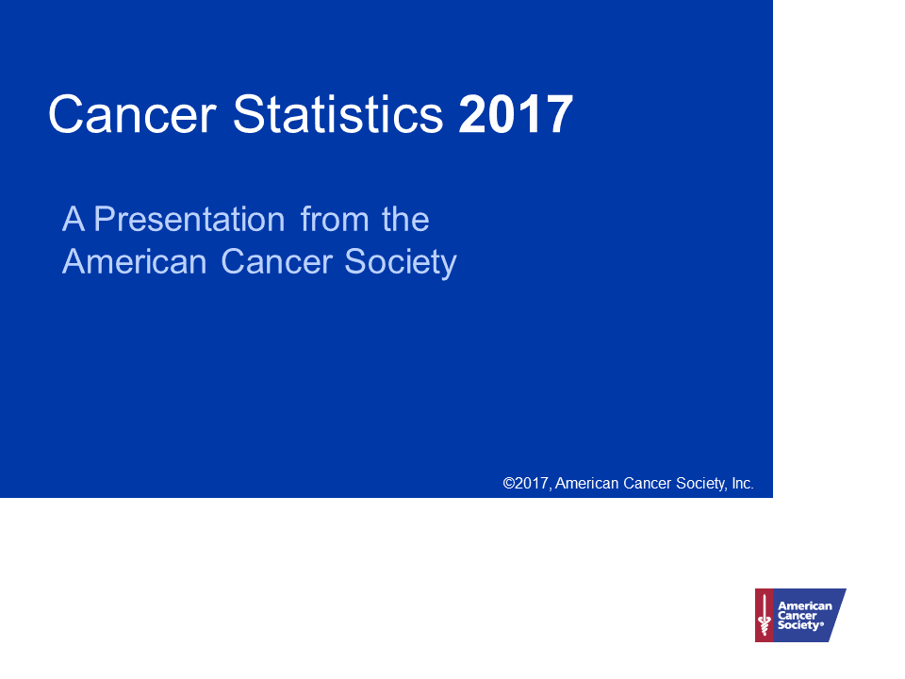

Slide 2
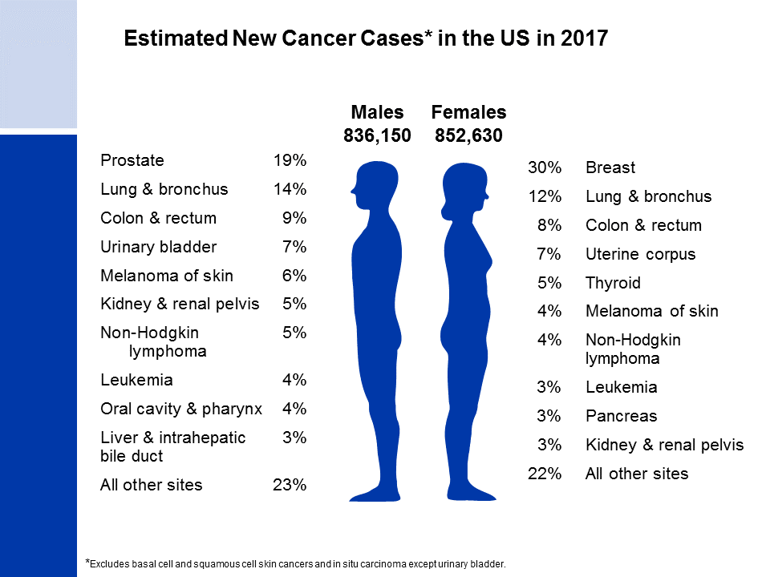
Notes:
It is estimated that almost 1.7 million new cases of cancer will be diagnosed in 2017. Prostate cancer is the most common cancer among males (19%), followed by lung (14%) and colorectal (9%) cancers. Among females, breast (30%), lung (12%), and colorectal (8%) cancers are the most common.

Slide 3
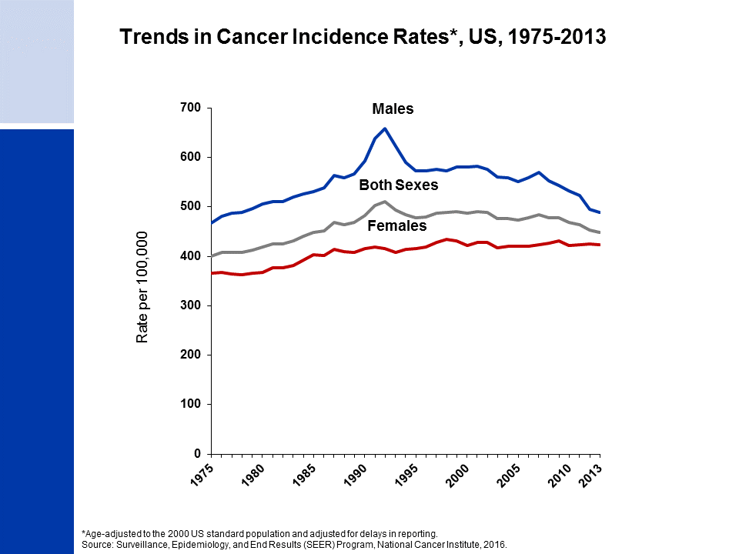
Notes:
This slide shows trends in cancer incidence rates for all sites combined from 1975 to 2013. The current cancer incidence rate (averaged over 2009-2013) is about 20% higher in men than women. The reasons for this are not well understood, but likely reflect differences in environmental and hormonal exposures. During the most recent 10 years of data, rates declined by about 2% per year in males and were stable in females. The decrease among males is driven by declines in prostate, lung, and colorectal cancers, whereas the stable trend in women is because declines in lung and colorectal cancers are offset by slightly increasing/stable rates for breast and uterine corpus cancers, which account for almost 40% of all cancers in women, as well as the rapid increase (4.6% per year) in thyroid cancer.
The 9 oldest SEER registries represent approximately 9% of the US population and are the only source for long-term (since 1975) population-based incidence data.

Slide 4
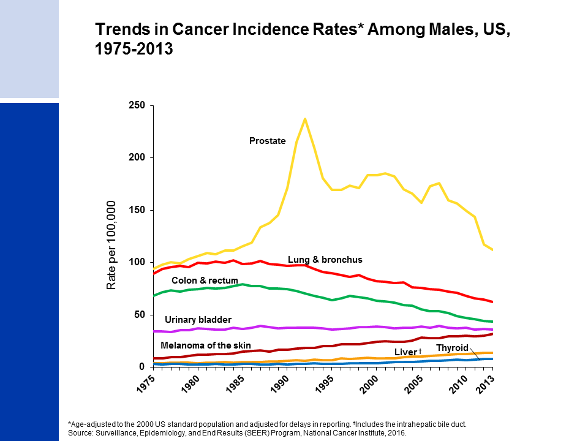
Notes:
Incidence rates for prostate cancer have changed substantially over the past 20 years: rapidly increasing from 1988 to 1992, declining sharply from 1992 to 1995, and generally decreasing from 2000 to 2013, with a marked drop between 2011 and 2012. This erratic trend primarily reflects changing patterns in the utilization of prostate-specific antigen (PSA) blood testing for the detection of asymptomatic prostate cancer. Incidence rates for both lung and colorectal cancers in males have been declining for more than two decades, whereas rates for liver and thyroid cancers and melanoma are increasing.

Slide 5
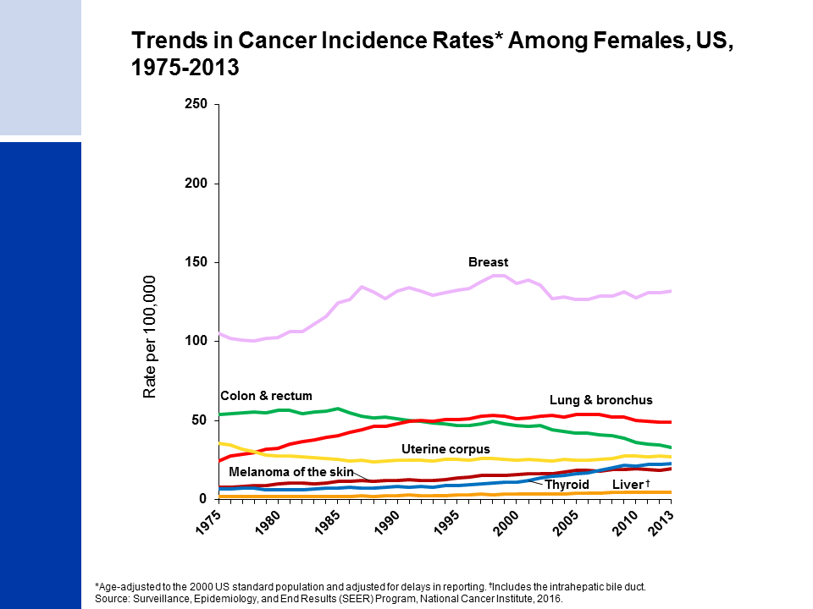
Notes:
Breast cancer incidence rates in females have been increasing very slightly over the last 10 years of available data (2004-2013), with the trend entirely driven by increasing rates among nonwhite women. This trend was preceded by a 7% decline from 2002 to 2003, which was primarily due to a reduction in use of hormone replacement therapy. Lung cancer rates began to decline in the mid-2000’s after increasing since at least 1975. Differences in the lung cancer pattern between males and females reflect later smoking uptake and slower cessation among women. Colorectal cancer incidence rates have been declining since the mid-1980s. In contrast, incidence rates are increasing for cancers of the liver and thyroid.

Slide 6
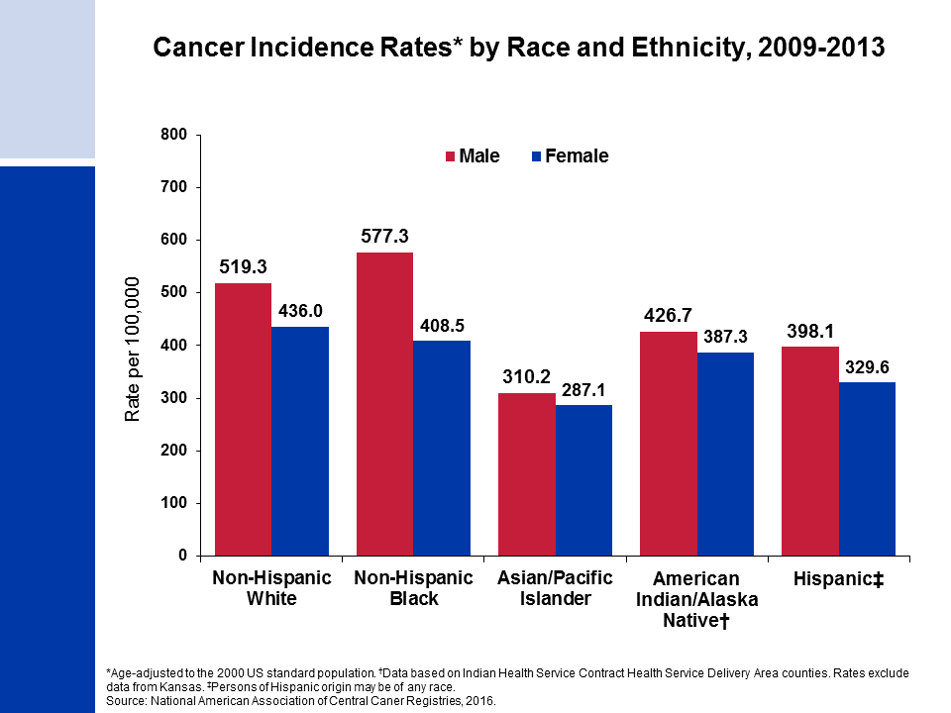
Notes:
Cancer incidence rates are higher in males than in females for each racial/ethnic population. The highest incidence rates are in blacks among males and in whites among females. Asian/Pacific Islanders have the lowest rates in both sexes.
It is important to note that these are broadly defined groups within which cancer rates vary substantially. In addition, rates for populations other than white and black may be underestimated due to incomplete information on race/ethnicity in medical records.

Slide 7
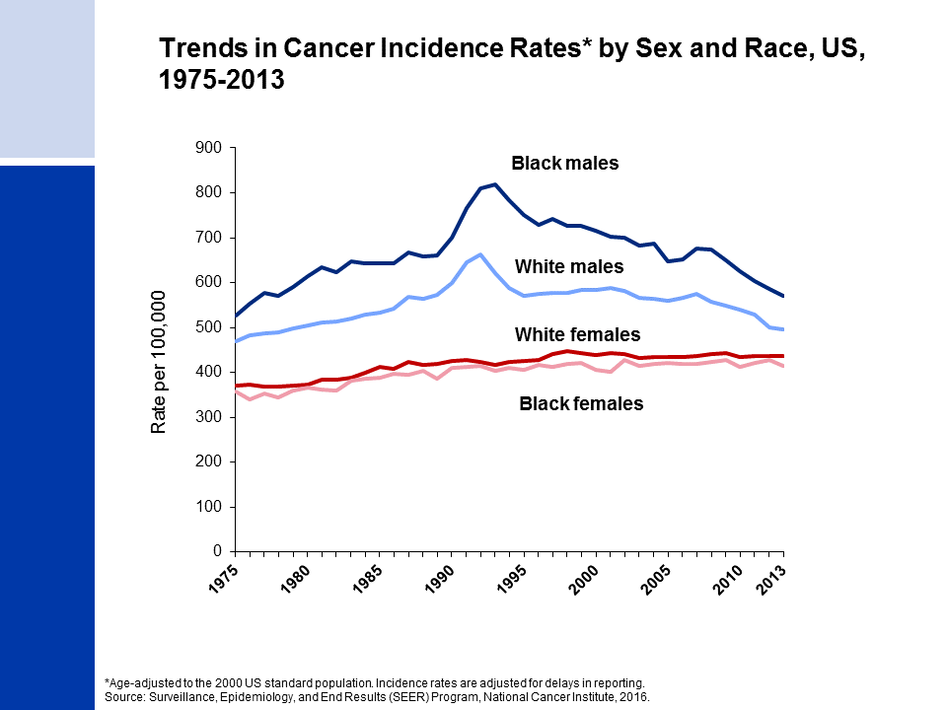
Notes:
Since the mid-1970s, cancer incidence rates for all sites combined have been substantially higher among black than white males, while among females rates are similar but slightly higher in whites. The higher rates among white compared to black females has been driven by lung and breast cancers; however, breast cancer incidence rates in these two groups are converging.

Slide 8
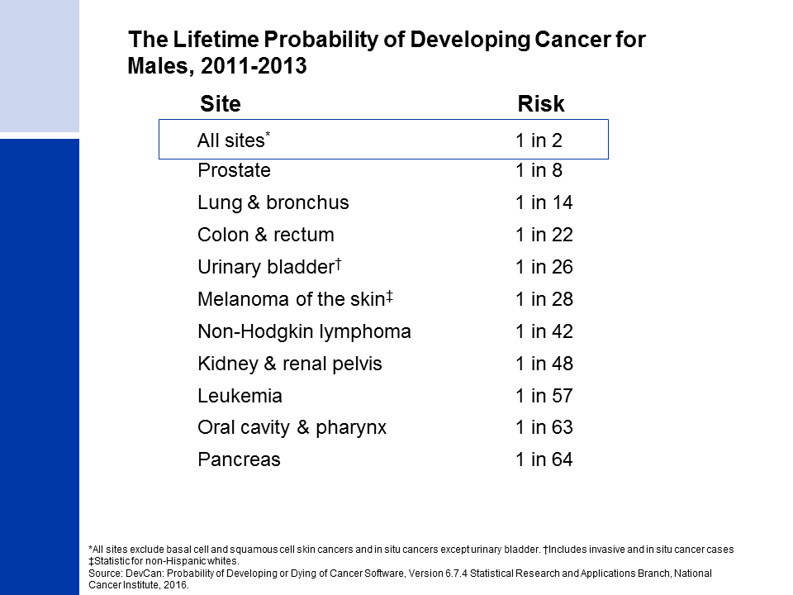
Notes:
The next four slides look at the lifetime probability of developing cancer and cancer survival.
For American males, the average lifetime risk of developing cancer is 40.8%, or a little less than one in two. These figures are based on the entire male population and vary for individuals because of lifestyle and other factors. For example, cancer risk among smokers is higher than among nonsmokers.

Slide 9
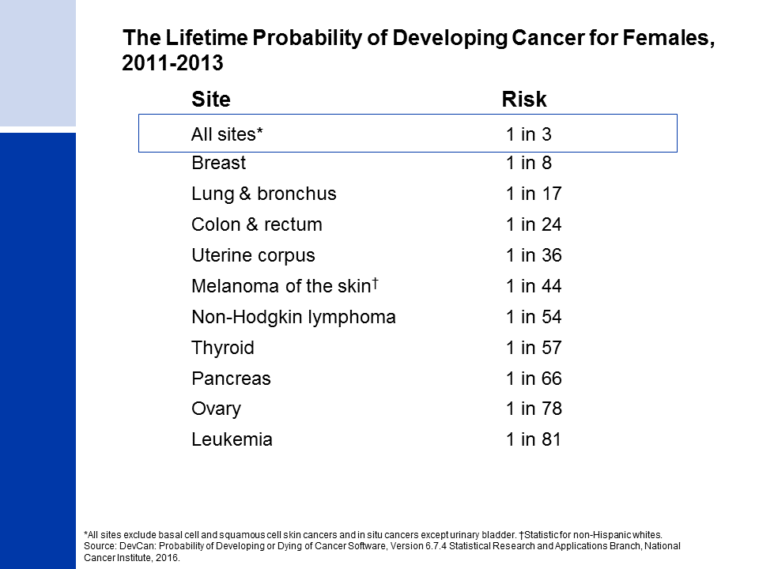
Notes:
The risk of an American woman developing cancer over her lifetime is 37.5% (a little more than one in three).

Slide 10

Notes:
There have been notable improvements in survival rates for most cancer types due to earlier detection and/or advances in treatment. For example, due to improvements in treatment, the five-year relative survival rate for leukemia has increased from 34% in the mid-1970s to 63% in the most recent time period.

Slide 11
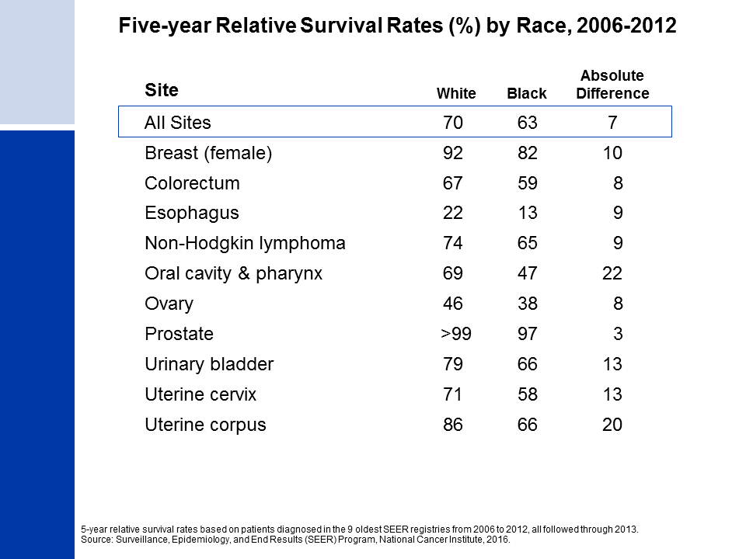
Notes:
While gains in survival have occurred for both whites and blacks, blacks have lower survival rates than whites for most cancer types. The largest differences are for cancers of the oral cavity and uterine corpus. Factors that contribute to racial disparities in survival include a later stage of diagnosis among blacks, as well as a lower likelihood of receiving high quality treatment. Additional factors include differences in tumor characteristics unrelated to early detection and differences in the prevalence of comorbidities (other health conditions).

Slide 12
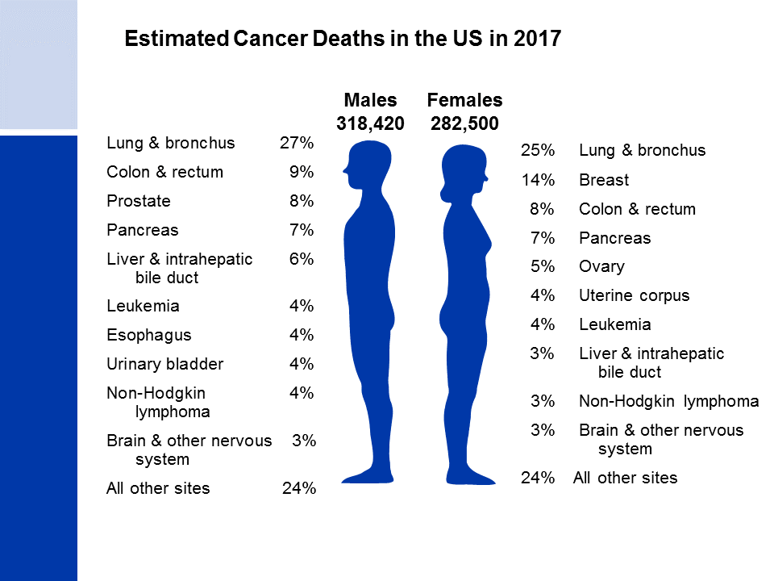
Notes:
Now we will turn our attention to cancer mortality. Lung cancer is by far the leading cause of cancer death among males (27%), followed by colorectal (9%) and prostate (8%) cancers. Among females, lung (25%), breast (14%), and colorectal (8%) cancers are the leading causes of cancer death.

Slide 13

Notes:
Cancer death rates have been declining in males and females since the early 1990s. From 1991 to 2014, the combined death rate dropped 25%. Over the past 10 years (2005 to 2014), the death rate for all cancers combined decreased by about 1.5% in both males and females.

Slide 14
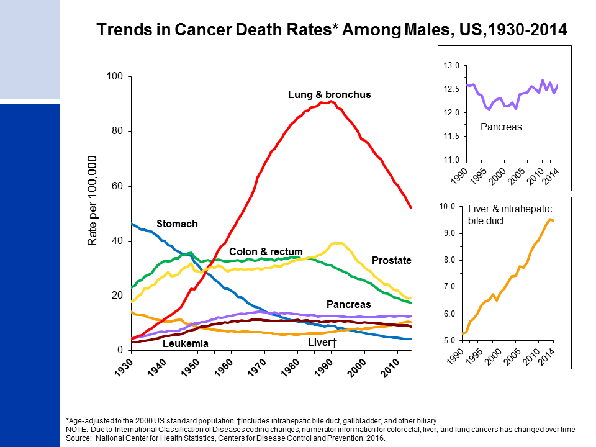
Notes:
Prior to 1990, most of the increase in the male cancer death rate was attributable to the rapid increase in lung cancer deaths due to the tobacco epidemic. In the past decade, however, death rates for lung cancer, along with prostate cancer, have declined more rapidly (>3% per year) than for any other cancer. The death rate for stomach cancer, which was the leading cause of cancer death among males early in the 20th century, has decreased by more than 90% since 1930. The death rate for colorectal cancer has been declining since the early 1980s. In contrast to declining death rates for most cancers, liver cancer death rates increased by 3% per year from 2004 to 2013, and death rates for pancreatic cancer have also been increasing slightly.

Slide 15
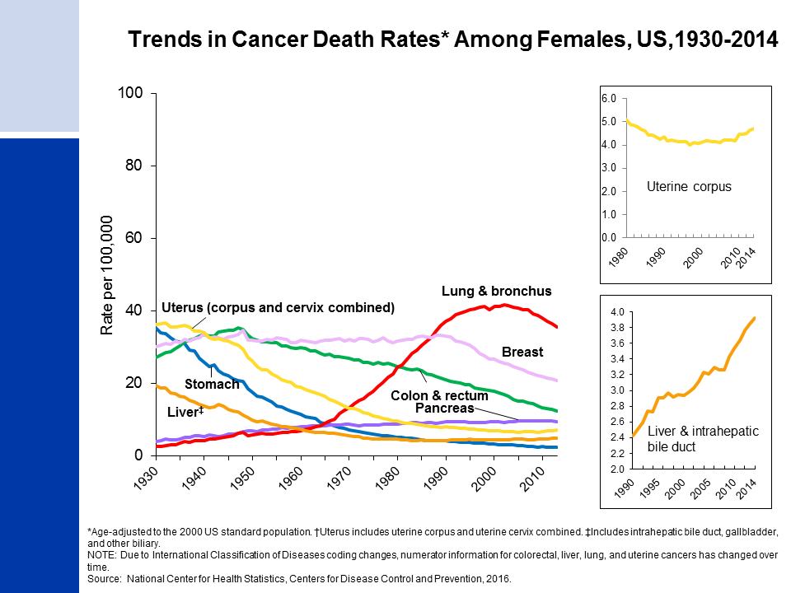
Notes:
The lung cancer death rate in females didn’t begin declining until the early 2000s because of the delay in smoking uptake and cessation in women compared to men. Breast cancer death rates changed little between 1930 and 1989, but decreased 38% from 1989 to 2014. As in males, the death rate for stomach cancer has decreased by more than 90%. Also similar to males, liver cancer death rates increased by about 2% per year from 2005 to 2014. In contrast to males, colorectal cancer death rates in women have been decreasing since the late 1940s. Uterine corpus cancer death rates (shown in the inset) have been increasing since 2000.

Slide 16
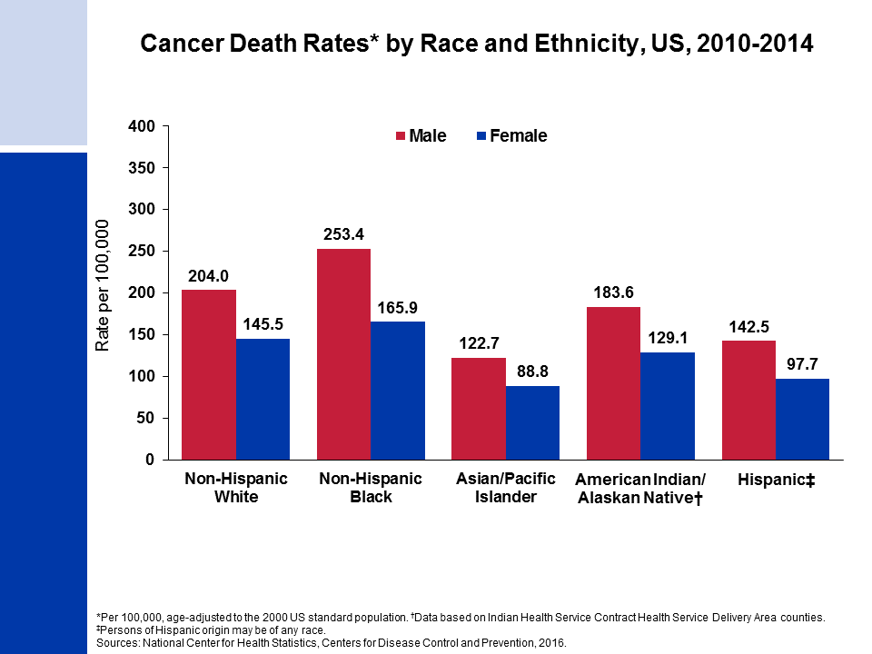
Notes:
Cancer death rates are higher among males than among females for every racial and ethnic group. Black males and females have the highest cancer mortality rates and Asian/Pacific Islanders have the lowest, about half the rates of blacks.
It is important to note that these are broadly defined groups within which cancer rates vary substantially. In addition, rates for populations other than white and black may be underestimated due to incomplete information on race/ethnicity in medical records.

Slide 17
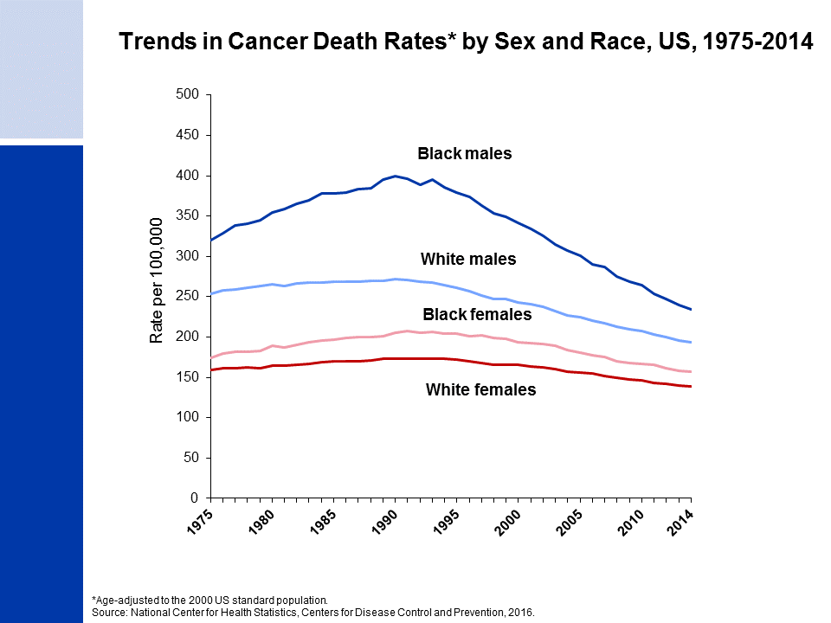
Notes:
The excess risk of cancer death in black men compared to white men dropped from 47% in 1990 to 21% in 2014. The black/white disparity declined similarly in women, from a peak of 20% in 1998 to 13% in 2014.

Slide 18
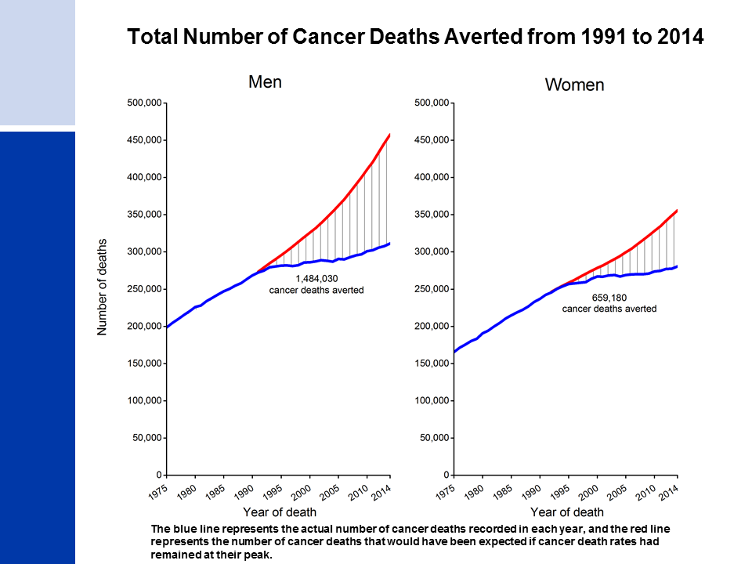
Notes:
Since 1991, there have been an estimated 2.1 million fewer cancer deaths as a result of two decades of consistent declines in cancer deaths rates.

Slide 19
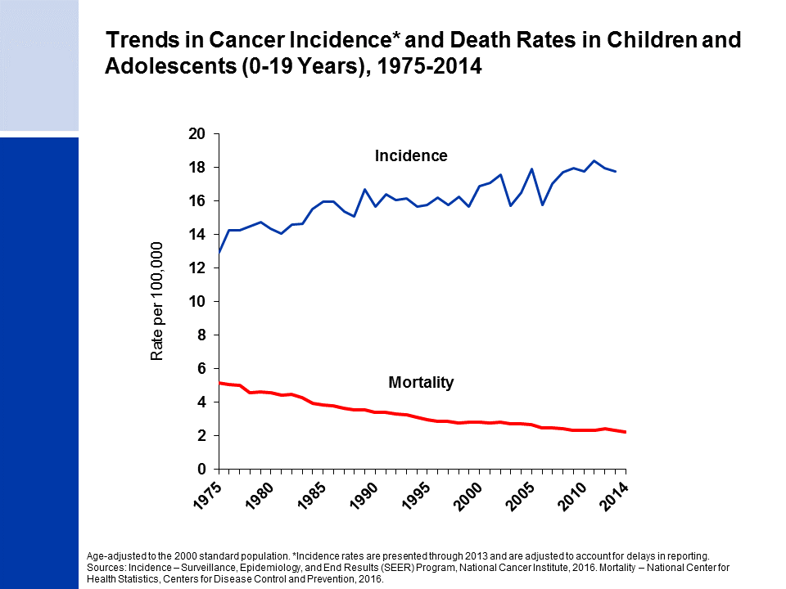
Notes:
The next series of slides present the burden of cancer among children and adolescents in the US. Cancer incidence and mortality trends in children (ages 0 to 14 years) and adolescents (ages 15 to 19 years) are very similar. Since 1975, cancer incidence rates have been increasing slightly by about 0.6% per year, while cancer death rates have decreased by more than half.
Among children and adolescents combined (ages 0 to 19 years), brain cancer has surpassed leukemia as the leading cause of cancer death. Although treatment options have improved for both cancers, therapeutic advances for leukemia have been particularly dramatic. From 1975 to 2014, the death rate in this age group declined by 73% for leukemia compared with 27% for tumors of the brain and other nervous system.

Slide 20
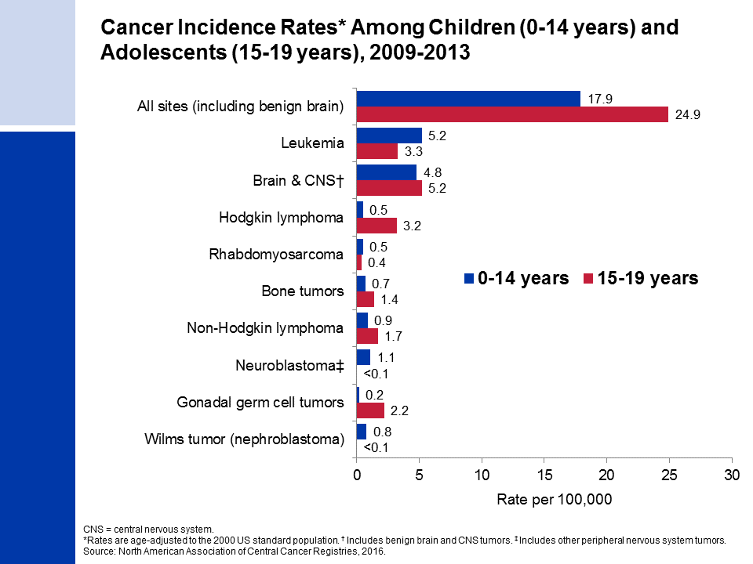
Notes:
This slide shows cancer incidence rates in children and adolescents by cancer type according to the International Classification of Childhood Cancers. This system is more appropriate for cancer in children because it categorizes cancers based on a combination of both histology (microscopic structure) and tumor location, rather than location alone. Leukemia accounts for 29% of all cancers diagnosed in children, but just 14% of cancers diagnosed in adolescents.
Cancer registries were mandated by law to begin reporting benign and borderline malignant brain and central nervous system tumors on January 1, 2004. Reporting was expanded to include these cancers because benign tumors cause disruption to normal function similar to malignant tumors and because benign cancers can have a prognosis similar to malignant cancers, depending on the location of the tumor. Approximately one-third of all brain tumors diagnosed in children and adolescents from 2009 to 2013 were benign or borderline malignant.

Slide 21
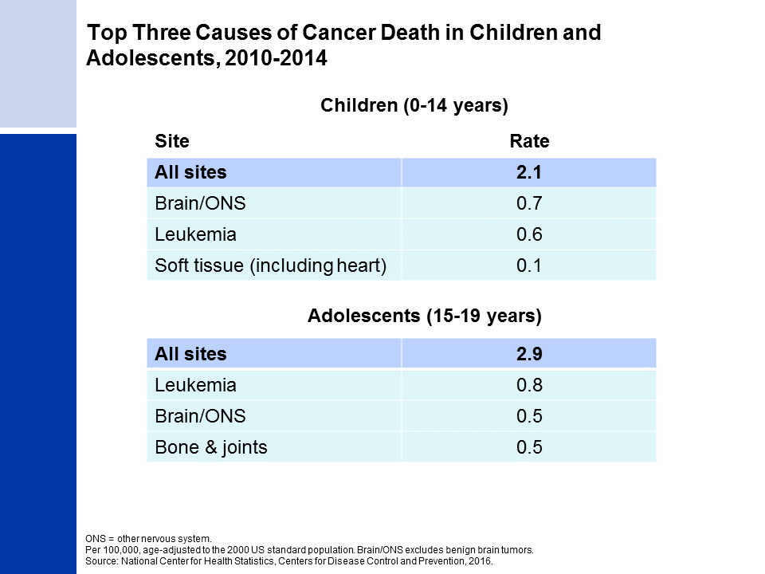
Notes:
The top causes of childhood and adolescent cancer death are similar, but they rank differently. The most common cause of cancer death in children is brain and other nervous system tumors, followed closely by leukemia. In adolescents, leukemia ranks first, followed by brain and other nervous system.
The reason that leukemia is a more common cause of cancer death in adolescents than in children, despite having a lower incidence rate, is because survival rates for leukemia are higher in children than adolescents. In contrast, survival for brain and other nervous system is lower in children than in adolescents (as is shown on the next slide).

Slide 22
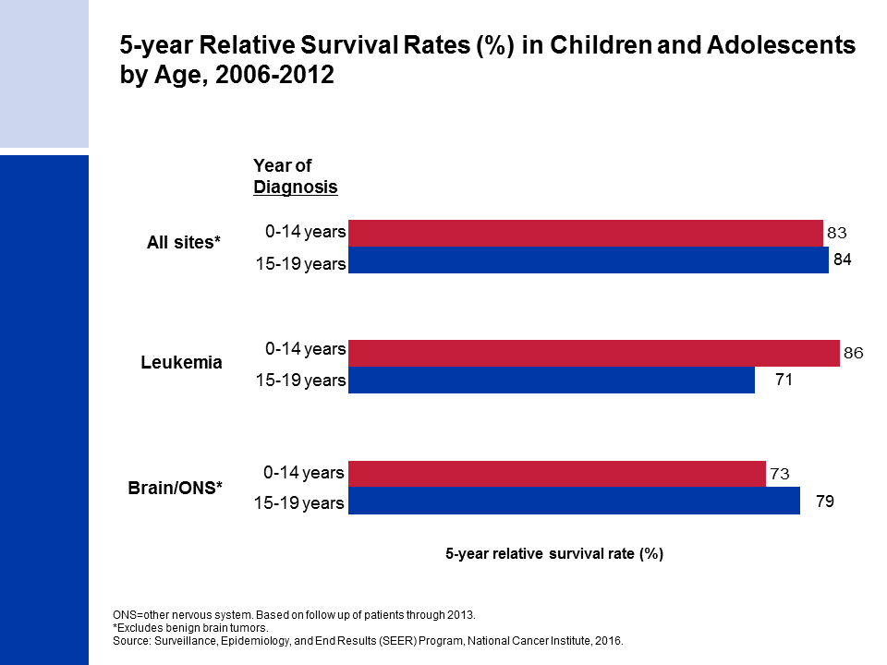
Notes:
Survival rates are similar for children and adolescents overall, but vary by cancer site. For example, the current 5-year relative survival rate for leukemia is 86% for children but only 71% for adolescents.

Slide 23
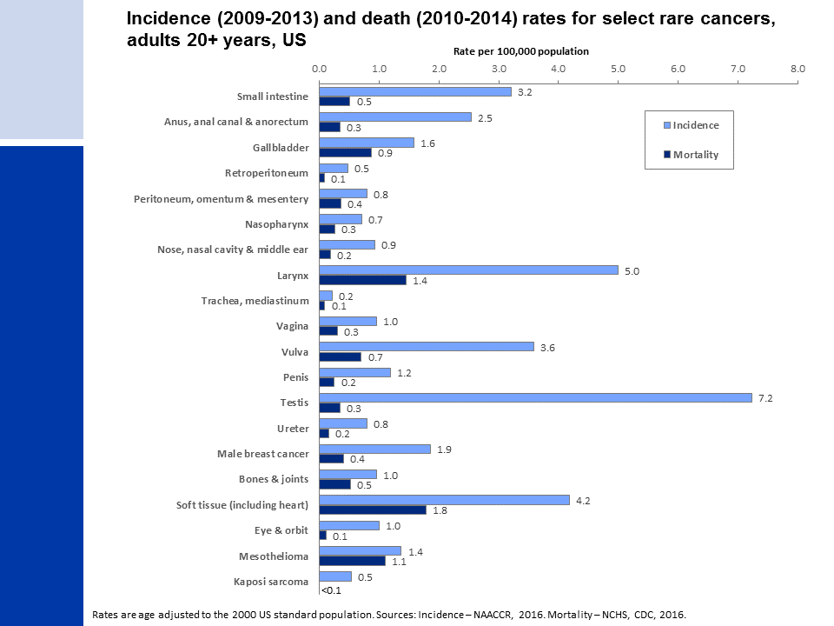
Notes:
The special section of Cancer Facts & Figures 2017 focuses on rare cancers that occur in adults ages 20 and older. In this report, rare cancers are defined as those with an incidence rate less than 6 cases per 100,000 people (testicular cancer is also included, as it is conventionally considered a rare cancer). In 2017, rare cancers will account for approximately 208,000 (13%) of the nearly 1.7 million new cancer cases diagnosed in the US.

