Slide 1

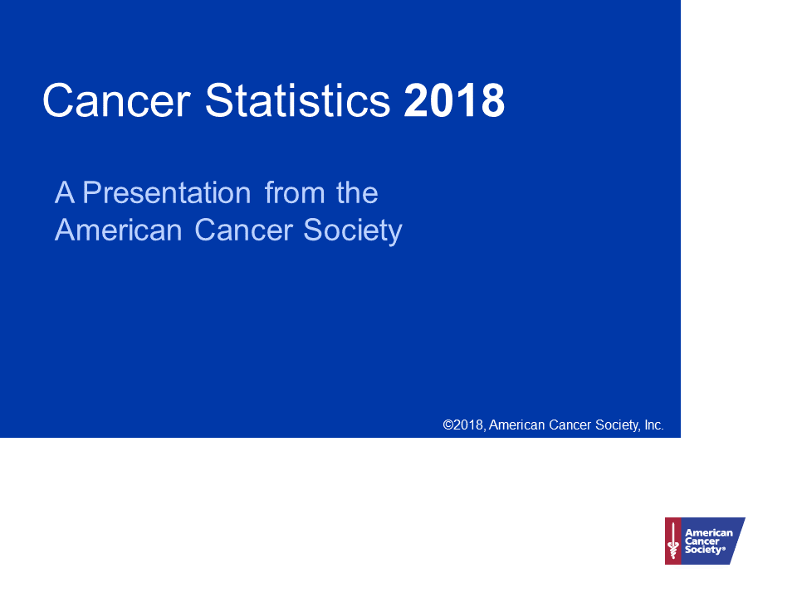

Slide 2
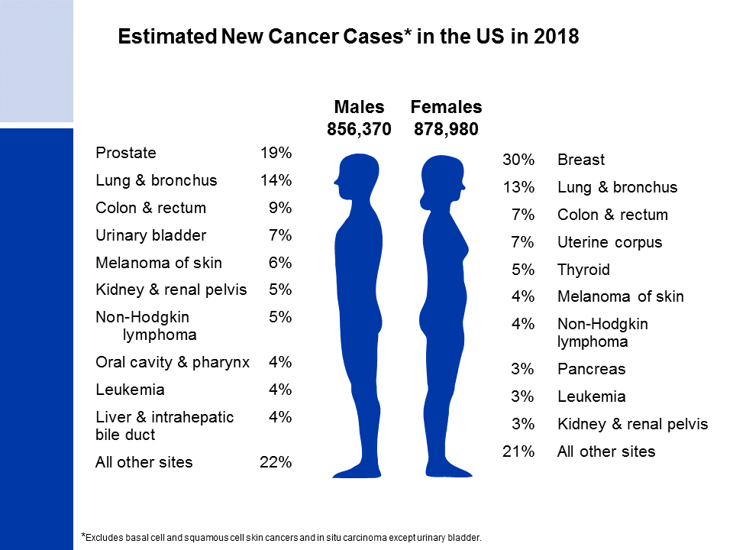
Notes:
It is estimated that about 1.7 million new cases of cancer will be diagnosed in 2018. Prostate cancer is the most common cancer among males (19%), followed by lung (14%) and colorectal (9%) cancers. Among females, breast (30%), lung (13%), and colorectal (7%) cancers are the most common.
Rankings based on estimates should be interpreted with caution because they are model-based projections.

Slide 3
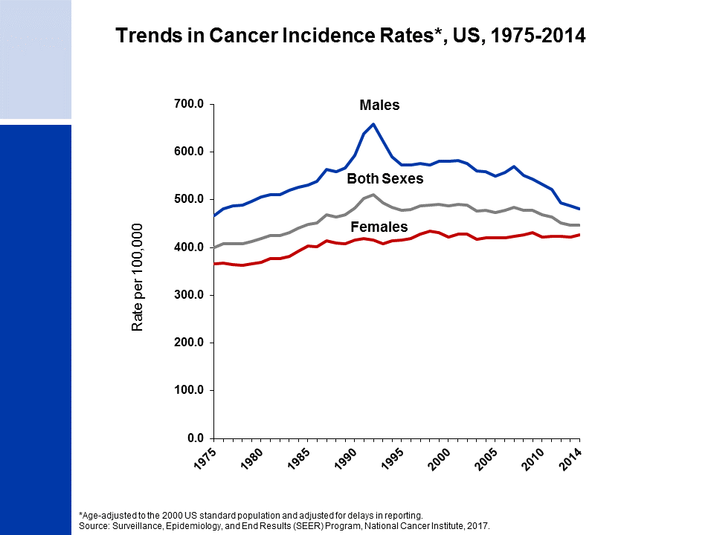
Notes:
This slide shows trends in cancer incidence rates for all sites combined from 1975 to 2014. The current average annual cancer incidence rate (2010-2014) is about 20% higher in men than in women. The reasons for this are not well understood, but likely reflect differences in environmental and hormonal exposures. During the most recent 10 years of data, rates declined by about 2% per year in males and were stable in females. The decrease among males is driven by declines in prostate, lung, and colorectal cancers, whereas the stable trend in women is because declines in lung and colorectal cancers are offset by increasing or stable rates for breast, thyroid, and uterine corpus cancers, which account for more than 40% of all cancers in women.
The 9 oldest SEER registries represent approximately 9% of the US population and are the source for historic (since 1975) population-based cancer incidence data.

Slide 4
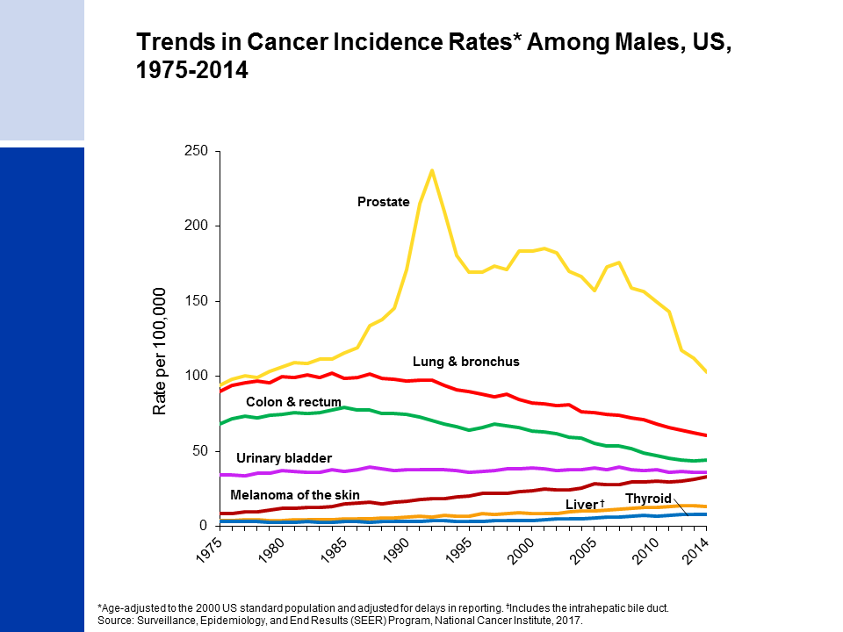
Notes:
Incidence rates for prostate cancer have changed substantially over the past 20 years, increasing rapidly from 1988 to 1992, declining sharply from 1992 to 1995, and generally decreasing from 2000 to 2014, with a marked drop between 2011 and 2012. This erratic trend primarily reflects changing patterns in the utilization of prostate-specific antigen (PSA) blood testing for the detection of asymptomatic prostate cancer. Incidence rates have been declining for lung and colorectal cancers in males for more than two decades, whereas rates for melanoma are increasing. Rates for thyroid and liver cancers appear to have stabilized in recent years after increasing for decades.

Slide 5
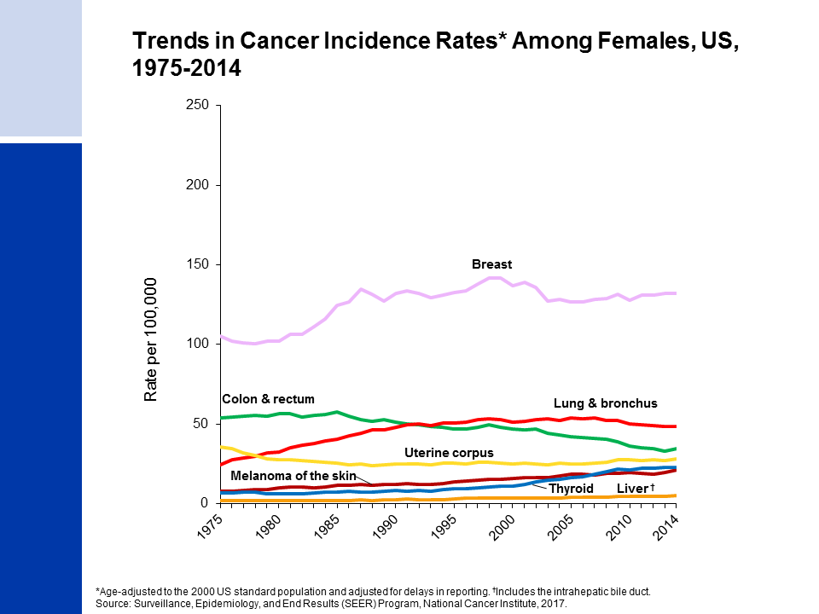
Notes:
Breast cancer incidence rates in females have been increasing very slightly over the last 10 years of available data (2005-2014), with the trend entirely driven by increasing rates among nonwhite women. This trend was preceded by a 7% decline from 2002 to 2003, which is primarily attributed to a reduction in use of hormone replacement therapy. Lung cancer rates began to decline in the mid-2000’s after increasing since at least 1975. Differences in the lung cancer pattern between males and females reflect differences in smoking pattern, including later uptake and slower cessation among women. Colorectal cancer incidence rates have been declining since the mid-1980s. In contrast, incidence rates are increasing for cancers of the liver and thyroid, although the pace of the increase may be slowing for thyroid, particularly among whites.

Slide 6
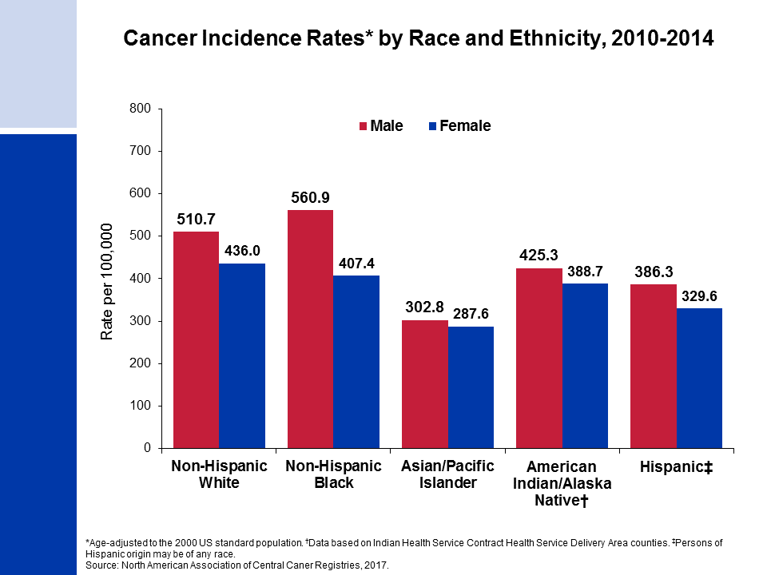
Notes:
Cancer incidence rates are higher in males than in females for each racial/ethnic population. The highest incidence rates are in blacks among males and in whites among females. Asian/Pacific Islanders have the lowest rates in both sexes.
It is important to note that these are broadly defined groups within which cancer rates vary substantially. In addition, rates for populations other than white and black may be underestimated due to incomplete information on race/ethnicity in medical records.

Slide 7
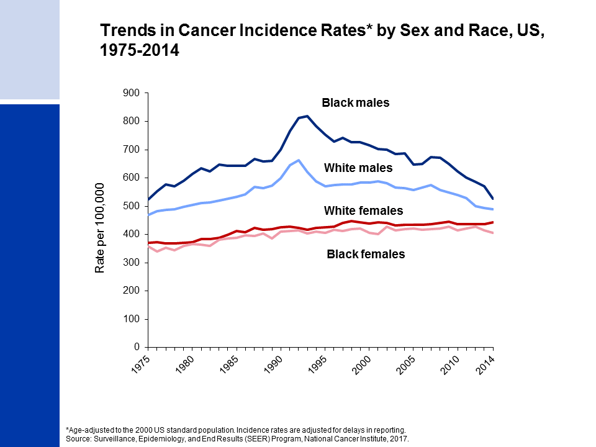
Notes:
Since the mid-1970s, cancer incidence rates for all sites combined have been substantially higher among black than white males, while among females rates are similar but slightly higher in whites. The higher rates among white compared to black females has been driven by lung and breast cancers; however, breast cancer incidence rates in these two groups are converging.

Slide 8
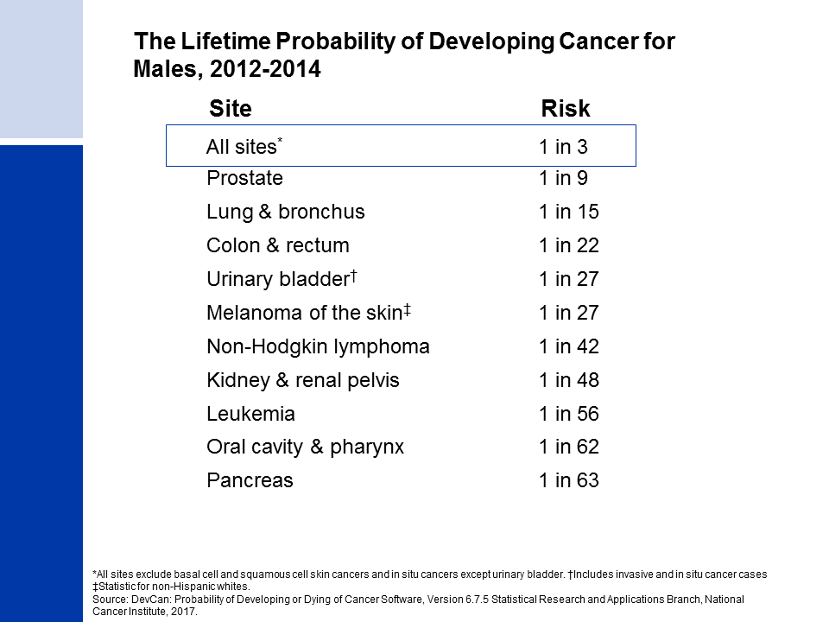
Notes:
For American males, the average lifetime risk of developing cancer is 39.7%, a little more than 1 in 3. These figures are based on the average experience of the entire male population and vary for individuals because of lifestyle and other factors. For example, cancer risk among smokers is higher than among nonsmokers.

Slide 9
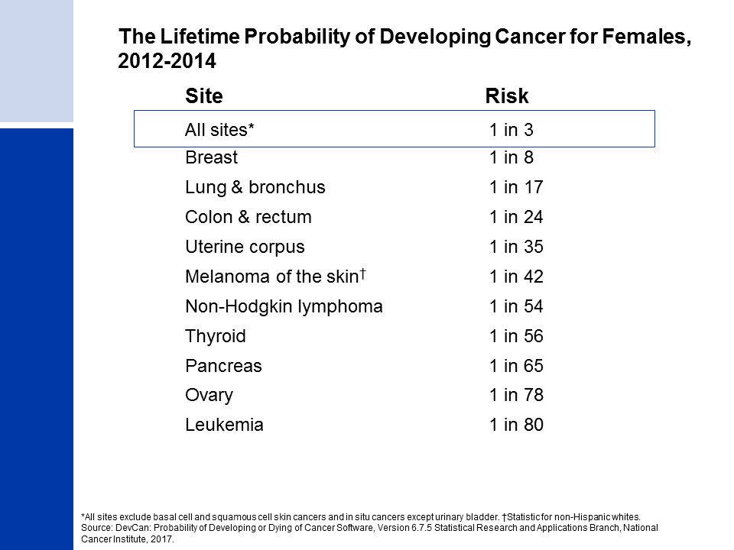
Notes:
The risk of an American woman developing cancer over her lifetime is 37.6% (slightly more than one in three).

Slide 10

Notes:
There have been notable improvements in survival rates for most cancer types due to earlier detection and/or advances in treatment. For example, due to improvements in treatment, the five-year relative survival rate for leukemia has increased from 34% in the mid-1970s to 64% in the most recent time period.
These survival trends are based on patients diagnosed in the nine oldest SEER registries and may vary slightly from those of more complete population coverage.

Slide 11
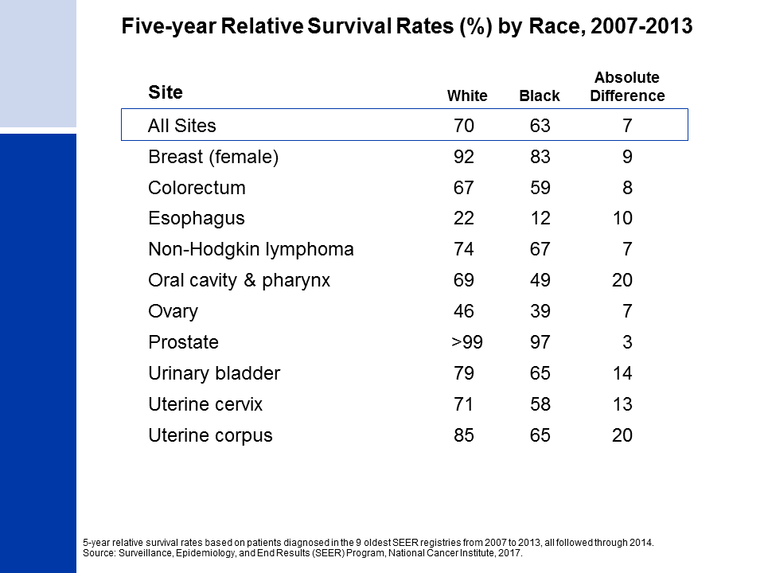
Notes:
While gains in survival have occurred for both whites and blacks, blacks have lower survival rates than whites for most cancer types. The largest differences are for cancers of the oral cavity and uterine corpus. Factors that contribute to racial disparities in survival include a later stage of diagnosis among blacks, as well as a lower likelihood of receiving high quality treatment. Additional factors include differences in tumor characteristics unrelated to early detection and differences in the prevalence of comorbidities (other health conditions).

Slide 12
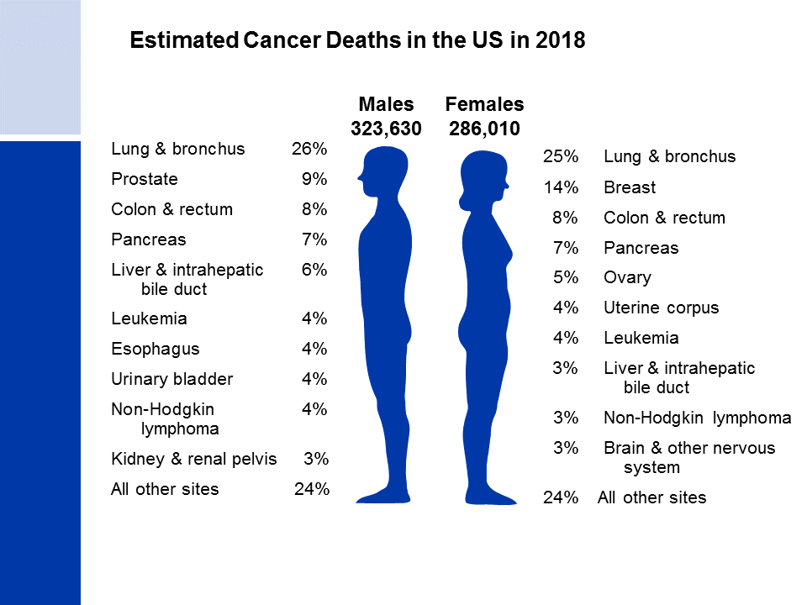
Notes:
Now we will turn our attention to cancer mortality. Lung cancer is by far the leading cause of cancer death among males (26%), followed by prostate and colorectal cancers. Among females, lung, breast, and colorectal cancers are the leading causes of cancer death.

Slide 13

Notes:
Cancer death rates have been declining in males and females since the early 1990s. From 1991 to 2015, the combined death rate dropped 26%. Over the past 10 years (2006 to 2015), the death rate for all cancers combined decreased by about 1.5% in both males and females.

Slide 14
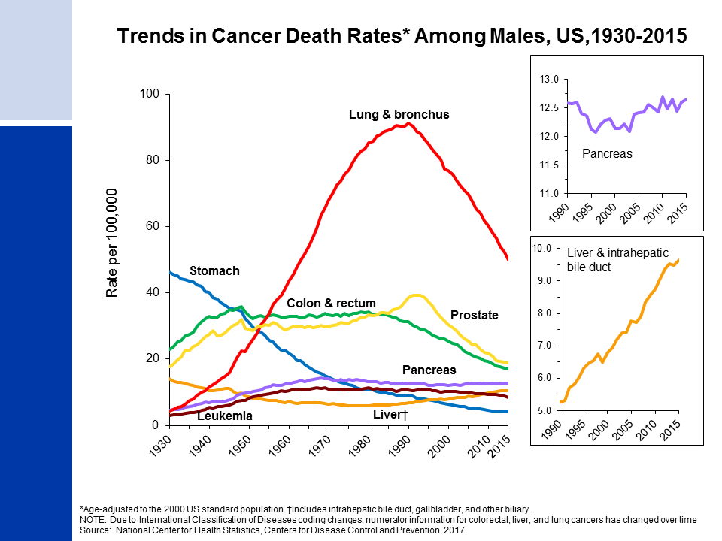
Notes:
Prior to 1990, most of the increase in the male cancer death rate was caused by the rapid increase in lung cancer deaths due to the tobacco epidemic. In the past decade, however, death rates for lung cancer, along with prostate cancer, have declined more rapidly (about 3% per year) than for any other cancer. The death rate for stomach cancer, which was the leading cause of cancer death among males early in the 20th century, has decreased by more than 90% since 1930. The death rate for colorectal cancer in men has been declining since the early 1980s. In contrast to declining death rates for most cancers, liver cancer death rates increased by 2% per year from 2006 to 2015, and death rates for pancreatic cancer have also been increasing slightly.

Slide 15
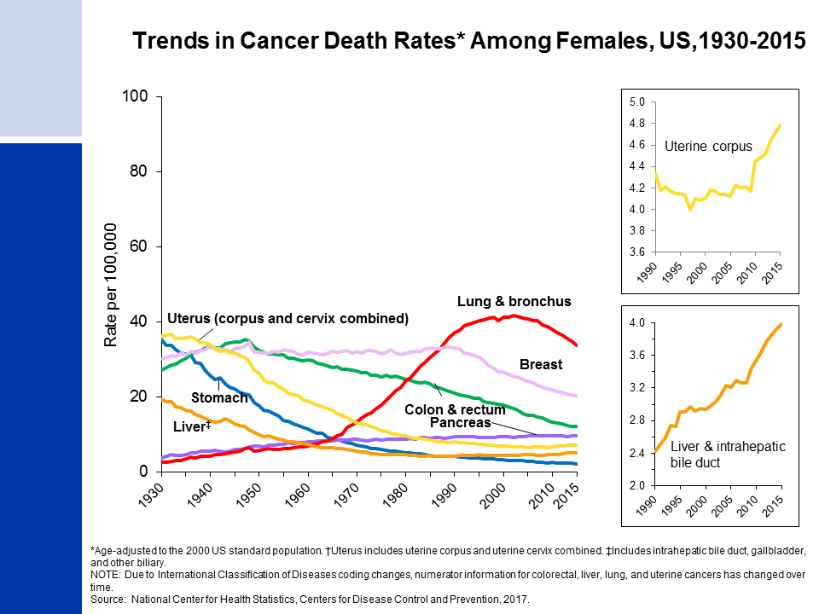
Notes:
The lung cancer death rate in females didn’t begin declining until the early 2000s because of the delay in smoking uptake and cessation in women compared to men. Breast cancer death rates changed little between 1930 and 1989, but decreased 39% from 1989 to 2015. As in males, the death rate for stomach cancer has decreased by more than 90%. Also similar to males, liver cancer death rates increased by about 2% per year from 2006 to 2015. In contrast to males, colorectal cancer death rates in women have been decreasing since the late 1940s. Uterine corpus cancer death rates (shown in the inset) have been increasing since the mid-1990s.

Slide 16
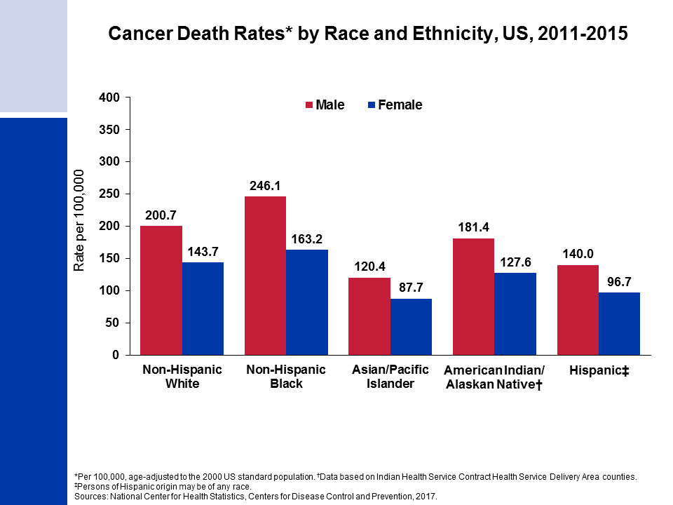
Notes:
Cancer death rates are higher among males than among females for every racial and ethnic group. Black males and females have the highest cancer mortality rates and Asian/Pacific Islanders have the lowest, about half the rates of blacks.
It is important to note that these are broadly defined groups within which cancer rates vary substantially. In addition, rates for populations other than white and black may be underestimated due to incomplete information on race/ethnicity in medical records.

Slide 17
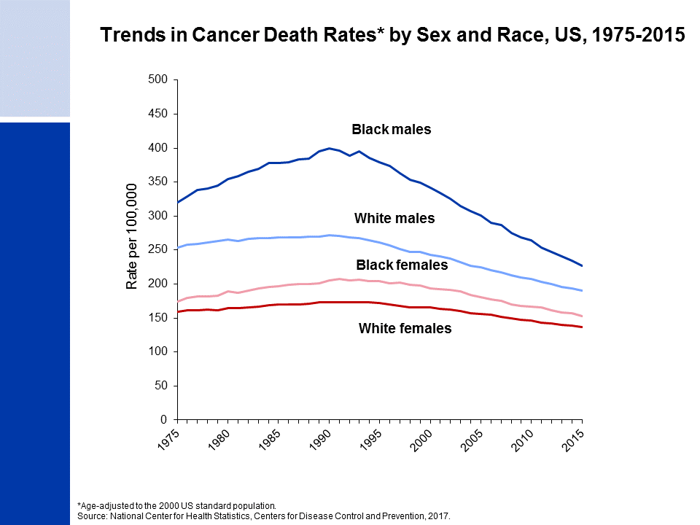
Notes:
The excess risk of cancer death in blacks versus whites dropped from 47% in 1990 to 19% in 2015 among men and from 21% in 1997 to 12% in 2015 among women.

Slide 18
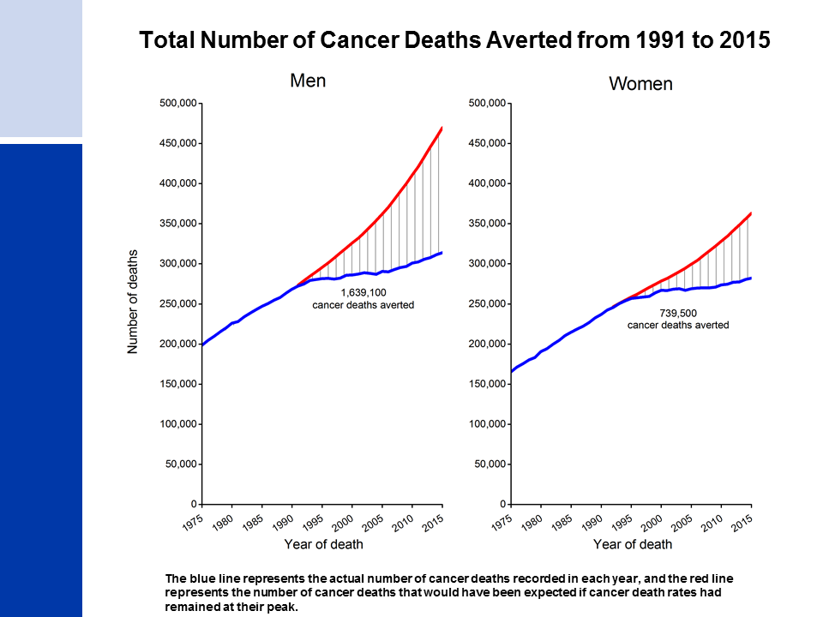
Notes:
Since 1991, there have been almost 2.4 million fewer cancer deaths as a result of two decades of consistent declines in cancer deaths rates.

Slide 19
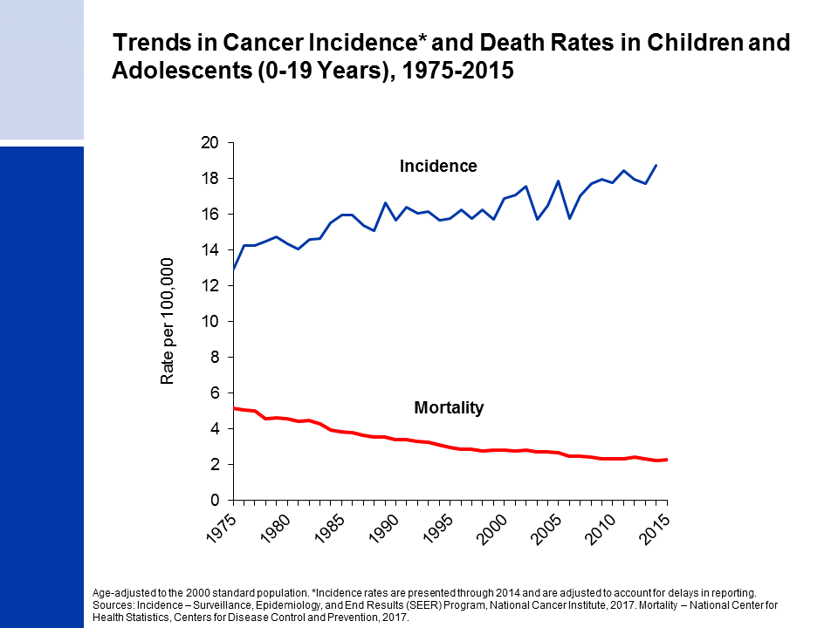
Notes:
The next series of slides present the burden of cancer among children and adolescents in the US. Cancer incidence and mortality trends in children (ages 0 to 14 years) and adolescents (ages 15 to 19 years) are very similar. Since 1975, cancer incidence rates have been increasing slightly by about 0.6% per year, while cancer death rates have decreased by more than half.
Among children and adolescents combined (ages 0 to 19 years), brain cancer has surpassed leukemia as the leading cause of cancer death. Although treatment options have improved for both cancers, therapeutic advances for leukemia have been particularly dramatic. From 1975 to 2015, the death rate in this age group declined by 70% for leukemia compared with 30% for tumors of the brain and other nervous system.

Slide 20
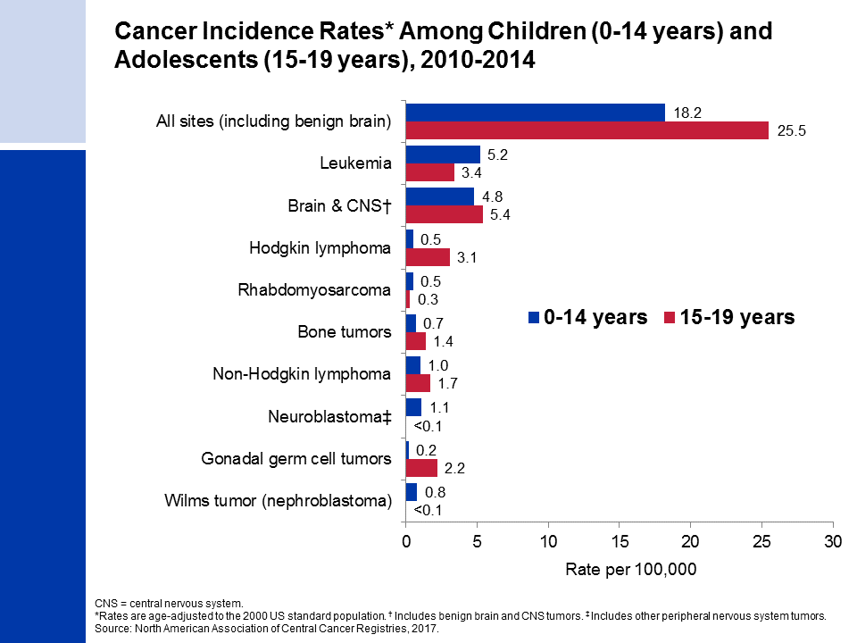
Notes:
This slide shows cancer incidence rates in children (ages 0-14 years) and adolescents (ages 15-19 years) by cancer type according to the International Classification of Childhood Cancers. This system is more appropriate for children because it categorizes cancers based on a combination of both histology (microscopic structure) and tumor location, rather than location alone. Leukemia accounts for 29% of all cancers diagnosed in children, but just 13% of cancers diagnosed in adolescents.
Cancer registries were mandated by law to begin reporting benign and borderline malignant brain and central nervous system tumors on January 1, 2004. Reporting was expanded to include these cancers because benign tumors cause disruption to normal function similar to malignant tumors and because the prognosis for benign and malignant tumors is often similar. During 2010-2014, approximately one-quarter of all brain tumors diagnosed in children and more than one-half of those in adolescents were benign or borderline malignant.

Slide 21
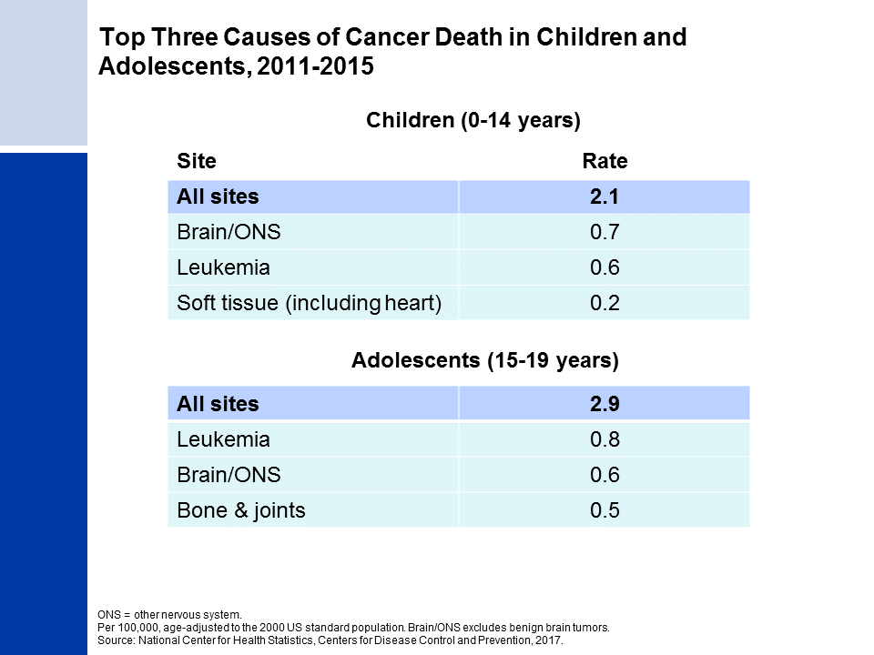
Notes:
The top causes of cancer death in children and adolescents are brain and other nervous system tumors and leukemia. The reason leukemia has a higher death rate in adolescents than in children, despite having a lower incidence rate, is because survival rates for leukemia are higher in children than adolescents.

Slide 22
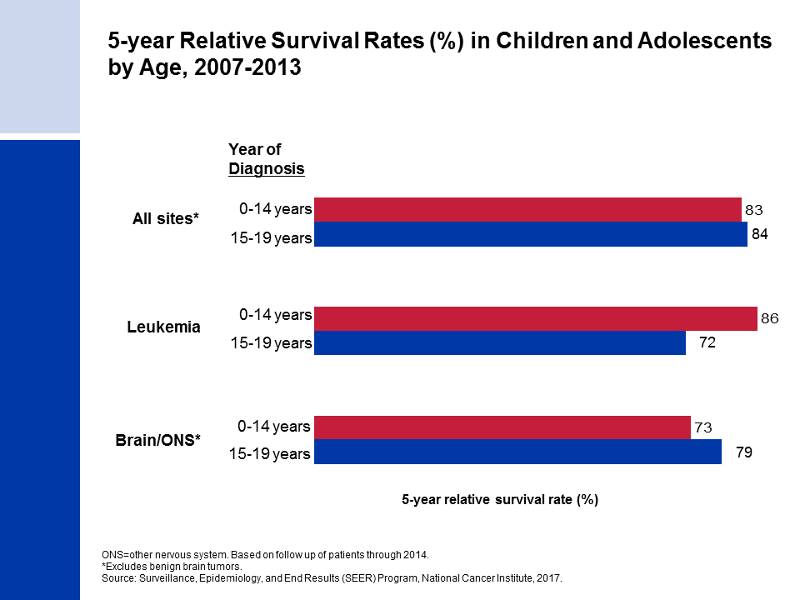
Notes:
Survival rates are similar for children and adolescents overall, but vary by cancer site. For example, the current 5-year relative survival rate for leukemia is 86% for children but only 72% for adolescents. In contrast, survival for brain and other nervous system is lower in children than in adolescents.

Slide 23
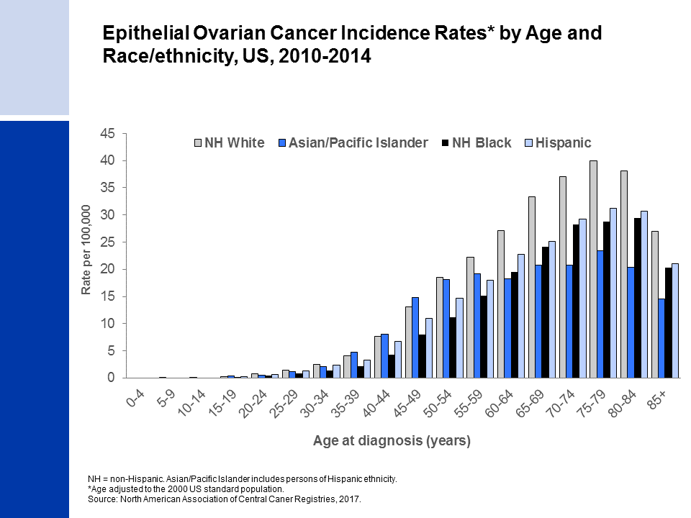
Notes:
The special section in Cancer Facts & Figure 2018 focuses on ovarian cancer and includes information on the disease’s occurrence, risk factors, early detection, and treatment. Much of the available information on ovarian cancer is specific to epithelial tumors, the most common subtype. As shown in the above figure, non-Hispanic white and Asian/Pacific Islander women have the highest incidence of epithelial ovarian cancers until age 50-54 years; however, from age 70, rates in non-Hispanic whites are double those in Asians/Pacific Islanders.
(Note: Data for American Indian/Alaska Native women are not shown above due to sparse data.)

