Slide 1
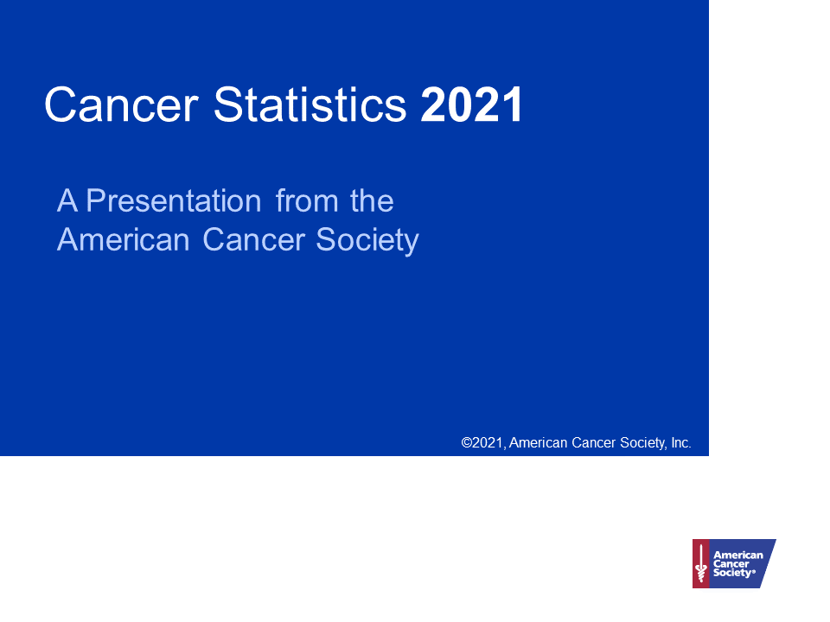

Slide 2
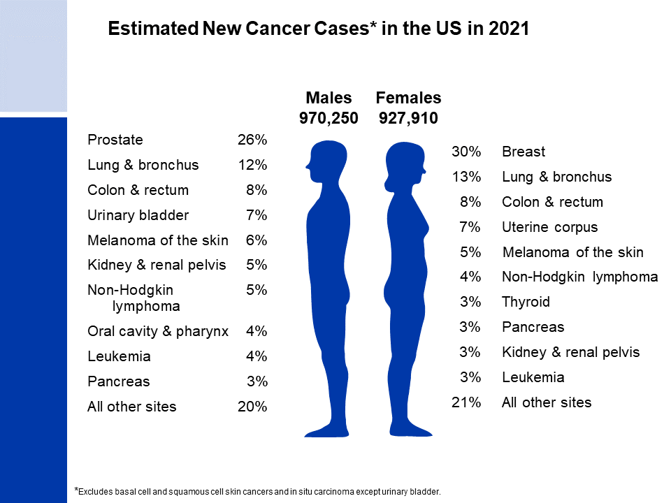
Notes:
It is estimated that nearly 1.9 million new cases of cancer will be diagnosed in 2021. Prostate cancer is the most common cancer among males (26%), followed by lung (12%) and colorectal (8%) cancers. Among females, breast (30%), lung (13%), and colorectal (8%) cancers are the most common.
Rankings based on estimates should be interpreted with caution because they are model-based projections.

Slide 3
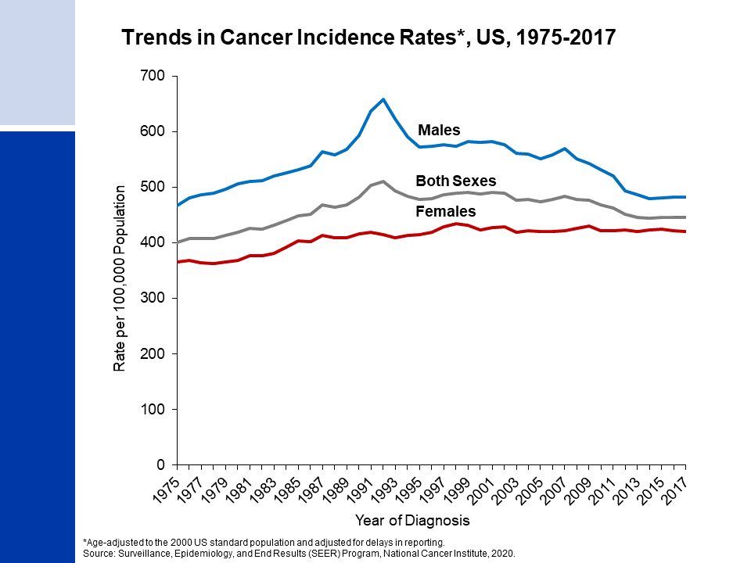
Notes:
This slide shows trends in cancer incidence rates for all sites combined from 1975 to 2017, which reflect changes in medical practice as well as behaviors associated with cancer risk. For example, the spike in incidence for males during the early 1990s reflects rapid changes in prostate cancer incidence rates due to a surge in detection of asymptomatic disease as a result of widespread uptake of the PSA test. The current average annual cancer incidence rate (2013-2017) is 14% higher in men than in women (down from 39% higher in 1995) for reasons that are not well understood but likely reflect lifetime differences in cumulative exposures to environmental and hormonal factors.
The 9 oldest SEER registries represent approximately 9% of the US population and are the source for historic (since 1975) population-based cancer incidence data.

Slide 4
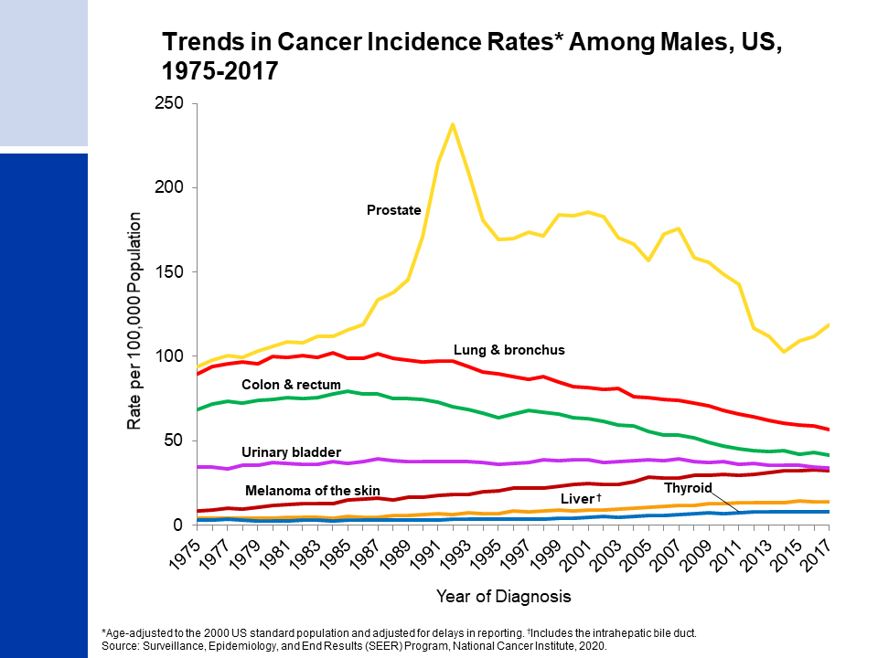
Notes:
Incidence rates for prostate cancer have changed substantially over the past 20 years largely driven by changing patterns in the utilization of prostate-specific antigen (PSA) blood testing; rates increased rapidly from 1988 to 1992, reflecting rapid uptake of PSA testing in previously unscreened men, but generally declined thereafter through 2014, until stabilizing through 2017. Latter trends reflect a downturn in the use of the PSA test following changing recommendations from the US Preventive Services Task Force and ACS. Lung cancer incidence declined steadily in recent decades reflecting historic reductions in smoking whereas colorectal cancer declines have begun to slow in recent years. Incidence rates for melanoma are increasing, whereas trends for thyroid and liver cancers have stabilized in recent years.

Slide 5
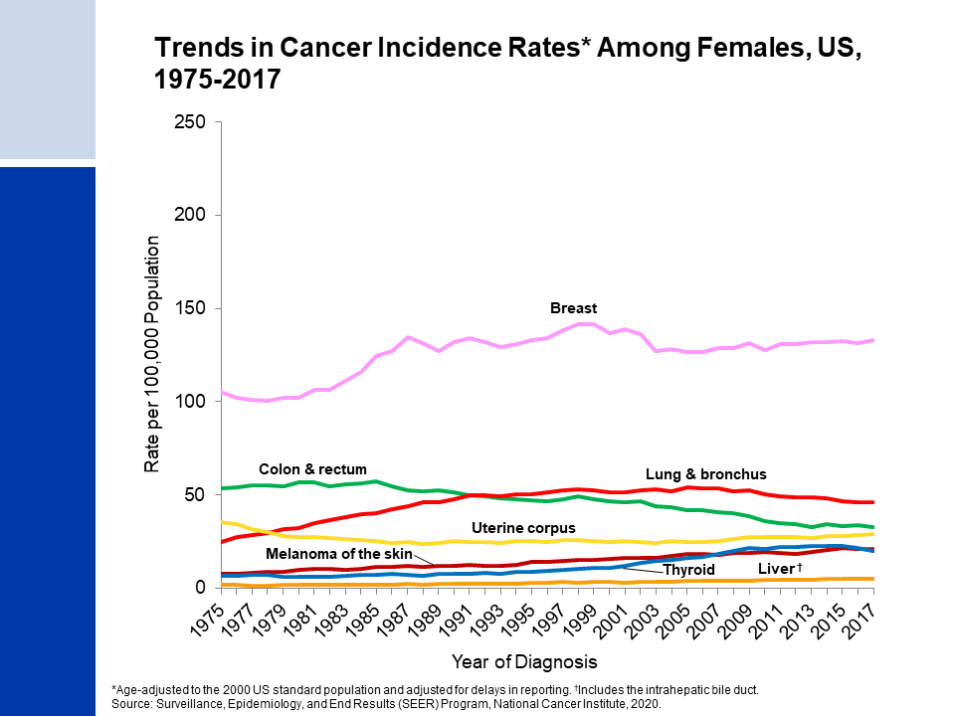
Notes:
Breast cancer incidence rates in females have been increasing slightly (about 0.5% per year) over the last 10 years of available data (2008-2017). This trend was preceded by a 7% decline from 2002 to 2003, which is primarily attributed to a reduction in use of hormone replacement therapy. Lung cancer rates began to decline in the mid-2000’s after increasing since at least 1975. The later and slower lung cancer decline in women than in men reflects differences in smoking patterns, including later uptake in large numbers and slower cessation among women. Colorectal cancer incidence rates have been generally declining since the mid-1980s but the decrease has slowed in recent years, similar to the pattern in men. In contrast, incidence rates are increasing for liver, melanoma, and thyroid cancers, although the pace of the increase appears to be slowing for thyroid cancer (particularly among whites).

Slide 6
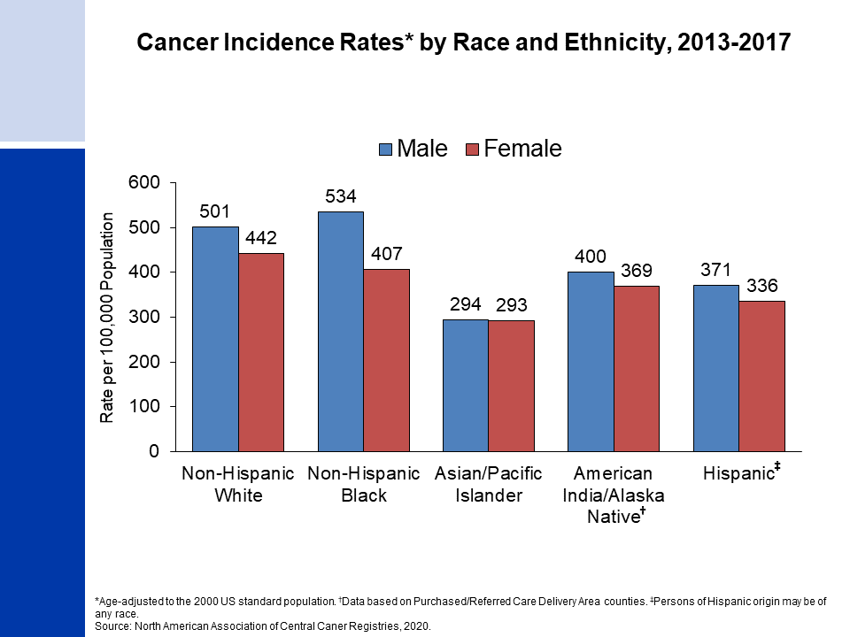
Notes:
Cancer incidence rates are higher in males than in females for each racial/ethnic population, although rates are very similar in Asian/Pacific Islanders. The highest incidence rates are in blacks among males and in whites among females. Asian/Pacific Islanders have the lowest rates in both sexes.
It is important to note that these are broadly defined groups within which cancer rates vary substantially. In addition, rates for populations other than white and black may be underestimated due to incomplete information on race/ethnicity in medical records.

Slide 7
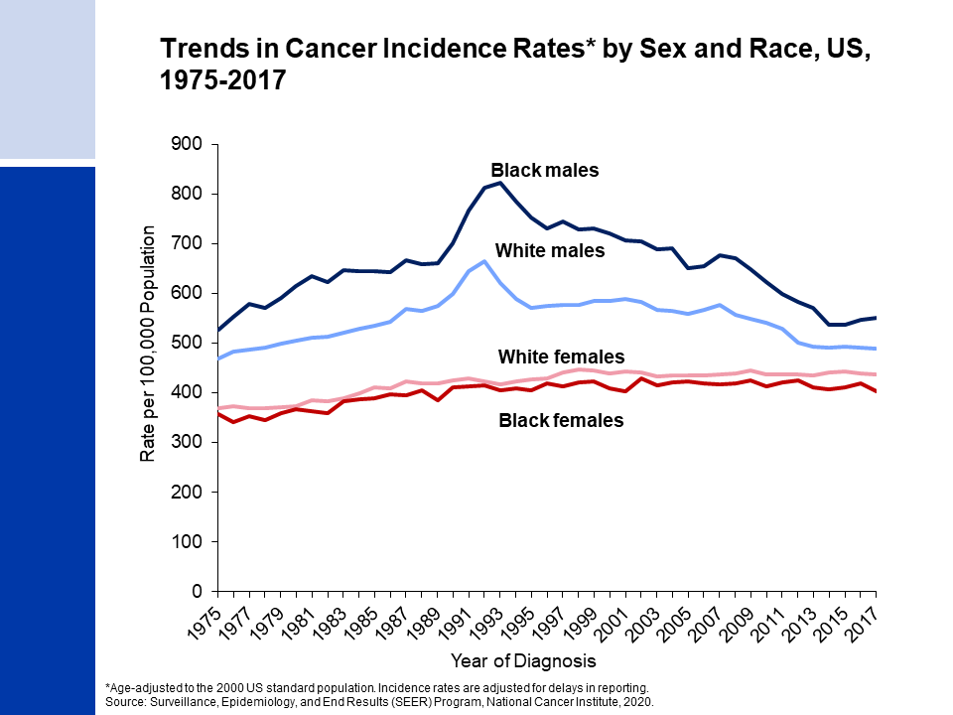
Notes:
Since the mid-1970s, cancer incidence rates for all sites combined have been substantially higher among Black than White males, while among females rates are slightly higher in Whites because of higher rates of lung and breast cancers.

Slide 8
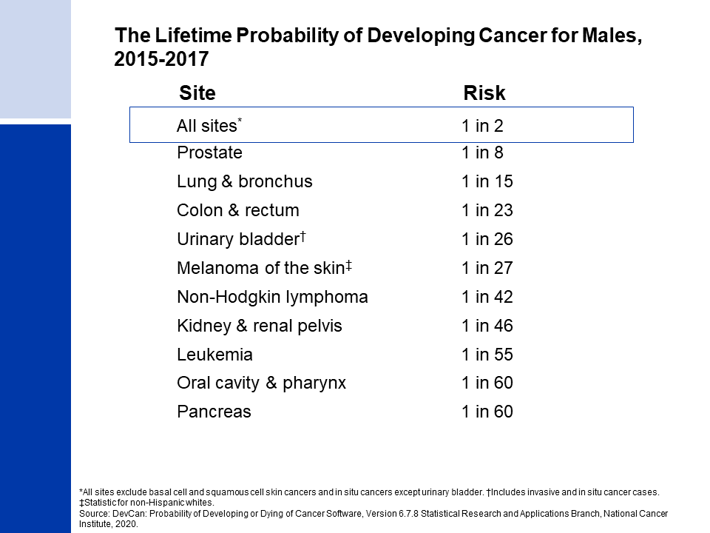
Notes:
For American males, the average lifetime risk of developing cancer is 40.5%, or approximately 1 in 2. These figures are based on the average experience of the entire male population and vary for individuals because of lifestyle and other factors. For example, cancer risk among smokers is higher than among nonsmokers.

Slide 9

Notes:
The risk of an American woman developing cancer over her lifetime is 38.9% (a bit more than one in three).

Slide 10
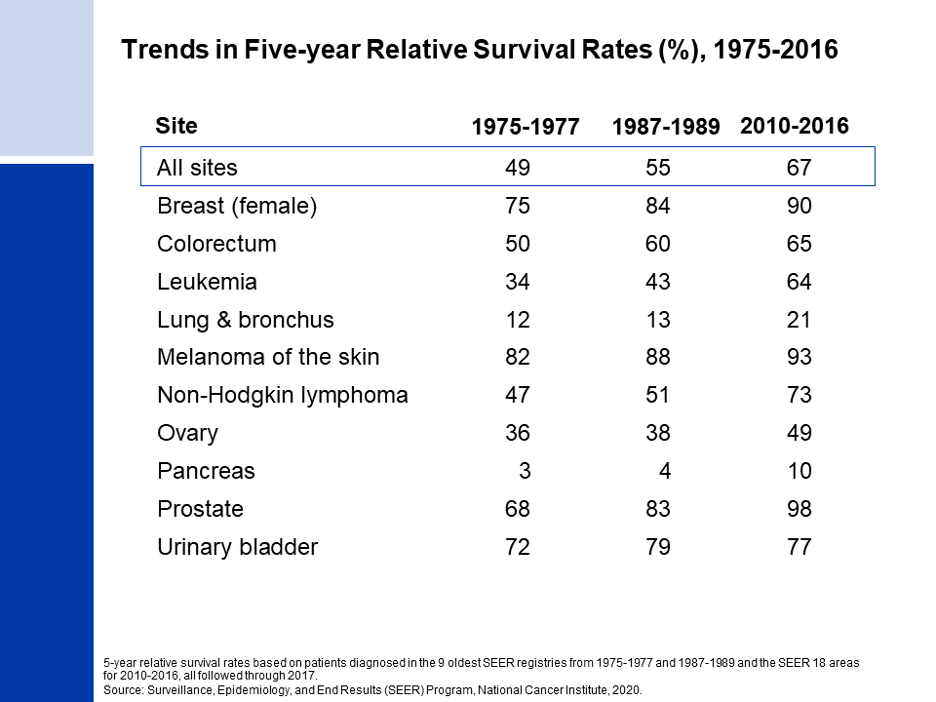
Notes:
There have been notable improvements in survival rates for most cancer types due to earlier detection and/or advances in treatment. For example, the five-year relative survival rate for leukemia has increased from 34% in the mid-1970s to 64% in the most recent time period due to improvements in treatment.

Slide 11
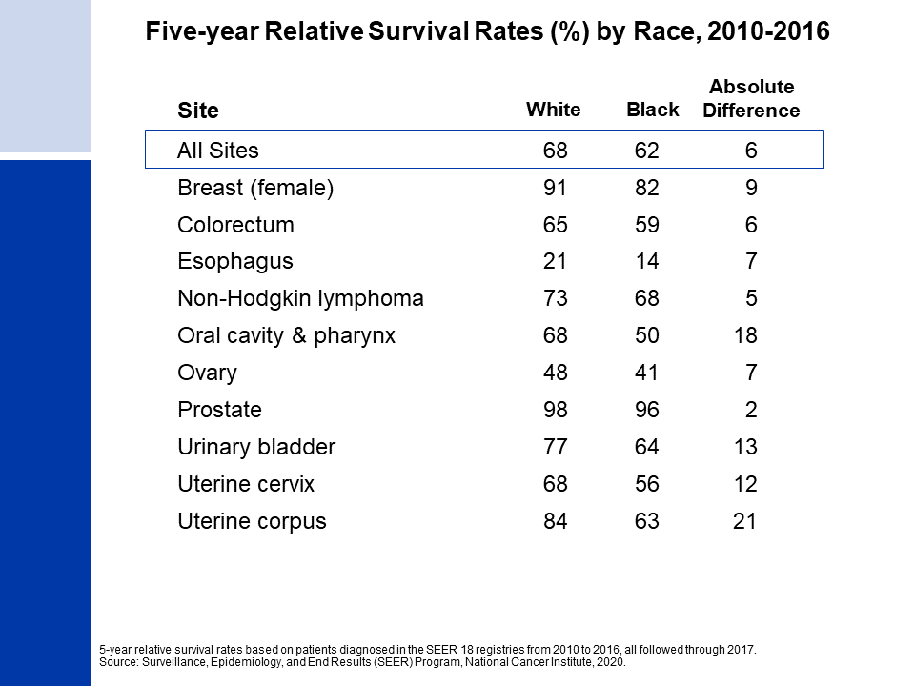
Notes:
While gains in survival have occurred for both Whites and Black cancer patients, those who are Black continue to have lower survival rates for most cancer types. The largest differences are for cancers of the oral cavity and uterine corpus. Factors that contribute to these disparities include less access to high-quality health care and a later stage of diagnosis among Black individuals. Differences in tumor characteristics may also play a role.

Slide 12
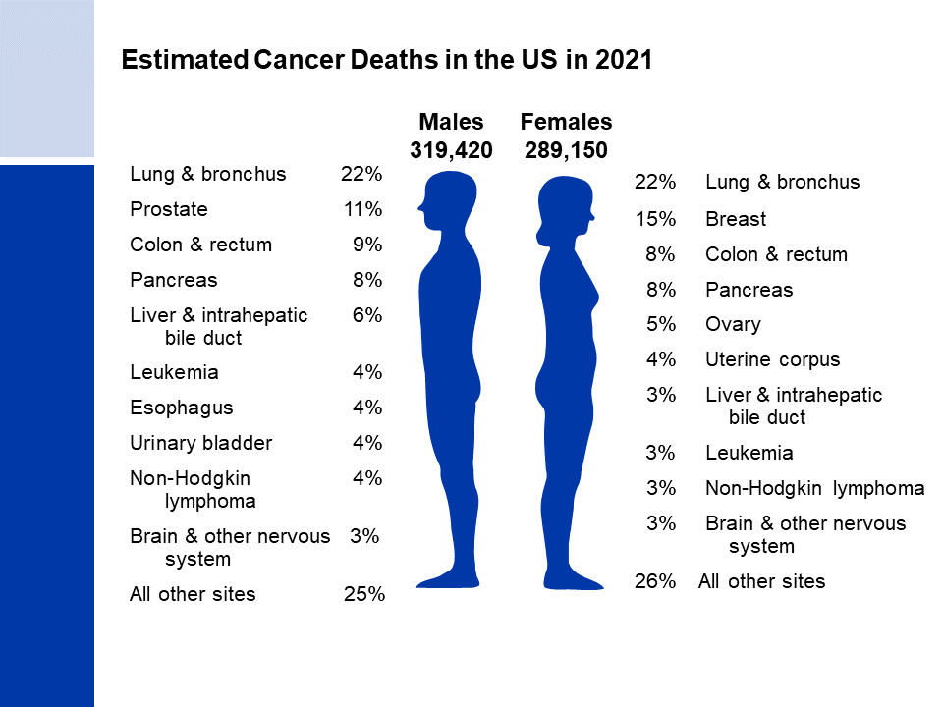
Notes:
Now we will turn our attention to cancer mortality. Lung cancer is by far the leading cause of cancer death among males (22%), followed by prostate (11%) and colorectal (9%) cancers. Among females, lung (22%), breast (15%), and colorectal (8%) cancers are the leading causes of cancer death.

Slide 13
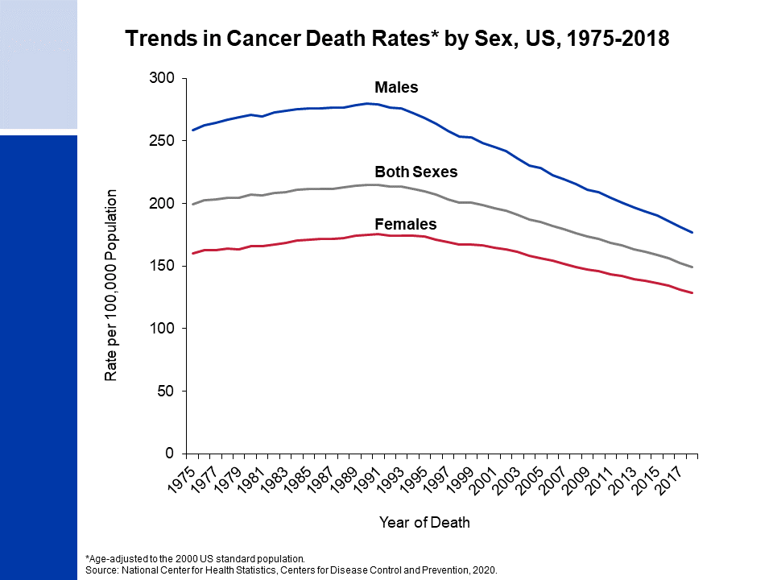
Notes:
Cancer death rates have been declining in males and females since the early 1990s; from 1991 to 2018, the combined death rate dropped 31%.

Slide 14
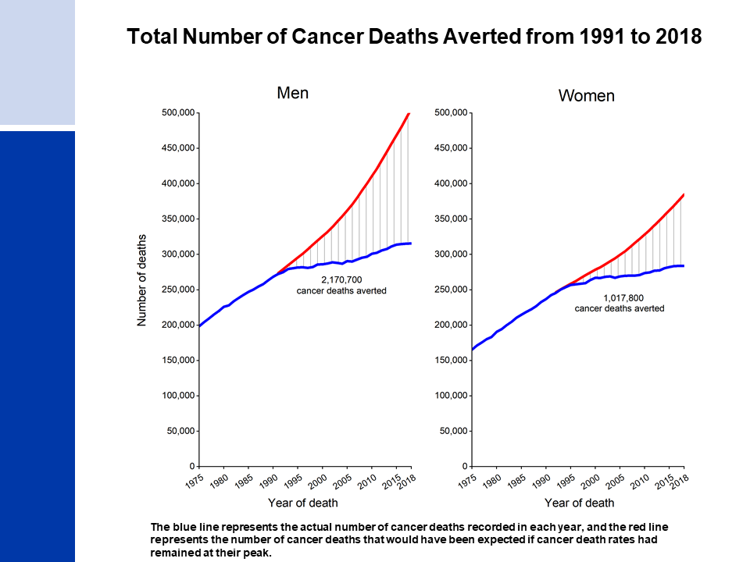
Notes:
As a result of continuous declines in the cancer death rate since 1991, there were an estimated 3.2 million fewer cancer deaths through 2018 than would have been expected if the death rate had remained at its peak.

Slide 15
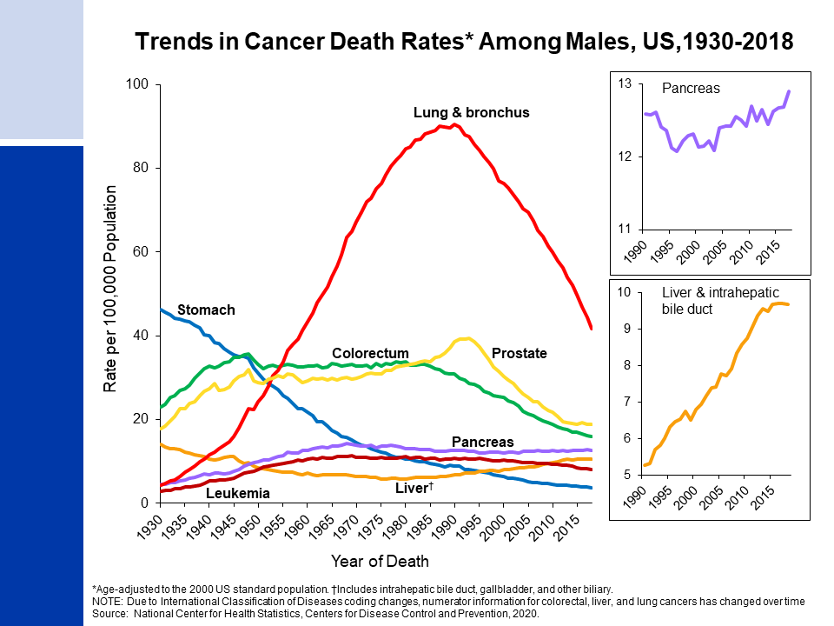
Notes:
Prior to 1990, most of the increase in the male cancer death rate was caused by the rapid increase in lung cancer due to the tobacco epidemic. However, lung cancer mortality in men has declined steeply since 1990, with the pace nearly doubling from a 3.1% annual decline from 2009-2013 to 5.5% from 2014-2018 because of improved treatment for non-small cell lung cancer, the most common subtype (80%). The death rate for stomach cancer, which was the leading cause of cancer death among males early in the 20th century, has decreased by more than 90% since 1930 because of declines in incidence as a result of refrigeration and lower intake of sodium-preserved foods. Death rates for colorectal and prostate cancers in men began declining in the early 1980s and early 1990s, respectively, but declines have slowed (colorectal) and stabilized (prostate) in recent years. Liver cancer death rates increased rapidly (3% per year) in the 2000s, but now have stabilized. Death rates for pancreatic cancer have also been increasing slowly (0.3% annually since 2000).

Slide 16
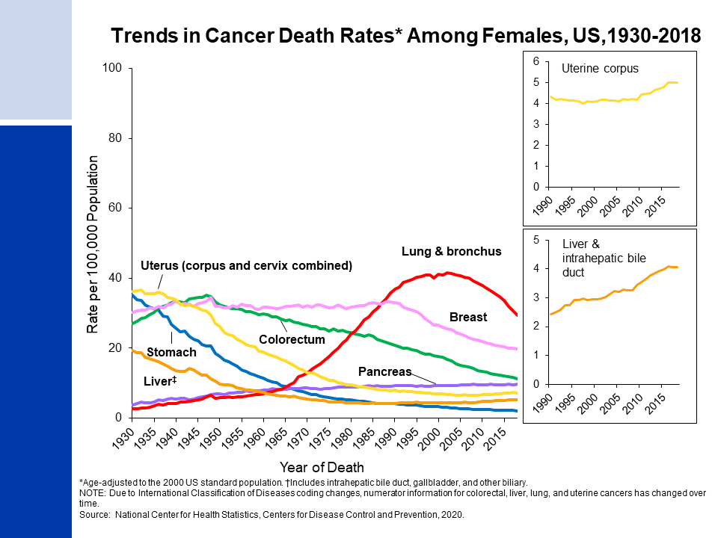
Notes:
The lung cancer death rate in females didn’t begin declining until the early 2000s because of the delay in smoking uptake and cessation in women compared to men. Similar to men, however, the decline accelerated from 1.8% per year during 2009-2013 to 4.4% during 2014-2018. Breast cancer death rates changed little between 1930 and 1989, but decreased steadily between 1989 and 2018 for a total drop of 41%. While male liver cancer death rates have stabilized, rates in women continue to rise by 1% annually. Colorectal cancer death rates have been steadily decreasing since the late 1940s in women, although progress has slowed in recent years. Uterine corpus cancer death rates (shown in the inset) have been increasing since the mid-1990s, likely at least in part to increased obesity.

Slide 17
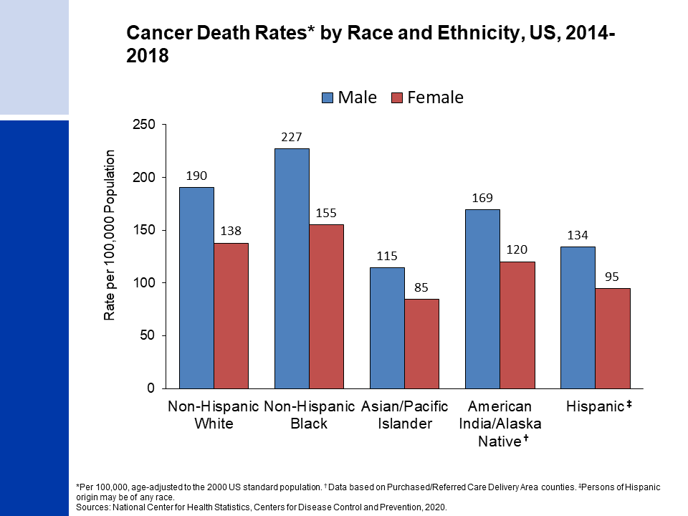
Notes:
Cancer death rates are higher among males than among females for every racial and ethnic group. Black males and females have the highest cancer mortality rates and Asian/Pacific Islanders have the lowest, about half those of Blacks.
It is important to note that these are broadly defined groups within which cancer rates vary substantially. In addition, rates for populations other than white and black may be underestimated due to incomplete information on race/ethnicity in medical records.

Slide 18
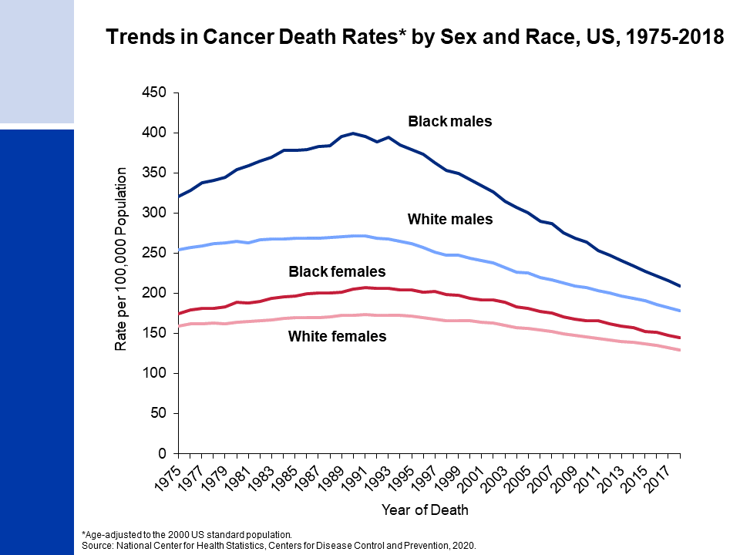
Notes:
The excess risk of cancer death in non-Hispanic Blacks versus Whites individuals has dropped from 33% in 1993 to 13% in 2018 among men and women combined, with the gap higher in men (19%) than in women (12%).

Slide 19
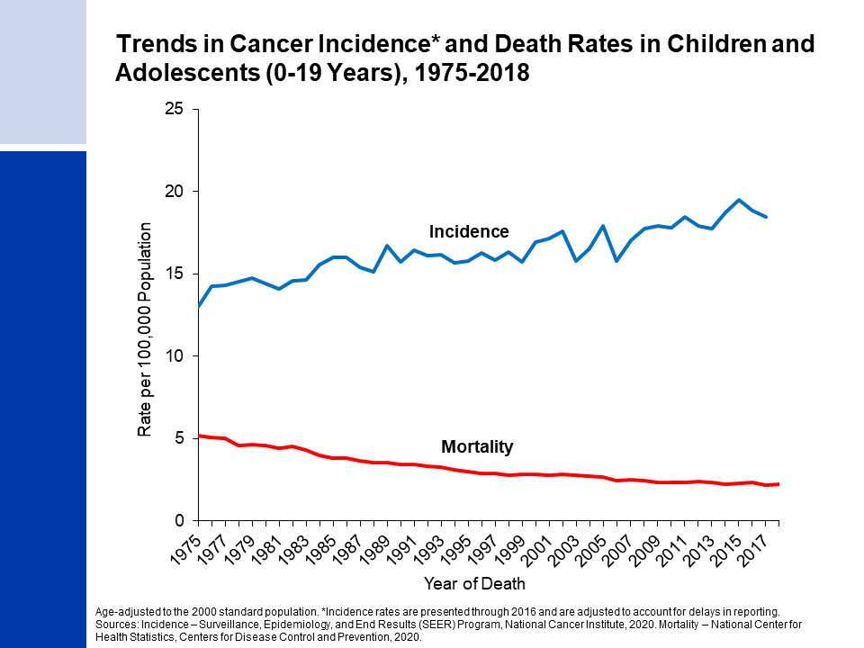
Notes:
The next series of slides present the burden of cancer among children and adolescents in the US. Cancer incidence and mortality trends in children (ages 0 to 14 years) and adolescents (ages 15 to 19 years) are very similar. Since 1975, cancer incidence rates among children and adolescent combined have been increasing slightly by 0.7% per year, while cancer death rates have decreased by more than half.

Slide 20
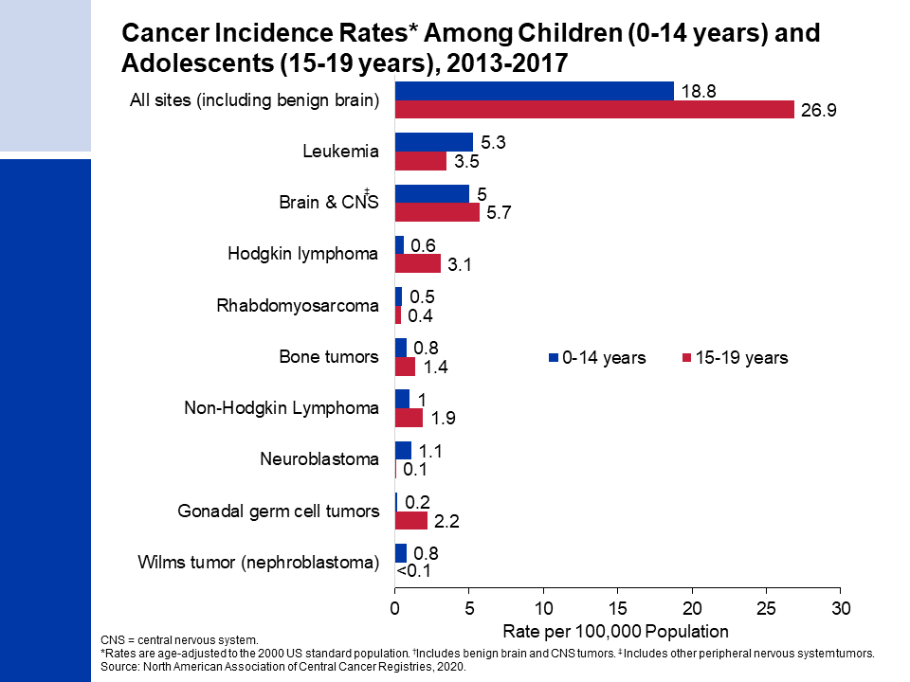
Notes:
This slide shows cancer incidence rates in children (ages 0-14 years) and adolescents (ages 15-19 years) by cancer type according to the International Classification of Childhood Cancers. This system is more appropriate for children because it categorizes cancers based on a combination of both histology (microscopic structure) and tumor location, rather than location alone. Leukemia accounts for 28% of all cancers diagnosed in children, but just 13% of cancers diagnosed in adolescents.
Cancer registries were mandated by law to begin reporting benign and borderline malignant brain and central nervous system tumors on January 1, 2004. Reporting was expanded to include these cancers because benign tumors cause disruption to normal function similar to malignant tumors and because the prognosis for benign and malignant tumors is often similar. During 2013-2017, approximately one-quarter of all brain tumors diagnosed in children and more than one-half of those in adolescents were benign or borderline malignant.

Slide 21
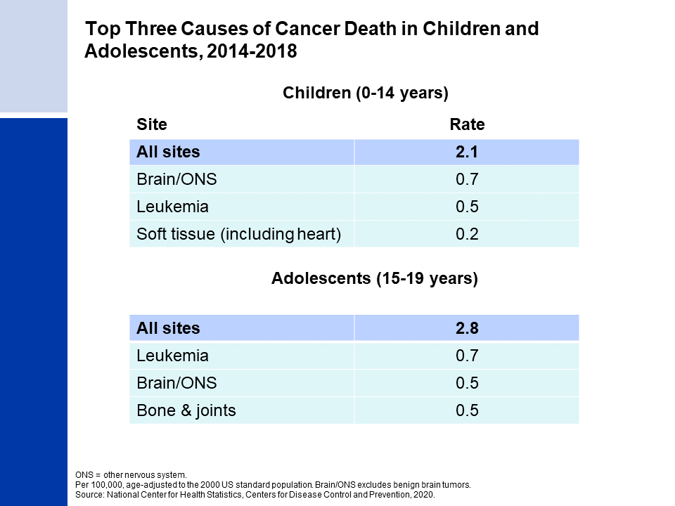
Notes:
The top causes of cancer death in children and adolescents are brain and other nervous system tumors and leukemia. The reason leukemia has a higher death rate in adolescents than in children, despite having a lower incidence rate, is because survival rates for leukemia are higher in children than adolescents.

Slide 22
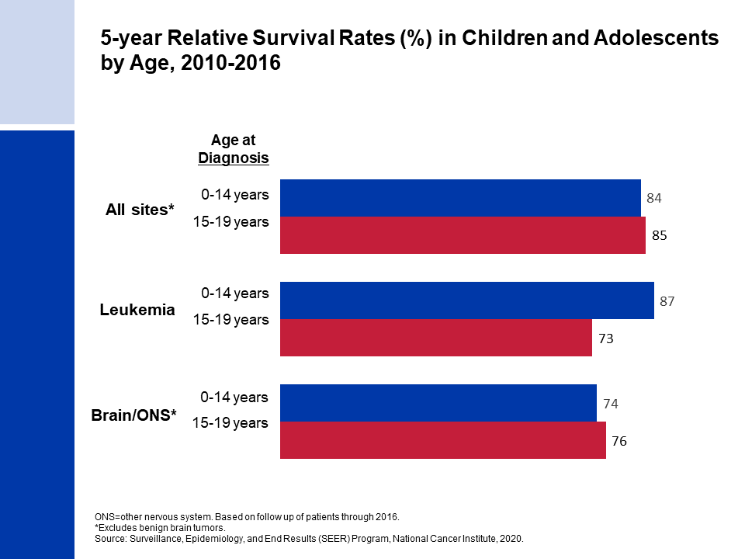
Notes:
For example, the current 5-year relative survival rate for leukemia is 87% for children but 73% for adolescents. In contrast, survival for brain and other nervous system is slightly lower in children than in adolescents.

Slide 23
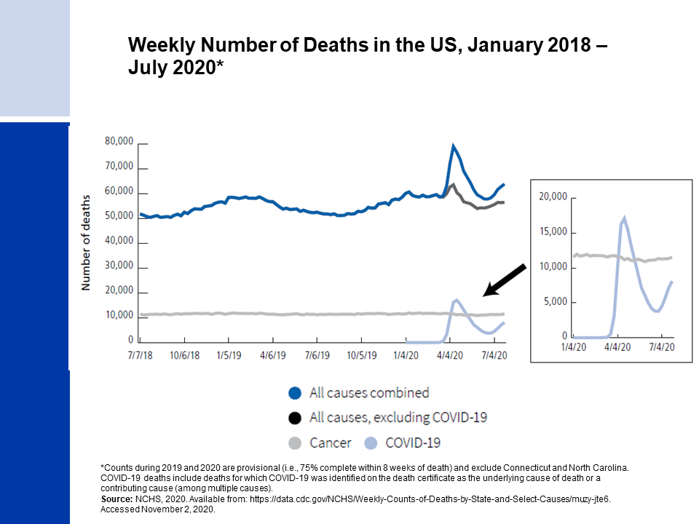
Notes:
The United States has one of the highest rates of COVID-19 infection in the world, and as of mid-November 2020, 240,000 Americans had died from the disease. COVID-19 deaths account for two-thirds of the excess deaths in the US from March through July 2020. Increased deaths from other causes are partly due to misclassification of deaths from COVID-19, but also because of disruptions in care. Additional excess mortality from other illnesses will likely be protracted. For example, cancer deaths dipped during the early months of the pandemic (gray line in inset figure), but will likely rebound in higher numbers than expected in the months and years to come because of delays in diagnosis and treatment.

Slide 24
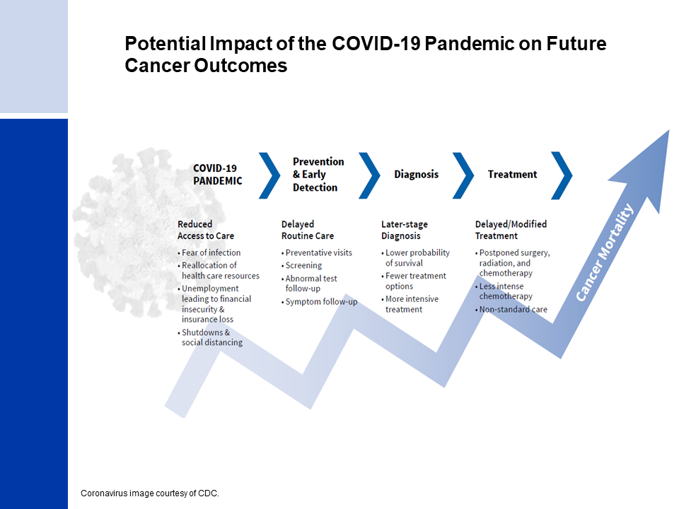
Notes:
The impact of COVID-19 on cancer diagnoses and outcomes at the population level will be unknown for several years because of the time necessary for data collection, compilation, quality control, and dissemination. We anticipate that disruptions in access to care in 2020 across the cancer continuum will lead to downstream increases in advanced stage diagnoses that may result in increased cancer mortality in the years to come.

