Slide 1

Cancer Statistics 2023

Slide 2
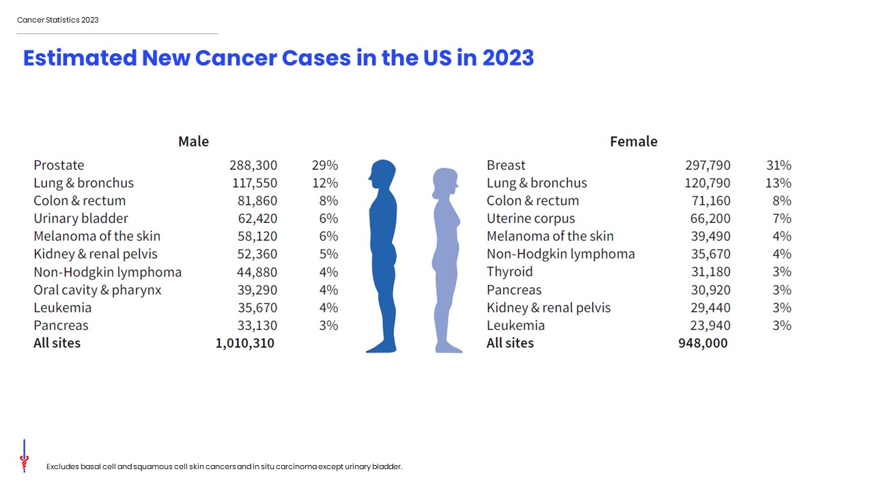
Notes:
In 2023, a little over 1.9 million new cases of cancer are expected to be diagnosed in the United States. Prostate cancer is the most common cancer among males (29%), followed by lung (12%) and colorectal (8%) cancers. Among females, breast (31%), lung (13%), and colorectal (8%) cancers are the most common.
Ranking is based on modeled projections and may differ from the most recent observed data.

Slide 3
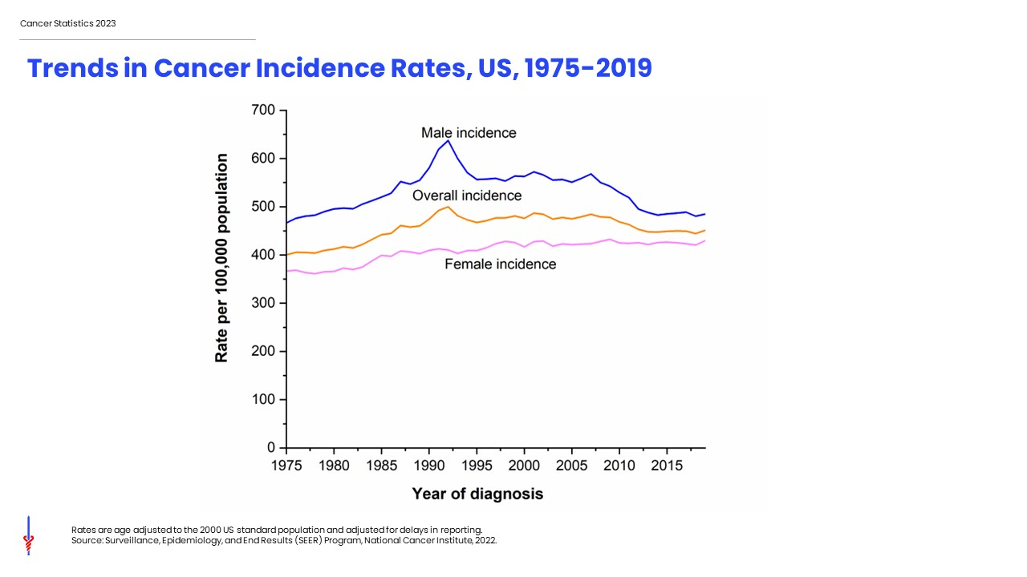
Notes:
This slide shows long-term trends in cancer incidence rates for all sites combined by sex from 1975 to 2019, males in blue, females in pink, and combine males and females in orange. Cancer incidence trends reflect patterns in cancer risk factors as well as changes in medical practices, such as cancer screening.
Overall cancer incidence in men generally decreased from the early 1990s until around 2013, then stabilized through 2019. Among women, the rate was fairly stable through the mid-1980s but has since increased slowly (by <0.5% per year). Consequently, the incidence disparity between males and females has narrowed from a male-to-female incidence rate ratio of 1.59 in 1992 to 1.14 in 2019.

Slide 4
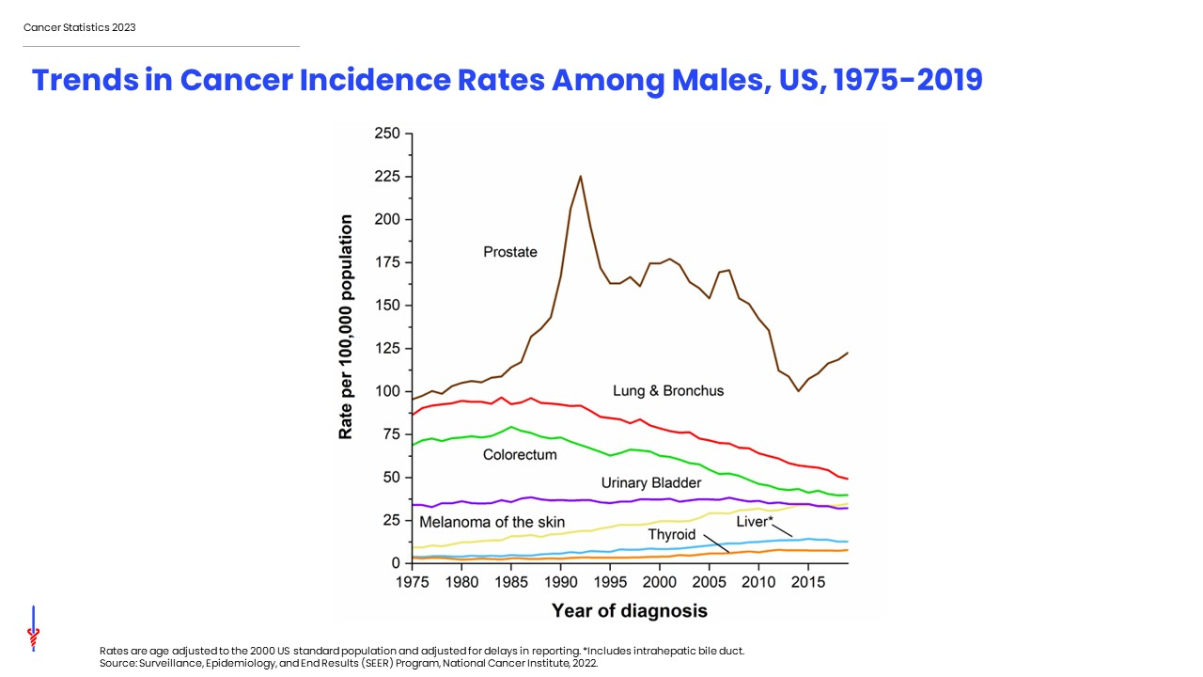
Notes:
This slide shows trends in cancer incidence among males in the US by cancer site. Prostate cancer, shown in brown, is the most commonly diagnosed cancer in men. Prostate cancer incidence trends largely reflect changes in the use of screening with the prostate-specific antigen (PSA) test. For example, incidence spiked during the early 1990s, reflecting a surge in the detection of asymptomatic disease with the initial widespread rapid uptake of screening among previously unscreened men. The rapid drop in the incidence rate from 2007 to 2014 reflects decreased PSA testing following recommendations against routine screening for men aged 75 years and older in 2008 and all men in 2012 from the US Preventive Services Task Force. However, the prostate cancer incidence rate rose by 3% annually from 2014 through 2019, mostly driven by the diagnosis of advanced disease.
Incidence rates have been declining for lung and colorectal cancers in males for more than two decades. In contrast, incidence rates for melanoma and liver cancer have stabilized in the most recent time period, following a long history of increase.

Slide 5
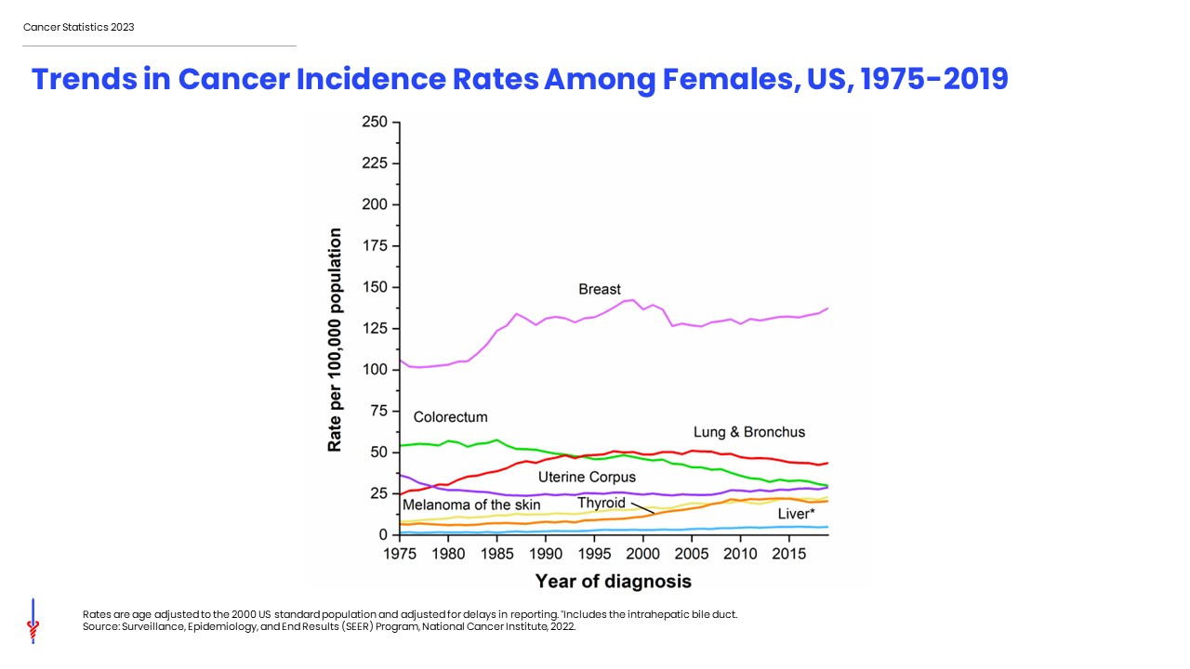
Notes:
This slide shows trends in cancer incidence among females in the US. Breast cancer, shown in the pink line, is the most commonly diagnosed cancer in women. Breast cancer incidence rates have increased by about 0.5% per year since the mid-2000s, likely due to changing patterns in risk factors, such as continued declines in fertility and increases in excess body weight, which may also contribute to the increasing incidence of uterine corpus cancer.
Lung cancer rates began to decline in the mid-2000’s after increasing since at least 1975. Differences in lung cancer trends between men and women reflect differences in smoking patterns, including later uptake and slower cessation among women. Colorectal cancer incidence rates have generally been declining since the mid-1980s. After decades of increase, thyroid cancer incidence rates have declined since 2014 by about 2% per year, due in part to changes in screening practices and diagnosis criteria.

Slide 6
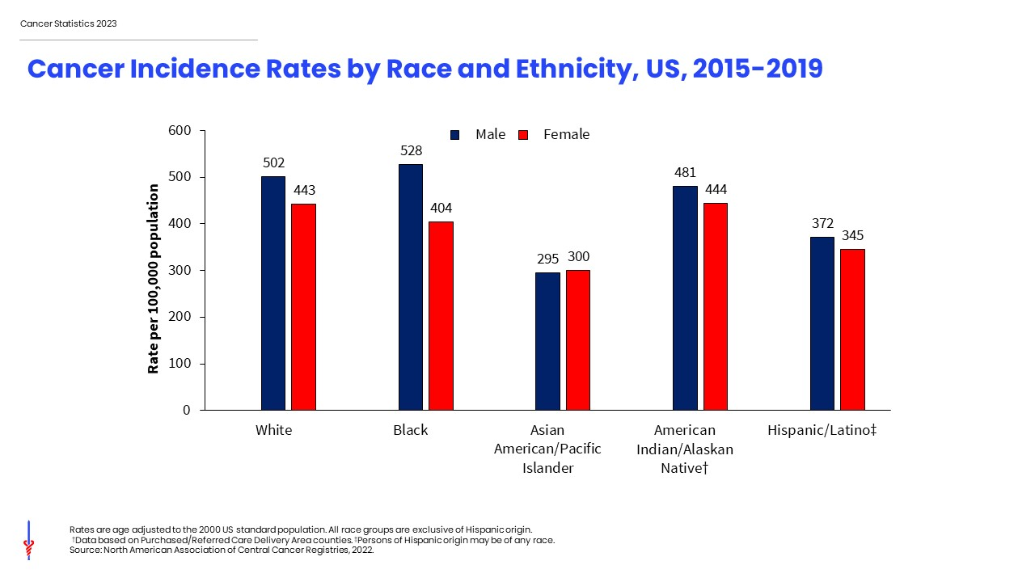
Notes:
This slide shows cancer incidence rates by broadly defined racial and ethnic groups for males in the blue bars and females in the red bars. Cancer incidence rates are higher in males than females for every racial/ethnic group except for Asian American and Pacific Islander persons. Black men have the highest incidence and Asian Americans and Pacific Islanders have the lowest incidence.
It is important to note that there are substantial variations within these broadly defined groups and that rates for populations other than White and Black may be underestimated due to incomplete information or racial misclassification on medical records.

Slide 7
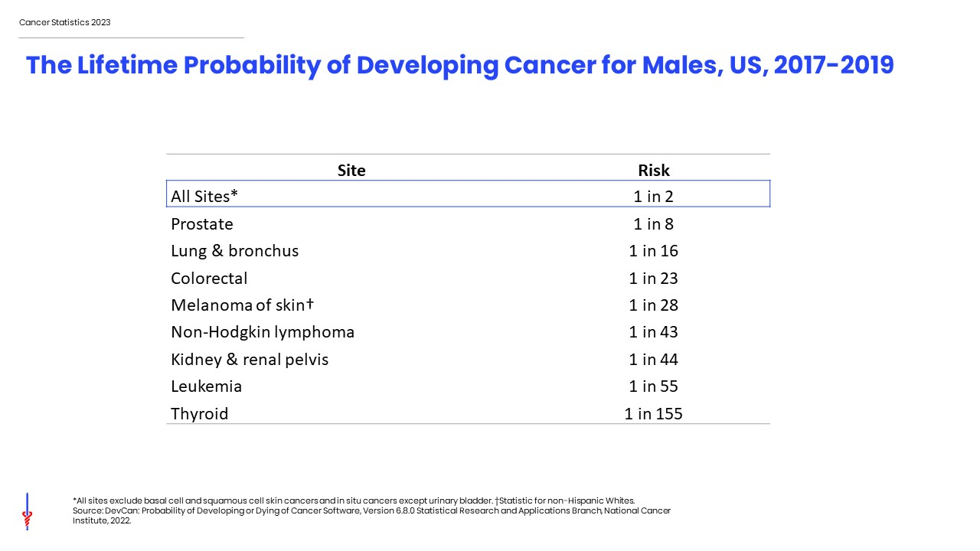
Notes:
In the US, 1 in 2 men will develop cancer in their lifetime. This slide shows the lifetime risk, or likelihood, of an average male in the US developing cancer.
These statistics are based on the average experience of the entire male population and vary for individuals due to lifestyle and other factors. For example, the risk of developing cancer is higher among people who smoke.

Slide 8
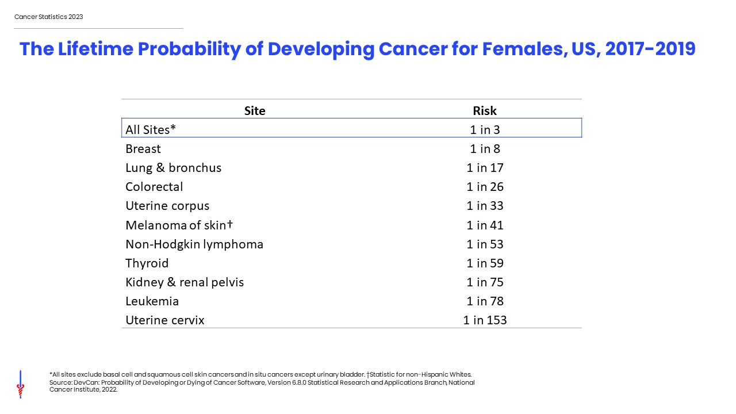
Notes:
In the US, 1 in 3 women will develop cancer in their lifetime. This slide shows the lifetime risk, or likelihood, of an average female in the US developing cancer.
These statistics are based on the average experience of the entire female population and vary for individuals due to lifestyle and other factors. For example, the risk of developing cancer is higher among people who smoke.

Slide 9
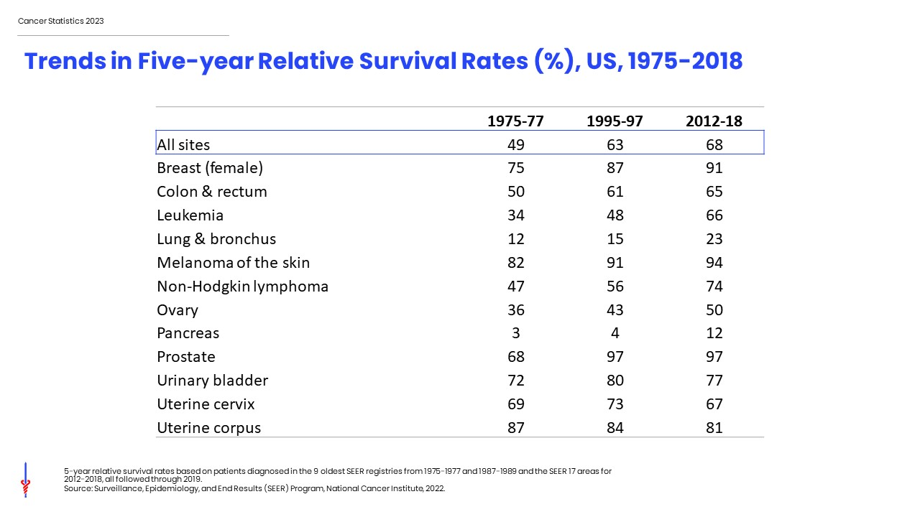
Notes:
This table shows the 5-year relative survival rate by cancer site. There have been notable improvements in survival for most cancer types due to earlier detection and/or advances in treatment. For example, the five-year relative survival rate for leukemia has increased from 34% in the mid-1970s to 66% in the most recent time period because of improved treatment.

Slide 10
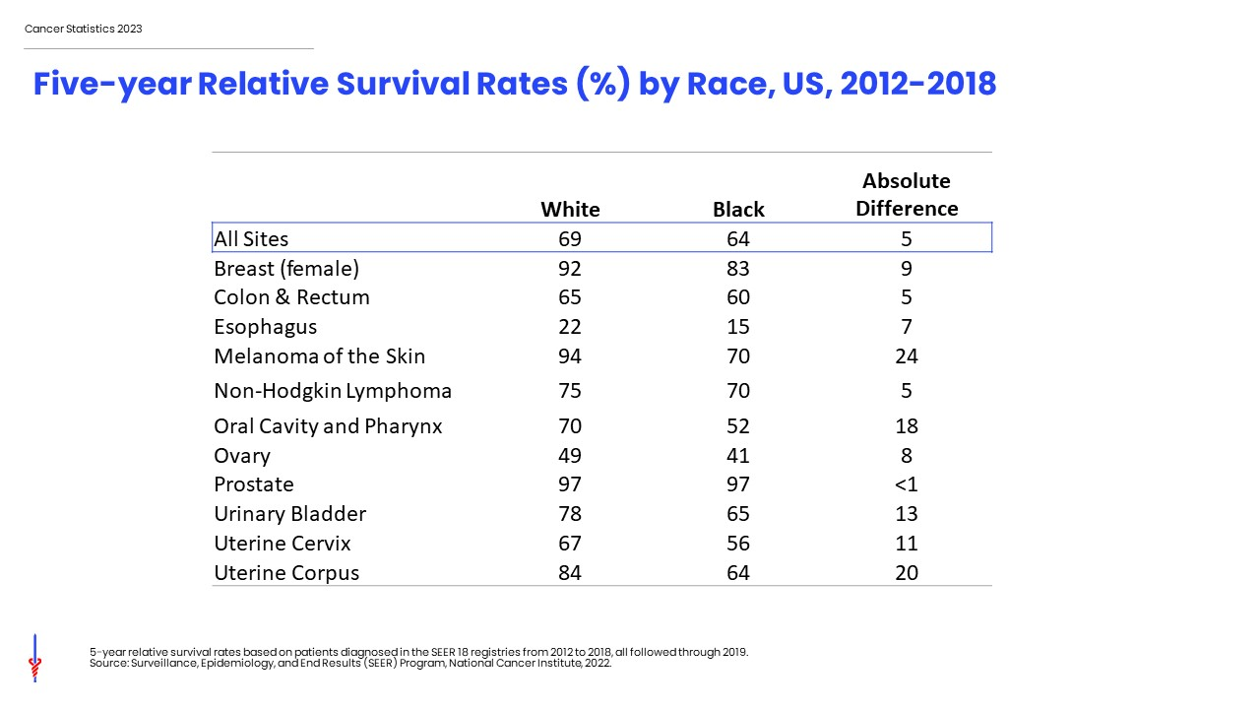
Notes:
While gains in survival have occurred for both White and Black cancer patients, Black people continue to have lower survival rates for most cancer types. The largest differences are for melanoma of the skin and cancers of the oral cavity and pharynx and uterine corpus. Factors contributing to these disparities include later stage diagnosis and less access to high-quality treatment. Differences in tumor characteristics may also play a small role for some cancer types.

Slide 11
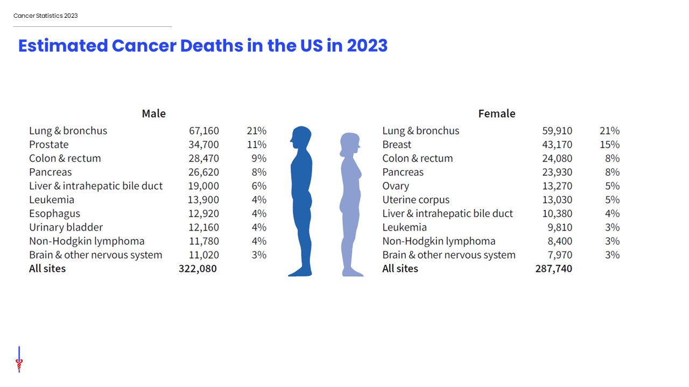
Notes:
Now we will turn our attention to cancer mortality. Lung cancer is by far the leading cause of cancer death among males (21%), followed by prostate (11%) and colorectal (9%) cancers. Among females, lung (21%), breast (15%), and colorectal (8%) cancers account for are the leading causes of cancer death. Lung cancer causes more than 350 deaths per day in men and women combined, more than breast, prostate, and pancreatic cancers combined, and two-and-a-half times more than colorectal cancer, the 2nd leading cause of cancer death.

Slide 12
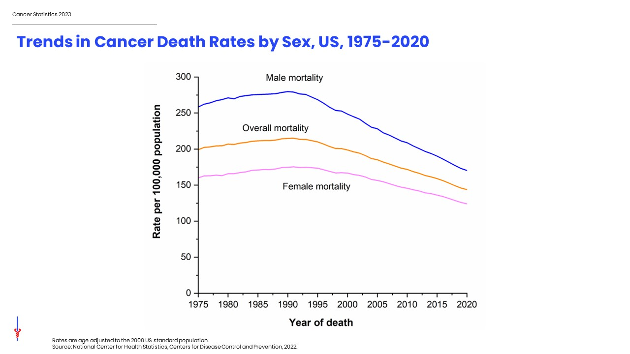
Notes:
This slide shows trends in cancer death rates among males in blue, females in pink, and combined sexes in orange.
The cancer death rate in males and females combined has declined by 33% since its peak in 1991.

Slide 13
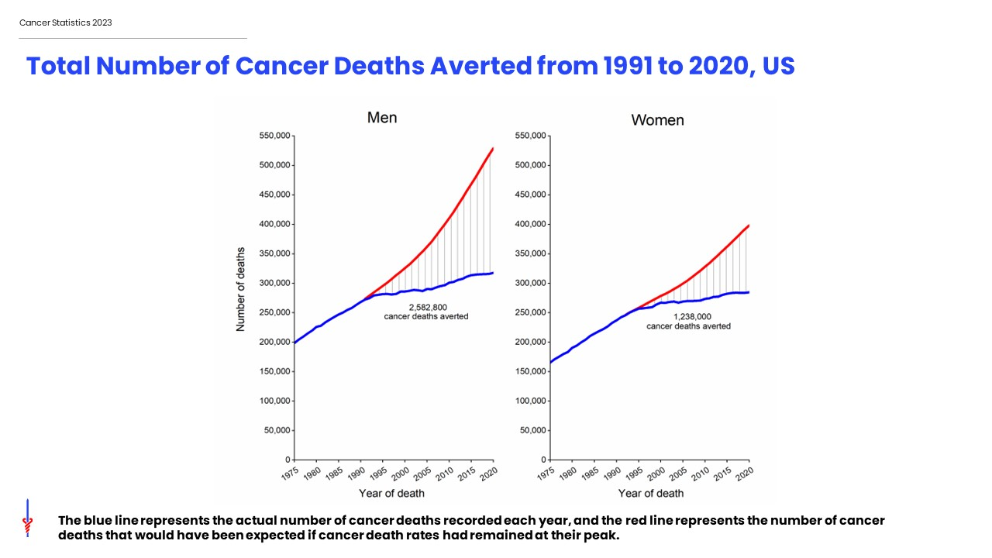
Notes:
As a result of continuous declines in the cancer death rate since 1991, there were an estimated 3.8 million fewer cancer deaths through 2020 than would have been expected if the death rate had remained at its peak. This graph shows the number of averted cancer deaths in men on the left and women on the right. The blue line represents the actual number of cancer deaths recorded each year, and the red line represents the number of cancer deaths that would have been expected if cancer death rates had remained at their peak

Slide 14
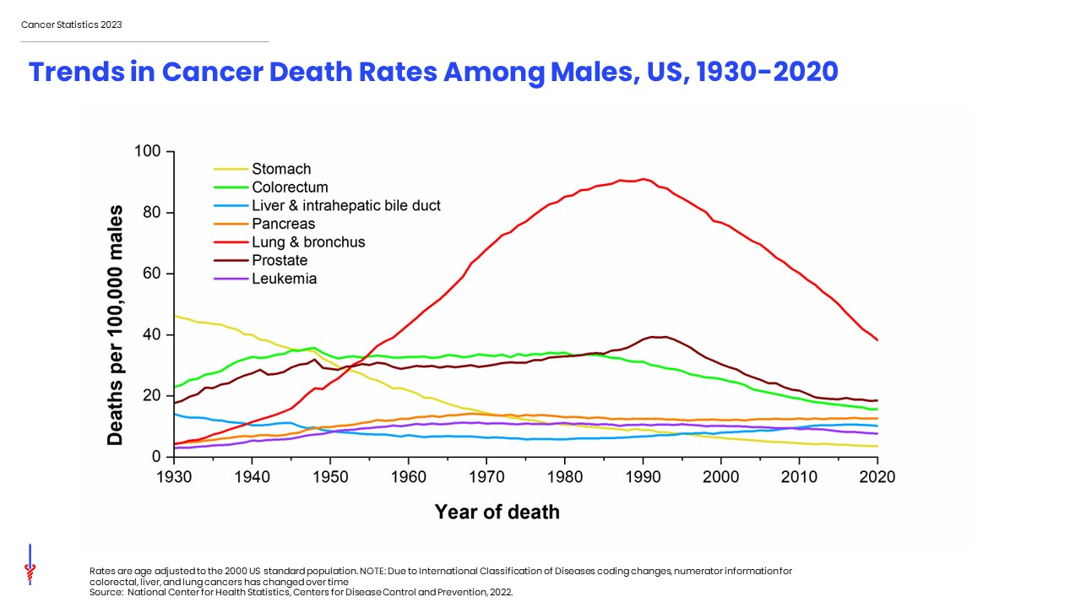
Notes:
This figure shows trends in cancer death rates in males by cancer type. Lung cancer mortality, shown in red, increased steeply during most of the 20th century due to the tobacco epidemic but has declined rapidly since 1990; the pace of decline has accelerated over the past decade from annual decline of 3% to 5% during 2014-2020 due to improved treatment. The death rate for stomach cancer, shown in yellow, was the leading cause of cancer death among males early in the 20th century but has decreased by more than 90% since 1930 because of declines in incidence as a result of refrigeration and lower intake of sodium-preserved foods. Death rates for colorectal cancer, in green, has dropped by 55% in men since 1980. The slowing decline in prostate cancer mortality, shown in brown, likely reflects recent upticks in advanced-stage diagnoses associated with reductions in PSA testing. Liver cancer death rates increased rapidly for decades but have declined since 2017 by 1.3% annually whereas death rates for pancreatic cancer continue to increase slowly (by 0.3% annually since 2000).

Slide 15
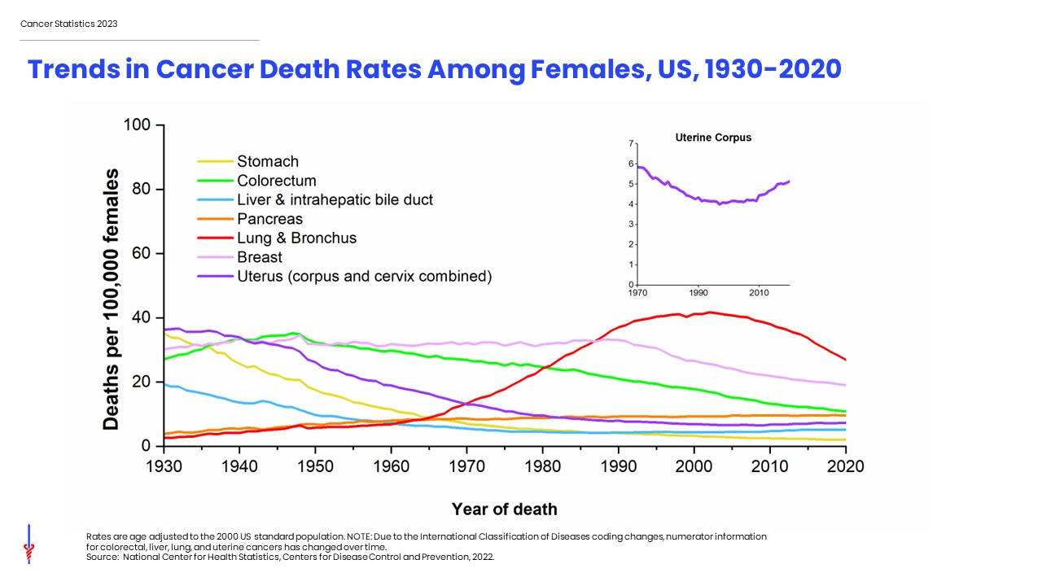
Notes:
This figure shows long-term trends in cancer death rates for females in the United States. Lung cancer death rates in females didn’t begin declining until the early 2000s because of the delay in smoking uptake and cessation in women compared to men. Breast cancer death rates changed little between 1930 and 1989 but have since decreased by 43% due to earlier detection and improved treatment. Stomach cancer mortality has decreased by more than 90%, similar to males, and liver cancer mortality has stabilized after years of increase. Historically, uterine corpus and cervix cancer deaths were combined, shown in purple. In contrast with declines in uterine cervix cancer death rates, uterine corpus cancer death rates have increased since the 1990s, shown in upper left figure.

Slide 16
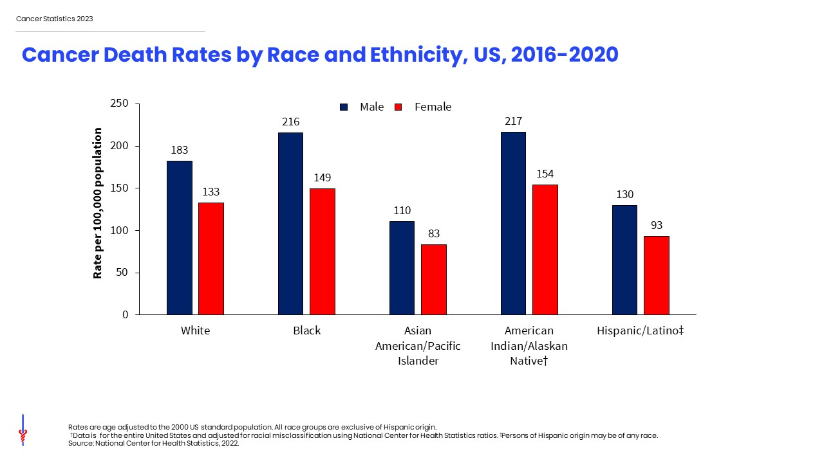
Notes:
Cancer death rates are higher among males than among females for every racial and ethnic group. Non-Hispanic Black males and females have the highest cancer mortality rates and non-Hispanic Asian/Pacific Islander individuals have the lowest, about half those of Black people.
American Indian/Alaska Native death rates are for the entire US and adjusted due to racial misclassification that is common on death certificates. More information can be found in the American Cancer Society publication Cancer statistics for American Indian and Alaska Native individuals, 2022: Including increasing disparities in early onset colorectal cancer published in CA: A Cancer Journal for Clinicians.

Slide 17
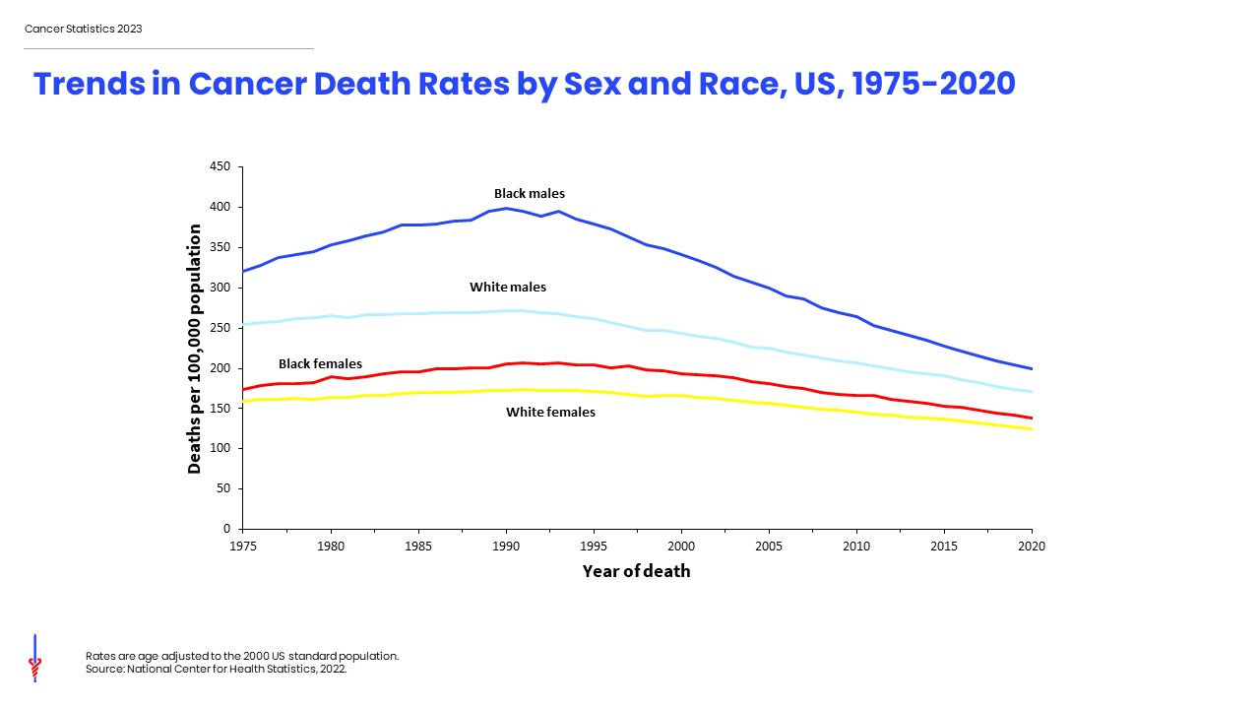
Notes:
The excess risk of cancer death in Black versus Whites individuals has dropped from 33% in 1993 to 12% in 2020 among men and women combined, with the gap larger in men than in women. Progress in reducing Black-White mortality disparity is largely due to more rapid declines in the incidence (and thus mortality) of smoking-related cancers because of a steep drop in smoking initiation among Black teens from the 1970s to 1990s.

Slide 18
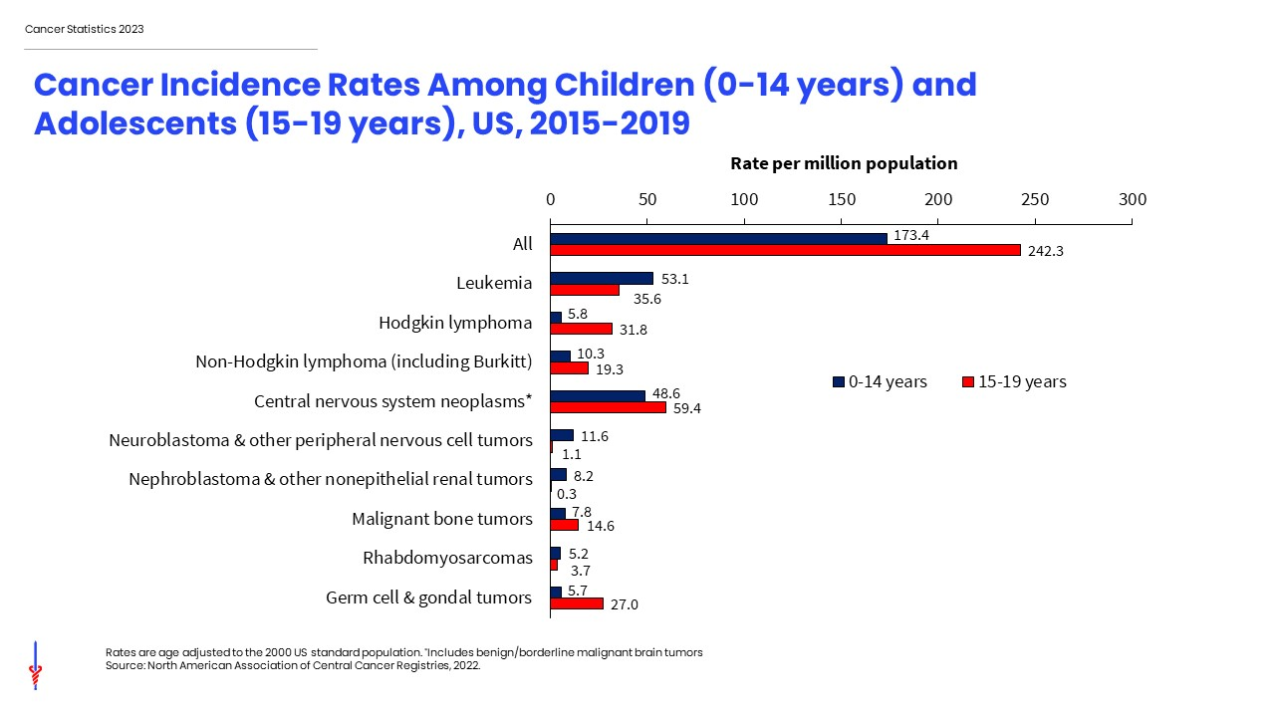
Notes:
This slide shows cancer incidence rates in children and adolescents by cancer type according to the International Classification of Childhood Cancers (ICCC). This system is more appropriate for children than adult tumor classification because it categorizes cancers based on a combination of tumor histology (microscopic structure) and location rather than location alone. Leukemia accounts for 28% of all cancers diagnosed in children but just 13% of cancers diagnosed in adolescents, among whom brain cancer is most common (21%).
Cancer registries were mandated by law to begin reporting benign and borderline malignant brain and central nervous system tumors on January 1, 2004. Reporting was expanded to include these cancers because benign tumors disrupt normal function similar to malignant tumors, often including moderate to severe long-term and late effects. Nearly one-third of all brain tumors diagnosed in children and more than one-half of those in adolescents are benign or borderline malignant.

Slide 19
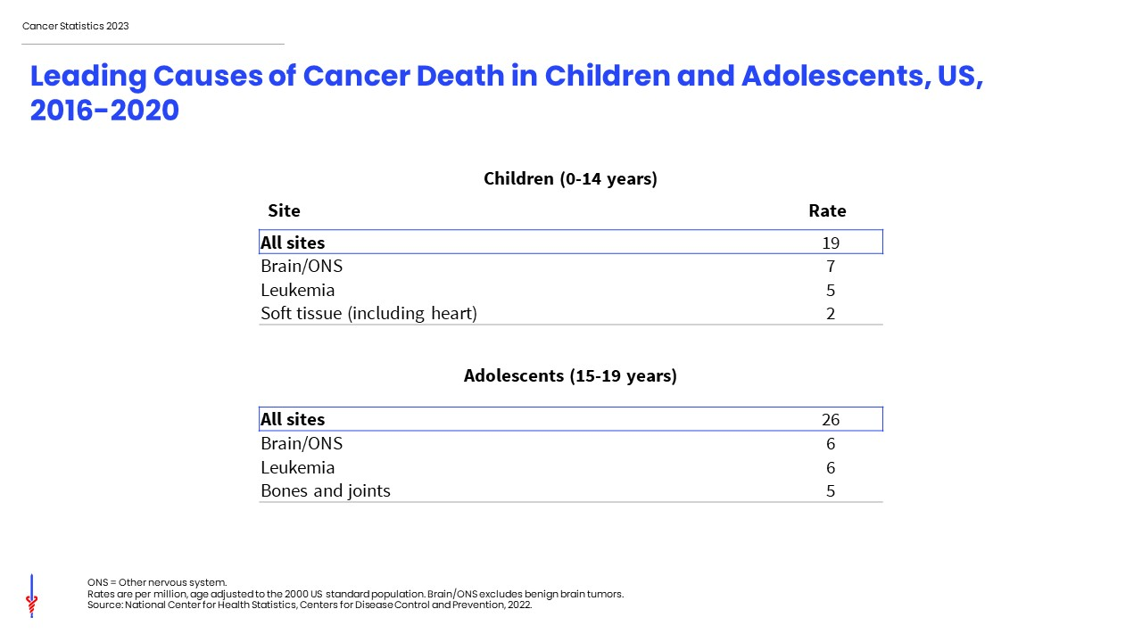
Notes:
This slide shows death rates per million children and adolescents for the leading causes of cancer-related death. Brain and other nervous system tumors are the most common cause of cancer-related death in both children and adolescents.

Slide 20
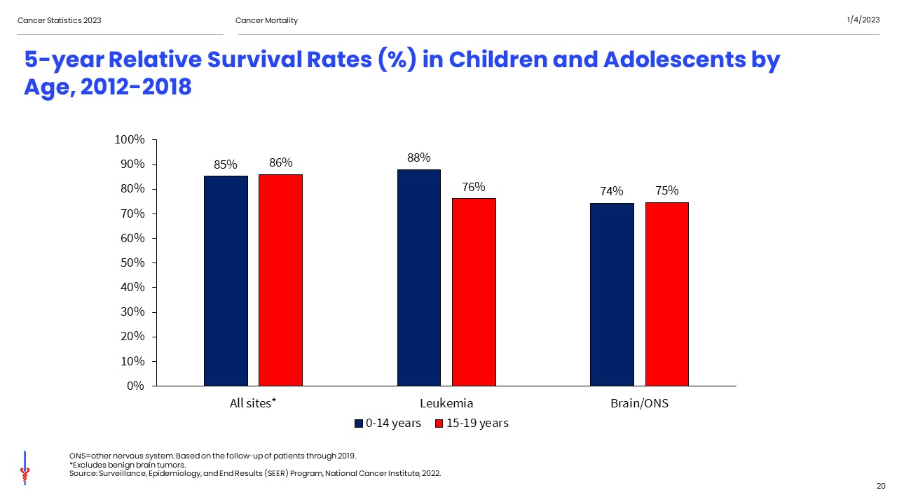
Notes:
Five-year relative survival for children and adolescents for all cancer sites are similar, 85% versus 86% respectively, but varies substantially by cancer type and age at diagnosis. For example, the current 5-year survival rate for leukemia is 88% for children but 76% for adolescents. In contrast, survival for brain and other nervous system tumors is similar.

Slide 21
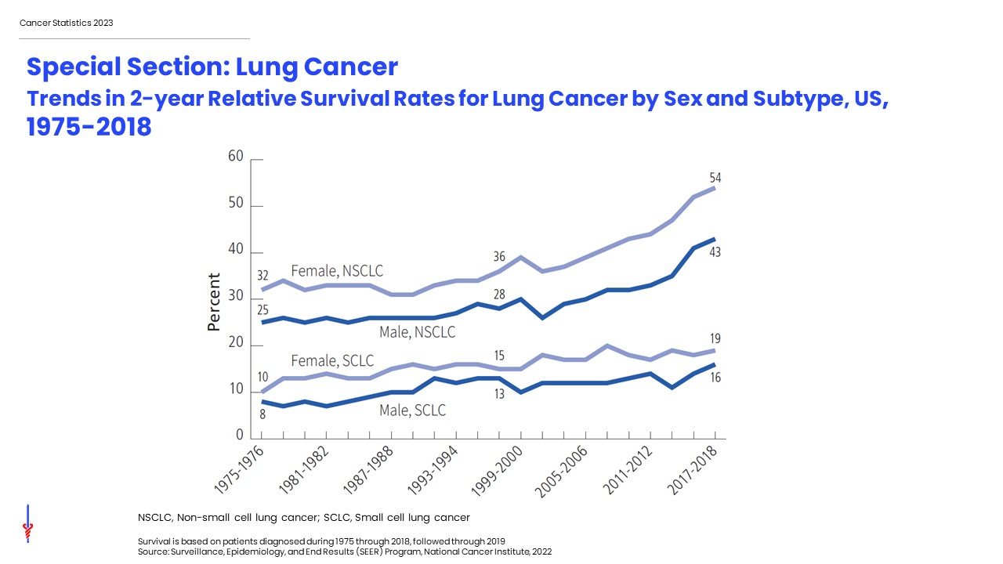
Notes:
The special section this year focuses on lung cancer, which is the most common cause of cancer death. After decades of little improvement in treatment and poor outcomes, recent advances have led to exciting gains in survival for non-small cell lung cancer. This slide shows the trends in 2-year relative survival rates for lung cancer in women in light blue and men in dark blue for non-small cell lung cancer in the top two lines and small cell lung cancer in the bottom two lines. Two-year survival for NSCLC increased from 36% in 1997-1998 to 54% in 2017-2018 for women and from 28% to 43% for men.

