Slide 1
Cancer Statistics
2025
Please note that ACS reserves all rights with respect to this publication and the materials provided herein. Any reproduction or re-use of this publication or portions of it, should credit the appropriate edition of the American Cancer Society Annual Cancer Facts & Figures publication. For permissions, please email the ACS Legal Department at permissionrequest@cancer.org.

Slide 2
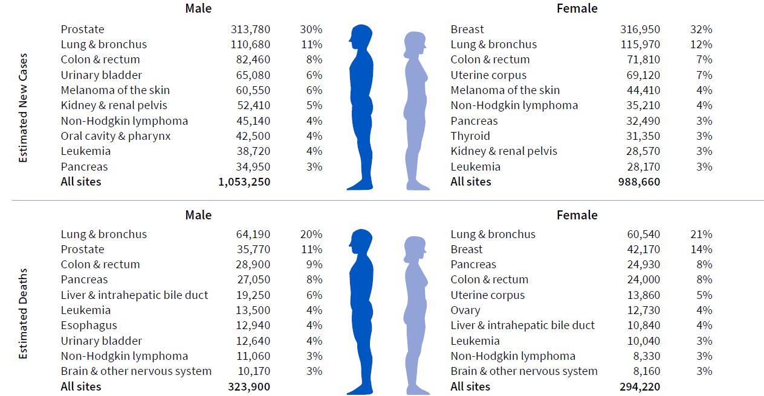
Estimated number of new cancer cases in the US in 2025
Cancer Statistics 2025
Excludes basal cell and squamous cell skin cancers and in situ carcinoma except urinary bladder.
Source: Cancer Facts & Figures 2025.
©2025, American Cancer Society, Inc., Surveillance and Health Equity Science
Notes:
In 2025, a little over 2 million new cancer cases are expected to be diagnosed in the United States. Prostate cancer is the most common cancer among males (30%), followed by lung (11%) and colorectal (8%) cancers. Among females, breast (32%), lung (12%), and colorectal (7%) cancers are the most common.

Slide 3
Trends in cancer incidence rates, US, 1975-2021
Cancer Statistics 2025
Rates are age adjusted to 2000 US standard population and adjusted for delays in reporting. Data for 2020 is shown separate from trend line.
Data source: Surveillance, Epidemiology, and End Results program, National Cancer Institute 2024.
©2025, American Cancer Society, Inc., Surveillance and Health Equity Science
Notes:
This slide shows long-term trends in cancer incidence rates for all sites combined by sex from 1975 to 2021. Cancer incidence trends reflect patterns in the prevalence of cancer risk factors, as well as changes in medical practices, such as cancer screening. Cancer incidence rates for 2020 are 9%-10% lower than those for 2019 because of COVID-19 pandemic disruptions that led to less screening and other elective healthcare visits, and thus less cancer detection.

Slide 4
Trends in cancer incidence rates among males, US, 1975-2021
Cancer Statistics 2025
Rates are age adjusted to 2000 US standard population and adjusted for delays in reporting. Incidence data for 2020 is shown separate from trend line.
ªExcludes appendix
^{b}Includes intrahepatic bile duct.
Data source: Surveillance, Epidemiology, and End Results program, National Cancer Institute, 2024.
©2025, American Cancer Society, Inc., Surveillance and Health Equity Science
Notes:
This slide shows trends in cancer incidence among males in the US by cancer site. Prostate cancer incidence is driven by the use of prostate-specific antigen (PSA) testing to screen for asymptomatic cancer. Rates spiked in the early 1990s because of initial widespread uptake of screening, then dropped by almost 40% from 2007 to 2014 because of a drop in screening precipitated by recommendations by the US Preventive Services Task Force against routine screening for men 75 and older in 2008 and all men in 2012. After 2014, rates have steadily increased, largely driven by increases in advanced stage disease.

Slide 5

Trends in cancer incidence rates among females, US, 1975-2021
Cancer Statistics 2025
Rate is age adjusted to 2000 US standard population and adjusted for delays in reporting. Incidence data for 2020 is shown separate from trend line.
ªExcludes appendix
^{b}Includes intrahepatic bile duct.
Data source: Surveillance, Epidemiology, and End Results program, National Cancer Institute, 2024.
©2025, American Cancer Society, Inc., Surveillance and Health Equity Science
Notes:
This slide shows trends in cancer incidence among females in the US. Breast cancer has been slowly increasing since the mid-2000s by about 0.5% per year because of increases in obesity (postmenopausal women) and continued declines in the fertility rate.

Slide 6
Trends in cancer incidence rates by sex and age, 1998-2021
Cancer Statistics 2025
Rates are age adjusted to the 2000 US standard population and adjusted for delays in case reporting. Data for 2020 are shown separate from trend lines.
©2025, American Cancer Society, Inc., Surveillance and Health Equity Science
Notes:
This graph shows delay-adjusted incidence rates by sex and age. Sex differences in cancer risk vary markedly by age. For example, cancer rates in middle-aged women (50-64 years) are statistically equivalent to those in middle-aged men in 2021, after being 21% lower in 2007. Among people younger than 50 years, the chasm between male and female rates is widening. The incidence among women was 51% higher than men in 2002, but 82% higher in 2021.

Slide 7
Cancer incidence rates by race and ethnicity, US, 2017-2021
Cancer Statistics 2025
Rate is age adjusted to 2000 US standard population and adjusted for delays in reporting. Race is exclusive of Hispanic origin.
ªRates for American Indian/Alaska Native people are restricted to Purchased/Referred Delivery Care Areas.
Data source: North American Association for Central Cancer Registries, 2024.
©2025, American Cancer Society, Inc., Surveillance and Health Equity Science
Notes:
This slide shows cancer incidence rates for all cancers combined by race and ethnicity and sex. Among men, cancer rates are highest among Black men while rates in women are highest among American Indian/Alaska Native women.

Slide 8
Lifetime probability of developing cancer for males, US, 2018-2019,2021
Cancer Statistics 2025
Site | Risk
All sitesª | 1 in 3 (39.9%)
Prostate | 1 in 8 (12.8%)
Lung & bronchus | 1 in 17 (5.8%)
Colon & rectum | 1 in 24 (4.1%)
Melanoma of the skin^{b} | 1 in 29 (3.5%)
Kidney & renal pelvis | 1 in 45 (2.2%)
ªExcludes basal cell and squamous cell skin cancers and in situ cancer except for urinary bladder. ^{b}Probabilities for non-Hispanic White individuals only.
Data source: DevCan 6.9.0, National Cancer Institute, 2024.
©2025, American Cancer Society, Inc., Surveillance and Health Equity Science
Notes:
This slide shows the lifetime risk, or likelihood, of an average male in the US developing cancer. One of every three men, or 39.9% of men, will develop some type of cancer in his lifetime.

Slide 9
Lifetime probability of developing cancer for females, US, 2018-2019, 2021
Cancer Statistics 2025
Site | Risk
All sitesª | 1 in 3 (39.0%)
Breast | 1 in 8 (13.1%)
Lung & bronchus | 1 in 18 (5.6%)
Colon & rectum | 1 in 26 (3.8%)
Uterine corpus | 1 in 32 (3.1%)
Melanoma of the skin^{b} | 1 in 40 (2.5%)
ªExcludes basal cell and squamous cell skin cancers and in situ cancer except for urinary bladder. ^{b}Probabilities for non-Hispanic White individuals only.
Data source: DevCan 6.9.0, National Cancer Institute, 2024.
©2025, American Cancer Society, Inc., Surveillance and Health Equity Science
Notes:
This slide shows the lifetime risk, or likelihood, of an average female in the US developing cancer. One of every three women, 39.0%, will develop some type of cancer in her lifetime.

Slide 10
Trends in five-year relative survival (%), US, 1975-2020
Cancer Statistics 2025
Site | 1975-77 | 1995-97 | 2014-2020
All sites | 49 | 63 | 69
Breast (female) | 75 | 87 | 91
Colon & rectum | 50 | 61 | 64
Leukemia | 34 | 48 | 67
Liver & intrahepatic bile duct | 3 | 7 | 22
Lung & bronchus | 12 | 15 | 27
Melanoma of the skin | 82 | 91 | 94
Non-Hodgkin lymphoma | 47 | 56 | 74
Ovary | 36 | 43 | 51
Pancreas | 3 | 4 | 13
Prostate | 68 | 97 | 97
Uterine cervix | 69 | 73 | 67
Uterine corpus | 87 | 84 | 81
Survival is age adjusted for normal life expectancy and are based on cases diagnosed in the Surveillance, Epidemiology, and End Results (SEER) 9 areas for 1975-1977 and 1995-1997 and in the SEER 22 areas for 2014-2020; cases followed through 2021.
Data source: Surveillance, Epidemiology, and End Results program, National Cancer Institute, 2025.
©2025, American Cancer Society, Inc., Surveillance and Health Equity Science
Notes:
This table shows the 5-year relative survival rate by cancer site. There have been notable improvements in survival for most cancer types due to earlier detection and/or advances in treatment. Overall cancer survival has increased from 49% in the mid-1970s to 69% for diagnoses during 2014-2020.

Slide 11
Five-year relative survival (%) by race, US, 2014-2020
Cancer Statistics 2025
Survival is age adjusted for normal life expectancy and are based on cases diagnosed in the Surveillance, Epidemiology, and End Results (SEER) 22 areas for 2014-2020 and cases were followed through 2021. Race is exclusive of Hispanic origin. Colorectum excludes appendiceal cancer.
Source: Surveillance, Epidemiology, and End Results program, National Cancer Institute, 2024.
©2025, American Cancer Society, Inc., Surveillance and Health Equity Science
Notes:
Survival is lower in Black people compared to White people for almost every cancer type; for example, the 5-year relative survival rate for uterine corpus cancer is 63% in Black women versus 84% in White women, largely due to later stage diagnosis, more aggressive disease, and less access to high-quality treatment.

Slide 12
Estimated number of new cancer deaths in the US in 2025
Cancer Statistics 2025
Excludes basal cell and squamous cell skin cancers and in situ carcinoma except urinary bladder.
Source: Cancer Facts & Figures 2025.
©2025, American Cancer Society, Inc., Surveillance and Health Equity Science
Notes:
In 2025, 618,120 deaths from cancer are expected in the United States. Lung cancer is the leading cause of cancer death among males (20%), followed by prostate (11%) and colorectal (9%) cancers. Among females, lung (21%), breast (14%), and pancreatic (8%) cancers are the leading causes of cancer death.

Slide 13
Trends in cancer death rates, US, 1975-2022
Cancer Statistics 2025
Year of Death
Rates are age adjusted to the 2000 US standard population.
Data source: National Center for Health Statistics, Centers for Disease Control and Prevention, 2024.
©2025, American Cancer Society, Inc., Surveillance and Health Equity Science
Notes:
This slide shows trends in cancer death rates by sex. The cancer death rate in males and females combined has declined by 34% since its peak in 1991.

Slide 14
Total number of cancer deaths averted in men (1991 onward) and women (1992 onward), US
Cancer Statistics 2025
The blue line represents the actual number of cancer deaths recorded each year, and the red line represents the number of cancer deaths that would have been expected if cancer death rates had remained at their peak.
©2025, American Cancer Society, Inc., Surveillance and Health Equity Science
Notes:
As a result of continuous declines in cancer mortality since 1991, there were an estimated 4.5 million fewer cancer deaths through 2022 than would have been expected if the death rate remained at its peak. This graph shows the number of averted cancer deaths in men on the left and women on the right. The blue line represents the actual number of cancer deaths recorded each year, and the red line represents the number of cancer deaths that would have been expected if cancer death rates had remained at their peak.

Slide 15
Trends in cancer death rates among males, US, 1930-2022
Cancer Statistics 2025
Year of Death
Rates are age adjusted to the 2000 US standard population and exclude deaths in Puerto Rico and other US territories. Due to improvements in classification, site-specific information differs from contemporary data for cancers of the liver, lung and bronchus, and colon and rectum.
Data source: National Center for Health Statistics, Center for Disease Control and Prevention, 2024.
©2025, American Cancer Society, Inc., Surveillance and Health Equity Science
Notes:
This figure shows long-term trends in cancer death rates in males by cancer type.

Slide 16
Trends in cancer death rates among females, US, 1930-2022
Cancer Statistics 2025
Rates are age adjusted to the 2000 US standard population and exclude deaths in Puerto Rico and other US territories. Due to improvements in classification, site-specific information differs from contemporary data for cancers of the liver, lung and bronchus, colon and rectum, and uterus.
Data source: National Center for Health Statistics, Center for Disease Control and Prevention, 2024.
©2025, American Cancer Society, Inc., Surveillance and Health Equity Science
Notes:
This figure shows long-term trends in cancer death rates for females by cancer type.

Slide 17
Cancer death rates by race and ethnicity, US, 2018-2022
Cancer Statistics 2025
Rate is age adjusted to 2000 US standard population and adjusted for delays in reporting. Race is exclusive of Hispanic origin. ªRates for American Indian/Alaska Native people are adjusted for racial misclassification on death certificates.
Source: National Centers for Health Statistics, Center for Disease Control and Prevention, 2024
©2025, American Cancer Society, Inc., Surveillance and Health Equity Science
Notes:
This slide shows cancer incidence rates for all cancers combined by race and ethnicity and sex. The highest rates are in American Indian and Alaska Native and Black men and American Indian and Alaska Native women.

Slide 18
Incidence rates for children (0-14 years) and adolescents (15-19 years), US, 2017-2021
Cancer Statistics 2025
Rates are age adjusted to the 2000 US standard population. ªIncludes benign/borderline malignant brain tumors.
Data source: North American Association of Central Cancer Registries, 2024.
©2025, American Cancer Society, Inc., Surveillance and Health Equity Science
Notes:
This slide shows cancer incidence rates in children and adolescents by cancer type according to the International Classification of Childhood Cancers (ICCC).

Slide 19
Five-year relative survival in children and adolescents by age, US, 2014-2020
Cancer Statistics 2025
Survival is for cases diagnosed 2014-2020 and followed through 2021. ªExcludes benign/borderline malignant brain tumors.
Source: Surveillance, Epidemiology, and End Results program, 2024.
©2025, American Cancer Society, Inc., Surveillance and Health Equity Science
Notes:
This slide shows 5-year relative survival for children, ages 0-14 years in red, and adolescents, ages 15-19 years shown in blue, for major cancers.

