Slide 1
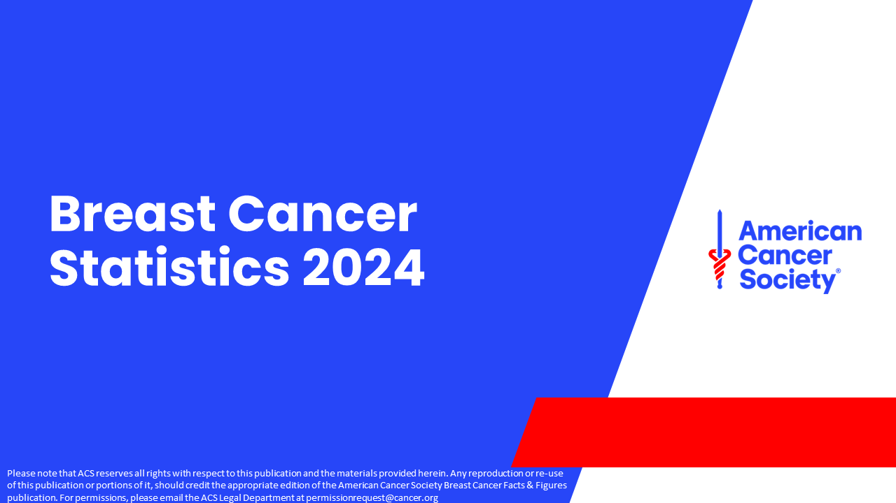

Slide 2
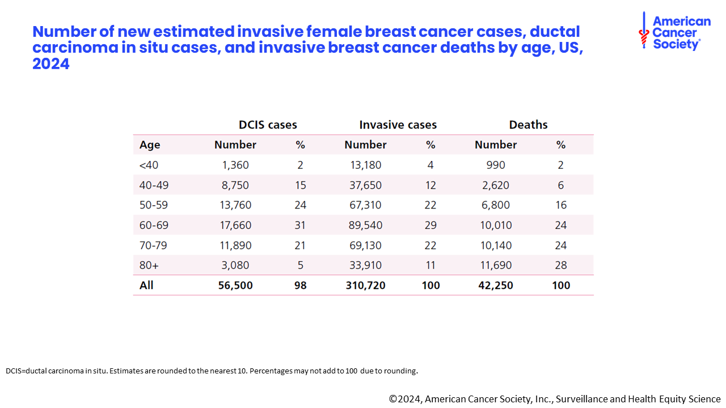
Notes:
In 2024 an estimated 310,720 women will be diagnosed with invasive breast cancer, and an additional 56,500 women will be diagnosed with ductal carcinoma in situ. An estimated 42,450 women are expected to die from invasive breast cancer in 2024.

Slide 3
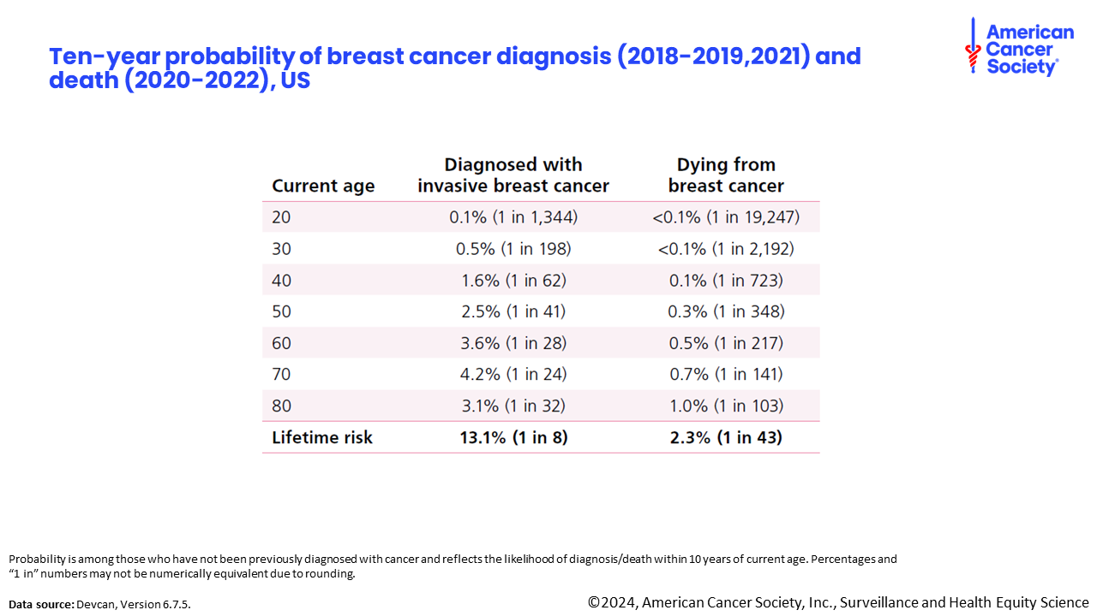
Notes:
Approximately 1 in 8 women (13.1%) will be diagnosed with invasive breast cancer in her lifetime, and 1 in 43 (2.3%) will die from the disease. Lifetime risk is the average risk for all women after accounting for other causes of death, but does not account for individual factors that influence risk, such as race or ethnicity, family history, etc.

Slide 4
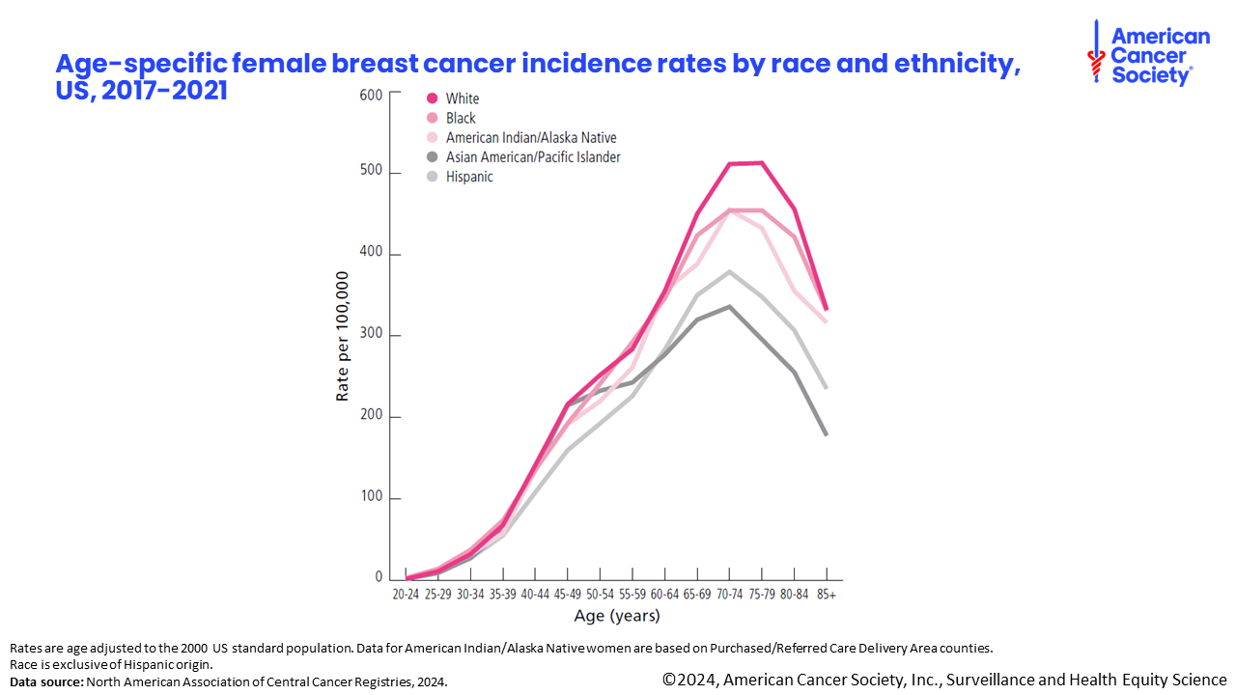
Notes:
Breast cancer incidence increases with age until the seventh decade of life and then decreases, likely due to less screening after age 70.

Slide 5
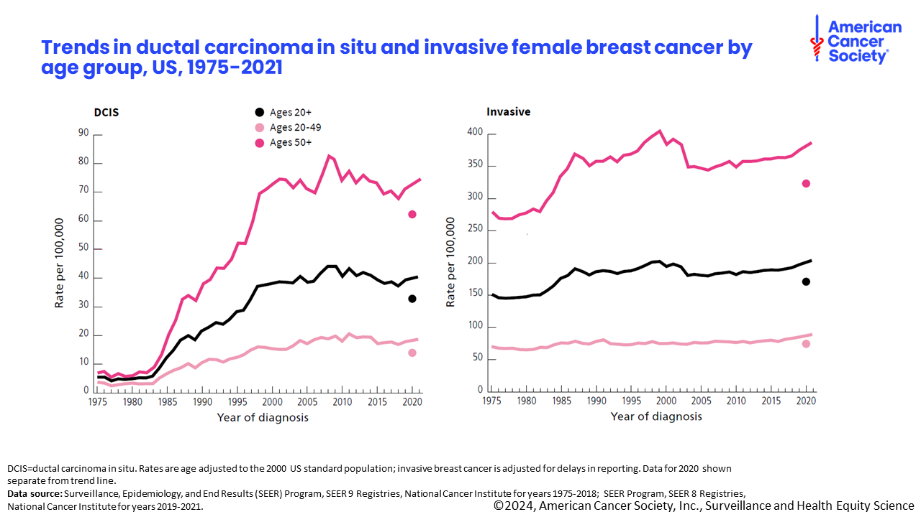
Notes:
Between 1980 and 2000, invasive breast cancer incidence rates increased by 32% in women overall, with a steeper incline among women 50 years and older (40% increase) compared to those younger than 50 (15% increase) largely reflecting the widespread, rapid uptake of mammography screening. Invasive breast cancer dropped steeply in the early 2000s following the decreased use of menopausal hormone therapy (which was reported to increase breast cancer) but thereafter began to slowly increase. In the most recent decade of data, invasive breast cancer has increased by about 1% per year with a larger increase among women ages 20-49 years old (1.4% per year) than women 50 years and older (0.7% per year).
DCIS is almost exclusively diagnosed during screenings and increased by 10-fold in women ages 50 years and older during the 1980s and 1990s. During the most recent decade of data, rates for DCIS have been stable.

Slide 6
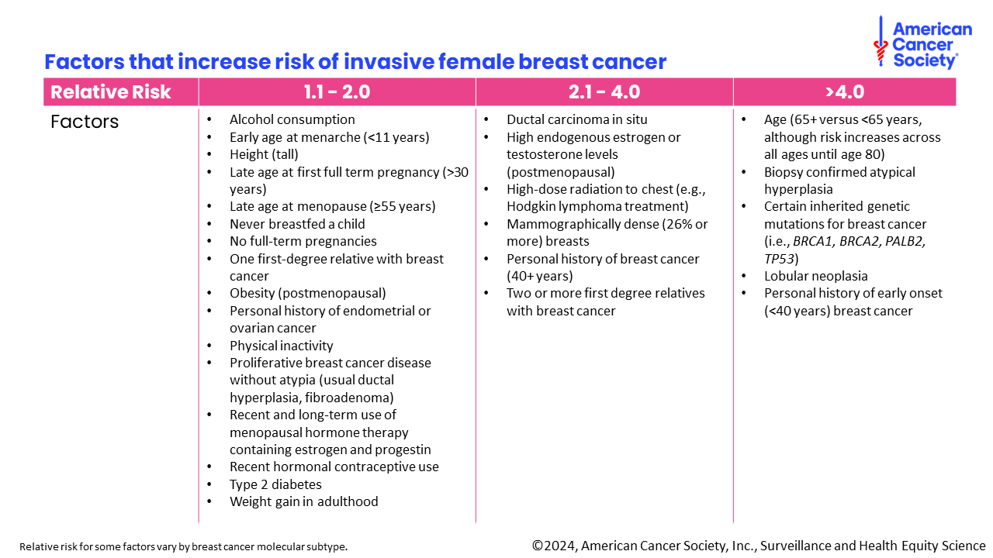
Notes:
Most women who develop breast cancer have no known risk factors. Potentially modifiable risk factors include excess body weight, physical inactivity, and alcohol consumption. The strongest risk factors are a personal or family history of breast cancer, or a history of lesions associated with risk, high-dose radiation to the chest, or certain inherited genetic variations.
References:
Islami F, Marlow EC, Thomson B, et al. Proportion and number of cancer cases and deaths attributable to potentially modifiable risk factors in the United States, 2019. CA Cancer J Clin. Published online July 11, 2024. doi:10.3322/caac.21858
Tung N, Lin NU, Kidd J, et al. Frequency of Germline Mutations in 25 Cancer Susceptibility Genes in a Sequential Series of Patients With Breast Cancer. J Clin Oncol. 2016;34:1460-1468.
Roa BB, Boyd AA, Volcik K, Richards CS. Ashkenazi Jewish population frequencies for common mutations in BRCA1 and BRCA2. Nat Genet. 1996;14:185-187.
Lambertini M, Santoro L, Del Mastro L, et al. Reproductive behaviors and risk of developing breast cancer according to tumor subtype: A systematic review and meta-analysis of epidemiological studies. Cancer Treat Rev. 2016;49:65-76.
Nichols HB, Schoemaker MJ, Cai J, et al. Breast Cancer Risk After Recent Childbirth: A Pooled Analysis of 15 Prospective Studies. Ann Intern Med. 2019;170:22-30.
Reeves GK, Kan S-W, Key T, et al. Breast cancer risk in relation to abortion: Results from the EPIC study. Int J Cancer. 2006;119:1741-1745.
Chen L, Malone KE, Li CI. Bra wearing not associated with breast cancer risk: a population-based case-control study. Cancer Epidemiol Biomarkers Prev. 2014;23:2181-2185.
Brinton LA, Brown SL. Breast Implants and Cancer. J Natl Cancer Inst. 1997;89:1341-1349.
De Bruijn KM, Arends LR, Hansen BE, Leeflang S, Ruiter R, van Eijck CH. Systematic review and meta-analysis of the association between diabetes mellitus and incidence and mortality in breast and colorectal cancer. Br J Surg. 2013;100(11):1421-1429. doi:10.1002/bjs.9229.
De Bruin ML, Sparidans J, van’t Veer MB, et al. Breast cancer risk in female survivors of Hodgkin’s lymphoma: lower risk after smaller radiation volumes. J Clin Oncol. 2009;27(26):4239-4246. doi:10.1200/JCO.2008.19.9174.
Hulka BS, Moorman PG. Breast cancer: hormones and other risk factors. Maturitas. 2001;38(1):103-116. doi:10.1016/s0378-5122(00)00196-1.

Slide 7
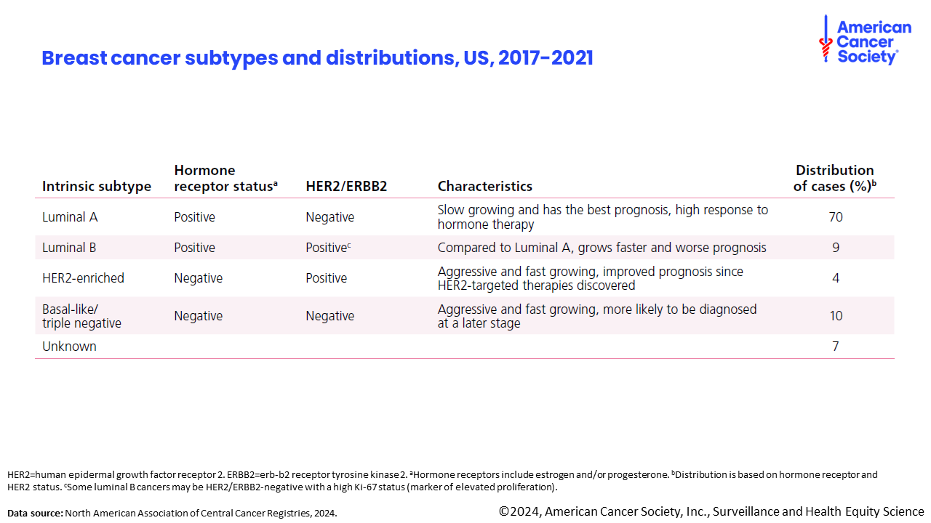
Notes:
Four out of five breast cancers test positive for hormone (estrogen and/or progesterone) receptors (HR+) and are generally classified as either Luminal A (70%) or Luminal B (9%) based on the presence of HER2/ERBB2.

Slide 8
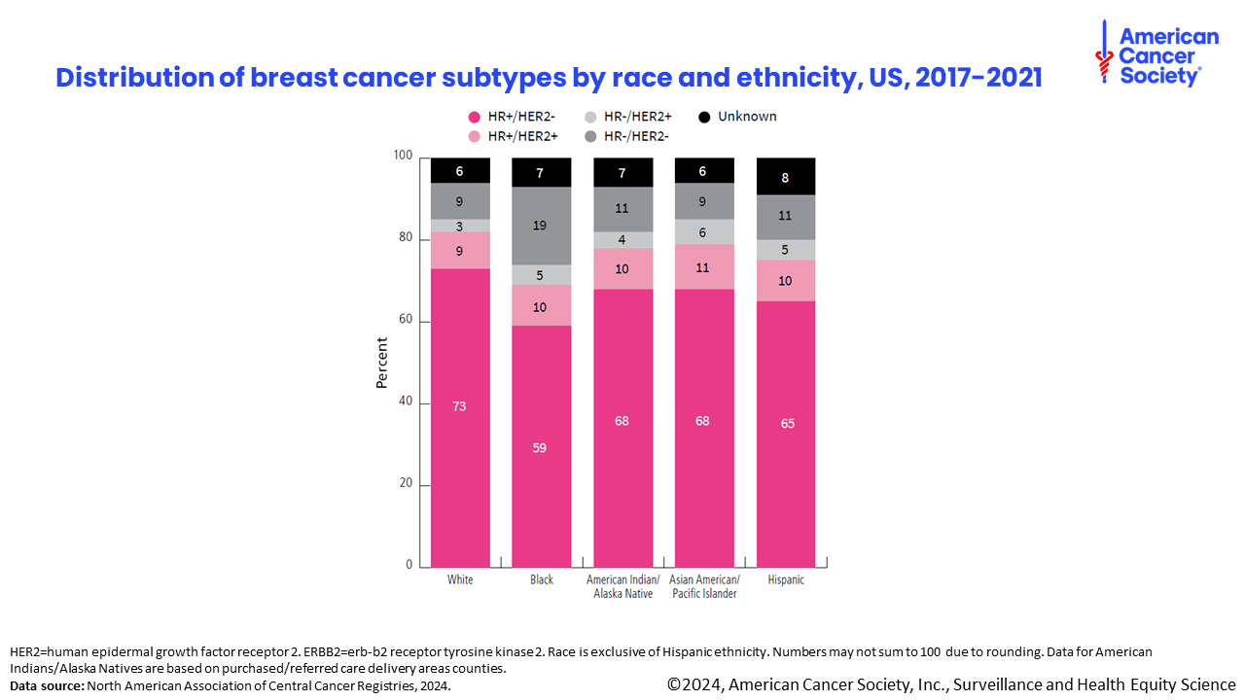
Notes:
HR+/HER2- breast cancer is the most common subtype in every racial and ethnic group, with the highest proportion (73%) among White women and the lowest in Black women (59%).

Slide 9
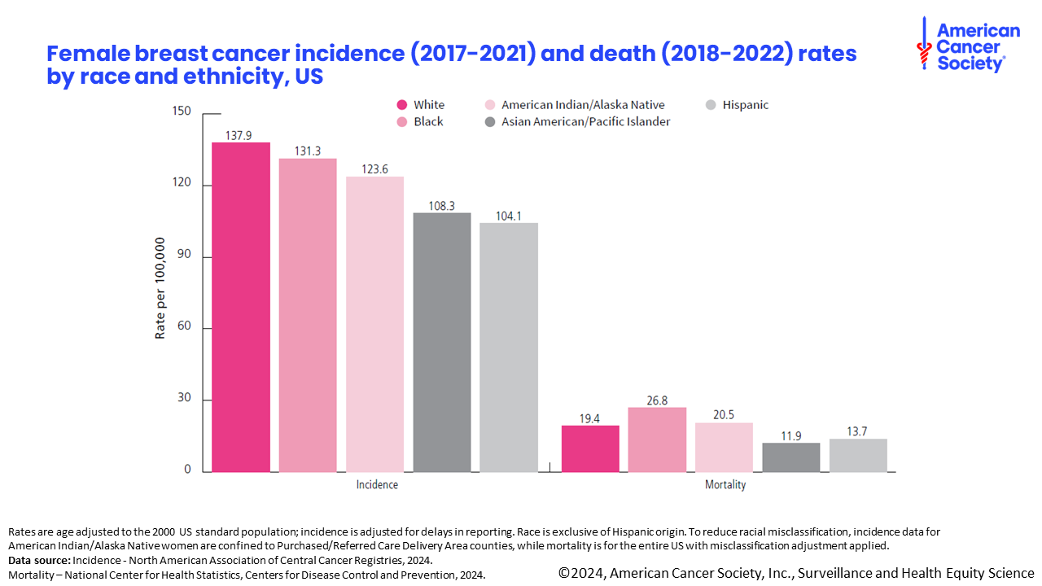
Notes:
Breast cancer incidence ranges from 104.1 (per 100,000) in Hispanic women to 137.9 in White women whereas death rates range from 11.9 (per 100,000) in Asian American/Pacific Islander women to 26.8 in Black women.

Slide 10
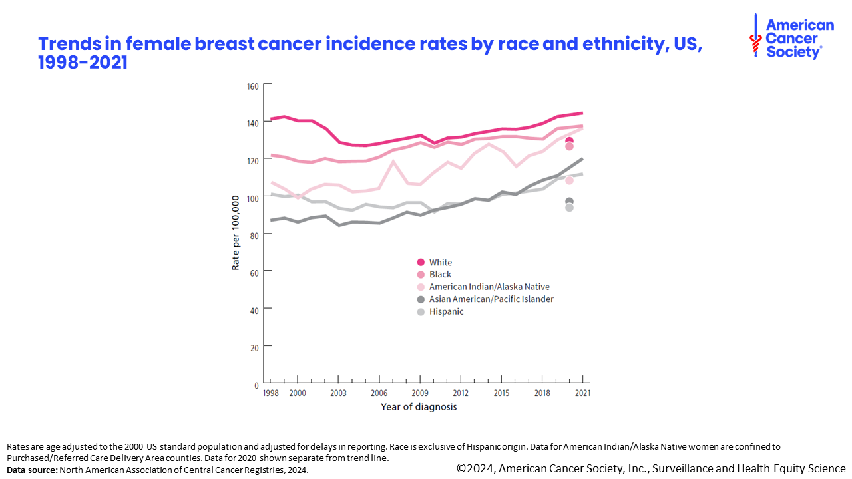
Notes:
Overall, the breast cancer incidence rate has increased slowly since the mid-2000s, at least in part because of changing patterns in risk factors, such as increased excess body weight and fewer and/or later childbirths.

Slide 11
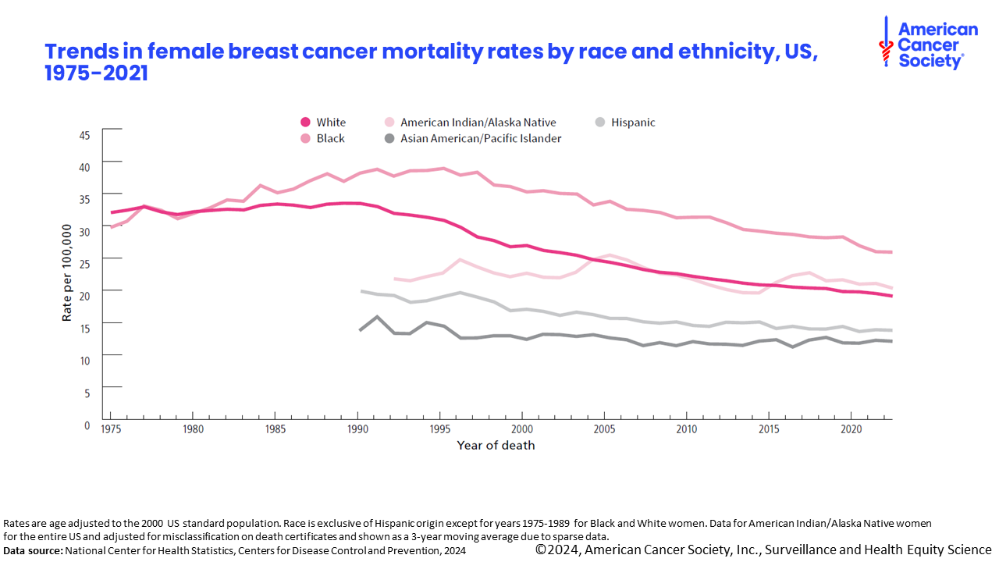
Notes:
The breast cancer death rate has dropped by 44% since 1989 due to advancements in early detection and treatment, however not all women have benefited equally from this progress. Unequal dissemination of mammography screening and adjuvant hormonal therapies in the 1980s led to the emergence of the Black-White breast cancer mortality disparity that peaked in 2011 with rates 44% higher in Black than White women, the gap has only decreased to 36% higher in 2022. American Indian/Alaska Native women have similarly been left behind in progress against breast cancer, as their breast cancer death rates have remained stable over the past 3 decades.

Slide 12
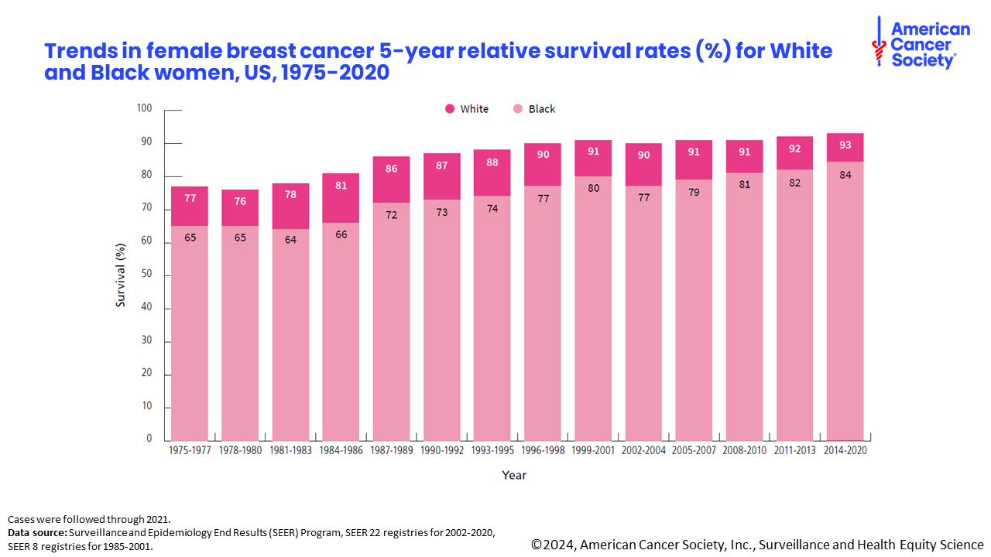
Notes:
The 5-year relative survival has increased from 77% in 1975-1977 to 93% in 2014-2020 in White women and from 65% to 84% in Black women.

Slide 13
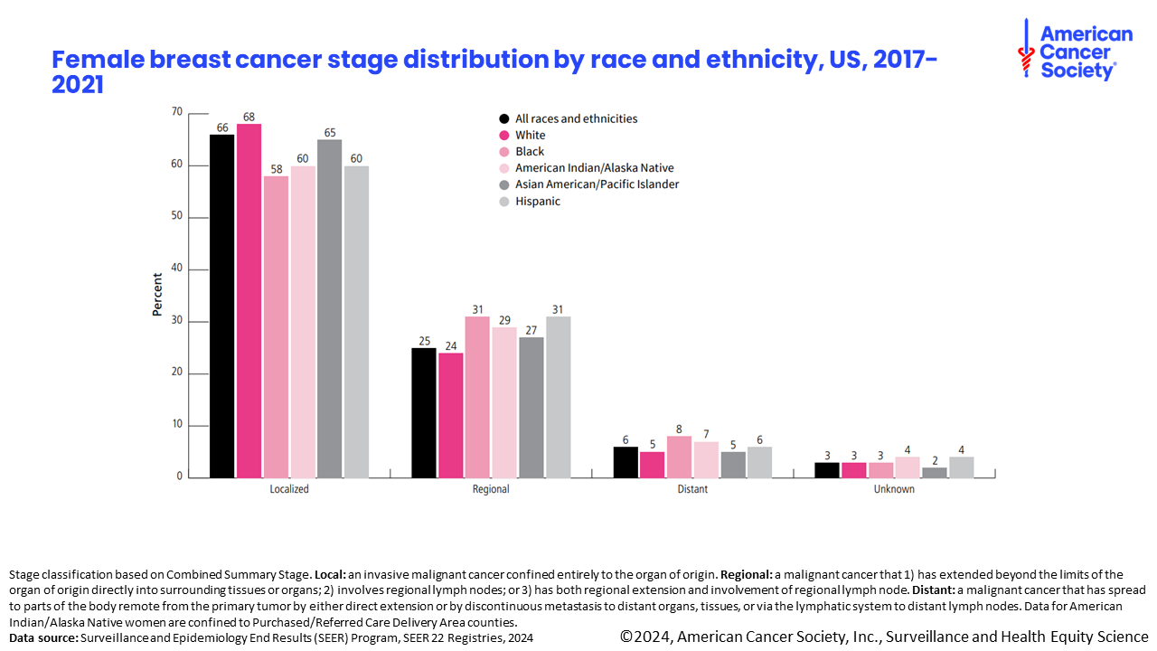
Notes:
Two-thirds (66%) of breast cancer patients are diagnosed at localized-stage disease, when treatment is likely to be less extensive and more successful. Black women are least likely to be diagnosed with localized-stage breast cancer and more likely to be diagnosed with regional- or distant-staged cancer than other racial and ethnic groups.

Slide 14
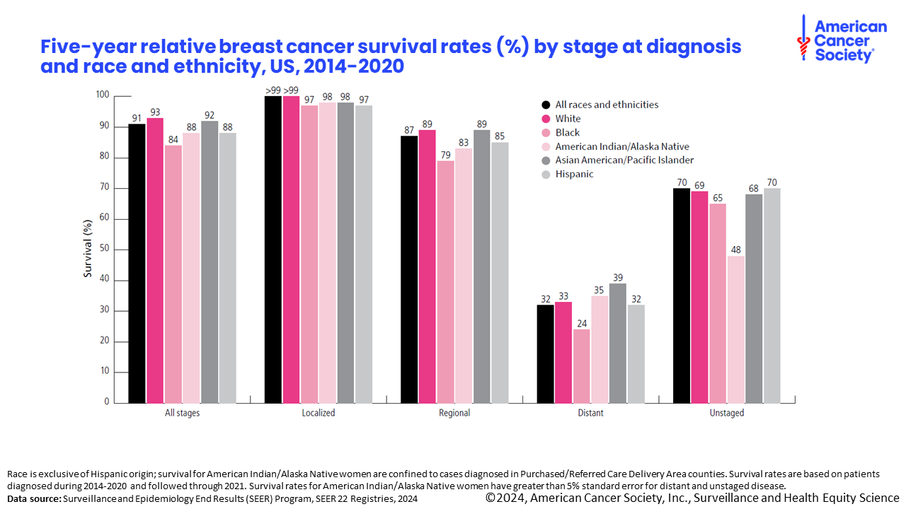
Notes:
The 5-year relative survival rates is over 99% for breast cancers diagnosed at localized-stage, when treatment is usually more effective and less extensive, but drops to 87% for regional-stage and 32% for distant-stage disease.
Stage classification based on Combined Summary Stage. Local: an invasive malignant cancer confined entirely to the organ of origin. Regional: a malignant cancer that 1) has extended beyond the limits of the organ of origin directly into surrounding tissues or organs; 2) involves regional lymph nodes; or 3) has both regional extension and involvement of regional lymph node. Distant: a malignant cancer that has spread to parts of the body remote from the primary tumor by either direct extension or by discontinuous metastasis to distant organs, tissues, or via the lymphatic system to distant lymph nodes.

Slide 15
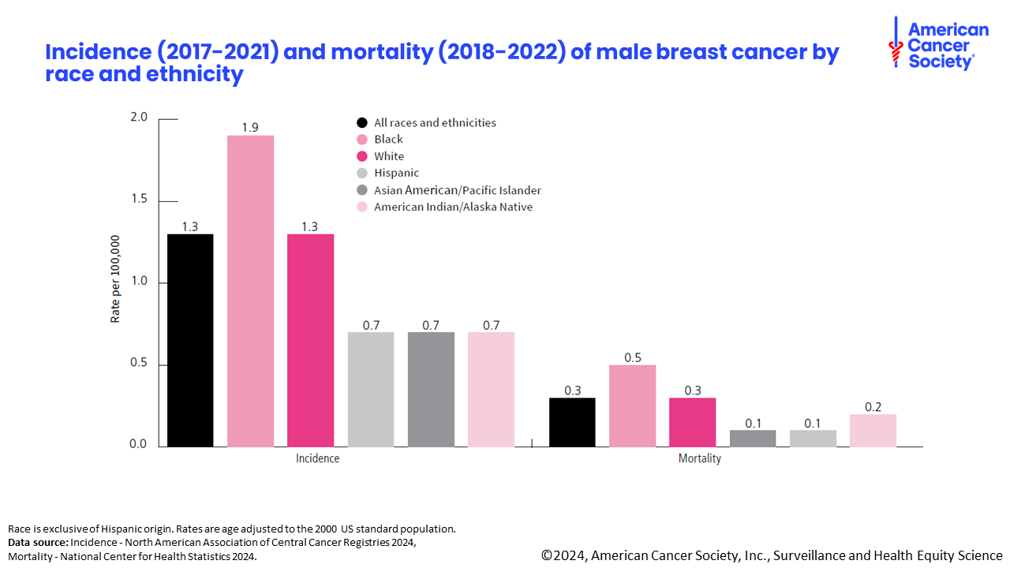
Notes:
Black men have the highest incidence (1.9 per 100,000) of breast cancer and the highest mortality (0.5 per 100,000) of all racial and ethnic groups.

Slide 16
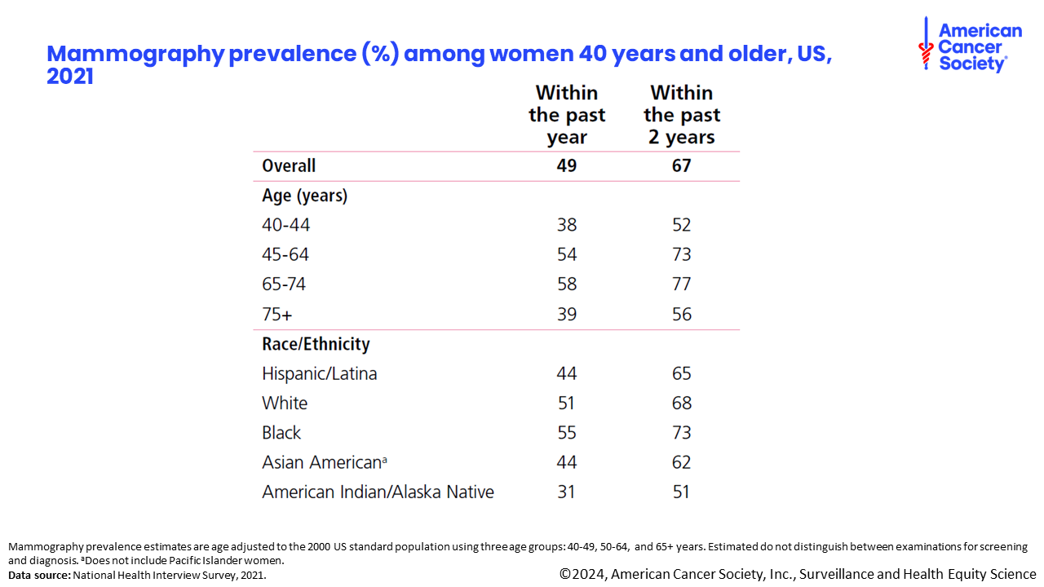
Notes:
Among women 40 years and older in the US, an estimated 49% had a mammogram in the past year and 67% had a mammogram in the past two years in 2021. Younger women, ages 40-44, Asian American, and American Indian/Alaska native had among the lowest mammography prevalence.

