Slide 2
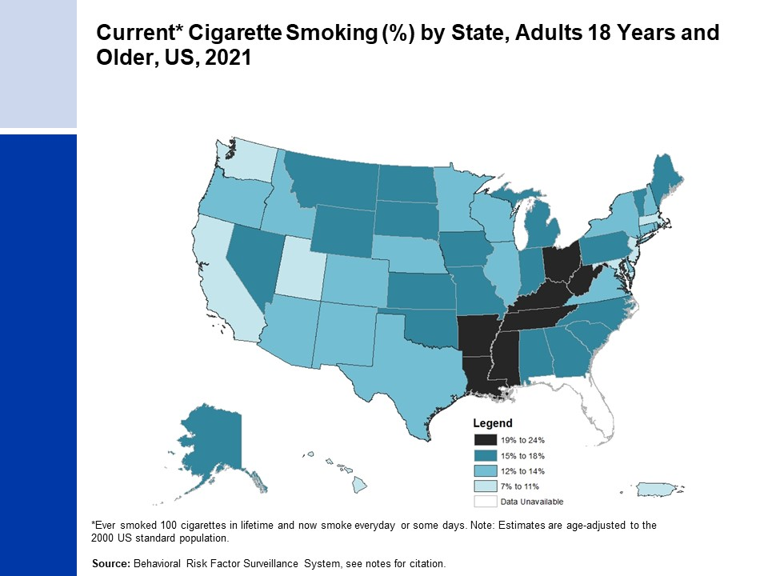
Notes:
Centers for Disease Control and Prevention (CDC). Behavioral Risk Factor Surveillance System Survey Data. Atlanta, Georgia: U.S. Department of Health and Human Services, Centers for Disease Control and Prevention, 2021. https://www.cdc.gov/brfss/data_documentation/index.htm

Slide 3
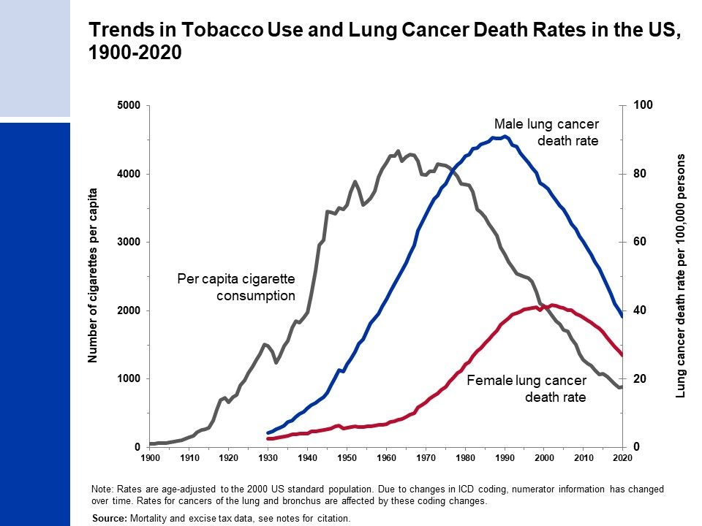
Notes:
- Death rates: US Mortality Volumes 1930 to 1959, US Mortality Data 1960 to 2020, National Center for Health Statistics, Centers for Disease Control and Prevention.
- Cigarette consumption: 1900-1999: US Department of Agriculture. 2000-2015: Wang, TW et al. PMID: 27932780. 2016-2020: Alcohol and Tobacco Tax and Trade Bureau (https://www.ttb.gov/tobacco/tobacco-statistics) and US Census population estimates (https://www.census.gov/data/tables/time-series/demo/popest/2010s-national-detail.html).

Slide 4
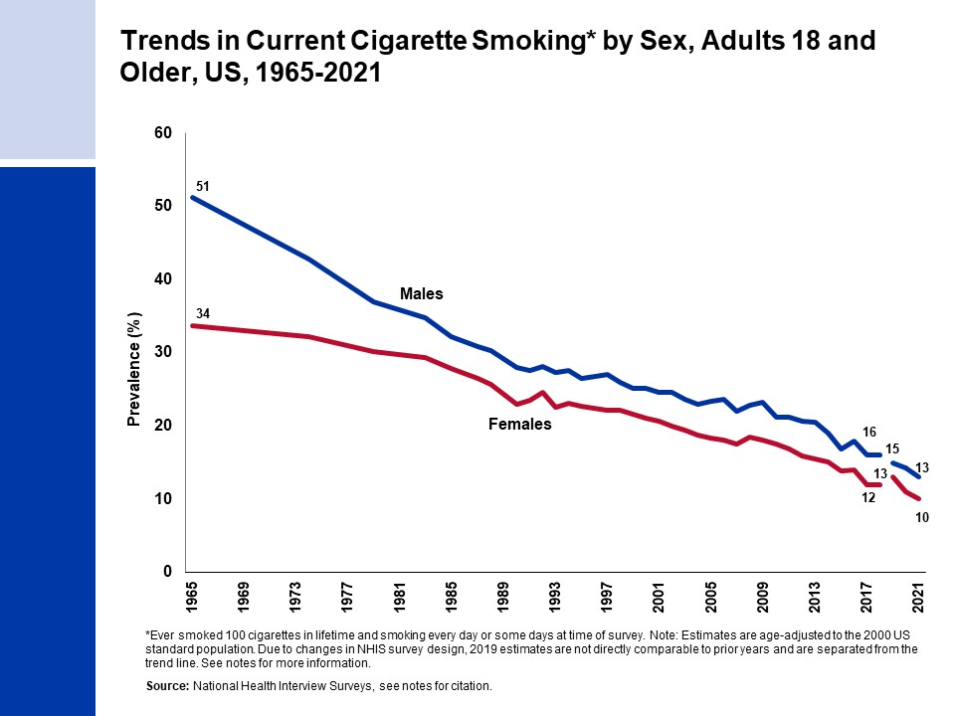
Notes:
- National Center for Health Statistics. Health, United States, 2018. Hyattsville, MD. 2019.
National Health Interview Survey, National Center for Health Statistics, Centers for Disease Control and Prevention, 2018-2021. Public-use data file and documentation. https://www.cdc.gov/nchs/nhis/index.htm
Due to changes in NHIS survey design, 2019 estimates are not directly comparable to prior years and are separated from the trend line. The NHIS survey data collection mode was modified after the onset of the COVID-19 pandemic, where interviews changed to telephone-based modes in the second quarter of 2020 through April 2021 versus in-person modes in prior years and the first quarter of 2020. In May 2021, interviewers were directed to return to in-person interviews with some flexibility to conduct follow-up through telephone interviews. Readers are referred to the NHIS website for further information on potential biases due to COVID-19 related data collection changes.

Slide 5
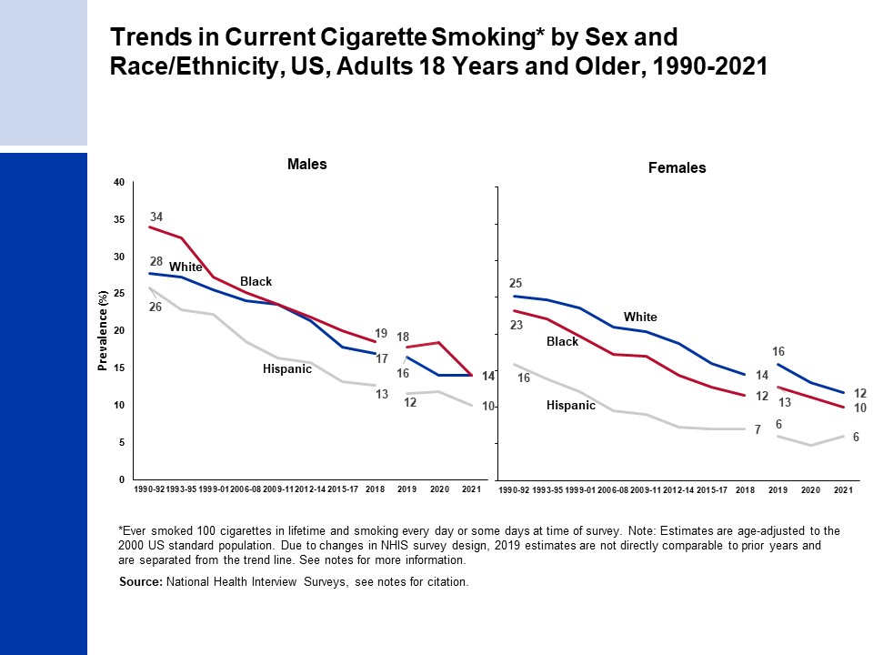
Notes:
- Estimates for White and Black persons are among non-Hispanic individuals.
- National Center for Health Statistics. Health, United States, 2018. Hyattsville, MD. 2019.
National Health Interview Survey, National Center for Health Statistics, Centers for Disease Control and Prevention, 2018-2021. Public-use data file and documentation. https://www.cdc.gov/nchs/nhis/index.htm
Due to changes in NHIS survey design, 2019 estimates are not directly comparable to prior years and are separated from the trend line. The NHIS survey data collection mode was modified after the onset of the COVID-19 pandemic, where interviews changed to telephone-based modes in the second quarter of 2020 through April 2021 versus in-person modes in prior years and the first quarter of 2020. In May 2021, interviewers were directed to return to in-person interviews with some flexibility to conduct follow-up through telephone interviews. Readers are referred to the NHIS website for further information on potential biases due to COVID-19 related data collection changes.

Slide 6
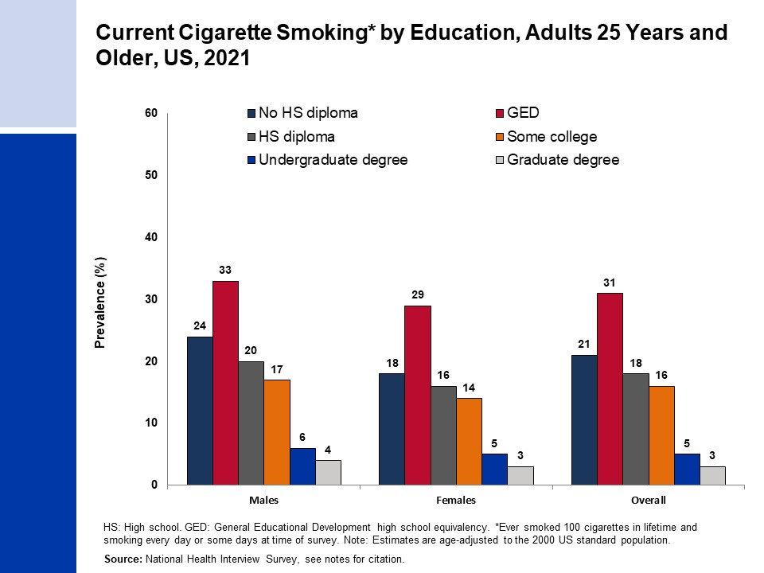
Notes:
- Estimate for “Some college” includes those with an Associate’s degree.
- National Health Interview Survey, National Center for Health Statistics, Centers for Disease Control and Prevention, 2021. Public-use data file and documentation. https://www.cdc.gov/nchs/nhis/index.htm

Slide 7
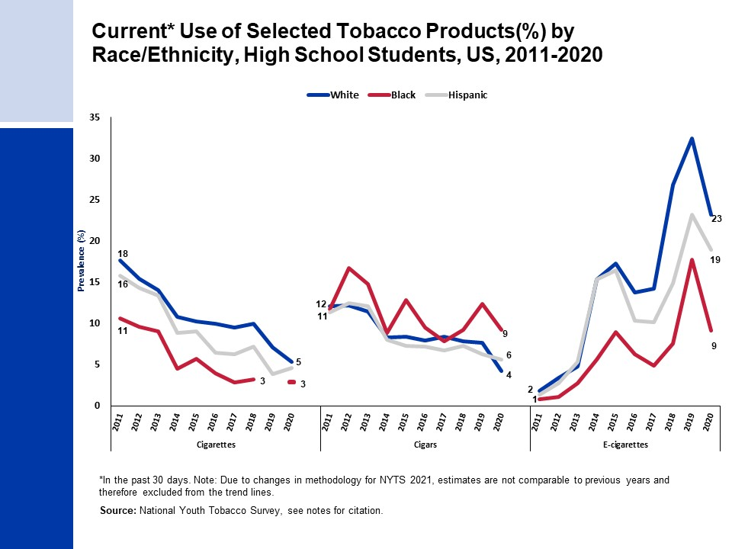
Notes:
Sources: 2020: Gentzke AS, et al. MMWR Morb Mortal Wkly Rep. 2020 Dec 18;69(50):1881-1888; 2019: Wang T, et al. MMWR Surveill Summ. 2019 Nov 6;68(12):1-22; 2018: Gentzke AS et al. MMWR Morb Mortal Wkly Rep. 2019 Feb 15;68(6):157-164; 2017: Wang T, et al. MMWR Morb Mortal Wkly Rep. 2018 Jun 8;67(22):629-633; 2016: Jamal A, et al. MMWR Morb Mortal Wkly Rep. 2017 Jun 16;66(23):597-603; 2015: Singh T, et al. MMWR Morb Mortal Wkly Rep. 2016 Apr 15;65(14):361-7; 2014: Arrazola RA, et al. MMWR Morb Mortal Wkly Rep. 2015 Apr 17;64(14):381-5; 2013: Arrazola RA, et al. MMWR Morb Mortal Wkly Rep. 2014 Nov 14;63(45):1021-6;2011 & 2012: Arrazola RA, et al. MMWR Morb Mortal Wkly Rep. 2013 Nov 15;62(45):893-7.

Slide 8
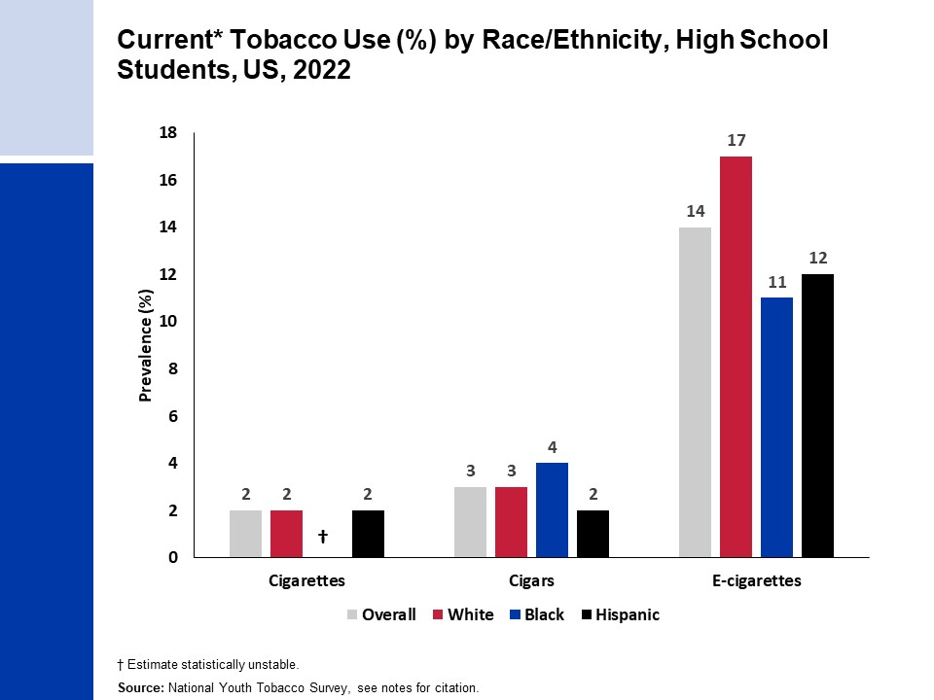
Notes:
Source: Park-Lee E, et al. PMID: 36355596, based on data from National Youth Tobacco Survey, 2022.

Slide 9
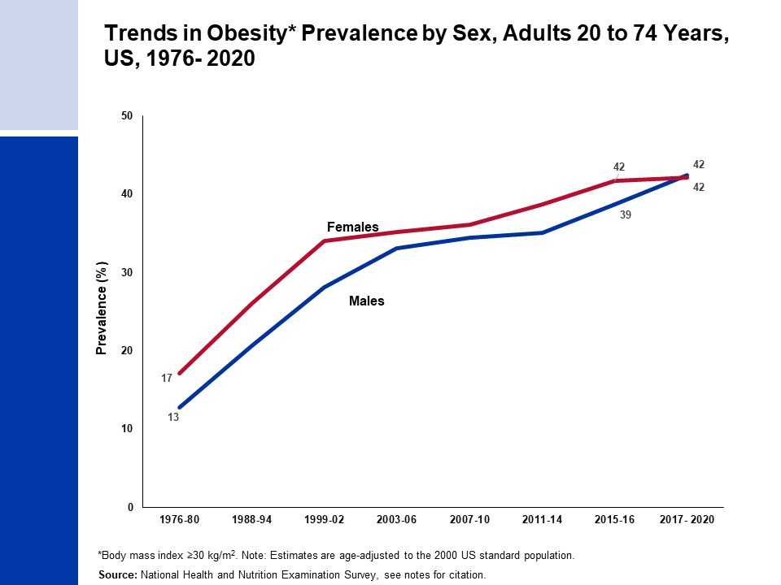
Notes:
National Center for Health Statistics. Health, United States, 2013: With Special Feature on Prescription Drugs. Hyattsville, MD. 2014.
National Center for Health Statistics. National Health and Nutrition Examination Survey, 2011-March 2020. Public-use data files and documentation. https://wwwn.cdc.gov/nchs/nhanes/Default.aspx

Slide 10
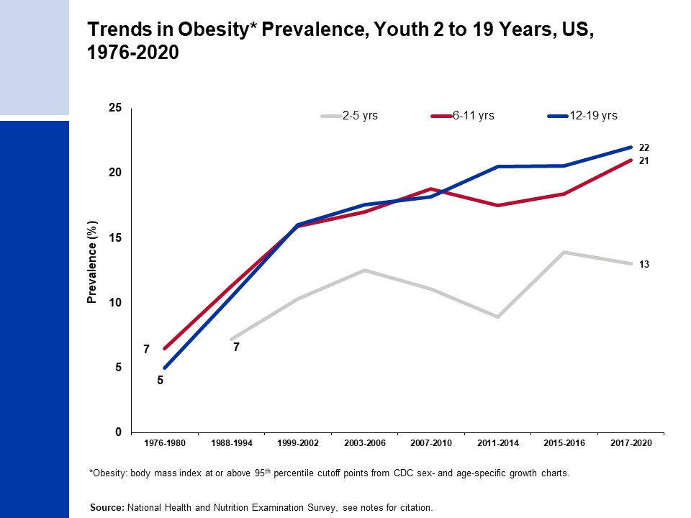
Notes:
National Center for Health Statistics. Health, United States, 2013: With Special Feature on Prescription Drugs. Hyattsville, MD. 2014.
National Center for Health Statistics. Health, United States, 2017: With Special Feature on Mortality. Hyattsville, MD. 2018.
National Center for Health Statistics. National Health and Nutrition Examination Survey, 2015-March 2020. Public-use data files and documentation. https://wwwn.cdc.gov/nchs/nhanes/Default.aspx

Slide 11
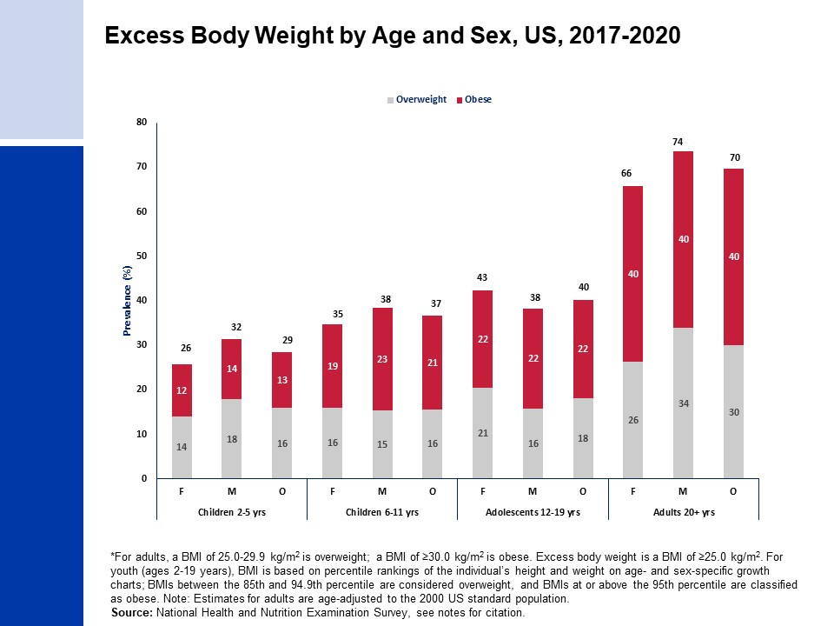
Notes:
National Center for Health Statistics. National Health and Nutrition Examination Survey, 2017- March 2020. Public-use data files and documentation. https://wwwn.cdc.gov/nchs/nhanes/Default.aspx

Slide 12
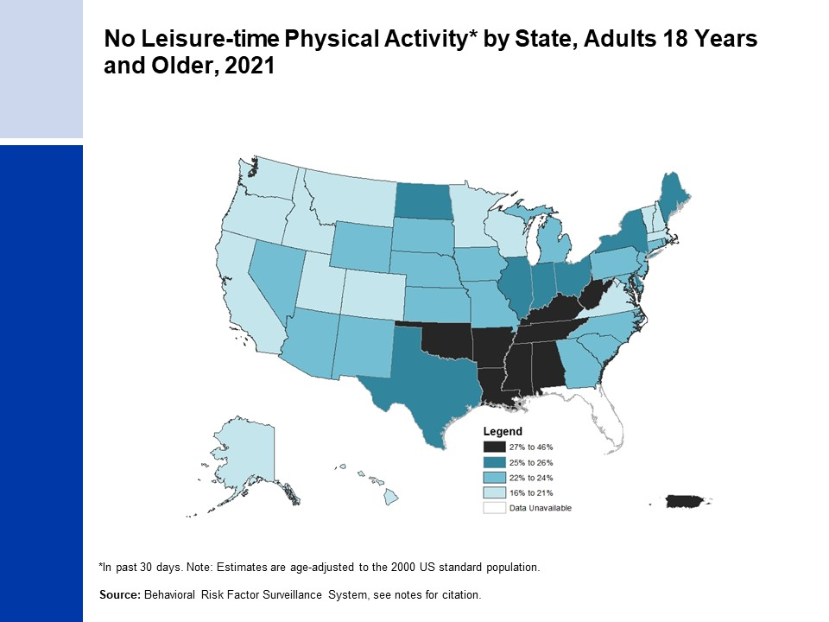
Notes:
Centers for Disease Control and Prevention (CDC). Behavioral Risk Factor Surveillance System Survey Data. Atlanta, Georgia: U.S. Department of Health and Human Services, Centers for Disease Control and Prevention, 2021. https://www.cdc.gov/brfss/data_documentation/index.htm

Slide 13
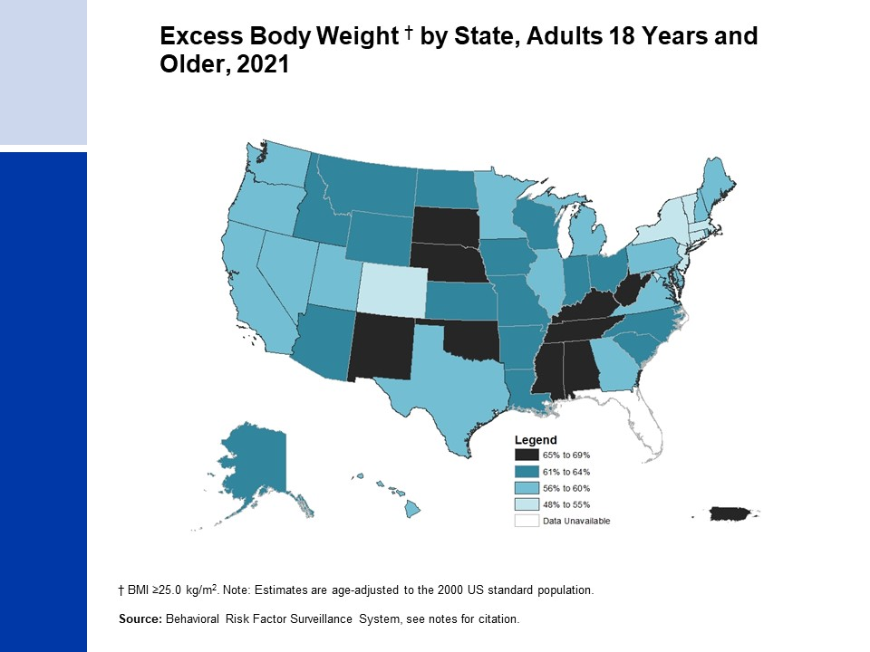
Notes:
Centers for Disease Control and Prevention (CDC). Behavioral Risk Factor Surveillance System Survey Data. Atlanta, Georgia: U.S. Department of Health and Human Services, Centers for Disease Control and Prevention, 2021. https://www.cdc.gov/brfss/data_documentation/index.htm

Slide 14
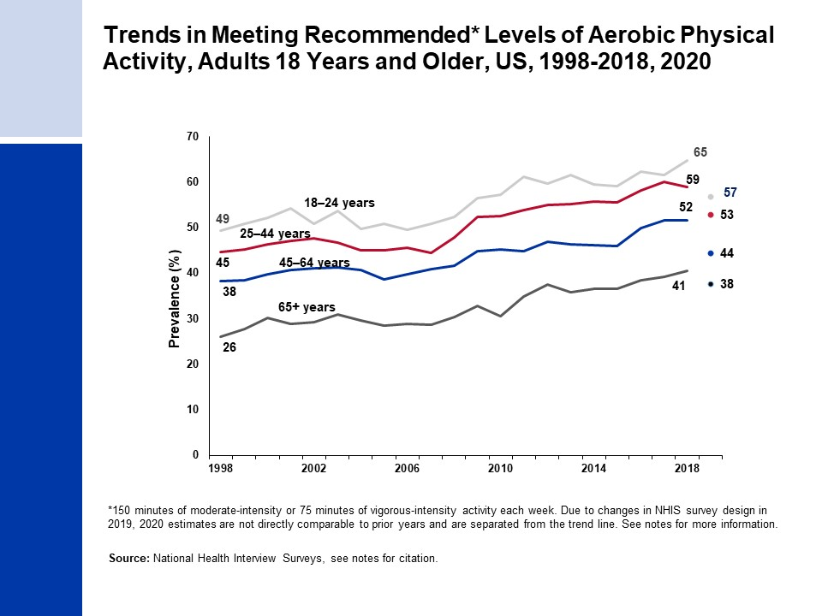
Notes:
National Center for Health Statistics. Health, United States, 2018. Hyattsville, MD. 2019.
National Health Interview Survey, National Center for Health Statistics, Centers for Disease Control and Prevention, 2018, 2020. Public-use data file and documentation. https://www.cdc.gov/nchs/nhis/index.htm
Due to changes in NHIS survey design in 2020 estimates are not directly comparable to prior years and are separated from the trend line. The NHIS survey data collection mode was modified after the onset of the COVID-19 pandemic, where interviews changed to telephone-based modes in the second quarter of 2020 through April 2021 versus in-person modes in prior years and the first quarter of 2020.

Slide 15
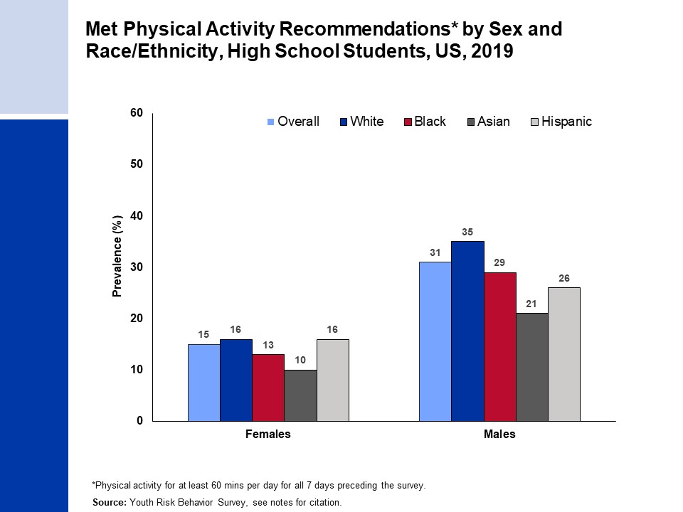
Notes:
Estimates for White, Black, and Asian persons are among non-Hispanic individuals.
Centers for Disease Control and Prevention. High School Youth Risk Behavior Survey Data, 2019. Available from URL: https://nccd.cdc.gov/youthonline/App/Default.aspx

Slide 16
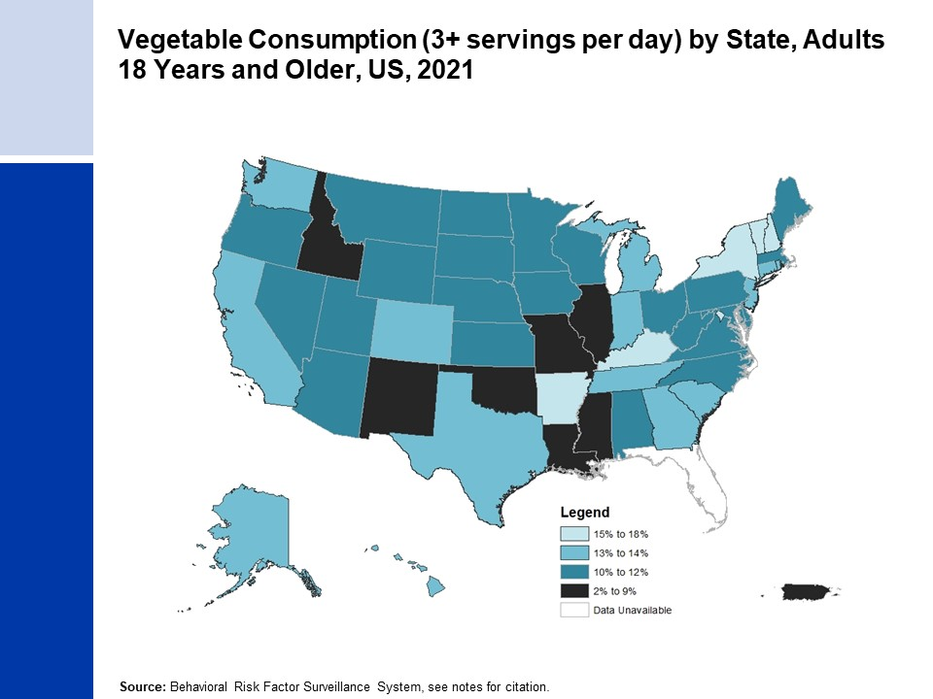
Notes:
- Centers for Disease Control and Prevention (CDC). Behavioral Risk Factor Surveillance System Survey Data. Atlanta, Georgia: U.S. Department of Health and Human Services, Centers for Disease Control and Prevention, 2021.

Slide 17
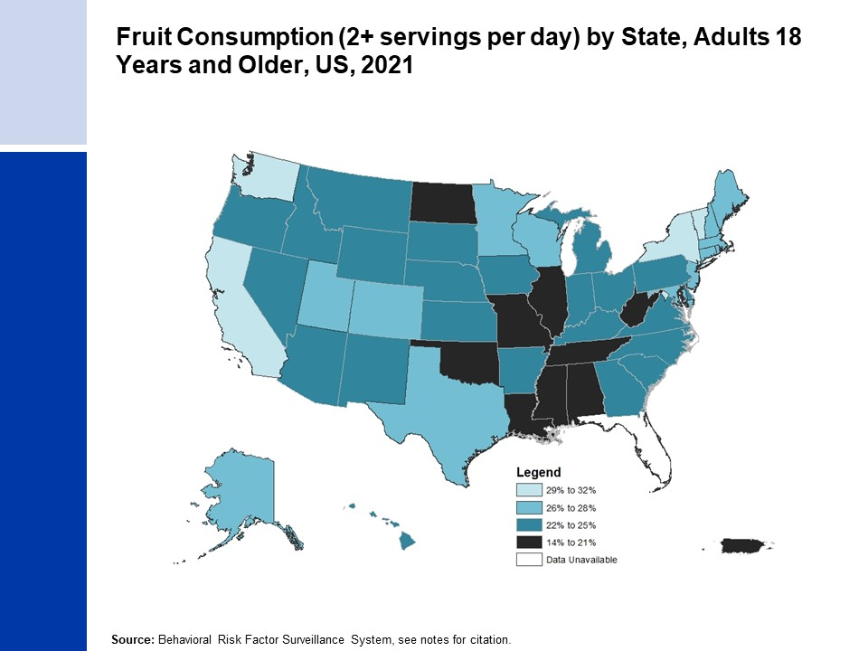
Notes:
- Centers for Disease Control and Prevention (CDC). Behavioral Risk Factor Surveillance System Survey Data. Atlanta, Georgia: U.S. Department of Health and Human Services, Centers for Disease Control and Prevention, 2021.

Slide 18
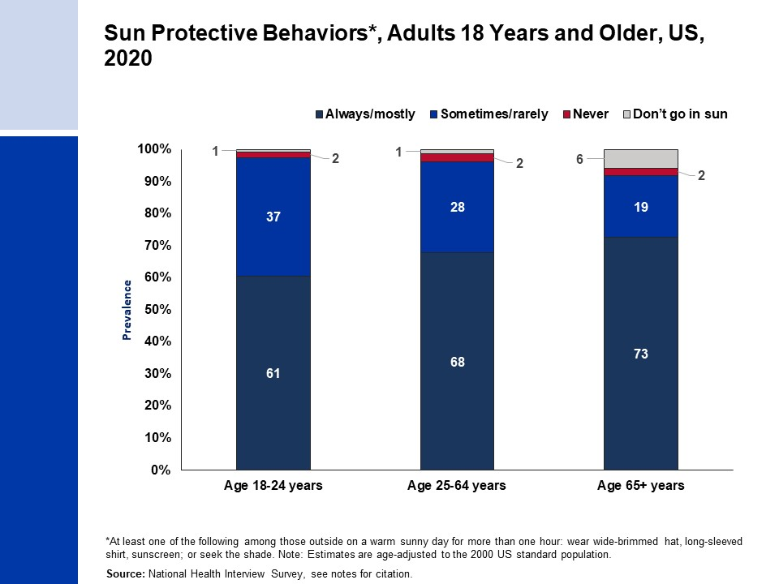
Notes:
- National Health Interview Survey, National Center for Health Statistics, Centers for Disease Control and Prevention, 2020. Public-use data file and documentation. https://www.cdc.gov/nchs/nhis/index.htm

Slide 19
Notes:
Saslow D, et al. PMID: 32639044

Slide 20
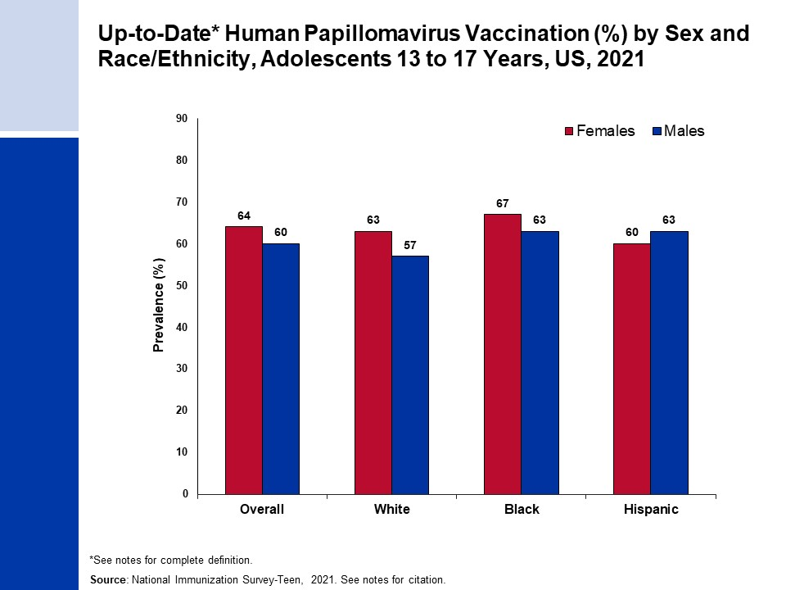
Notes:
Up-to-Date HPV vaccination includes those who received ≥3 doses, and those who received 2 doses when the first HPV vaccine dose was initiated before age 15 years and the time between the first and second dose was at least 5 months minus 4 days.
Estimates for White, Black persons are among non-Hispanic individuals. Centers for Disease Control and Prevention, National Center for Immunization and Respiratory Diseases. TeenVaxView. Available from URL: https://www.cdc.gov/vaccines/imz-managers/coverage/teenvaxview/data-reports/index.html Accessed February 15, 2023.

Slide 21
Notes:
Up-to-Date HPV vaccination includes those who received ≥3 doses, and those who received 2 doses when the first HPV vaccine dose was initiated before age 15 years and the time between the first and second dose was at least 5 months minus 4 days.
Estimates for White, Black persons are among non-Hispanic individuals. Centers for Disease Control and Prevention, National Center for Immunization and Respiratory Diseases. National Immunization Survey-Teen. Available from URL: https://www.cdc.gov/vaccines/imz-managers/nis/datasets-teen.html. Accessed February 15, 2023.

Slide 22
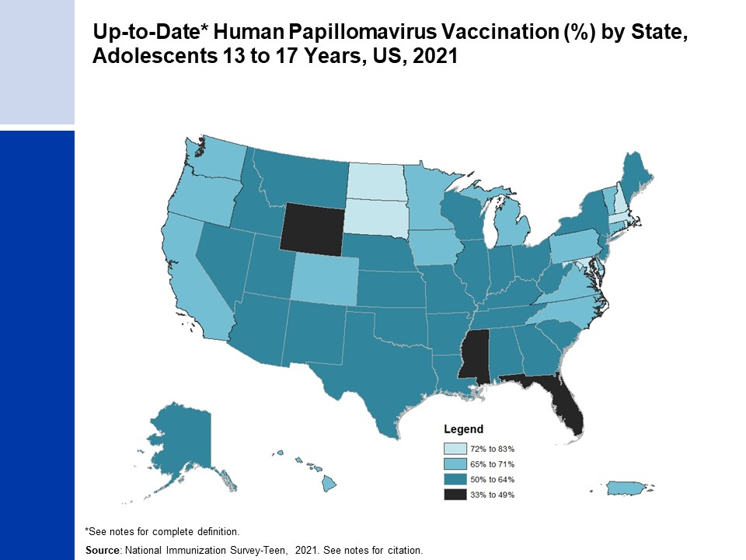
Notes:
Up-to-Date HPV vaccination includes those who received ≥3 doses, and those who received 2 doses when the first HPV vaccine dose was initiated before age 15 years and the time between the first and second dose was at least 5 months minus 4 days.
Centers for Disease Control and Prevention, National Center for Immunization and Respiratory Diseases. TeenVaxView. Available from URL: https://www.cdc.gov/vaccines/imz-managers/coverage/teenvaxview/data-reports/index.html Accessed February 15, 2023.

Slide 23
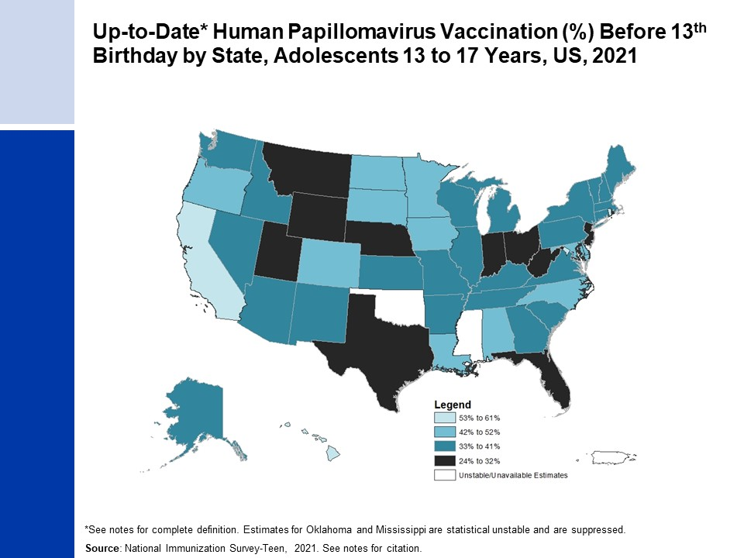
Notes:
Up-to-Date HPV vaccination includes those who received ≥3 doses, and those who received 2 doses when the first HPV vaccine dose was initiated before age 15 years and the time between the first and second dose was at least 5 months minus 4 days.
Centers for Disease Control and Prevention, National Center for Immunization and Respiratory Diseases. National Immunization Survey-Teen. Available from URL: https://www.cdc.gov/vaccines/imz-managers/nis/datasets-teen.html. Accessed February 15, 2023.

Slide 24
Notes:
National Health Interview Survey, National Center for Health Statistics, Centers for Disease Control and Prevention, 2000-2021. Public-use data files and documentation. https://www.cdc.gov/nchs/nhis/index.htm
Due to changes in NHIS survey design, 2019 estimates are not directly comparable to prior years and are separated from the trend line. The NHIS survey data collection mode was modified after the onset of the COVID-19 pandemic, where interviews changed to telephone-based modes in the second quarter of 2020 through April 2021 versus in-person modes in prior years and the first quarter of 2020. In May 2021, interviewers were directed to return to in-person interviews with some flexibility to conduct follow-up through telephone interviews. Readers are referred to the NHIS website for further information on potential biases due to COVID-19 related data collection changes.

Slide 25
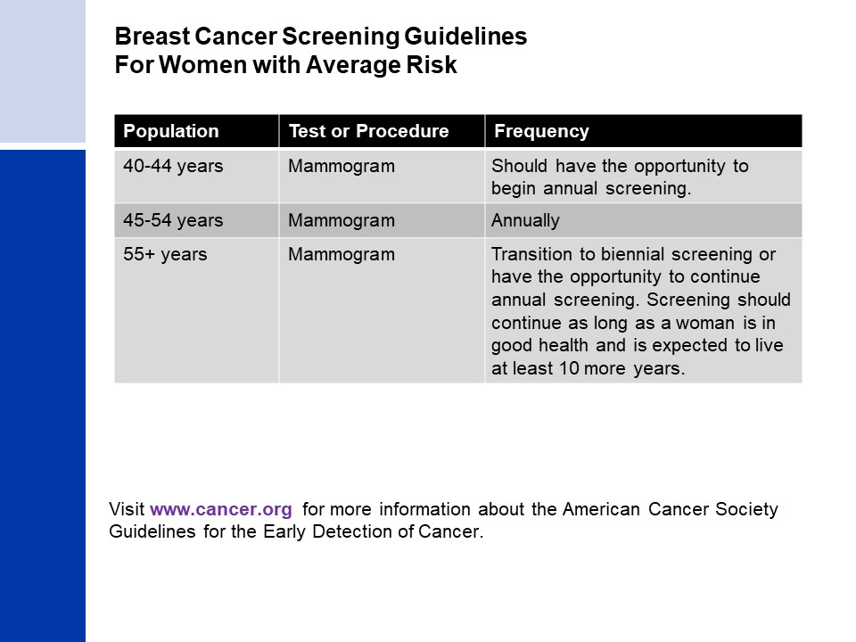
Notes:
Oeffinger KC, et al. PMID: 26501536
Smith RA, et al. PMID: 29846940

Slide 26
Notes:
Estimates for White, Black persons are among non-Hispanic individuals. Estimates for Asian persons may be Hispanic or non-Hispanic individuals.
National Center for Health Statistics. Health, United States, 2018. Hyattsville, MD. 2019.
National Health Interview Survey, National Center for Health Statistics, Centers for Disease Control and Prevention, 2018-2021. Public-use data file and documentation. https://www.cdc.gov/nchs/nhis/index.htm
Due to changes in NHIS survey design, 2019 estimates are not directly comparable to prior years and are separated from the trend line. The NHIS survey data collection mode was modified after the onset of the COVID-19 pandemic, where interviews changed to telephone-based modes in the second quarter of 2020 through April 2021 versus in-person modes in prior years and the first quarter of 2020. In May 2021, interviewers were directed to return to in-person interviews with some flexibility to conduct follow-up through telephone interviews. Readers are referred to the NHIS website for further information on potential biases due to COVID-19 related data collection changes.

Slide 27
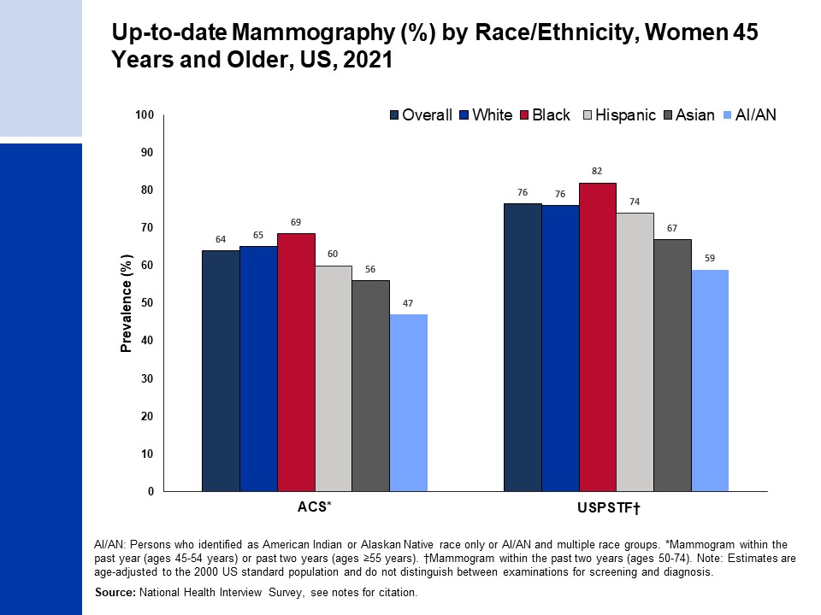
Notes:
Estimates for White, Black, and Asian persons are among non-Hispanic individuals.
National Health Interview Survey, National Center for Health Statistics, Centers for Disease Control and Prevention, 2021. Public-use data file and documentation. https://www.cdc.gov/nchs/nhis/index.htm
USPSTF, et al. PMID: 26757170

Slide 28
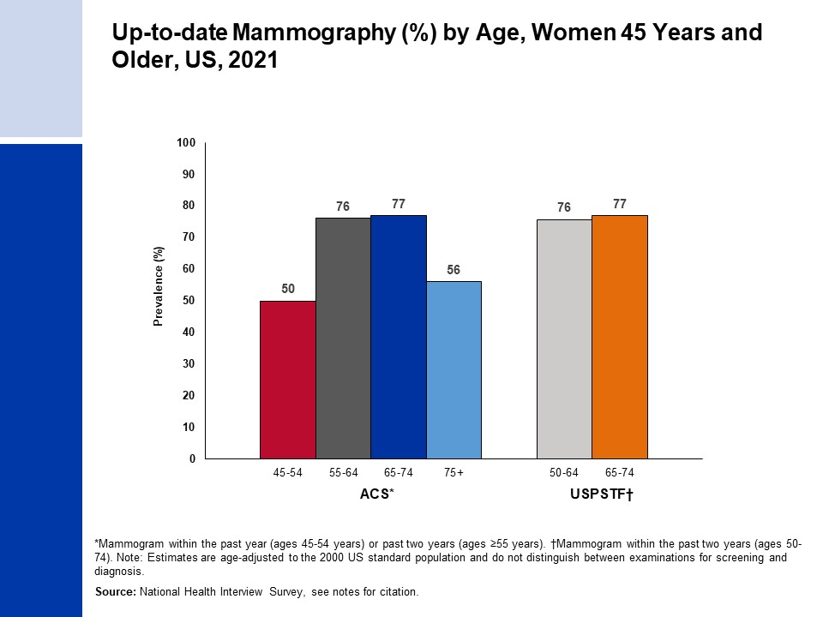
Notes:
National Health Interview Survey, National Center for Health Statistics, Centers for Disease Control and Prevention, 2021. Public-use data file and documentation. https://www.cdc.gov/nchs/nhis/index.htm
USPSTF, et al. PMID: 26757170

Slide 29
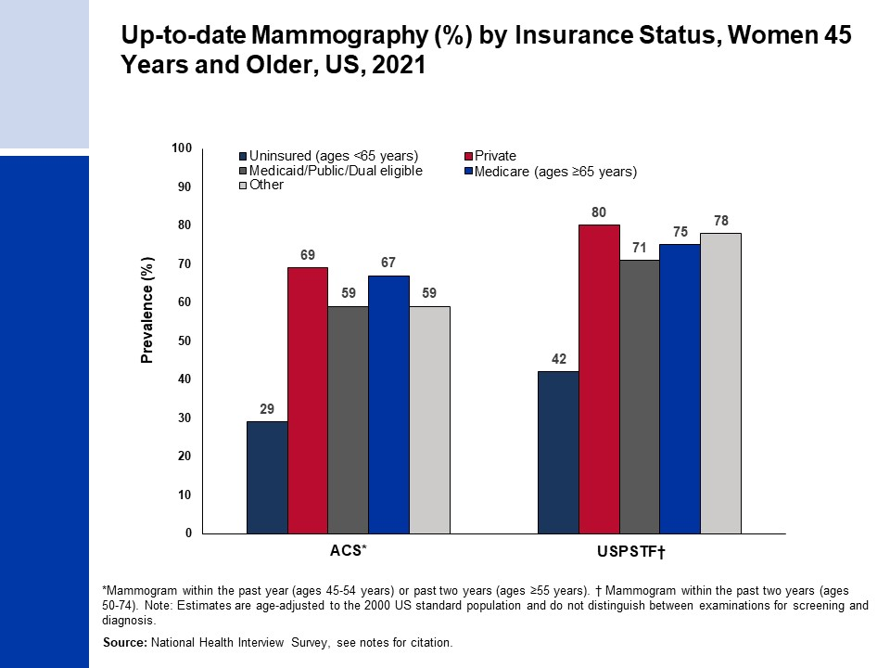
Notes:
National Health Interview Survey, National Center for Health Statistics, Centers for Disease Control and Prevention, 2021. Public-use data file and documentation. https://www.cdc.gov/nchs/nhis/index.htm
USPSTF, et al. PMID: 26757170

Slide 30
Notes:
Frontham ETH, et al. PMID: 32729638

Slide 31
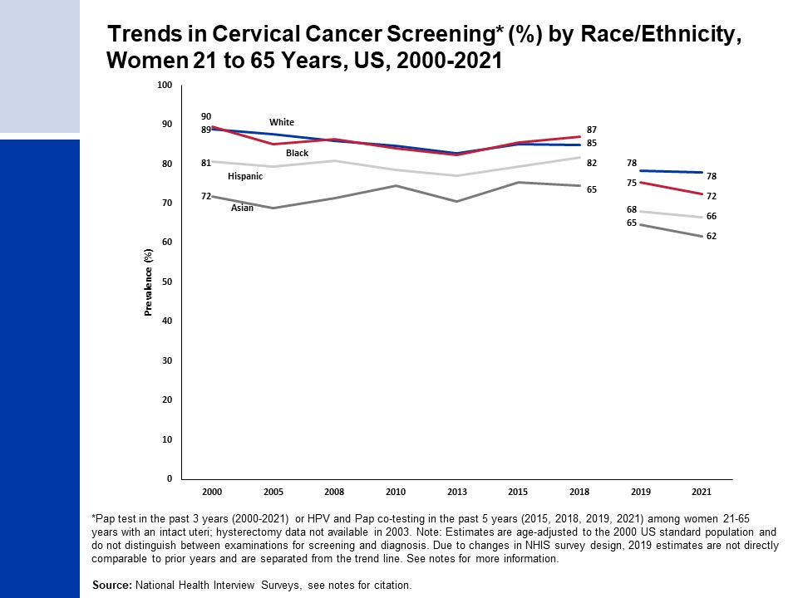
Notes:
- Estimates for White, Black and Asian persons are among non-Hispanic individuals. Estimates for Asian persons do not include Native Hawaiian or other Pacific Islander individuals.
National Health Interview Surveys, National Center for Health Statistics, Centers for Disease Control and Prevention, 2000-2021. Public-use data file and documentation. https://www.cdc.gov/nchs/nhis/index.htm
Due to changes in NHIS survey design, 2019 estimates are not directly comparable to prior years and are separated from the trend line. The NHIS survey data collection mode was modified after the onset of the COVID-19 pandemic, where interviews changed to telephone-based modes in the second quarter of 2020 through April 2021 versus in-person modes in prior years and the first quarter of 2020. In May 2021, interviewers were directed to return to in-person interviews with some flexibility to conduct follow-up through telephone interviews. Readers are referred to the NHIS website for further information on potential biases due to COVID-19 related data collection changes.

Slide 32
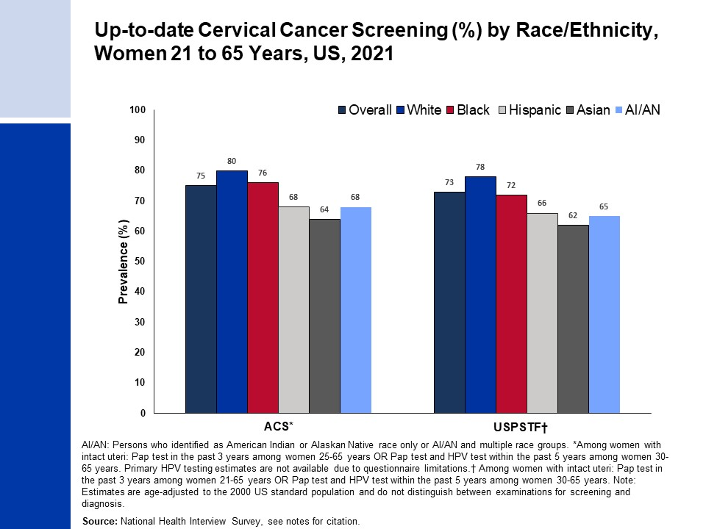
Notes:
Estimates for White, Black, Asian, and AI/AN persons are among non-Hispanic individuals.
National Health Interview Survey, National Center for Health Statistics, Centers for Disease Control and Prevention, 2021. Public-use data file and documentation. https://www.cdc.gov/nchs/nhis/index.htm
USPSTF, et al. PMID: 30140884

Slide 33
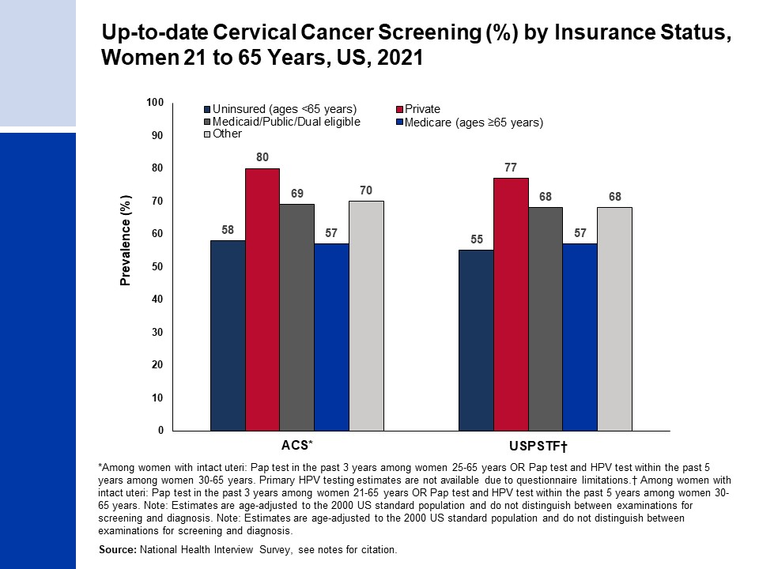
Notes:
National Health Interview Survey, National Center for Health Statistics, Centers for Disease Control and Prevention, 2021. Public-use data file and documentation. https://www.cdc.gov/nchs/nhis/index.htm
USPSTF, et al. PMID: 30140884

Slide 34
Notes:
Wolf AMD, et al. PMID: 29846947
Smith RA, et al. PMID: 29846940

Slide 35
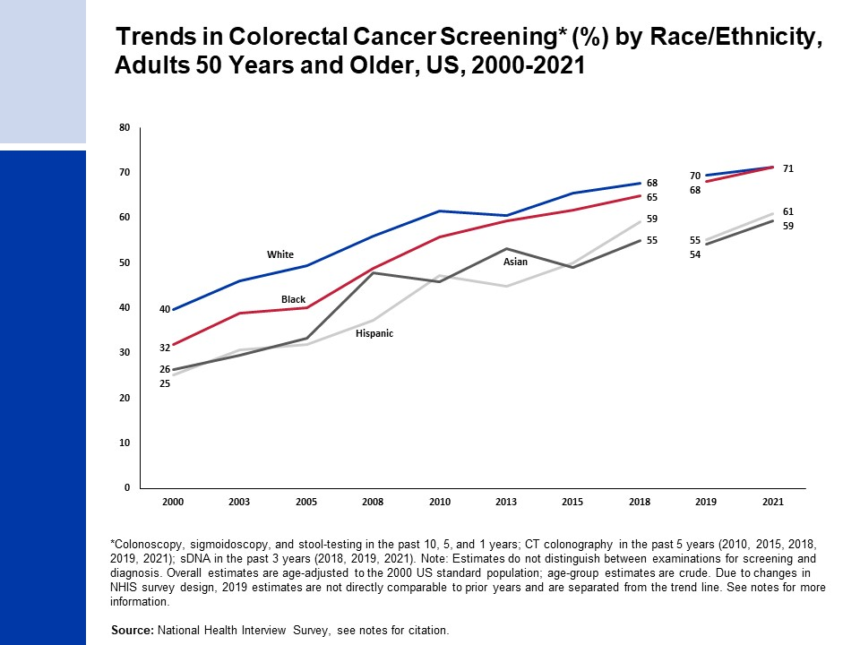
Notes:
- Estimates for White, Black and Asian persons are among non-Hispanic individuals. Estimates for Asian persons do not include Native Hawaiian or other Pacific Islander individuals.
National Health Interview Survey, National Center for Health Statistics, Centers for Disease Control and Prevention, 2000-2021. Public-use data files and documentation. https://www.cdc.gov/nchs/nhis/index.htm
Due to changes in NHIS survey design, 2019 estimates are not directly comparable to prior years and are separated from the trend line. The NHIS survey data collection mode was modified after the onset of the COVID-19 pandemic, where interviews changed to telephone-based modes in the second quarter of 2020 through April 2021 versus in-person modes in prior years and the first quarter of 2020. In May 2021, interviewers were directed to return to in-person interviews with some flexibility to conduct follow-up through telephone interviews. Readers are referred to the NHIS website for further information on potential biases due to COVID-19 related data collection changes.

Slide 36
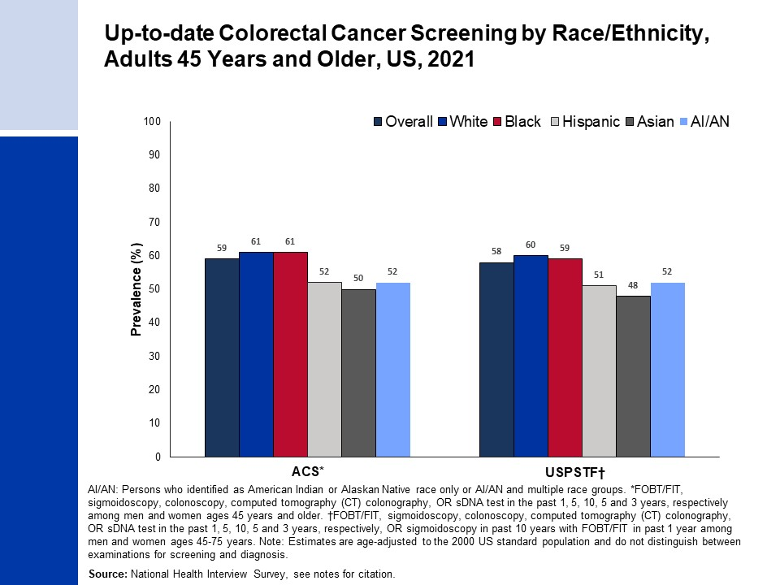
Notes:
- Estimates for White, Black, Asian, and AI/AN persons are among non-Hispanic individuals.
National Health Interview Survey, National Center for Health Statistics, Centers for Disease Control and Prevention, 2021. Public-use data file and documentation. https://www.cdc.gov/nchs/nhis/index.htm
USPSTF, et al. PMID: 34003218

Slide 37
Notes:
- National Health Interview Survey, National Center for Health Statistics, Centers for Disease Control and Prevention, 2021. Public-use data file and documentation. https://www.cdc.gov/nchs/nhis/index.htm

Slide 38
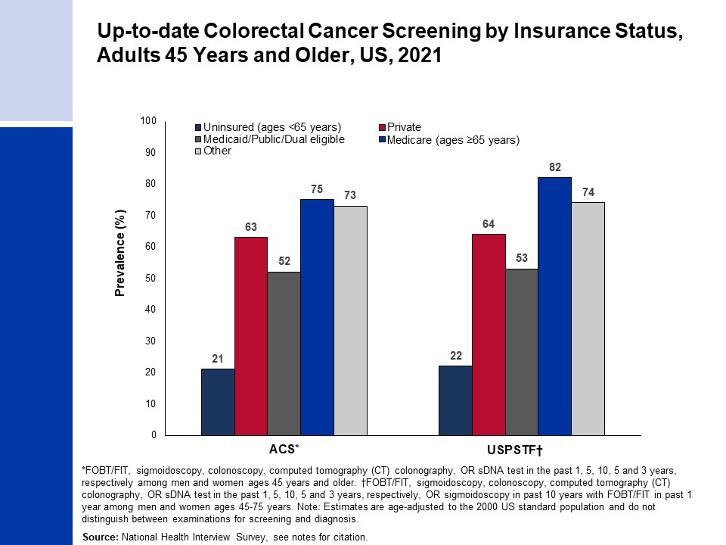
Notes:
National Health Interview Survey, National Center for Health Statistics, Centers for Disease Control and Prevention, 2021. Public-use data file and documentation. https://www.cdc.gov/nchs/nhis/index.htm
USPSTF, et al. PMID: 34003218

Slide 39
Notes:
USPSTF, et al. PMID: 33687470

Slide 40
Notes:
- Wolf AM, et al. PMID: 20200110
- Smith RA, et al. PMID: 29846940

