Slide 1

A presentation from the American Cancer Society
Cancer Prevention & Early Detection Facts & Figures 2024
©2024, American Cancer Society, Inc

Slide 2
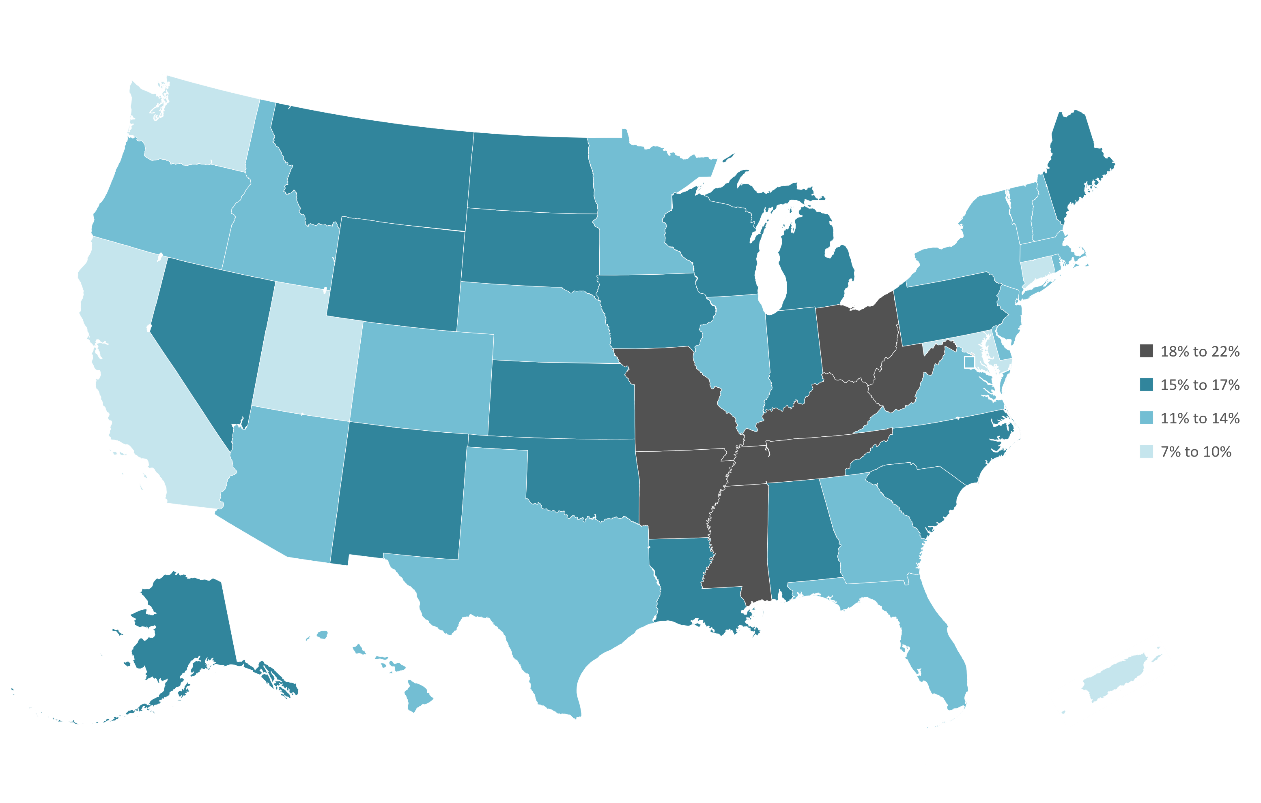

Current Cigarette Smoking, Adults 18 Years and Older, by State, 2022
Estimates are age adjusted to the year 2000 US standard population using 5 age groups: 18-24, 25-34, 35-44, 45-64, ≥65 years. Current cigarette smoking is defined as ever smoked 100 cigarettes in lifetime and now smoke every day or some days.
Source: Behavioral Risk Factor Surveillance System, 2022.

Slide 3
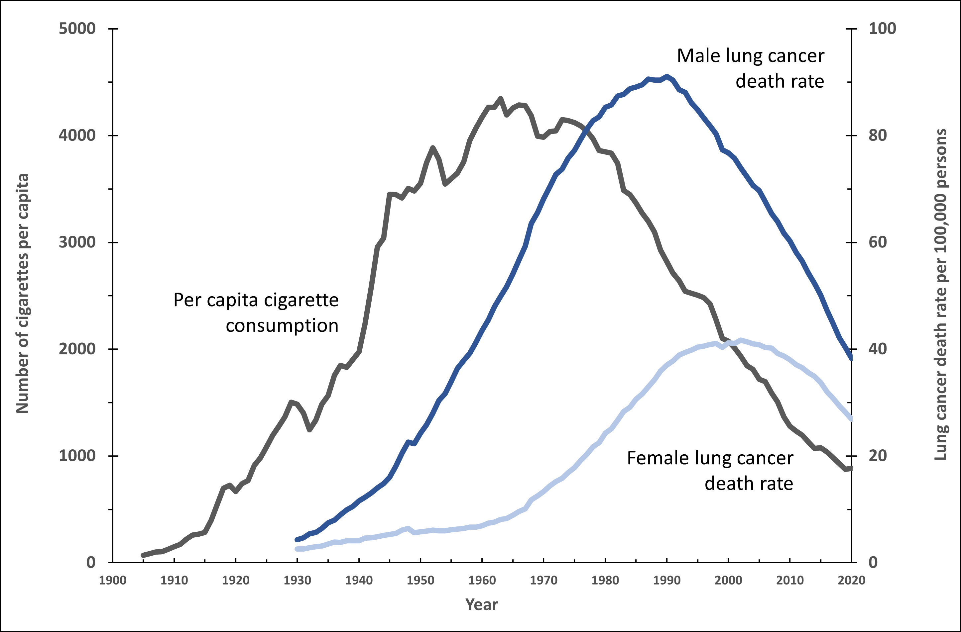
Trends in Tobacco Use and Lung Cancer Death Rates in the US
Rates are age-adjusted to the 2000 US standard population. Due to changes in ICD coding, numerator information has changed over time. Rates for cancers of the lung and bronchus are affected by these coding changes.
Sources: Death rates: US Mortality Volumes 1930 to 1959, US Mortality Data 1960 to 2020, National Center for Health Statistics, Centers for Disease Control and Prevention. Cigarette consumption: 1900-1999: US Department of Agriculture. 2000-2015: Wang, TW et al. PMID: 27932780. 2016-2020: Alcohol and Tobacco Tax and Trade Bureau (https://www.ttb.gov/tobacco/tobacco-statistics) and US Census population estimates (https://www.census.gov/data/tables/time-series/demo/popest/2010s-national-detail.html).
Notes:
-

Slide 4
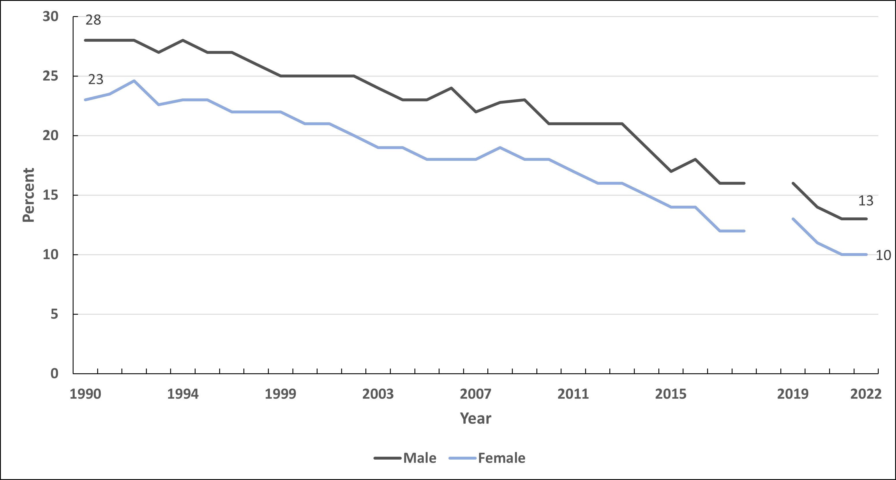
Current Cigarette Smoking Trends, Adults 18 Years and Older by Sex, US, 1990-2022
Estimates are age adjusted to the year 2000 US standard population using 5 age groups: 18-24, 25-34, 35-44, 45-64, ≥65 years. The NHIS underwent a significant redesign in 2019 preventing comparability to prior years indicated by the line break.
Current cigarette smoking is defined as ever smoked 100 cigarettes in lifetime and now smoke every day or some days.
Sources: Health, United States, 2019. National Health Interview Survey, 2019-2022.

Slide 5
Current Cigarette Smoking Trends, Adults 18 Years and Older by Sex and Race/Ethnicity, US, 1990-2022
Estimates are age adjusted to the year 2000 US standard population using 5 age groups: 18-24, 25-34, 35-44, 45-64, ≥65 years. The NHIS underwent a significant redesign in 2019 preventing comparability to prior years indicated by the line break. Current cigarette smoking is defined as ever smoked 100 cigarettes in lifetime and now smoke every day or some days.
Sources: Health, United States, 2018.² National Health Interview Survey, 2015-2022.

Slide 6
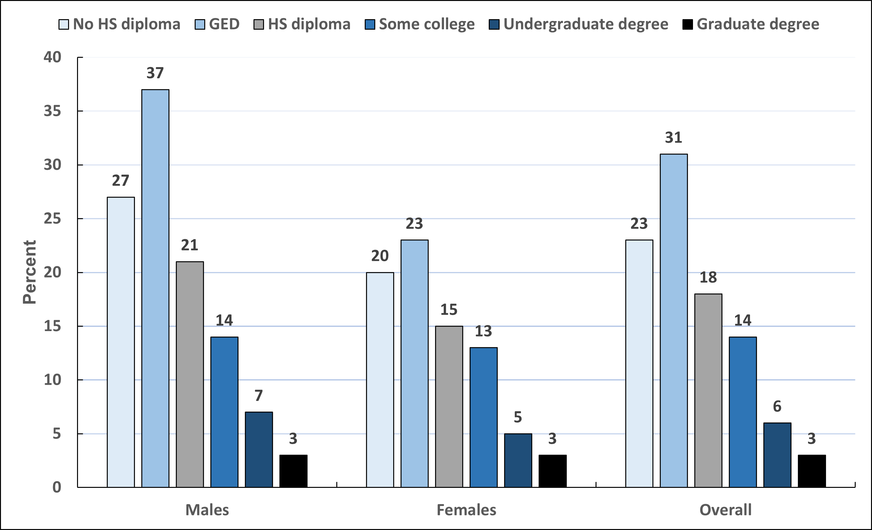
Current Cigarette Smoking by Education, Adults 25 Years and Older, US, 2022
GED-General Educational Development high school equivalency. FPL-federal poverty level. By education, estimates are age adjusted using the 4 age groups: 25-34, 35-44, 45-64, ≥65 years. Current cigarette smoking is defined as ever smoked 100 cigarettes in lifetime and now smoke every day or some days.
Source: National Health Interview Survey, 2022.
Notes:
- Estimate for “Some college” includes those with an Associate’s degree.

Slide 7
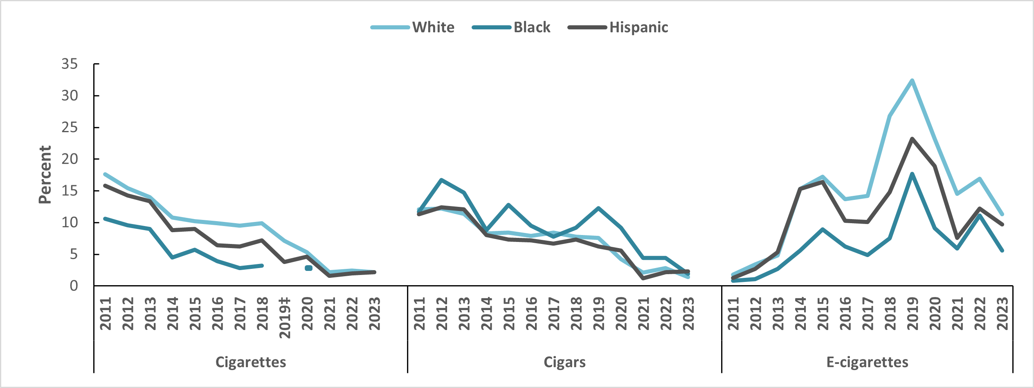
Current Use of Selected Tobacco Products, by Race/Ethnicity, High School Students, US, 2011-2023
Estimates are crude. Current tobacco use is defined as in the past 30 days. ‡Estimates of cigarette smoking in Black persons in 2019 and 2021-2023 are statistically unstable and not shown. See Special Notes, Page 42 of Cancer Prevention and Early Detection Facts and Figures 2024.
Sources: Birdsey J et al, 2023.³ Park-Lee E et al, 2022.⁴ Gentzke AS et al, 2022.⁵ Gentzke AS et al, 2020.⁶ Wang TW et al, 2019.⁷ Gentzke AS et al, 2019.⁸ Wang TW et al, 2018.⁹ Jamal A et al, 2017.¹⁰ Singh T et al, 2016.¹¹ Arrazola RA et al, 2015.¹² Arrazola RA et al, 2014.¹³ CDC, 2013.¹⁴

Slide 8
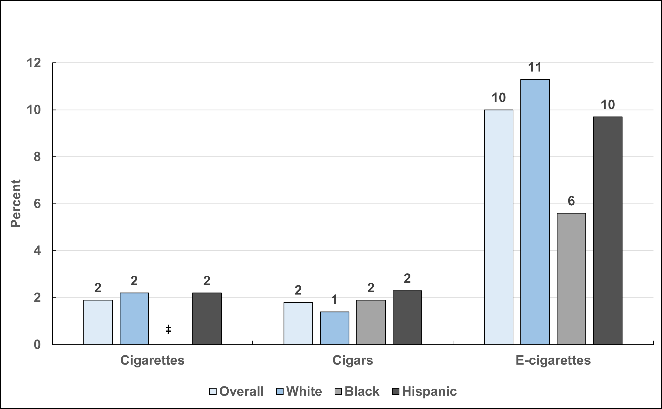
Current Tobacco Use, by Race/Ethnicity, High School Students, US, 2023
Estimates are crude. *In the past 30 days. ‡Estimates are statistically unstable and not shown. See Special Notes, Page 42 of Cancer Prevention and Early Detection Facts and Figures 2024
Source: Birdsey J et al, 2023.³

Slide 9
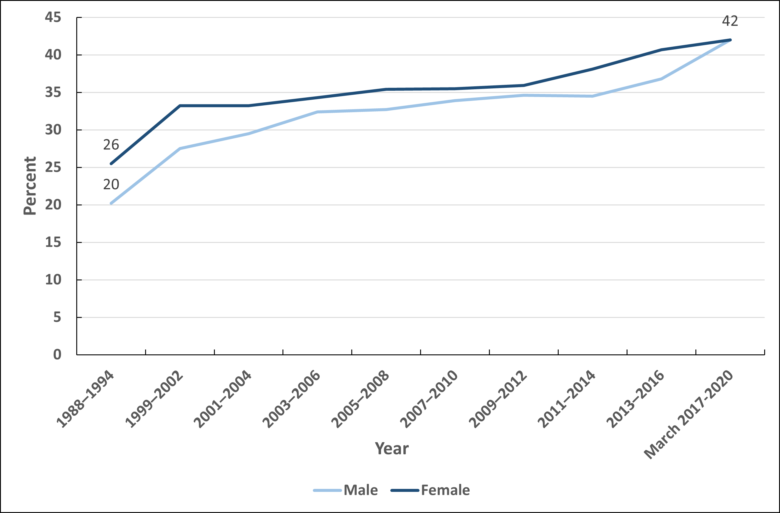
Obesity Trends, Adults 20+ Years, by Sex, US, 1988-March 2020
Estimates are age-adjusted to the year 2000 standard population using five age groups: 20–34 years, 35–44 years, 45–54 years, 55–64 years, and 65 years and over. Obesity is defined as a body mass index ≥30.0 kg/m2.
Source: Health United States, 2019. National Health and Nutrition Examination Surveys, March 2017-2020.

Slide 10
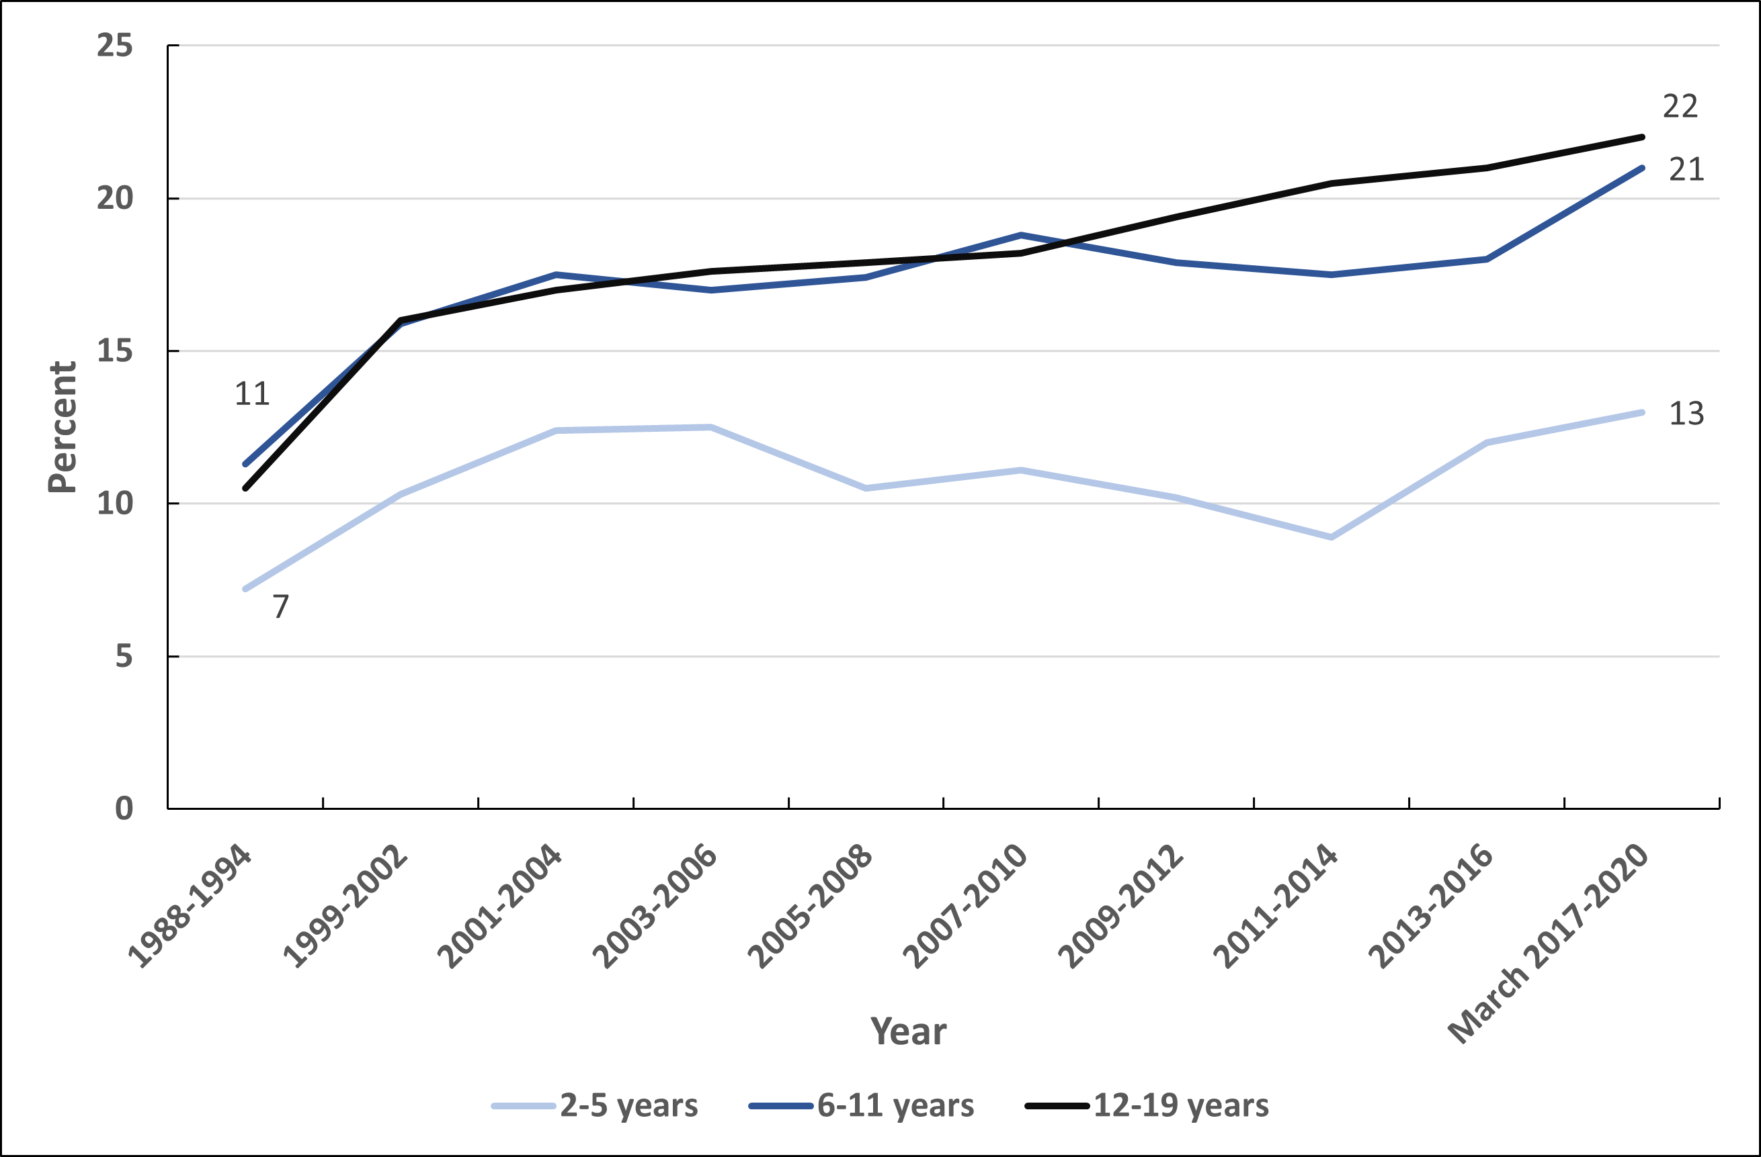
Obesity Trends, Youth 2-19 Years by Sex, US, 1988-March 2020
Estimates are crude. Obesity is defined as a body mass index at or above the 95th percentile (top 5%).
Source: Health, United States, 2019. National Health and Nutrition Examination Surveys, 2017-March 2020.

Slide 11
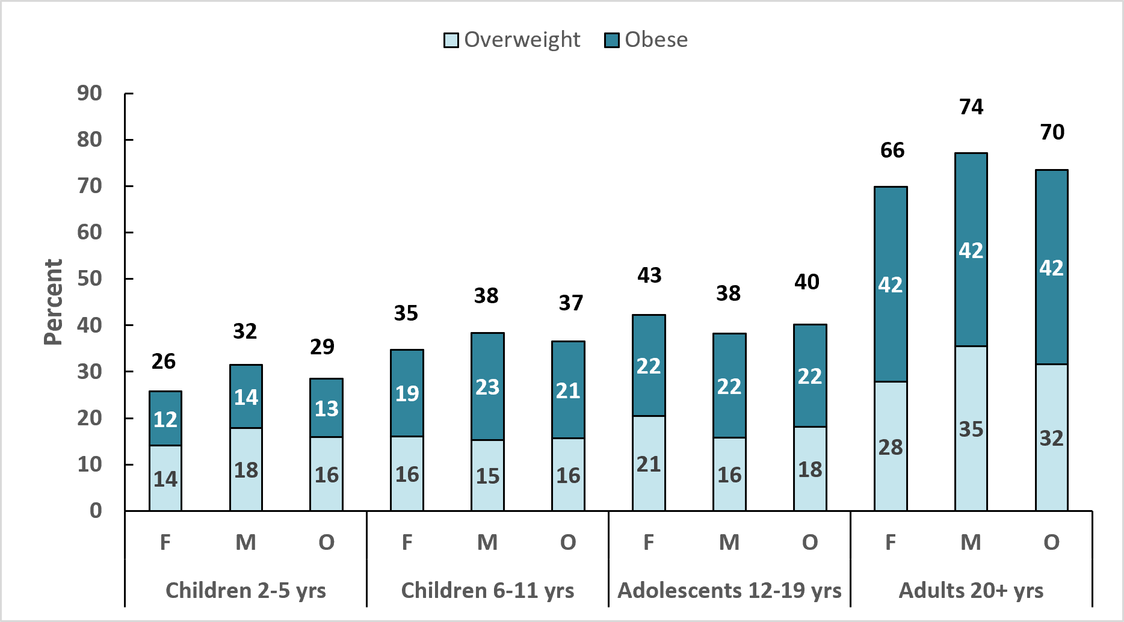
Excess Body Weight, Youth and Adults, US, 2017-March 2020
BMI-Body Mass Index. F-females, M-males, O-overall. For adults, a BMI of 25.0-29.9 kg/m2 is overweight; a BMI of ≥30.0 kg/m2 is obese. Excess body weight is a BMI of ≥25.0 kg/m2. For youth (ages 2-19 years), BMI is based on percentile rankings of the individual’s height and weight on age- and sex-specific growth charts; BMIs between the top 85th and 94.9th percentile are considered overweight, and BMIs at or above the 95th percentile (top 5%) are classified as obese. Estimates for ages 20+ are age adjusted to the year 2000 US standard population using five age groups: 20-34, 35-44, 45-54, 55-64, ≥65 years.
Source: National Health and Nutrition Examination Survey, 2017-March 2020.

Slide 12
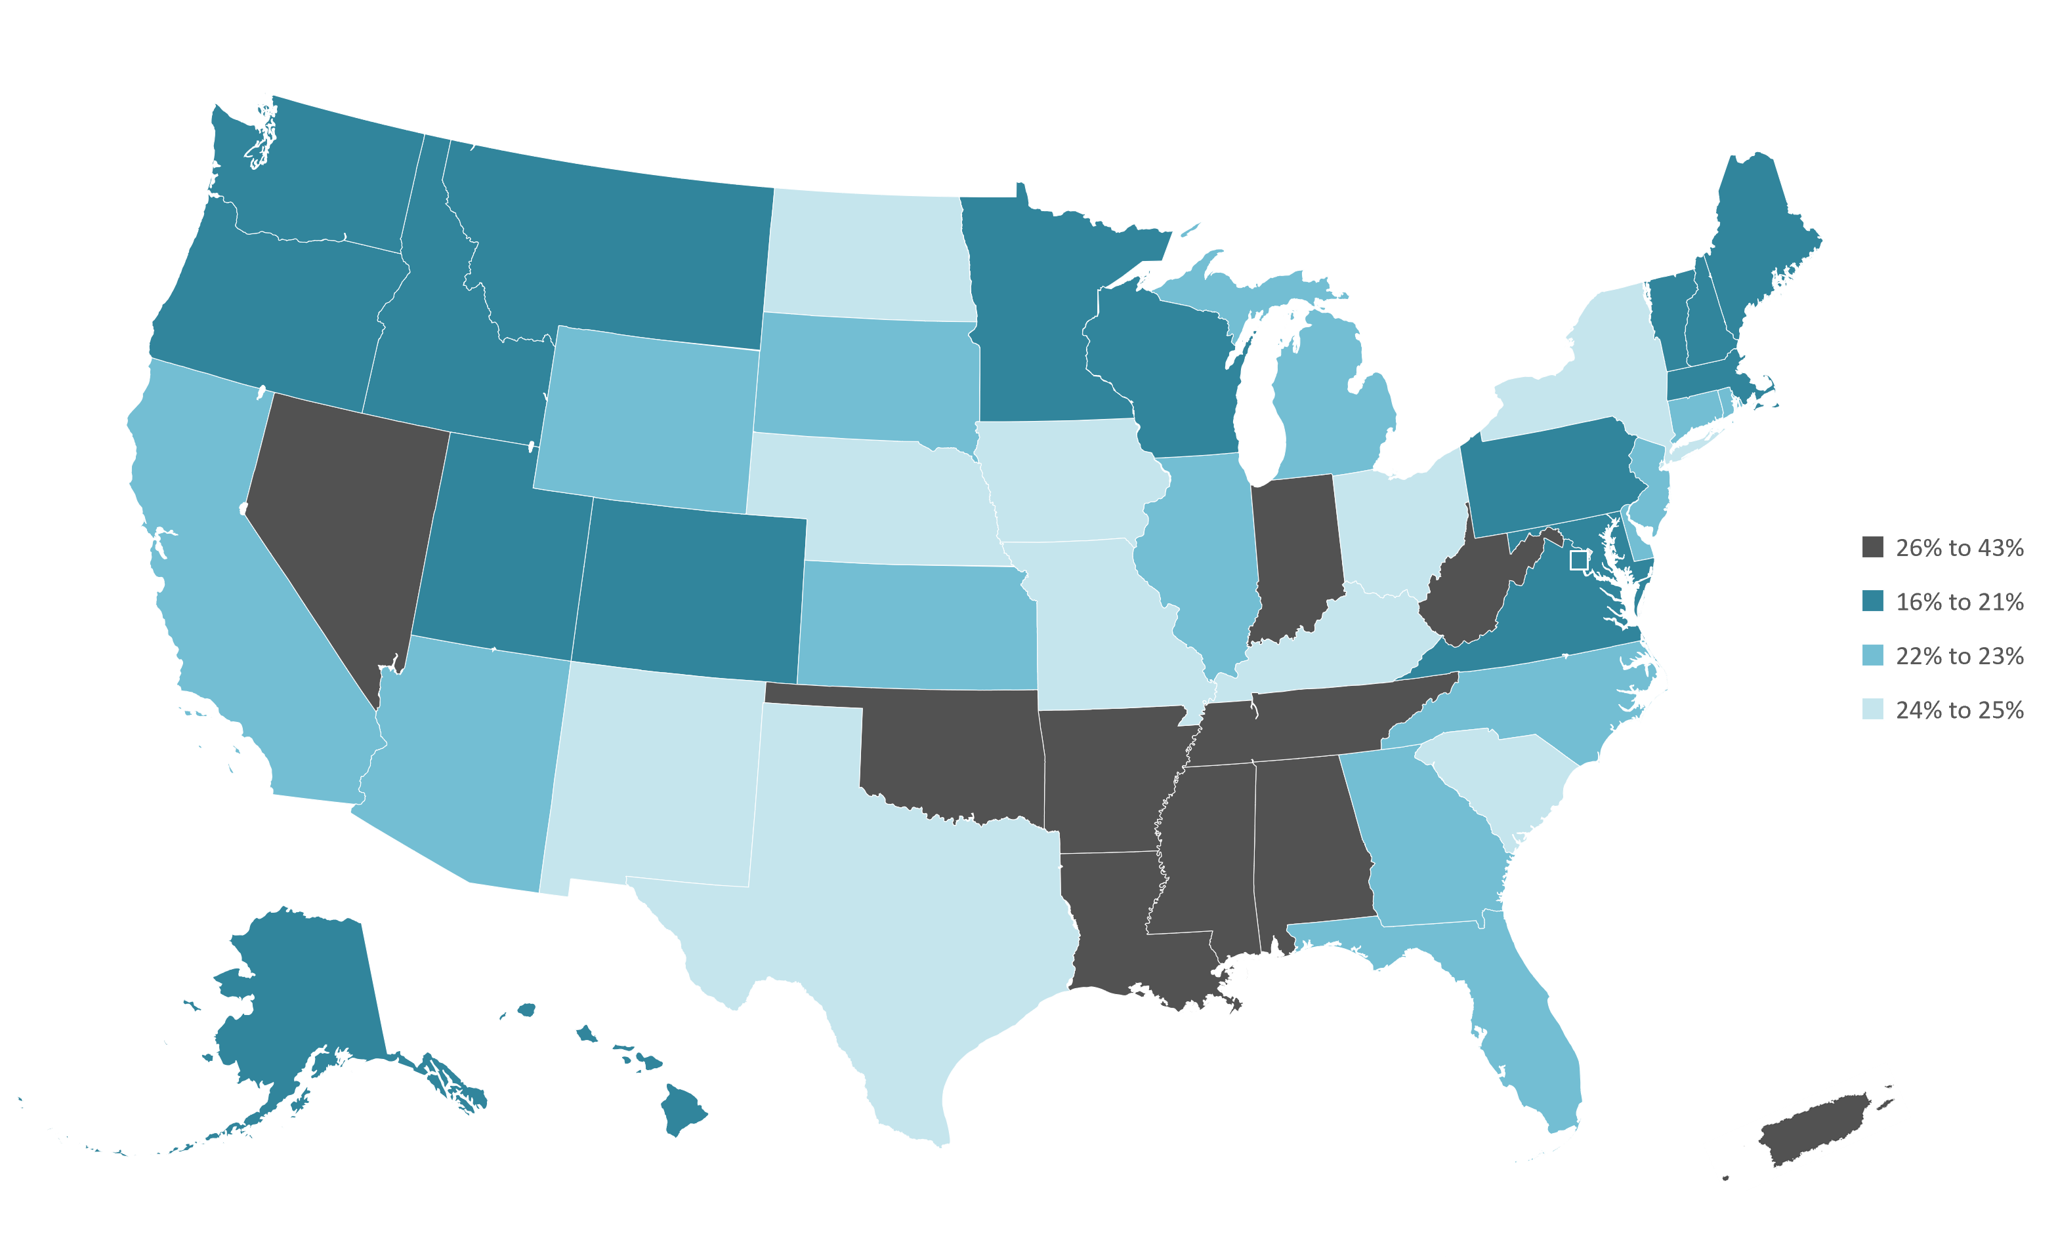
No Leisure-time Physical Activity, Adults 18 Years and Older, by State, 2022
Estimates are age adjusted to the year 2000 US standard population using five age groups: 18-24, 25-34, 35-44, 45-64, ≥65 years. No physical activity or exercise other than their job in the past 30 days.
Source: Behavioral Risk Factor Surveillance System, 2022.

Slide 13
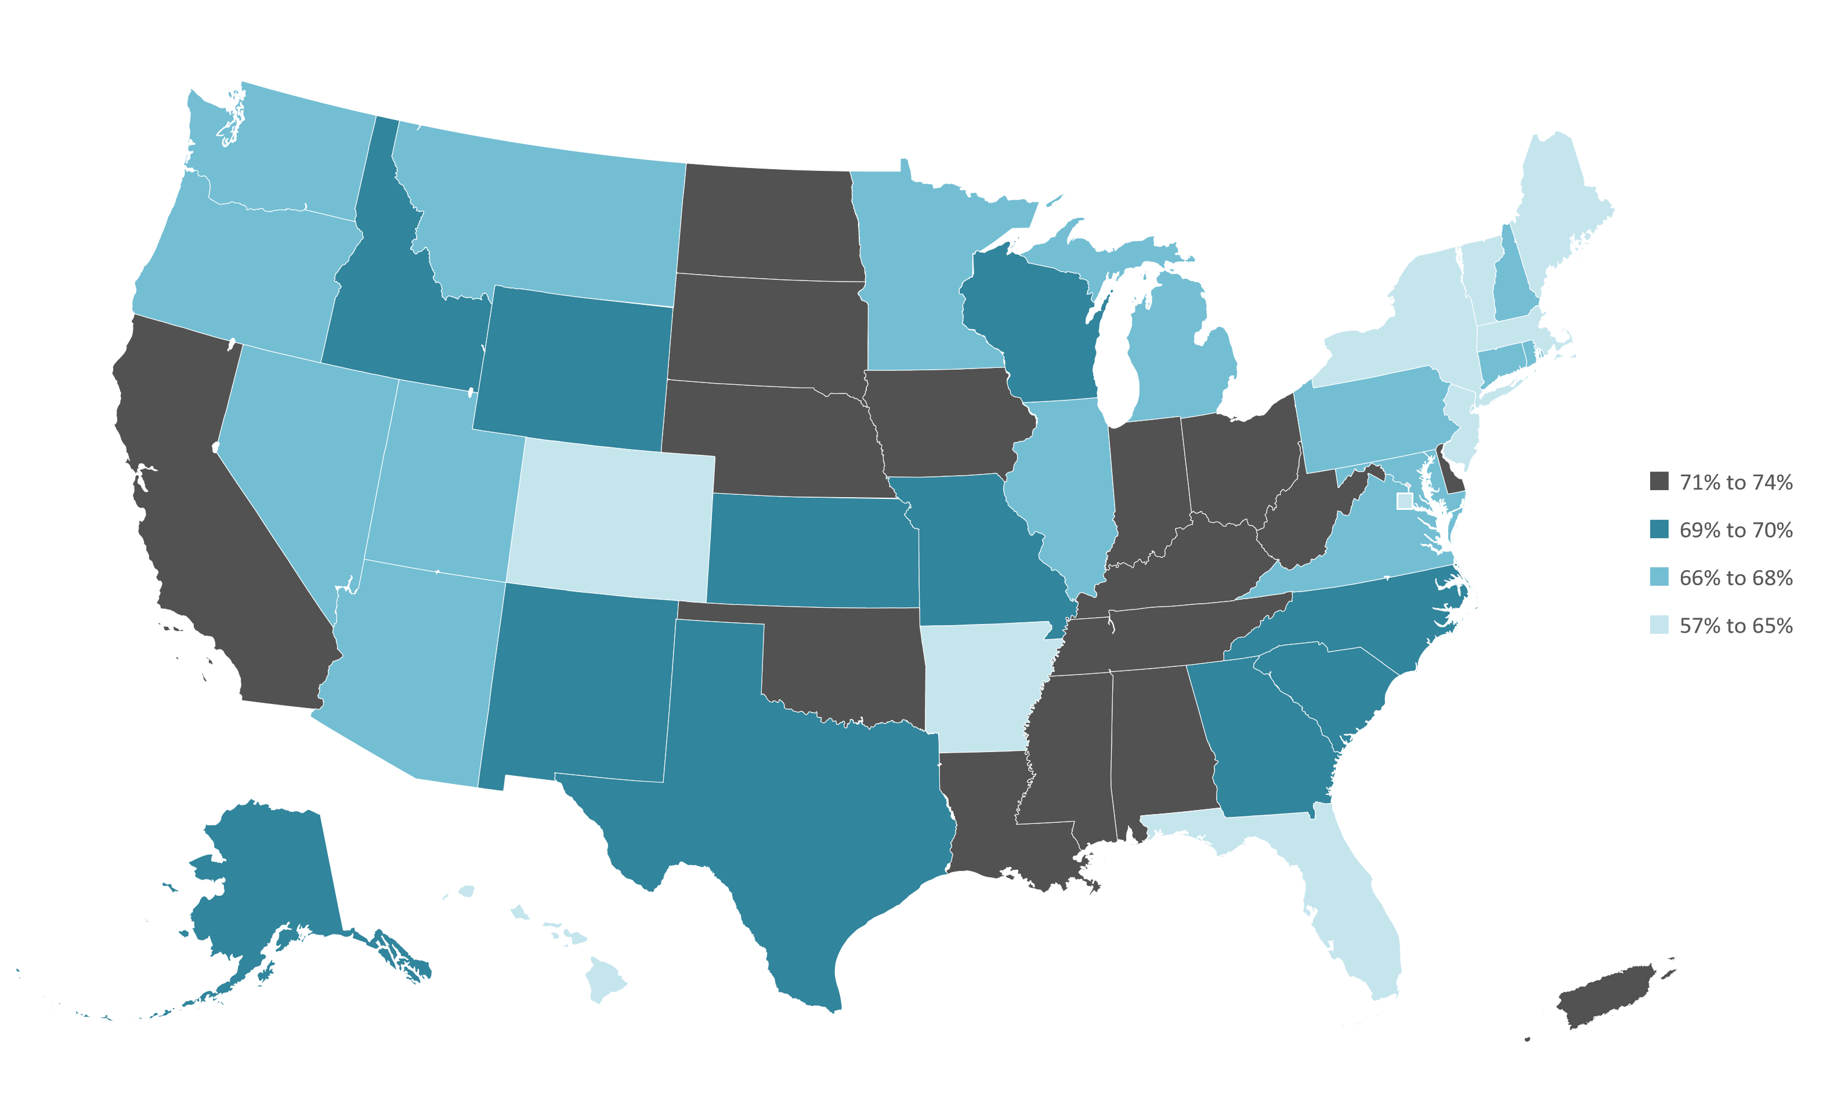
Excess Body Weight, Adults 18 Years and Older, by State, 2022
BMI-Body Mass Index. Estimates are age adjusted to the year 2000 US standard population using five age groups: 18-24, 25-34, 35-44, 45-64, ≥65 years. Excess body weight is defined as a BMI ≥25.0 kg/m².
Source: Behavioral Risk Factor Surveillance System, 2022.

Slide 14
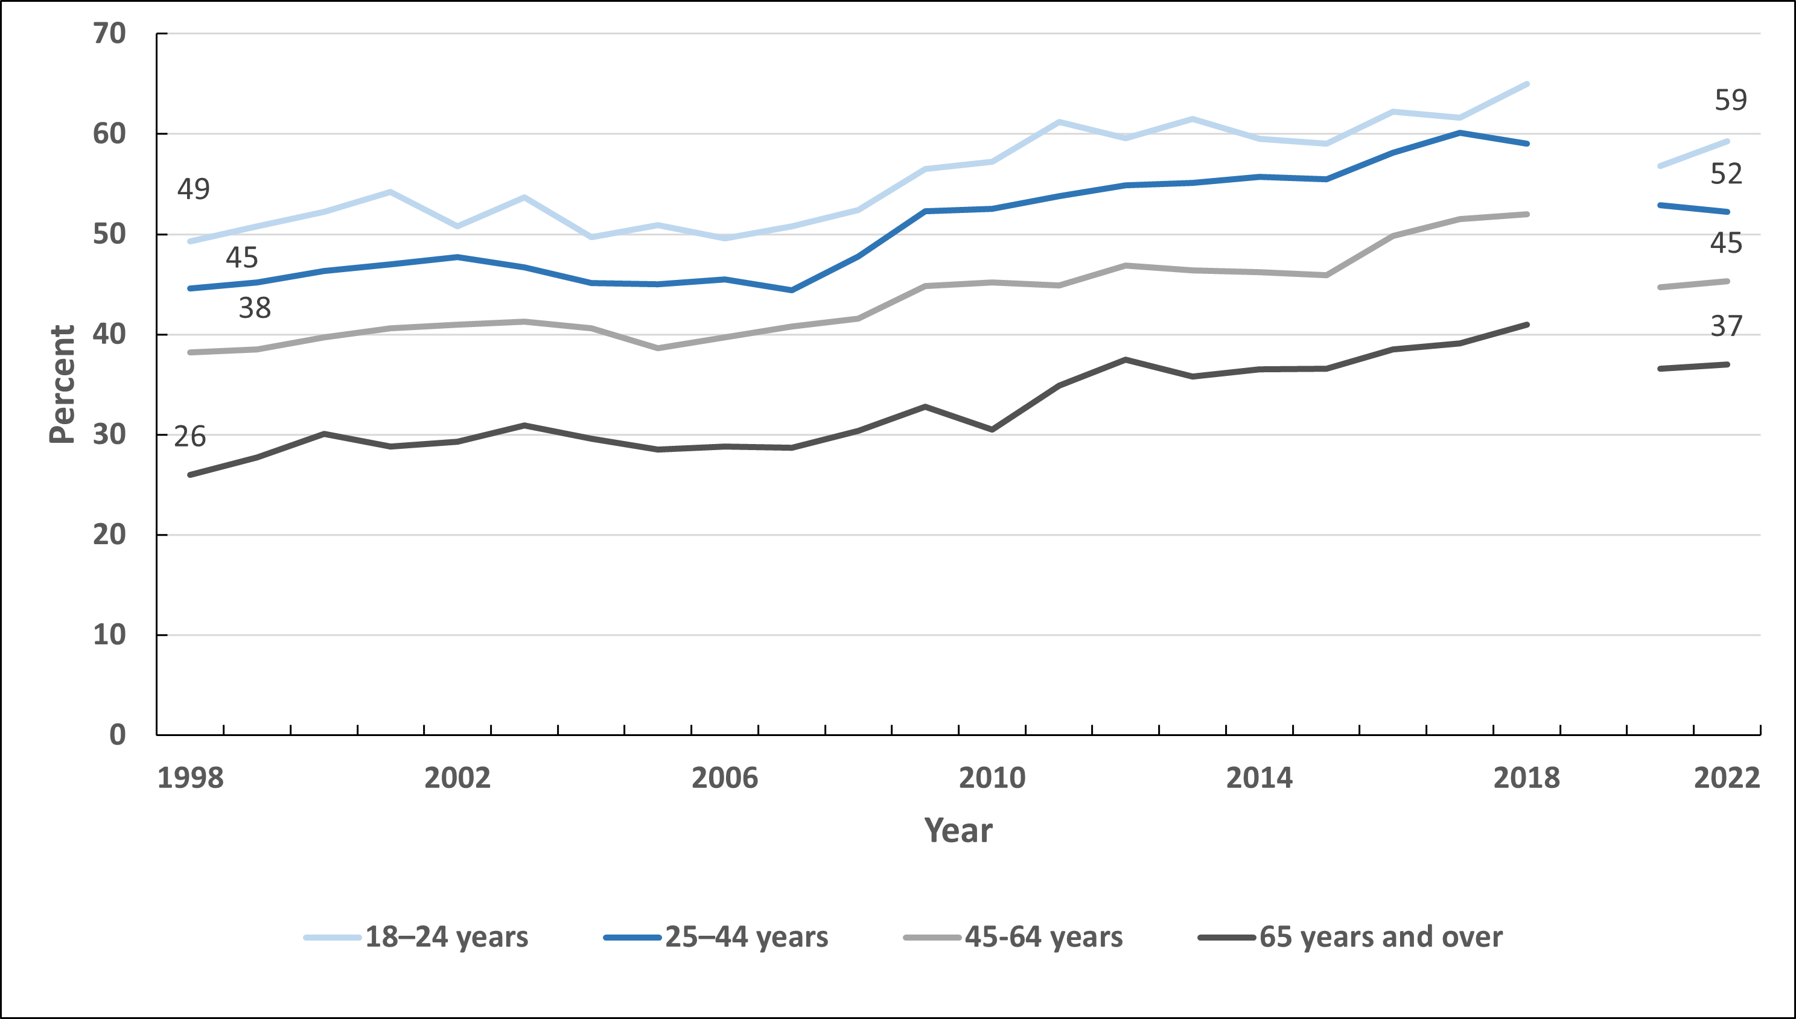
Trends in Meeting Recommended Levels of Aerobic Physical Activity, Adults 18 Years and Older, US, 1998-2018, 2020-2022
Estimates are age adjusted to the year 2000 US standard population using 5 age groups: 18-44, 45-54, 55-64, 65-74, 75+ years to align with the Health, United States, 2019 age adjustments. The NHIS underwent a significant redesign in 2019 preventing comparability to prior years indicated by the line break. Meeting recommended levels of aerobic physical activity defined as 150 minutes of moderate intensity aerobic activity or vigorous-intensity aerobic activity each week.
Sources: Health, United States, 2019. National Health Interview Survey, 2020 and 2022.

Slide 15
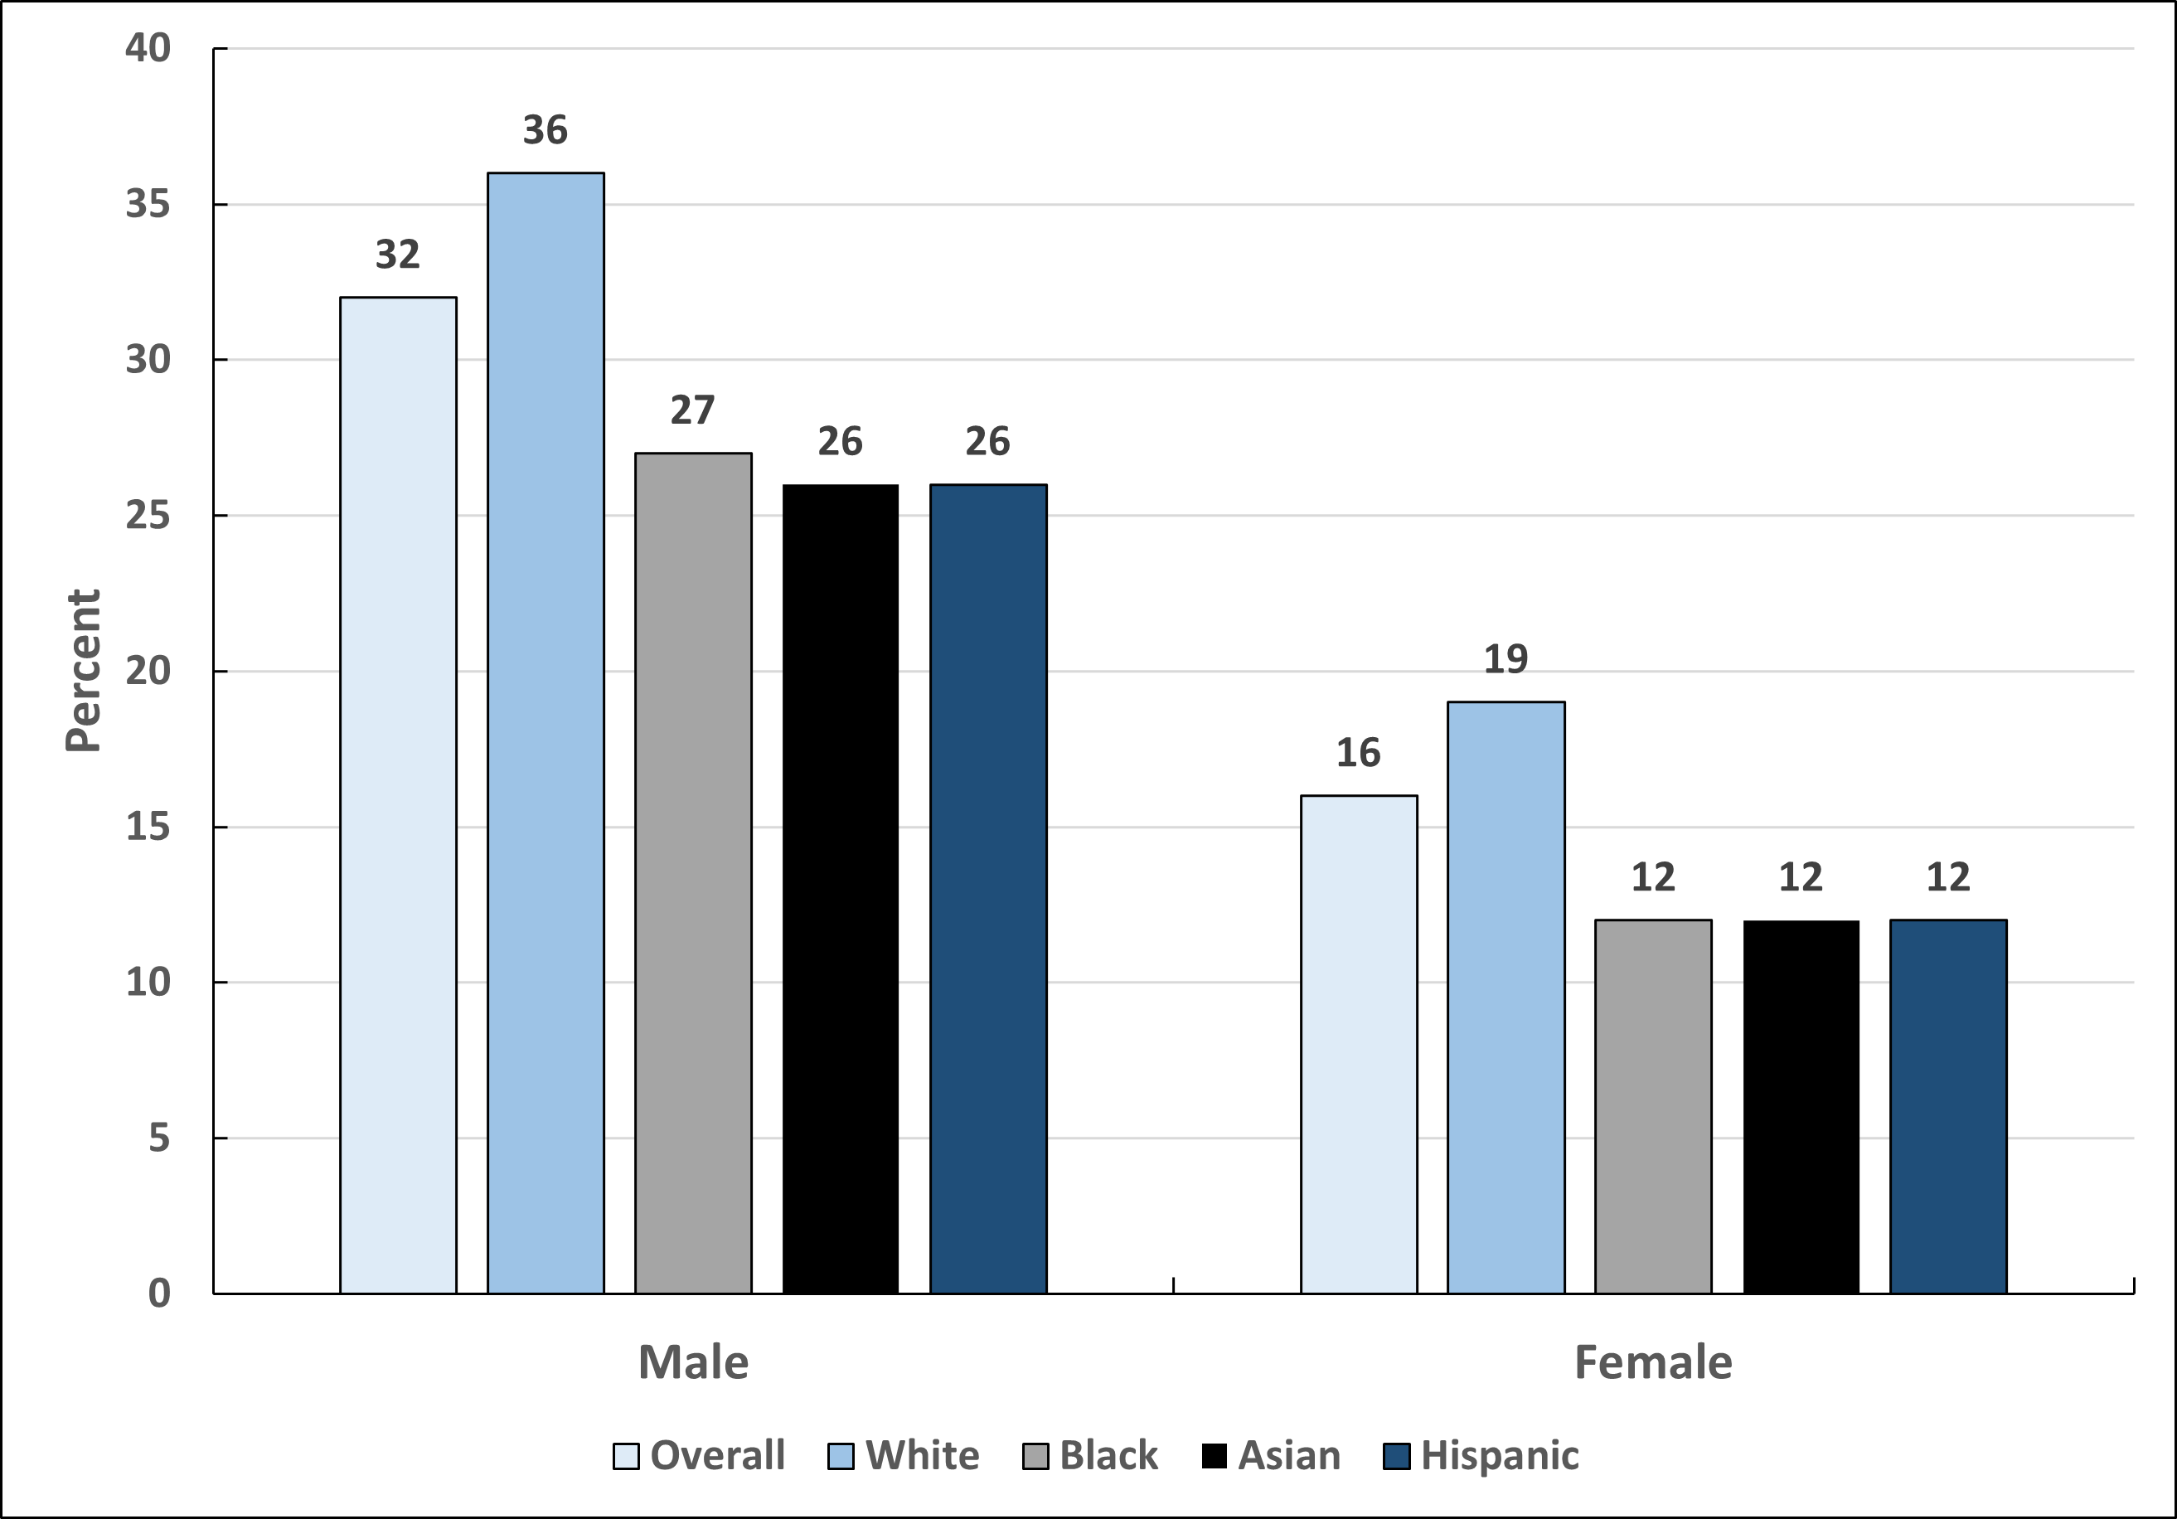
Met Physical Activity Recommendations by Sex and Race/Ethnicity, High School Students, US, 2021
Physical activity for at least 60 mins per day for all 7 days preceding the survey.
Source: Youth Risk Behavior Survey 2021.

Slide 16
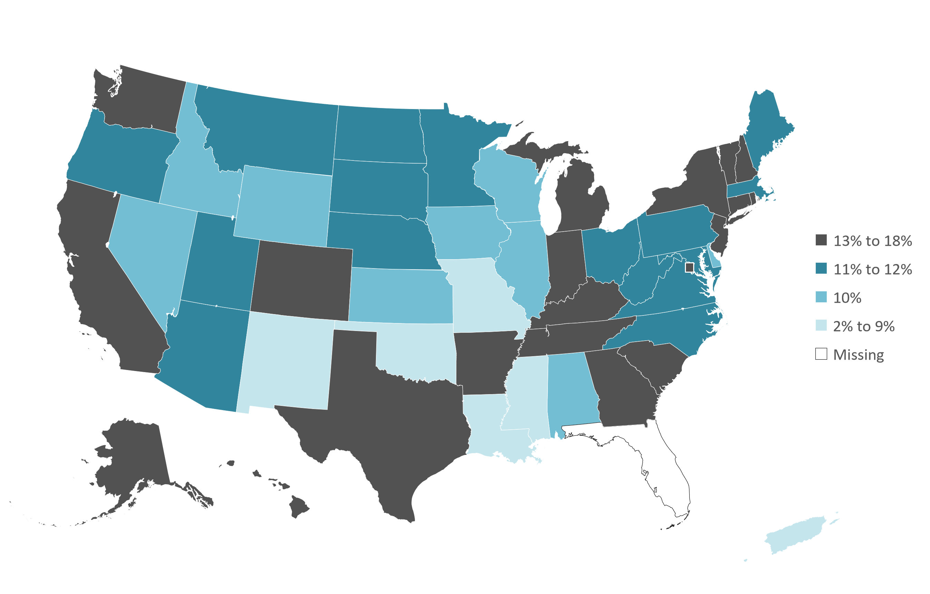
Vegetable Consumption (3+ servings per day) by State, Adults 18 Years and Older, US, 2021
Estimates are age adjusted to the year 2000 US standard population using five age groups: 18-24, 25-34, 35-44, 45-64, ≥65 years.
Source: Behavioral Risk Factor Surveillance System, 2021.

Slide 17
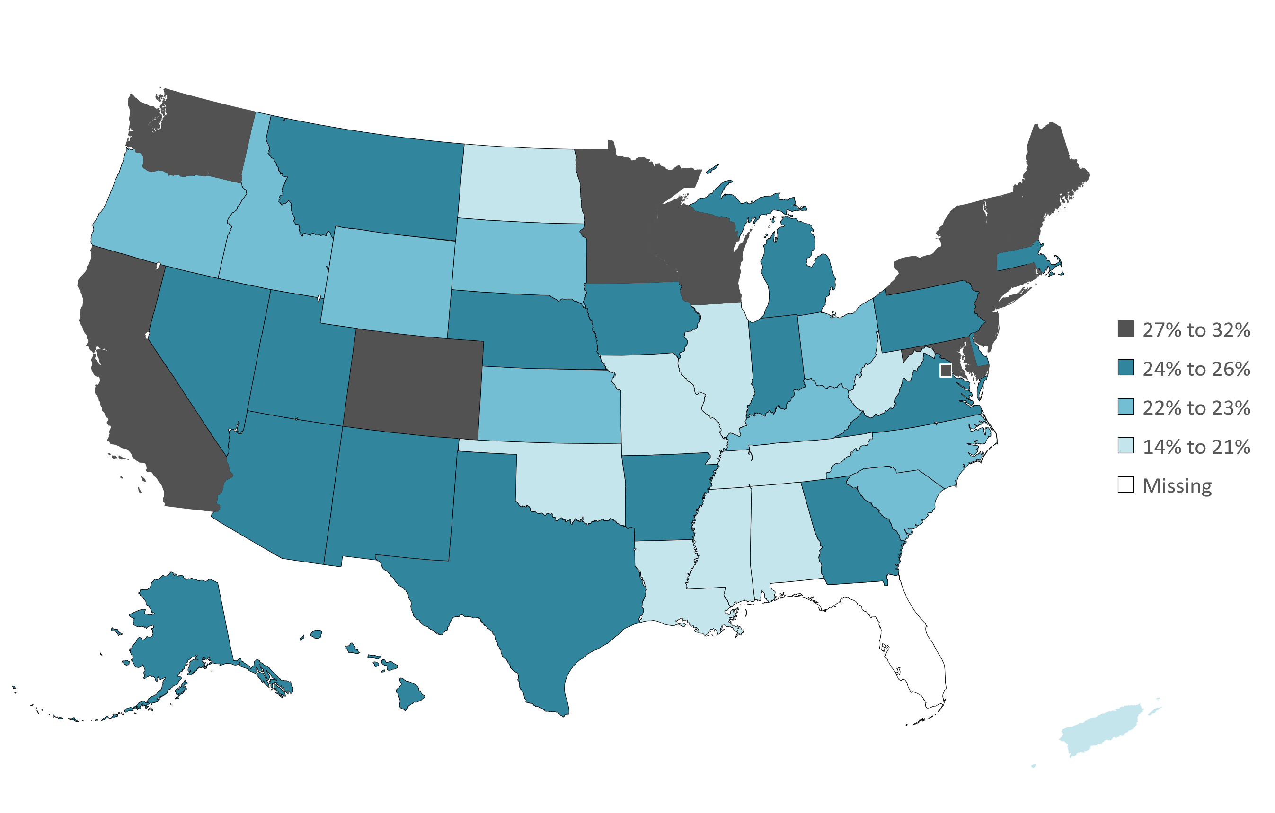
Fruit Consumption (2+ servings per day) by State, Adults 18 Years and Older, US, 2021
Estimates are age adjusted to the year 2000 US standard population using five age groups: 18-24, 25-34, 35-44, 45-64, ≥65 years.
Source: Behavioral Risk Factor Surveillance System, 2021.

Slide 18
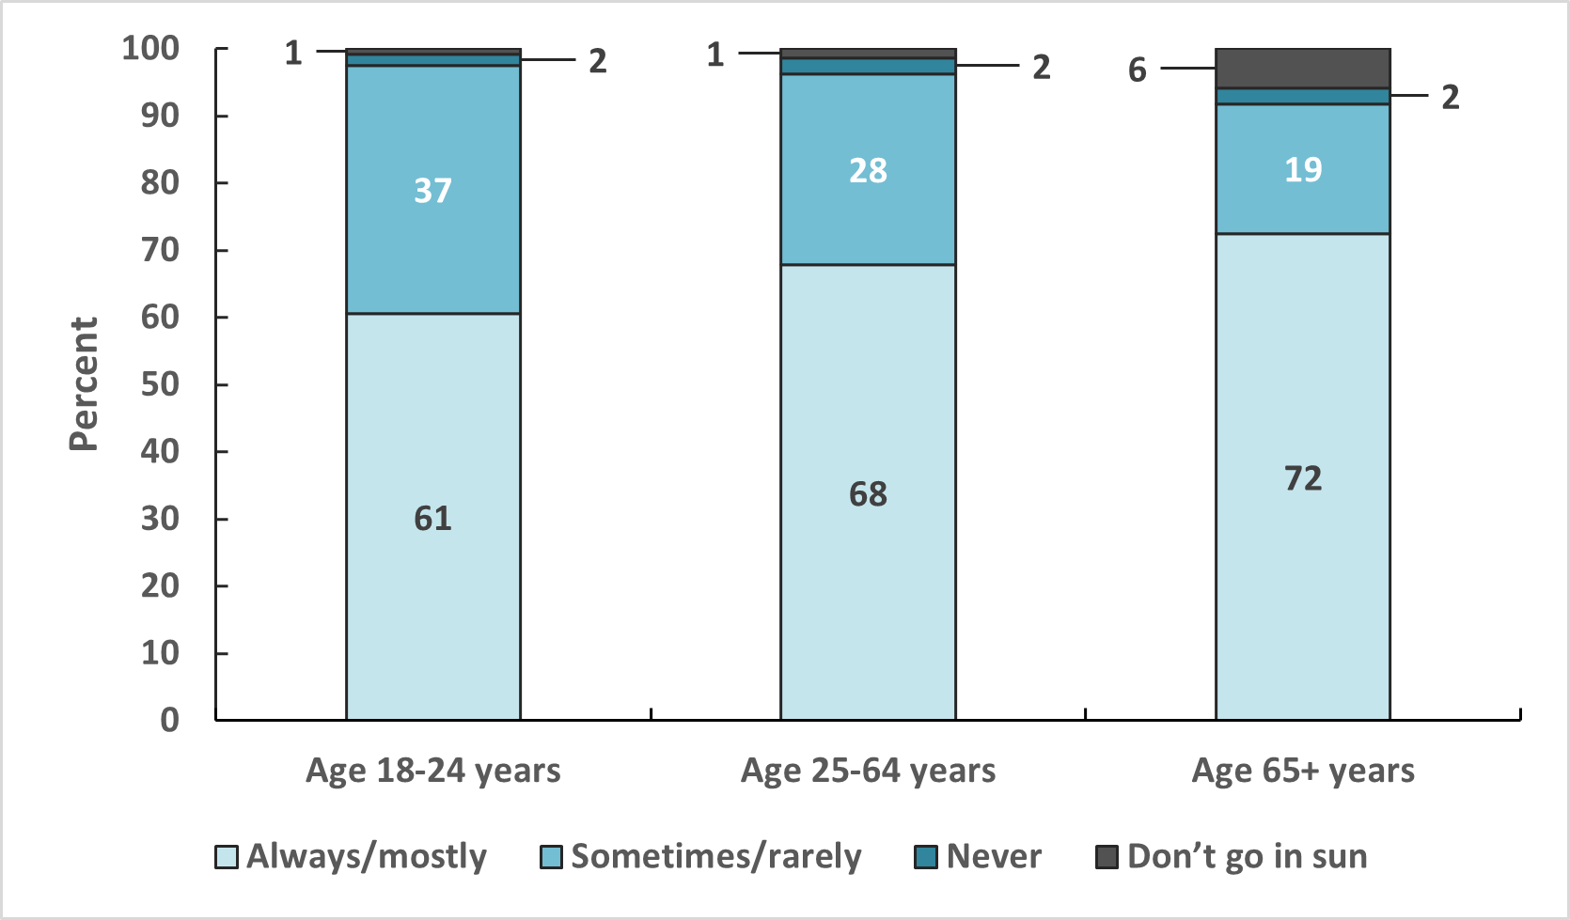
Sun Protective Behaviors, Adults 18 Years and Older, US, 2020
Estimates of sun protective behavior are crude. Sun protective behaviors are defined as at least one of the following: wear wide-brimmed hat, long-sleeve shirt, sunscreen, or seek the shade.
Source: National Health Interview Survey, 2020.

Slide 19
HPV Vaccination Recommendations
Recommendation
HPV vaccination is routinely recommended at age 11 or 12 years; vaccination can be given starting at age 9 years.
Vaccination is recommended for all persons through age 26 years who are not adequately vaccinated.
Catch-up HPV vaccination is not recommended for all adults aged >26 years. Instead, shared clinical decision-making regarding HPV vaccination is recommended for some adults aged 27-45 years who are not adequately vaccinated. HPV vaccines are not licensed for use in adults aged >45 years.
Visit www.cancer.org for more information about the American Cancer Society Guidelines for the Early Detection of Cancer.
Source: Saslow D, Andrews KS, Manassaram-Baptiste D, Smith RA, Fontham ETH; American Cancer Society Guideline Development Group. Human papillomavirus vaccination 2020 guideline update: American Cancer Society guideline adaptation. CA Cancer J Clin. 2020;70(4):274-280. doi:10.3322/caac.21616.

Slide 20
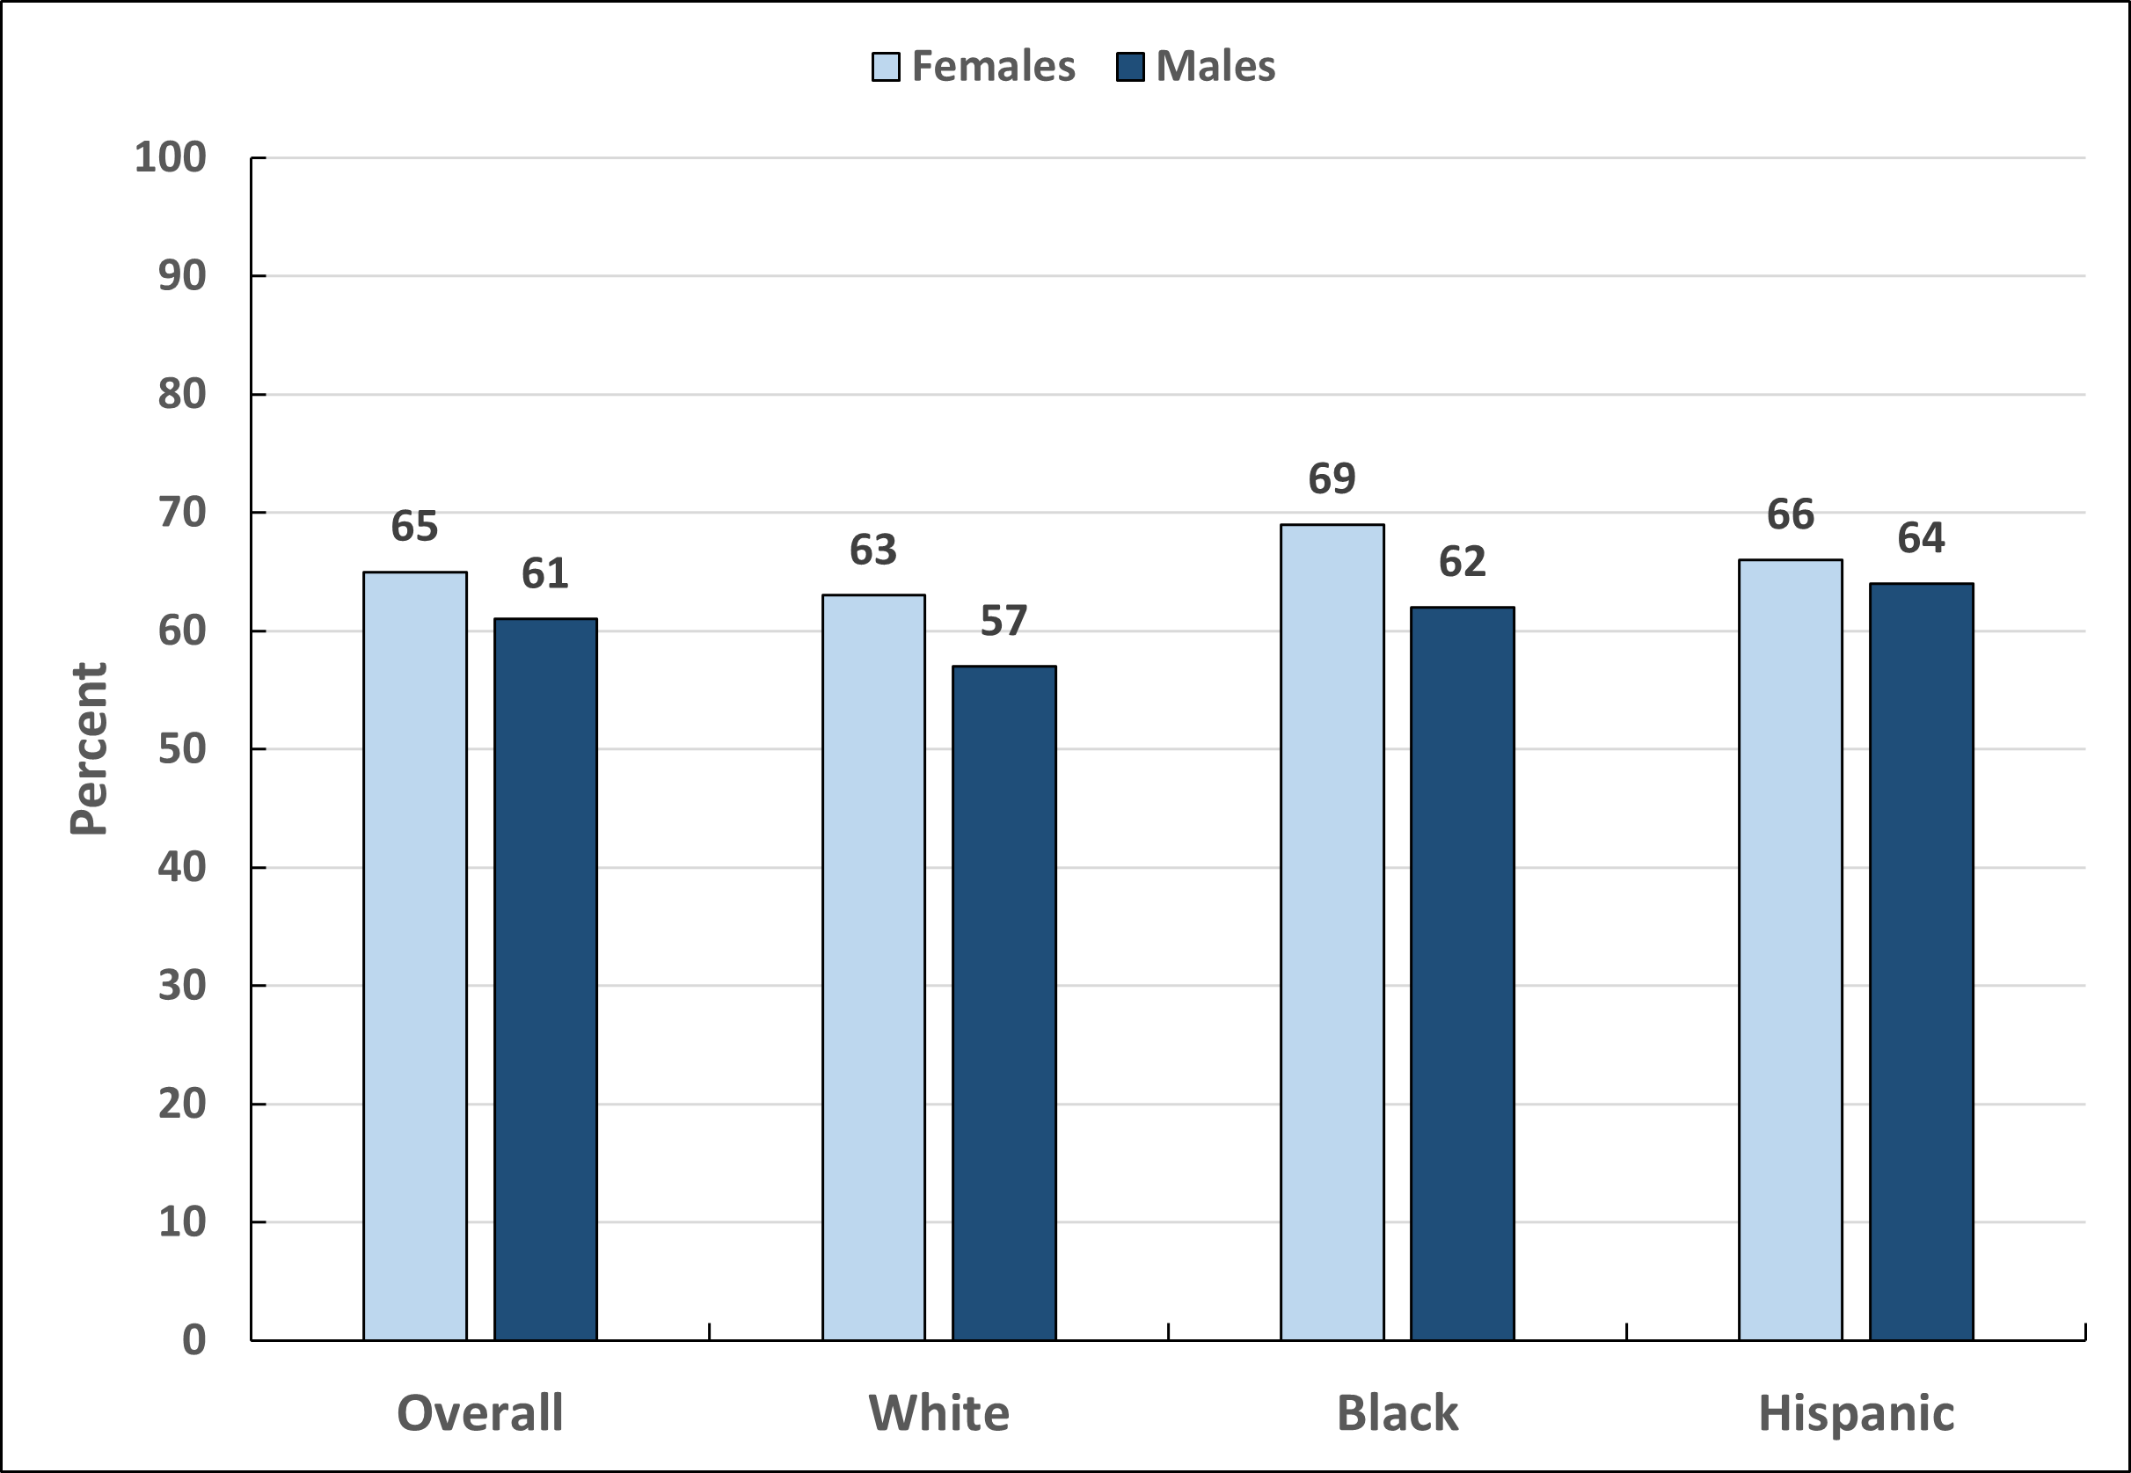
Up-to-Date Human Papillomavirus Vaccination, by Sex and Race/Ethnicity, Adolescents 13 to 17 Years, US, 2022
Estimates are crude. Up-to-date HPV vaccination is defined as 2 doses separated by 5 months (minus 4 days) for immunocompetent adolescents initiating the HPV vaccine series before their 15th birthday, and 3 doses for all others.
Sources: TeenVaxView, 2022.²³ National Immunization Survey-Teen, 2022.

Slide 21
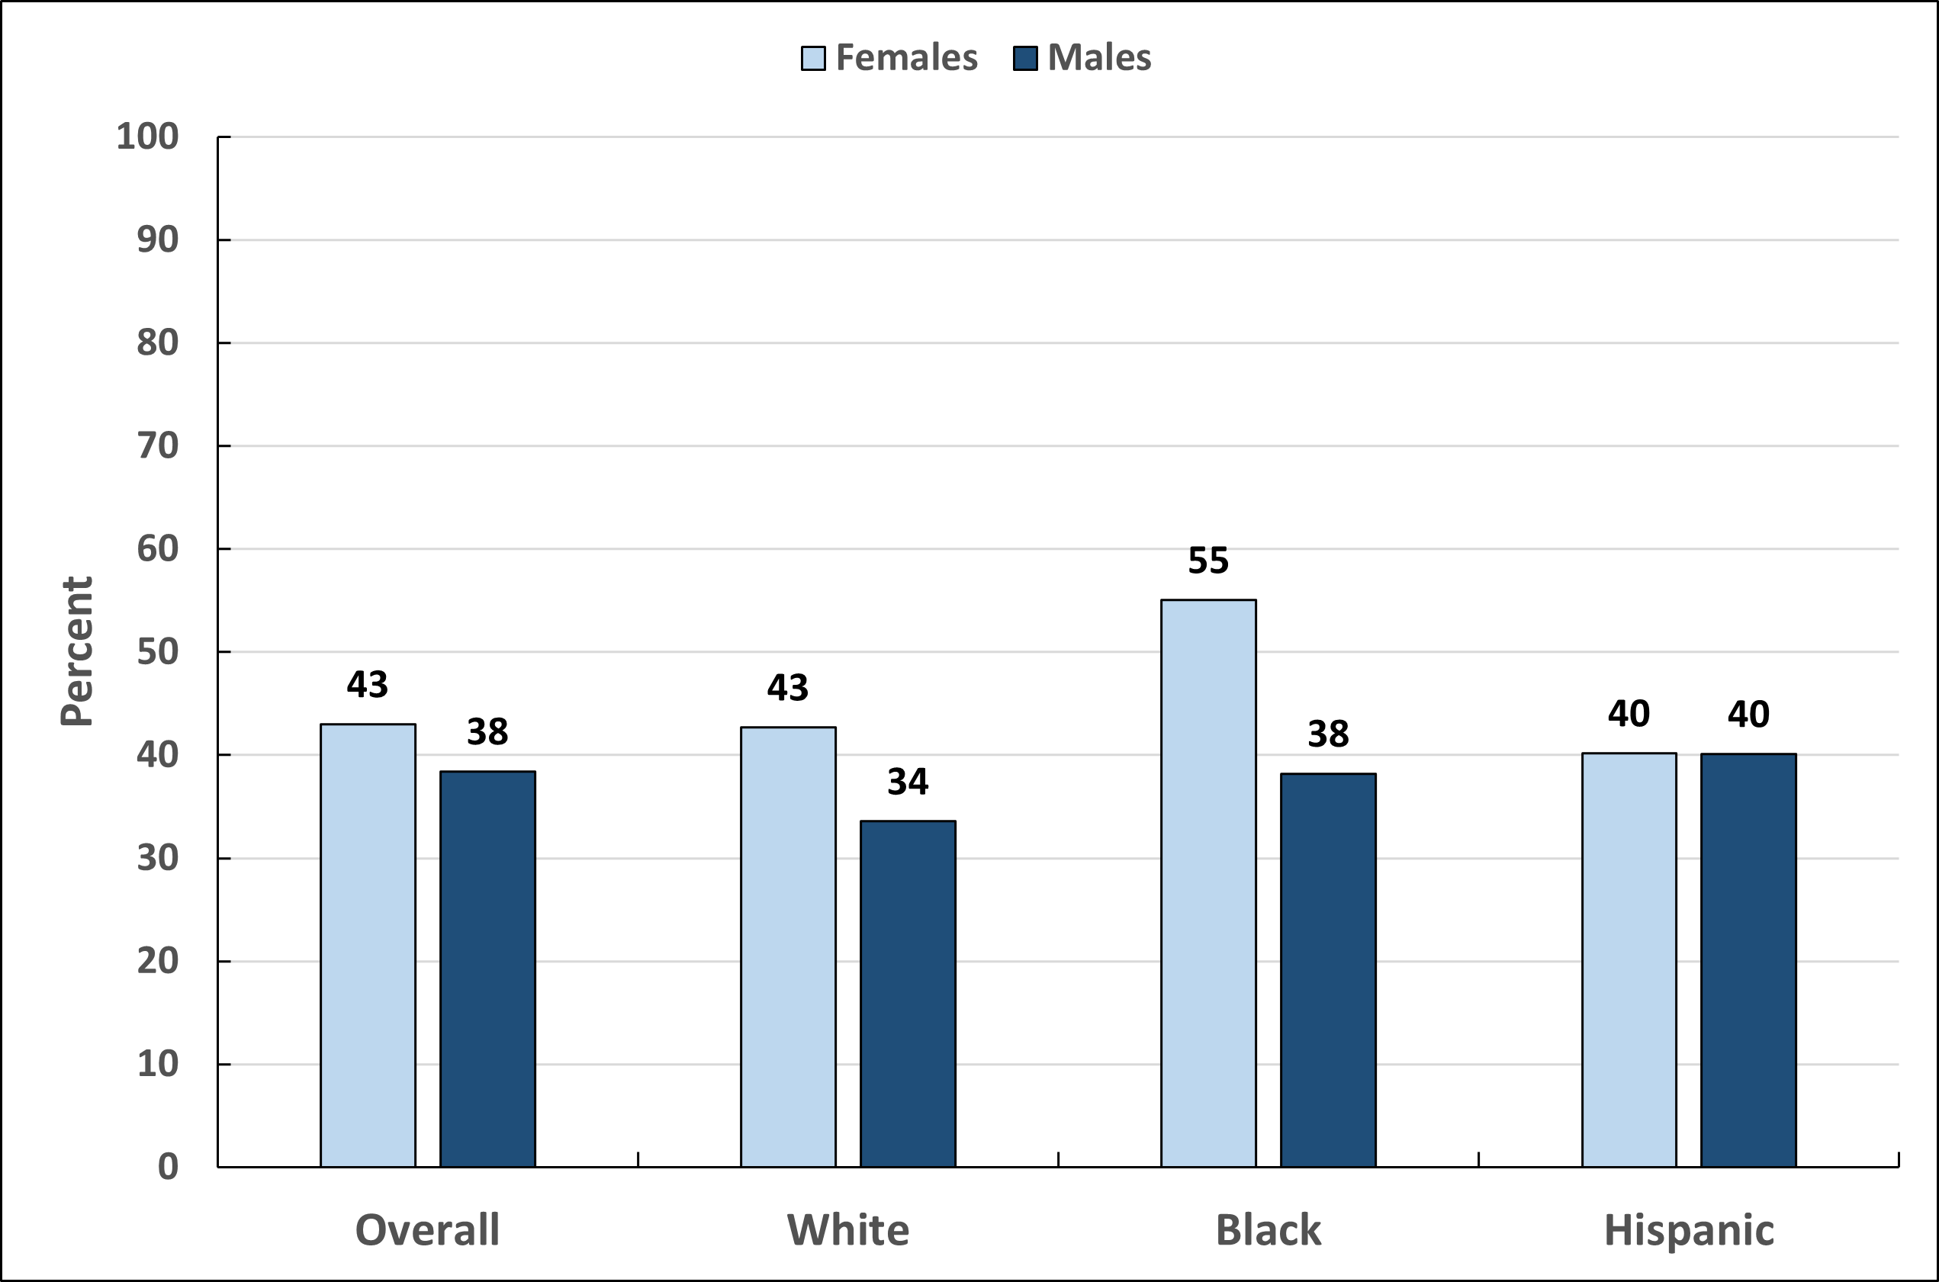
Up-to-Date Human Papillomavirus Vaccination Before 13th Birthday, by Sex and Race/Ethnicity, Adolescents 13 to 17 Years, US, 2022
Estimates are crude. Up-to-date HPV vaccination is defined as 2 doses separated by 5 months (minus 4 days) for immunocompetent adolescents initiating the HPV vaccine series before their 15th birthday, and 3 doses for all others.
Sources: TeenVaxView, 2022.²³ National Immunization Survey-Teen, 2022.

Slide 22
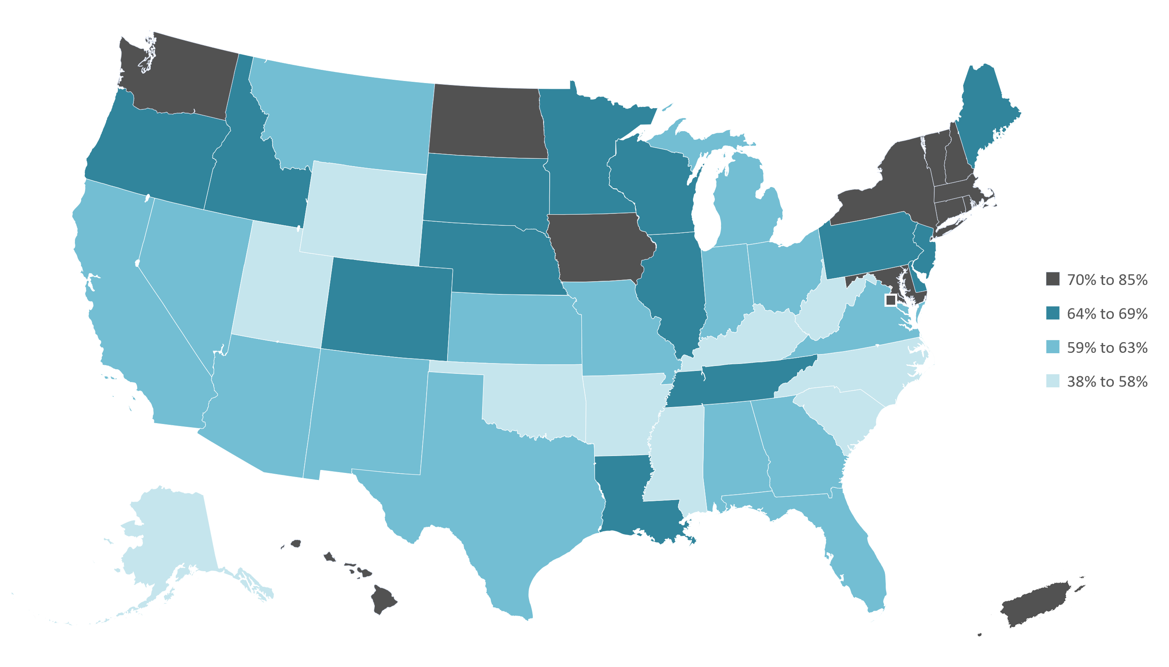
Up-to-date Human Papillomavirus Vaccination, Adolescents 13-17 Years, by State, 2022
Estimates are crude. Up-to-date HPV vaccination is defined as 2 doses separated by 5 months (minus 4 days) for immunocompetent adolescents initiating the HPV vaccine series before their 15th birthday, and 3 doses for all others.
Source: NIS Teen 2022.

Slide 23
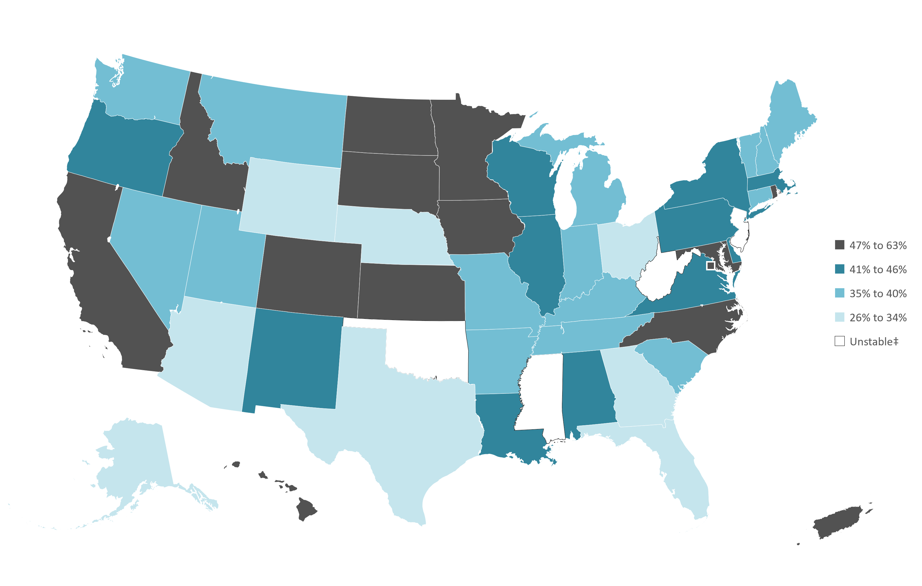
Up-to-date Human Papillomavirus Vaccination Before 13th Birthday, Adolescents 13-17 Years, by State, 2020-2022
Estimates are crude. Up-to-date HPV vaccination is defined as 2 doses separated by 5 months (minus 4 days) for immunocompetent adolescents initiating the HPV vaccine series before their 15th birthday, and 3 doses for all others. Estimates based on vaccinations received before 13th birthday among 13–17-year-olds. Multiple years were combined for statistical reliability. ‡Estimates are statistically unstable and not shown. See Special Notes, Page 42 of Cancer Prevention and Early Detection Facts and Figures 2024
Source: NIS Teen 2020-2022.

Slide 24
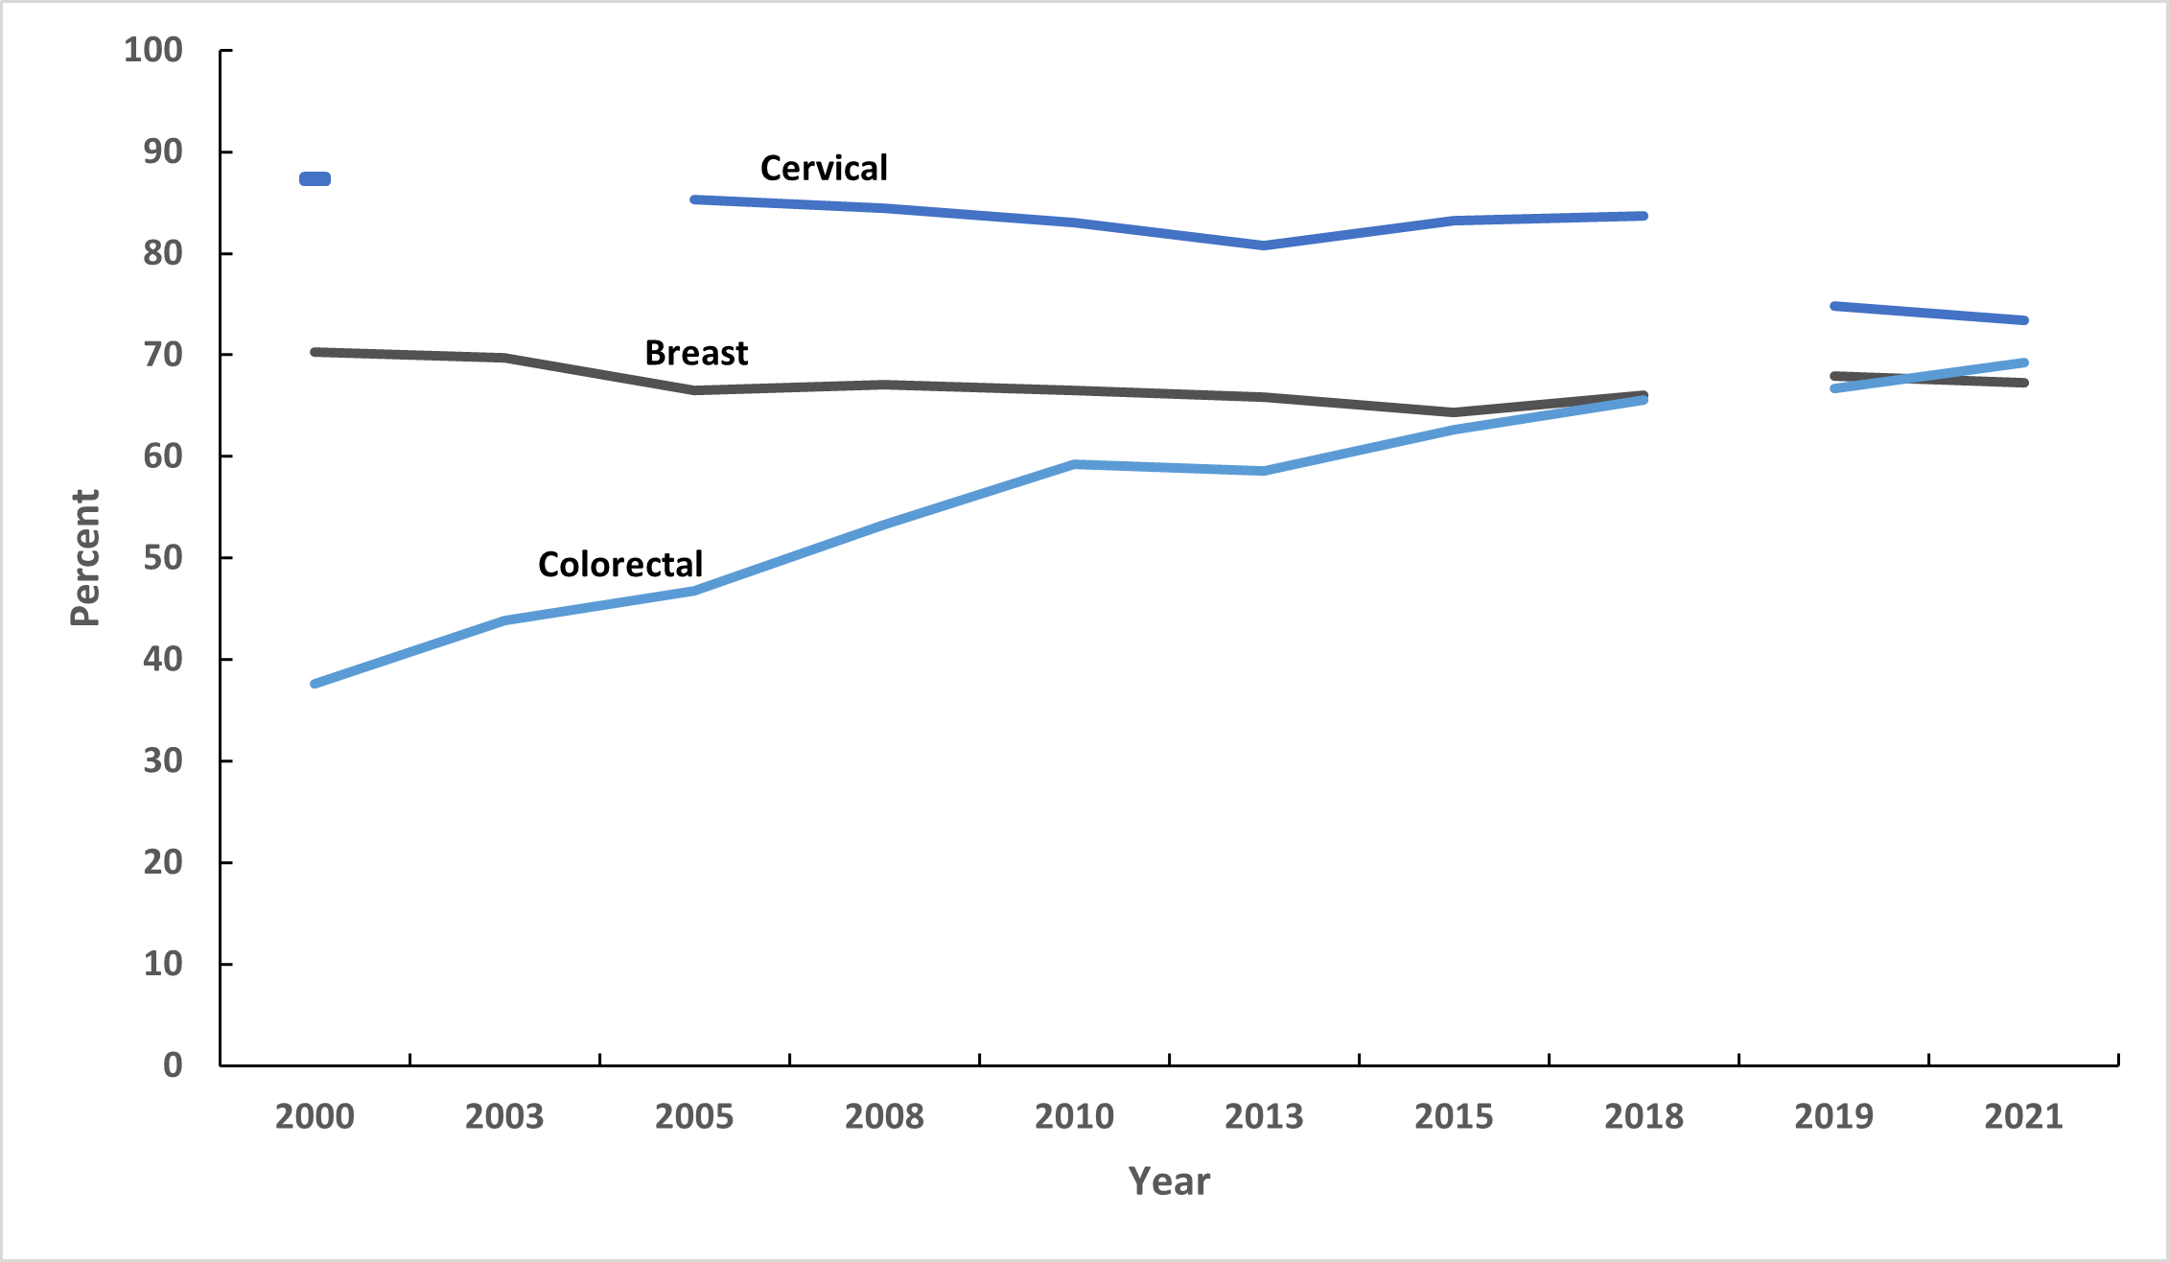
Trends in Breast, Cervical, and Colorectal Cancer Screening, US, 2000-2021
Respondents' sex was self-reported. The NHIS underwent a significant redesign in 2019 preventing comparability to prior years indicated by the line break. Breast cancer screening is defined as mammography in the past 2 years among females 40+ years. Breast cancer screening estimates are age-adjusted to the year 2000 US standard population using three age groups: 40-49, 50-64, and 65+ years. Cervical cancer screening is defined as Pap test in the past 3 years (2000-on) among females 21-65 years or HPV and Pap co-testing in the past 5 years (2015-on) among females 30-65 years who have not had a hysterectomy; hysterectomy data not available in 2003. Cervical cancer screening estimates are age-adjusted to the year 2000 US standard population using four age groups: 21-29, 30-39, 40-49, and 50-65 years. Colorectal cancer screening is defined as colonoscopy, sigmoidoscopy, and stool-testing in the past 10, 5, and 1 years; CT colonography in the past 5 years (2010-on); sDNA in the past 3 years (2018-on) among adults 50+ years. Colorectal cancer screening estimates are age-adjusted to the year 2000 US standard population using two age groups: 50-64 and 65+ years.
Sources: National Health Interview Survey, 2000-2021.

Slide 25
Breast Cancer Screening Guidelines for Women with Average Risk
Population | Test or Procedure | Recommendation
Women, ages 45-54 | Mammography | Women should have the opportunity to begin annual screening between the ages of 40 and 44. Women should undergo regular screening mammography starting at age 45. Women ages 45 to 54 should be screened annually.
Women, ages 55+ |  | Transition to biennial screening, or have the opportunity to continue annual screening. Continue screening as long as overall health is good and life expectancy is 10+ years.
Visit www.cancer.org for more information about the American Cancer Society Guidelines for the Early Detection of Cancer.
Source: Oeffinger KC, Fontham ETH, Etzioni R, et al. Breast Cancer Screening for Women at Average Risk: 2015 Guideline Update From the American Cancer Society. JAMA. 2015;314(15):1599–1614. doi:10.1001/jama.2015.12783.

Slide 26
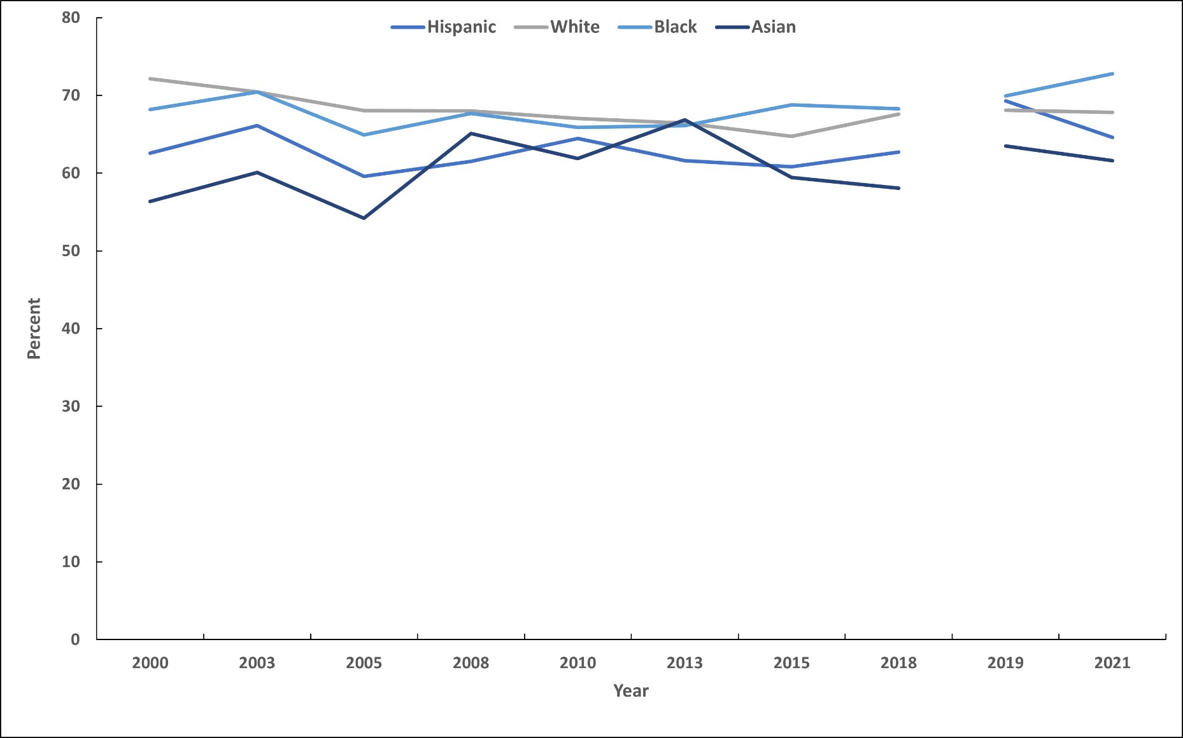
Trends in Mammography Within the Past Two Years, Females 40 Years and Older, by Race/Ethnicity, US, 2000-2021
Respondents' sex was self-reported. The NHIS underwent a significant redesign in 2019 preventing comparability to prior years indicated by the line break. Breast cancer screening is defined as mammography in the past 2 years among females 40+ years. Breast cancer screening estimates are age-adjusted to the year 2000 US standard population using three age groups: 40-49, 50-64, and 65+ years.
Sources: National Health Interview Survey, 2000-2021

Slide 27
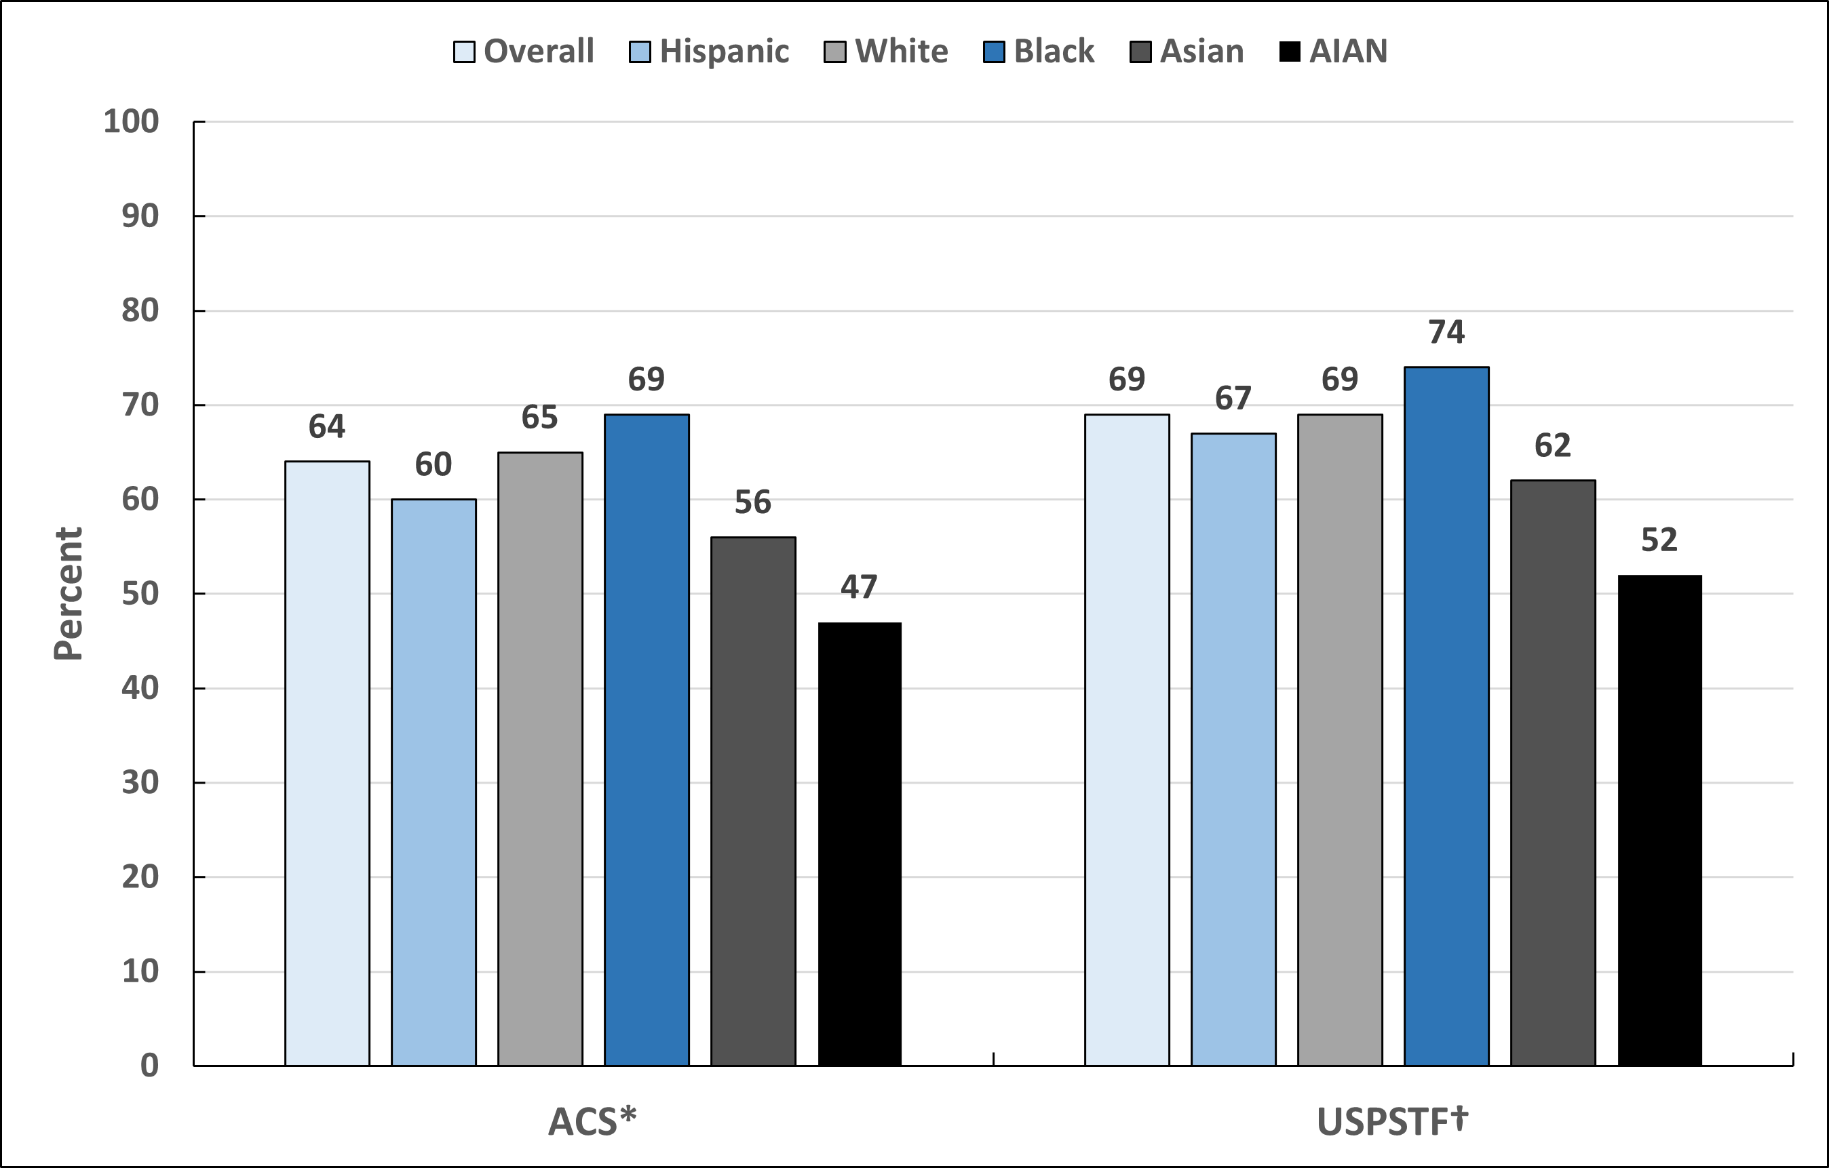
Up-to-date Mammography, by Race/Ethnicity, Females 40 Years and Older, US, 2021
ACS-American Cancer Society, USPSTF-United States Preventive Services Task Force. AIAN-American Indian or Alaska Native. Respondents' sex was self-reported. *Mammogram within the past year (ages 45-54 years) or past two years (ages ≥55 years). ACS estimates are age-adjusted to the year 2000 US standard population using 3 age groups: 45-49, 50-64, and ≥65 years. †USPSTF 2024 Recommendation: Mammogram within the past two years (ages 40-74). Estimates are age-adjusted using 3 age groups: 40-49, 50-64, and 65-74 years.
Source: National Health Interview Survey, 2021.

Slide 28
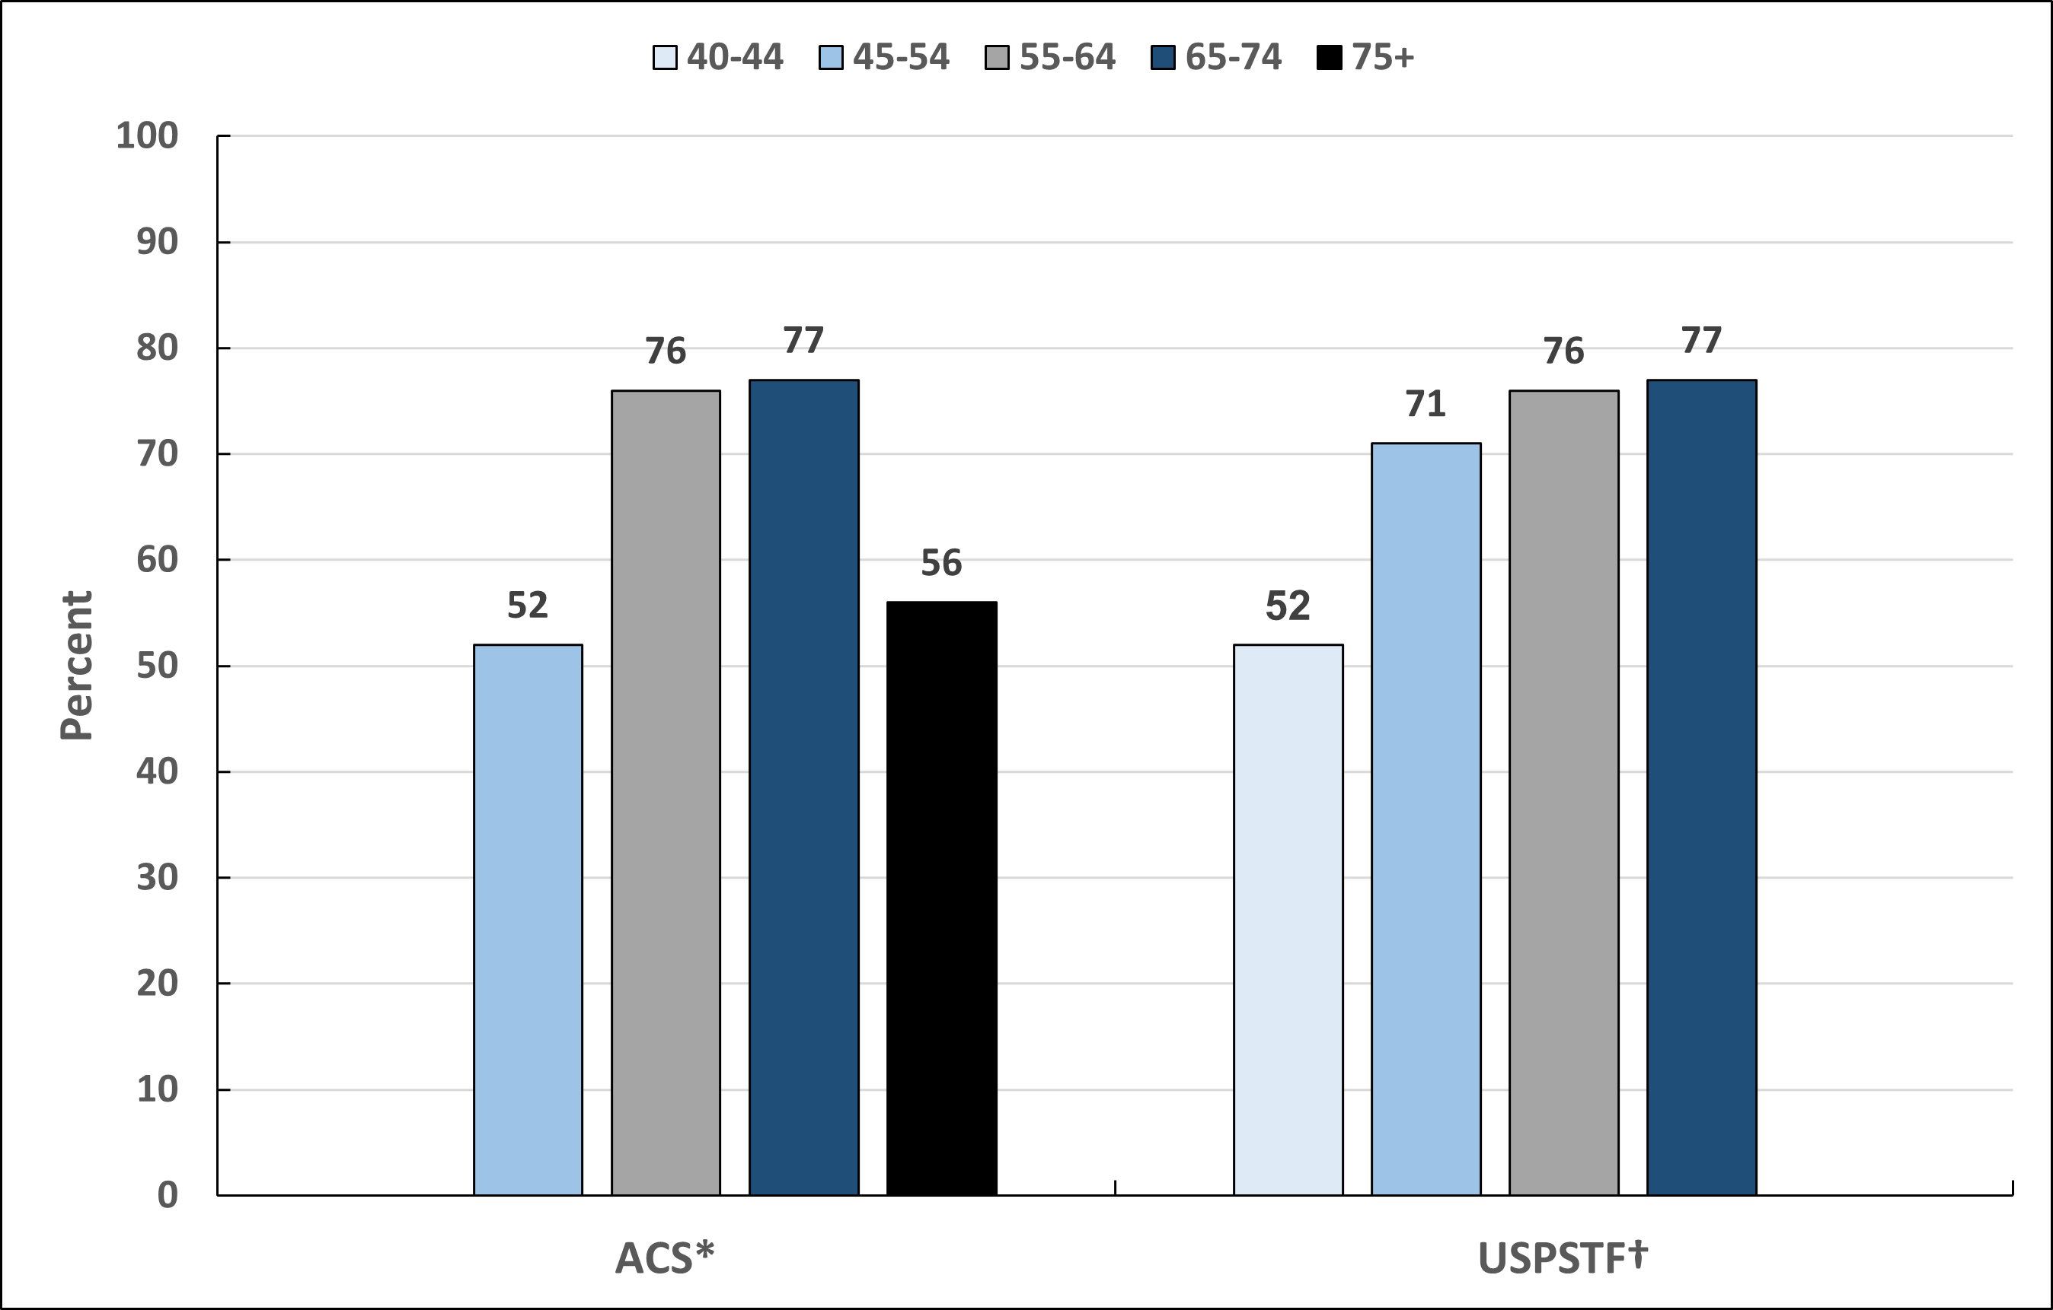
Up-to-date Mammography, by Age, Females 40 Years and Older, US, 2021
ACS-American Cancer Society, USPSTF-United States Preventive Services Task Force. Respondents' sex was self-reported. *Mammogram within the past year (ages 45-54 years) or past two years (ages ≥55 years). *ACS estimates are age-adjusted to the year 2000 US standard population using 3 age groups: 45-49, 50-64, and ≥65 years. †USPSTF 2024 Recommendation: Mammogram within the past two years (ages 40-74). Estimates are age-adjusted using 3 age groups: 40-49, 50-64, and 65-74 years.
Source: National Health Interview Survey, 2021.

Slide 29
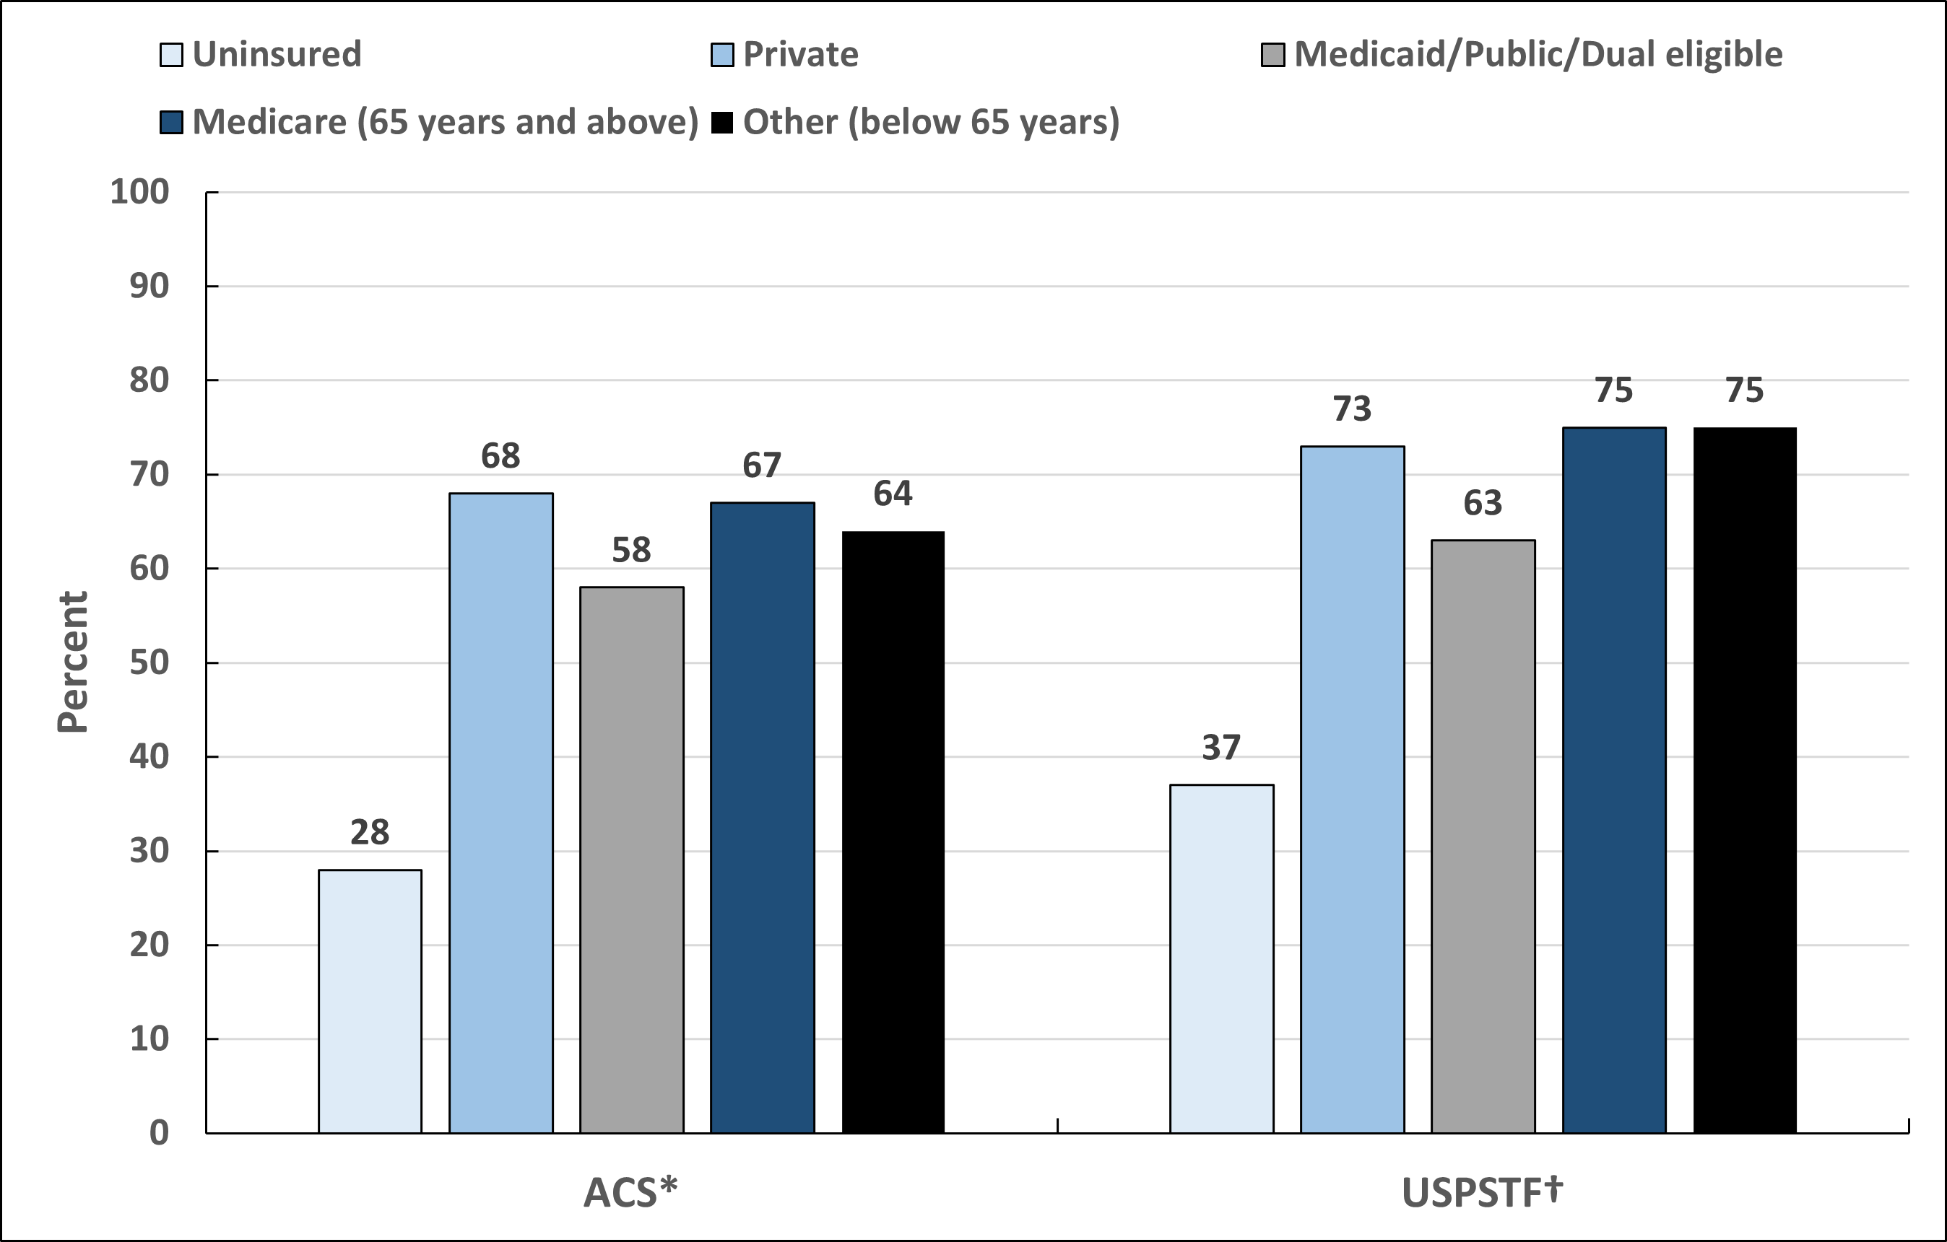
Up-to-date Mammography, by Insurance Status, Females 40 Years and Older, US, 2021
ACS-American Cancer Society, USPSTF-United States Preventive Services Task Force. Respondents' sex was self-reported. *Mammogram within the past year (ages 45-54 years) or past two years (ages ≥55 years). ACS estimates are age-adjusted to the year 2000 US standard population using 3 age groups: 45-49, 50-64, and ≥65 years. †USPSTF 2024 Recommendation: Mammogram within the past two years (ages 40-74). Estimates are age-adjusted using 3 age groups: 40-49, 50-64, and 65-74 years.
Source: National Health Interview Survey, 2021.

Slide 30
Cervical Cancer Screening Guidelines for Women with Average Risk
Population | Test or Procedure | Recommendation
Women, ages 25-65 | Primary HPV test (preferred), Pap test alone or co-testing (acceptable) | Preferred: Primary HPV test alone every 5 years with an FDA-approved test for primary HPV screening. Acceptable: Co-testing (HPV test and Pap test) every 5 years or Pap test alone every 3 years.
Women, ages >65 |  | Discontinue screening if results from regular screening in the past 10 years were negative, with the most recent test within the past 5 years.
Women who have been vaccinated against HPV |  | Follow age-specific screening recommendations (same as unvaccinated individuals).
Women who have had a total hysterectomy |  | Stop cervical cancer screening.
Visit www.cancer.org for more information about the American Cancer Society Guidelines for the Early Detection of Cancer.
Source: Fontham ETH, Wolf AMD, Church TR, et al. Cervical cancer screening for individuals at average risk: 2020 guideline update from the American Cancer Society. CA Cancer J Clin. 2020;70(5):321-346. doi:10.3322/caac.21628.

Slide 31
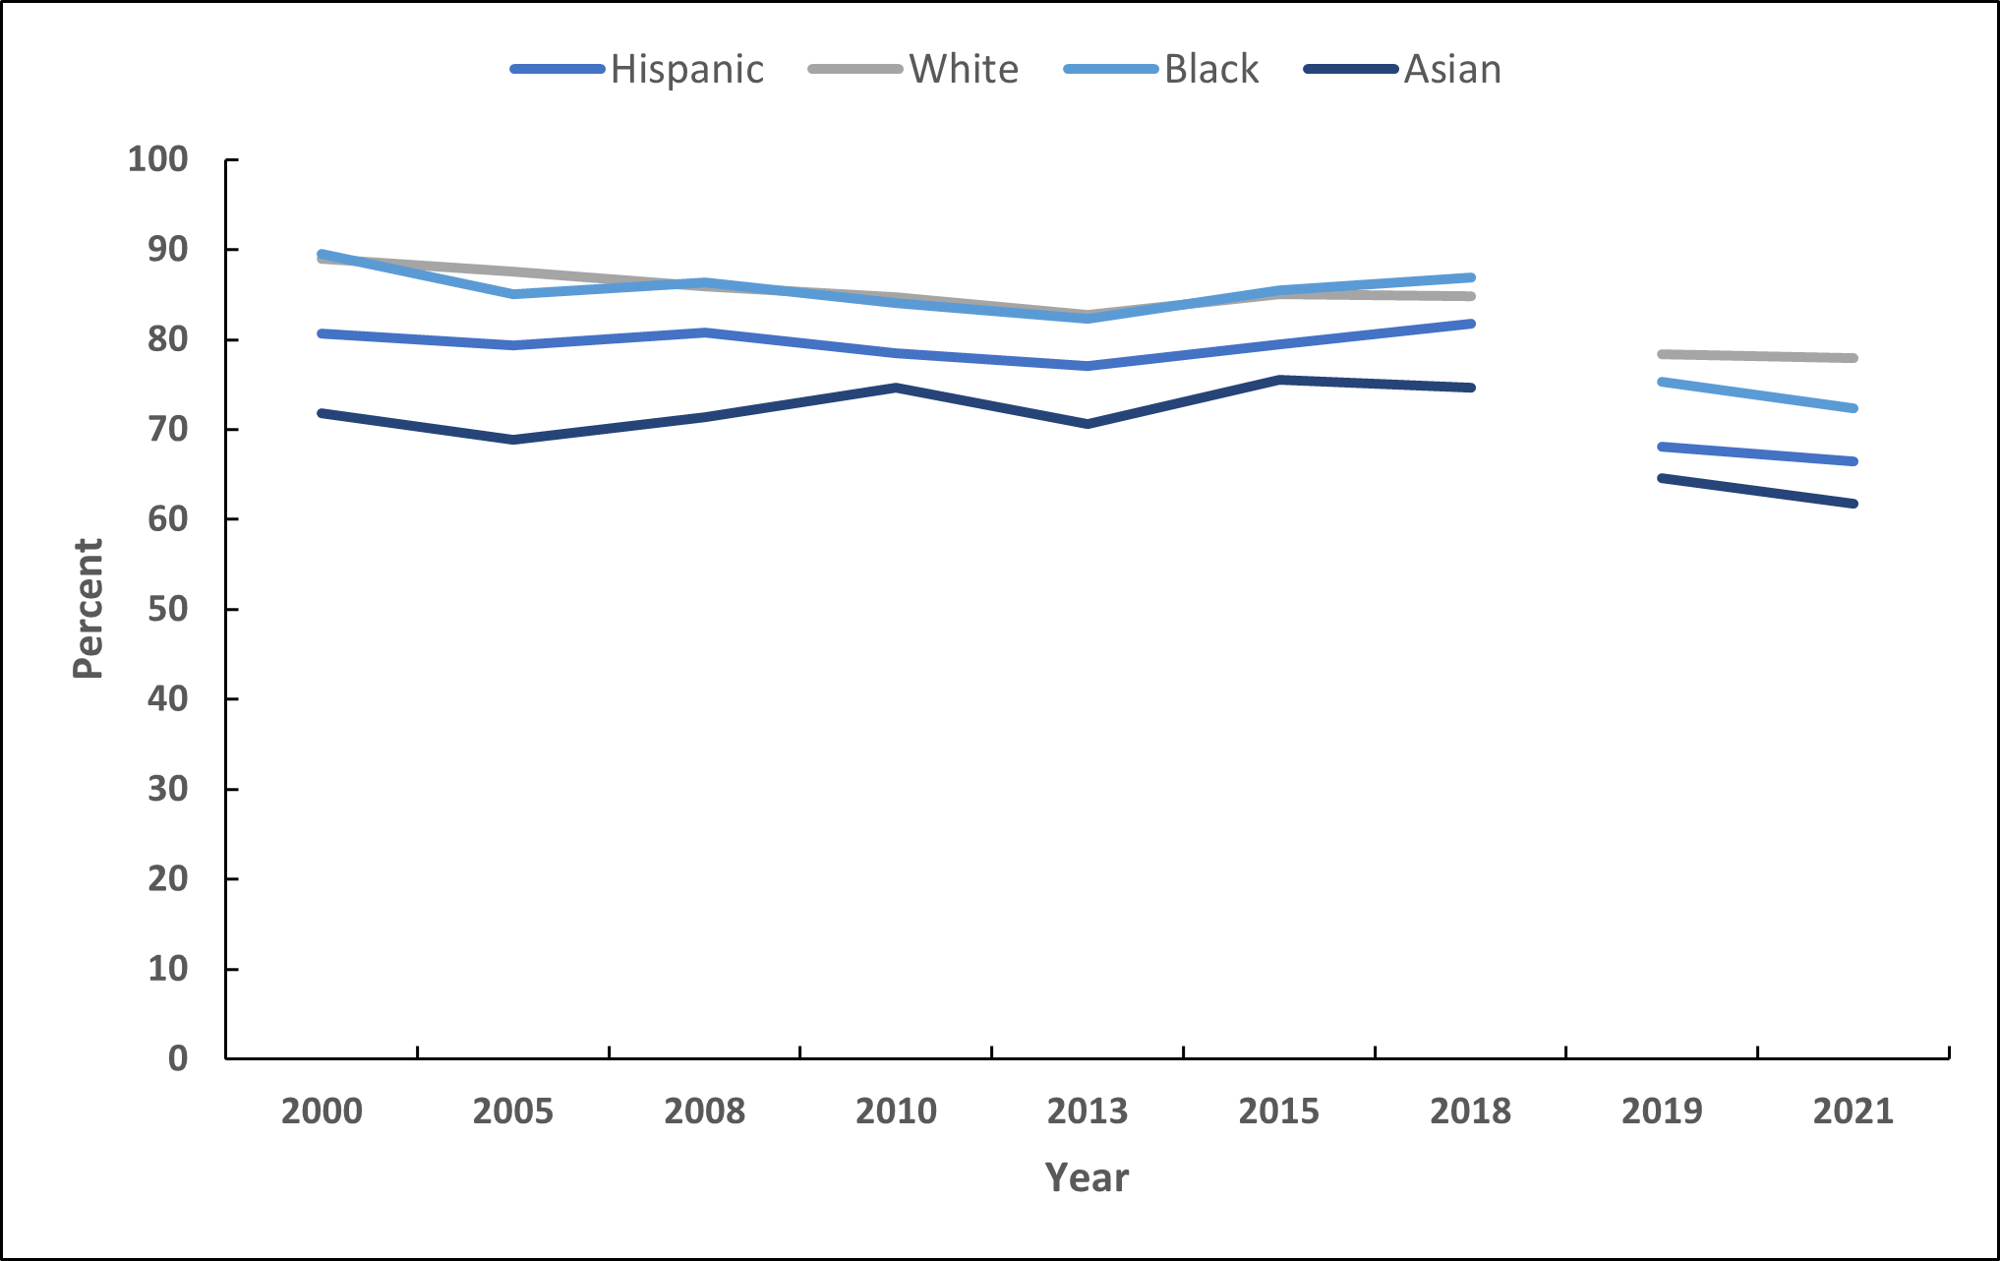
Trends in Cervical Cancer Screening, Females 21-65 Years, by Race/Ethnicity, US, 2000-2021
Respondents' sex was self-reported. The NHIS underwent a significant redesign in 2019 preventing comparability to prior years indicated by the line break. Cervical cancer screening is defined as Pap test in the past 3 years (2000-on) among females 21-65 years or HPV and Pap co-testing in the past 5 years (2015-on) among females 30-65 years who have not had a hysterectomy; hysterectomy data not available in 2003. Cervical cancer screening estimates are age-adjusted to the year 2000 US standard population using four age groups: 21-29, 30-39, 40-49, and 50-65 years.
Sources: National Health Interview Survey, 2000-2021.

Slide 32
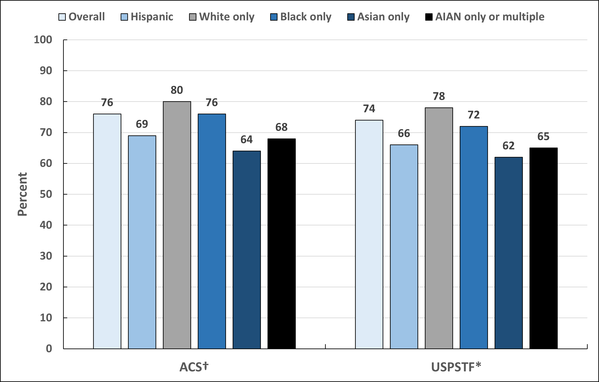
Up-to-date Cervical Cancer Screening, Females 21-65 Years, by Race/Ethnicity, US, 2021
ACS-American Cancer Society, USPSTF-United States Preventive Services Task Force. AIAN-American Indian or Alaska Native. Respondents' sex was self-reported. Estimates are among females who have not had a hysterectomy. †Pap test in the past 3 years OR Pap test and HPV test within the past 5 years among females 25-65 years. ACS estimates are age-adjusted to the year 2000 US standard population using 4 age groups: 25-29, 30-39, 40-49, and 50-65 years. *Pap test in the past 3 years among females 21-65 years OR Pap test and HPV test within the past 5 years among females 30-65 years. USPSTF estimates are age-adjusted using 4 age groups: 21-29, 30-39, 40-49, and 50-65 years. Primary HPV testing estimates are not available due to questionnaire limitations.
Source: National Health Interview Survey, 2021.

Slide 33
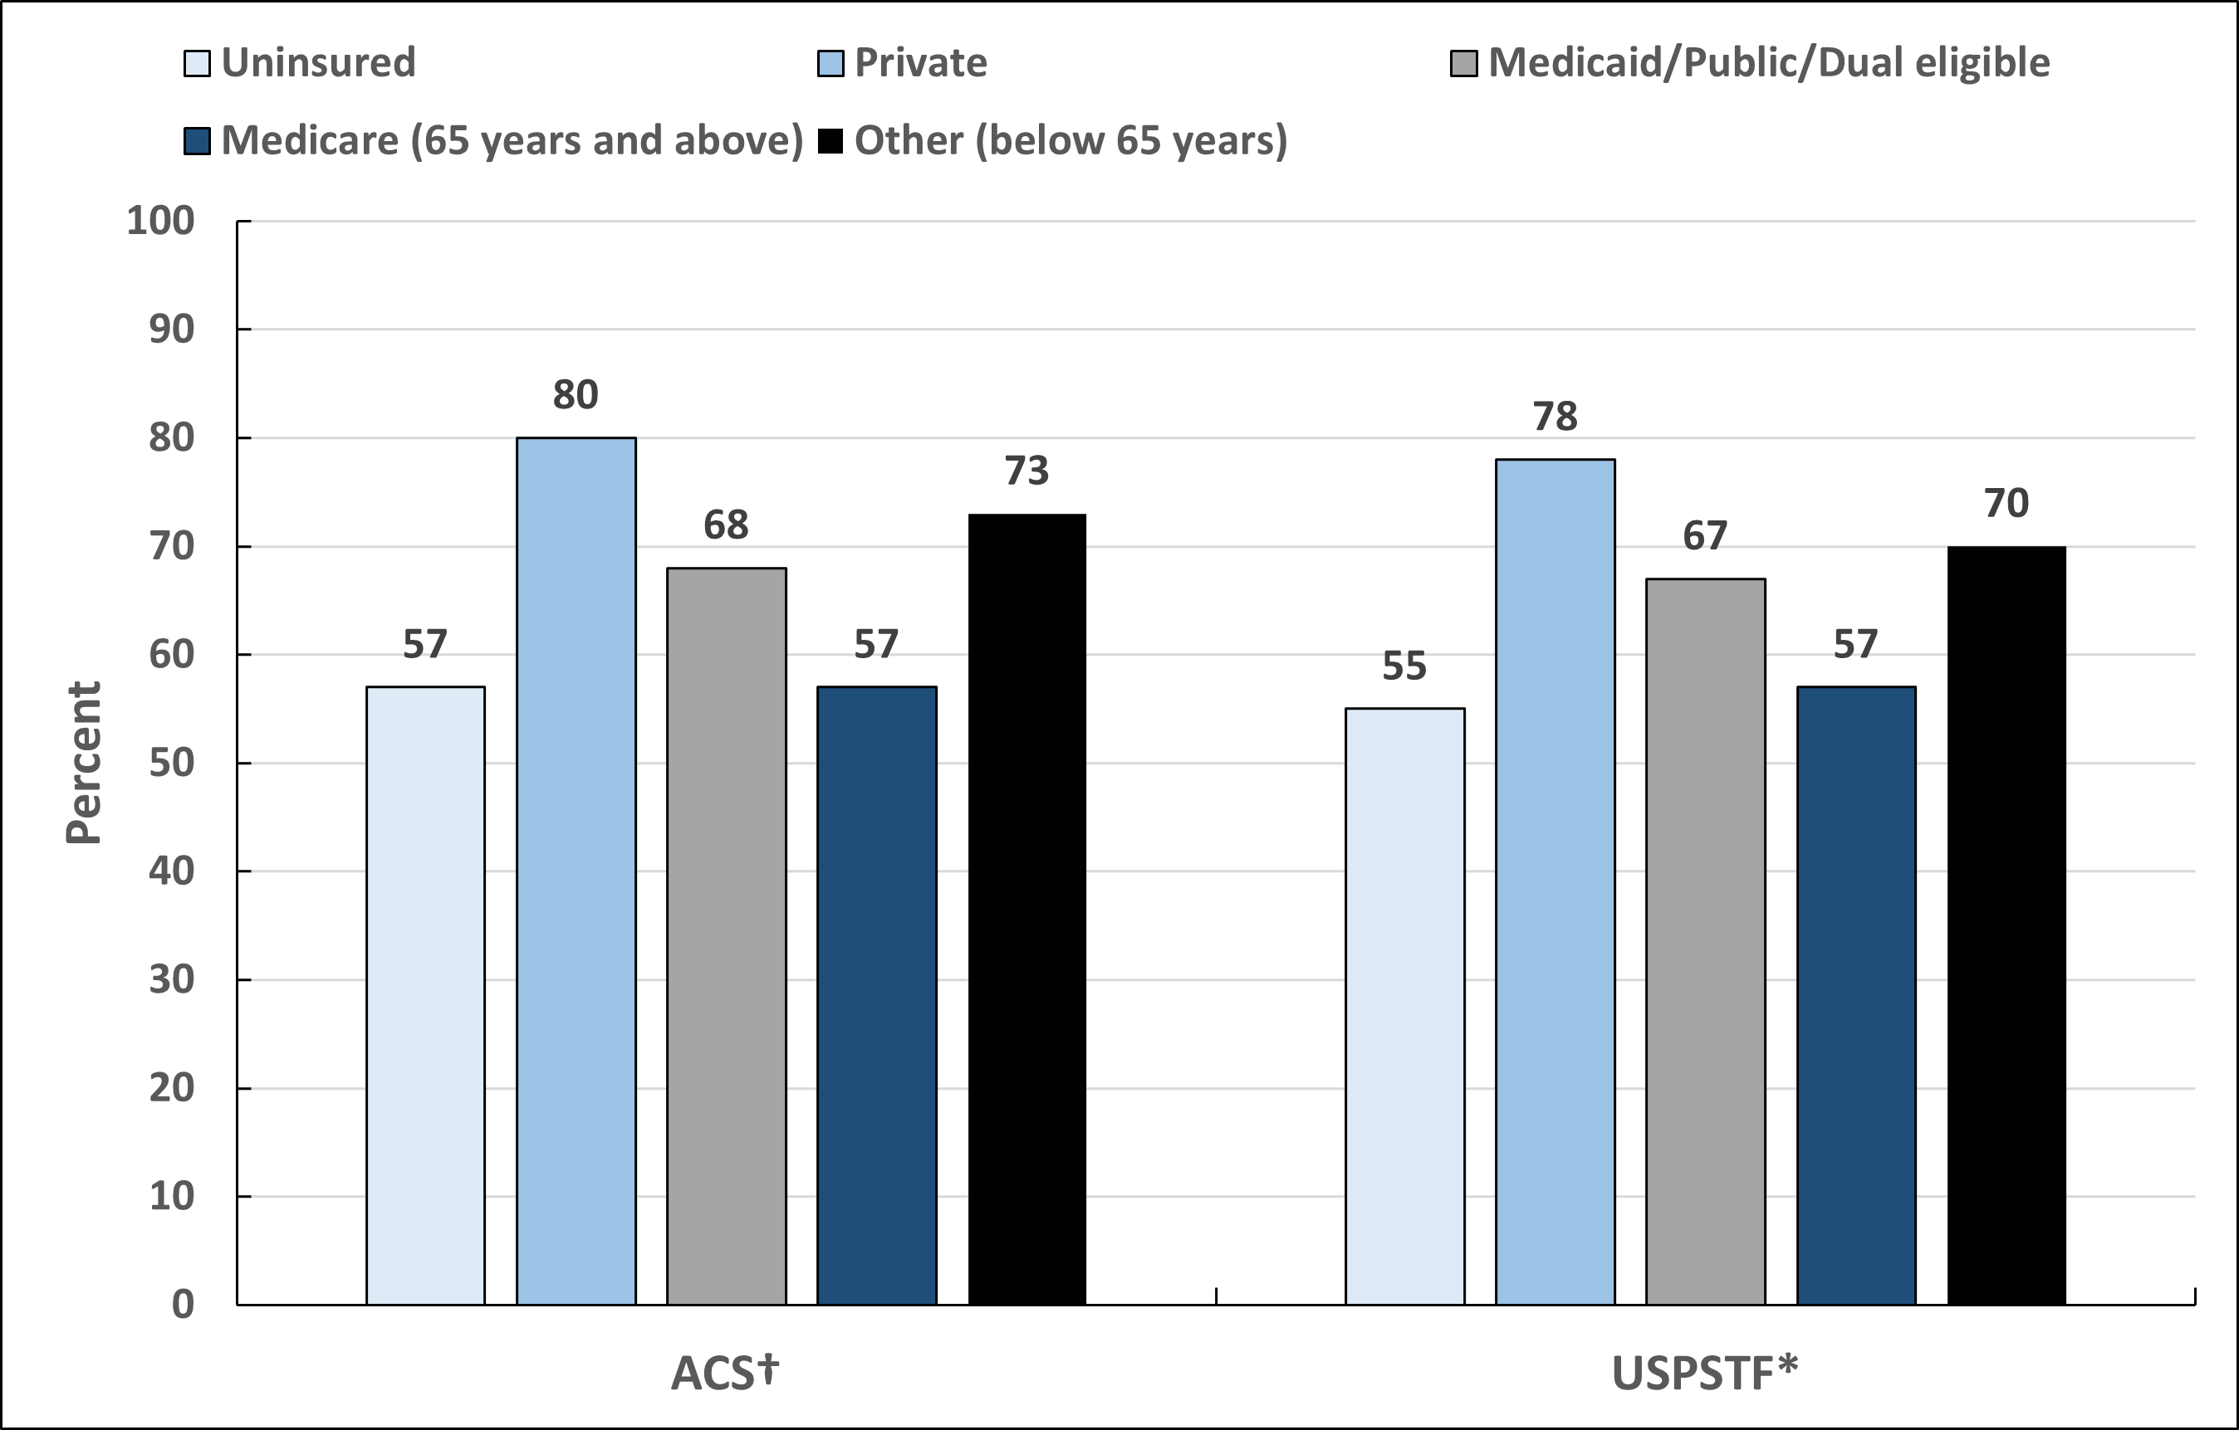
Up-to-date Cervical Cancer Screening, Females 21-65 Years, by Insurance Status, US, 2021
ACS-American Cancer Society, USPSTF-United States Preventive Services Task Force. Respondents' sex was self-reported. Estimates are among females who have not had a hysterectomy. †Pap test in the past 3 years OR Pap test and HPV test within the past 5 years among females 25-65 years. ACS estimates are age-adjusted to the year 2000 US standard population using 4 age groups: 25-29, 30-39, 40-49, and 50-65 years. *Pap test in the past 3 years among females 21-65 years OR Pap test and HPV test within the past 5 years among females 30-65 years. USPSTF estimates are age-adjusted using 4 age groups: 21-29, 30-39, 40-49, and 50-65 years. Primary HPV testing estimates are not available due to questionnaire limitations.
Source: National Health Interview Survey, 2021.

Slide 34
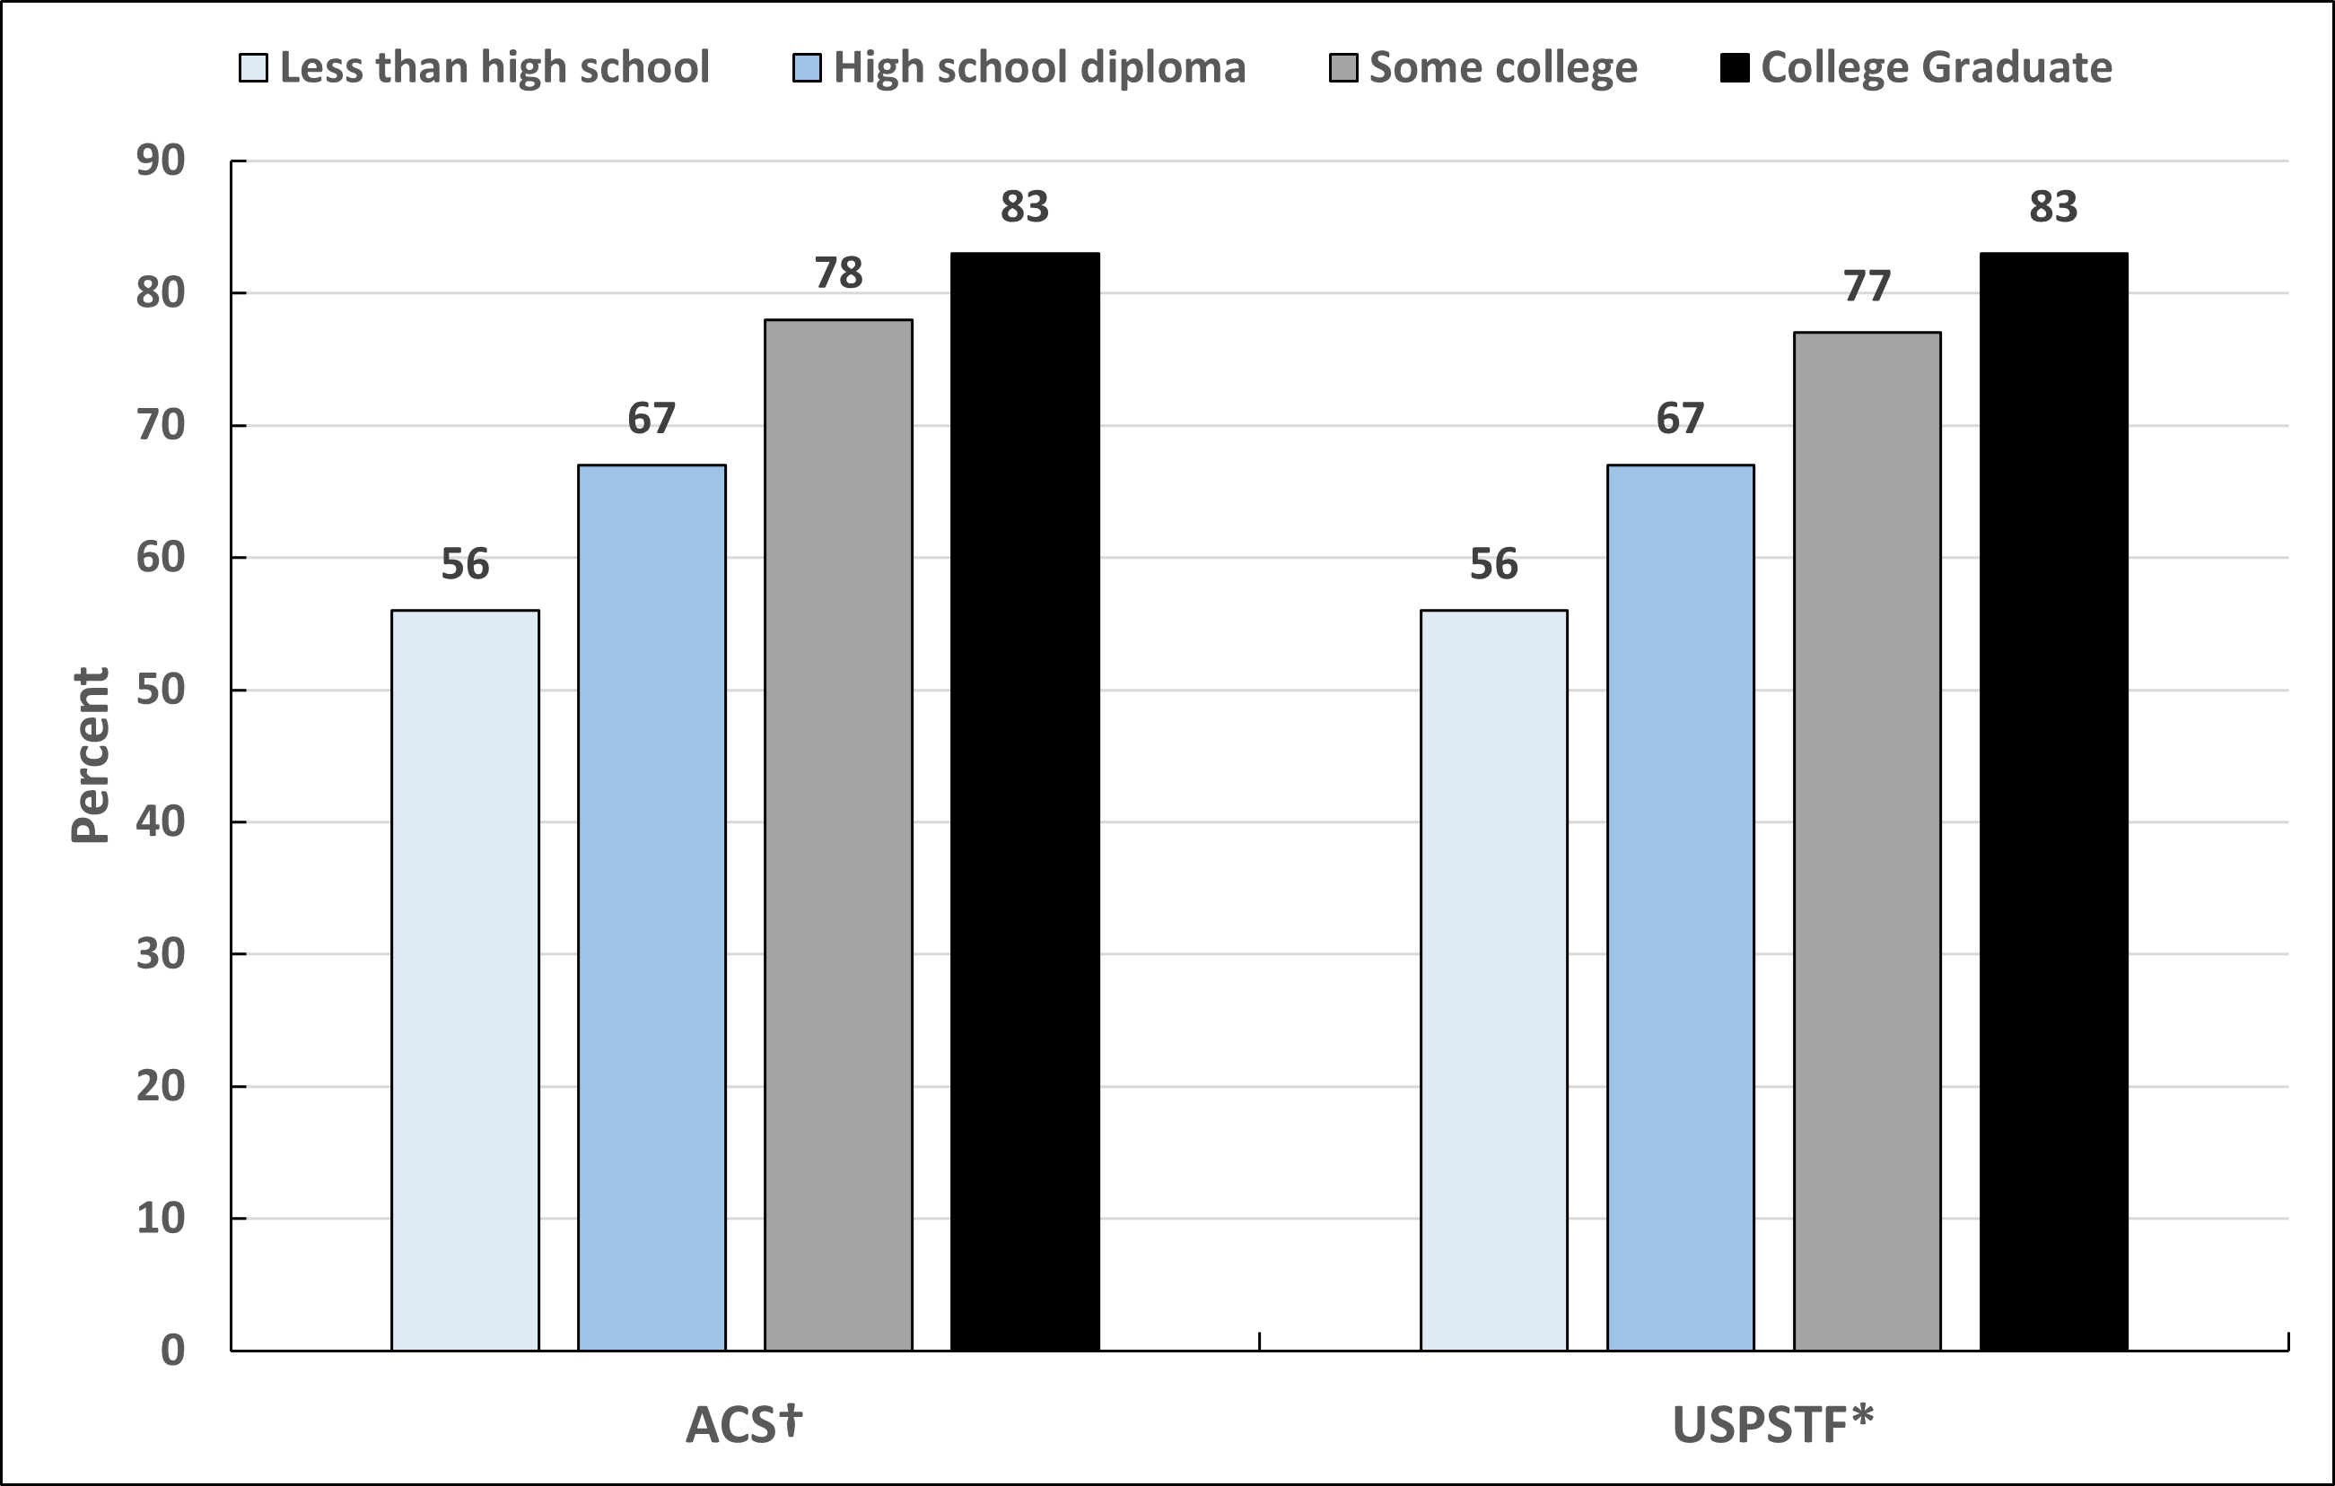
Up-to-date Cervical Cancer Screening, Females 25-65 Years, by Education, US, 2021
ACS-American Cancer Society, USPSTF-United States Preventive Services Task Force. Respondents' sex was self-reported. Estimates are among females who have not had a hysterectomy. †Pap test in the past 3 years OR Pap test and HPV test within the past 5 years among females 25-65 years. ACS estimates are age-adjusted to the year 2000 US standard population using 4 age groups: 25-29, 30-39, 40-49, and 50-65 years. *Pap test in the past 3 years among females 21-65 years OR Pap test and HPV test within the past 5 years among females 30-65 years. For education, USPSTF estimates are adjusted using the 25-65 age adjustment above. Primary HPV testing estimates are not available due to questionnaire limitations.
Source: National Health Interview Survey, 2021.
Notes:
- Estimate for “Some college” includes those with an Associate’s degree.

Slide 35
Colorectal Cancer Screening Guidelines For People with Average Risk
Population | Test or Procedure | Recommendation
Men and women, ages 45+ | Guaiac-based fecal occult blood test (gFOBT) with at least 50% sensitivity or fecal immunochemical test (FIT) with at least 50% sensitivity, OR | Annually
 | Multi-target stool DNA test, OR | Every 3 years
 | Flexible sigmoidoscopy (FSIG), OR | Every 5 years alone, or consideration can be given to combining FSIG performed every 5 years with a highly sensitive gFOBT or FIT performed annually
 | Colonoscopy, OR | Every 10 years
 | CT Colonography | Every 5 years
All positive tests (other than colonoscopy) should be followed up with colonoscopy.
Visit www.cancer.org for more information about the American Cancer Society Guidelines for the Early Detection of Cancer.
Source: Wolf AMD, Fontham ETH, Church TR, et al. Colorectal cancer screening for average-risk adults: 2018 guideline update from the American Cancer Society. CA Cancer J Clin. 2018;68(4):250-281. doi:10.3322/caac.21457.

Slide 36
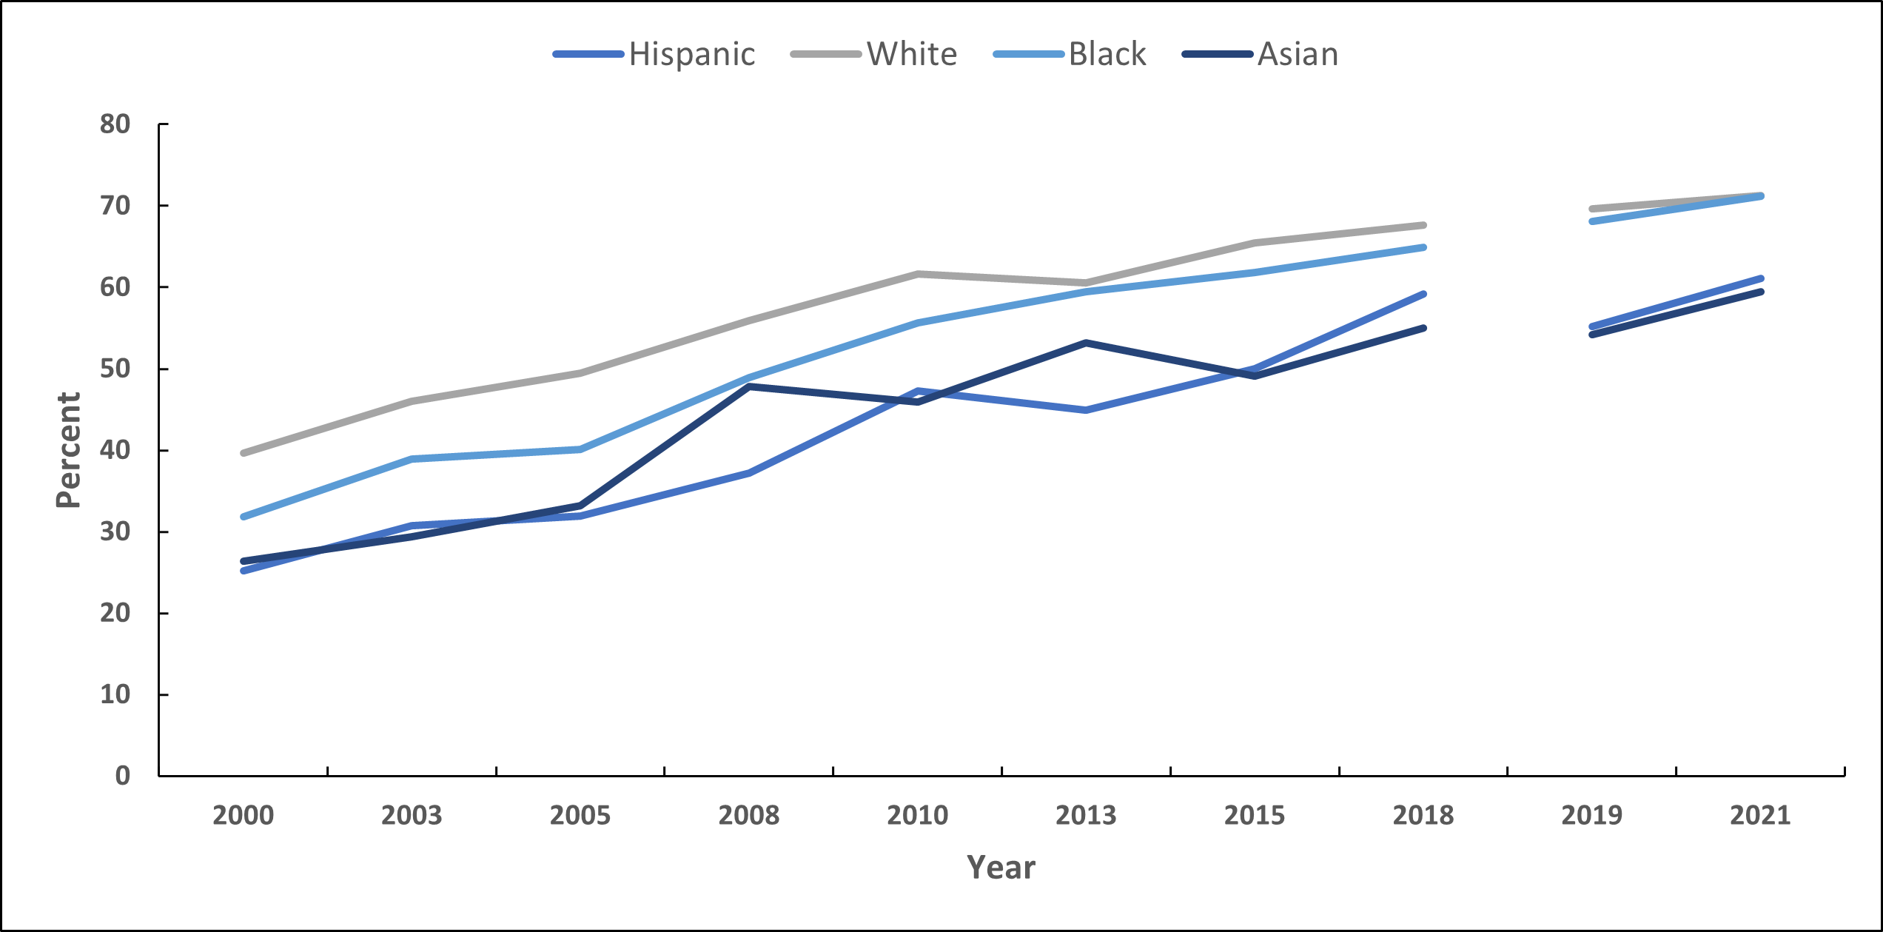
Trends in Colorectal Cancer Screening, Adults 50 Years and Older, by Race/Ethnicity, US, 2000-2021
Estimates are age-adjusted to the year 2000 US standard population using two age groups: 50-64 and 65+ years. The NHIS underwent a significant redesign in 2019 preventing comparability to prior years indicated by the line break. Colorectal cancer screening is defined as colonoscopy, sigmoidoscopy, and stool-testing in the past 10, 5, and 1 years; CT colonography in the past 5 years (2010-on); sDNA in the past 3 years (2018-on) among adults 50+ years.
Source: National Health Interview Survey, 2000-2021.

Slide 37
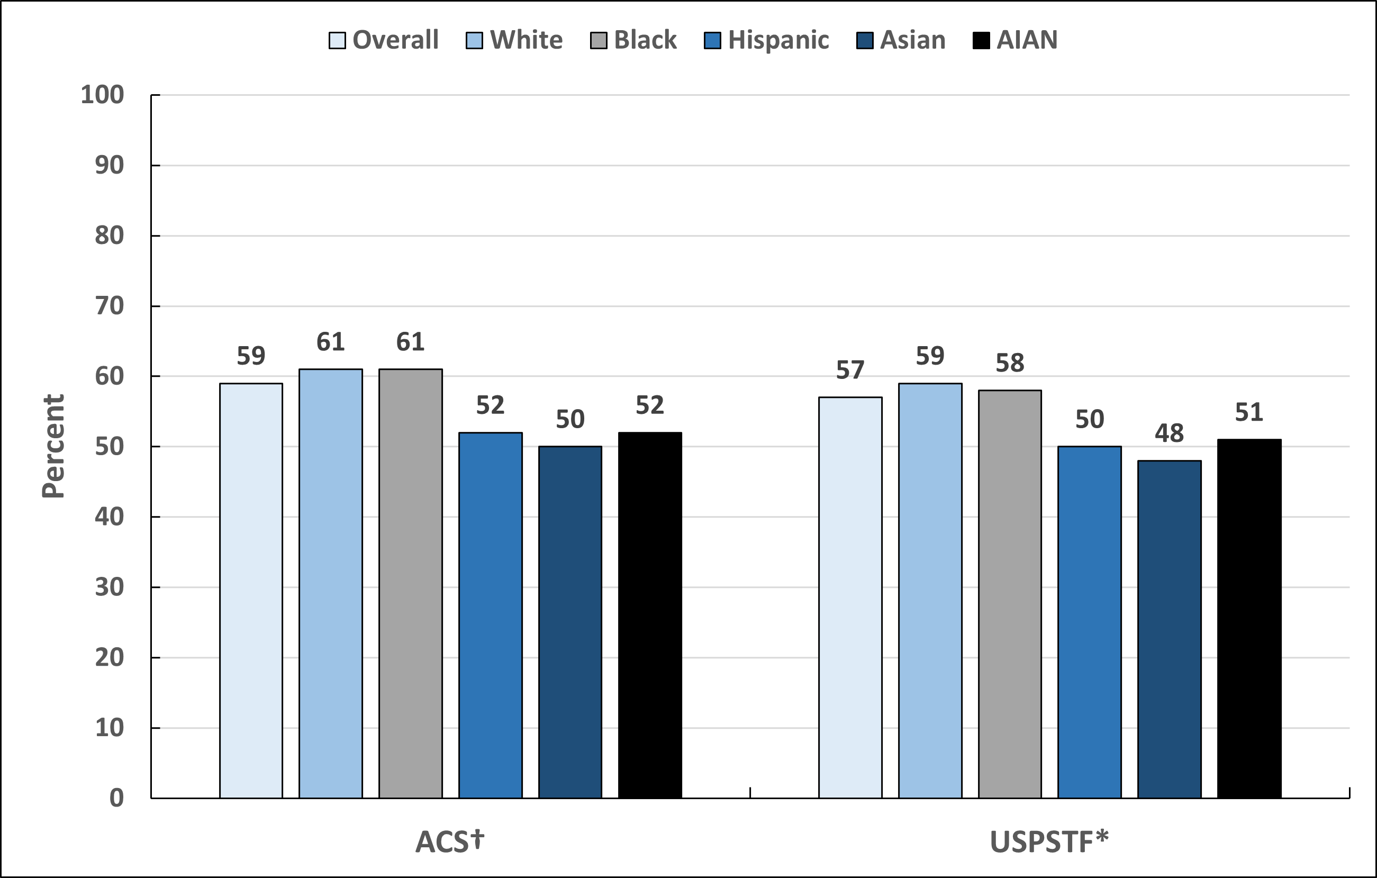
Up-to-date Colorectal Cancer Screening by Race/Ethnicity, Adults 45 Years and Older, US, 2021
ACS-American Cancer Society, USPSTF-United States Preventive Services Task Force. AIAN-American Indian or Alaska Native. †Age ≥45 years: FOBT/FIT, sigmoidoscopy, colonoscopy, computed tomography (CT) colonography, OR sDNA test in the past 1, 5, 10, 5 and 3 years, respectively. ACS estimates are age adjusted to the year 2000 US standard population using three age groups: 45-49, 50-64, and ≥65 years. *For ages 45-75: FOBT/FIT, sigmoidoscopy, colonoscopy, computed tomography (CT) colonography, OR sDNA test in the past 1, 5, 10, 5 and 3 years, respectively, OR sigmoidoscopy in past 10 years with FOBT/FIT in past 1 year. USPSTF estimates are age adjusted using three age groups: 45-49, 50-64, and 65-75 years.
Source: National Health Interview Survey, 2021.

Slide 38
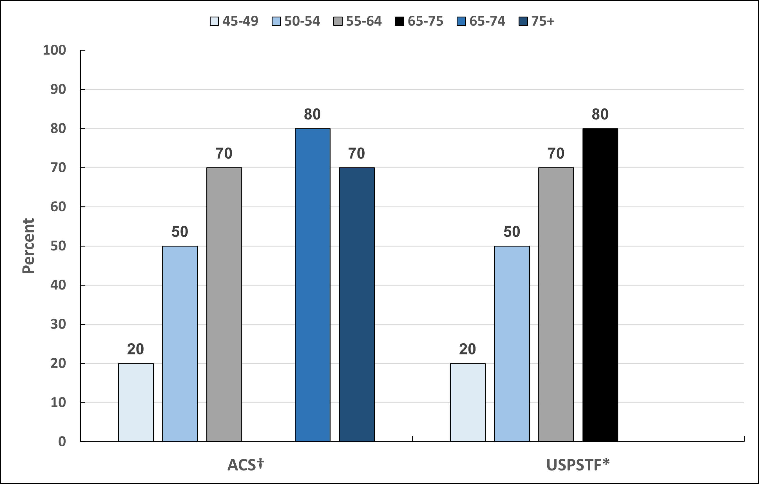
Up-to-date Colorectal Cancer Screening by Age, Adults 45 Years and Older, US, 2021
ACS-American Cancer Society, USPSTF-United States Preventive Services Task Force. †Age ≥45 years: FOBT/FIT, sigmoidoscopy, colonoscopy, computed tomography (CT) colonography, OR sDNA test in the past 1, 5, 10, 5 and 3 years, respectively. ACS estimates are age adjusted to the year 2000 US standard population using three age groups: 45-49, 50-64, and ≥65 years. *For ages 45-75: FOBT/FIT, sigmoidoscopy, colonoscopy, computed tomography (CT) colonography, OR sDNA test in the past 1, 5, 10, 5 and 3 years, respectively, OR sigmoidoscopy in past 10 years with FOBT/FIT in past 1 year. USPSTF estimates are age adjusted using three age groups: 45-49, 50-64, and 65-75 years.
Source: National Health Interview Survey, 2021.

Slide 39
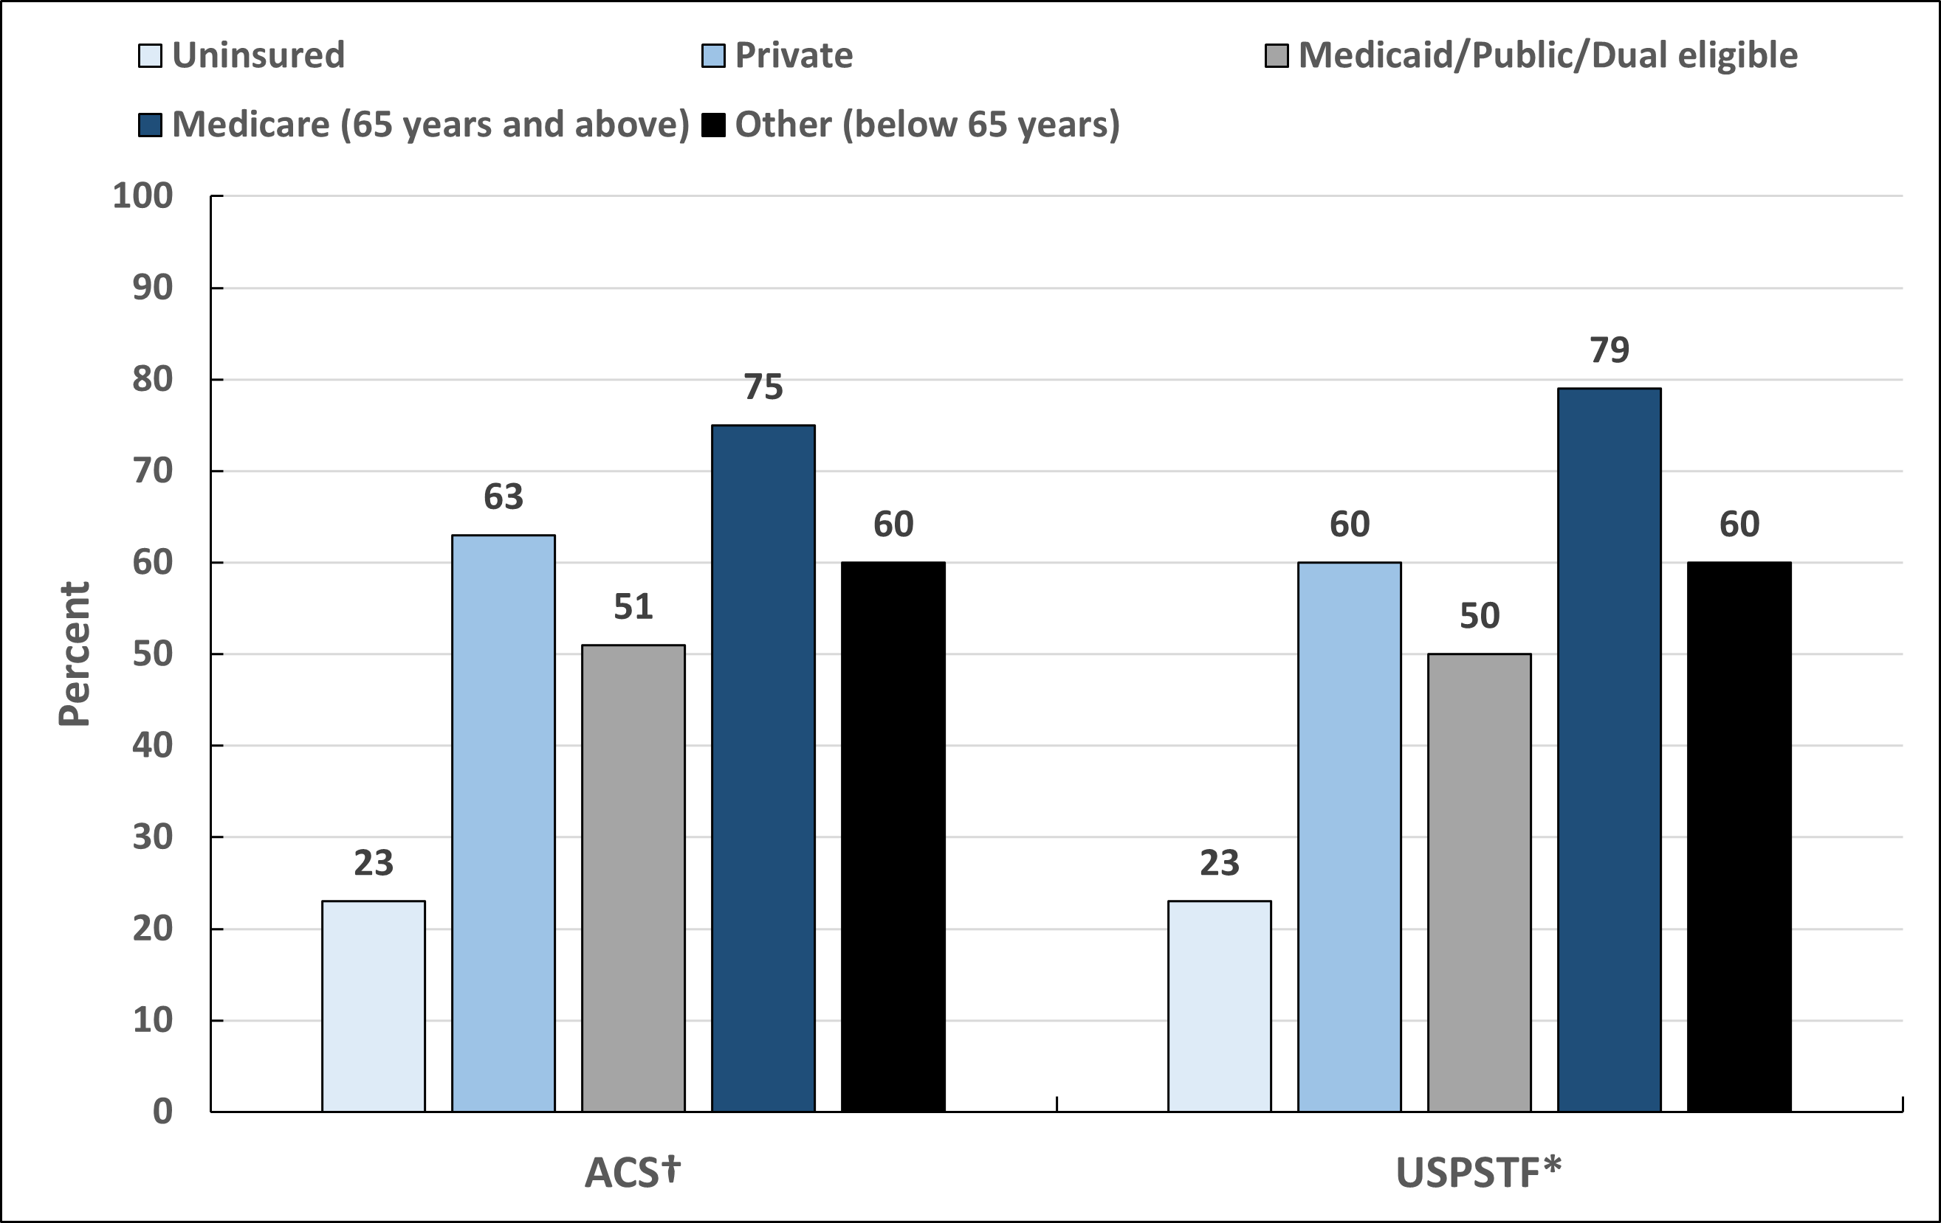
Up-to-date Colorectal Cancer Screening by Insurance, Adults 45 Years and Older, US, 2021
ACS-American Cancer Society, USPSTF-United States Preventive Services Task Force. †Age ≥45 years: FOBT/FIT, sigmoidoscopy, colonoscopy, computed tomography (CT) colonography, OR sDNA test in the past 1, 5, 10, 5 and 3 years, respectively. ACS estimates are age adjusted to the year 2000 US standard population using three age groups: 45-49, 50-64, and ≥65 years. *For ages 45-75: FOBT/FIT, sigmoidoscopy, colonoscopy, computed tomography (CT) colonography, OR sDNA test in the past 1, 5, 10, 5 and 3 years, respectively, OR sigmoidoscopy in past 10 years with FOBT/FIT in past 1 year. USPSTF estimates are age adjusted using three age groups: 45-49, 50-64, and 65-75 years.
Source: National Health Interview Survey, 2021.

Slide 40
Lung Cancer Screening Guidelines
Population | Test or Procedure | Recommendation
Individuals ages 50 to 80 years who currently smoke, or formerly smoked and have a 20 or greater pack-year history of cigarette smoking, are in reasonably good health with at least 5 years of expected longevity | Low-dose helical CT (LDCT) | Annually
Visit www.cancer.org for more information about the American Cancer Society Guidelines for the Early Detection of Cancer.
Source: Wolf AMD, Oeffinger KC, Shih TY, et al. Screening for lung cancer: 2023 guideline update from the American Cancer Society. CA Cancer J Clin. 2024;74(1):50-81. doi:10.3322/caac.21811.

Slide 41
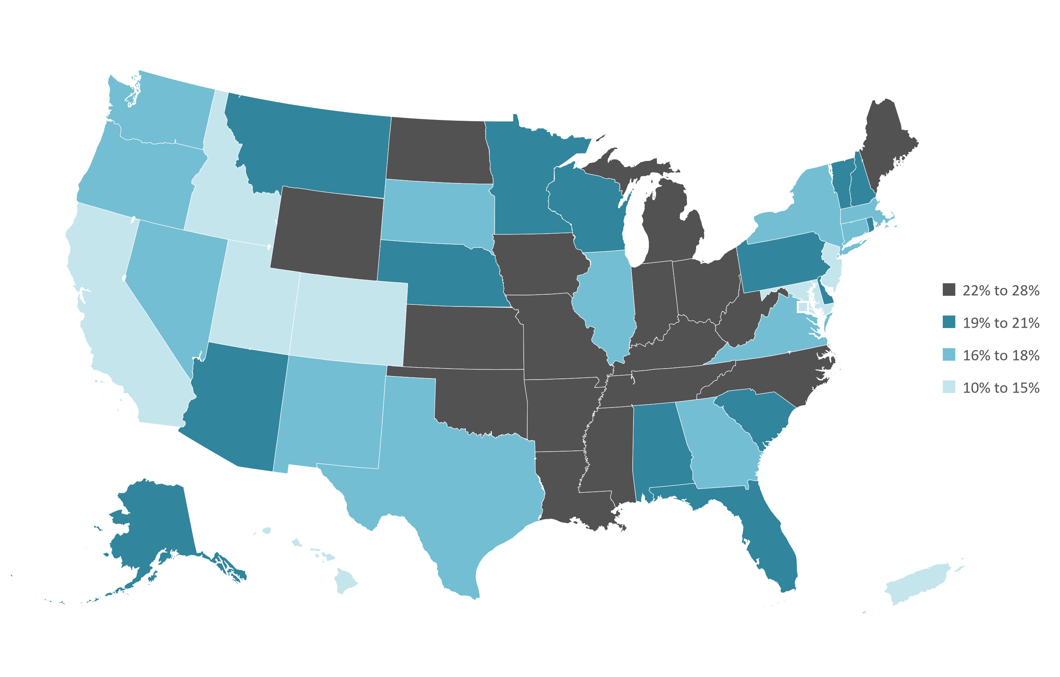
Lung Cancer Screening Eligibility, Adults 50-79 Years, by State, US, 2022
ACS-American Cancer Society. Estimates are crude. The American Cancer Society recommends annual screening for lung cancer with a low-dose CT (LDCT) scan for people aged 50 to 80 years who smoke or used to smoke and have at least a 20 pack-year history of smoking. Due to survey questionnaire limitations, estimates are among individuals ages 50-79 years instead of among ages 50-80 years
Source: Behavioral Risk Factor Surveillance System, 2022.

Slide 42
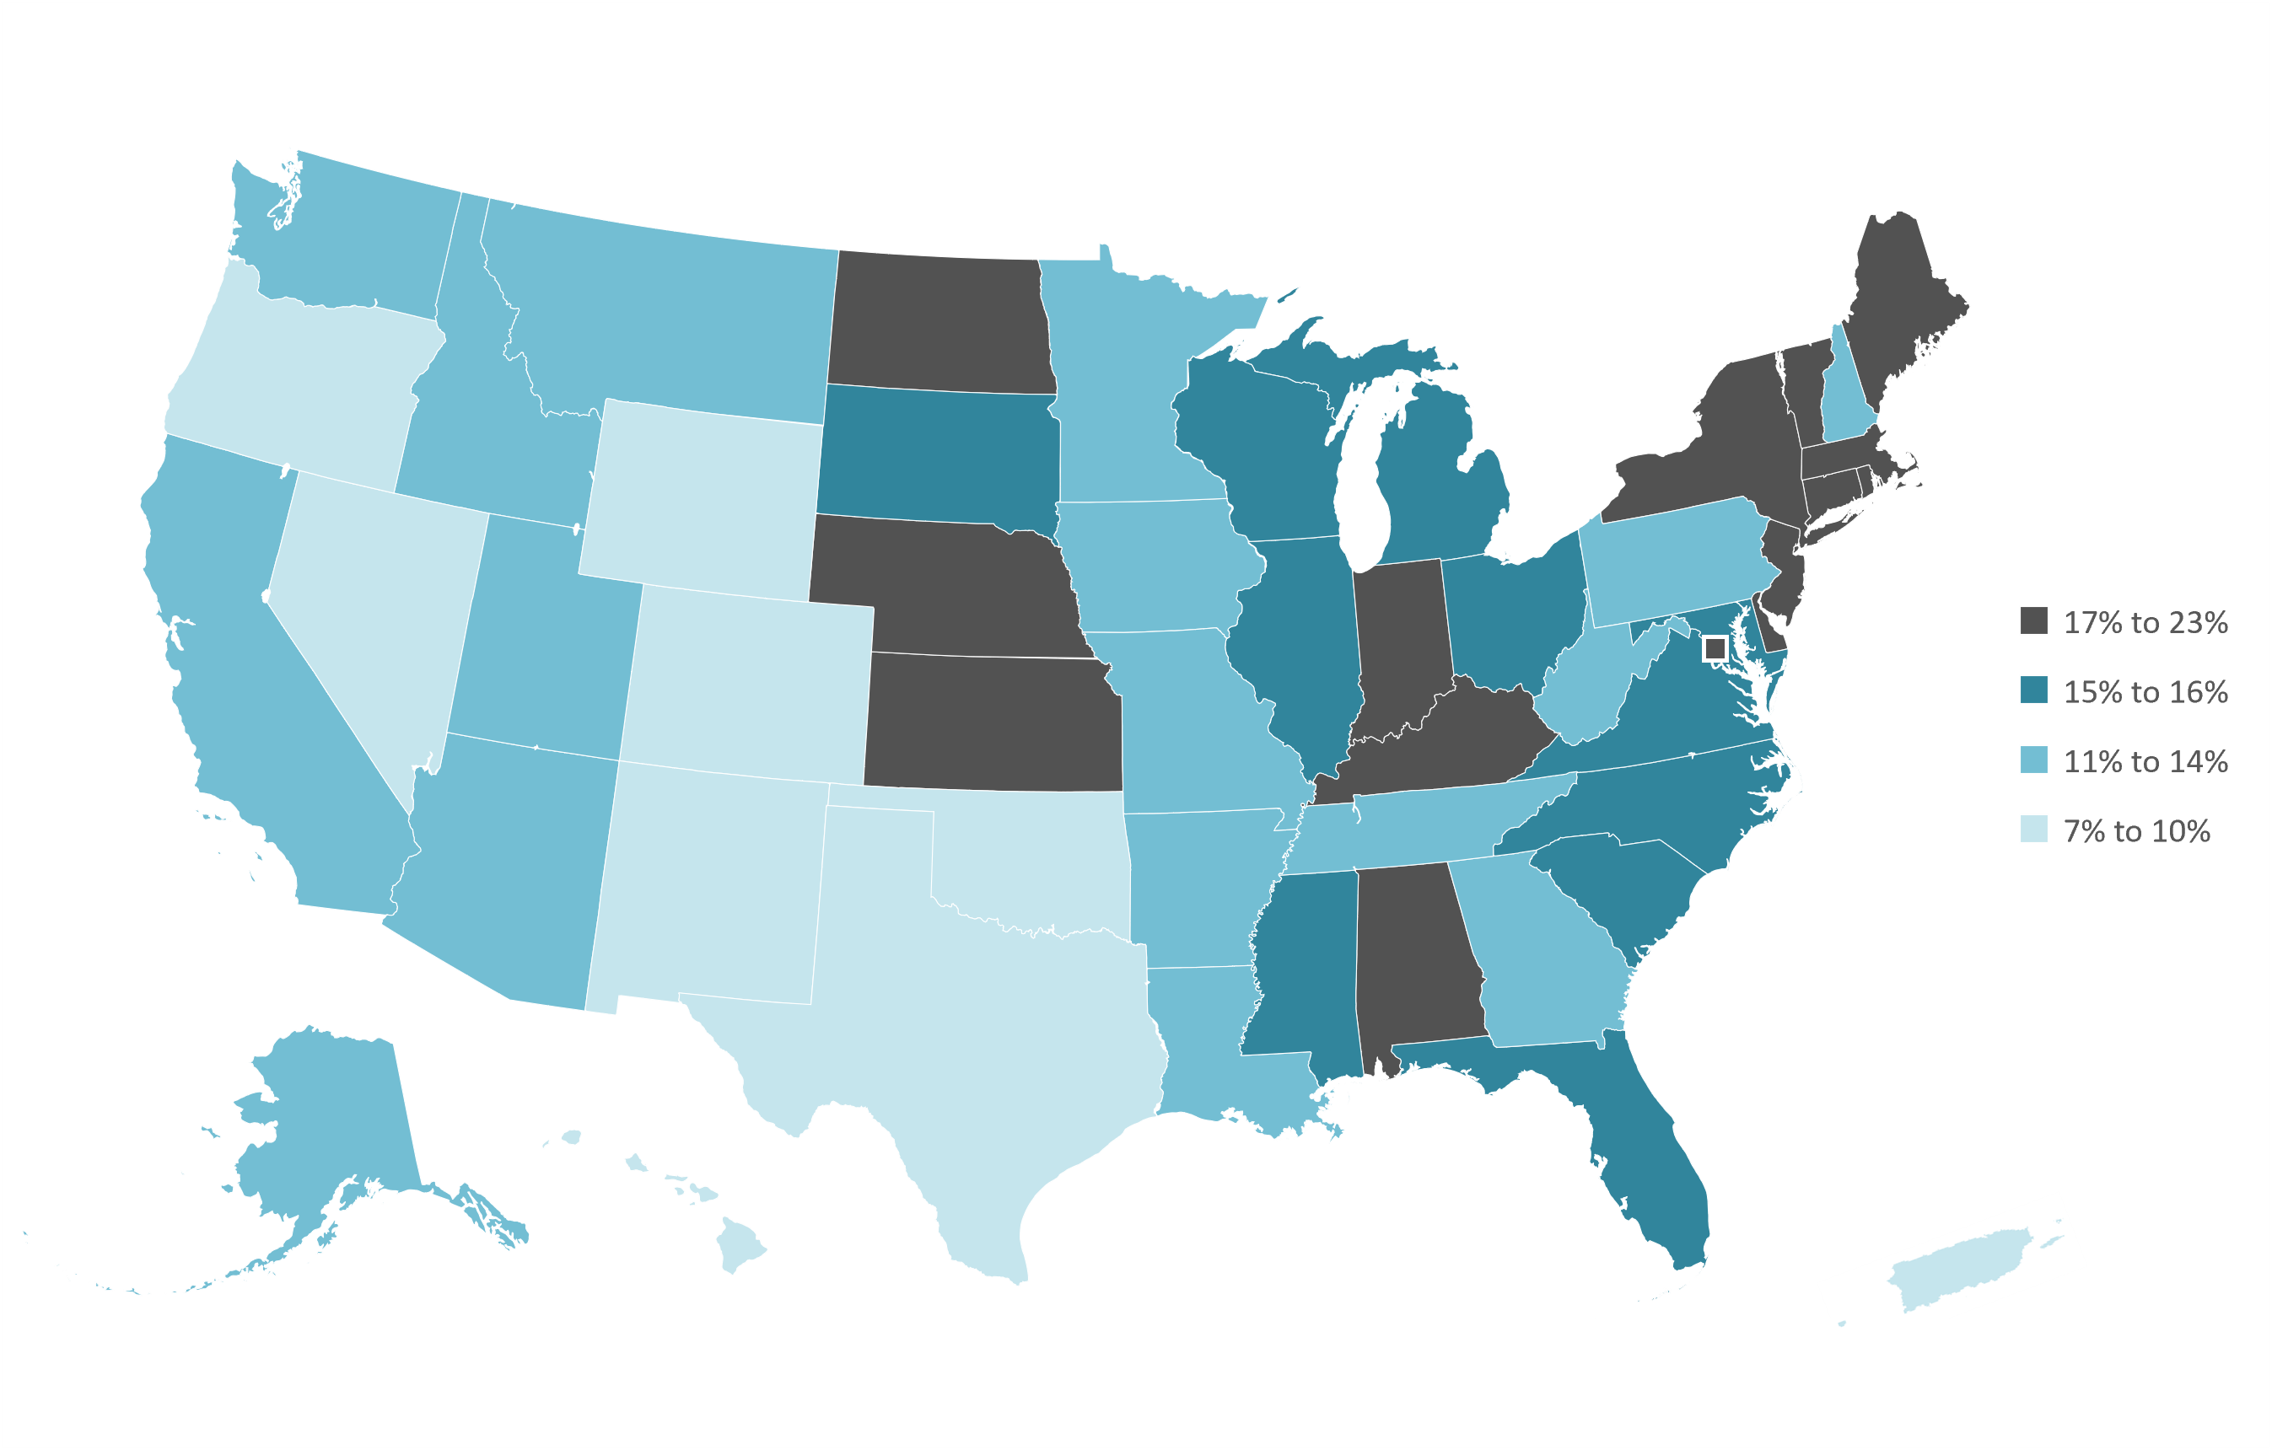
Lung Cancer Screening, Adults 50-79 Years, by State, US, 2022
ACS-American Cancer Society. Estimates are age-adjusted using four age groups: 50-54, 55-59, 60-69, 70-79 years. The American Cancer Society recommends annual screening for lung cancer with a low-dose CT (LDCT) scan for people aged 50 to 80 years who smoke or used to smoke and have at least a 20 pack-year history of smoking. Due to survey questionnaire limitations, estimates are among individuals ages 50-79 years instead of among ages 50-80 years.
Source: Behavioral Risk Factor Surveillance System, 2022.

Slide 43
Prostate Cancer Screening Guidelines Among Average Risk Men
Population | Test or Procedure | Recommendation
Men, ages 50+ | Prostate-specific antigen test with or without digital rectal examination | Men who have at least a 10-year life expectancy should have an opportunity to make an informed decision with their health care provider about whether to be screened for prostate cancer, after receiving information about the potential benefits, risks, and uncertainties associated with prostate cancer screening. Prostate cancer screening should not occur without an informed decision-making process. African American men should have this conversation with their provider beginning at age 45.
Visit www.cancer.org for more information about the American Cancer Society Guidelines for the Early Detection of Cancer.
Source: Wolf AM, Wender RC, Etzioni RB, et al. American Cancer Society guideline for the early detection of prostate cancer: update 2010. CA Cancer J Clin. 2010;60(2):70-98. doi:10.3322/caac.20066.

