Slide 1

A presentation from the American Cancer Society
Cancer Prevention & Early Detection Facts & Figures 2026
Please note that ACS reserves all rights with respect to this publication and the materials provided herein. Any reproduction or re-use of this publication or portions of it, should credit the appropriate edition of the American Cancer Society Annual Cancer Prevention & Early Detection Facts & Figures publication. For permissions, please email the ACS Legal Department at permissionrequest@cancer.org.
Notes:
This slide deck presents the

Slide 2
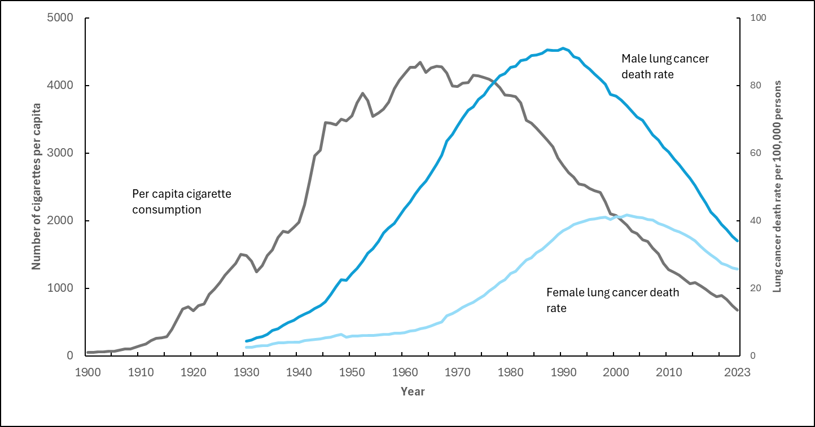

Cancer Prevention & Early Detection Facts & Figures 2026
Tobacco Use and Lung and Bronchus Cancer Death Rates, US, 1900-2023
Rates are age-adjusted to the year 2000 US population standard. Due to changes in ICD coding, numerator information has changed over time. Rates for cancers of the lung and bronchus are affected by these coding changes. Due to changes in disease classification over time, lung and bronchus cancer death rates include cancers of the trachea and pleura.
Sources: Death rate: Cancer Statistics Center. http://cancerstatisticscenter.cancer.org. Accessed January 27, 2026. Cigarette consumption: 1900-1992: Surveillance for Selected Tobacco-Use Behaviors – United States, 1900-1994, 1993-1999: USDA Tobacco Yearbook: Reports 2003-2007. https://usda.library.cornell.edu/concern/publications/z603qx40z?locale=en, 2000-2014: Wang, TW et al. PMID: 27932780. 2014-2023: Adult Tobacco Consumption in the U.S. https://chronicdata.cdc.gov/Policy/Adult-Tobacco-Consumption-In-The-U-S-2000-Present/rnvb-cpxx/about_data.
Notes:
This slide shows per-capita cigarette consumption and lung cancer death rates in males and females between 1900 and 2023. There is a clear relationship over time between cigarette consumption and lung cancer death rates. Male lung cancer death rates in the US peaked in 1990, about 30 years after cigarette consumption peaked in the early 1960s, demonstrating the typical lag time between smoking exposure and lung cancer. Female lung cancer death rates increased more slowly and peaked in 2002.
In 2023, cigarette consumption was at a historical low (comparable to levels observed in 1920s) and male and female lung cancer death rates are declining rapidly, reflecting the progress gained from tobacco control interventions. Such interventions have reduced smoking rates, increased cessation, and are estimated to have averted 3.9 million lung cancer deaths during 1975-2022 (1). Yet, lung cancer is still ranked as the leading cause of cancer death in both males and females in 2025, partly because there is a lag time between smoking exposure and cancer occurrence but also, importantly, because reductions in smoking have been uneven; prevalence remains high in many groups, including individuals with low socioeconomic status, racially minoritized groups including American Indian or Alaska Native and Black individuals, those with mental illness, sexual and gender diverse persons, veterans, and people with disabilities.
(1) Islami F, Nargis N, Liu Q, et al. Averted lung cancer deaths due to reductions in cigarette smoking in the United States, 1970-2022. CA Cancer J Clin. 2025. doi:10.3322/caac.70005.

Slide 3
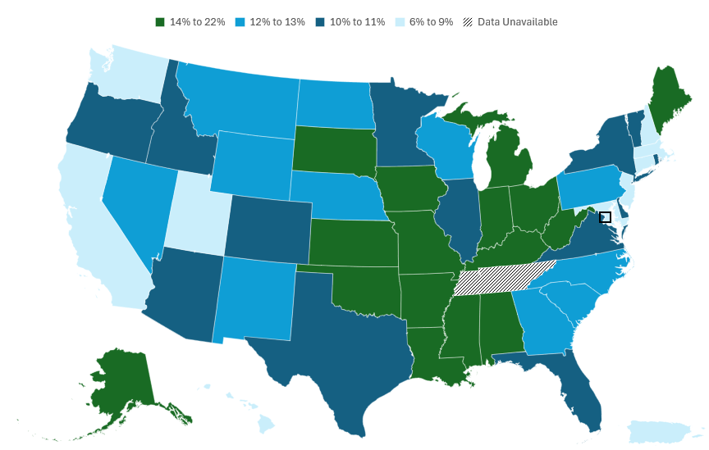
Cancer Prevention & Early Detection Facts & Figures 2026
Current Cigarette Smoking (%), Adults 18 Years and Older, by State, US, 2024
Tennessee was not included in the 2024 Behavioral Risk Factor Surveillance System due to insufficient data. Estimates are age adjusted to the year 2000 US population standard using 5 age groups: 18-24, 25-34, 35-44, 45-64, and >65 years. Current cigarette smoking is defined as ever smoked 100 cigarettes in lifetime and now smoke every day or some days. State grouping was based on quartiles of the prevalence distribution.
Source: Behavioral Risk Factor Surveillance System, 2024.
Notes:
This slide presents current cigarette smoking prevalence in adults across US states, DC, and PR in 2024.
Smoking prevalence varied widely across states in 2024 (lowest in Utah - 6% and highest in West Virginia - 22%); most states with smoking prevalence above the median were in the Southern and Midwestern regions.

Slide 4
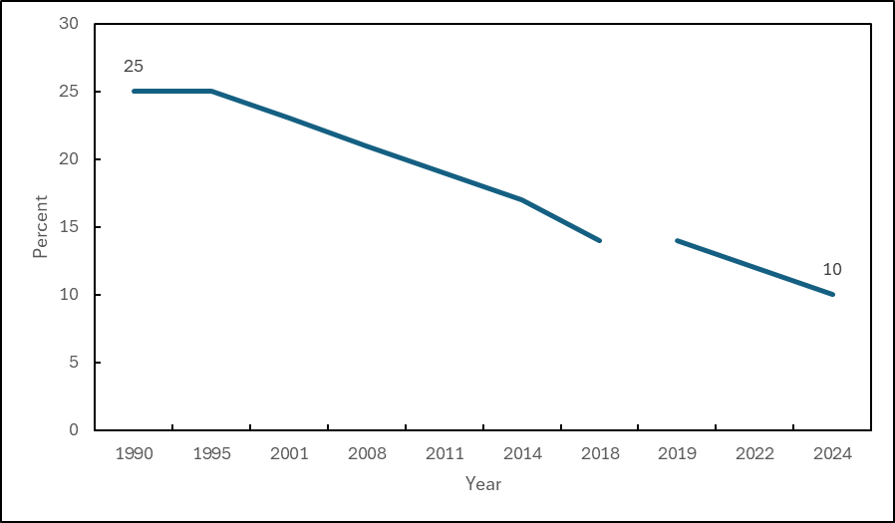
Cancer Prevention & Early Detection Facts & Figures 2026
Current Cigarette Smoking Prevalence (%), Adults 18 Years and Older, US, 1990-2024
Estimates are age adjusted to the year 2000 US population standard using 5 age groups: 18-24, 25-34, 35-44, 45-64, and ≥65 years. The National Health Interview Survey underwent a significant redesign in 2019, preventing comparability to prior years, as indicated by the line break. Current cigarette smoking is defined as ever smoked 100 cigarettes in lifetime and now smoke every day or some days.
Sources: National Center for Health Statistics, 2019. National Health Interview Survey, 2019, 2022, and 2024.
Notes:
This slide shows current cigarette smoking prevalence trends between 1990 and 2024 in US adults. The prevalence of current smoking in 2024 was 10%, a 76% relative decline in smoking prevalence since its peak level of 42% in 1965. Overall, smoking prevalence declined relatively by 60% between 1990 and 2024 (from 25% to 10%).

Slide 5
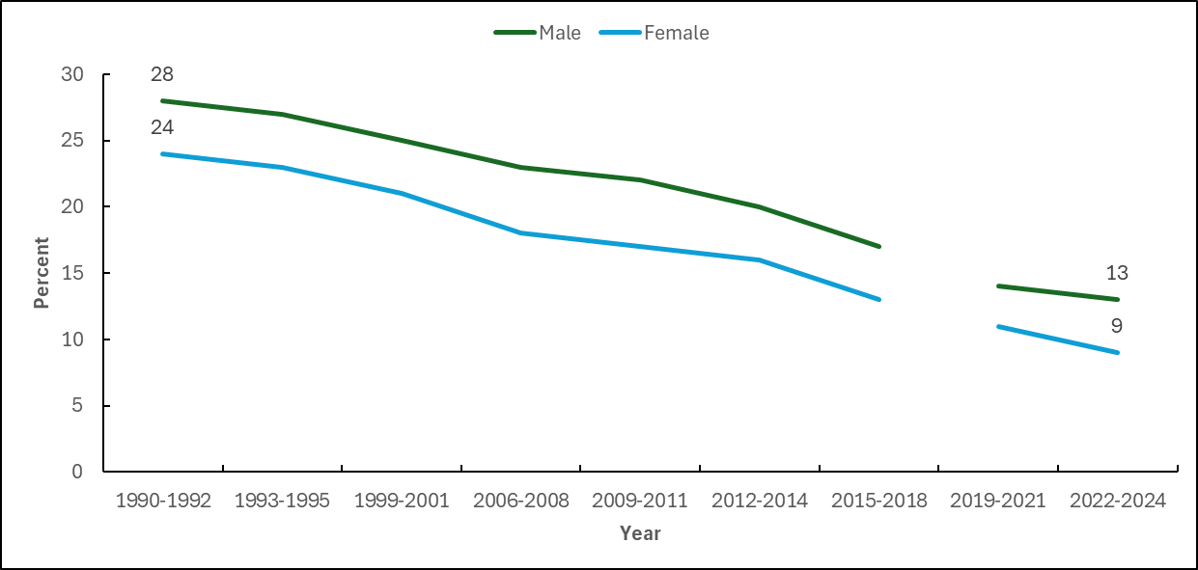
Cancer Prevention & Early Detection Facts & Figures 2026
Current Cigarette Smoking Prevalence (%), Adults 18 Years and Older, by Sex, US, 1990-2024
Estimates are age adjusted to the year 2000 US population standard using 5 age groups: 18-24, 25-34, 35-44, 45-64, and ≥65 years. The National Health Interview Survey underwent a significant redesign in 2019, preventing comparability to prior years, as indicated by the line break. Annual data were combined to increase statistical reliability of subgroup estimates. Current cigarette smoking is defined as ever smoked 100 cigarettes in lifetime and now smoke every day or some days.
Sources: National Center for Health Statistics, 2019. National Health Interview Survey, 2015-2024.
Notes:
This slide shows current cigarette smoking prevalence trends between 1990-1992 and 2022-2024 in US adults, by sex. The prevalence of current smoking in 2024 was 13% in males and 9% in females. Overall, smoking prevalence declined relatively between 1990-1992 and 2022-2024 by 54% in males (from 28% to 13%), and by 63% in females (from 24% to 9%).

Slide 6
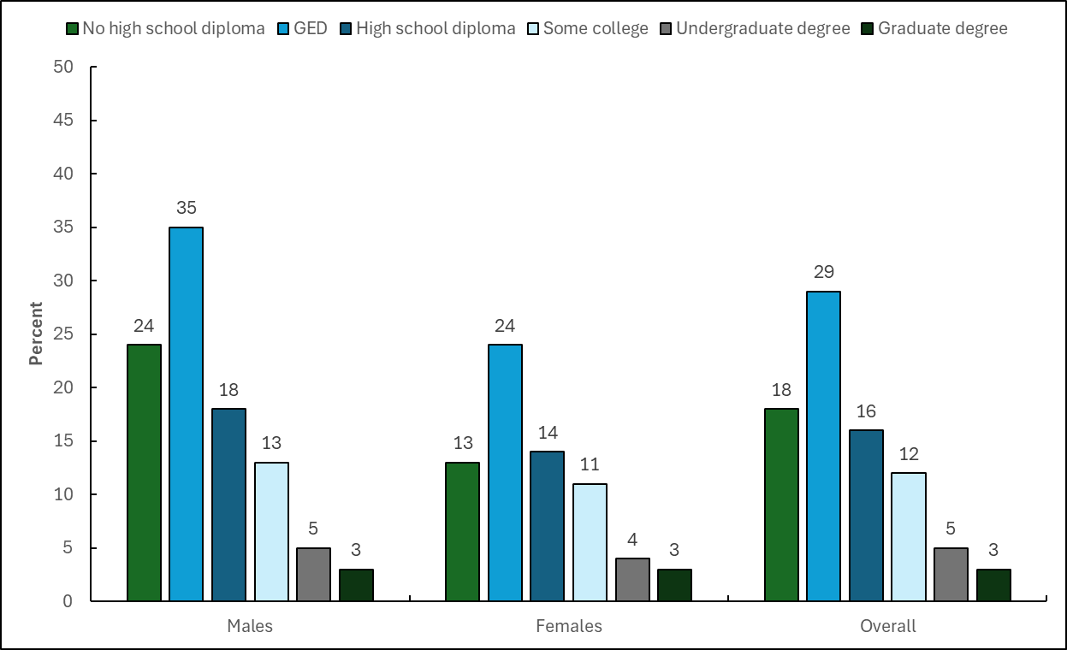
Cancer Prevention & Early Detection Facts & Figures 2026
Current Cigarette Smoking (%), Adults 25 Years and Older, by Education Level, US, 2024
GED-General Educational Development high school equivalency. Estimates are age adjusted to the year 2000 US population standard using 4 age groups: 25-34, 35-44, 45-64, and ≥65 years for education. Current cigarette smoking is defined as ever smoked 100 cigarettes in lifetime and currently smoke every day or some days.
Source: National Health Interview Survey, 2024.
Notes:
This slide presents prevalence of current cigarette smoking among US adults in 2024 by educational level. There is a strong gradient in smoking prevalence by education level in both males and females (decreasing prevalence with increasing levels of education). About 29% of individuals with a GED and 18% of those with no high school diploma reported currently smoking compared to just 3% of those with a graduate degree.

Slide 7
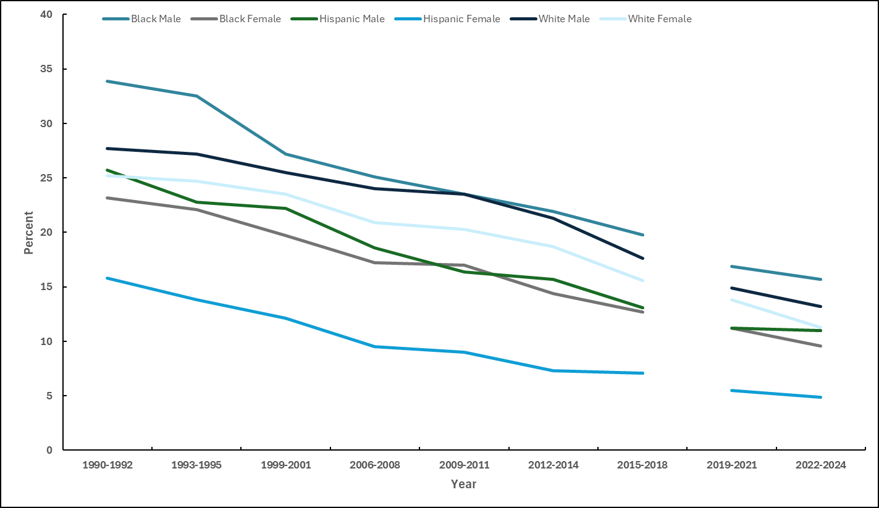
Cancer Prevention & Early Detection Facts & Figures 2026
Current Cigarette Smoking Prevalence (%), Adults 18 Years and Older, by Sex and Race/Ethnicity, US, 1990-2024
Estimates are age adjusted to the year 2000 US population standard using 5 age groups: 18-24, 25-34, 35-44, 45-64, and ≥65 years. The National Health Interview Survey underwent a significant redesign in 2019, preventing comparability to prior years as indicated by the line break. Annual data were combined to increase statistical reliability of subgroup estimates. Current cigarette smoking is defined as ever smoked 100 cigarettes in lifetime and now smoke every day or some days.
Sources: National Center for Health Statistics, 2019. National Health Interview Survey, 2015-2024.
Notes:
This slide presents current cigarette smoking prevalence trends between 1990-1992 and 2022-2024 in US adults, by sex and race/ethnicity categories. There have been historical reductions in cigarette smoking observed in all racial/ethnic groups, though substantial disparities remain, with historically and continuing higher prevalence in Black males.

Slide 8
Cancer Prevention & Early Detection Facts & Figures 2026
Current Use of Selected Tobacco Products (%), High School Students, by Race/Ethnicity, US, 2011-2024
Estimates are crude. Current tobacco use is defined as in the past 30 days. ‡Estimates are statistically unstable and not shown. See Special Notes, page 51 of Cancer Prevention & Early Detection Facts & Figures 2026. Sources: 2024: Jamal A, et al. 2024; 2023: Birdsey J, et al. 2023; 2022: Park-Lee E, et al. 2022; 2021: Gentzke AS, et al. 2022; 2020: Gentzke AS, et al. 2020; 2019: Wang TW, et al, 2019; 2018: Gentzke AS, et al. 2019; 2017: Wang TW, et al. 2018; 2016: Jamal A, et al. 2017; 2015: Singh T, et al. 2016; 2014: Arrazola RA, et al. 2015; 2013: Arrazola RA, et al. 2014; 2011-2012: Centers for Disease Control and Prevention (CDC). 2013.
Notes:
This slide shows trends in prevalence of current use of cigarette smoking, cigar smoking, and e-cigarette use in US high school students between 2011 and 2024. With declines between 2011 and 2024 in cigarette and cigar smoking, e-cigarettes became the most popular tobacco product used by high school students since 2014. Current e-cigarette use prevalence increased to 28% in 2019 and subsequently declined to 7.8% in 2024. In 2024, 1.7% of high school students smoked cigarettes and 1.5% smoked cigars. But there were differences in use patterns and trends by race/ethnicity. Cigarette smoking was typically higher among White and Hispanic students compared to Black students. Cigar use was consistently higher in Black students than in White or Hispanic students. E-cigarette use was generally higher in White and Hispanic students over time but converged across racial/ethnic groups beginning in 2024.

Slide 9
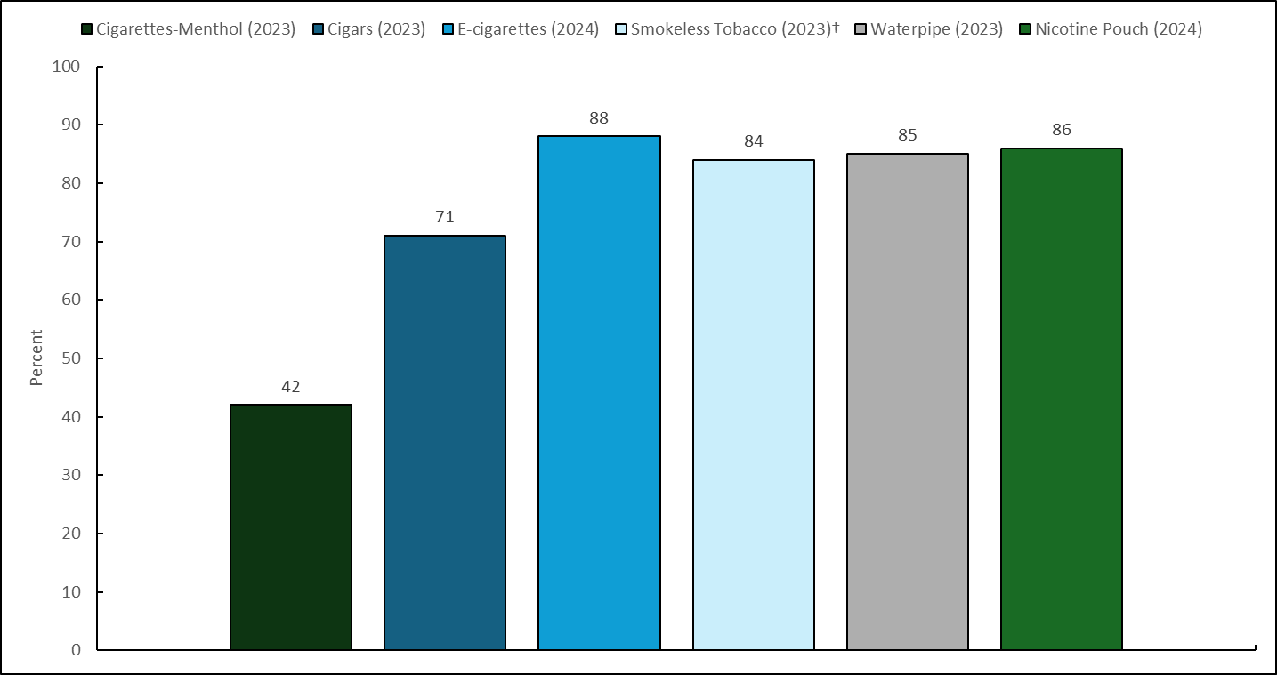
Cancer Prevention & Early Detection Facts & Figures 2026
Flavored Tobacco Use Among Current Tobacco Users (%), High School Students, US, 2023 and 2024
Data from US territories are excluded from national estimates as they were sampled separately. Current tobacco use is defined as in the past 30 days. Flavored tobacco is any flavor other than tobacco-flavored or unflavored among current tobacco users. Reported in 2024 for e-cigarettes, nicotine pouches, and in 2023 for all other products. †Includes chewing tobacco, snuff, dip, and snus.
Sources: Jamal A, et al. 2024. Park-Lee E, et al. 2024. National Youth Tobacco Survey, 2023-2024. Birdsey J, et al. 2023.
Notes:
This slide shows the prevalence of flavored tobacco use among US high school students that currently used tobacco products in 2023 and 2024. Close to 9-in-10 high school students who reported currently using tobacco products used a flavored product, from 42% for cigarettes (menthol) and 71% for cigars to about 90% for e-cigarettes and nicotine pouches.

Slide 10
Cancer Prevention & Early Detection Facts & Figures 2026
Obesity and Severe Obesity Trends (%), Adults 20+ Years, by Sex, US, 1988-August 2023
BMI-Body mass index. For adults (ages 20+ years), obesity is a BMI at or above 30.0 kg/m2, and severe obesity is a BMI at or above 40.0 kg/m2. Pregnant females are excluded from the analysis. Estimates are age adjusted to the year 2000 US population standard using 3 age groups: 20-39, 40-59, and ≥60 years.
Sources: Fryar CD, et al. 2020. National Health and Nutrition Examination Survey, 2017-August 2023.
Notes:
This slide presents trends in prevalence of obesity and severe obesity in US Adults 20+ years by sex, between 1988-1994 to August 2021-August 2023. Obesity prevalence has markedly increased over time; prevalence during August 2021-August 2023 was nearly 2 times higher in both males (39%) and females (41%) compared to 1988-1994 (males: 20%, females: 25%). Severe obesity among females increased more than 3-fold, rising from 4% during 1988-1994 to 13% during August 2021-August 2023, compared to an almost 4-fold increase from 2% to 7% in males over this period.

Slide 11
Cancer Prevention & Early Detection Facts & Figures 2026
Obesity Trends (%), Children and Adolescents 2-19 Years, by Sex, US, 1988-August 2023
BMI-Body mass index. Estimates are crude. For ages 2-19 years, BMI is based on percentile rankings of the individual’s height and weight on the CDC age- and sex-specific growth charts. BMIs at or above the 95th percentile (top 5%) are classified as obese.
Sources: Fryar CD, et al. 2020. National Health and Nutrition Examination Survey, August 2021-August 2023.
Notes:
This slide shows obesity prevalence trends between 1988-1994 and August 2021-August 2023 by age-group, among US children and adolescents 2-19 years. Obesity prevalence among youth ages 2-19 years was 21% (males: 23%, females: 19%) in August 2021-August 2023, more than doubling from 10% in 1988-1994. Prevalence increased from 7% to 15% in ages 2-5 years and from 11% to 23% in both ages 6-11 years and 12-19 years.

Slide 12
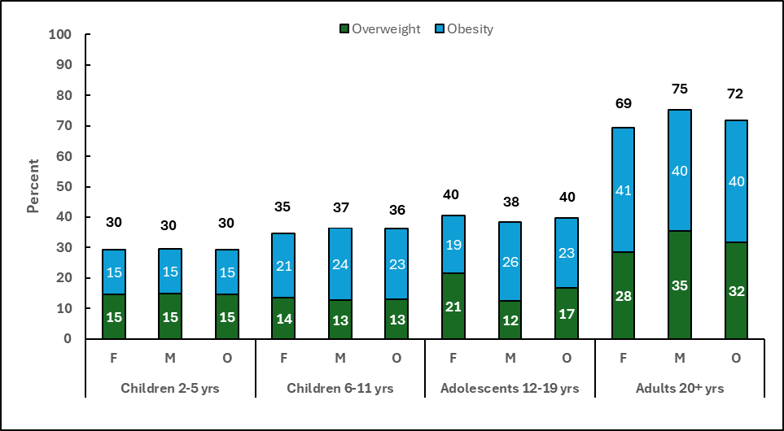
Cancer Prevention & Early Detection Facts & Figures 2026
Overweight and Obesity (%), Youth and Adults, US, August 2021-August 2023
BMI-Body mass index. F-females, M-males, O-overall. For youth (ages 2-19 years), BMI is based on percentile rankings of the individual’s height and weight on age- and sex-specific growth charts; BMIs between the top 85th and <95th percentile are considered overweight, and BMIs at or above the 95th percentile (top 5%) are classified as obese. Estimates are crude. For adults (ages 20+ years), a BMI of 25.0 to <30.0 kg/m2 is overweight, and a BMI of ≥30.0 kg/m2 is obese. Excess body weight is a BMI of ≥25.0 kg/m2. Estimates for ages 20+ are age adjusted to the year 2000 US population standard using 5 age groups: 20-34, 35-44, 45-54, 55-64, and ≥65 years.
Source: National Health and Nutrition Examination Survey, August 2021-2023.
Notes:
This slide presents prevalence of overweight and obesity, overall, by sex, and by age-group.

Slide 13
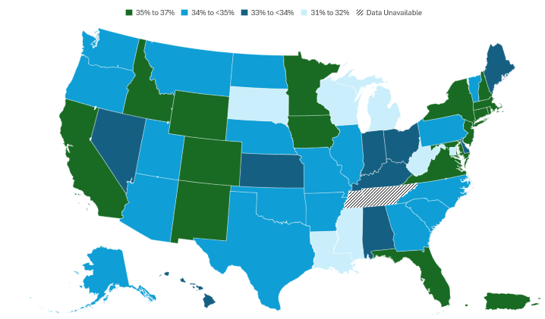
Cancer Prevention & Early Detection Facts & Figures 2026
Overweight (%), Adults 18 Years and Older, by State, US, 2024
Overweight is defined as a body mass index ≥25.00 kg/m2 to <30.00 kg/m2. Tennessee was not included in the 2024 Behavioral Risk Factor Surveillance System due to insufficient data. Estimates are age adjusted to the year 2000 US population standard using 5 age groups: 18-24, 25-34, 35-44, 45-64, and ≥65 years.
Source: Behavioral Risk Factor Surveillance System, 2024.
Notes:
This slide presents prevalence of overweight (body mass index ≥25.0 kg/m2 to <30.0 kg/m2) in adults across US states, DC and PR in 2024. In 2024, overweight prevalence ranged from 31% in South Dakota to 37% in New Hampshire, New Jersey, Colorado, and New Mexico, with a state median of 36% in the Northeast, 34% in the West, 34% in the Midwest, and 34% in the South.

Slide 14
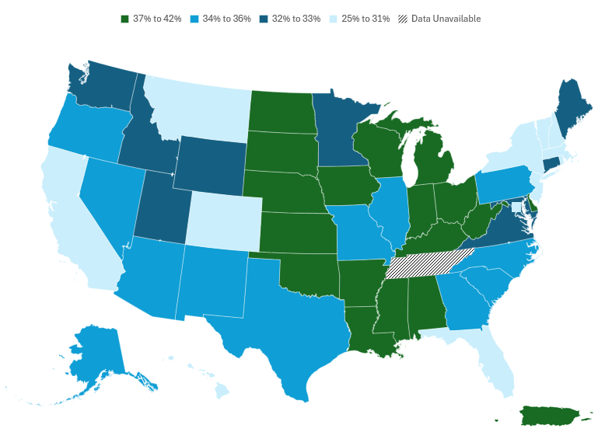
Cancer Prevention & Early Detection Facts & Figures 2026
Obesity (%), Adults 18 Years and Older, by State, US, 2024
Obesity is defined as a body mass index ≥30.00 kg/m2. Tennessee was not included in the 2024 Behavioral Risk Factor Surveillance System due to insufficient data. Estimates are age adjusted to the year 2000 US population standard using 5 age groups: 18-24, 25-34, 35-44, 45-64, and ≥65 years.
Source: Behavioral Risk Factor Surveillance System, 2024.
Notes:
This slide presents prevalence of obesity (body mass index ≥30.0 kg/m2) in adults across US states, DC and PR in 2024. In 2024, obesity prevalence ranged from 25% in Colorado to 42% in West Virginia, with a state median of 31% in the Northeast, 33% in the West, 38% in the Midwest, and 37% in the South.

Slide 15
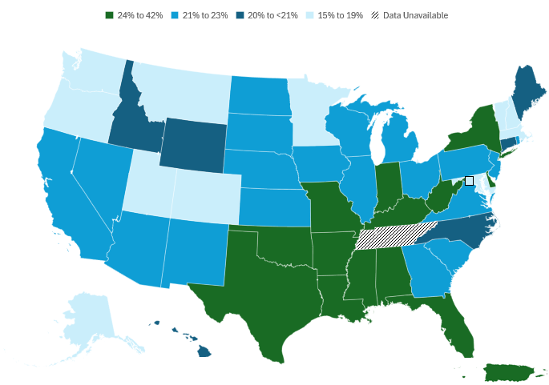
Cancer Prevention & Early Detection Facts & Figures 2026
No Leisure-time Physical Activity (%), Adults 18 Years and Older, by State, US, 2024
Tennessee was not included in the 2024 Behavioral Risk Factor Surveillance System due to insufficient data. Estimates are age adjusted to the year 2000 US population standard using 5 age groups: 18-24, 25-34, 35-44, 45-64, and ≥65 years. No leisure-time physical activity in the past month.
Source: Behavioral Risk Factor Surveillance System, 2024.
Notes:
This slide presents prevalence of reporting no leisure-time physical activity in adults across US states, DC and PR in 2024. In 2024, Puerto Rico had the highest proportion of no leisure-time physical activity in adults (42%), while Vermont, District of Columbia, and Colorado had the lowest (15%). In 2024, states with high prevalence of no leisure-time physical activity often had a high prevalence of obesity, particularly in the South and parts of the Midwest.

Slide 16
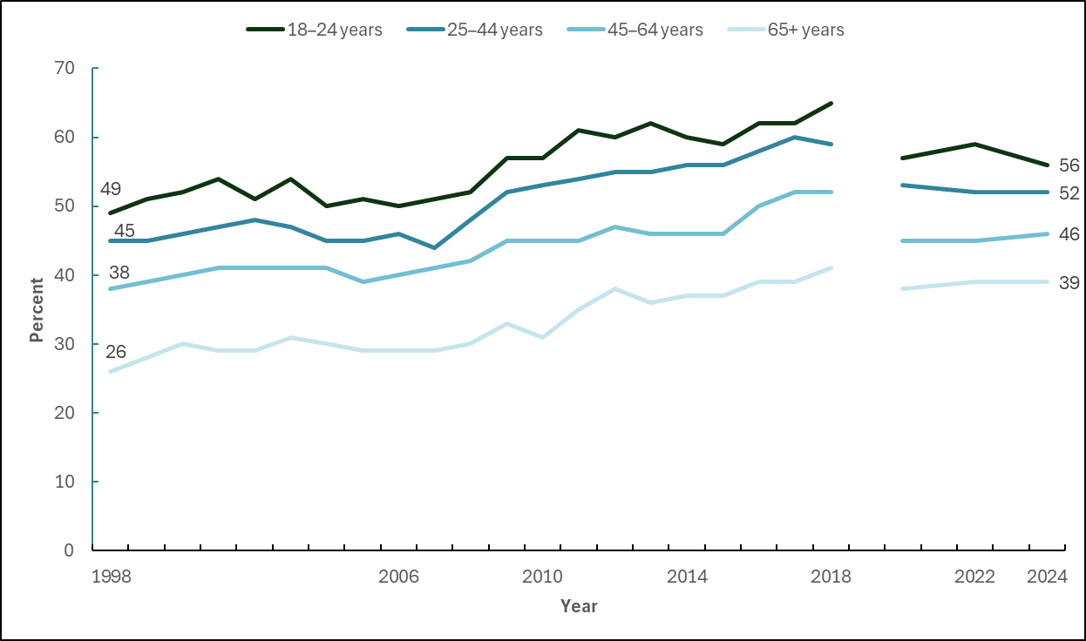
Cancer Prevention & Early Detection Facts & Figures 2026
Trends in Meeting Recommended Levels of Aerobic Physical Activity, Adults 18 Years and Older, US, 1998-2024
Estimates are crude. The NHIS underwent a significant redesign in 2019 preventing comparability to prior years indicated by the line break. Meeting recommended levels of aerobic physical activity is defined as 150 minutes or more of moderate-intensity aerobic activity or 75 minutes or more of vigorous-intensity aerobic activity each week.
Sources: Health, United States, 2019. National Health Interview Survey, 2020, 2022, and 2024.
Notes:
This slide presents prevalence of meeting recommended aerobic physical activity levels in US adults between 1998 and 2024, by age-group. Historically, and in 2024, prevalence of meeting recommended aerobic activity levels decreased with increasing age, with 56% of 18–24-year-old individuals reporting meeting recommended levels compared to 39% of those 65+ years.

Slide 17
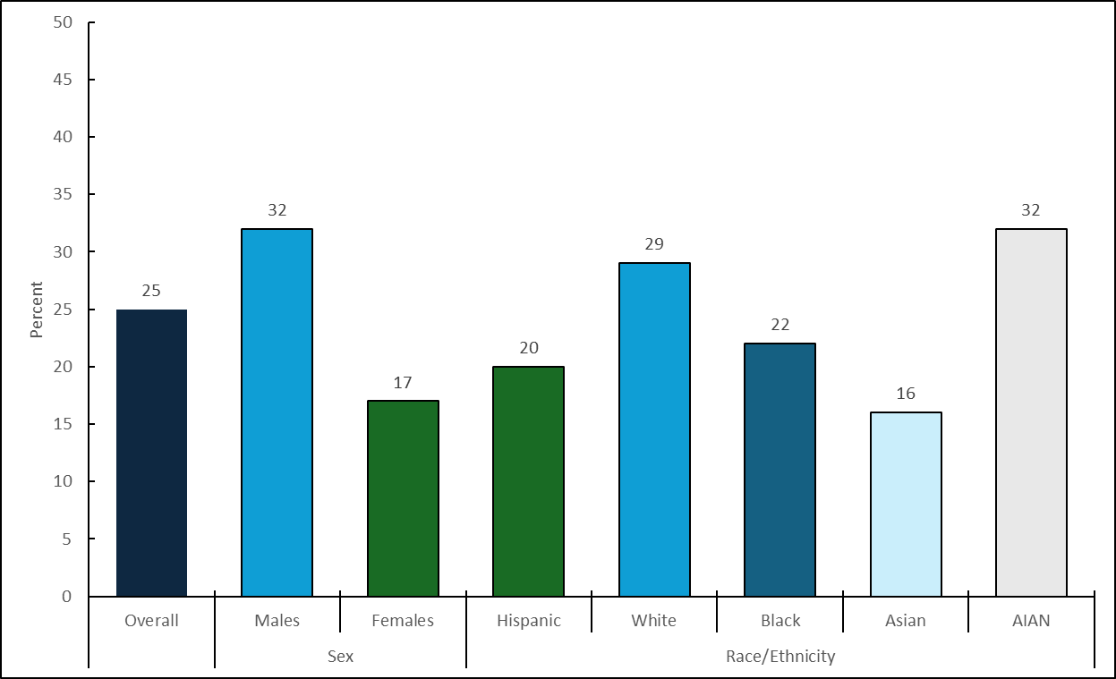
Cancer Prevention & Early Detection Facts & Figures 2026
Met Physical Activity Recommendations (%), High School Students, by Sex and Race/Ethnicity, US, 2023
Estimates are crude. AIAN–American Indian or Alaska Native. Physical activity that increased heart rate and made breathing hard some of the time for a total of ≥60 minutes/day on all 7 days preceding the survey.
Source: Youth Risk Behavior Survey 2023.
Notes:
This slide presents prevalence of meeting recommended physical activity levels among US high school students in 2023, by sex and race/ethnicity categories. About 25% of high school students overall met recommended physical activity levels (32% of males, 17% of females), with prevalence ranging from 32% of American Indian/Alaska Native students, 29% of White students, 22% of Black students, 20% of Hispanic students, and 16% of Asian students.

Slide 18
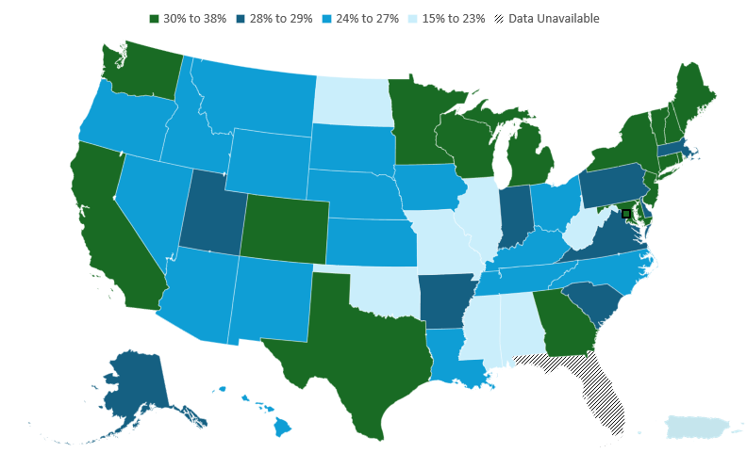
Cancer Prevention & Early Detection Facts & Figures 2026
Fruit Consumption (2+ servings per day, %), Adults 18 Years and Older, by State, US, 2021
Florida was not included in the 2021 Behavioral Risk Factor Surveillance System due to insufficient data. Estimates are age adjusted to the year 2000 US population standard using five age groups: 18-24, 25-34, 35-44, 45-64, and ≥65 years.
Source: Behavioral Risk Factor Surveillance System, 2021.
Notes:
This slide presents prevalence of consuming 2+ servings of fruit per day in adults across US states, DC and PR in 2021. Prevalence varied widely from 15% in Puerto Rico to 38% in the District of Columbia.

Slide 19
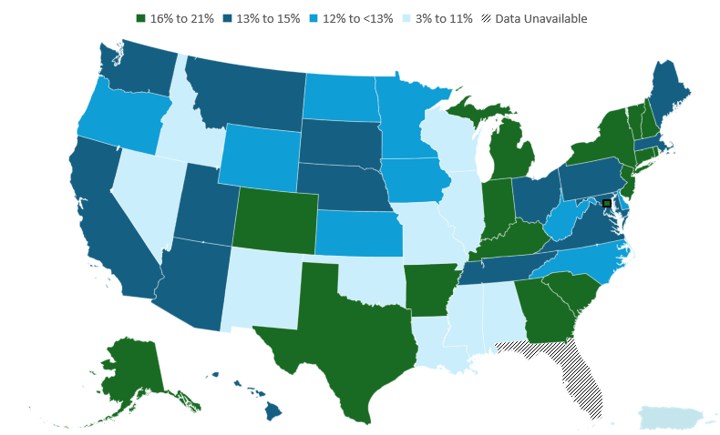
Cancer Prevention & Early Detection Facts & Figures 2026
Vegetable Consumption (3+ servings per day, %), Adults 18 Years and Older, by State, US, 2021
Florida was not included in the 2021 Behavioral Risk Factor Surveillance System due to insufficient data. Estimates are age adjusted to the year 2000 US population standard using five age groups: 18-24, 25-34, 35-44, 45-64, and ≥65 years.
Source: Behavioral Risk Factor Surveillance System, 2021.
Notes:
This slide presents prevalence of consuming 3+ servings of vegetables per day in adults across US states, DC and PR in 2021. Prevalence varied widely from 3% in Puerto Rico to 21% in the District of Columbia and Vermont.

Slide 20
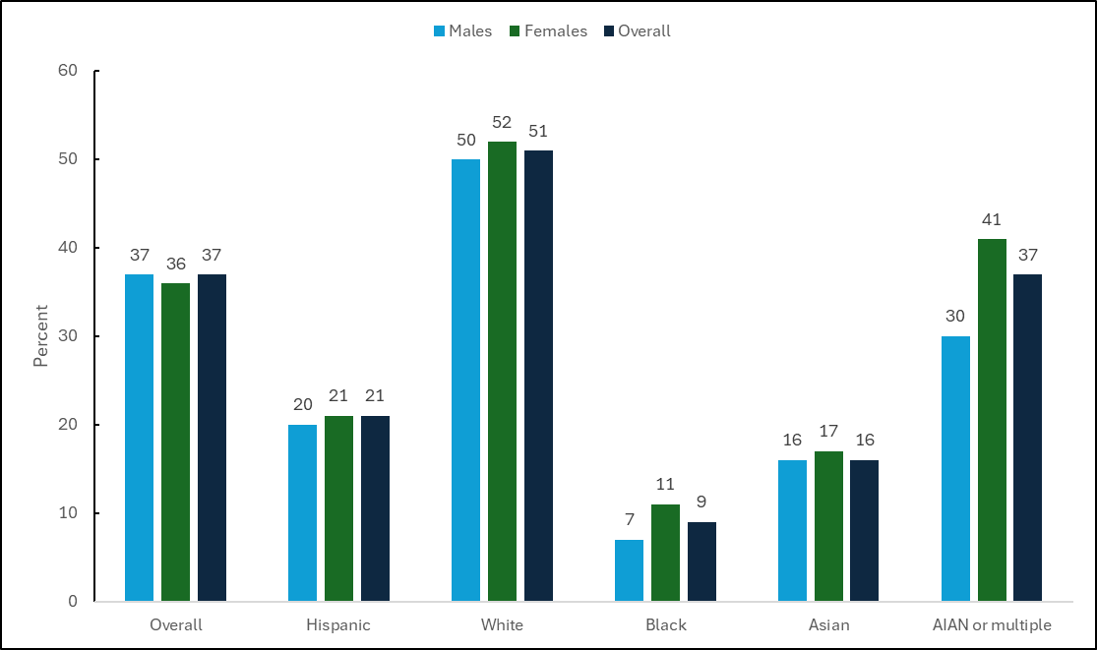
Cancer Prevention & Early Detection Facts & Figures 2026
Sunburn (%), Adults 18 Years and Older, by Sex and Race/Ethnicity, US, 2024
AIAN-American Indian or Alaska Native. All estimates except age are age adjusted to the year 2000 US population standard using 5 age groups: 18-24, 25-34, 35-44, 45-64, and ≥65 years. Any sunburns in the past 12 months. Sunburn is defined as when even a small part of your skin turns red or hurts for 12 hours or more.
Source: National Health Interview Survey, 2024.
Notes:
This slide presents reported sunburn prevalence in 2024 among adults in the US by sex and race/ethnicity categories. In 2024, 37% of adults (males: 37%, females: 36%) reported having a sunburn in the past year, with higher prevalence among White adults (males: 50%, females: 52%) than Hispanic, Black, Asian, or American Indian/Alaska Native adults.

Slide 21
Cancer Prevention & Early Detection Facts & Figures 2026
ACS Guideline for Human Papillomavirus Vaccination (HPV)
Population | Test or Procedure | Recommendation
Children, ages 9-14 years | HPV Vaccination | HPV vaccination works best when given to boys and girls between ages 9 and 12 years. Special emphasis has been given to start at age 9 to increase the success of completing the series by age 13. Children ages 13 to 14 years who have not been vaccinated or who have not received all their shots should get the vaccine as soon as possible. Two doses are recommended for most persons starting the series before their 15th birthday Recommended to begin at age 9 years for better immune response Second dose should be given 6 to 12 months after the first dose Adolescents who receive two doses less than 5 months apart will require a third dose
 |  | Children and young adults ages 15-26 years who have not been vaccinated or who have not received all their shots should get the vaccine as soon as possible. Vaccination of young adults will not prevent as many cancers as vaccination of children and teens. Three doses are recommended for most persons starting the series between the ages of 15-26 years Second dose should be given 1-2 months after the first dose Third dose should be given 6 months after the first dose
Children and young adults, ages 15-26 years |  | Children and young adults ages 15-26 years who have not been vaccinated or who have not received all their shots should get the vaccine as soon as possible. Vaccination of young adults will not prevent as many cancers as vaccination of children and teens. Three doses are recommended for most persons starting the series between the ages of 15-26 years Second should be given 1-2 months after the first dose Third dose should be given 6 months after the first dose
Adults, ages >26 years |  | ACS does not recommend HPV vaccination for adults older than 26 years.
Visit Cancer Screening Guidelines | Detecting Cancer Early | American Cancer Society for more information about the American Cancer Society Guidelines.
Source: Saslow D, Andrews KS, Manassaram-Baptiste D, Smith RA, Fontham ETH; American Cancer Society Guideline Development Group. Human papillomavirus vaccination 2020 guideline update: American Cancer Society guideline adaptation. CA Cancer J Clin. 2020;70(4):274-280. doi:10.3322/caac.21616.
Notes:
This slide presents the American Cance Society HPV vaccination guidelines published in 2020.

Slide 22
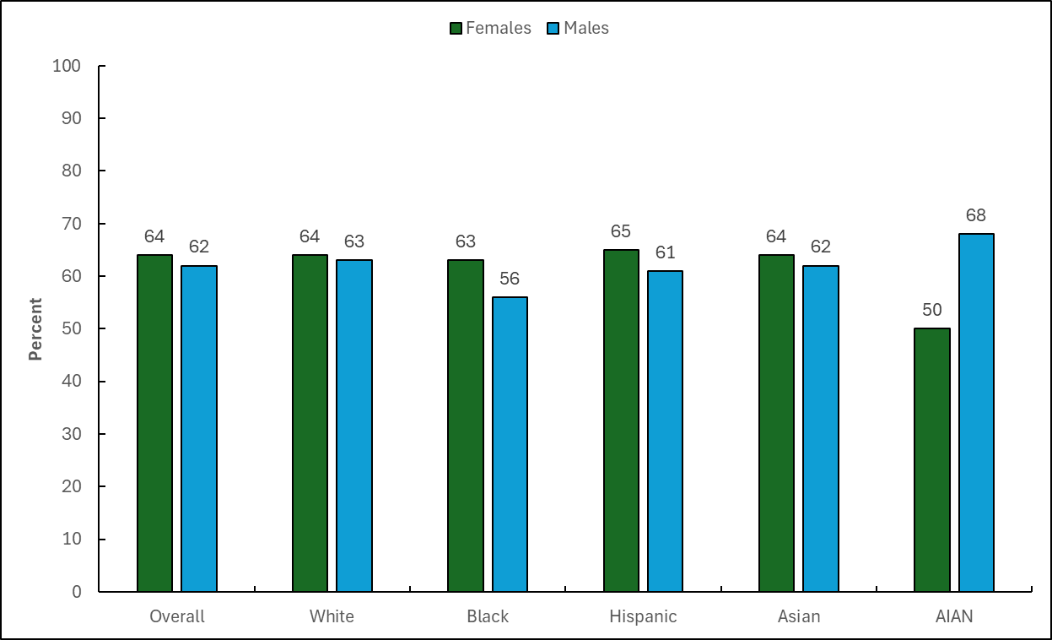
Cancer Prevention & Early Detection Facts & Figures 2026
Up-to-Date Human Papillomavirus Vaccination (%), Youth 13-17 Years, by Sex and Race/Ethnicity, US, 2024
Estimates are crude. AIAN-American Indian or Alaska Native. Data from US territories excluded from national estimates as they were sampled separately. Up-to-date HPV in ages 13-17 years is defined as 2 doses separated by 5 months (minus 4 days) for immunocompetent adolescents initiating the HPV series before their 15th birthday, and 3 doses for all others.
Sources: National Immunization Survey-Teen, 2024.
Notes:
This slide presents the prevalence of being up-to-date with HPV in youth ages 13-17 years by sex and race/ethnicity categories in 2024. About 64% of females and 62% of males ages 13-17 years were up-to-date with the HPV vaccination series in 2024. Across race/ethnicity groups, prevalence of up-to-date HPV vaccination was 64% and 63% for White females and males respectively, 63% and 56% for Black females and males, respectively, 65% and 61% for Hispanic females and males, respectively, 64% and 62% for Asian females and males, respectively, and 50% and 68% in American Indian/Alaska Native females and males, respectively.

Slide 23
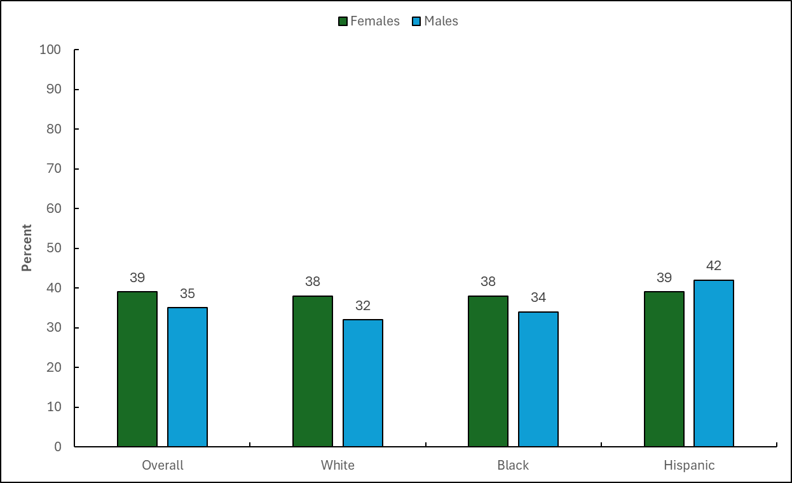
Cancer Prevention & Early Detection Facts & Figures 2026
Up-to-Date Human Papillomavirus Vaccination Before 13th Birthday (%), Youth 13-17 Years, by Sex and Race/Ethnicity, US, 2023
Estimates are crude. Data from US territories excluded from national estimates as they were sampled separately. Up-to-date HPV vaccination for before 13th birthday is defined ≥ 2 doses of the HPV before 13th birthday among ages 13-17 years. Up-to-date HPV before 13th birthday among Asian and American Indian or Alaska Native youth not released publicly in the National Immunization Survey-Teen 2023.
Sources: National Immunization Survey-Teen, 2023.
Notes:
This slide presents the prevalence of being up-to-date with HPV before 13th birthday in youth ages 13-17 years by sex and race/ethnicity categories in 2023. About 39% of females and 35% of males ages 13-17 years were up-to-date with the HPV vaccination series before their 13th birthday. Across race/ethnicity groups, prevalence of up-to-date HPV vaccination before the 13th birthday was 38% and 32% for White females and males respectively, 38% and 34% for Black females and males respectively, whereas it was 39% and 42% for Hispanic females and males, respectively.

Slide 24
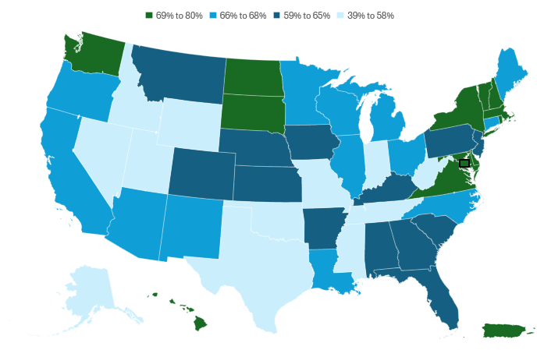
Cancer Prevention & Early Detection Facts & Figures 2026
Up-to-date Human Papillomavirus Vaccination (%), Youth 13-17 Years, by State, US, 2024
Estimates are crude. Data from Puerto Rico were sampled separately. Up-to-date HPV in ages 13-17 years is defined as 2 doses separated by 5 months (minus 4 days) for immunocompetent adolescents initiating the HPV series before their 15th birthday, and 3 doses for all others.
Source: National Immunization Survey-Teen, 2024.
Notes:
This slide presents the prevalence of being up-to-date with HPV in youth ages 13-17 years, across US states, DC, and PR in 2024. In 2024, 64% of youth ages 13-17 years were up-to-date with the HPV vaccination series, but estimates differed widely across states, with the lowest prevalence in Mississippi (39%) and highest in Massachusetts (80%).

Slide 25
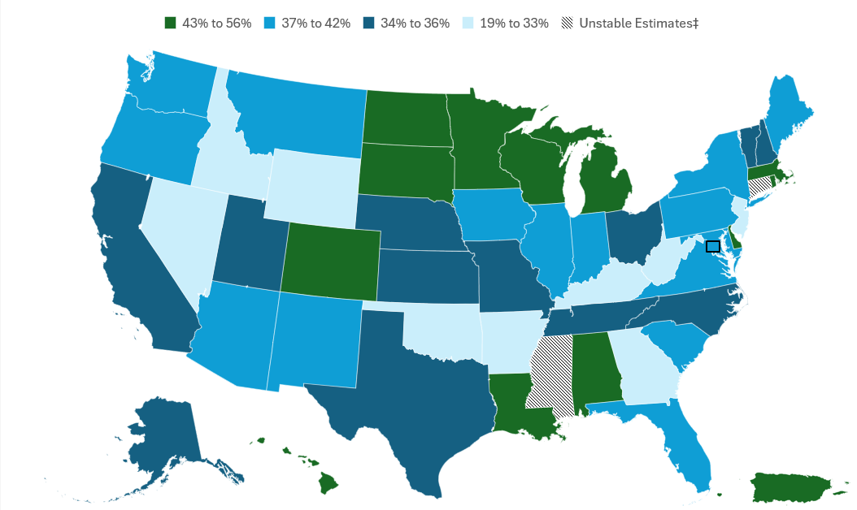
Cancer Prevention & Early Detection Facts & Figures 2026
Up-to-date Human Papillomavirus Vaccination Before 13th Birthday (%), Youth 13-17 Years, by State, US, 2023
Estimates are crude. Data from Puerto Rico were sampled separately. Up-to-date human papillomavirus vaccination is defined in this figure as ≥ 2 doses of the human papillomavirus vaccine before 13th birthday among ages 13-17 years. ‡Estimates are statistically unstable and not shown. See Special Notes, page 51 of Cancer Prevention & Early Detection Facts & Figures 2026.
Source: National Immunization Survey-Teen, 2023.
Notes:
This slide presents the prevalence of being up-to-date with Human Papillomavirus Vaccination before 13th Birthday in youth ages 13-17 years, across US states, DC, and PR in 2023. Up-to-date prevalence before the 13th birthday varied widely across states from 19% in New Jersey to 56% in Puerto Rico.

Slide 26
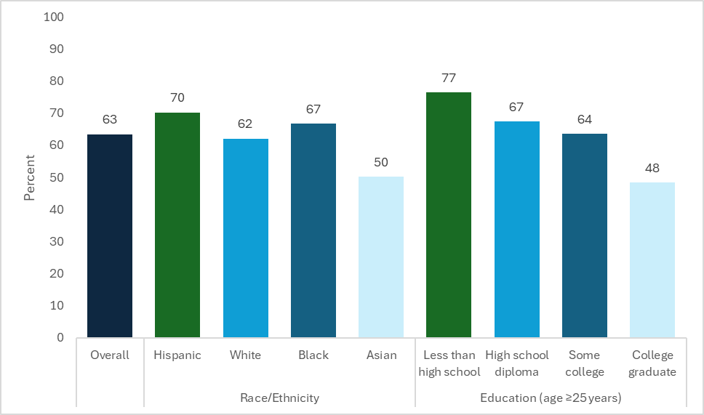
Cancer Prevention & Early Detection Facts & Figures 2026
Prolonged Exposure Among Individuals With Occupational Chemical Exposure (%), US Adults, 2023
Estimates are age adjusted to the year 2000 US population standard using 5 age groups: 18-24, 25-34, 35-44, 45-64, and ≥65 years and by 4 age groups: 25-34, 35-44, 45-64, and ≥65 years for education. Among those with occupational chemical exposure to solvents, industrial glues, heavy metals, pesticides or motor engine exhaust in the past 12 months; those who are exposed for 4 or more hours a week are considered to have prolonged exposure.
Source: National Health Interview Survey, 2023.
Notes:
This slide shows reported prolonged occupational exposure in US adults to chemicals (solvents, industrial glues, heavy metals, pesticides, or motor engine exhaust) in the past year in 2023, some of which have been identified as carcinogenic. In 2023, 11% of US adults reported such occupational exposure, where 63% of those with any exposure were subjected to prolonged exposure for 4+ hours a week. Hispanic workers (70%) and workers without a high school diploma (77%) were more likely to have prolonged occupational exposure to chemicals during the week than White workers (62%), Asian workers (50%), and workers who graduated college (48%)

Slide 27
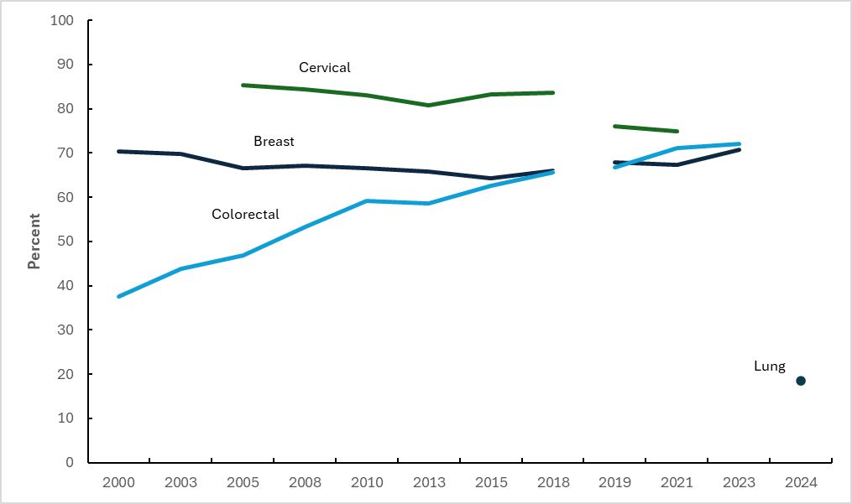
Cancer Prevention & Early Detection Facts & Figures 2026
Breast, Cervical, Colorectal, and Lung Cancer Screening (%), US, 2000-2024
The National Health Interview Survey (NHIS) underwent a significant redesign in 2019, preventing comparability to prior years indicated by the line break. Breast cancer screening is defined as a mammography in the past 2 years among females ages 40+ years. Breast cancer screening estimates are age adjusted to the year 2000 US standard population using three age groups: 40-49, 50-64, and 65+ years. Cervical cancer screening is defined as a Papanicolaou test in the past 3 years (2000-on) among females ages 21-65 years, HPV and Papanicolaou co-testing (2015-on), or HPV test alone (2019-on) in the past 5 years among females 30-65 years who have not had a hysterectomy; hysterectomy data not available in 2003. Up-to-date cervical cancer screening not available in the 2023 NHIS. Cervical cancer screening estimates are age adjusted to the year 2000 US standard population using 4 age groups: 21-29, 30-39, 40-49, and 50-65 years. Colorectal cancer screening is defined as colonoscopy, sigmoidoscopy, or fecal occult blood test/fecal immunochemical test in the past 10, 5, and 1 years; computed tomography colonography in the past 5 years (2010-on); or multi-target stool DNA test (sDNA) in the past 3 years (2018-on) among adults 50+ years. Due to questionnaire limitations, sDNA testing in 2019 was restricted to individuals who had ever received a fecal occult blood test or fecal immunochemical test. Colorectal cancer screening estimates are age adjusted to the year 2000 US standard population using 2 age groups: 50-64 and 65+ years. Lung cancer screening is defined as annual screening for lung cancer with low-dose CT in adults ages 50 to 80 years who have a 20 pack-year smoking history and currently smoke or have quit within the past 15 years. Lung cancer screening estimates are age-adjusted to the year 2000 US population standard using 3 age groups: 50-59, 60-69, and 70-80 years.
Source: National Health Interview Surveys, 2000-2024.
Notes:
This slide presents trends in up-to-date breast, cervical, colorectal, and lung cancer screening in eligible individuals between 2000 and 2021 (for cervical), 2023 (for breast and colorectal), and 2024 (lung). Self-reported biennial screening mammography in females ages 40 years and older increased between the 1980s and 2000, before gradually declining to between 64%-70% during 2000-2023. Between 2000-2013, self-reported cervical cancer screening prevalence in females ages 21-65 years modestly declined and then stabilized between 2013-2018. During the COVID-19 pandemic, screening declined, and cervical cancer screening has yet to return to pre-pandemic levels.(1) Between 2000 and 2023, colorectal cancer screening prevalence increased overall from 38% to 72% among adults 50 years and older. In 2024, lung cancer screening prevalence was 19% among eligible adults.
(1) Star J, Han X, Smith RA, Schafer EJ, Jemal A, Bandi P. Cancer Screening 3 Years After the Onset of the COVID-19 Pandemic. JAMA. Published online March 5, 2025. doi:10.1001/jama.2025.0902

Slide 28
Cancer Prevention & Early Detection Facts & Figures 2026
ACS Guideline for Breast Cancer Screening - Average Risk
Population | Test or Procedure | Recommendation
Women, ages 45–54 years | Mammography | Women should have the opportunity to begin annual screening between the ages of 40 and 44. Women should undergo regular screening mammography starting at age 45. Women ages 45 to 54 should be screened annually.
Women, ages 55+ years |  | Transition to biennial screening or could continue annual screening. Continue screening if overall health is good and life expectancy is 10+ years.
All individuals should become familiar with the potential benefits, limitations, and harms associated with cancer screening.
Visit Cancer Screening Guidelines | Detecting Cancer Early | American Cancer Society for more information about the American Cancer Society Guidelines.
Source: Oeffinger KC, Fontham ETH, Etzioni R, et al. Breast Cancer Screening for Women at Average Risk: 2015 Guideline Update From the American Cancer Society. JAMA. 2015;314(15):1599–1614. doi:10.1001/jama.2015.12783.
Notes:
This slide presents the American Cancer Society breast cancer screening guideline published in 2015. The American Cancer Society is in the process of updating their breast cancer screening guidelines for both females at average and higher than average risk.

Slide 29
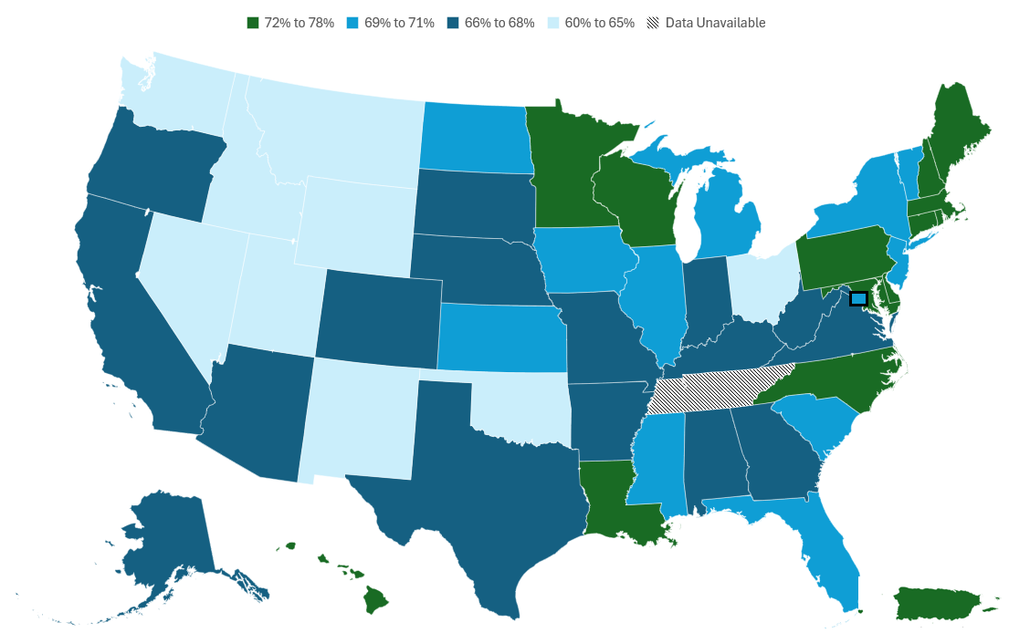
Cancer Prevention & Early Detection Facts & Figures 2026
Breast Cancer Screening (%), Females 45 Years and Older, by State, US, 2024
Tennessee was not included in the 2024 Behavioral Risk Factor Surveillance System due to insufficient data. Mammogram within the past year (ages 45-54 years) or past two years (ages ≥55 years). Estimates are age adjusted to the year 2000 US population standard using 3 age groups: 45-49, 50-64, and ≥65 years.
Source: Behavioral Risk Factor Surveillance System, 2024.
Notes:
This slide shows state-level up-to-date prevalence in breast cancer screening in 2024 according to ACS guidelines. In 2024, women ages 45 years and older, living in Wyoming had the lowest mammography prevalence (60%) within the past two years, while those residing in Connecticut, Rhode Island, and Massachusetts had the highest (78%).

Slide 30
Cancer Prevention & Early Detection Facts & Figures 2026
Mammography Within the Past Two Years (%), Females 40 Years and Older, by Race/Ethnicity, US, 2000-2023
Estimates are age adjusted to the year 2000 US population standard using 3 age groups: 40-49, 50-64, and 65+ years. The National Health Interview Survey underwent a significant redesign in 2019, preventing comparability to prior years indicated by the line break.
Source: National Health Interview Survey, 2000-2023.
Notes:
This slide shows trends in breast cancer screening prevalence between 2000 and 2023 according to race/ethnicity categories. Historically, mammography prevalence has been lowest in Hispanic and Asian females compared to White and Black females.

Slide 31
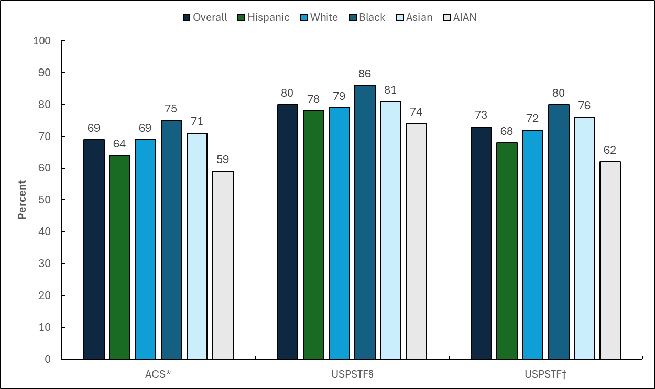
Cancer Prevention & Early Detection Facts & Figures 2026
Mammography (%), Females 40 Years and Older, by Race/Ethnicity, US, 2023
ACS-American Cancer Society, USPSTF-United States Preventive Services Task Force, AIAN-American Indian or Alaska Native only or multiple race categories. *Mammogram within the past year (females ages 45-54 years) or past two years (ages ≥55 years). Estimates are age adjusted to the year 2000 US population standard using 3 age groups: 45-49, 50-64, and ≥65 years. §USPSTF 2016 Recommendation: Mammogram within the past 2 years among females ages 50-74 years. Estimates are age adjusted using 2 age groups: 50-64, and 65-74 years. †USPSTF 2024 recommendation: Mammogram within the past two years among females ages 40-74 years. Data are presented only as baseline estimates, as this recommendation was not in place at time of survey. Estimates are age adjusted using 3 age groups: 40-49, 50-64, and 65-74 years.
Source: National Health Interview Survey, 2023.
Notes:
This slide presents prevalence estimates for up-to-date breast cancer screening, consistent with the American Cancer Society guideline and the US Preventive Services Task Force recommendation, overall and according to race/ethnicity categories, in 2023. According to the ACS guideline, 69% of all age-eligible females were up-to-date with recommended breast cancer screening. About 75% of Black females were up-to-date for breast cancer screening, followed by 71% of Asian females, 69% of White females, 64% of Hispanic females and only 59% of American Indian/Alaska Native females.

Slide 32
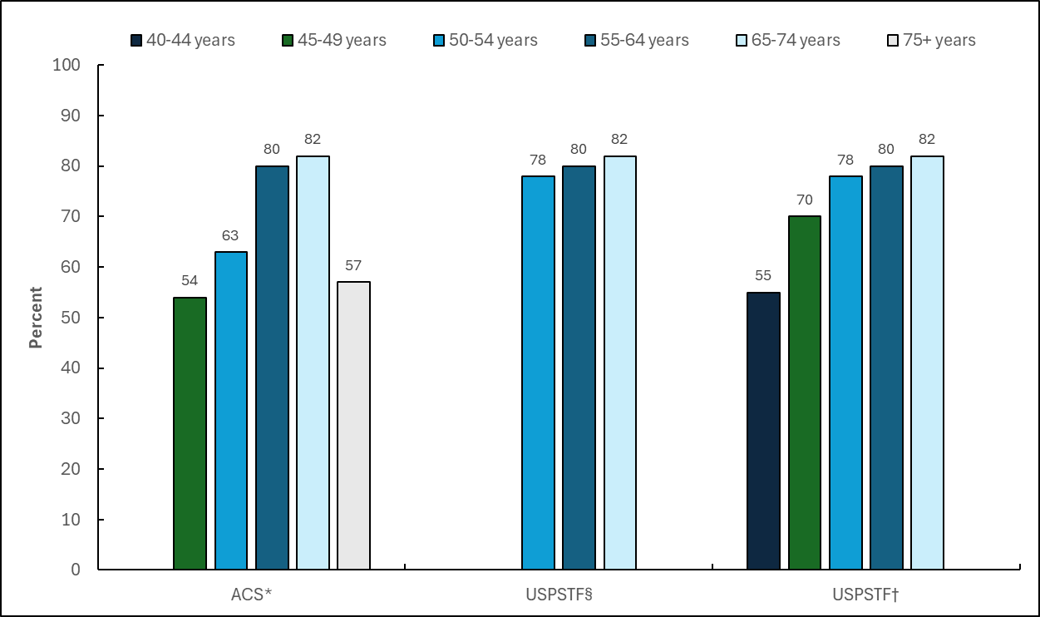
Cancer Prevention & Early Detection Facts & Figures 2026
Mammography (%), Females 40 Years and Older, by Age, US, 2023
ACS-American Cancer Society, USPSTF-United States Preventive Services Task Force. Estimates stratified by age are crude. *Mammogram within the past year (females ages 45-54 years) or past two years (females ages ≥55 years). §USPSTF 2016 Recommendation: Mammogram within the past 2 years among females ages 50-74 years. †USPSTF 2024 recommendation: Mammogram within the past two years among females ages 40-74 years. Data are presented only as baseline estimates, as this recommendation was not in place at time of survey.
Source: National Health Interview Survey, 2023.
Notes:
This slide presents prevalence estimates for up-to-date breast cancer screening with, consistent with the American Cancer Society guideline and the US Preventive Services Task Force recommendation, according to eligible age-groups, in 2023. According to the ACS guideline, 82% and 80% of individuals 65-74 years and 55-64 years were up-to-date for breast cancer screening, respectively, compared to only about 63% of individuals ages 50-54 years and 54% of those ages 45-49 years.

Slide 33
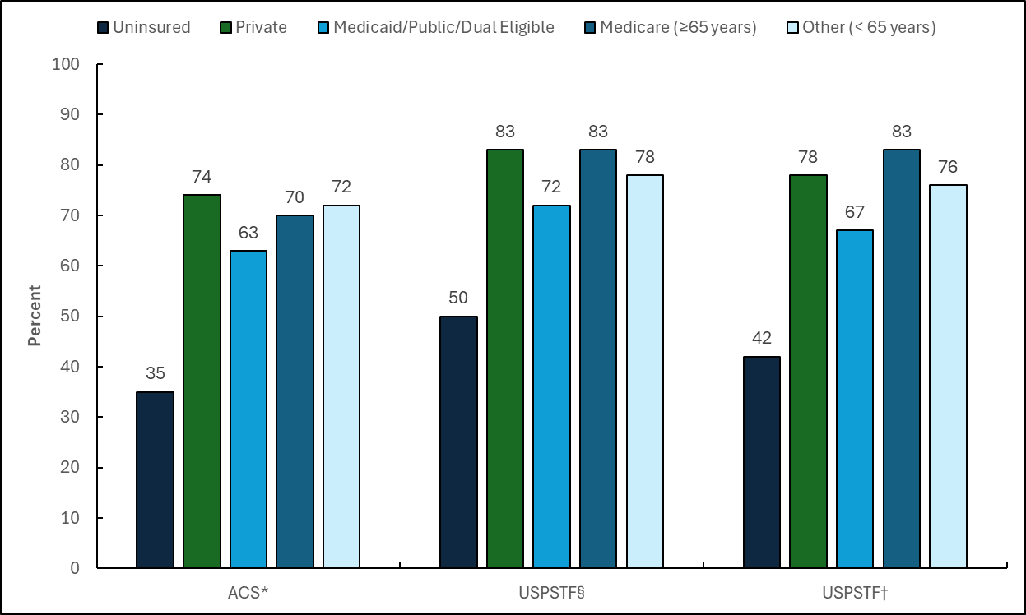
Cancer Prevention & Early Detection Facts & Figures 2026
Mammography (%), Females 40 Years and Older, by Insurance Status, US, 2023
ACS-American Cancer Society, USPSTF-United States Preventive Services Task Force. Estimates stratified by insurance status are crude. *Mammogram within the past year (females ages 45-54 years) or past two years (females ages ≥55 years). §USPSTF 2016 Recommendation: Mammogram within the past 2 years among females ages 50-74 years. †USPSTF 2024 recommendation: Mammogram within the past two years among females ages 40-74 years. Data are presented only as baseline estimates, as this recommendation was not in place at time of survey.
Source: National Health Interview Survey, 2023.
Notes:
This slide presents prevalence estimates for up-to-date breast cancer screening with, consistent with the American Cancer Society guideline and the US Preventive Services Task Force recommendation, according to insurance status and type, in 2023. According to the ACS guideline, 74% of privately insured individuals were up-to-date for breast cancer screening, followed by 70% of Medicare insured (ages 65+ years) females, 63% of Medicaid/Public/Dual eligible insured individuals, compared to only about 35% of uninsured individuals.

Slide 34
Cancer Prevention & Early Detection Facts & Figures 2026
ACS Guideline for Cervical Cancer Screening- Average Risk
Population | Test or Procedure | Recommendation
Women and other individuals with a cervix at average risk for cervical cancer | Primary HPV testing (provider collected) | Start screening at age 25 and continue until at least age 65; screen every 5 years (preferred option).
Women and other individuals with a cervix at average risk for cervical cancer | Self-collected HPV testing* | Start at age 25 and continue until at least age 65; screen every 3 years. Test must be ordered by a health care provider.
Women and other individuals with a cervix at average risk for cervical cancer | Co-testing (HPV test + Pap test) | Start at age 25 and continue until at least age 65; screen every 5 years. Sample collected by a health care provider.
Women and other individuals with a cervix at average risk for cervical cancer | Pap test alone | Start at age 25 and continue until at least age 65; screen every 3 years. If other options are not available.
*Self-collection should only be done using FDA-approved tests and collection devices, available through a health care provider.
All individuals should become familiar with the potential benefits, limitations, and harms associated with cancer screening.
Visit Cancer Screening Guidelines | Detecting Cancer Early | American Cancer Society for more information about the American Cancer Society Guidelines.
Source: Perkins RB, Wolf AMD, Church TR, et al. Self-collected vaginal specimens for human papillomavirus testing and guidance on screening exit: An update to the American Cancer Society cervical cancer screening guideline. CA Cancer J Clin. 2026;e70041. doi:10.3322/caac.70041.
Notes:
This slide presents the American Cancer Society cervical cancer screening guideline published in 2025.

Slide 35
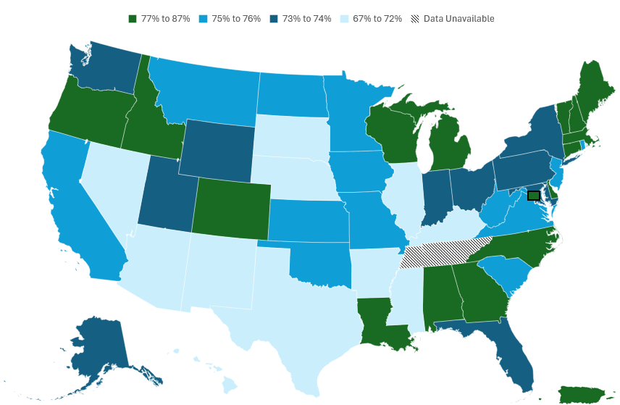
Cancer Prevention & Early Detection Facts & Figures 2026
Cervical Cancer Screening (%), Females 25-65 Years, by State, US, 2024
Tennessee was not included in the 2024 Behavioral Risk Factor Surveillance System due to insufficient data. Estimates are among females who have not had a hysterectomy. All estimates are age adjusted to the year 2000 US population standard using 4 age groups: 25-29, 30-39, 40-49, and 50-65 years. Pap test in the past 3 years or Pap test and HPV test or HPV test alone within the past 5 years among females 25-65 years.
Source: Behavioral Risk Factor Surveillance System, 2024.
Notes:
This slide shows state-level up-to-date prevalence in cervical cancer screening in 2024 according to ACS guidelines. In 2024, women ages 25 years and older, living in Nevada and Mississippi had the lowest cervical cancer screening prevalence (67%), while those residing in Puerto Rico had the highest (87%).

Slide 36
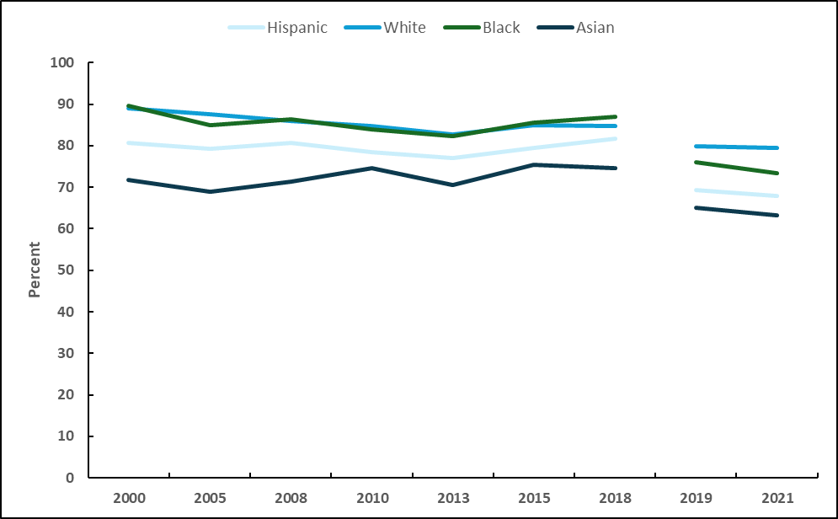
Cancer Prevention & Early Detection Facts & Figures 2026
Cervical Cancer Screening (%), Females 21-65 Years, by Race/Ethnicity, US, 2000-2021
Estimates are age adjusted to the year 2000 US standard population using 4 age groups: 21-29, 30-39, 40-49, and 50-65 years. The National Health Interview Survey (NHIS) underwent a significant redesign in 2019, preventing comparability to prior years indicated by the line break. Cervical cancer screening is defined as Pap test in the past 3 years (2000-2021) among females 21-65 years or HPV and Pap co-testing (2015-on) or HPV test alone within the past 5 years (2019-on) among females 30-65 years who have not had a hysterectomy; hysterectomy data not available in 2003. Up-to-date cervical cancer screening data not available in the NHIS 2023.
Source: National Health Interview Surveys, 2000-2021.
Notes:
This slide shows trends in up-to-date cervical cancer screening prevalence between 2000 and 2021 according to race/ethnicity categories. Historically, and in 2021, cervical cancer screening has been lowest among Hispanic and Asian than White and Black females.

Slide 37
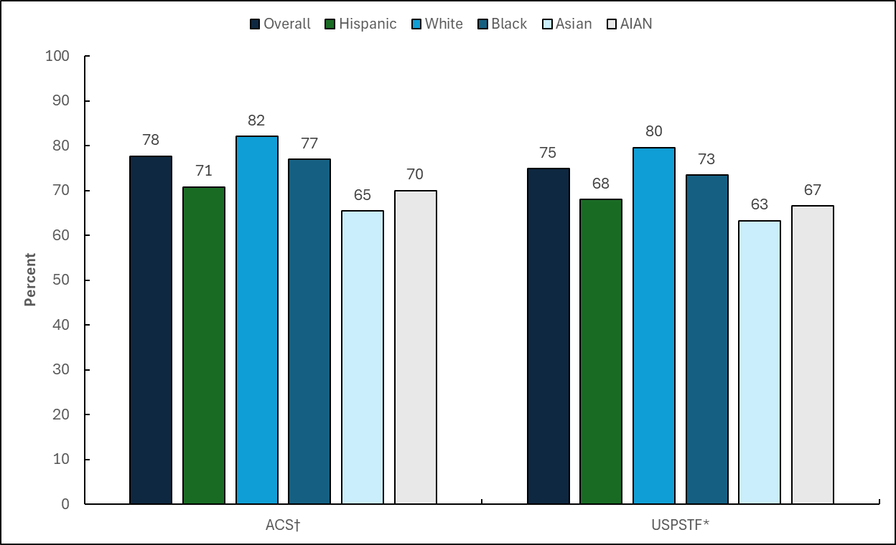
Cancer Prevention & Early Detection Facts & Figures 2026
Cervical Cancer Screening (%), Females 21-65 Years, by Race/Ethnicity, US, 2021
ACS-American Cancer Society, USPSTF-United States Preventive Services Task Force, AIAN-American Indian or Alaska Native only or multiple race categories. Estimates are among females who have not had a hysterectomy. Up-to-date cervical cancer screening data are not available in the National Health Interview Survey 2023. †Pap test in the past 3 years; Pap test and HPV test; or HPV test alone within the past 5 years among females 25-65 years. ACS estimates are age adjusted to the year 2000 US population standard using 4 age groups: 25-29, 30-39, 40-49, and 50-65 years. *Pap test in the past 3 years among females 21-65 years; Pap test and HPV test or HPV test alone within the past 5 years among females 30-65 years. USPSTF estimates are age adjusted using 4 age groups: 21-29, 30-39, 40-49, and 50-65 years.
Source: National Health Interview Survey, 2021.
Notes:
This slide presents up-to-date cervical cancer screening, consistent with the American Cancer Society guideline and the US Preventive Services Task Force recommendation, overall and according to race/ethnicity categories, in 2021. According to the ACS guideline, 78% of all age-eligible females were up-to-date with recommended cervical cancer screening. About 82% of White females were up-to-date for cervical cancer screening, followed by 77% of Black females, compared to 71%, 70%, and 65% of Hispanic, American Indian/Alaska Native, and Asian females.

Slide 38
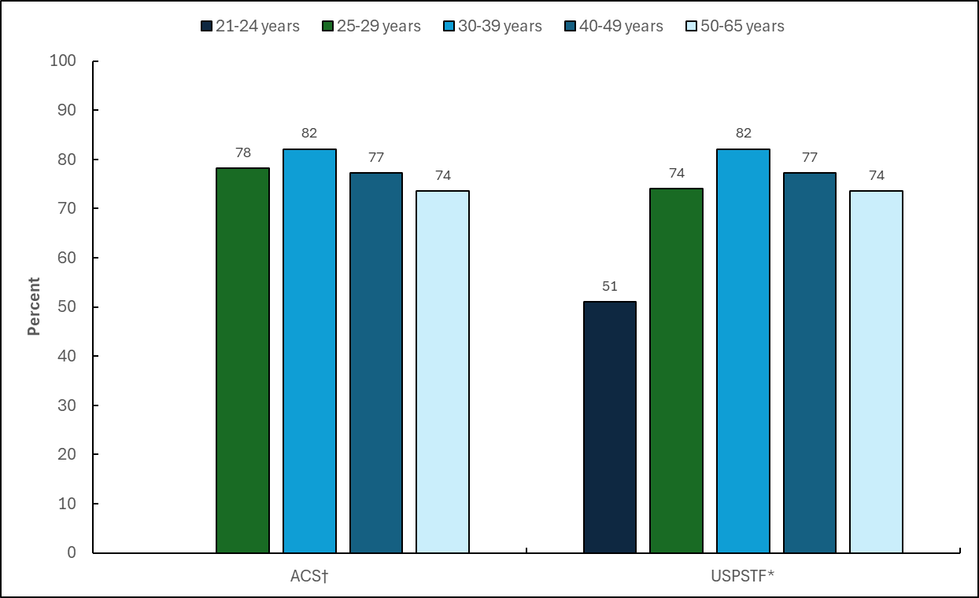
Cancer Prevention & Early Detection Facts & Figures 2026
Cervical Cancer Screening (%), Females 21-65 Years, by Age, US, 2021
ACS-American Cancer Society, USPSTF-United States Preventive Services Task Force. Estimates are among females who have not had a hysterectomy. Up-to-date cervical cancer screening data are not available in the National Health Interview Survey 2023. Estimates stratified by age are crude. †Pap test in the past 3 years; Pap test and HPV test or HPV test alone within the past 5 years among females 25-65 years. *Pap test in the past 3 years among females 21-65 years; Pap test and HPV test or HPV test alone within the past 5 years among females 30-65 years.
Source: National Health Interview Survey, 2021.
Notes:
This slide presents up-to-date cervical cancer screening, consistent with the American Cancer Society guideline and the US Preventive Services Task Force recommendation, according to eligible age-groups, in 2021. According to the ACS guideline, 82% of females ages 30-39 years were up-to-date for cervical cancer screening, followed by 78% of females ages 25–29, 77% of females ages 40-49, compared to only about 74% of females ages 50-65 years.

Slide 39
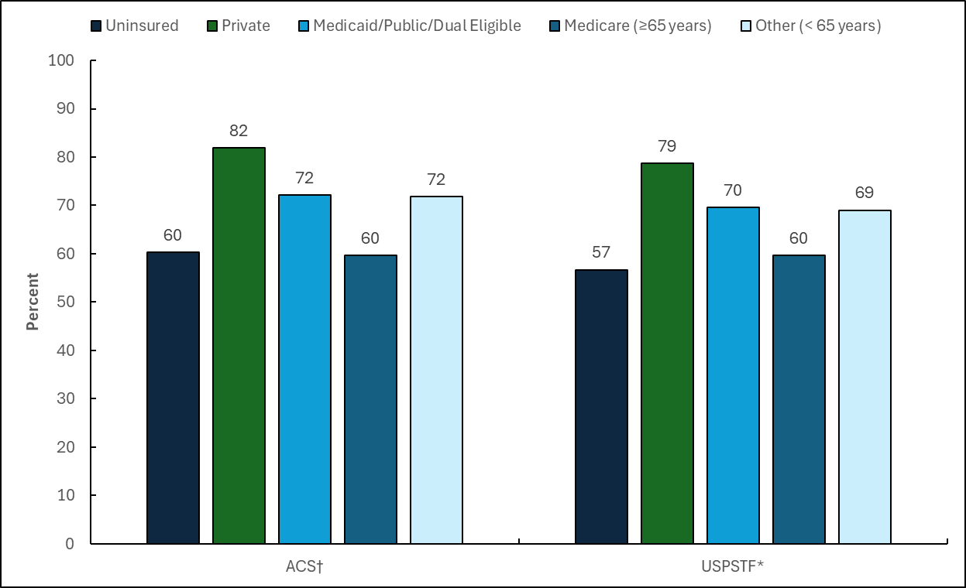
Cancer Prevention & Early Detection Facts & Figures 2026
Cervical Cancer Screening (%), Females 21-65 Years, by Insurance Status, US, 2021
ACS-American Cancer Society, USPSTF-United States Preventive Services Task Force. Insurance estimates are crude. Estimates are among females who have not had a hysterectomy. Up-to-date cervical cancer screening data are not available in the National Health Interview Survey 2023. Estimates stratified by insurance status are crude. †Pap test in the past 3 years; Pap test and HPV test or HPV test alone within the past 5 years among females 25-65 years. *Pap test in the past 3 years among females 21-65 years; Pap test and HPV test or HPV test alone within the past 5 years among females 30-65 years.
Source: National Health Interview Survey, 2021.
Notes:
This slide presents up-to-date cervical cancer screening, consistent with the American Cancer Society guideline and the US Preventive Services Task Force recommendation, according to insurance status and type, in 2021. According to the ACS guideline, 82% of privately insured females were up-to-date for cervical cancer screening, followed by 72% of Medicaid/Public/Dual eligible insured females, compared to only about 60% of uninsured females.

Slide 40
Cancer Prevention & Early Detection Facts & Figures 2026
ACS Guideline for Colorectal Cancer Screening- Average Risk
Population | Test or Procedure* | Recommendation
Adults, ages 45+ years | High-sensitivity guaiac-based fecal occult blood test (gFOBT) with at least 50% sensitivity or fecal immunochemical test (FIT), OR | Annually
 | Multi-target stool DNA test, OR | Every 3 years
 | Flexible sigmoidoscopy, OR | Every 5 years alone, or combined with a high-sensitivity gFOBT or FIT performed annually
 | Colonoscopy, OR | Every 10 years
 | CT Colonography | Every 5 years
*All positive tests (other than colonoscopy) should be followed up with a colonoscopy.
All individuals should become familiar with the potential benefits, limitations, and harms associated with cancer screening.
Visit Cancer Screening Guidelines | Detecting Cancer Early | American Cancer Society for more information about the American Cancer Society Guidelines.
Source: Wolf AMD, Fontham ETH, Church TR, et al. Colorectal cancer screening for average-risk adults: 2018 guideline update from the American Cancer Society. CA Cancer J Clin. 2018;68(4):250-281. doi:10.3322/caac.21457.
Notes:
This slide presents the American Cancer Society colorectal cancer screening guideline published in 2018.

Slide 41
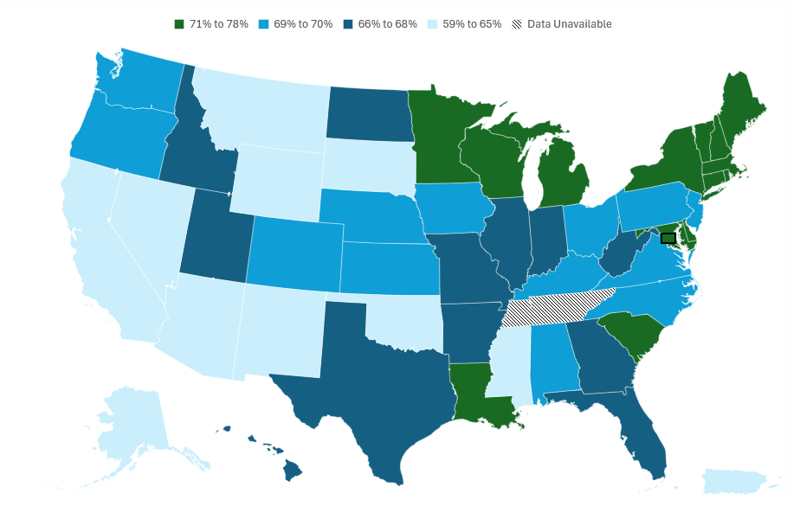
Cancer Prevention & Early Detection Facts & Figures 2026
Colorectal Cancer Screening (%), Adults 45 Years and Older, by State, US, 2024
Tennessee was not included in the 2024 Behavioral Risk Factor Surveillance System due to insufficient data. FOBT/FIT, sigmoidoscopy, colonoscopy, computed tomography (CT) colonography, or sDNA within the past 1, 5, 10, 5, and 3 years, respectively. Estimates are age adjusted to the year 2000 US population standard using 3 age groups: 45-49, 50-64, and ≥65 years.
Source: Behavioral Risk Factor Surveillance System, 2024.
Notes:
This slide shows state-level prevalence in up-to-date cervical cancer screening prevalence in 2024 according to ACS guidelines. In 2024, adults ages 45 years and older, living in New Mexico had the lowest colorectal cancer screening prevalence (59%), while those residing in Rhode Island had the highest (78%).

Slide 42
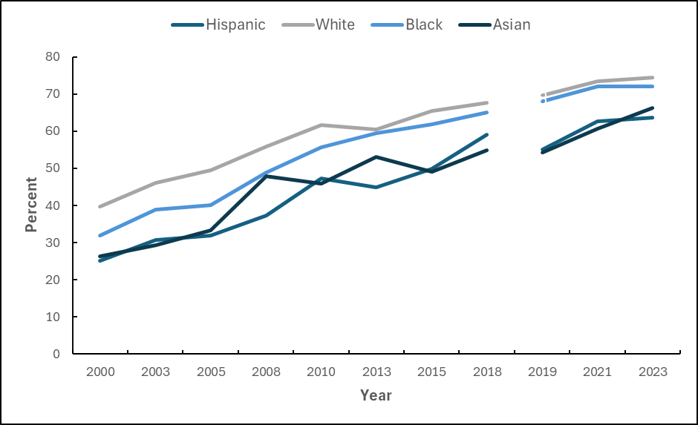
Cancer Prevention & Early Detection Facts & Figures 2026
Colorectal Cancer Screening (%), Adults 50 Years and Older, by Race/Ethnicity, US, 2000-2023
Estimates are age adjusted to the year 2000 US population standard using 2 age groups: 50-64 and 65+ years. The National Health Interview Survey underwent a significant redesign in 2019, preventing comparability to prior years indicated by the line break. Colorectal cancer screening is defined as colonoscopy, sigmoidoscopy, or fecal occult blood test/fecal immunochemical test in the past 10, 5, and 1 years; computed tomography colonography in the past 5 years (2010, 2015-on); or multi-target stool DNA test (sDNA) in the past 3 years (2018-on). Due to questionnaire limitations, sDNA testing in 2019 was restricted to individuals who had ever received a fecal occult blood test or fecal immunochemical test.
Source: National Health Interview Surveys, 2000-2023.
Notes:
This slide shows trends in colorectal cancer screening prevalence between 2000 and 2023 according to race/ethnicity categories. Historically, and in 2023, up-to-date screening was generally higher among White and Black than Hispanic and Asian individuals.

Slide 43
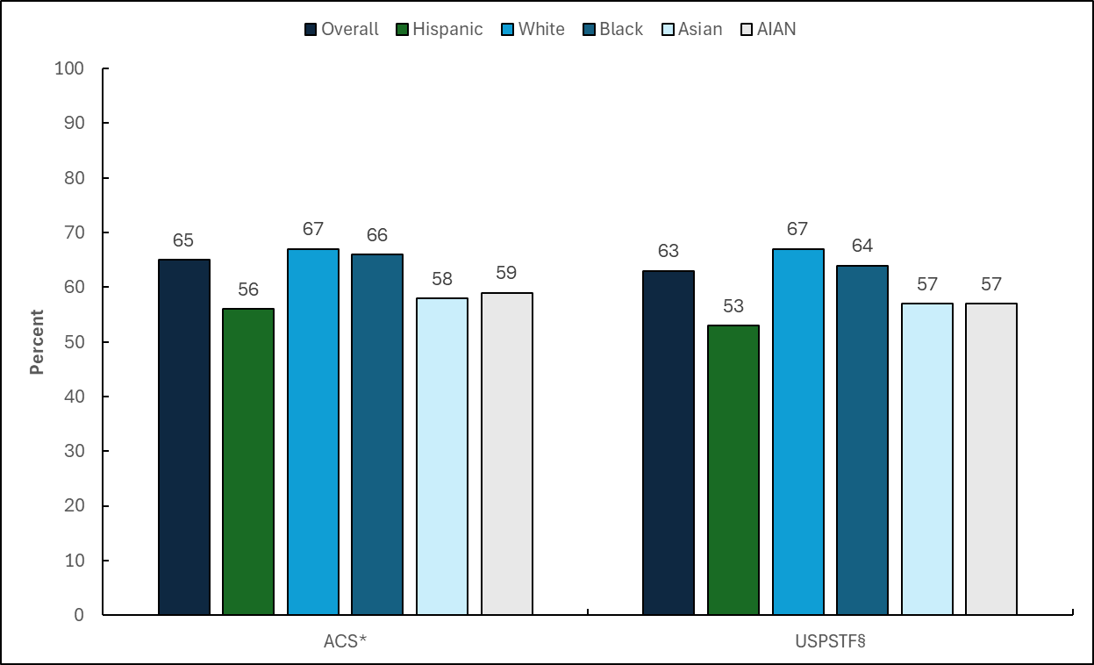
Cancer Prevention & Early Detection Facts & Figures 2026
Colorectal Cancer Screening (%), Adults 45 Years and Older, by Race/Ethnicity, US, 2023
ACS-American Cancer Society, USPSTF-United States Preventive Services Task Force, AIAN-American Indian or Alaska Native only or multiple race categories. *Fecal occult blood test (FOBT) or fecal immunochemical test (FIT), sigmoidoscopy, colonoscopy, computed tomography (CT) colonography, or multi-target stool DNA (sDNA) test in the past 1, 5, 10, 5 and 3 years, respectively. ACS estimates are age adjusted to the year 2000 US population standard using 3 age groups: 45-49, 50-64, and ≥65 years. §FOBT/FIT, sigmoidoscopy, colonoscopy, CT colonography, or sDNA test in the past 1, 5, 10, 5 and 3 years, respectively, or sigmoidoscopy in the past 10 years with FOBT/FIT in the past 1 year. USPSTF estimates are age adjusted using 3 age groups: 45-49, 50-64, and 65-75 years.
Source: National Health Interview Survey, 2023.
Notes:
This slide presents up-to-date colorectal cancer screening, consistent with the American Cancer Society guideline and the US Preventive Services Task Force recommendation, overall and according to race/ethnicity categories, in 2023. According to the ACS guideline, 65% of all age-eligible individuals were up-to-date with recommended colorectal cancer screening. About 67% of White and 66% of Black individuals were up-to-date for colorectal cancer screening, followed by 59%, 58%, and 56% of American Indian/Alaska Native, Asian, and Hispanic individuals, respectively.

Slide 44
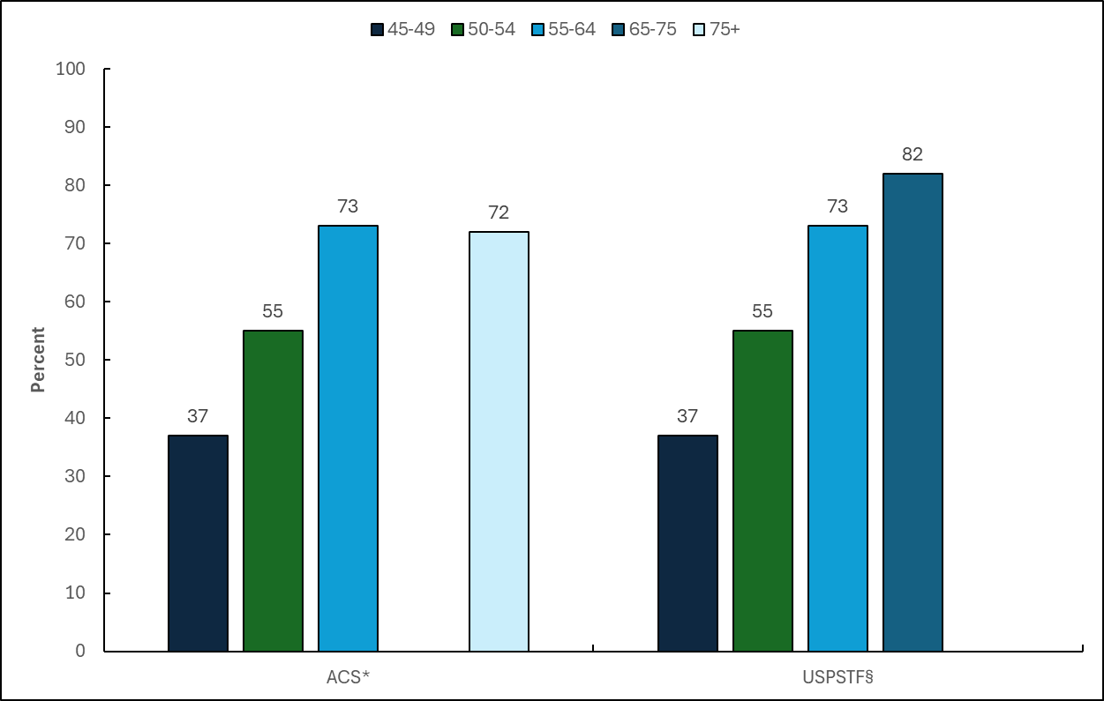
Cancer Prevention & Early Detection Facts & Figures 2026
Colorectal Cancer Screening (%), Adults 45 Years and Older, by Age, US, 2023
ACS-American Cancer Society, USPSTF-United States Preventive Services Task Force. Estimates stratified by age are crude. *Fecal occult blood test (FOBT) or fecal immunochemical test (FIT), sigmoidoscopy, colonoscopy, computed tomography (CT) colonography, or multi-target stool DNA (sDNA) test in the past 1, 5, 10, 5 and 3 years, respectively. §FOBT/FIT, sigmoidoscopy, colonoscopy, CT colonography, or sDNA test in the past 1, 5, 10, 5 and 3 years, respectively, or sigmoidoscopy in past 10 years with FOBT/FIT in the past 1 year.
Source: National Health Interview Survey, 2023.
Notes:
This slide presents up-to-date colorectal cancer screening, consistent with the American Cancer Society guideline and the US Preventive Services Task Force recommendation, according to eligible age-groups, in 2023. According to the ACS guideline, 82% of individuals ages 65-75 years were up-to-date for colorectal cancer screening, followed by 73% of individuals ages 55–64, 72% of individuals ages 75+, 55% of individuals ages 50-54, compared to only about 37% of individuals ages 45-49 years.

Slide 45
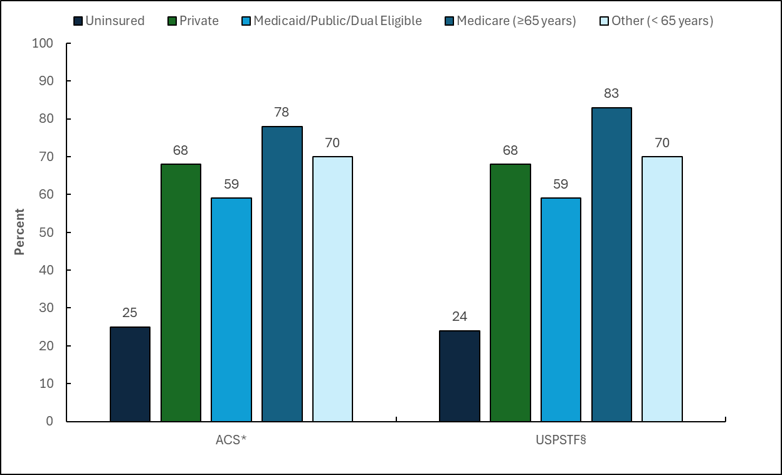
Cancer Prevention & Early Detection Facts & Figures 2026
Colorectal Cancer Screening (%), Adults 45 Years and Older, by Insurance Status, US, 2023
ACS-American Cancer Society, USPSTF-United States Preventive Services Task Force. Estimates by insurance status are crude. *Fecal occult blood test (FOBT) or fecal immunochemical test (FIT), sigmoidoscopy, colonoscopy, computed tomography (CT) colonography, or multi-target stool DNA (sDNA) test in the past 1, 5, 10, 5 and 3 years, respectively. §FOBT/FIT, sigmoidoscopy, colonoscopy, CT colonography, or sDNA test in the past 1, 5, 10, 5 and 3 years, respectively, or sigmoidoscopy in the past 10 years with FOBT/FIT in the past 1 year.
Source: National Health Interview Survey, 2023.
Notes:
This slide presents up-to-date colorectal cancer screening, consistent with the American Cancer Society guideline and the US Preventive Services Task Force recommendation, according to insurance status and type, in 2023. According to the ACS guideline, 78% of Medicare insured individuals (ages 65+ years) were up-to-date for colorectal cancer screening, followed by 68% of privately-insured individuals, 59% of Medicaid/Public/Dual insured individuals, compared to only 25% of uninsured individuals.

Slide 46
Cancer Prevention & Early Detection Facts & Figures 2026
ACS Guideline for Lung Cancer Screening -Average Risk
Population | Test or Procedure | Recommendation
Adults ages 50 to 80 years who currently smoke or formerly smoked and have a 20 or greater pack-year history of smoking (e.g., smoked 1 pack per day for 20 years or ½ pack per day for 40 years) that are in reasonably good health (at least 5 years of expected longevity), regardless of whether or when they quit. | Low-dose helical CT | Annually
All individuals should become familiar with the potential benefits, limitations, and harms associated with cancer screening.
Visit Cancer Screening Guidelines | Detecting Cancer Early | American Cancer Society for more information about the American Cancer Society Guidelines.
Source: Wolf AMD, Oeffinger KC, Shih TY, et al. Screening for lung cancer: 2023 guideline update from the American Cancer Society. CA Cancer J Clin. 2024;74(1):50-81. doi:10.3322/caac.21811.
Notes:
This slide presents the American Cancer Society lung cancer screening guideline published in 2024.

Slide 47
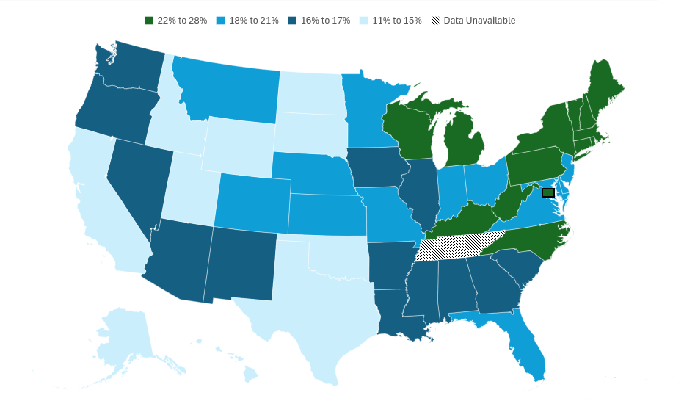
Cancer Prevention & Early Detection Facts & Figures 2026
Lung Cancer Screening (%), Adults 50-80 Years, by State, US, 2024
Tennessee was not included in the 2024 Behavioral Risk Factor Surveillance System due to insufficient data. All estimates are age adjusted to the year 2000 US population standard using 3 age groups: 50-59, 60-69, and 70-80 years. The American Cancer Society recommends annual screening for lung cancer with a low-dose CT (LDCT) scan for people ages 50 to 80 years who smoke or used to smoke and have at least a 20 pack-year history of smoking. Puerto Rico is not shown due to statically unstable estimates.
Source: Behavioral Risk Factor Surveillance System, 2024.
Notes:
This slide shows state-level prevalence in up-to-date lung cancer screening prevalence in 2024 according to ACS guidelines. In 2024, adults ages 50-80 years, living in California had the lowest lung cancer screening prevalence (11%), while those residing in Connecticut, Massachusetts, and Pennsylvania had the highest (28%).

Slide 48
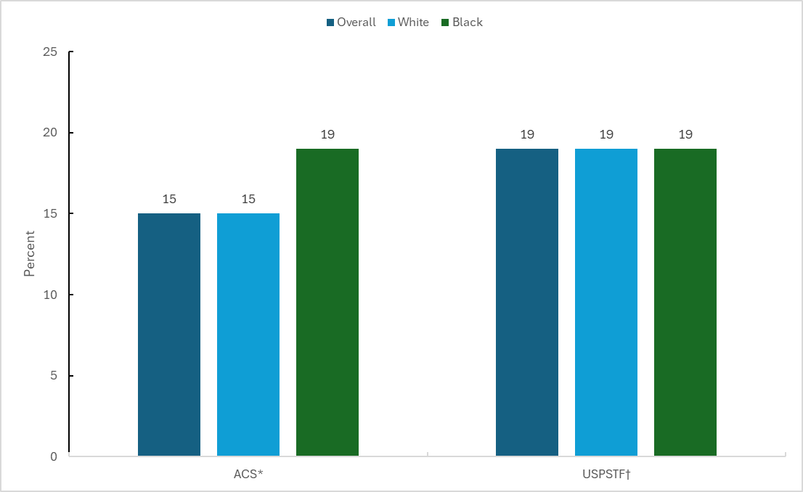
Cancer Prevention & Early Detection Facts & Figures 2026
Lung Cancer Screening (%), Adults 50-80 Years, by Race/Ethnicity, US, 2024
ACS-American Cancer Society, USPSTF-United States Preventive Services Task Force. Estimates are age adjusted using 3 age groups: 50-59, 60-69, and 70-80 years. *The American Cancer Society recommends annual screening for lung cancer with a low-dose CT (LDCT) scan for people ages 50 to 80 years who smoke or used to smoke and have at least a 20 pack-year history of smoking. †The USPSTF recommends annual screening for lung cancer with LDCT in adults ages 50 to 80 years who have a 20 pack-year smoking history and currently smoke or have quit within the past 15 years.
Source: National Health Interview Survey, 2024.
Notes:
This slide presents up-to-date lung cancer screening, consistent with the American Cancer Society guideline and the US Preventive Services Task Force recommendation, overall and according to race/ethnicity categories in 2024. According to the ACS guideline, 15% of all eligible individuals (ages 50-80) were up-to-date with recommended screening. About 19% of Black individuals were up-to-date for lung cancer screening, followed by 15% of White individuals.

Slide 49
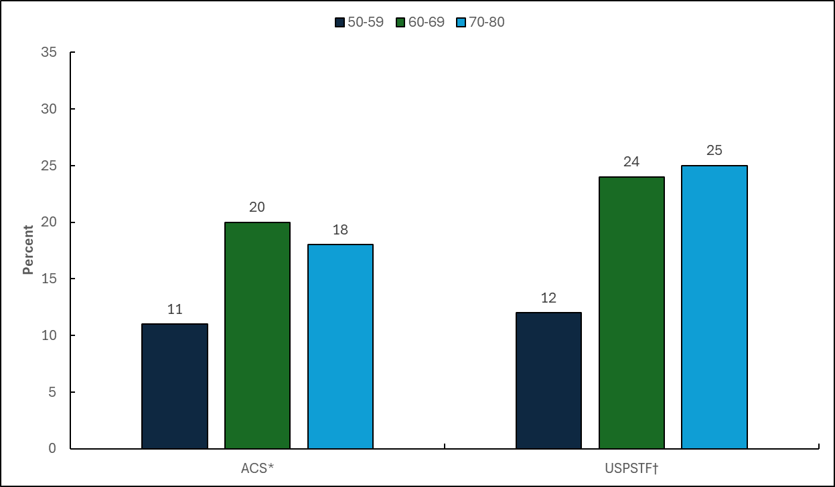
Cancer Prevention & Early Detection Facts & Figures 2026
Lung Cancer Screening (%), Adults 50-80 Years, by Age, US, 2024
ACS-American Cancer Society, USPSTF-United States Preventive Services Task Force. Estimates stratified by age are crude. *The American Cancer Society recommends annual screening for lung cancer with a low-dose CT (LDCT) scan for people ages 50 to 80 years who smoke or used to smoke and have at least a 20 pack-year history of smoking. †The USPSTF recommends annual screening for lung cancer with LDCT in adults ages 50 to 80 years who have a 20 pack-year smoking history and currently smoke or have quit within the past 15 years.
Source: National Health Interview Survey, 2024.
Notes:
This slide presents up-to-date lung cancer screening, consistent with the American Cancer Society guideline and the US Preventive Services Task Force recommendation, according to eligible age-groups, in 2024. According to the ACS guideline, 20% of eligible individuals ages 60-69 years were up-to-date for lung cancer screening, followed by 18% of individuals ages 70-80 years, compared to about 11% of individuals ages 50-59 years.

Slide 50
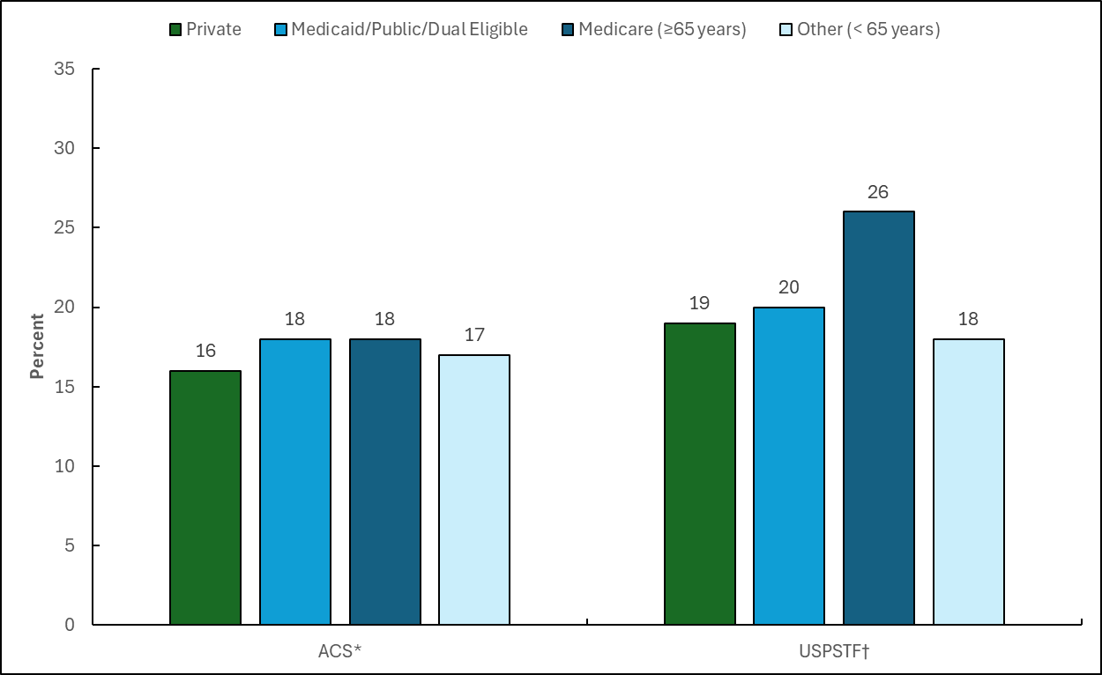
Cancer Prevention & Early Detection Facts & Figures 2026
Lung Cancer Screening (%), Adults 50-80 Years, by Insurance Status, US, 2024
ACS-American Cancer Society, USPSTF-United States Preventive Services Task Force. Estimates by insurance status are crude. *The American Cancer Society recommends annual screening for lung cancer with a low-dose CT (LDCT) scan for people ages 50 to 80 years who smoke or used to smoke and have at least a 20 pack-year history of smoking. †The USPSTF recommends annual screening for lung cancer with LDCT in adults ages 50 to 80 years who have a 20 pack-year smoking history and currently smoke or have quit within the past 15 years.
Source: National Health Interview Survey, 2024.
Notes:
This slide presents data for up-to-date lung cancer screening estimates consistent with the American Cancer Society guideline and the US Preventive Services Task Force recommendation, according to insurance status and type, in 2024. According to the ACS guideline, 18% of Medicare insured individuals (ages 65+ years) were up-to-date for lung cancer screening, followed by 18% of Medicaid/Public insured individuals, and 16% of privately-insured individuals.

Slide 51
Cancer Prevention & Early Detection Facts & Figures 2026
ACS Guideline for Prostate Cancer Screening -Average Risk
Population | Test or Procedure | Recommendation
Men, ages 50+ years | Prostate-specific antigen test with or without digital rectal examination | Men who have at least a 10-year life expectancy should have an opportunity to make an informed decision with their healthcare provider about whether to be screened for prostate cancer, after receiving information about the potential benefits, risks, and uncertainties. Prostate cancer screening should not occur without informed decision-making. African American men should have this conversation with their provider beginning at age 45.
All individuals should become familiar with the potential benefits, limitations, and harms associated with cancer screening.
Visit Cancer Screening Guidelines | Detecting Cancer Early | American Cancer Society for more information about the American Cancer Society Guidelines.
Source: Wolf AM, Wender RC, Etzioni RB, et al. American Cancer Society guideline for the early detection of prostate cancer: update 2010. CA Cancer J Clin. 2010;60(2):70-98. doi:10.3322/caac.20066.
Notes:
This slide presents the American Cancer Society prostate cancer screening guideline last revised in 2023.

