Slide 1
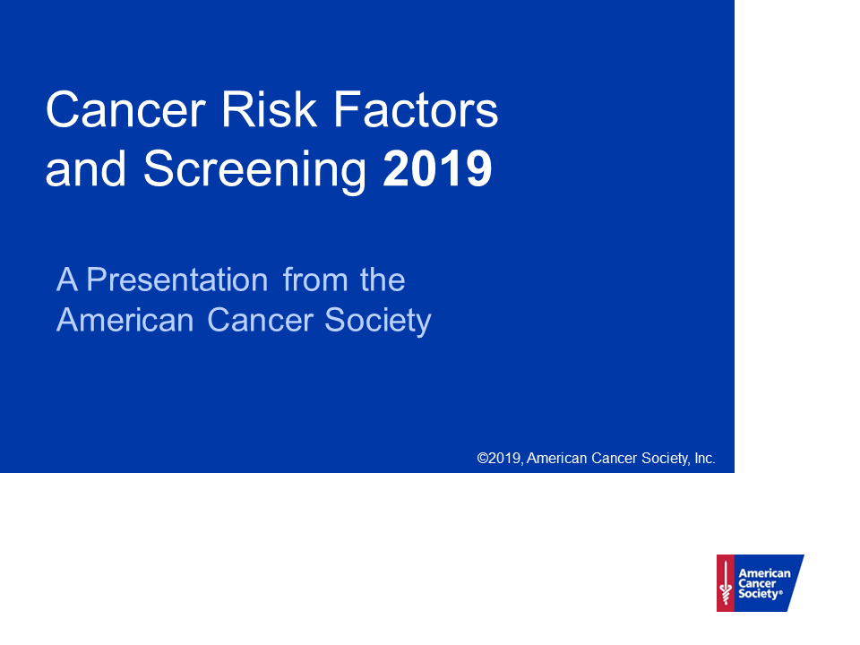

Slide 2
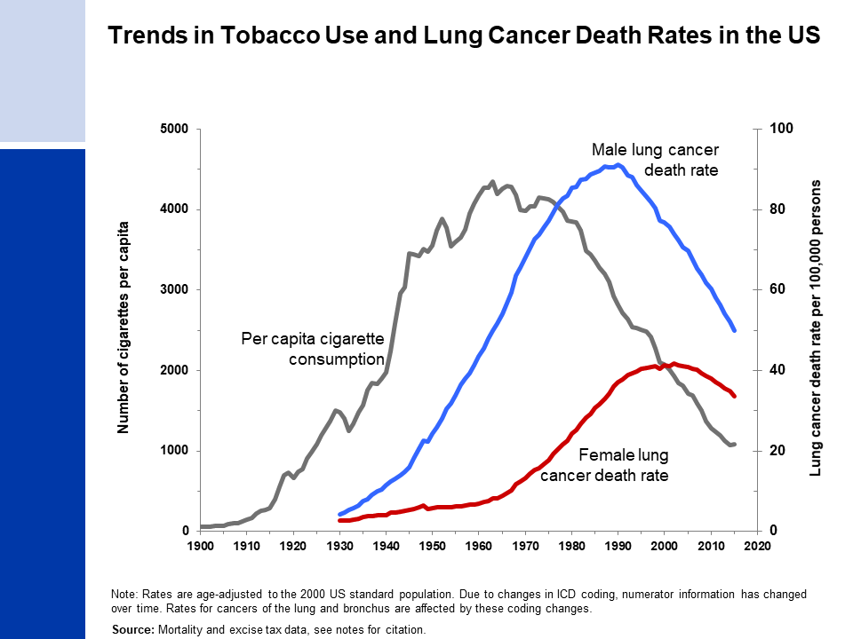
Notes:
- Death rates: US Mortality Volumes 1930 to 1959, US Mortality Data 1960 to 2015, National Center for Health Statistics, Centers for Disease Control and Prevention.
- Cigarette consumption: 1900-1999: US Department of Agriculture. 2000-2015: Wang, TW et al. PMID: 27932780

Slide 3
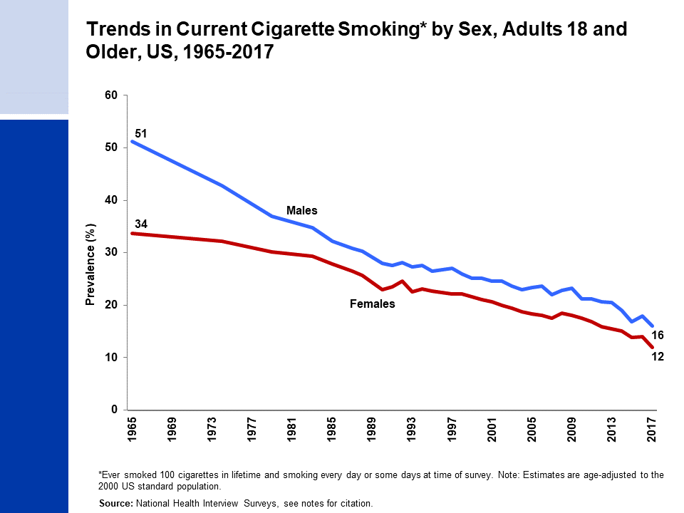
Notes:
- National Center for Health Statistics. Health, United States, 2017: With Special Feature on Mortality. Hyattsville, MD. 2018.
- National Health Interview Survey, National Center for Health Statistics, Centers for Disease Control and Prevention, 2017. Public-use data file and documentation. https://www.cdc.gov/nchs/nhis/index.htm

Slide 4
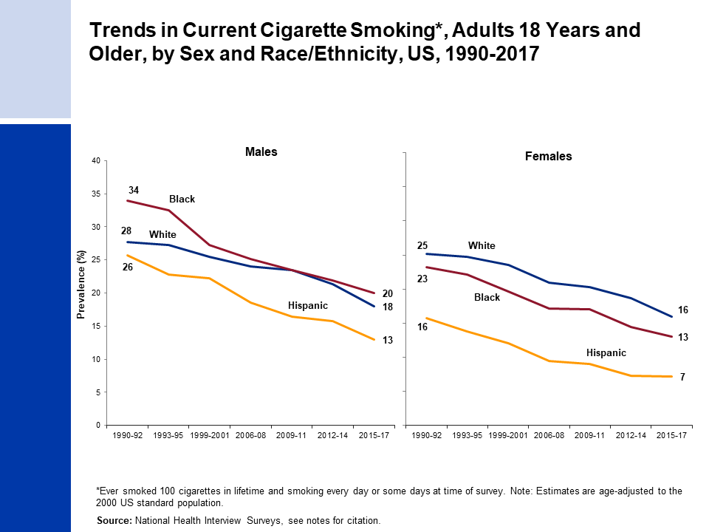
Notes:
- Estimates for white and black are among non-Hispanics.
- National Center for Health Statistics. Health, United States, 2015: With Special Feature on Racial and Ethnic Health Disparities. Hyattsville, MD. 2016.
- National Health Interview Survey, National Center for Health Statistics, Centers for Disease Control and Prevention, 2015, 2016, and 2017. Public-use data file and documentation. https://www.cdc.gov/nchs/nhis/index.htm

Slide 5
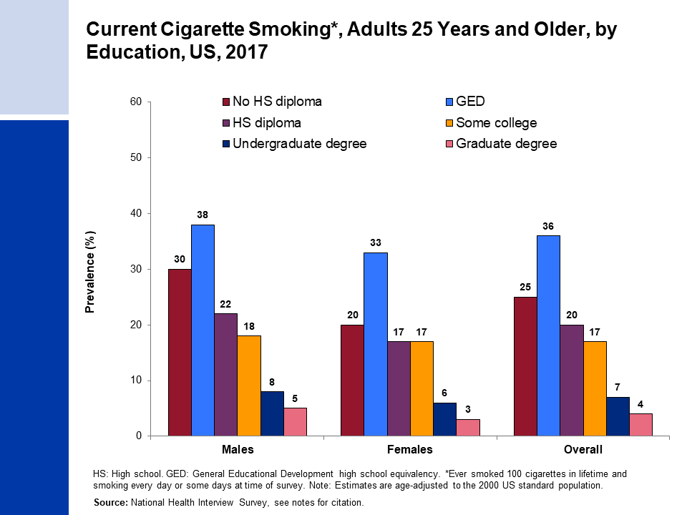
Notes:
- Estimate for “Some college” includes those with an Associate’s degree.
- National Health Interview Survey, National Center for Health Statistics, Centers for Disease Control and Prevention, 2017. Public-use data file and documentation. https://www.cdc.gov/nchs/nhis/index.htm

Slide 6
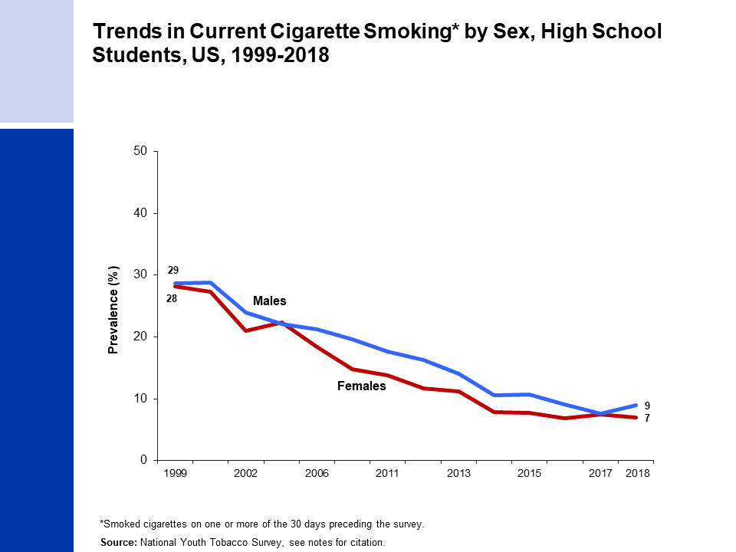
Notes:
1999: Centers for Disease Control and Prevention. PMID: 11057729
2000: Centers for Disease Control and Prevention. PMID: 11902401
2002: Marshall L, et al. PMID: 16708059
2004: Bloch AB, et al. PMID: 15800473
2006 & 2009: Arrazola RA, et al. PMID: 20798668
2011 & 2012: Arrazola RA, et al. PMID: 24226625
2013: Arrazola RA, et al. PMID: 25393220
2014: Arrazola RA, et al. PMID: 25879896
2015: Singh T, et al. PMID: 27077789
2016: Jamal A, et al. PMID: 28617771
2017: Wang TW, et al. PMID: 29879097
2018: Gentzke AS, et al. PMID: 30763302

Slide 7
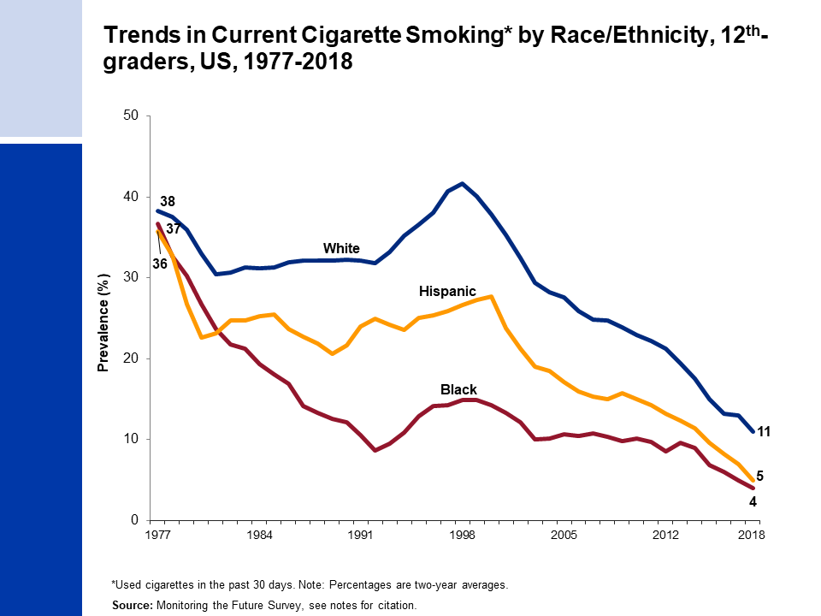
Notes:
Monitoring the Future Study, 1976-2018, University of Michigan. http://monitoringthefuture.org/
Johnston LD, Miech RA, O’Malley PM, et al. (2019). Demographic subgroup trends among adolescents in the use of various licit and illicit drugs, 1975–2018 (Monitoring the Future Occasional Paper No. 92). Ann Arbor, MI: Institute for Social Research, The University of Michigan.

Slide 8
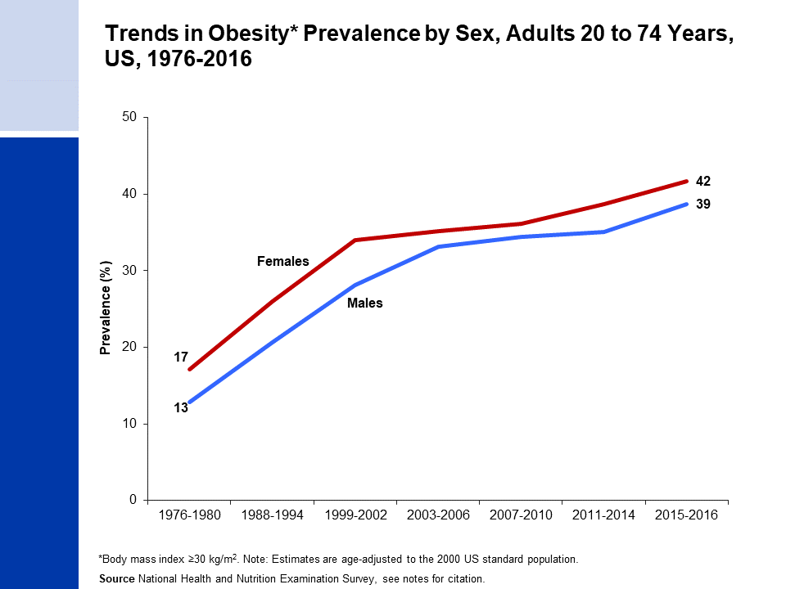
Notes:
National Center for Health Statistics. Health, United States, 2013: With Special Feature on Prescription Drugs. Hyattsville, MD. 2014.
National Center for Health Statistics. National Health and Nutrition Examination Survey, 2011-2016. Public-use data files and documentation. https://wwwn.cdc.gov/nchs/nhanes/Default.aspx

Slide 9
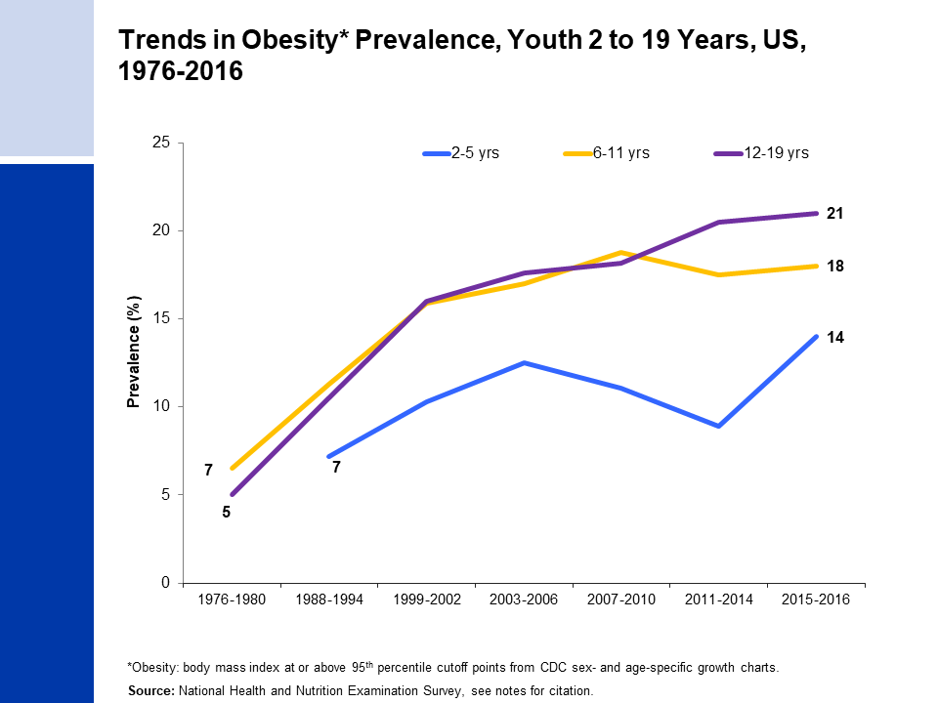
Notes:
National Center for Health Statistics. Health, United States, 2013: With Special Feature on Prescription Drugs. Hyattsville, MD. 2014.
National Center for Health Statistics. Health, United States, 2017: With Special Feature on Mortality. Hyattsville, MD. 2018.
Fryar CD, Carroll MD, Ogden CL. Prevalence of Overweight, Obesity, and Severe Obesity Among Children and Adolescents Aged 2–19 Years: United States, 1963–1965 Through 2015-2016. National Center for Health Statistics Health E-Stats. 2018.

Slide 10
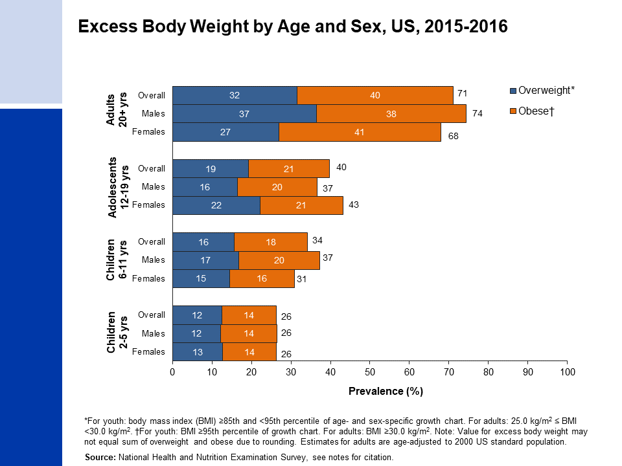
Notes:
Fryar CD, Carroll MD, Ogden CL. Prevalence of Overweight, Obesity, and Severe Obesity Among Adults Aged 20 and Over: United States, 1960–1962 Through 2015-2016. National Center for Health Statistics Health E-Stats. 2018.
National Center for Health Statistics. National Health and Nutrition Examination Survey, 2015-2016. Public-use data files and documentation. https://wwwn.cdc.gov/nchs/nhanes/Default.aspx

Slide 11
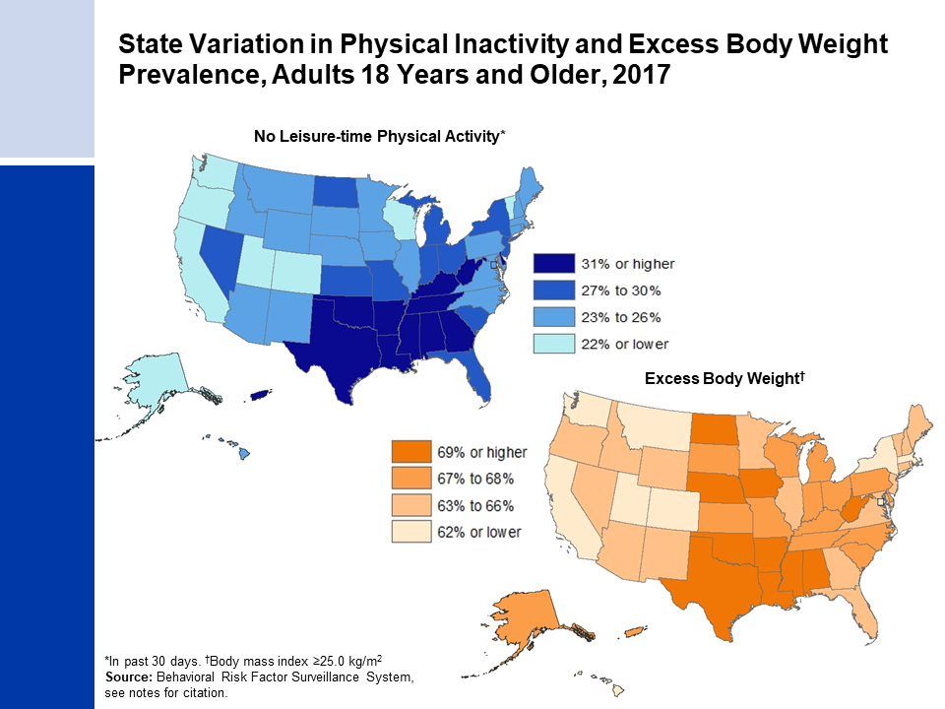
Notes:
- Centers for Disease Control and Prevention (CDC). Behavioral Risk Factor Surveillance System Survey Data. Atlanta, Georgia: U.S. Department of Health and Human Services, Centers for Disease Control and Prevention, 2017. https://www.cdc.gov/brfss/data_documentation/index.htm

Slide 12
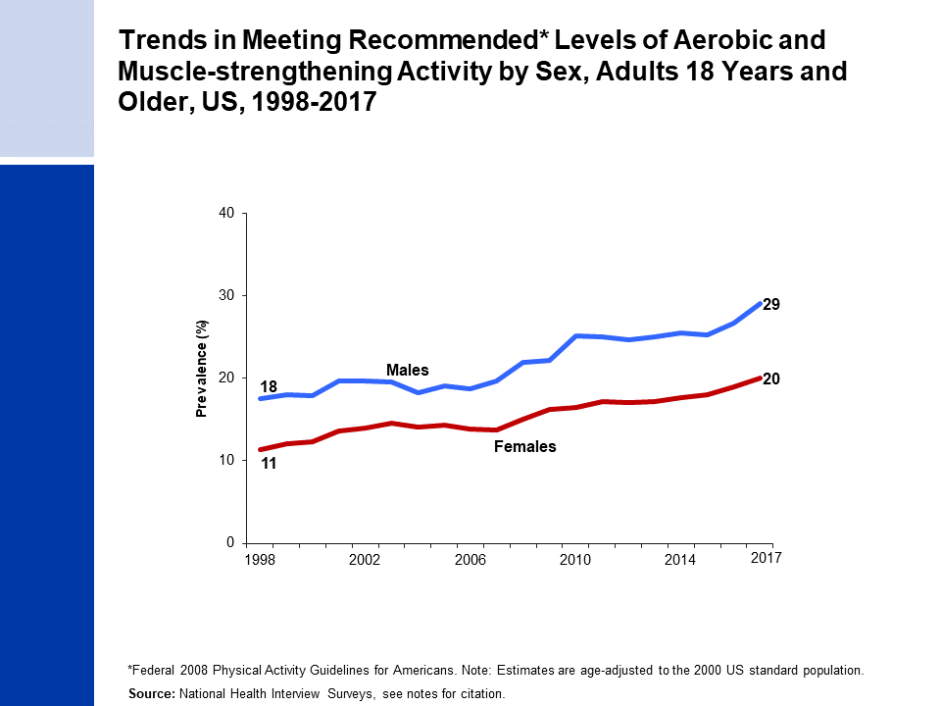
Notes:
National Center for Health Statistics. Health, United States, 2017: With a Special Feature on Mortality. Hyattsville, MD. 2018.
National Health Interview Survey, National Center for Health Statistics, Centers for Disease Control and Prevention, 2017. Public-use data file and documentation. https://www.cdc.gov/nchs/nhis/index.htm

Slide 13
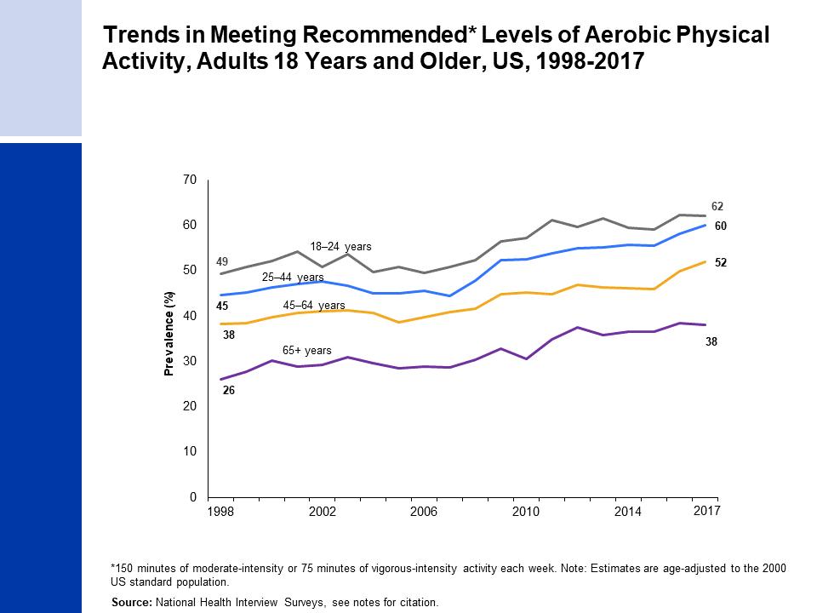
Notes:
National Center for Health Statistics. Health, United States, 2017: With a Special Feature on Mortality. Hyattsville, MD. 2018.
National Health Interview Survey, National Center for Health Statistics, Centers for Disease Control and Prevention, 2017. Public-use data file and documentation. https://www.cdc.gov/nchs/nhis/index.htm

Slide 14
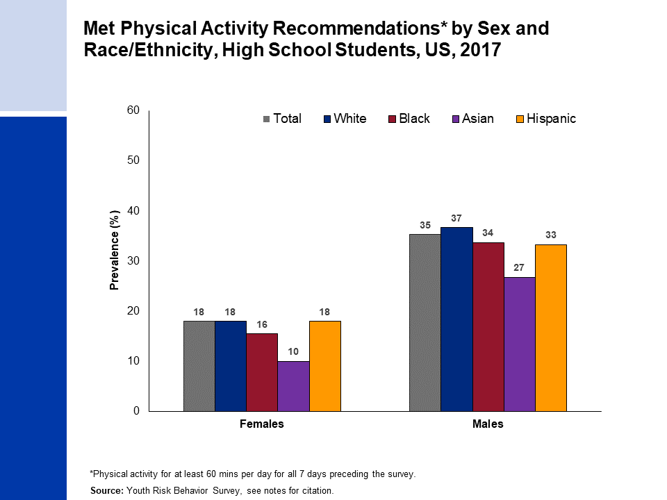
Notes:
Estimates for white, black, and Asian are among non-Hispanics.
Centers for Disease Control and Prevention. High School Youth Risk Behavior Survey Data, 2017. Available from URL: https://nccd.cdc.gov/youthonline/App/Default.aspx

Slide 15
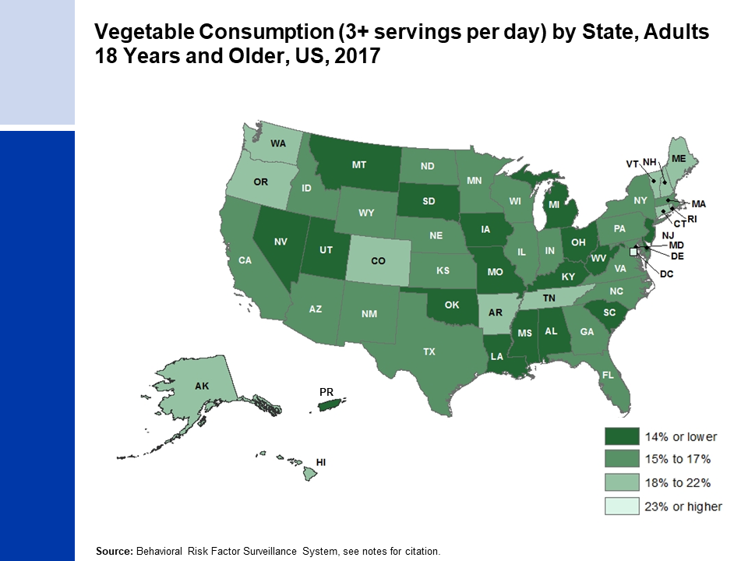
Notes:
- Centers for Disease Control and Prevention (CDC). Behavioral Risk Factor Surveillance System Survey Data. Atlanta, Georgia: U.S. Department of Health and Human Services, Centers for Disease Control and Prevention, 2017.

Slide 16
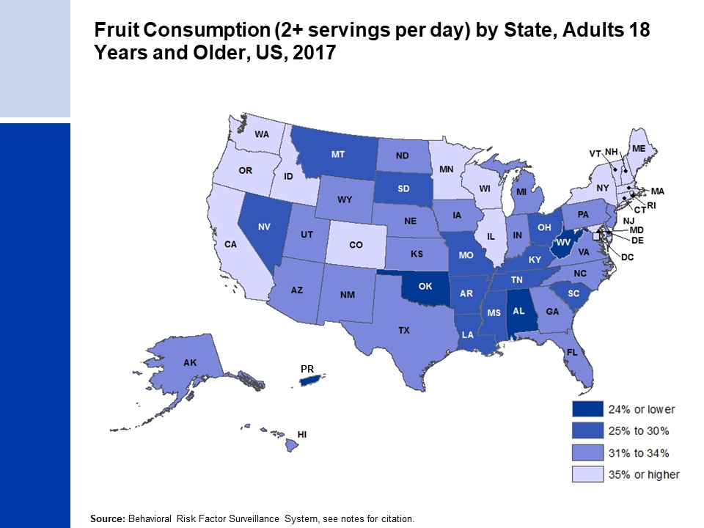
Notes:
- Centers for Disease Control and Prevention (CDC). Behavioral Risk Factor Surveillance System Survey Data. Atlanta, Georgia: U.S. Department of Health and Human Services, Centers for Disease Control and Prevention, 2017.

Slide 17
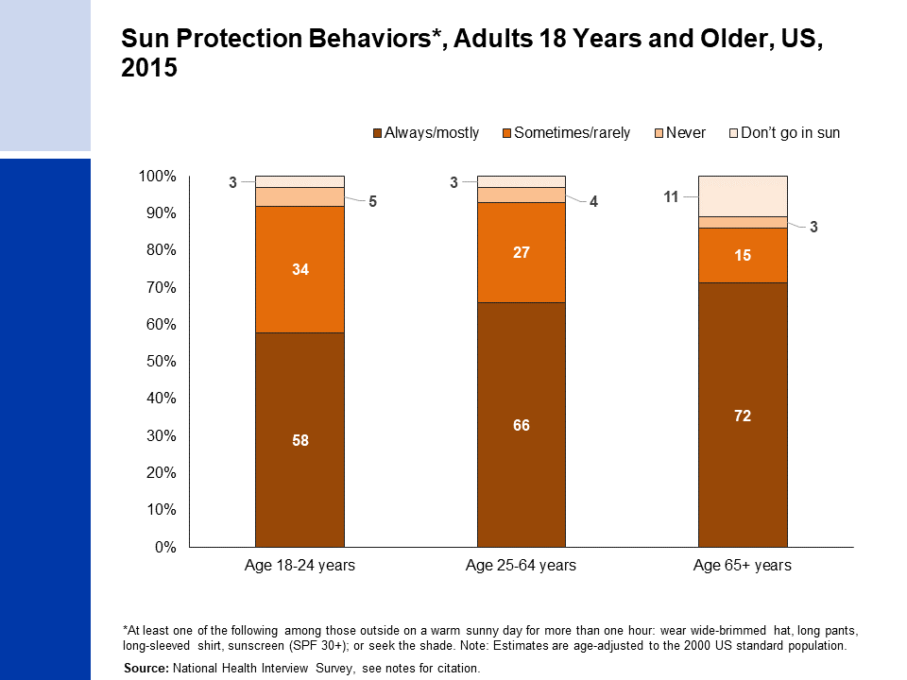
Notes:
- National Health Interview Survey, National Center for Health Statistics, Centers for Disease Control and Prevention, 2015. Public-use data file and documentation. https://www.cdc.gov/nchs/nhis/index.htm

Slide 18
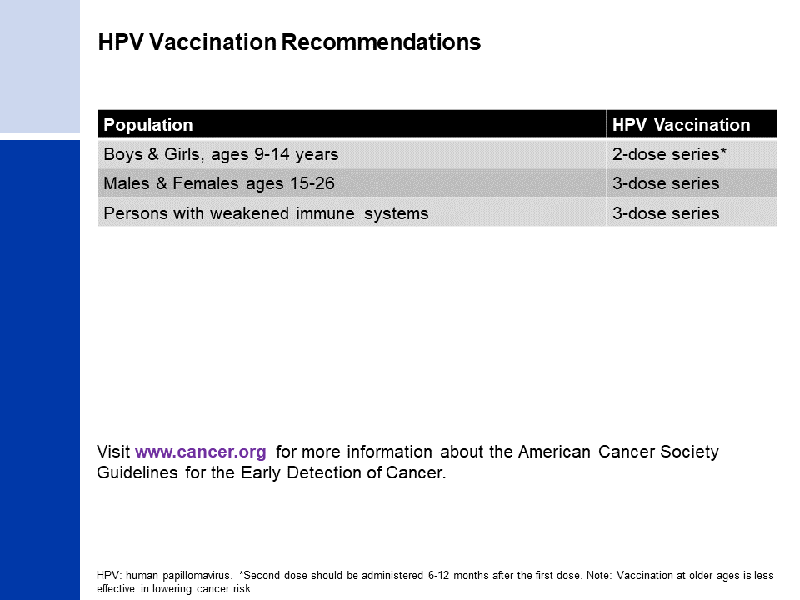
Notes:
Smith RA, et al. PMID: 28170086
Meites E, et al. PMID: 27977643

Slide 19
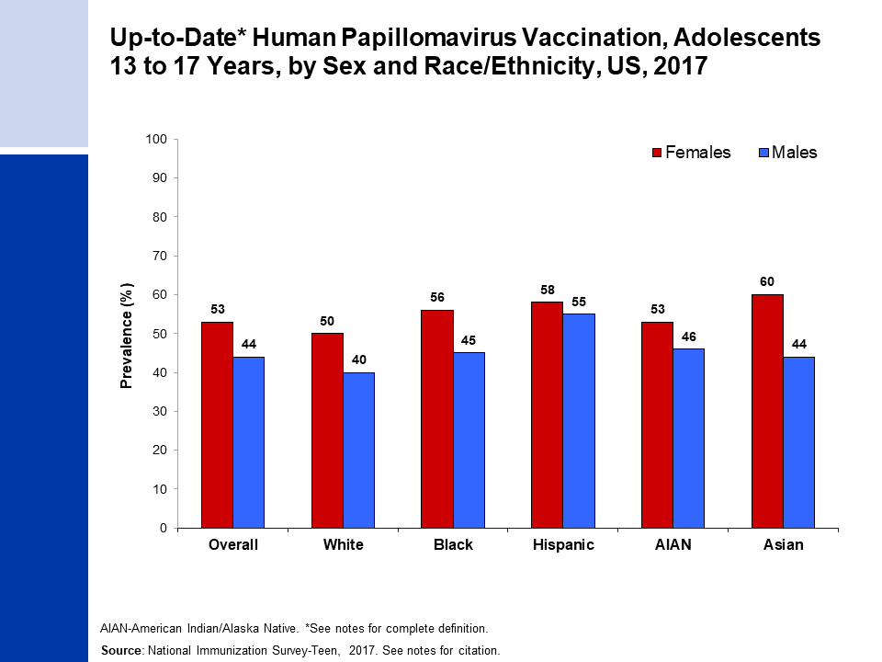
Notes:
Up-to-Date HPV vaccination includes those who received ≥3 doses, and those who received 2 doses when the first HPV vaccine dose was initiated before age 15 years and the time between the first and second dose was at least 5 months minus 4 days.
Estimates for white, black, AIAN, and Asian are among non-Hispanics. Native Hawaiian or other Pacific Islanders were not included due to small sample sizes.
Walker, et al. PMID: 30138305

Slide 20
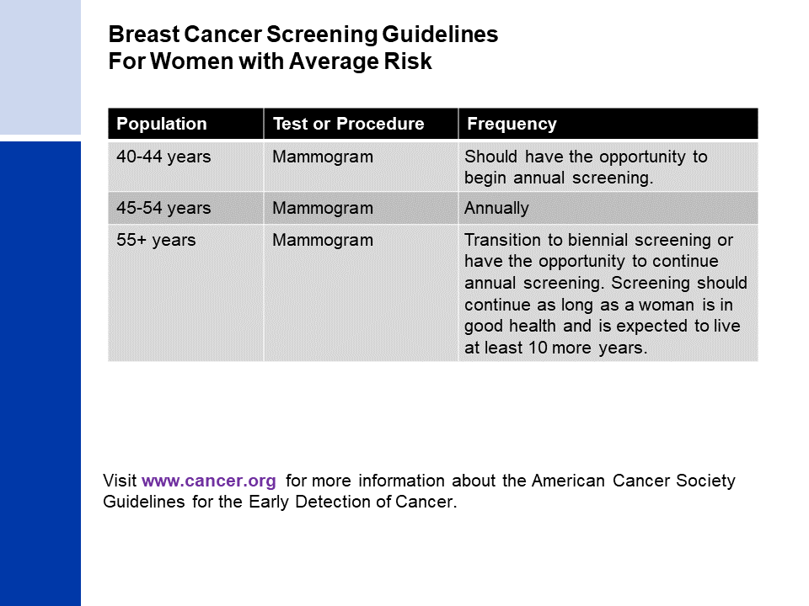
Notes:
Oeffinger KC, et al. PMID: 26501536
Smith RA, et al. PMID: 29846940

Slide 21
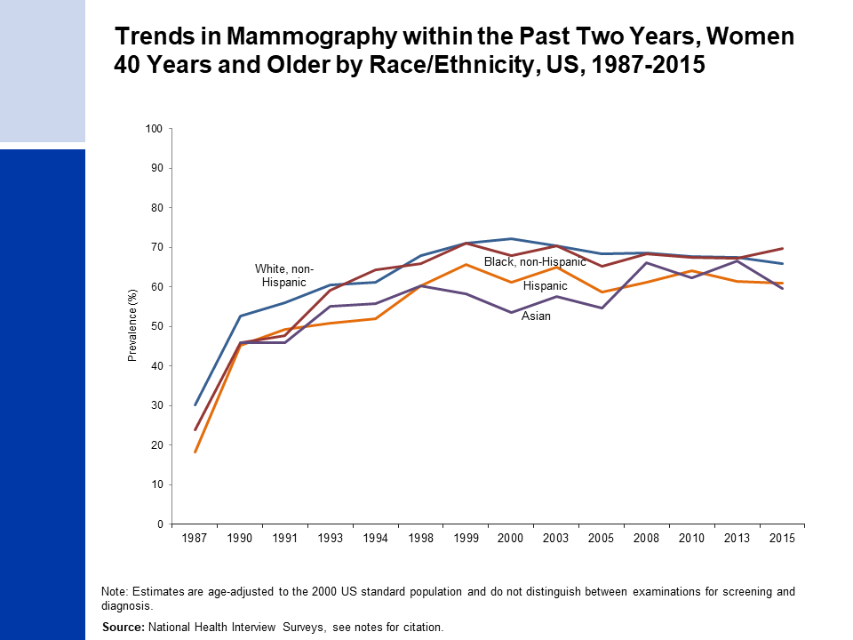
Notes:
Estimates for whites and blacks are among non-Hispanics. Estimates for Asians may be Hispanic or non-Hispanic.
National Center for Health Statistics. Health, United States, 2017: With special feature on mortality. Hyattsville, MD. 2018.

Slide 22
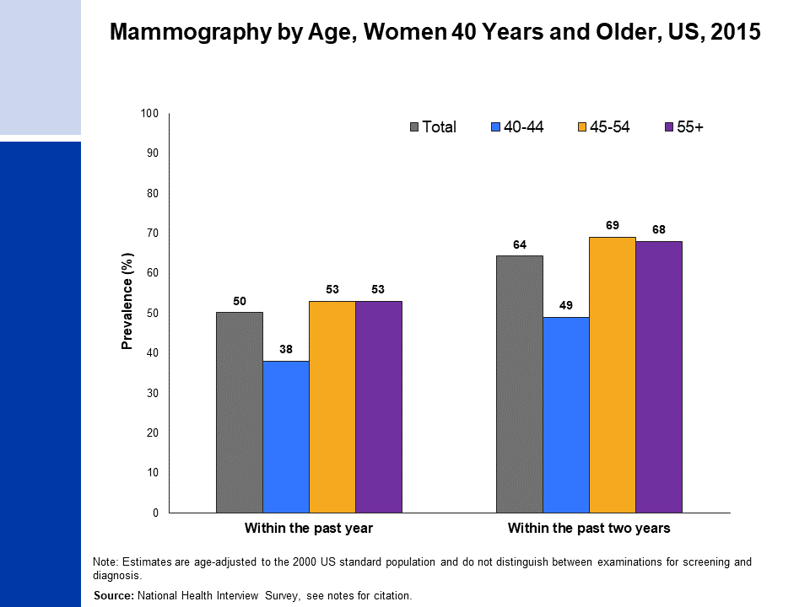
Notes:
- National Health Interview Survey, National Center for Health Statistics, Centers for Disease Control and Prevention, 2015. Public-use data file and documentation. https://www.cdc.gov/nchs/nhis/index.htm

Slide 23
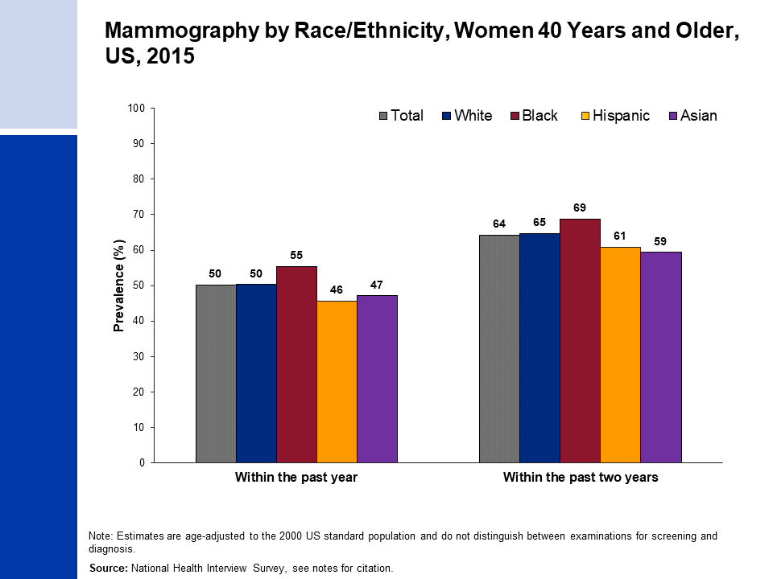
Notes:
- Estimates for white, black, and Asian are among non-Hispanics. Estimates for Asians do not include Native Hawaiians or other Pacific Islanders.
- National Health Interview Survey, National Center for Health Statistics, Centers for Disease Control and Prevention, 2015. Public-use data file and documentation. https://www.cdc.gov/nchs/nhis/index.htm

Slide 24
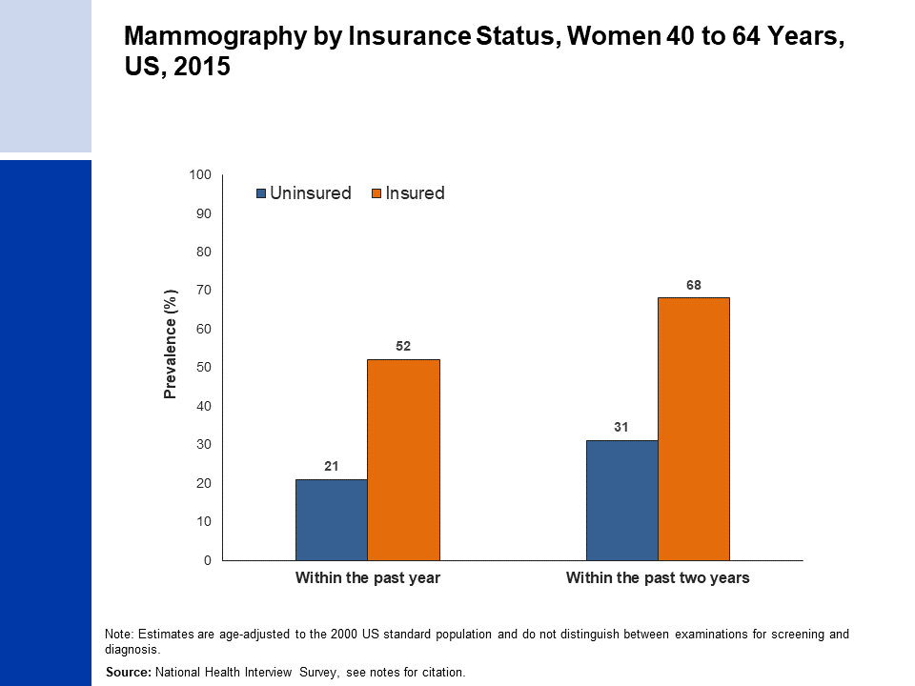
Notes:
- National Health Interview Survey, National Center for Health Statistics, Centers for Disease Control and Prevention, 2015. Public-use data file and documentation. https://www.cdc.gov/nchs/nhis/index.htm

Slide 25
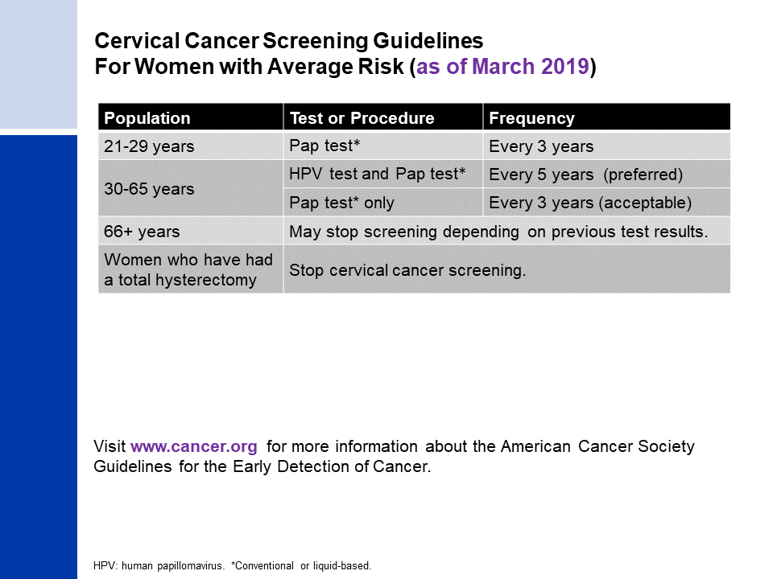
Notes:
- Saslow D, et al. PMID: 22422631
- Smith RA, et al. PMID: 29846940

Slide 26
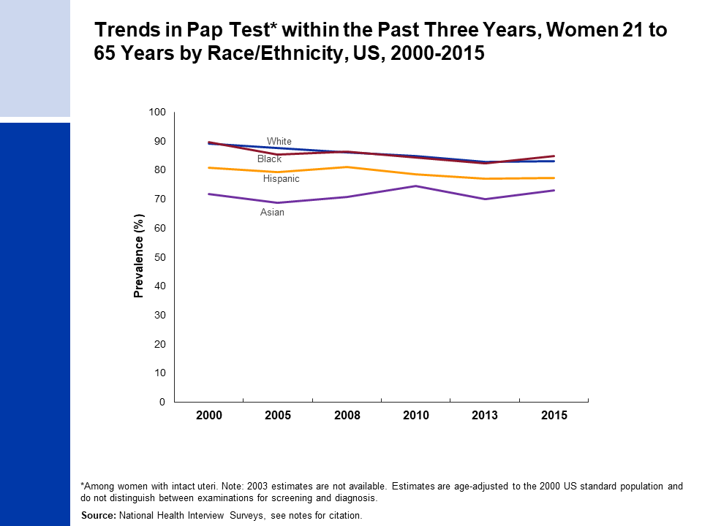
Notes:
- Estimates for white, black, and Asian are among non-Hispanics. Estimates for Asians do not include Native Hawaiians or other Pacific Islanders.
- National Health Interview Surveys, National Center for Health Statistics, Centers for Disease Control and Prevention, 2000-2015. Public-use data file and documentation. https://www.cdc.gov/nchs/nhis/index.htm

Slide 27
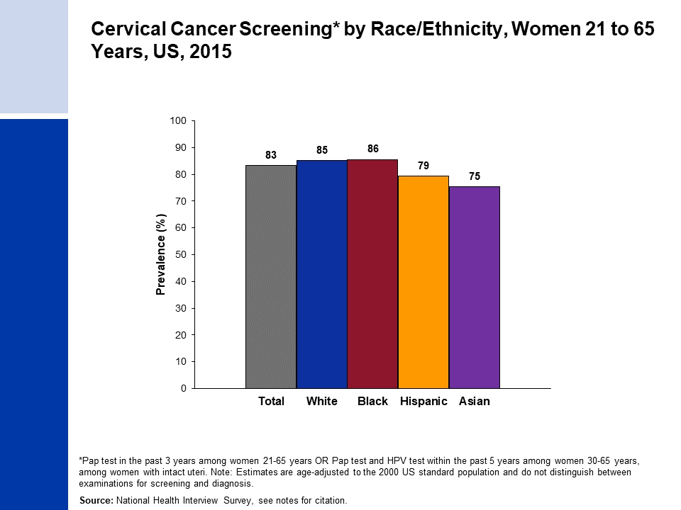
Notes:
- Estimates for white, black, and Asian are among non-Hispanics. Estimate for Asians does not include Native Hawaiians or other Pacific Islanders.
- National Health Interview Survey, National Center for Health Statistics, Centers for Disease Control and Prevention, 2015. Public-use data file and documentation. https://www.cdc.gov/nchs/nhis/index.htm

Slide 28
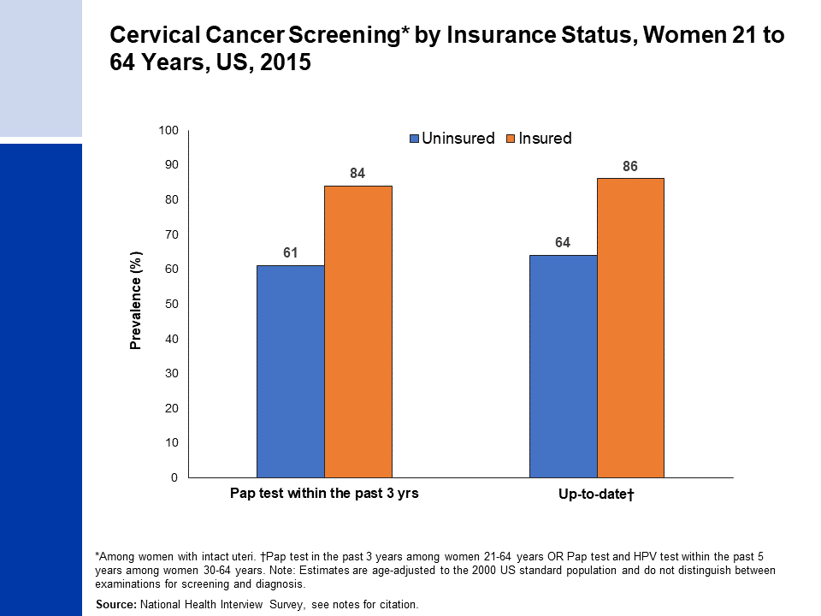
Notes:
- National Health Interview Survey, National Center for Health Statistics, Centers for Disease Control and Prevention, 2015. Public-use data file and documentation. https://www.cdc.gov/nchs/nhis/index.htm

Slide 29
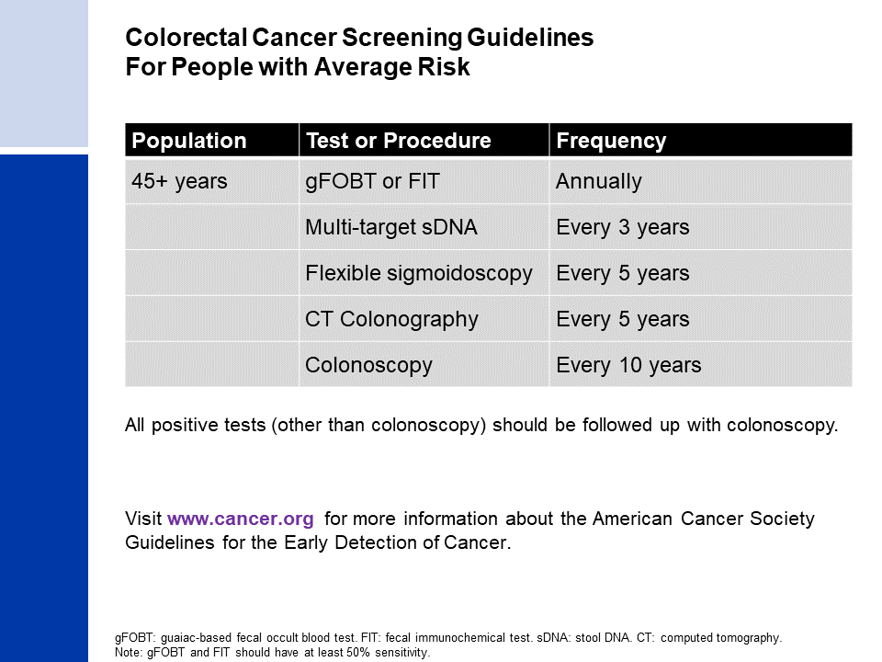
Notes:
Wolf AMD, et al. PMID: 29846947
Smith RA, et al. PMID: 29846940

Slide 30
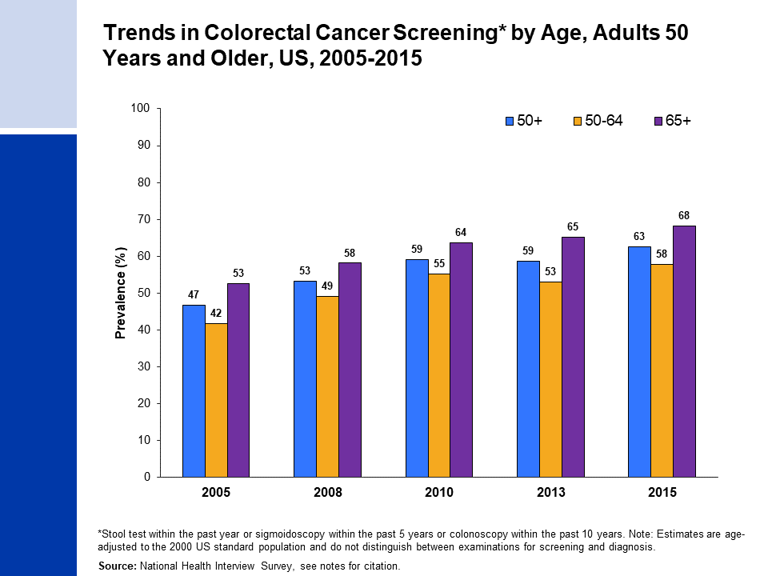
Notes:
- National Health Interview Survey, National Center for Health Statistics, Centers for Disease Control and Prevention, 2005-2015. Public-use data files and documentation. https://www.cdc.gov/nchs/nhis/index.htm

Slide 31
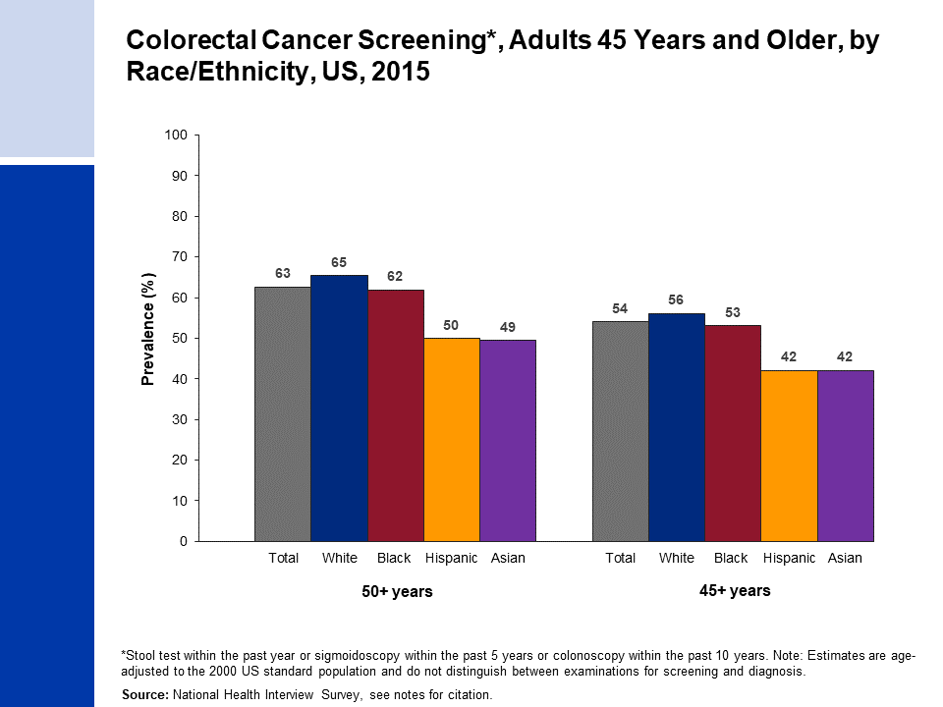
Notes:
- Estimates for white, black, and Asian are among non-Hispanics. Estimates for Asians do not include Native Hawaiians or other Pacific Islanders
- National Health Interview Survey, National Center for Health Statistics, Centers for Disease Control and Prevention, 2015. Public-use data file and documentation. https://www.cdc.gov/nchs/nhis/index.htm

Slide 32
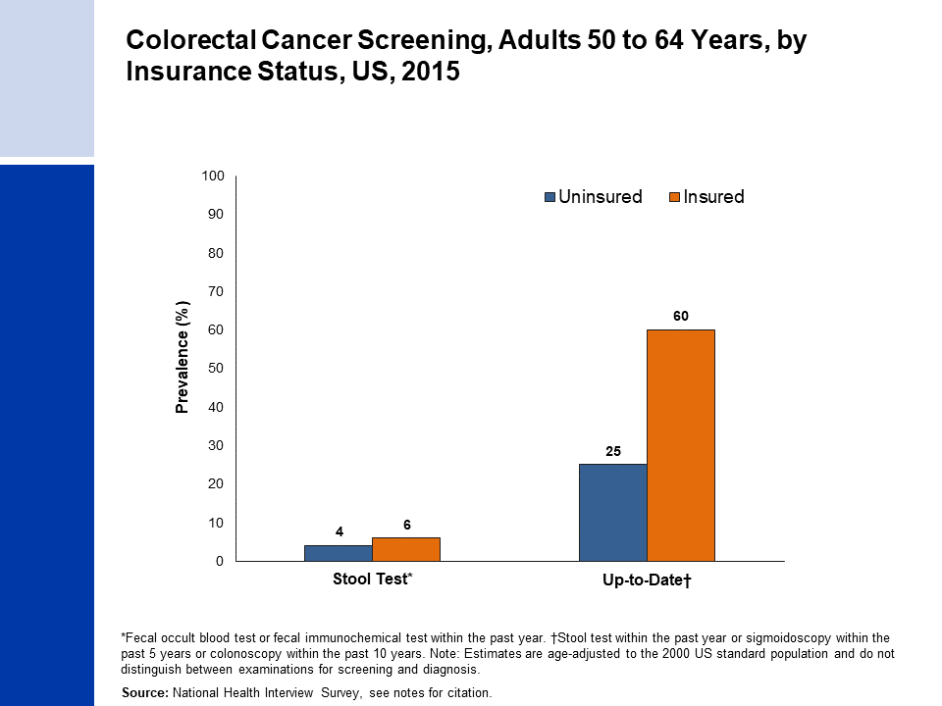
Notes:
- National Health Interview Survey, National Center for Health Statistics, Centers for Disease Control and Prevention, 2015. Public-use data file and documentation. https://www.cdc.gov/nchs/nhis/index.htm

Slide 33
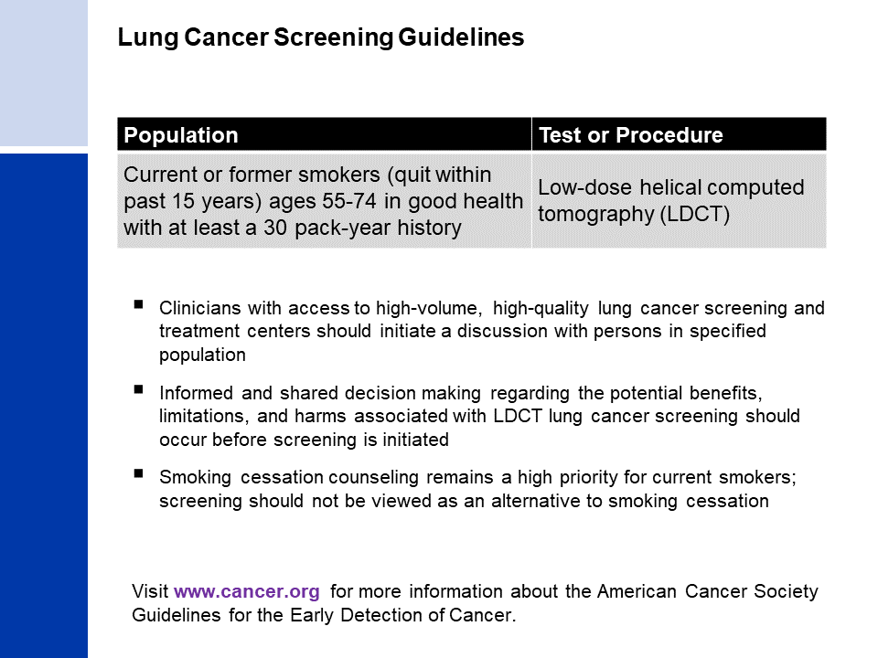
Notes:
Wender R, et al. PMID: 23315954
Smith RA, et al. PMID: 29846940

Slide 34
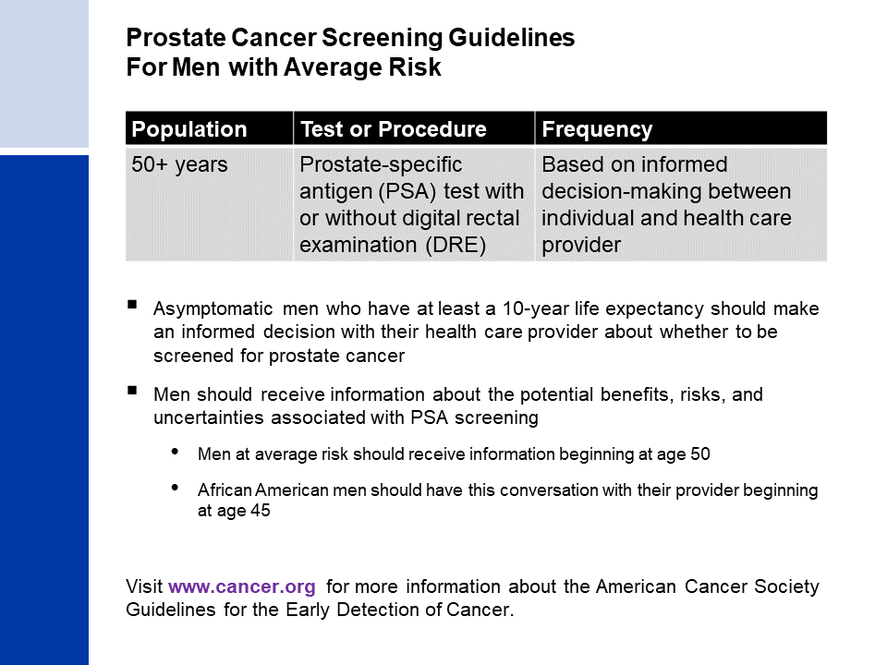
Notes:
- Wolf AM, et al. PMID: 20200110
- Smith RA, et al. PMID: 29846940

