Slide 1
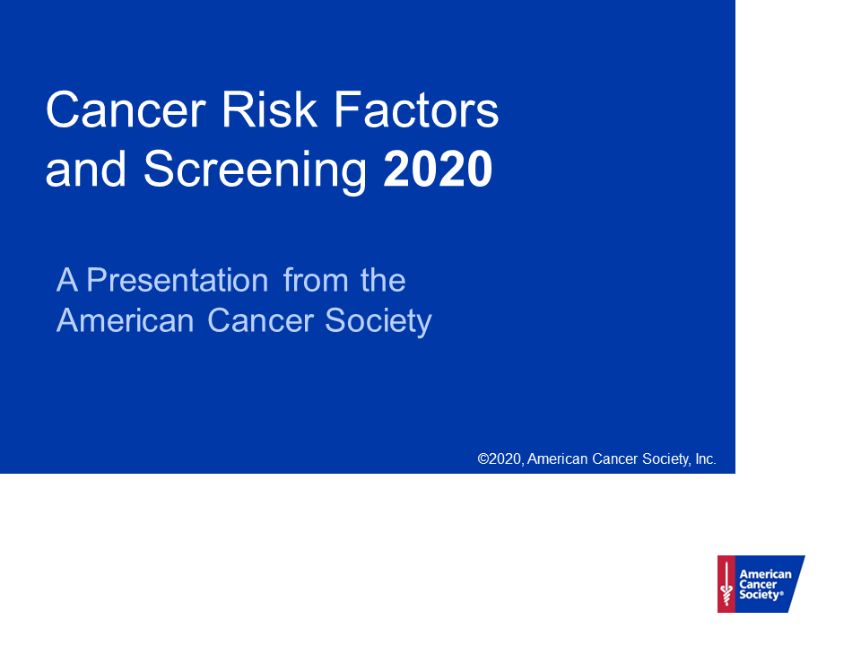

Slide 2
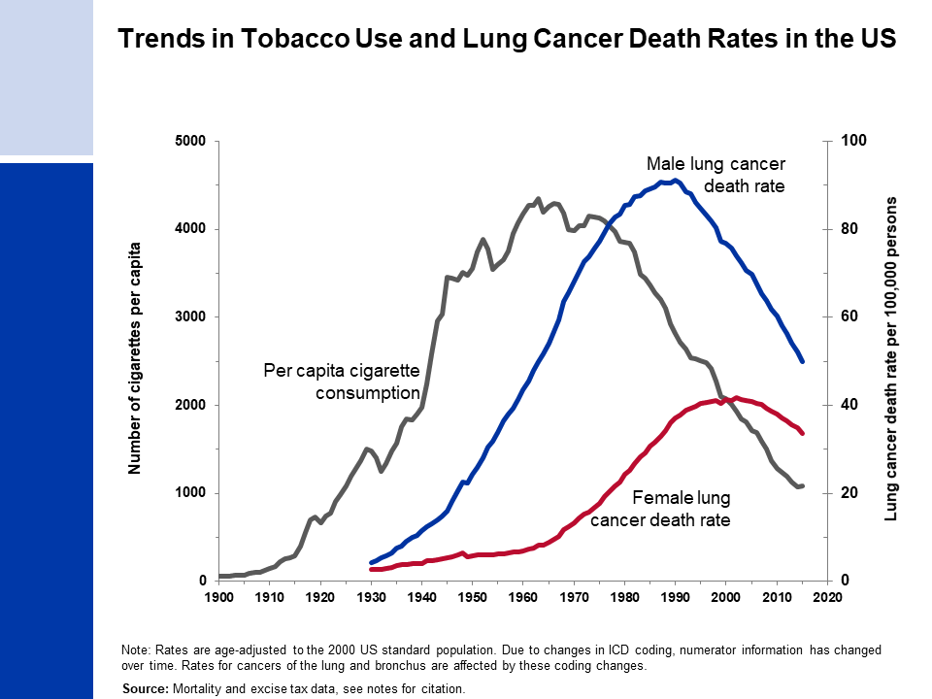
Notes:
Death rates: US Mortality Volumes 1930 to 1959, US Mortality Data 1960 to 2015, National Center for Health Statistics, Centers for Disease Control and Prevention.
Cigarette consumption: 1900-1999: US Department of Agriculture. 2000-2015: Wang, TW et al. PMID: 27932780

Slide 3
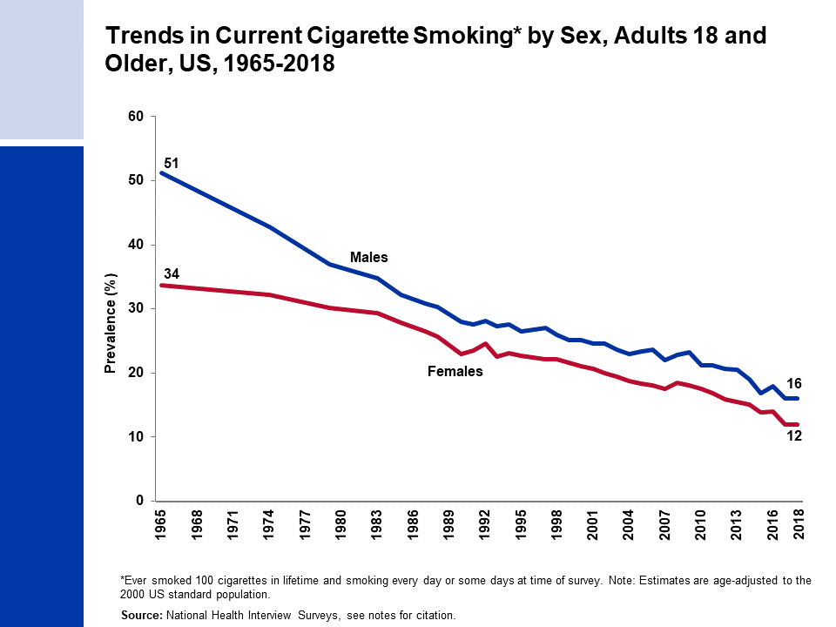
Notes:
National Center for Health Statistics. Health, United States, 2018. Hyattsville, MD. 2019.
National Health Interview Survey, National Center for Health Statistics, Centers for Disease Control and Prevention, 2018. Public-use data file and documentation. https://www.cdc.gov/nchs/nhis/index.htm

Slide 4
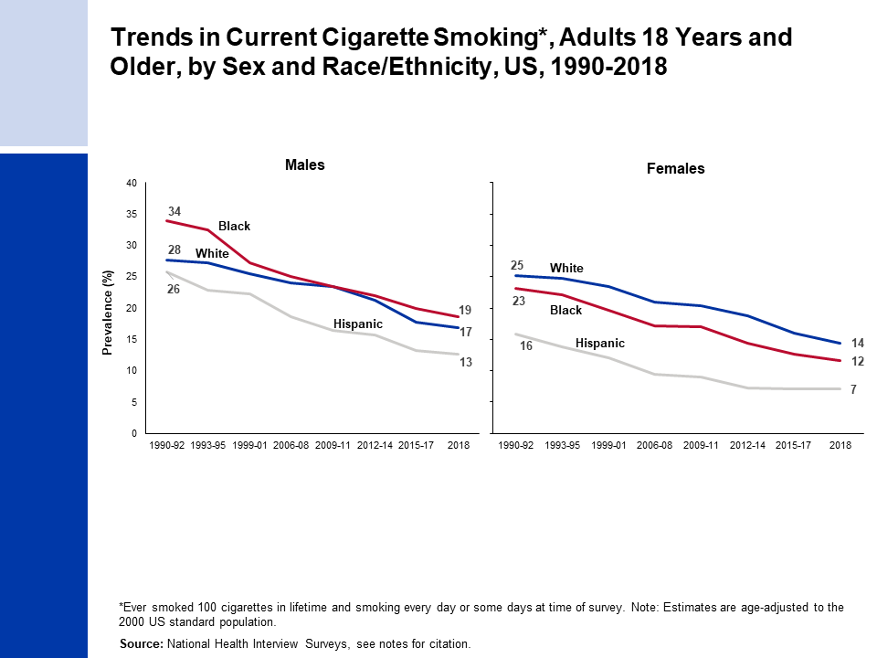
Notes:
Estimates for white and black are among non-Hispanics.
National Center for Health Statistics. Health, United States, 2018. Hyattsville, MD. 2019.
National Health Interview Survey, National Center for Health Statistics, Centers for Disease Control and Prevention, 2018. Public-use data file and documentation. https://www.cdc.gov/nchs/nhis/index.htm

Slide 5
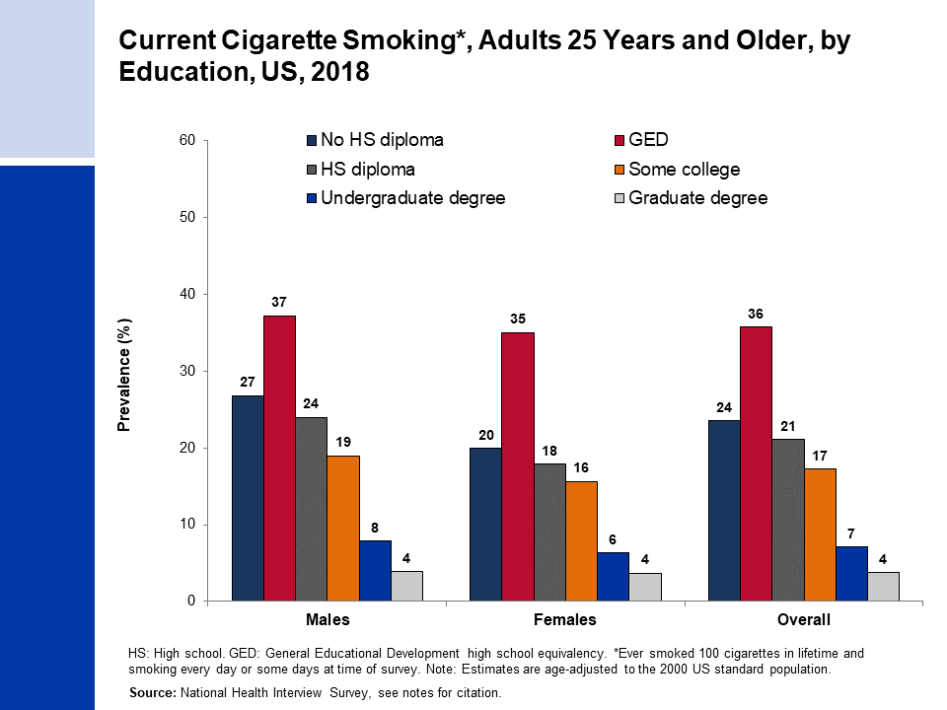
Notes:
Estimate for “Some college” includes those with an Associate’s degree.
National Health Interview Survey, National Center for Health Statistics, Centers for Disease Control and Prevention, 2018. Public-use data file and documentation. https://www.cdc.gov/nchs/nhis/index.htm

Slide 6
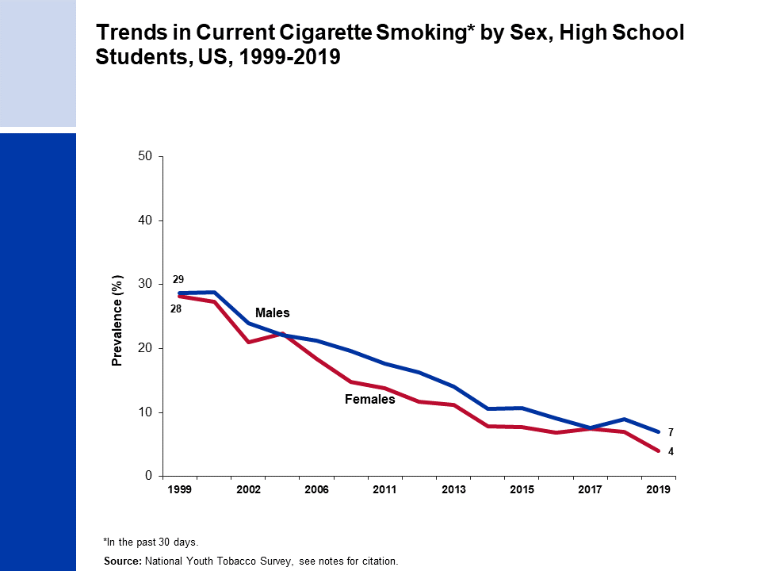
Notes:
1999: Centers for Disease Control and Prevention. PMID: 11057729
2000: Centers for Disease Control and Prevention. PMID: 11902401
2002: Marshall L, et al. PMID: 16708059
2004: Bloch AB, et al. PMID: 15800473
2006 & 2009: Arrazola RA, et al. PMID: 20798668
2011 & 2012: Arrazola RA, et al. PMID: 24226625
2013: Arrazola RA, et al. PMID: 25393220
2014: Arrazola RA, et al. PMID: 25879896
2015: Singh T, et al. PMID: 27077789
2016: Jamal A, et al. PMID: 28617771
2017: Wang TW, et al. PMID: 29879097
2018: Gentzke AS, et al. PMID: 30763302
2019: Wang TW, et al. PMID: 31805035

Slide 7
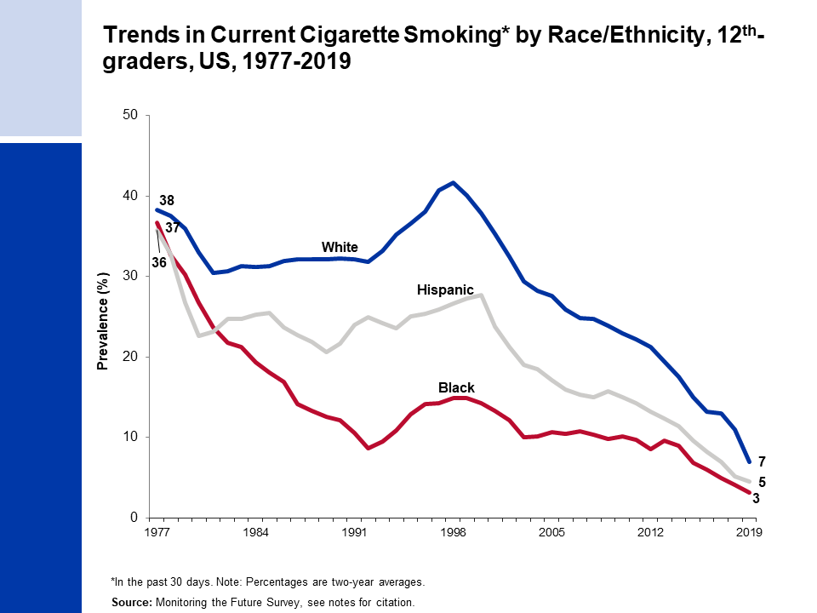
Notes:
Monitoring the Future Study, 1976-2019, University of Michigan. http://monitoringthefuture.org/
Johnston, L. D., Miech, R. A., O’Malley, P. M., Bachman, J. G., Schulenberg, J. E., & Patrick, M. E. (2020). Demographic subgroup trends among adolescents in the use of various licit and illicit drugs, 1975–2019 (Monitoring the Future Occasional Paper No. 94). Ann Arbor, MI: Institute for Social Research, The University of Michigan.

Slide 8
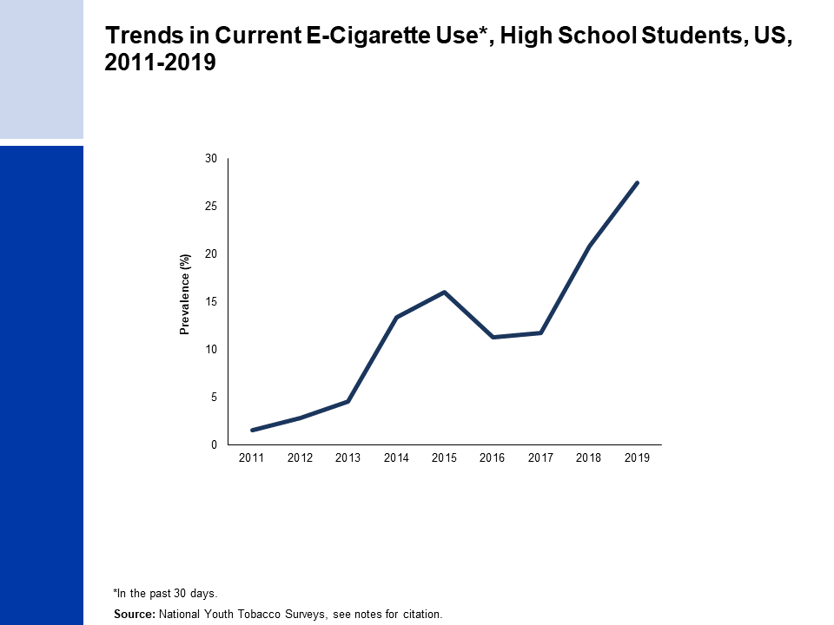
Notes:
Wang T, et al. PMID: 31805035
Gentzke AS, et al. PMID: 30763302

Slide 9
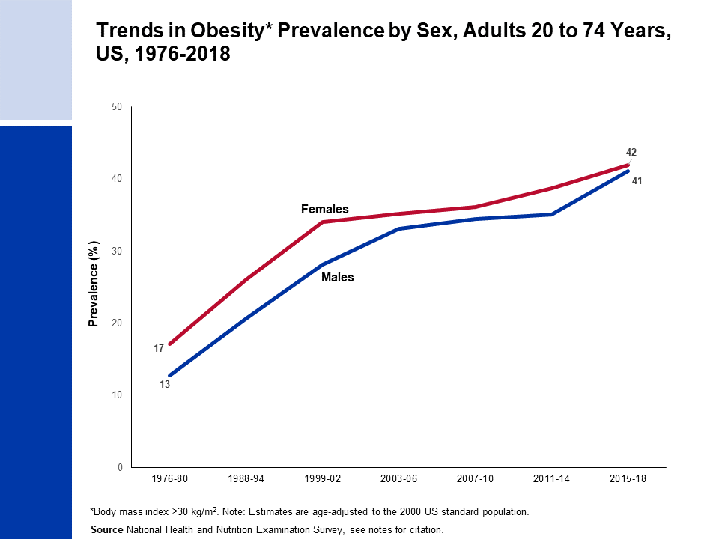
Notes:
National Center for Health Statistics. Health, United States, 2013: With Special Feature on Prescription Drugs. Hyattsville, MD. 2014.
National Center for Health Statistics. National Health and Nutrition Examination Survey, 2011-2018. Public-use data files and documentation. https://wwwn.cdc.gov/nchs/nhanes/Default.aspx

Slide 10
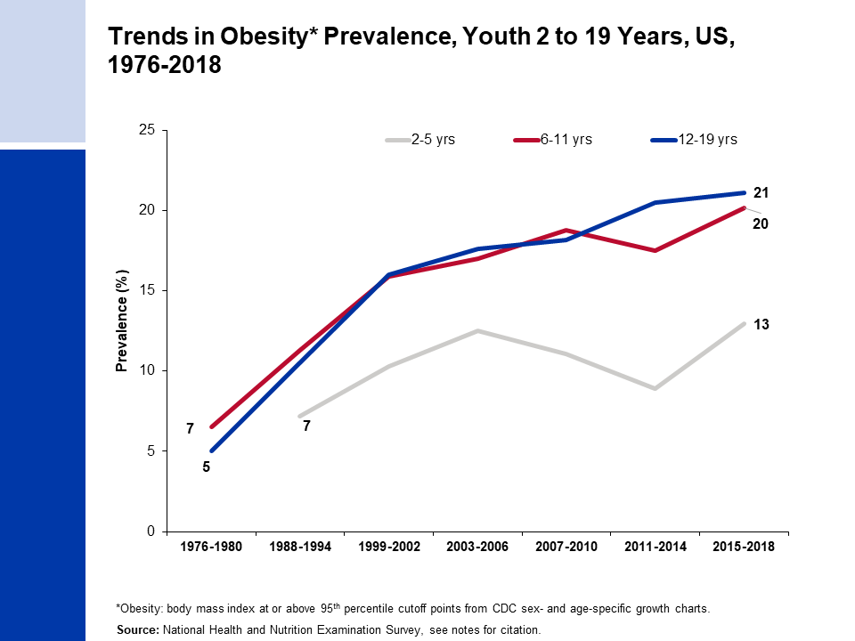
Notes:
National Center for Health Statistics. Health, United States, 2013: With Special Feature on Prescription Drugs. Hyattsville, MD. 2014.
National Center for Health Statistics. Health, United States, 2017: With Special Feature on Mortality. Hyattsville, MD. 2018.
National Center for Health Statistics. National Health and Nutrition Examination Survey, 2015-2018. Public-use data files and documentation. https://wwwn.cdc.gov/nchs/nhanes/Default.aspx

Slide 11
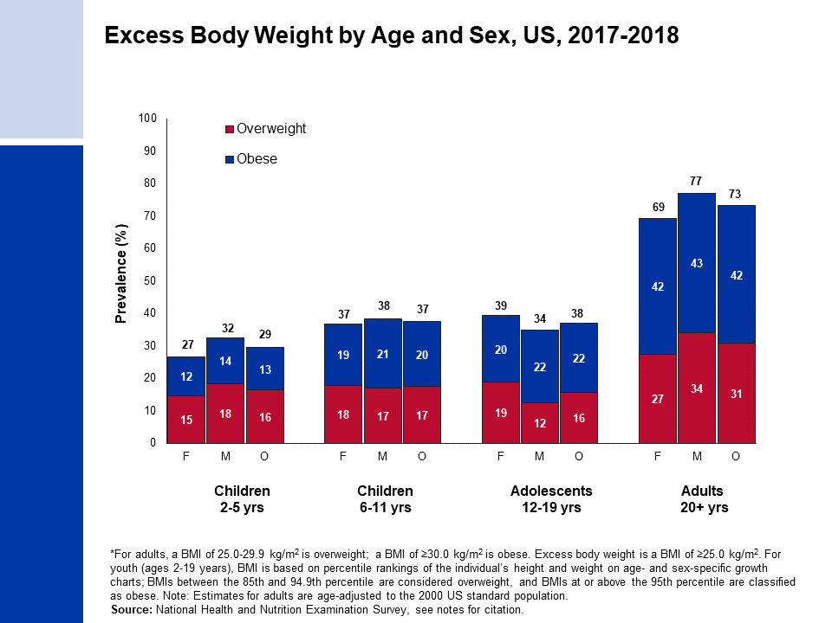
Notes:
Hales CM, Carrol MD, Fryar CD, Ogden CL. Prevalence of Obesity and Severe Obesity Among Adults: United States, 2017-2018. National Center for Health Statistics Data Brief No. 360. 2020.
National Center for Health Statistics. National Health and Nutrition Examination Survey, 2017-2018. Public-use data files and documentation. https://wwwn.cdc.gov/nchs/nhanes/Default.aspx

Slide 12
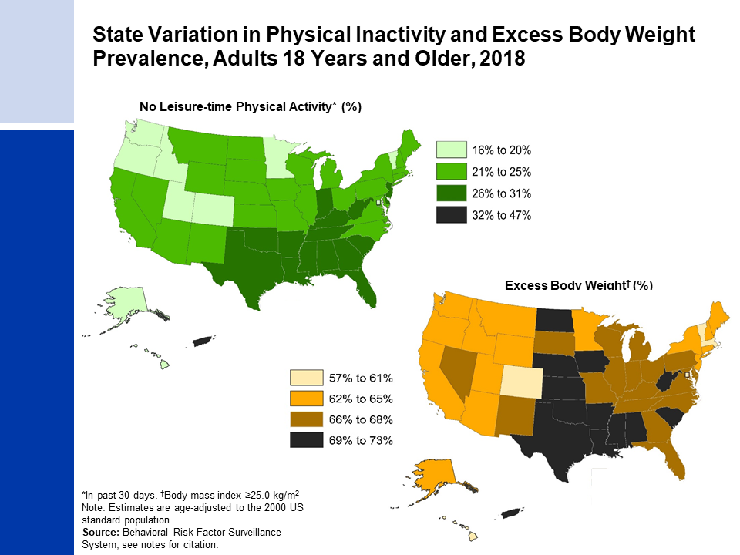
Notes:
Centers for Disease Control and Prevention (CDC). Behavioral Risk Factor Surveillance System Survey Data. Atlanta, Georgia: U.S. Department of Health and Human Services, Centers for Disease Control and Prevention, 2018. https://www.cdc.gov/brfss/data_documentation/index.htm

Slide 13
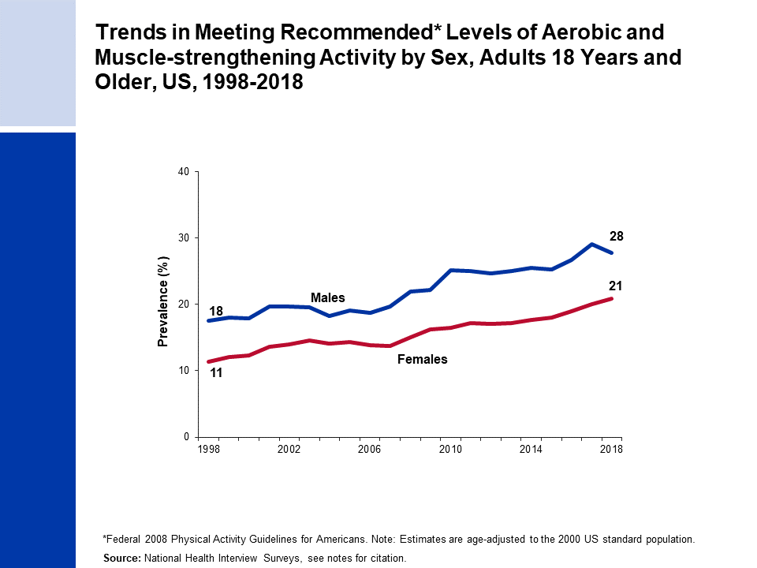
Notes:
National Center for Health Statistics. Health, United States, 2018. Hyattsville, MD. 2019.
National Health Interview Survey, National Center for Health Statistics, Centers for Disease Control and Prevention, 2018. Public-use data file and documentation. https://www.cdc.gov/nchs/nhis/index.htm

Slide 14
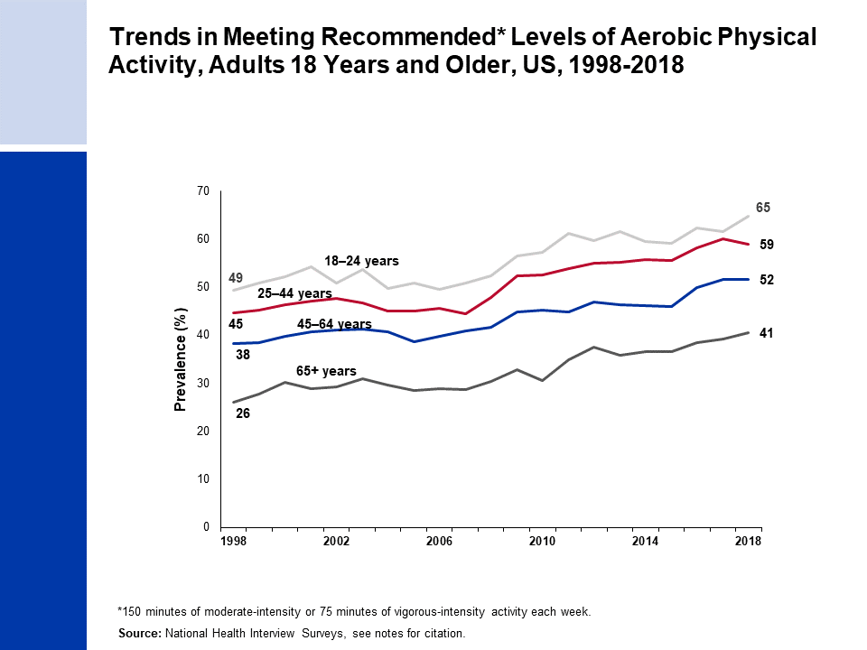
Notes:
National Center for Health Statistics. Health, United States, 2018. Hyattsville, MD. 2019.
National Health Interview Survey, National Center for Health Statistics, Centers for Disease Control and Prevention, 2018. Public-use data file and documentation. https://www.cdc.gov/nchs/nhis/index.htm

Slide 15
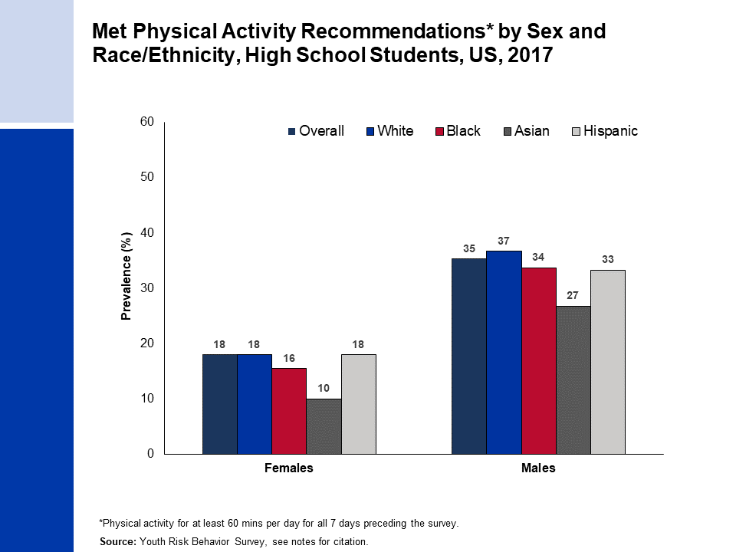
Notes:
Estimates for white, black, and Asian are among non-Hispanics.
Centers for Disease Control and Prevention. High School Youth Risk Behavior Survey Data, 2017. Available from URL: https://nccd.cdc.gov/youthonline/App/Default.aspx

Slide 16
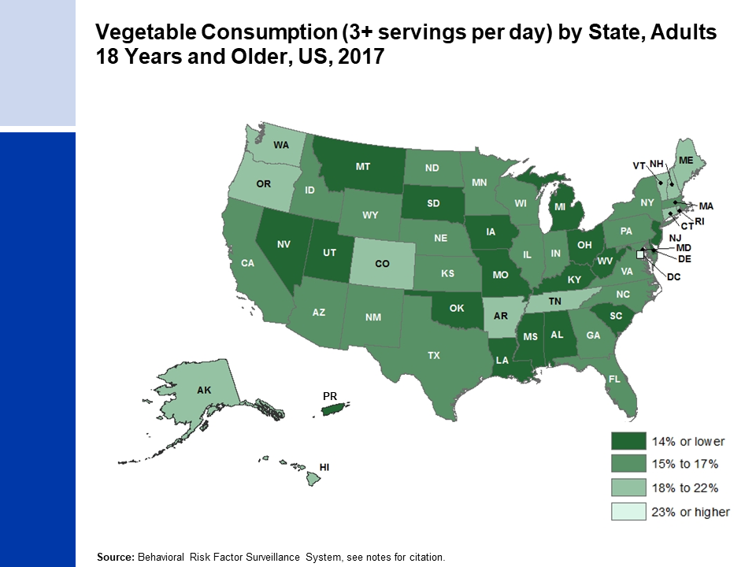
Notes:
Centers for Disease Control and Prevention (CDC). Behavioral Risk Factor Surveillance System Survey Data. Atlanta, Georgia: U.S. Department of Health and Human Services, Centers for Disease Control and Prevention, 2017.

Slide 17
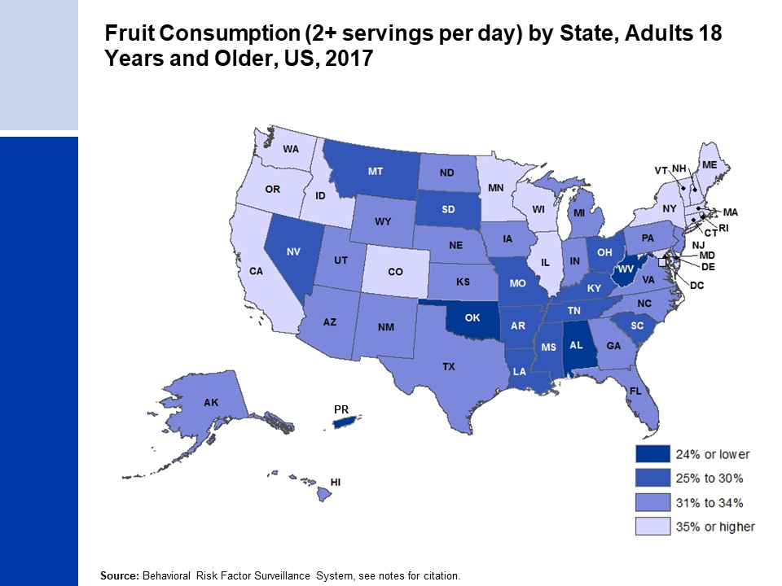
Notes:
Centers for Disease Control and Prevention (CDC). Behavioral Risk Factor Surveillance System Survey Data. Atlanta, Georgia: U.S. Department of Health and Human Services, Centers for Disease Control and Prevention, 2017.

Slide 18
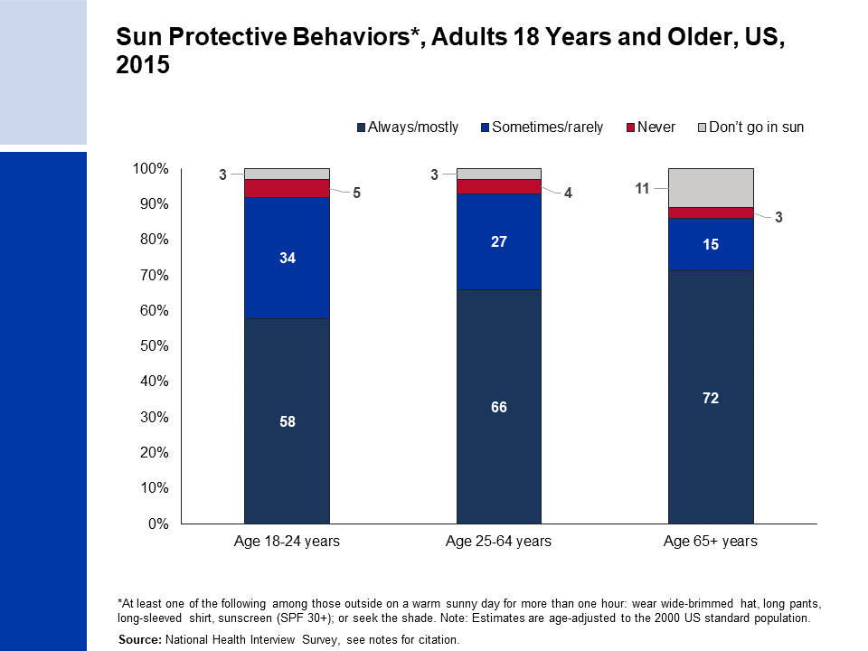
Notes:
National Health Interview Survey, National Center for Health Statistics, Centers for Disease Control and Prevention, 2015. Public-use data file and documentation. https://www.cdc.gov/nchs/nhis/index.htm

Slide 19
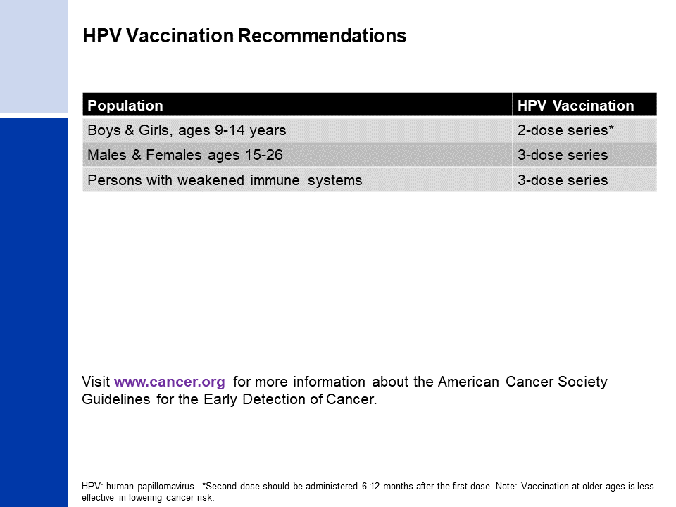
Notes:
Smith RA, et al. PMID: 28170086
Meites E, et al. PMID: 27977643

Slide 20
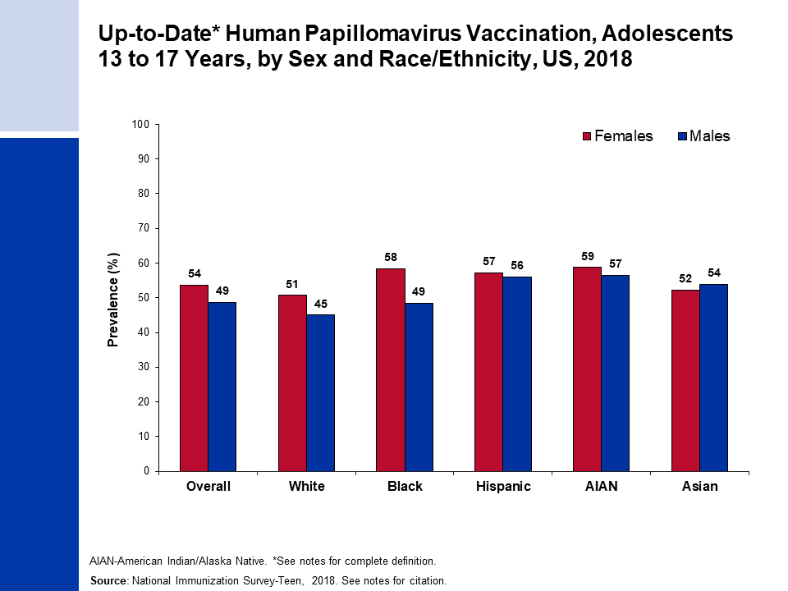
Notes:
Up-to-Date HPV vaccination includes those who received ≥3 doses, and those who received 2 doses when the first HPV vaccine dose was initiated before age 15 years and the time between the first and second dose was at least 5 months minus 4 days.
Estimates for white, black, AIAN, and Asian are among non-Hispanics. Native Hawaiian or other Pacific Islanders were not included due to small sample sizes.
Centers for Disease Control and Prevention, National Center for Immunization and Respiratory Diseases. TeenVaxView. Available from URL: https://www.cdc.gov/vaccines/imz-managers/coverage/teenvaxview/data-reports/index.html Accessed September 24, 2019.

Slide 21
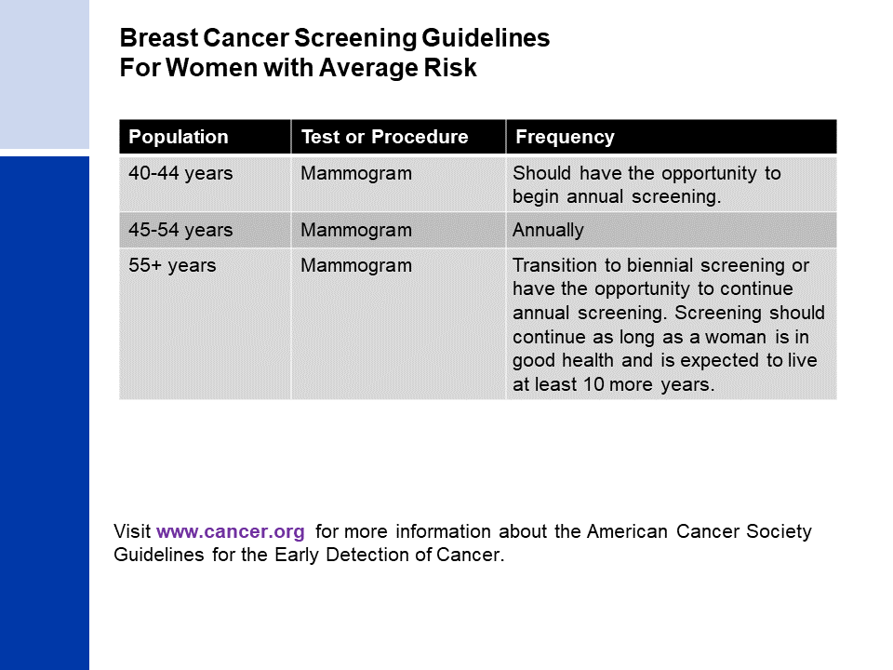
Notes:
Oeffinger KC, et al. PMID: 26501536
Smith RA, et al. PMID: 29846940

Slide 22
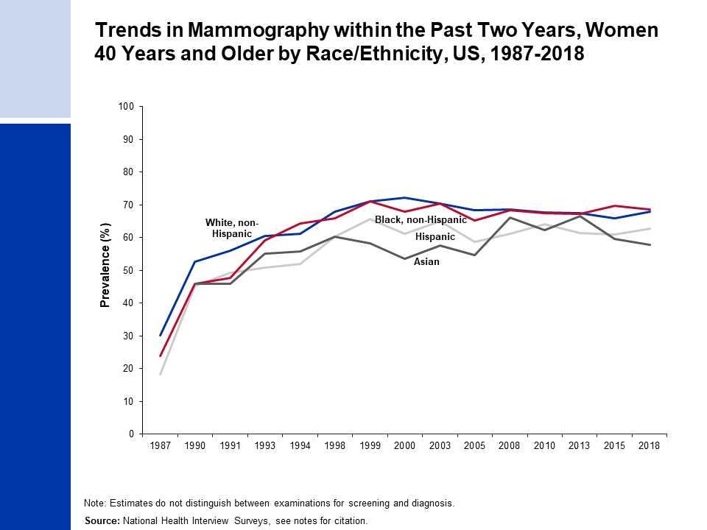
Notes:
Estimates for whites and blacks are among non-Hispanics. Estimates for Asians may be Hispanic or non-Hispanic.
National Center for Health Statistics. Health, United States, 2018. Hyattsville, MD. 2019.
National Health Interview Survey, National Center for Health Statistics, Centers for Disease Control and Prevention, 2018. Public-use data file and documentation. https://www.cdc.gov/nchs/nhis/index.htm

Slide 23
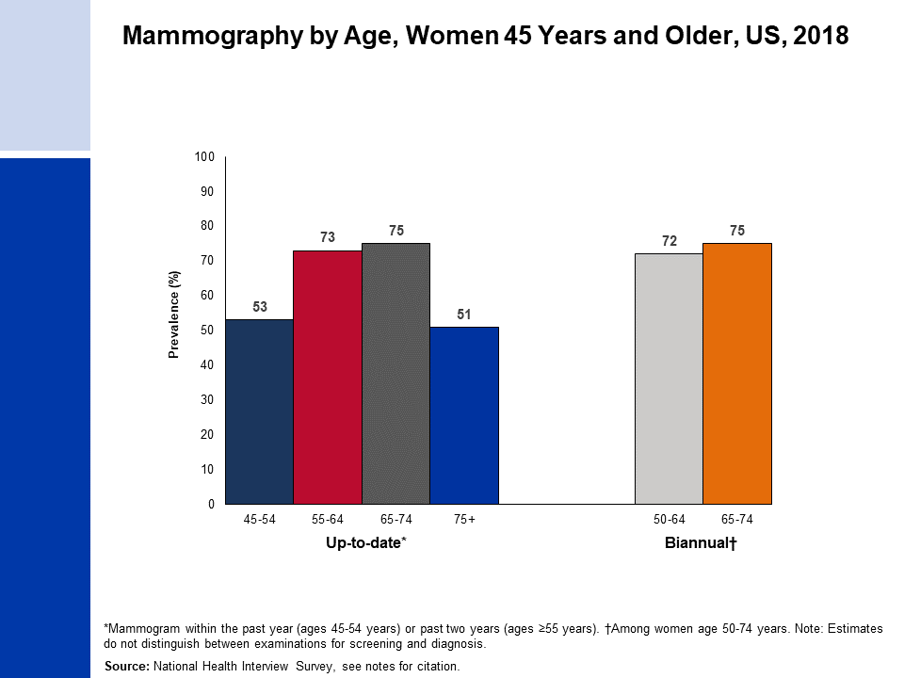
Notes:
National Health Interview Survey, National Center for Health Statistics, Centers for Disease Control and Prevention, 2018. Public-use data file and documentation. https://www.cdc.gov/nchs/nhis/index.htm

Slide 24
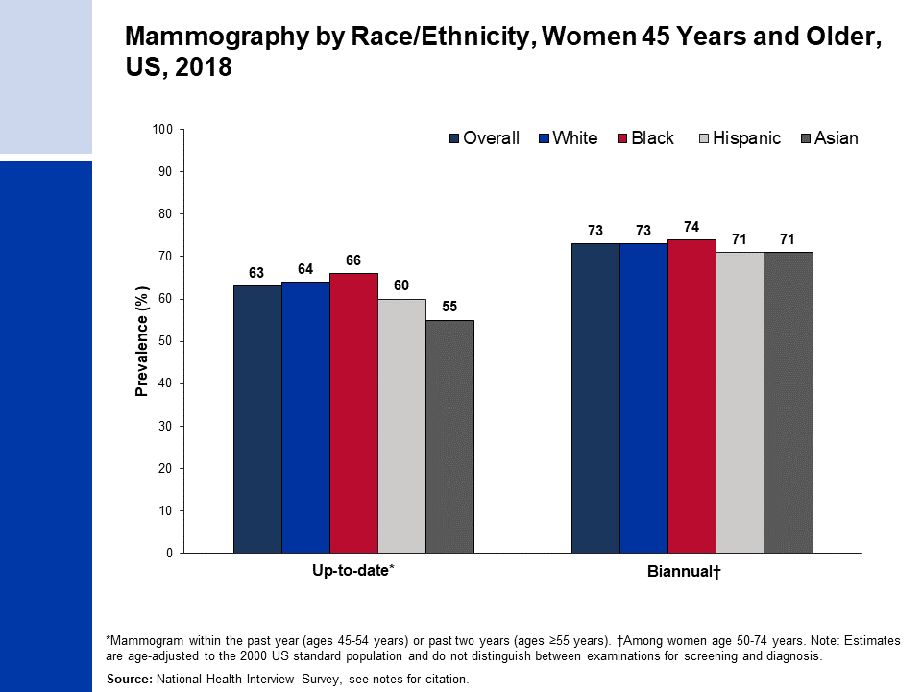
Notes:
Estimates for white, black, and Asian are among non-Hispanics. Estimates for Asians do not include Native Hawaiians or other Pacific Islanders.
National Health Interview Survey, National Center for Health Statistics, Centers for Disease Control and Prevention, 2018. Public-use data file and documentation. https://www.cdc.gov/nchs/nhis/index.htm

Slide 25
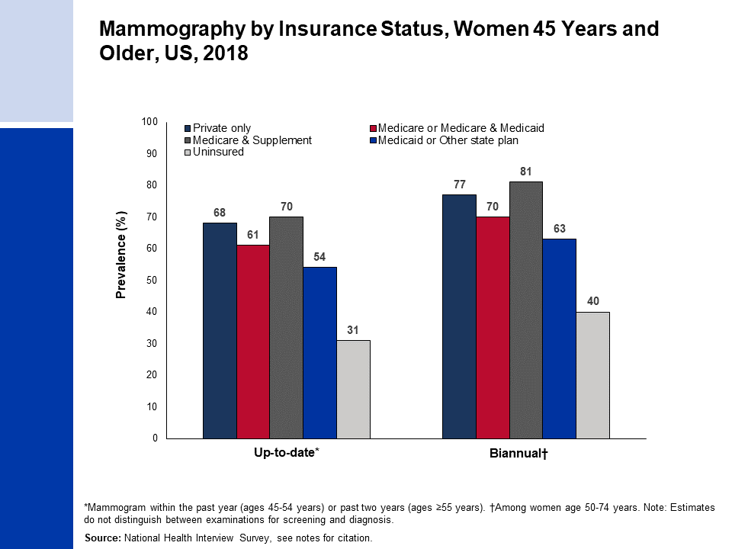
Notes:
National Health Interview Survey, National Center for Health Statistics, Centers for Disease Control and Prevention, 2018. Public-use data file and documentation. https://www.cdc.gov/nchs/nhis/index.htm

Slide 26
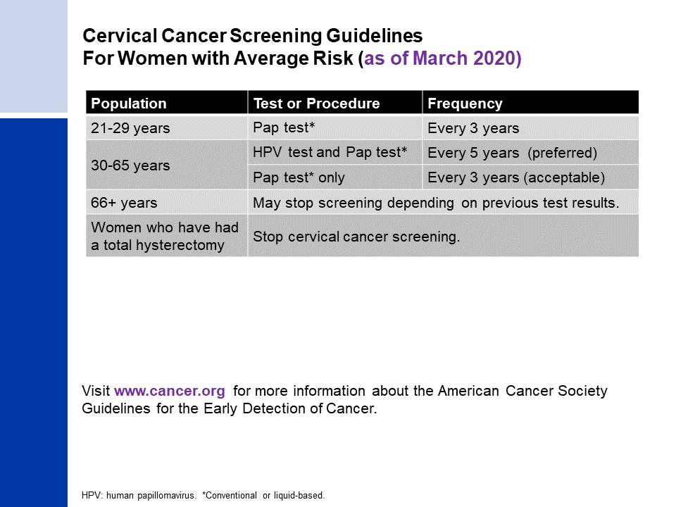
Notes:
Saslow D, et al. PMID: 22422631
Smith RA, et al. PMID: 29846940

Slide 27
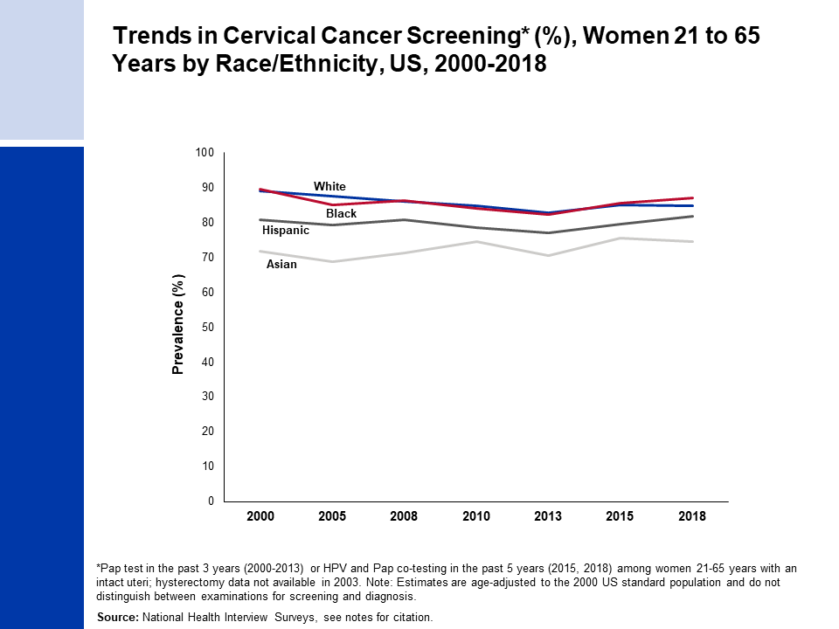
Notes:
Estimates for white, black, and Asian are among non-Hispanics. Estimates for Asians do not include Native Hawaiians or other Pacific Islanders.
National Health Interview Surveys, National Center for Health Statistics, Centers for Disease Control and Prevention, 2000-2018. Public-use data file and documentation. https://www.cdc.gov/nchs/nhis/index.htm

Slide 28
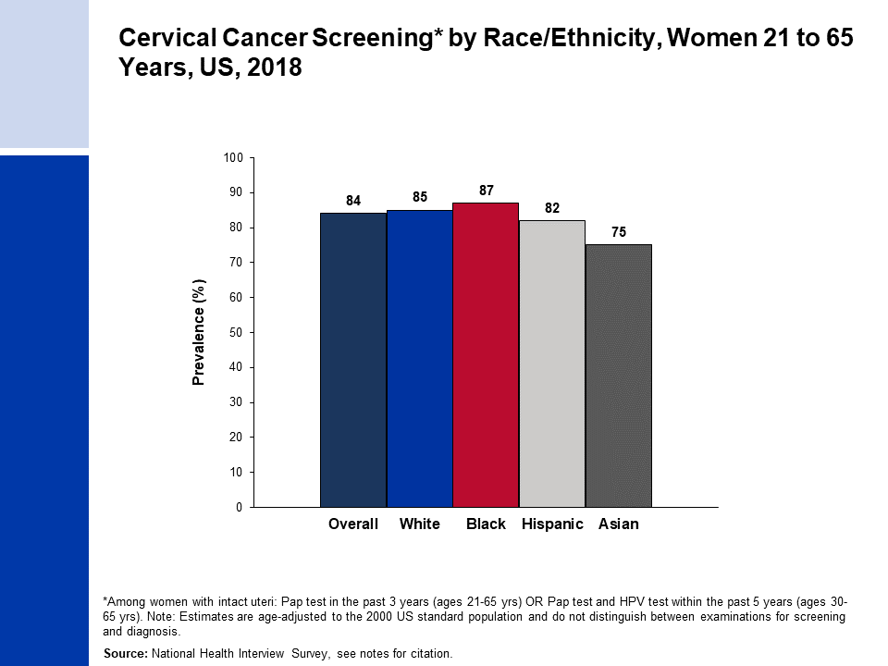
Notes:
Estimates for white, black, and Asian are among non-Hispanics. Estimate for Asians does not include Native Hawaiians or other Pacific Islanders.
National Health Interview Survey, National Center for Health Statistics, Centers for Disease Control and Prevention, 2018. Public-use data file and documentation. https://www.cdc.gov/nchs/nhis/index.htm

Slide 29
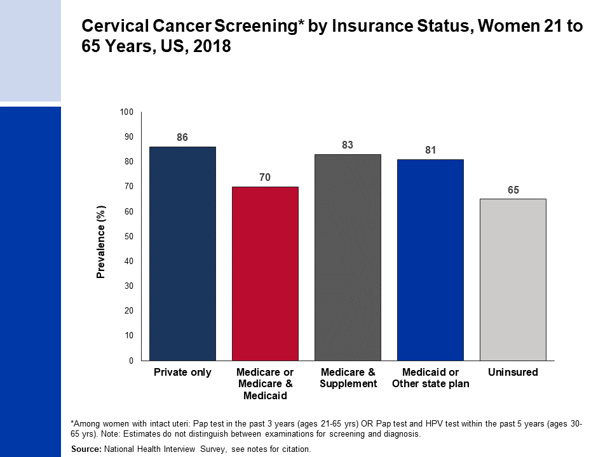
Notes:
National Health Interview Survey, National Center for Health Statistics, Centers for Disease Control and Prevention, 2018. Public-use data file and documentation. https://www.cdc.gov/nchs/nhis/index.htm

Slide 30
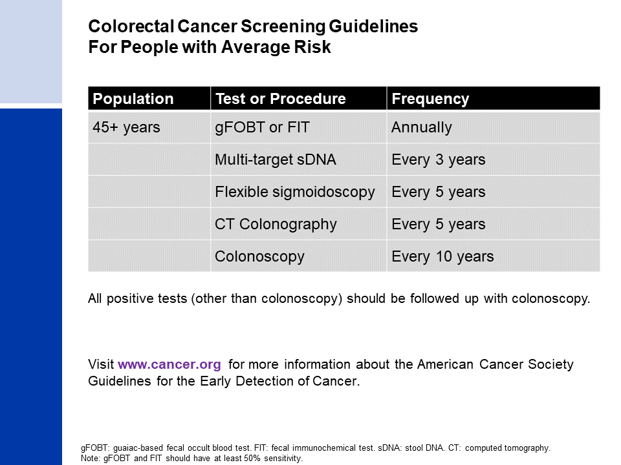
Notes:
Wolf AMD, et al. PMID: 29846947
Smith RA, et al. PMID: 29846940

Slide 31
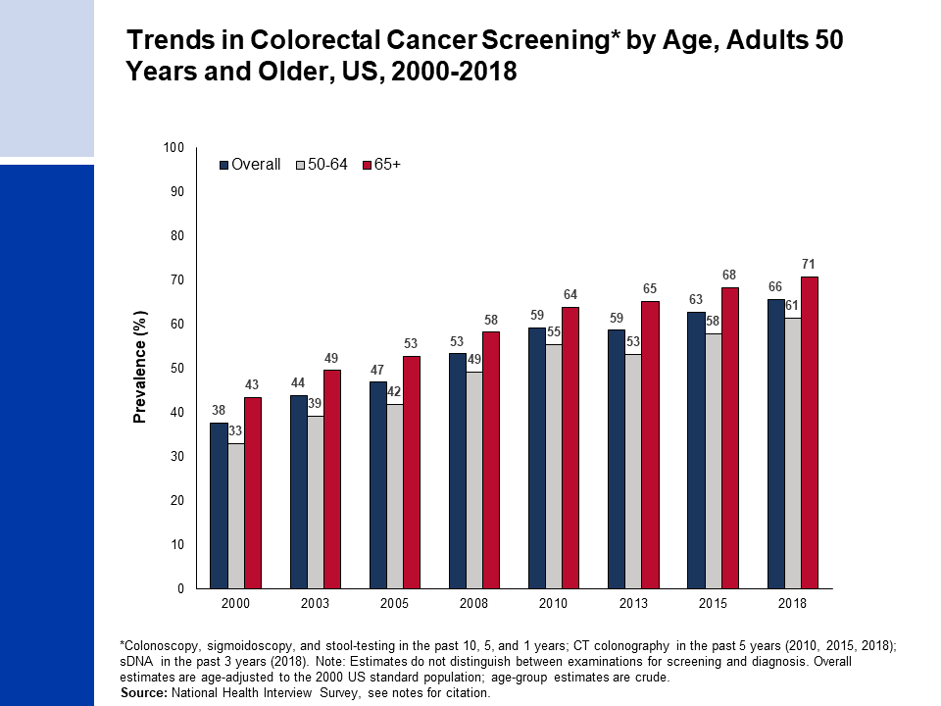
Notes:
National Health Interview Survey, National Center for Health Statistics, Centers for Disease Control and Prevention, 2000-2018. Public-use data files and documentation. https://www.cdc.gov/nchs/nhis/index.htm

Slide 32
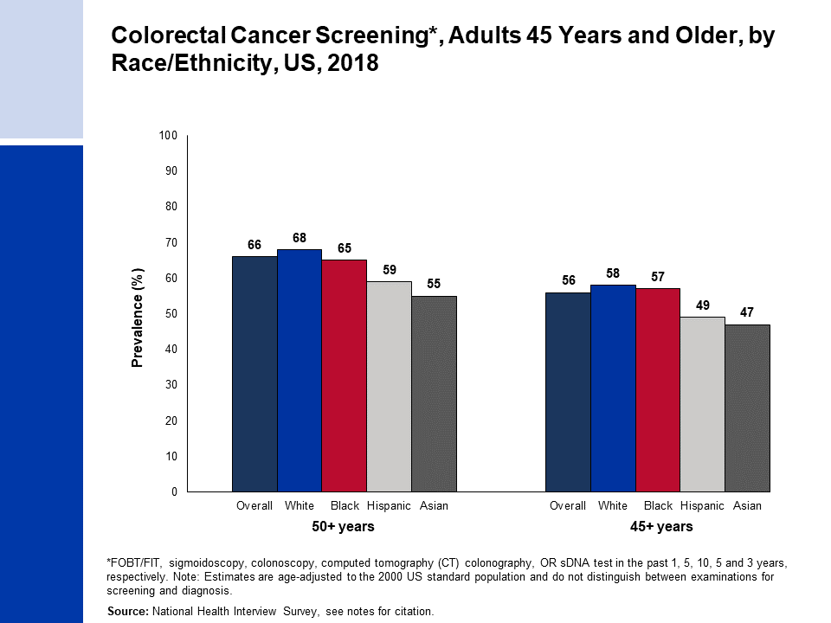
Notes:
Estimates for white, black, and Asian are among non-Hispanics. Estimates for Asians do not include Native Hawaiians or other Pacific Islanders
National Health Interview Survey, National Center for Health Statistics, Centers for Disease Control and Prevention, 2018. Public-use data file and documentation. https://www.cdc.gov/nchs/nhis/index.htm

Slide 33
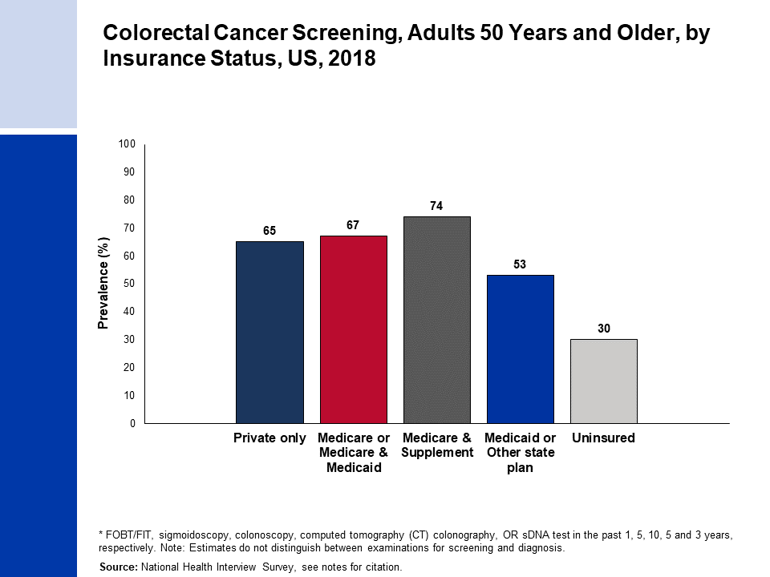
Notes:
National Health Interview Survey, National Center for Health Statistics, Centers for Disease Control and Prevention, 2018. Public-use data file and documentation. https://www.cdc.gov/nchs/nhis/index.htm

Slide 34
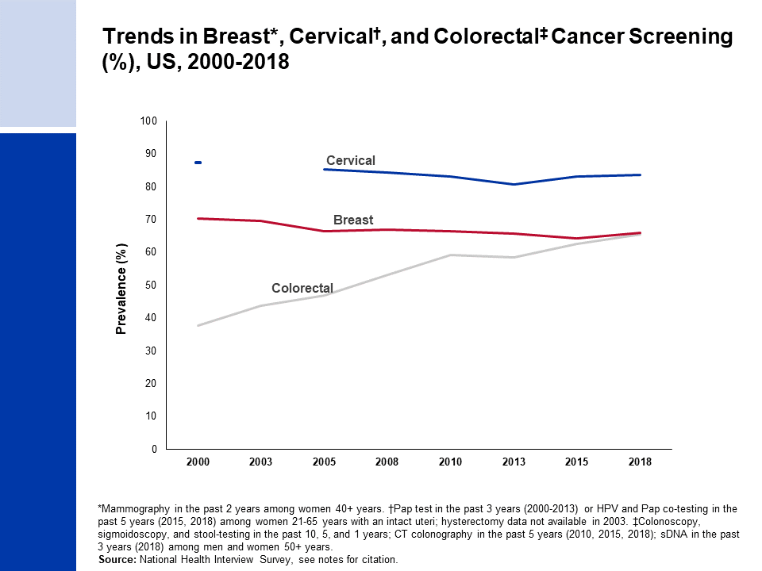
Notes:
National Health Interview Survey, National Center for Health Statistics, Centers for Disease Control and Prevention, 2000-2018. Public-use data files and documentation. https://www.cdc.gov/nchs/nhis/index.htm

Slide 35
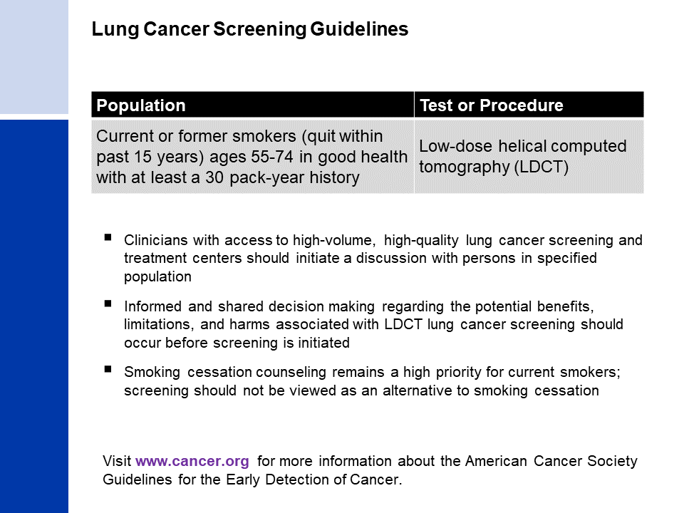
Notes:
Wender R, et al. PMID: 23315954
Smith RA, et al. PMID: 29846940

Slide 36
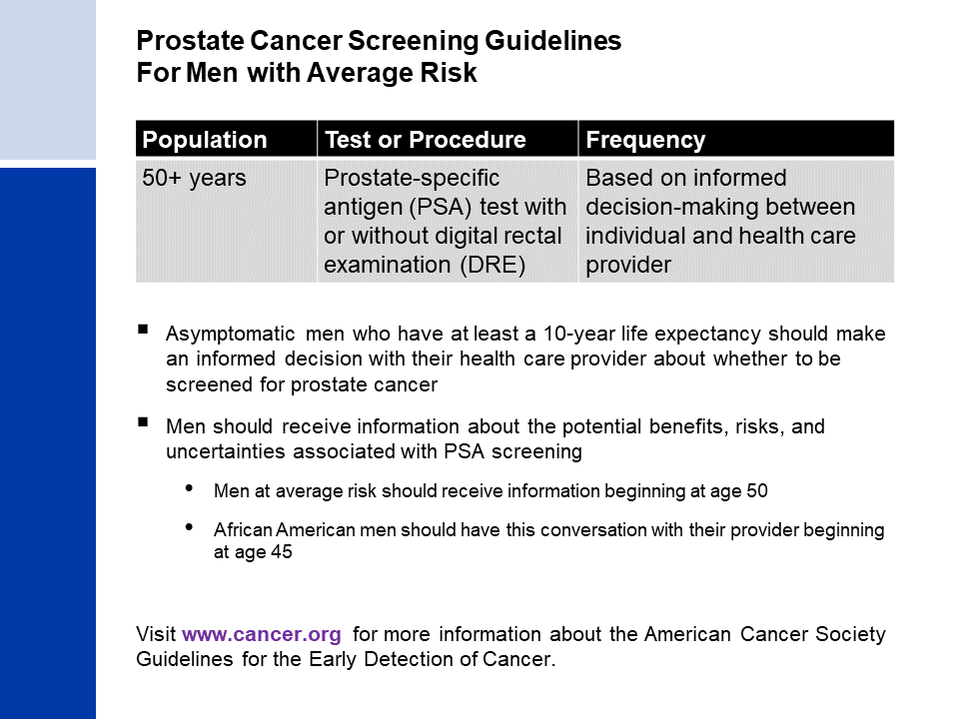
Notes:
- Wolf AM, et al. PMID: 20200110
- Smith RA, et al. PMID: 29846940

