Slide 1
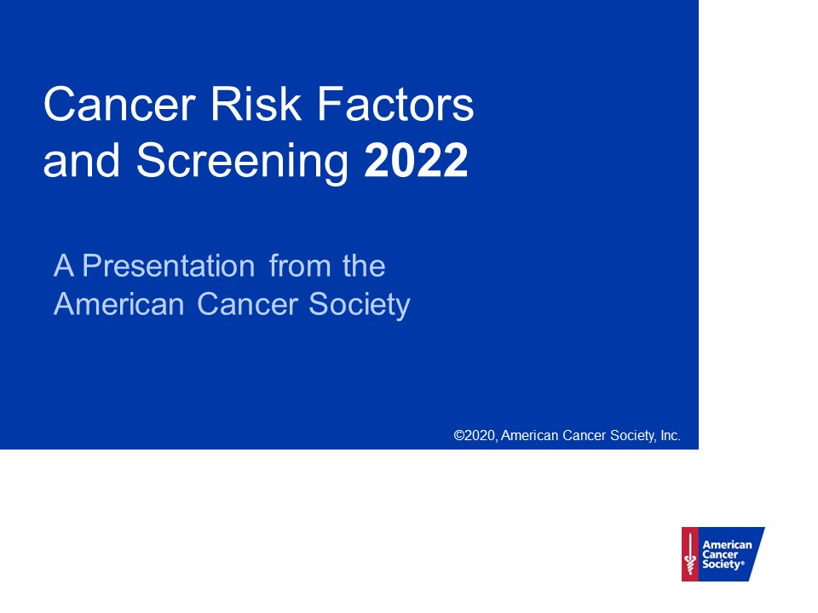

Slide 2
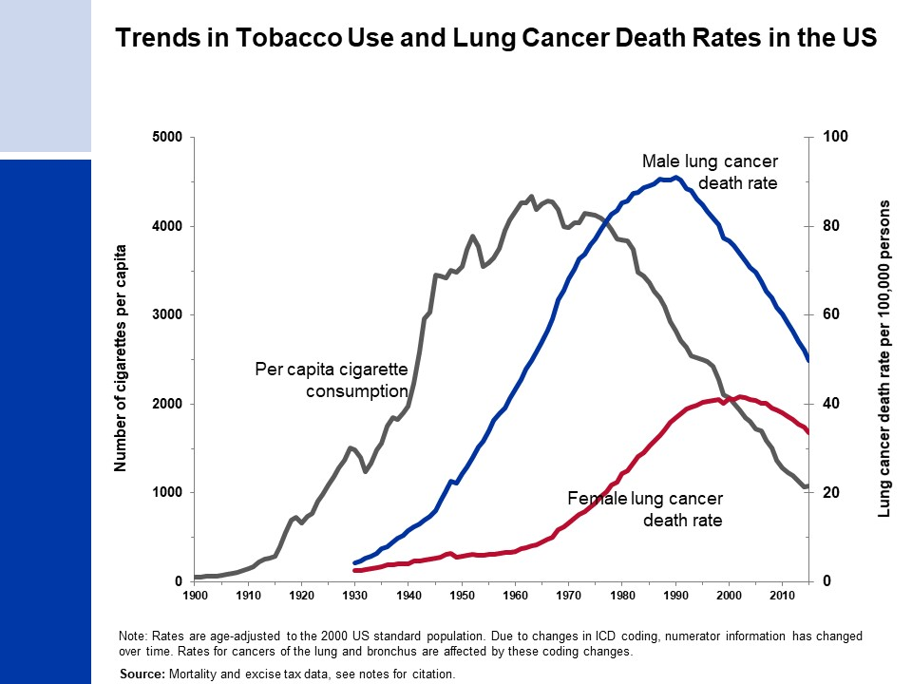
Notes:
- Death rates: US Mortality Volumes 1930 to 1959, US Mortality Data 1960 to 2015, National Center for Health Statistics, Centers for Disease Control and Prevention.
- Cigarette consumption: 1900-1999: US Department of Agriculture. 2000-2015: Wang, TW et al. PMID: 27932780

Slide 3
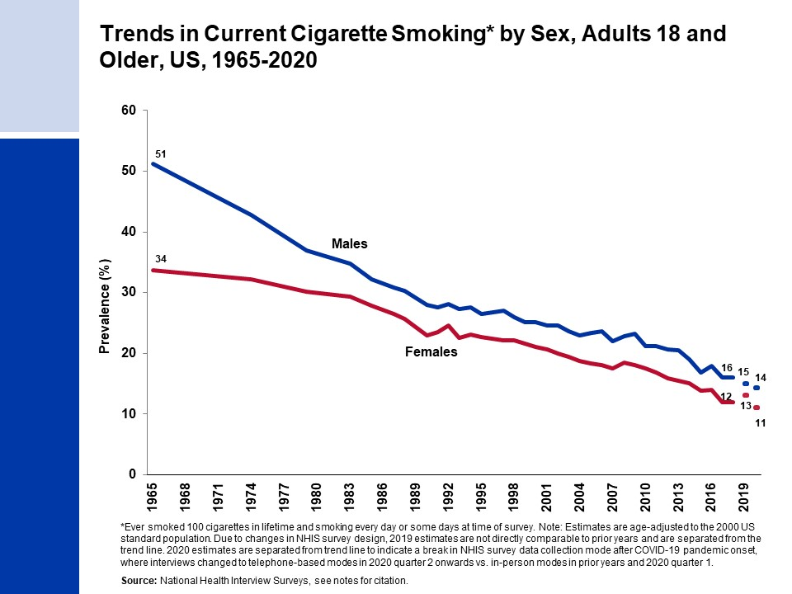
Notes:
- National Center for Health Statistics. Health, United States, 2018. Hyattsville, MD. 2019.
- National Health Interview Survey, National Center for Health Statistics, Centers for Disease Control and Prevention, 2018-2020. Public-use data file and documentation. https://www.cdc.gov/nchs/nhis/index.htm

Slide 4
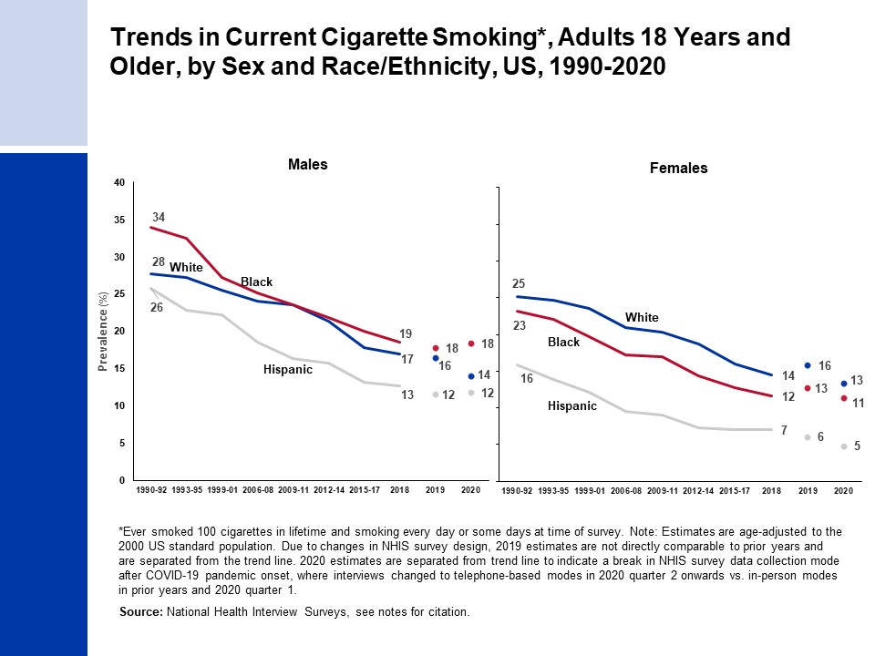
Notes:
- Estimates for White and Black persons are among non-Hispanics.
- National Center for Health Statistics. Health, United States, 2018. Hyattsville, MD. 2019.
- National Health Interview Survey, National Center for Health Statistics, Centers for Disease Control and Prevention, 2018-2020. Public-use data file and documentation. https://www.cdc.gov/nchs/nhis/index.htm

Slide 5
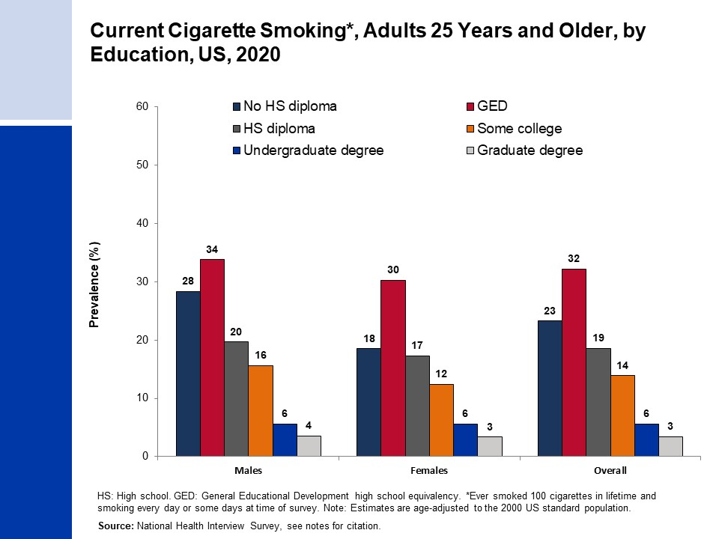
Notes:
- Estimate for “Some college” includes those with an Associate’s degree.
- National Health Interview Survey, National Center for Health Statistics, Centers for Disease Control and Prevention, 2020. Public-use data file and documentation. https://www.cdc.gov/nchs/nhis/index.htm

Slide 6
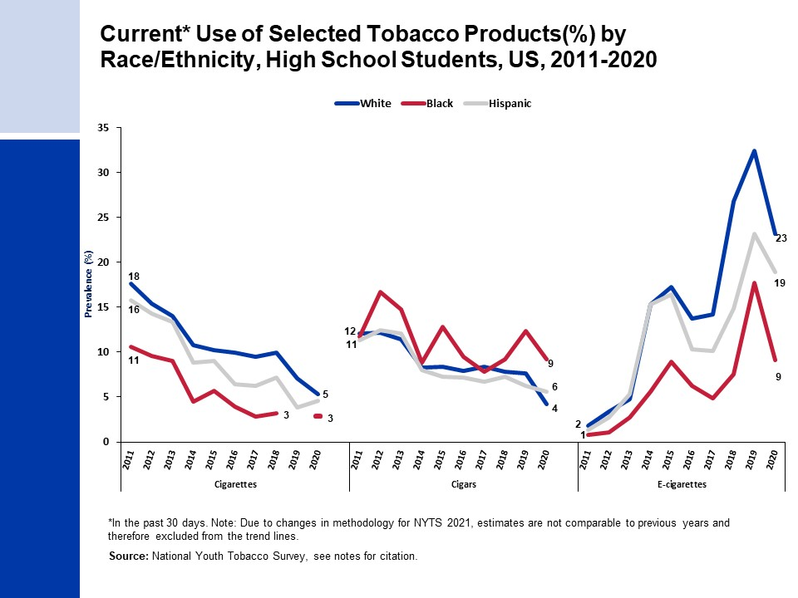
Notes:
Sources: 2020: Gentzke AS, et al. MMWR Morb Mortal Wkly Rep. 2020 Dec 18;69(50):1881-1888; 2019: Wang T, et al. MMWR Surveill Summ. 2019 Nov 6;68(12):1-22; 2018: Gentzke AS et al. MMWR Morb Mortal Wkly Rep. 2019 Feb 15;68(6):157-164; 2017: Wang T, et al. MMWR Morb Mortal Wkly Rep. 2018 Jun 8;67(22):629-633; 2016: Jamal A, et al. MMWR Morb Mortal Wkly Rep. 2017 Jun 16;66(23):597-603; 2015: Singh T, et al. MMWR Morb Mortal Wkly Rep. 2016 Apr 15;65(14):361-7; 2014: Arrazola RA, et al. MMWR Morb Mortal Wkly Rep. 2015 Apr 17;64(14):381-5; 2013: Arrazola RA, et al. MMWR Morb Mortal Wkly Rep. 2014 Nov 14;63(45):1021-6;2011 & 2012: Arrazola RA, et al. MMWR Morb Mortal Wkly Rep. 2013 Nov 15;62(45):893-7.

Slide 7
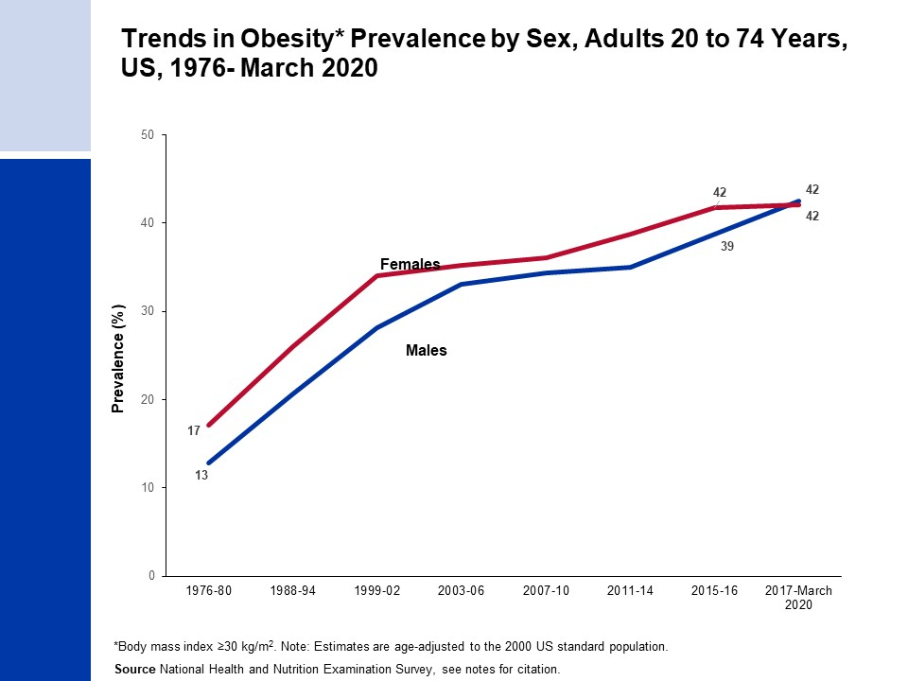
Notes:
National Center for Health Statistics. Health, United States, 2013: With Special Feature on Prescription Drugs. Hyattsville, MD. 2014.
National Center for Health Statistics. National Health and Nutrition Examination Survey, 2011-March 2020. Public-use data files and documentation. https://wwwn.cdc.gov/nchs/nhanes/Default.aspx

Slide 8
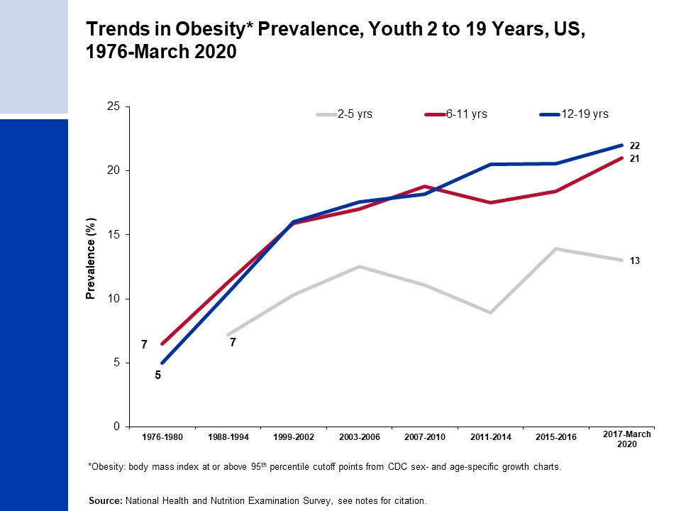
Notes:
National Center for Health Statistics. Health, United States, 2013: With Special Feature on Prescription Drugs. Hyattsville, MD. 2014.
National Center for Health Statistics. Health, United States, 2017: With Special Feature on Mortality. Hyattsville, MD. 2018.
National Center for Health Statistics. National Health and Nutrition Examination Survey, 2015-March 2020. Public-use data files and documentation. https://wwwn.cdc.gov/nchs/nhanes/Default.aspx

Slide 9
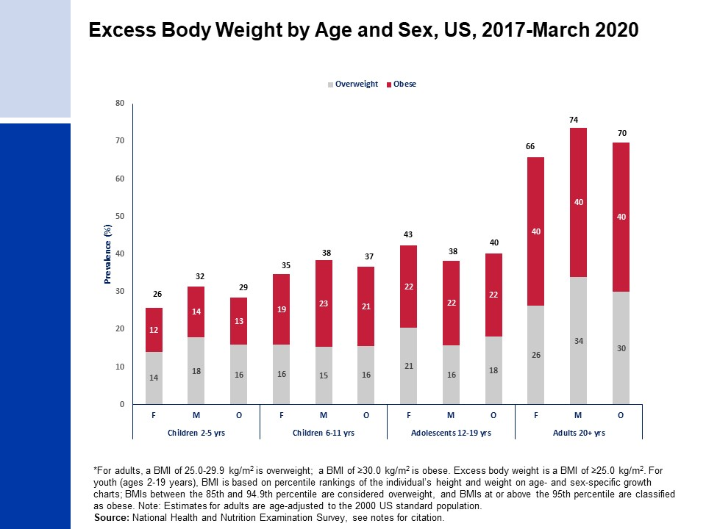
Notes:
National Center for Health Statistics. National Health and Nutrition Examination Survey, 2017- March 2020. Public-use data files and documentation. https://wwwn.cdc.gov/nchs/nhanes/Default.aspx

Slide 10
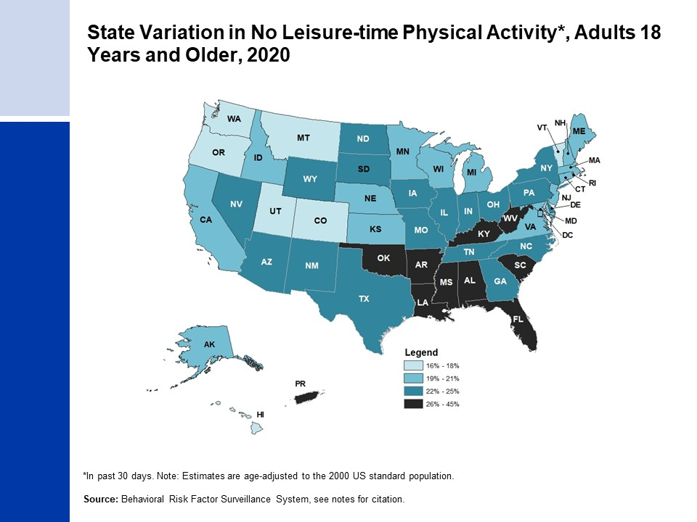
Notes:
Centers for Disease Control and Prevention (CDC). Behavioral Risk Factor Surveillance System Survey Data. Atlanta, Georgia: U.S. Department of Health and Human Services, Centers for Disease Control and Prevention, 2020. https://www.cdc.gov/brfss/data_documentation/index.htm

Slide 11
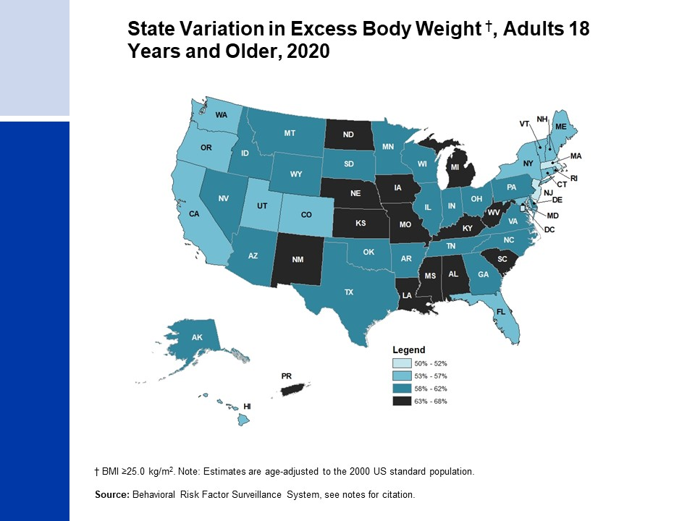
Notes:
Centers for Disease Control and Prevention (CDC). Behavioral Risk Factor Surveillance System Survey Data. Atlanta, Georgia: U.S. Department of Health and Human Services, Centers for Disease Control and Prevention, 2020. https://www.cdc.gov/brfss/data_documentation/index.htm

Slide 12
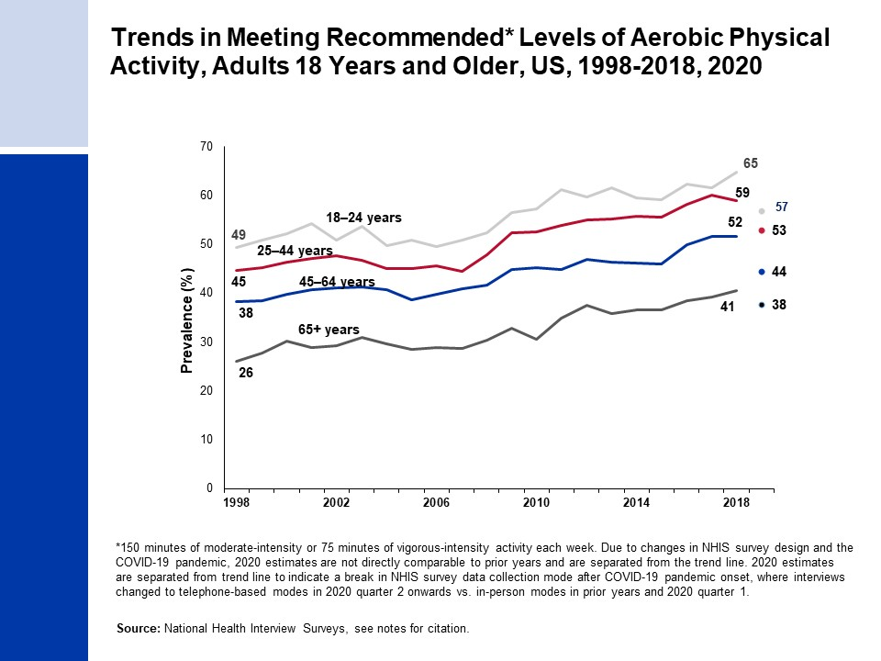
Notes:
National Center for Health Statistics. Health, United States, 2018. Hyattsville, MD. 2019.
National Health Interview Survey, National Center for Health Statistics, Centers for Disease Control and Prevention, 2018, 2020. Public-use data file and documentation. https://www.cdc.gov/nchs/nhis/index.htm

Slide 13
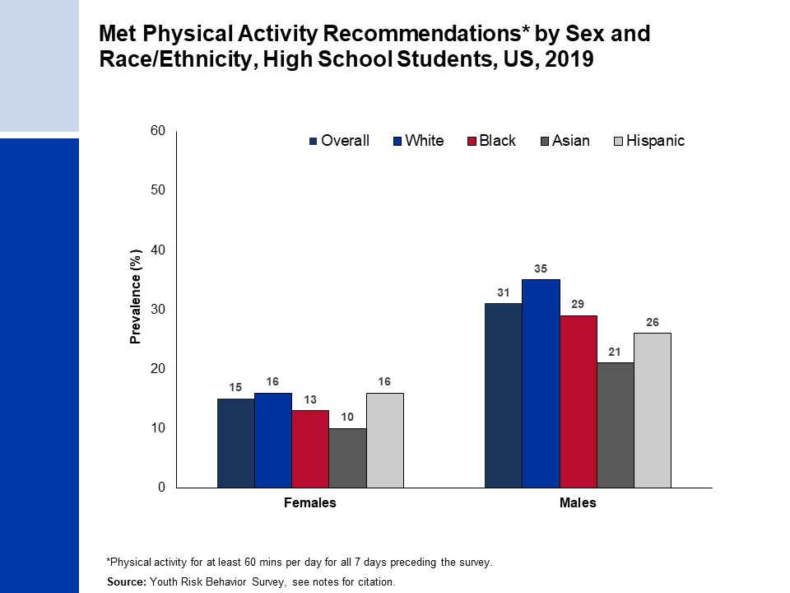
Notes:
Estimates for white, black, and Asian are among non-Hispanics.
Centers for Disease Control and Prevention. High School Youth Risk Behavior Survey Data, 2019. Available from URL: https://nccd.cdc.gov/youthonline/App/Default.aspx

Slide 14
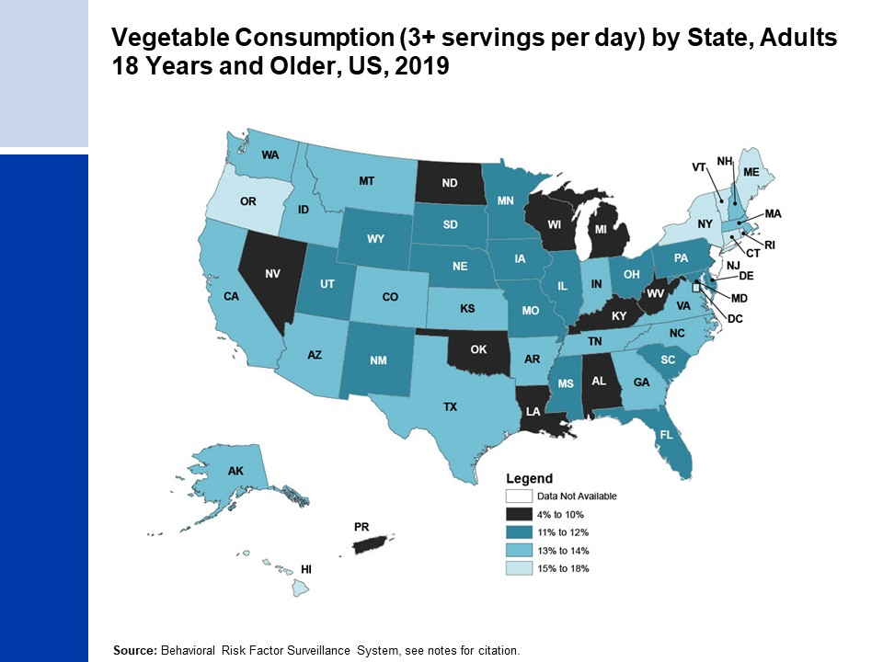
Notes:
- Centers for Disease Control and Prevention (CDC). Behavioral Risk Factor Surveillance System Survey Data. Atlanta, Georgia: U.S. Department of Health and Human Services, Centers for Disease Control and Prevention, 2019.

Slide 15
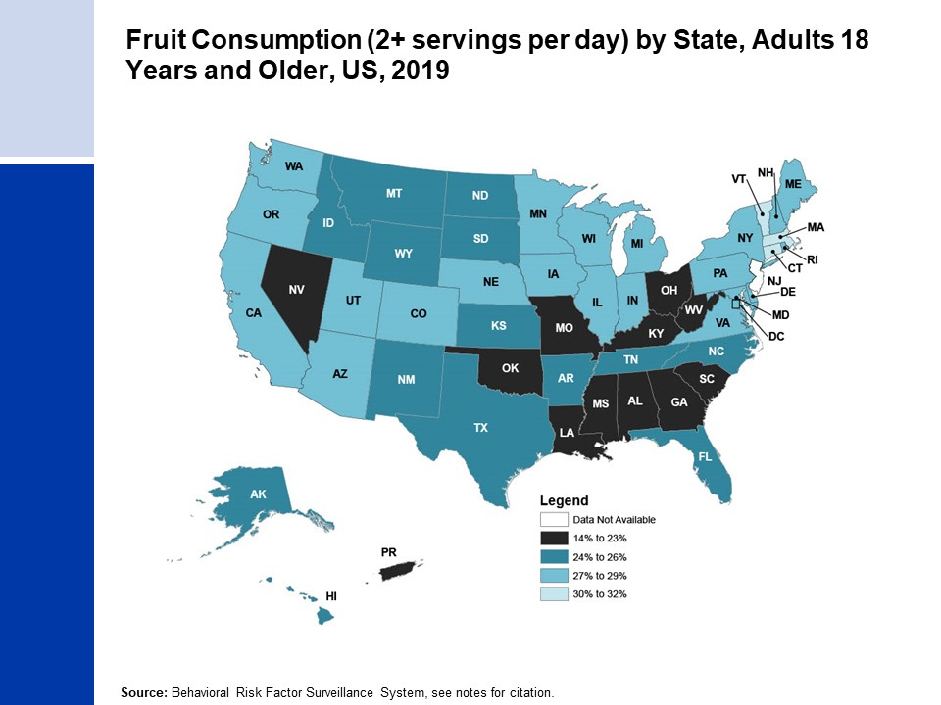
Notes:
- Centers for Disease Control and Prevention (CDC). Behavioral Risk Factor Surveillance System Survey Data. Atlanta, Georgia: U.S. Department of Health and Human Services, Centers for Disease Control and Prevention, 2019.

Slide 16
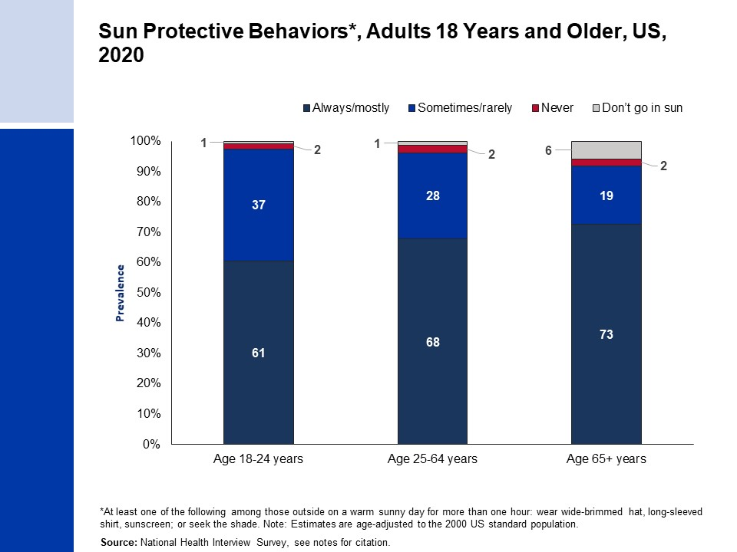
Notes:
- National Health Interview Survey, National Center for Health Statistics, Centers for Disease Control and Prevention, 2020. Public-use data file and documentation. https://www.cdc.gov/nchs/nhis/index.htm

Slide 17
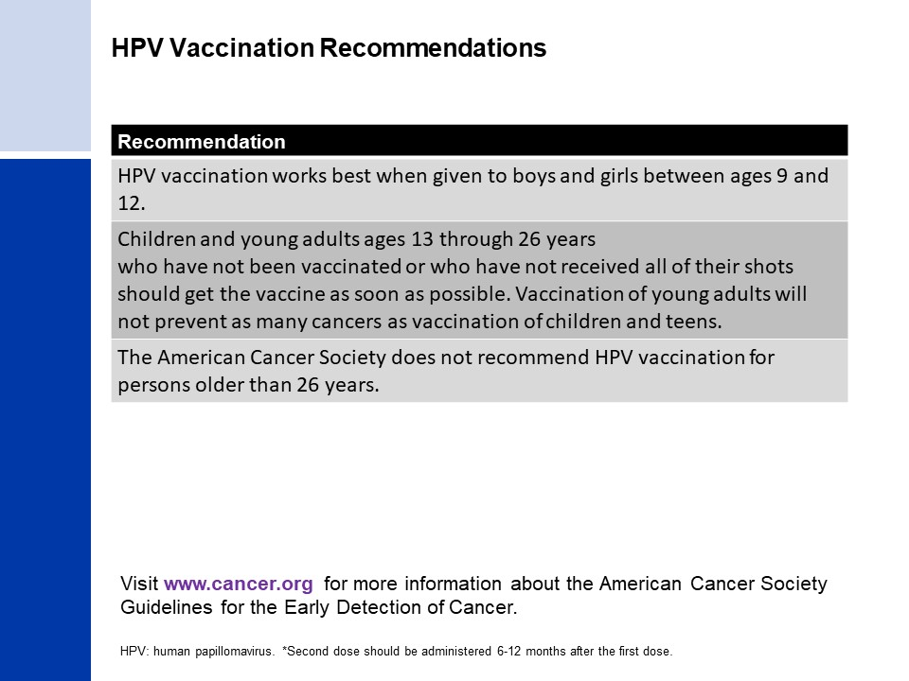
Notes:
Saslow D, et al. PMID: 32639044

Slide 18
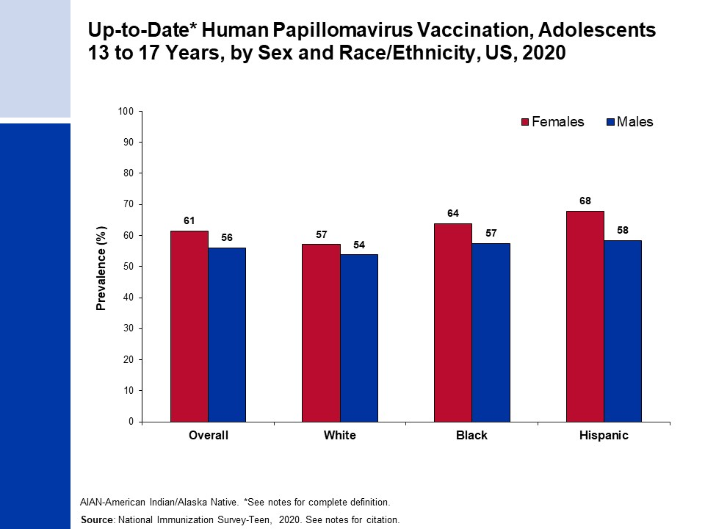
Notes:
Up-to-Date HPV vaccination includes those who received ≥3 doses, and those who received 2 doses when the first HPV vaccine dose was initiated before age 15 years and the time between the first and second dose was at least 5 months minus 4 days.
Estimates for white, black, and other are among non-Hispanics. Centers for Disease Control and Prevention, National Center for Immunization and Respiratory Diseases. TeenVaxView. Available from URL: https://www.cdc.gov/vaccines/imz-managers/coverage/teenvaxview/data-reports/index.html Accessed February 15, 2022.

Slide 19
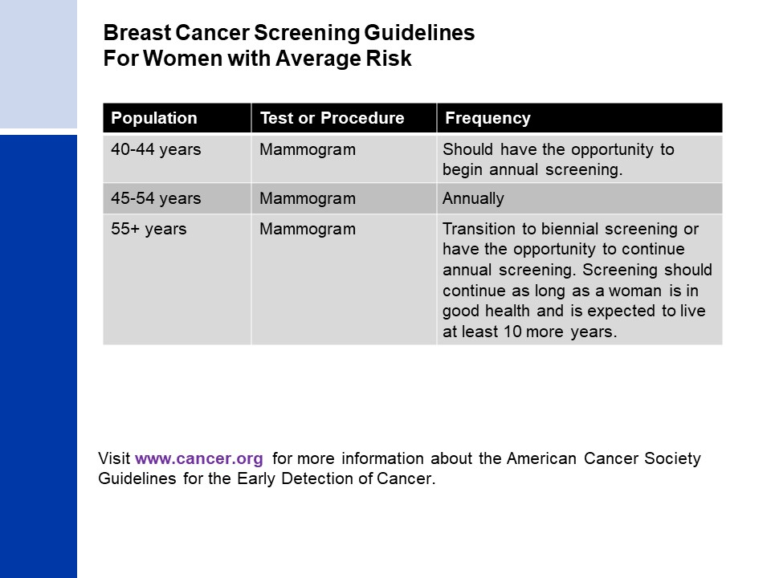
Notes:
Oeffinger KC, et al. PMID: 26501536
Smith RA, et al. PMID: 29846940

Slide 20
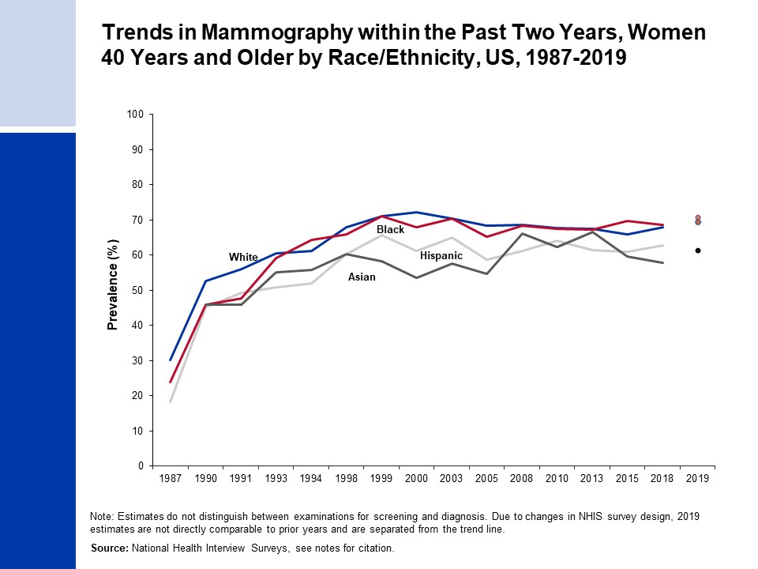
Notes:
Estimates for whites and blacks are among non-Hispanics. Estimates for Asians may be Hispanic or non-Hispanic.
National Center for Health Statistics. Health, United States, 2018. Hyattsville, MD. 2019.
National Health Interview Survey, National Center for Health Statistics, Centers for Disease Control and Prevention, 2018-2019. Public-use data file and documentation. https://www.cdc.gov/nchs/nhis/index.htm

Slide 21
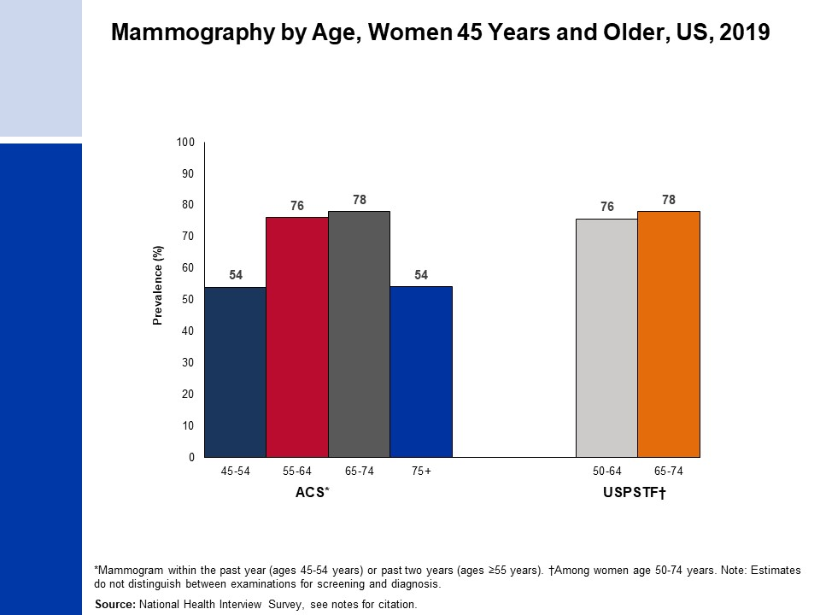
Notes:
- National Health Interview Survey, National Center for Health Statistics, Centers for Disease Control and Prevention, 2019. Public-use data file and documentation. https://www.cdc.gov/nchs/nhis/index.htm

Slide 22
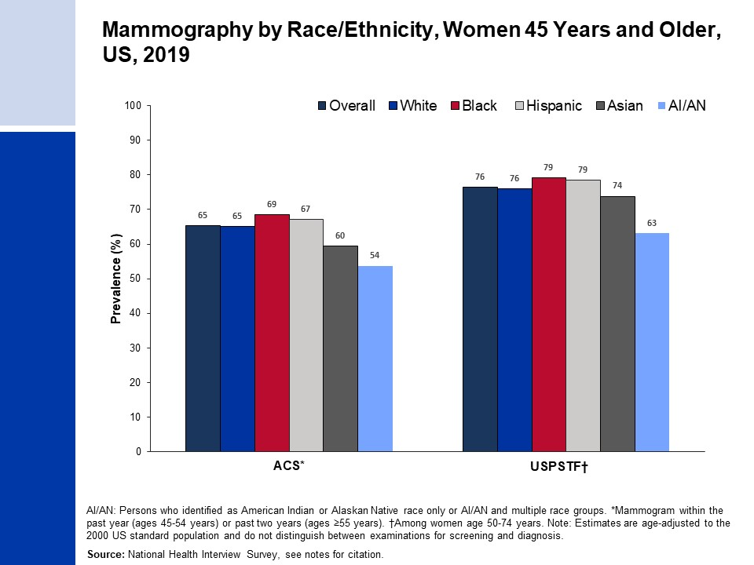
Notes:
- Estimates for White, Black, and Asian persons are among non-Hispanics.
- National Health Interview Survey, National Center for Health Statistics, Centers for Disease Control and Prevention, 2019. Public-use data file and documentation. https://www.cdc.gov/nchs/nhis/index.htm

Slide 23
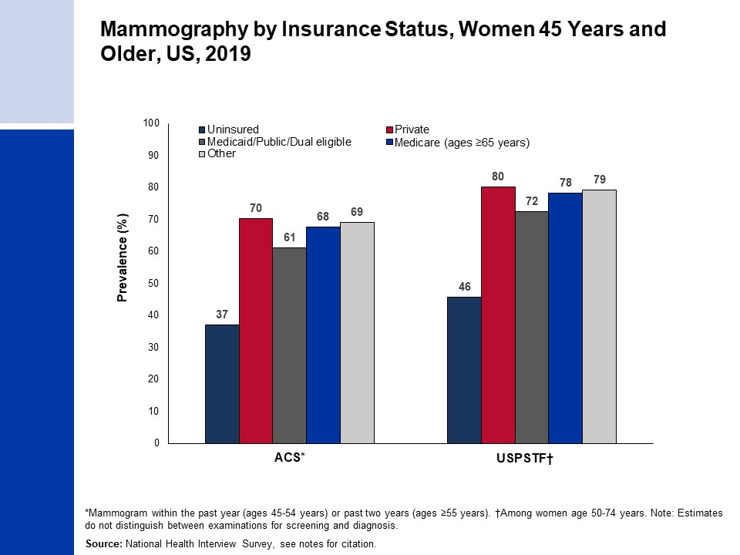
Notes:
- National Health Interview Survey, National Center for Health Statistics, Centers for Disease Control and Prevention, 2019. Public-use data file and documentation. https://www.cdc.gov/nchs/nhis/index.htm

Slide 24
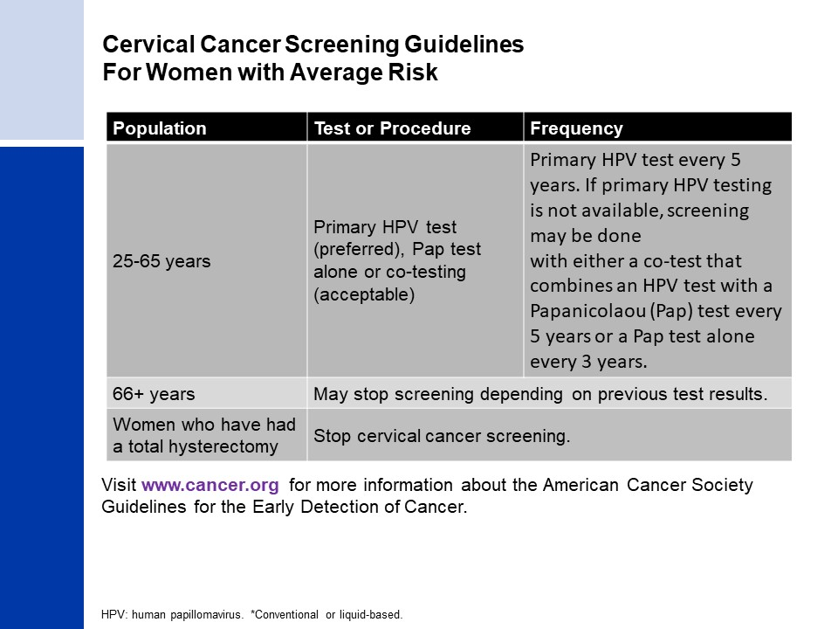
Notes:
Frontham ETH, et al. PMID: 32729638

Slide 25
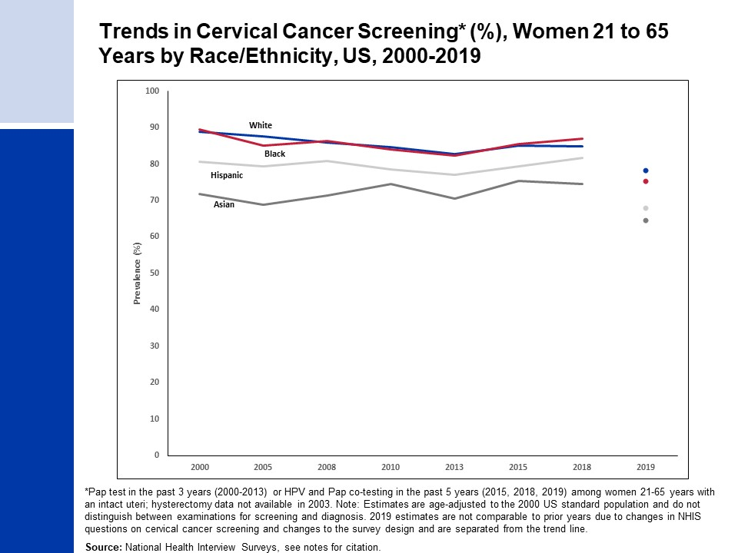
Notes:
- Estimates for white, black, and Asian are among non-Hispanics.
- National Health Interview Surveys, National Center for Health Statistics, Centers for Disease Control and Prevention, 2000-2019. Public-use data file and documentation. https://www.cdc.gov/nchs/nhis/index.htm

Slide 26
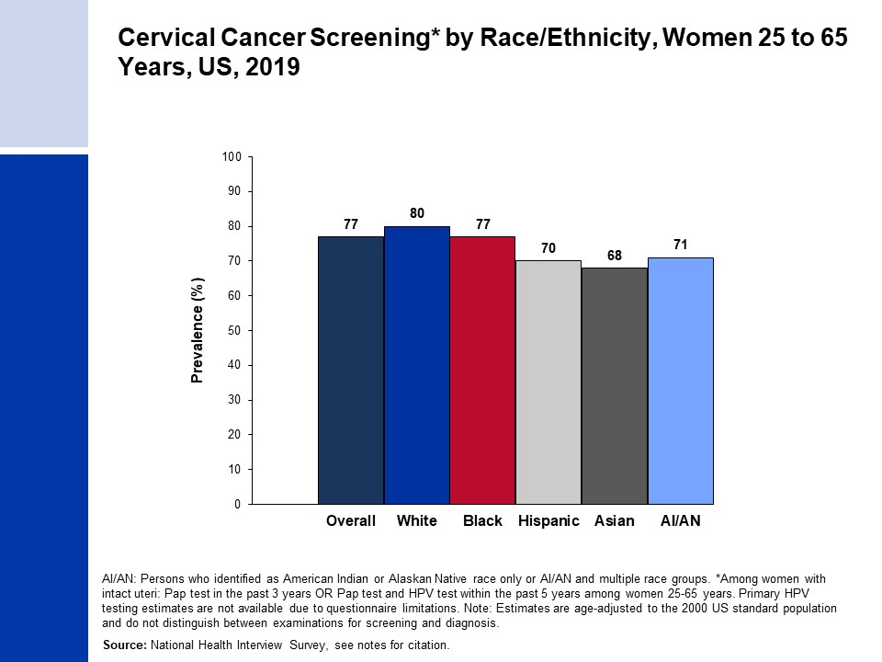
Notes:
Estimates for White, Black, Asian, and AI/AN persons are among non-Hispanics.
- National Health Interview Survey, National Center for Health Statistics, Centers for Disease Control and Prevention, 2019. Public-use data file and documentation. https://www.cdc.gov/nchs/nhis/index.htm

Slide 27
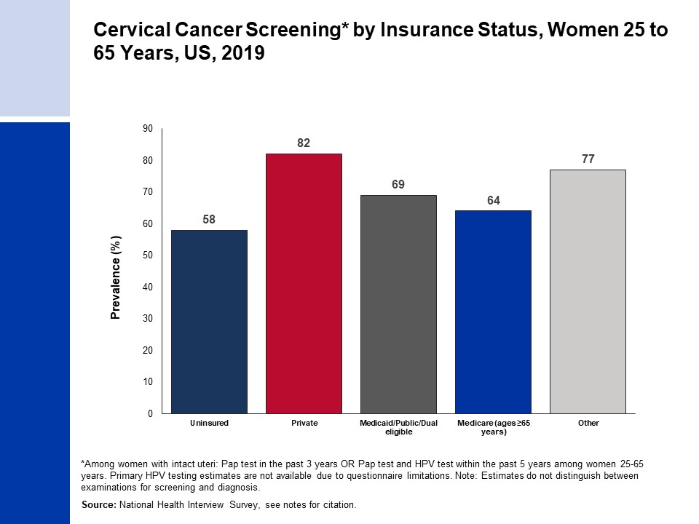
Notes:
- National Health Interview Survey, National Center for Health Statistics, Centers for Disease Control and Prevention, 2019. Public-use data file and documentation. https://www.cdc.gov/nchs/nhis/index.htm

Slide 28
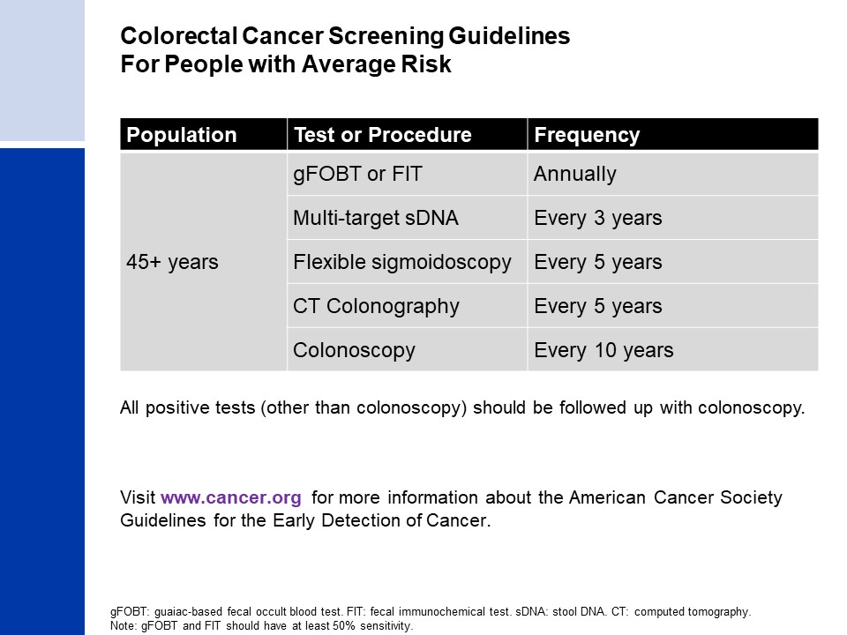
Notes:
Wolf AMD, et al. PMID: 29846947
Smith RA, et al. PMID: 29846940

Slide 29
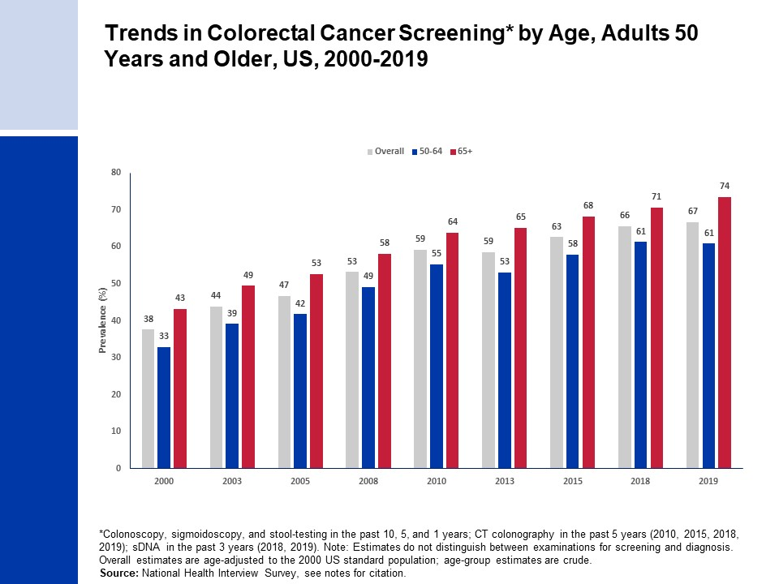
Notes:
- National Health Interview Survey, National Center for Health Statistics, Centers for Disease Control and Prevention, 2000-2019. Public-use data files and documentation. https://www.cdc.gov/nchs/nhis/index.htm

Slide 30
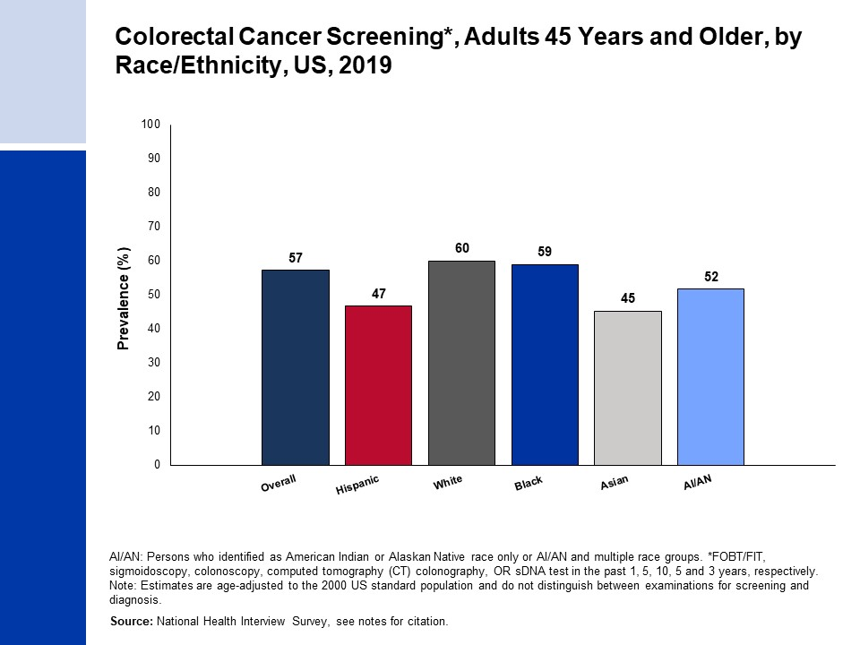
Notes:
- Estimates for White, Black, Asian, and AI/AN persons are among non-Hispanics.
- National Health Interview Survey, National Center for Health Statistics, Centers for Disease Control and Prevention, 2019. Public-use data file and documentation. https://www.cdc.gov/nchs/nhis/index.htm

Slide 31
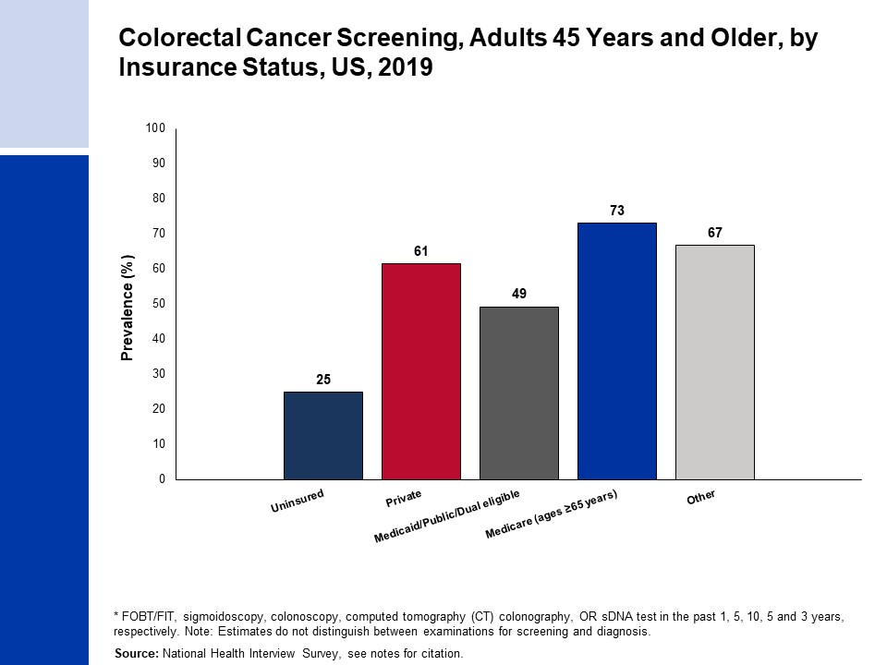
Notes:
- National Health Interview Survey, National Center for Health Statistics, Centers for Disease Control and Prevention, 2019. Public-use data file and documentation. https://www.cdc.gov/nchs/nhis/index.htm

Slide 32
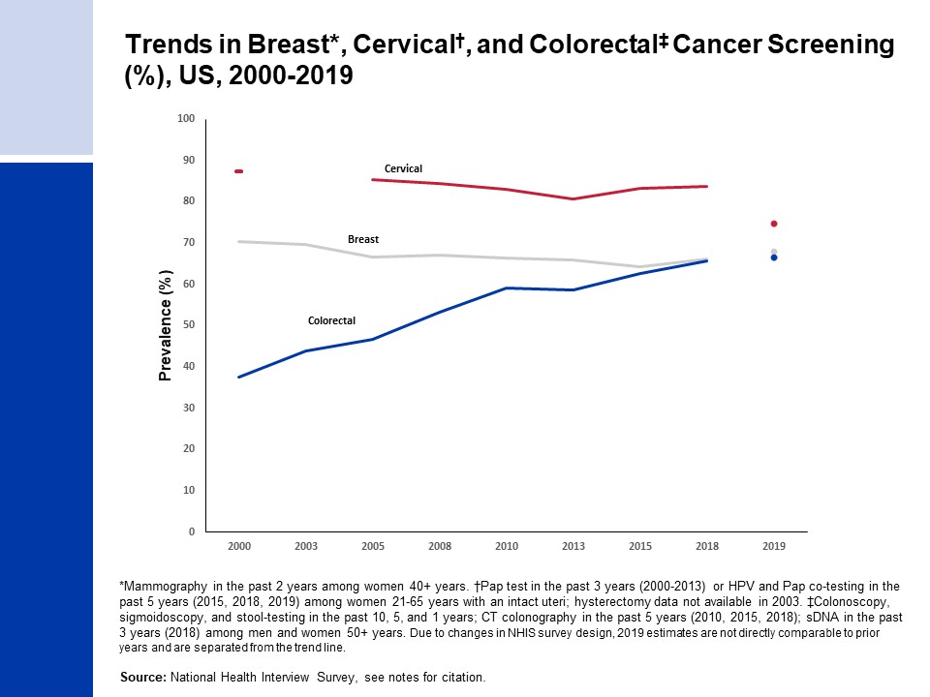
Notes:
- National Health Interview Survey, National Center for Health Statistics, Centers for Disease Control and Prevention, 2000-2019. Public-use data files and documentation. https://www.cdc.gov/nchs/nhis/index.htm

Slide 33
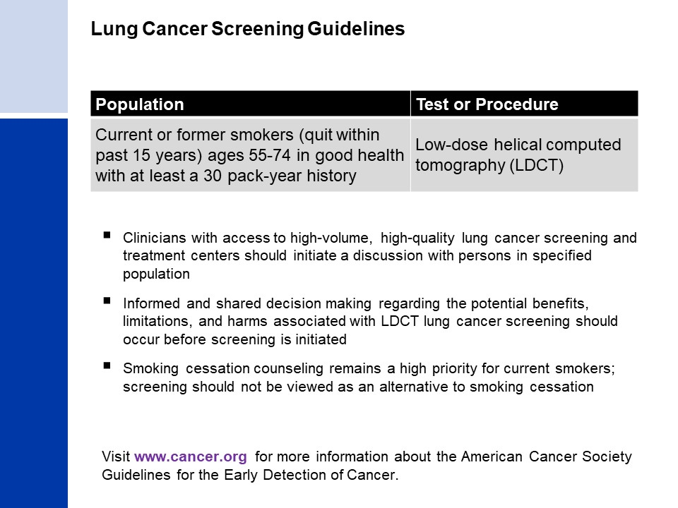
Notes:
Wender R, et al. PMID: 23315954
Smith RA, et al. PMID: 29846940

Slide 34
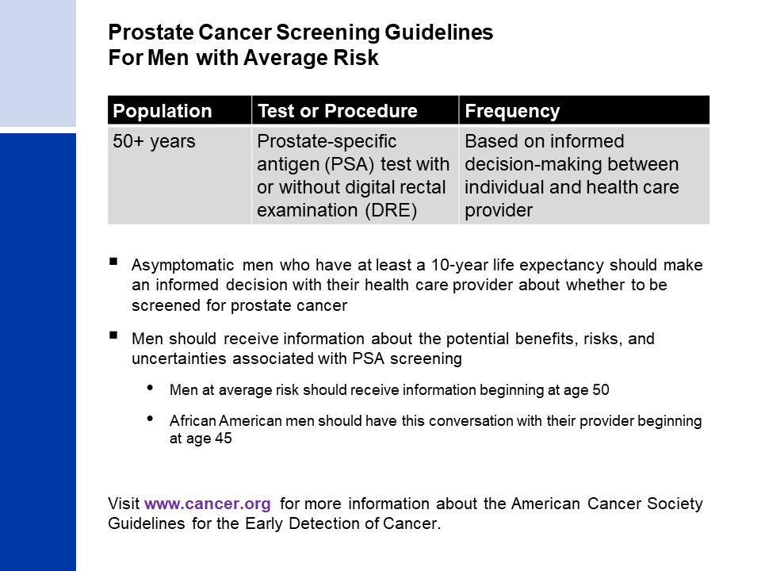
Notes:
- Wolf AM, et al. PMID: 20200110
- Smith RA, et al. PMID: 29846940

